Slide 1




User or Colonies Worker
Submit Process
Specification
Runtime Key D
Server Owner
Process API
Colony Owner
Colonies Server
Server Key
Colony Key
Colony
Register Colony
Colony API
Runtime API
Add Colony Runtime
ID D
Job Queues
ID C
Approve Colony Runtime
ID A
ID B
Process API
Assign Processes
Assign Processes
Internet
Edge Network
Runtime Key A
Runtime Key B
Runtime Key C
SDK
SDK
SDK
Code
Colonies Worker
Colonies Worker
Run code
Launch process
Launch process
Process
Process
Colonies Worker
Android
VM
K8s Container

Slide 2
User or Colonies Worker
1. Submit Process
Specification
Runtime Key D
Process API
Colonies Server
Colony
Colony API
Runtime API
ID D
Job Queues
ID C
ID A
ID B
Process API
2. Assign Processes
2. Assign Processes
Internet
Edge Network
Runtime Key A
Runtime Key B
Runtime Key C
SDK
SDK
SDK
Code
Colonies Worker
Colonies Worker
3. Run code
3. Launch process
3. Launch process
Process
Process
Colonies Worker
Android
VM
K8s Container

Slide 3
Server Owner
Process API
Colony Owner
Colonies Server
Server Key
Colony Key
Colony API
Colony
Register Colony
Runtime API
Add Colony Runtime(s)
ID C
Approve Colony Runtime(s)
ID A
ID B
Process API
Internet
Edge Network
Runtime Key A
Runtime Key B
Runtime Key C
SDK
SDK
SDK
Colonies Worker
Colonies Worker
Colonies Worker
Android
VM
K8s Container

Slide 4
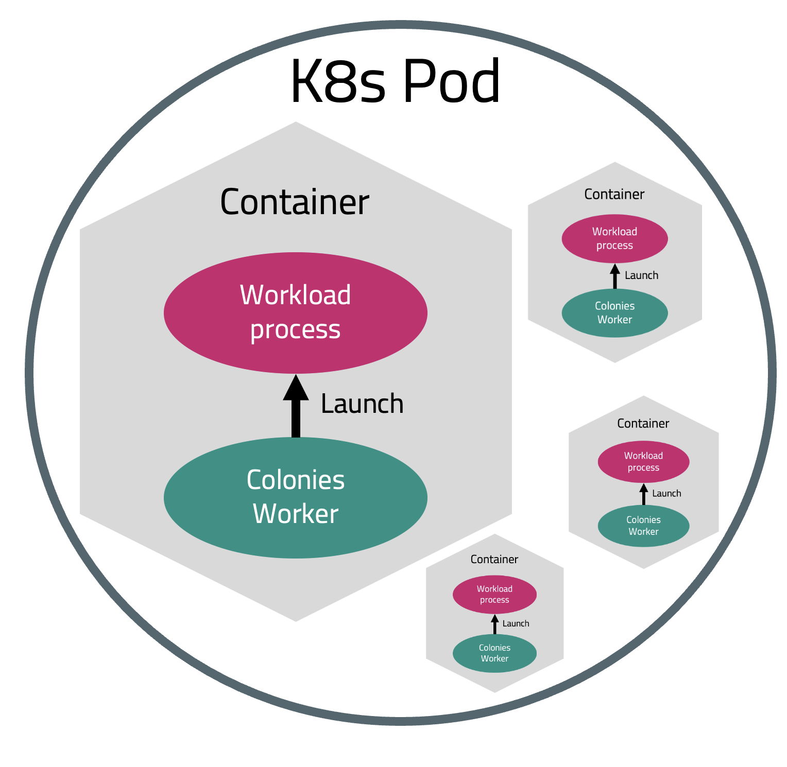
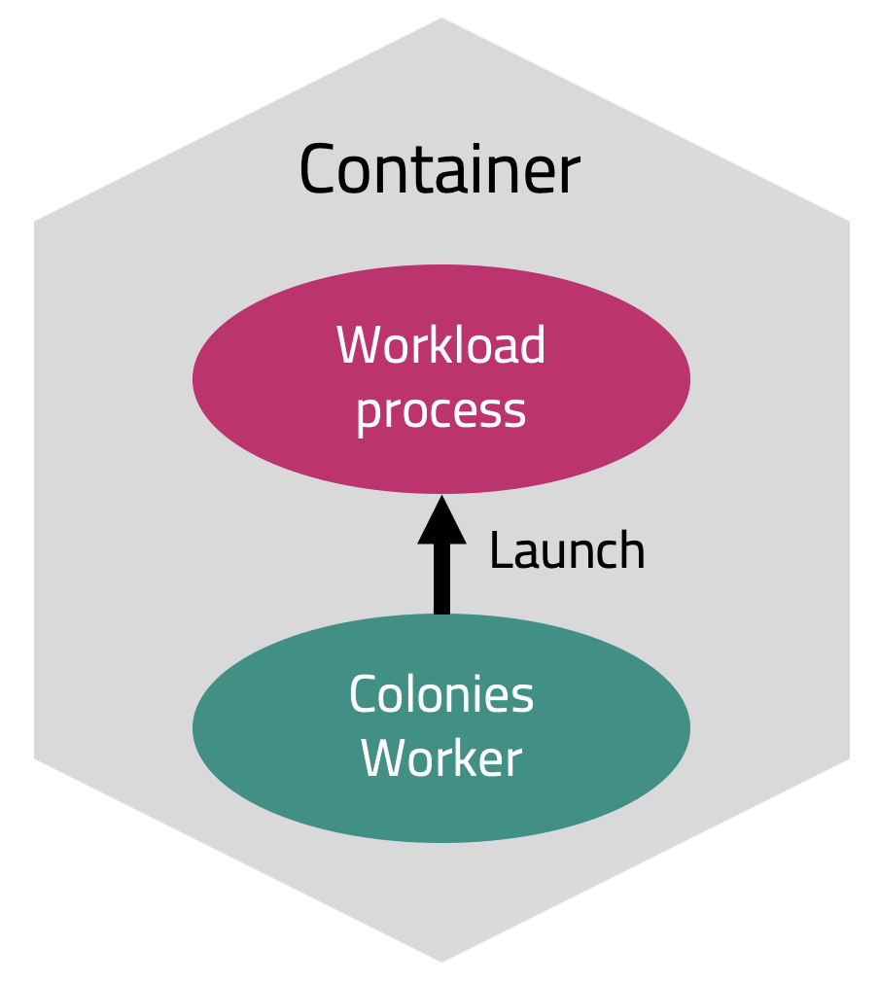
K8s Pod
Container
Colonies
Server
Workload
process
Assign processes
Launch
Colonies Worker

