Slide 1
A Multigrid Tutorial part two
William L. Briggs
Department of Mathematics
University of Colorado at Denver
Van Emden Henson
Center for Applied Scientific Computing
Lawrence Livermore National Laboratory
Steve McCormick
Department of Applied Mathematics
University of Colorado at Boulder
This work was performed, in part, under the auspices of the United States Department of Energy by University of California Lawrence Livermore National Laboratory under contract number W-7405-Eng-48. UCRL-VG-136819 Pt 2

Slide 2
Outline
Nonlinear Problems
Neumann Boundary Conditions
Anisotropic Problems
Variable Mesh Problems
Variable Coefficient Problems
Algebraic Multigrid

Slide 3

Nonlinear Problems
How should we approach the nonlinear system
and can we use multigrid to solve such a system?
A fundamental relation we’ve relied on, the residual equation
does not hold, since, if A(u) is a nonlinear operator,

Slide 4


The Nonlinear Residual Equation
We still base our development around the residual equation, now the nonlinear residual equation:
How can we use this equation as the basis for a solution method?

Slide 5
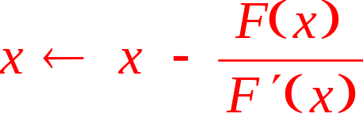
Let’s consider Newton’s Method
The best known and most important method for solving nonlinear equations!
We wish to solve F(x) = 0 .
Expand F in a Taylor series about x :
Dropping higher order terms, if x+s is a solution,
0=F(x)+sF’(x) thus s=-F(x)/F’(x)
Hence, we develop an iteration

Slide 6
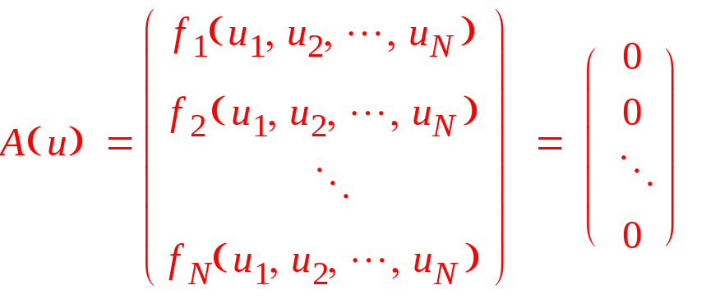
Newton’s method for systems
We wish to solve the system A(u) = 0. In vector form this is
Expanding A(v+e) in a Taylor series about v :
higher order terms

Slide 7
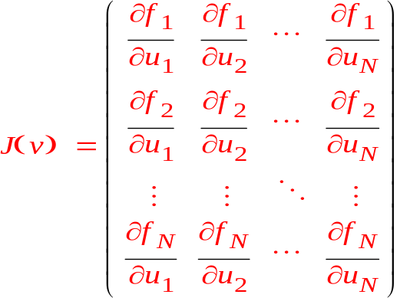


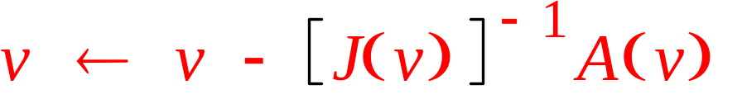
Newton for systems (cont.)
Where J(v) is the Jacobian system
If u=v+e is a solution, 0 = A(v) + J(v) e and
Leading to the iteration

Slide 8



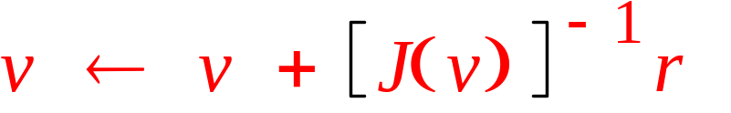
Newton’s method in terms of the residual equation
The nonlinear residual equation is
Expanding A(v+e) in a two-term Taylor series about v :
Newton’s method is thus:

Slide 9
How does multigrid fit in?
One obvious method is to use multigrid to solve J(v)e = r at each iteration step. This method is called Newton-multigrid and can be very effective.
However, we would like to use multigrid ideas to treat the nonlinearity directly.
Hence, we need to specialize the multigrid components (relaxation, grid transfers, coarsening) for the nonlinear case.

Slide 10
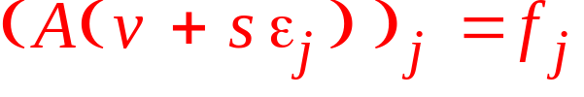

What is nonlinear relaxation?
Several of the common relaxation schemes have nonlinear counterparts. For A(u)=f, we describe the nonlinear Gauss-Seidel iteration:
  For each j=1, 2, …, N
    Set the jth component of the residual to zero and solve for v_{j} . That is, solve (A(v))_{j} = f_{j} .
Equivalently,
  For each j=1, 2, …, N
    Find s ∈ ℜ such that
    where is the canonical jth unit basis vector

Slide 11

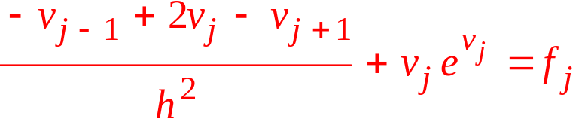

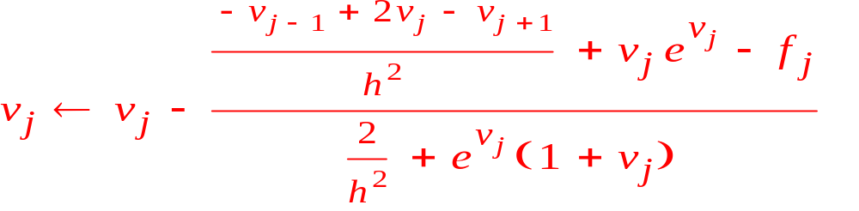
How is nonlinear Gauss-Seidel done?
Each is a nonlinear scalar equation for v_{j} . We use the scalar Newton’s method to solve!
Example: may be discretized so that is given by
Newton iteration for v_{j} is given by

Slide 12


How do we do coarsening for nonlinear multigrid?
Recall the nonlinear residual equation
In multigrid, we obtain an approximate solution v ^{h} on the fine grid, then solve the residual equation on the coarse grid.
The residual equation on appears as

Slide 13
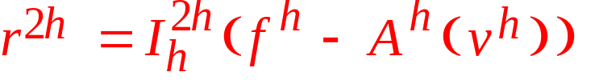
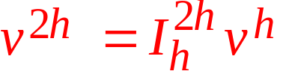
Look at the coarse residual equation
We must evaluate the quantities on in
Given v ^{h}, a fine-grid approximation, we restrict the residual to the coarse grid
For v ^{2h} we restrict v ^{h} by
Thus,

Slide 14



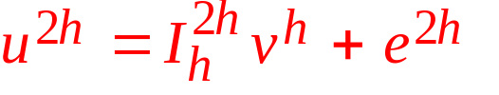
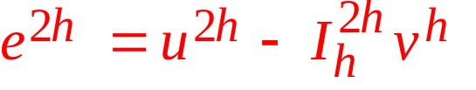
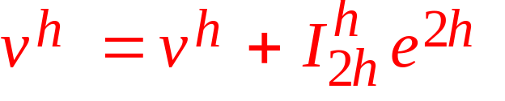
We’ve obtained a coarse-grid equation of the form .
Consider the coarse-grid residual equation:
We solve for and obtain
We then apply the correction:
coarse-grid unknown
All quantities are known

Slide 15



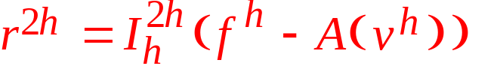


FAS, the Full Approximation Scheme, two grid form
Perform nonlinear relaxation on to obtain an approximation .
Restrict the approximation and its residual
Solve the coarse-grid residual problem
Extract the coarse-grid error
Interpolate and apply the correction

Slide 16
A few observations about FAS
If A is a linear operator then FAS reduces directly to the linear two-grid correction scheme.
A fixed point of FAS is an exact solution to the fine-grid problem and an exact solution to the fine-grid problem is a fixed point of the FAS iteration.

Slide 17
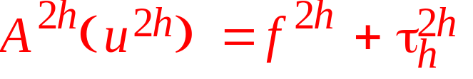
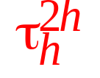



A few observations about FAS, continued
The FAS coarse-grid equation can be written as
where is the so-called tau correction.
In general, since , the solution to the FAS coarse-grid equation is not the same as the solution to the original coarse-grid problem .
The tau correction may be viewed as a way to alter the coarse-grid equations to enhance their approximation properties.

Slide 18


Still more observations about FAS
FAS may be viewed as an inner and outer iteration: the outer iteration is the coarse-grid correction, the inner iteration the relaxation method.
A true multilevel FAS process is recursive, using FAS to solve the nonlinear problem using . Hence, FAS is generally employed in a V- or W-cycling scheme.

Slide 19
And yet more observations about FAS!
For linear problems we use FMG to obtain a good initial guess on the fine grid. Convergence of nonlinear iterations depends critically on having a good initial guess.
When FMG is used for nonlinear problems the interpolant is generally accurate enough to be in the basin of attraction of the fine-grid solver.
Thus, one FMG cycle, whether FAS, Newton, or Newton-multigrid is used on each level, should provide a solution accurate to the level of discretization, unless the nonlinearity is extremely strong.

Slide 20
Intergrid transfers for FAS
Generally speaking, the standard operators (linear interpolation, full weighting) work effectively in FAS schemes.
In the case of strongly nonlinear problems, the use of higher-order interpolation (e.g., cubic interpolation) may be beneficial.
For an FMG scheme, where is the interpolation of a coarse-grid solution to become a fine-grid initial guess, higher-order interpolation is always advised.

Slide 21
What is in FAS?
As in the linear case, there are two basic possibilities:
is determined by discretizing the nonlinear operator A(u) in the same fashion as was employed to obtain , except that the coarser mesh spacing is used.
is determined from the Galerkin condition
where the action of the Galerkin product can be captured in an implementable formula.
The first method is usually easier, and more common.

Slide 22
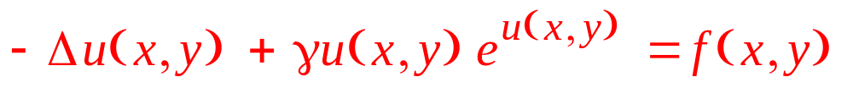

Nonlinear problems: an example
Consider
on the unit square [0,1] x [0,1] with homogeneous Dirichlet boundary conditions and a regular Cartesian grid.
Suppose the exact solution is

Slide 23
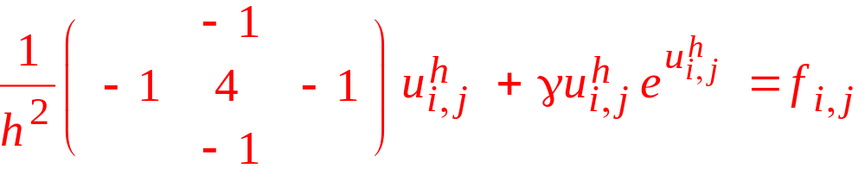
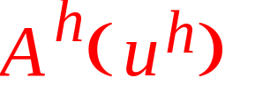
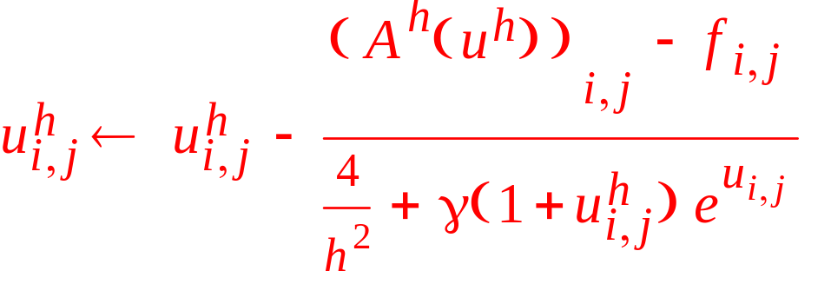
Discretization of nonlinear example
The operator can be written (sloppily) as
The relaxation is given by

Slide 24
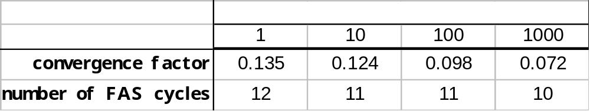

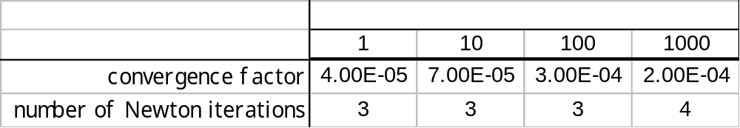
FAS and Newton’s method on
FAS
Newton’s Method

Slide 25

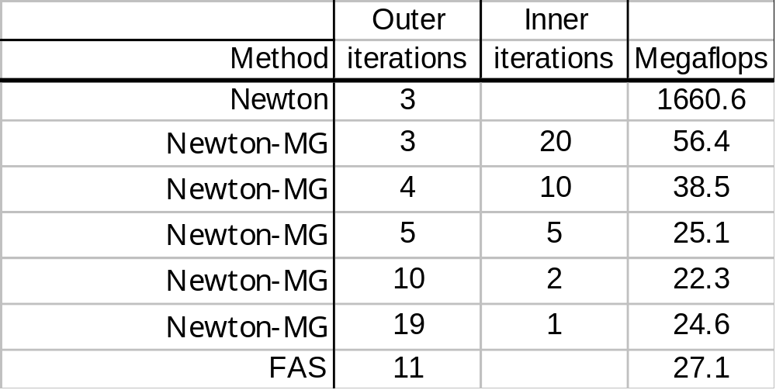
Newton, Newton-MG, and FAS on
Newton uses exact solve, Newton-MG is inexact Newton with a fixed number of inner V(2,1)-cycles the Jacobian problem, overall stopping criterion

Slide 26
Comparing FMG-FAS and FMG-Newton
We will do one FMG cycle using a single FAS V(2,1) -cycle as the “solver” at each new level. We then follow that with sufficiently many FAS V(2,1)-cycles as is necessary to obtain ||r|| < 10⁻¹⁰.
Next, we will do one FMG cycle using a Newton-multigrid step at each new level (with a single linear V(2,1)-cycle as the Jacobian “solver.”) We then follow that with sufficiently many Newton-multigrid steps as is necessary to obtain ||r|| < 10⁻¹⁰.

Slide 27
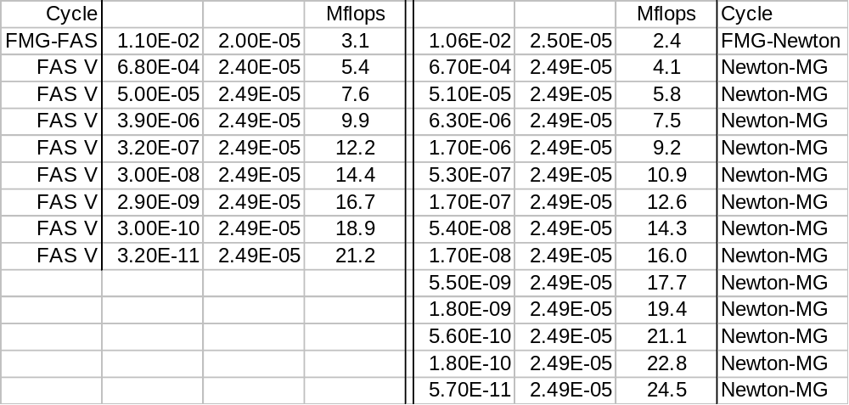


Comparing FMG-FAS and FMG-Newton

Slide 28
Outline

Nonlinear Problems
Neumann Boundary Conditions
Anisotropic Problems
Variable Mesh Problems
Variable Coefficient Problems
Algebraic Multigrid

Slide 29



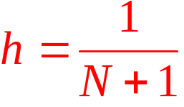

Neumann Boundary Conditions
Consider the (1-d) problem
We discretize this on the interval [0,1] with grid spacing for j=1,2, …, N+1 .
We extend the interval with two ghost points
0 x 1
0 1 2 3 … j ... N-1 N N+1
N+2
-1

Slide 30

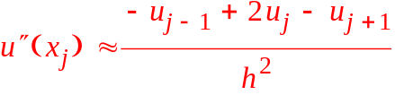

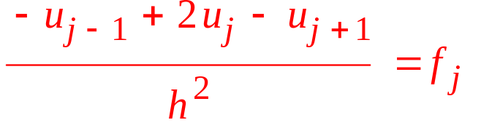

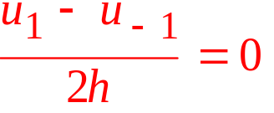
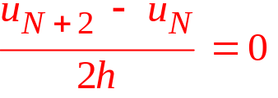
We use central differences
We approximate the derivatives with differences, using the ghost points:
Giving the system
-1
0 1 j-1 j j+1 N N+1
N+2

Slide 31




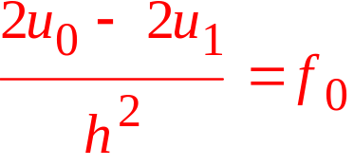
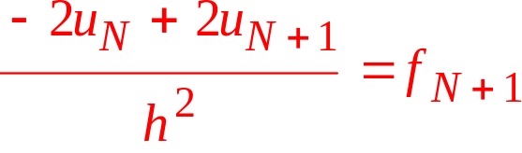
Eliminating the ghost points
Use the boundary conditions to eliminate ,
Eliminating the ghost points in the j=0 and j=N+1 equations gives the (N+2)x(N+2) system of equations:

Slide 32

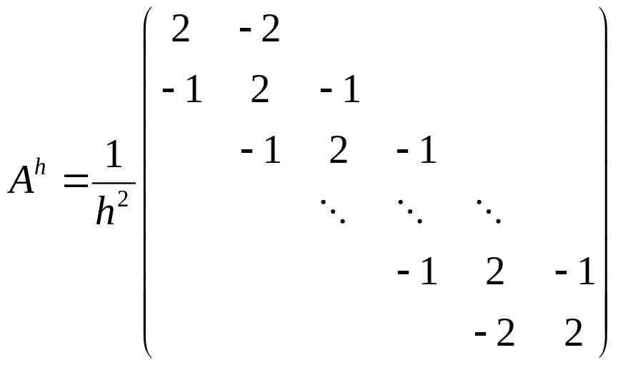
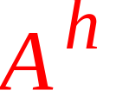

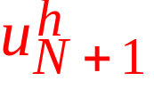
We write the system in matrix form
We can write , where
Note that is (N+2)x(N+2), nonsymmetric, and the system involves unknowns and at the boundaries.

Slide 33
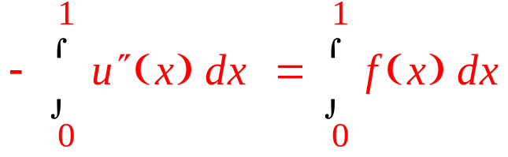
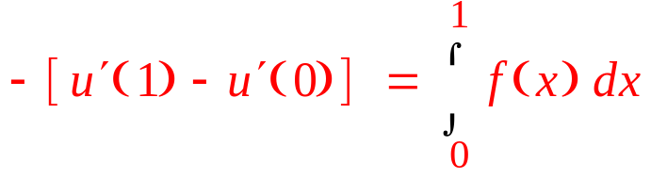
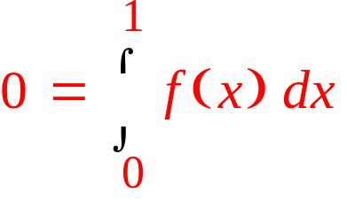
We must consider a compatibility condition
The problem , for and with is not well-posed!
If u(x) is a solution, so is u(x)+c for any constant c.
We cannot be certain a solution exists. If one does, it must satisfy
This integral compatibility condition is necessary! If f(x) doesn’t satisfy it, there is no solution!

Slide 34
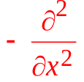
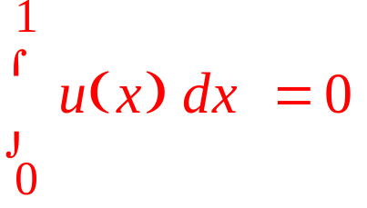
The well-posed system
The compatibility condition is necessary for a solution to exist. In general, it is also sufficient, which can be proven that is a well-behaved operator in the space of functions u(x) that have zero mean.
Thus we may conclude that if f(x) satisfies the compatibility condition, this problem is well-posed:
The last says that of all solutions u(x)+c we choose the one with zero mean.

Slide 35




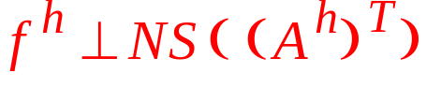
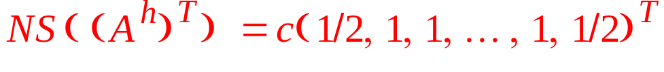

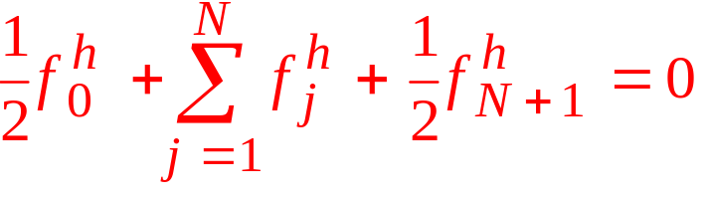
The discrete problem is not well posed
Since all row sums of are zero,
Putting into row-echelon form shows that
hence
By the Fundamental Theorem of Linear Algebra, has a solution if and only if
It is easy to show that
Thus, has a solution if and only if
That is,

Slide 36





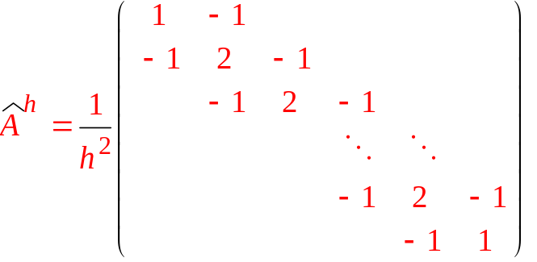
We have two issues to consider
Solvability. A solution exists iff
Uniqueness. If solves so does
Note that if then
and solvability and uniqueness can be handled together
This is easily done. Multiply 1st and last equations by 1/2, giving

Slide 37
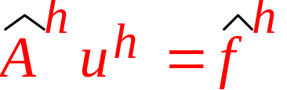
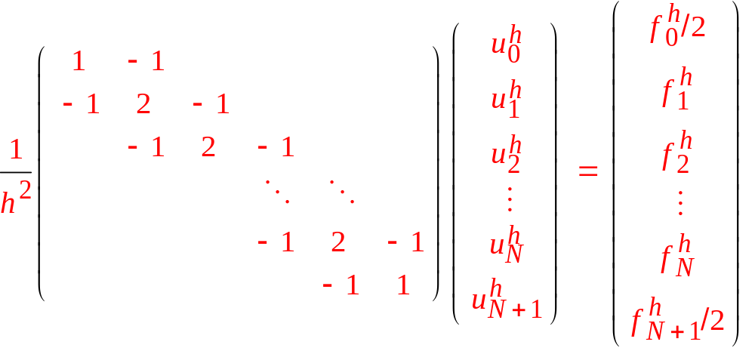
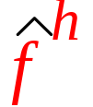
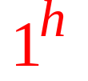
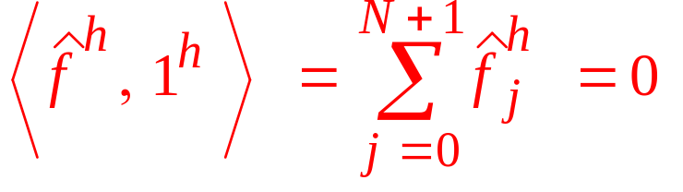
The new system is symmetric
We have the symmetric system :
Solvability is guaranteed by ensuring that is orthogonal to the constant vector :

Slide 38
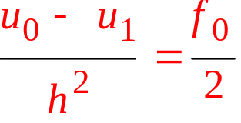
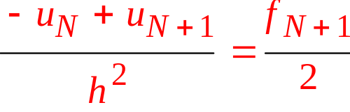


The well-posed discrete system
The (N+3)x(N+2) system is:
or, more simply
(choose the zero mean solution)

Slide 39








Multigrid for the Neumann Problem
We must have the interval endpoints on all grids
Relaxation is performed at all points, including endpoints:
We add a global Gram-Schmidt step after relaxation on each level to enforce the zero-mean condition

Slide 40
Interpolation must include the endpoints
We use linear interpolation:

Slide 41

Restriction also treats the endpoints
For restriction, we use , yielding the values

Slide 42
The coarse-grid operator
We compute the coarse-grid operator using the Galerkin condition
j^{2h} = 0 1

Slide 43


Coarse-grid solvability
Assuming satisfies , the solvability condition, we can show that theoretically the coarse-grid problem is also solvable.
To be certain numerical round-off does not perturb solvability, we incorporate a Gram-Schmidt like step each time a new right-hand side is generated for the coarse grid:

Slide 44





Neumann Problem: an example
Consider the problem ,
which has as a solution for any c (c=-1/12 gives the zero mean solution).

Slide 45
Outline

Nonlinear Problems
Neumann Boundary Conditions
Anisotropic Problems
Variable Mesh Problems
Variable Coefficient Problems
Algebraic Multigrid


Slide 46

Anisotropic Problems
All problems considered thus far have had as the off-diagonal entries.
We consider two situations when the matrix has two different constant on the off-diagonals. These situations arise when
  the (2-d) differential equation has constant, but different, coefficients for the derivatives in the coordinate directions
  the discretization has constant, but different, mash spacing in the different coordinate directions

Slide 47





We consider two types of anisotropy
Different coefficients on the derivatives
discretized on a uniform grid with spacing h .
Constant, but different, mesh spacings:

Slide 48



Both problems lead to the same stencil

Slide 49

Why standard multigrid fails
Note that has weak connections in the y-direction. MG convergence factors degrade as α gets small. Poor performance at α = 0.1 .
Consider α ⇒ 0 .
This is a collection of disconnected 1-d problems!
Point relaxation will smooth oscillatory errors in the x-direction (strong connections), but with no connections in the y-direction the errors in that direction will generally be random, and no point relaxation will have the smoothing property in the y-direction.

Slide 50





We analyze weighted Jacobi
The eigenvalues of the weighted Jacobi iteration matrix for this problem are

Slide 51
Two strategies for anisotropy
Semicoarsening Because we expect MG-like convergence for the 1-d problems along lines of constant y, we should coarsen the grid in the x-direction, but not in the y-direction.
Line relaxation Because the the equations are strongly coupled in the x-direction it may be advantageous to solve simultaneously for entire lines of unknowns in the x-direction (along lines of constant y)

Slide 52


Semicoarsening with point relaxation
Point relaxation on smooths in the x-direction. Coarsen by removing every other x-line.
We do not coarsen along the y-lines.
Semicoarsening is not as “fast” as full coarsening. The number of points on is about half the number of points on , instead of the usual one-fourth.

Slide 53


Interpolation with semicoarsening
We interpolate in the 1-dimensional way along each line of constant y.
The coarse-grid correction equations are

Slide 54




Line relaxation with full coarsening
The other approach to this problem is to do full coarsening, but to relax entire lines (constant y) of variables simultaneously.
Write in block form as
where
and

Slide 55





Line relaxation
One sweep of line relaxation consists of solving a tridiagonal system for each line of constant y.
The kth such system has the form where is the kth subvector of with entries and the kth right-hand side subvector is
Because D is tridiagonal, the kth system can be solved very efficiently.

Slide 56

Why line relaxation works
The eigenvalues of the weighted block Jacobi iteration matrix are

Slide 57




Semicoarsening with line relaxation
We might not know the direction of weak coupling or it might vary.
Suppose we want a method that can handle either
or
We could use semicoarsening in the x-direction to handle and line relaxation in the y-direction to take care of .

Slide 58
Semicoarsening with line relaxation
The original grid
Original grid viewed as a stack of “pencils.” Line relaxation is used to solve problem along each pencil.
Coarsening is done by deleting every other pencil

Slide 59

An anisotropic example
Consider with u=0 on the boundaries of the unit square, and stencil given by
Suppose so the exact solution is given by
Observe that if α is small, the x-direction dominates while if α is large, the y-direction dominates

Slide 60


What is smooth error?
Consider α=0.001 and suppose point Gauss-Seidel is applied to a random initial guess. The error after 50 sweeps appears as:
Error along line of constant x
y
x
Error along line of constant y

Slide 61
We experiment with 3 methods
Standard V(2,1)-cycling, with point Gauss-Seidel relaxation, full coarsening, and linear interpolation
Semicoarsening in the x-direction. Coarse and fine grids have the same number of points in the y-direction. 1-d full weighting and linear interpolation are used in the x-direction, there is no y-coupling in the intergrid transfers
Semicoarsening in the x-direction combined with line relaxation in the y-direction. 1-d full weighting and interpolation.

Slide 62



With semicoarsening, the operator must change
To account for unequal mesh spacing, the residual and relaxation operators must use a modified stencil
Note that as grids become coarser, grows while remains constant.

Slide 63
How do the 3 methods work for various values of α ?
Asymptotic convergence factors:
Note: semicoarsening in x works well for α < .001 but degrades noticeably even at α = .1
α
y-direction strong
x-direction strong

Slide 64


A semicoarsening subtlety
Suppose α is small, so that semicoarsening in x is used. As we progress to coarser grids, gets small but remains constant.
If, on some coarse grid, becomes comparable to , the problem effectively becomes recoupled in the y-direction. Continued semicoarsening can produce artificial anisotropy, strong in the y-direction.
When this occurs, it is best to stop semicoarsening and continue with full coarsening on any further coarse grids.

Slide 65
Outline

Nonlinear Problems
Neumann Boundary Conditions
Anisotropic Problems
Variable Mesh Problems
Variable Coefficient Problems
Algebraic Multigrid



Slide 66










Variable Mesh Problems
Non-uniform grids are commonly used to accommodate irregularities in problem domains
Consider how we might approach the 1-d problem
posed on this grid:

Slide 67





We need some notation for the mesh spacing
Let N be a positive integer. We define the spacing interval between and :

Slide 68




We define the discrete differential operator
Using second order finite differences (and plugging through a mess of algebra!) we obtain this discrete representation for the problem:
where

Slide 69






We modify standard multigrid to accommodate variable spacing
We choose every second fine-grid point as a coarse-grid point
We use linear interpolation, modified for the spacing. If , then for

Slide 70





We use the variational properties to derive restriction and .
This produces a stencil on that is similar, but not identical, to the fine-grid stencil. If the resulting system is scaled by , then the Galerkin product is the same as the fine-grid stencil.
For 2-d problems this approach can be generalized readily to logically rectangular grids. However, for irregular grids that are not logically rectangular, AMG is a better choice.

Slide 71
Outline

Nonlinear Problems
Neumann Boundary Conditions
Anisotropic Problems
Variable Mesh Problems
Variable Coefficient Problems
Algebraic Multigrid




Slide 72








Variable coefficient problems
A common difficulty is the variable coefficient problem, given in 1-d by
where a(x) is a positive function on [0,1]
We seek to develop a conservative, or self-adjoint, method for discretizing this problem.
Assume we have available to us the values of a(x) at the midpoints of the grid

Slide 73



We discretize using central differences
We can use second-order differences to approximate the derivatives. To use a grid spacing of h we evaluate a(x)u’(x) at points midway between the gridpoints:
Points used to evaluate (au’ ) ’ at

Slide 74





We discretize using central differences
To evaluate we must sample a(x) at the point and use second order differences:
where
Points used to evaluate u’ at
Points used to evaluate (au’ ) ’ at

Slide 75




The basic stencil is given
We combine the differences for u’ and for (au’ ) ’ to obtain the operator
and the problem becomes, for

Slide 76

Coarsening the variable coefficient problem
A reasonable approach is to use a standard multigrid algorithm with linear interpolation, full weighting, and the stencil
where
The same stencil can be obtained via the Galerkin relation

Slide 77



Standard multigrid degrades if a(x) is highly variable
It can be shown that the variable coefficient discretization is equivalent to using standard multigrid with simple averaging on the Poisson problem on a certain variable-mesh spacing.
But simple averaging won’t accurately represent smooth components if is close to but far from .
-(a(x)u’)’ = f
-u’’(x) = f

Slide 78




One remedy is to apply operator interpolation
Assume that relaxation does not change smooth error, so the residual is approximately zero. Applying at yields
Solving for

Slide 79



Thus, the operator induced interpolation is
And, as usual, the restriction and coarse-grid operators are defined by the Galerkin relations

Slide 80


A Variable coefficient example
We use V(2,1) cycle, full weighting, linear interpolation.
We use and

Slide 81
Outline

Nonlinear Problems
Neumann Boundary Conditions
Anisotropic Problems
Variable Mesh Problems
Variable Coefficient Problems
Algebraic Multigrid





Slide 82
Algebraic multigrid: for unstructured-grids
Automatically defines coarse “grid”
AMG has two distinct phases:
  setup phase: define MG components
  solution phase: perform MG cycles
AMG approach is opposite of geometric MG
  fix relaxation (point Gauss-Seidel)
  choose coarse “grids” and prolongation, P, so that error not reduced by relaxation is in range(P)
  define other MG components so that coarse-grid correction eliminates error in range(P) (i.e., use Galerkin principle)
(in contrast, geometric MG fixes coarse grids, then defines suitable operators and smoothers)
Notes:
21

Slide 83




AMG has two phases:
Setup Phase
  Select Coarse “grids,”
  Define interpolation,
  Define restriction and coarse-grid operators
Solve Phase
  Standard multigrid operations, e.g., V-cycle, W-cycle, FMG, FAS, etc
Note: Only the selection of coarse grids does not parallelize well using existing techniques!

Slide 84






AMG fundamental concept:
Smooth error = “small” residuals
Consider the iterative method error recurrence
Error that is slow to converge satisfies
More precisely, it can be shown that smooth error satisfies

Slide 85




AMG uses strong connection to determine MG components
It is easy to show from (1) that smooth error satisfies
Define i is strongly connected to j by
For M-matrices, we have from (2)
implying that smooth error varies slowly in the direction of strong connections

Slide 86





Some useful definitions
The set of strong connections of a variable , that is, the variables upon whose values the value of depends, is defined as
The set of points strongly connected to a variable is denoted: .
The set of coarse-grid variables is denoted C.
The set of fine-grid variables is denoted F.
The set of coarse-grid variables used to interpolate the value of the fine-grid variable is denoted .

Slide 87




Choosing the Coarse Grid
Two Criteria
  (C1) For each , each point should either be in or should be strongly connected to at least one point in
  (C2) should be a maximal subset with the property that no two -points are strongly connected to each other.
Satisfying both (C1) and (C2) is sometimes impossible. We use (C2) as a guide while enforcing (C1).

Slide 88
Selecting the coarse-grid points
C-point selected (point with largest “value”)
Neighbors of C-point become F-points
Next C-point selected (after updating “values”)
F-points selected, etc.

Slide 89



Examples: Laplacian Operator
5-pt FD, 9-pt FE (quads), and 9-pt FE (stretched quads)
9-pt FE
(stretched quads)
5-pt FD
9-pt FE (quads)

Slide 90


Prolongation is based on smooth error, strong connections (from M-matrices)
Smooth error is given by:
C
F
F
i
Prolongation :
C
C
F
Notes:
Prolongation from direct neighbors. Use of long range prolongation is a research issue.
Weights can be defined in different ways.

Slide 91






Prolongation is based on smooth error, strong connections (from M-matrices)
Sets:
    Strongly connected -pts.
    Strongly connected -pts.
    Weakly connected points.
C
F
F
i
The definition of smooth error,
C
C
F
Gives:
Strong C
Strong F
Weak pts.
Notes:
Prolongation from direct neighbors. Use of long range prolongation is a research issue.
Weights can be defined in different ways.

Slide 92



Finally, the prolongation weights are defined
In the smooth-error relation, use for weak connections. For the strong F-points use :
yielding the prolongation weights:

Slide 93
AMG setup costs: a bad rap
Many geometric MG methods need to compute prolongation and coarse-grid operators
The only additional expense in the AMG setup phase is the coarse grid selection algorithm
AMG setup phase is only 10-25% more expensive than in geometric MG and may be considerably less than that!

Slide 94
AMG Performance:
Sometimes a Success Story
AMG performs extremely well on the model problem (Poisson’s equation, regular grid)- optimal convergence factor (e.g., 0.14) and scalability with increasing problem size.
AMG appears to be both scalable and efficient on diffusion problems on unstructured grids (e.g., 0.1-0.3).
AMG handles anisotropic diffusion coefficients on irregular grids reasonably well.
AMG handles anisotropic operators on structured and unstructured grids relatively well (e.g., 0.35).

Slide 95












So, what could go wrong?
Strong F-F connections: weights are dependent on each other
For point the value is interpolated from , , and is needed to make the interpolation weights for approximating .
For point the value is interpolated from , , and is needed to make the interpolation weights for approximating .
It’s an implicit system!

Slide 96



Is there a fix?
A Gauss-Seidel like iterative approach to weight definition is implemented. Usually two passes suffice. But does it work?
Frequently, it does:
    Convergence factors for
Laplacian, stretched quadrilaterals

Slide 97


AMG for systems
How can we do AMG on systems?
Naïve approach: “Block” approach (block Gauss-Seidel, using scalar AMG to “solve” at each cycle)
Great Idea! Except that it doesn’t work! (relaxation does not evenly smooth errors in both unknowns)

Slide 98



AMG for systems: a solution
To solve the system problem, allow interaction between the unknowns at all levels:
and
This is called the “unknown” approach.
Results: 2-D elasticity, uniform quadrilateral mesh:

Slide 99


How’s it perform (vol I)?
Regular grids, plain, old, vanilla problems
The Laplace Operator:
Anisotropic Laplacian:

Slide 100

How’s it perform (vol II)?
Structured Meshes, Rectangular Domains
5-point Laplacian on regular rectangular grids
Convergence factor (y-axis) plotted against number of nodes (x-axis)

Slide 101

How’s it perform (vol III)?
Unstructured Meshes, Rectangular Domains
Laplacian on random unstructured grids (regular triangulations, 15-20% nodes randomly collapsed into neighboring nodes)
Convergence factor (y-axis) plotted against number of nodes (x-axis)

Slide 102






How’s it perform (vol IV)?
Isotropic diffusion, Structured/Unstructured Grids
on structured, unstructured grids
Problems used: “a” means parameter c=10, “b” means c=1000
N=16642 N=66049 N=13755 N=54518
Structured Structured Unstruct. Unstruct.

Slide 103

How’s it perform (vol V)?
Laplacian operator, unstructured Grids

Slide 104
Outline

Nonlinear Problems
Neumann Boundary Conditions
Anisotropic Problems
Variable Mesh Problems
Variable Coefficient Problems
Algebraic Multigrid






Slide 105
Multigrid Rules!
We conclude with a few observations:
  We have barely scratched the surface of the myriad ways that multigrid has been, and can be, employed.
  With diligence and care, multigrid can be made to handle many types of complications in a robust, efficient manner.
  Further extensions to multigrid methodology are being sought by many people working on many different problems.

