Slide 1


Slide 2
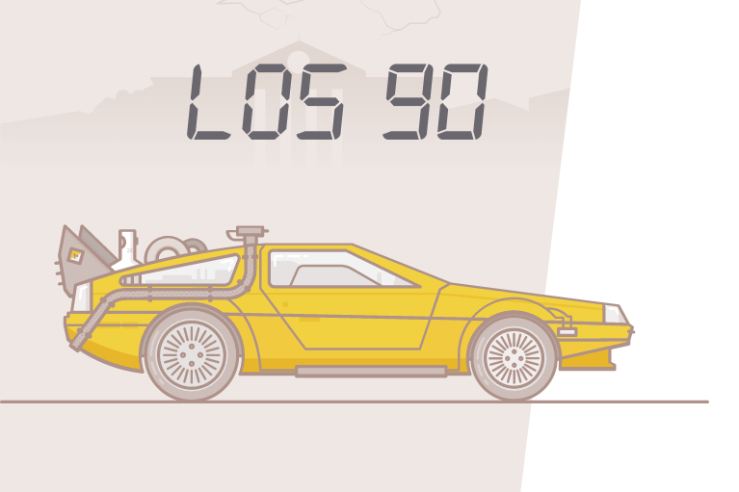

Slide 3


Slide 4

http://greensock.com

Slide 5

https://github.com/Prinzhorn/skrollr

Slide 6


http://mediaelementjs.com/

Slide 7

http://p5js.org/

Slide 8

Plugins
http://greensock.com/
http://prinzhorn.github.io/skrollr/
http://mediaelementjs.com/
http://p5js.org/
https://jakearchibald.github.io/svgomg/
Referencias
https://www.zuto.com/88-miles-per-hour/
http://alfredservice.com/
http://soundcityproject.com/
http://mcwhopper.com/
http://www.topos.mx/amuleto
Más referencias
http://greensock.com/examples-showcases
http://www.awwwards.com/websites/?categories=animation&type=nominees

Slide 9

https://hourofcode.com/es

Slide 10


Slide 11


