Slide 1

Zero to Hero: Mastering Content Security Policy

Slide 2
Crypto Keys
Private Keys
Wallet address (Public keys)

Slide 3
Types of Wallets
Exchange Wallets
Binance, Coinbase, Crypto.com
Software Wallets
Hardware Wallet
Nano
MetaMask, Trust Wallet,

Slide 4
Terms
Origins
Sites
Domains
Notes:
To understand CSP, requires understanding the differences between these three terms:

Slide 5
CSP Tools in Chrome
(Ty)

Slide 6


Chrome Plugins
Two Chrome plugins to help tailor the Content Security Policy (CSP) header for an application
CSP Evaluator
Caspr: Enforcer

Slide 7
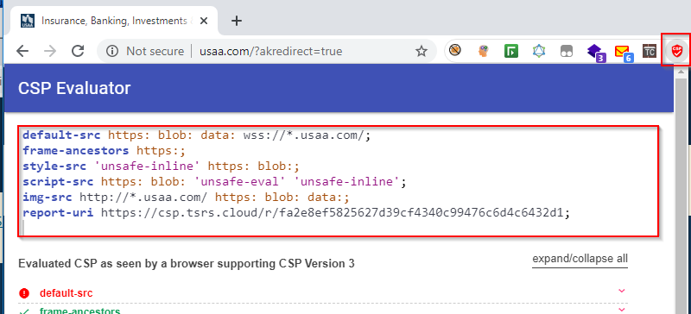
CSP Evaluator
This plugin shows the current CSP configuration and identify problem areas.
https://chrome.google.com/webstore/detail/csp-evaluator/fjohamlofnakbnbfjkohkbdigoodcejf
Notes:
CSP Evaluator allows developers and security experts to check if a Content Security Policy (CSP) serves as a strong mitigation against cross-site scripting attacks.
CSP Evaluator was created by Google and the checks are based on a large-scale study.
It help developers to harden their CSP and improve the security of their applications.
Navigate to the application and open the CSP Evaluator plugin.
The CSP Evaluator plugin will record the current header setting and provide comments on ways to improve the configuration.
In order to use the Caspr plugin in step 2 to change the CSP, copy the contents of the textbox provided in the CSP Evaluator dialog to the clipboard.

Slide 8
Demo: CSP Evaluator

Slide 9
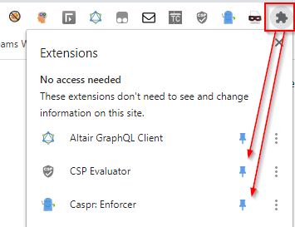
Caspr: Enforcer
This plugin allows testing and refinement of changes to the CSP header in the Chrome browser before the web server is configured.
https://chrome.google.com/webstore/detail/caspr-enforcer/fekcdjkhlbjngkimekikebfegbijjafd
Notes:
Casper Enforcer allows testing and refinement of the CSP.
It allows you to changes the CSP header in the browser before the web server is configured.
For example, navigate to https://ezcardinfodemouat.fisglobal.com/
Click on the CSP Evaluator icon. If the site has a CSP policy, it will automatically be populated within the CSP Evaluator textbox as shown below:

Slide 10
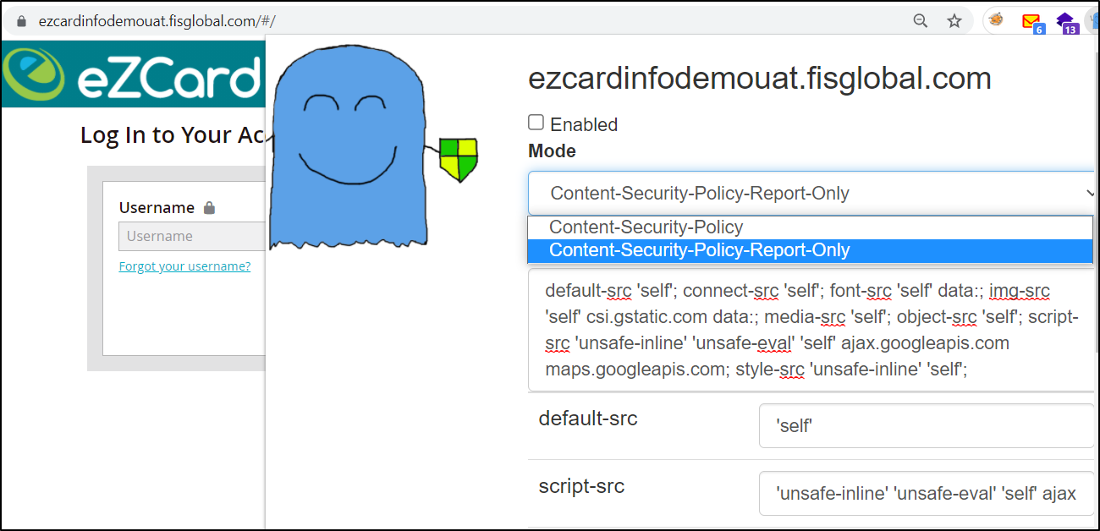
Demo: Using Caspr to help tailor the CSP
Notes:
1. Using the copied policy in the clipboard, paste the CSP header into the textbox as shown below.
2. Click the ‘Enabled’ box to begin the override capability for CSP header in the browser.
3. Select ‘Content-Security-Policy-Report-Only’ from the dropdown. By choosing the “Report-Only” selection, CSP policy violations will be reported in the console but will not affect the functionality of the webpage. This feature allows the tester to fully test the application while collecting error details.
4. Changes can be made to the ‘Policy’ in any of the fields noted below. Click ‘Refresh’ in the browser to apply any modifications made to the header.
5. For example, removing the “unsafe-eval” attribute in the “script-src” directive as shown below. The changes can be made on either the policy field or the individual directive fields. Making changes to both locations is not required (remember to click Refresh after any modification):
6. Errors produced by changes in the CSP policy above will be collected in the Chrome console. There are two choices: collect log entries at the page level or for the entire application. See “Collecting CSP errors from Chrome” below.
Collecting CSP errors from Chrome
Because the configuration above is set to “Report-Only”, Chrome will collect errors due to any CSP misconfiguration. Potential errors are generated by performing regression tests against the application. Regression testing would include clicking all links, buttons, and executing scripts. Any errors resulting from CSP policy violations are displayed in the console tab of the browser. NOTE: there could potentially be a number of errors in the log but the ones of interest here are the ones prefixed with “[Report-Only]”.
1. Collecting log entries for the entire application
The following instructions describe how to view these errors and save them to a file:
Open the F12-Developer tools console
From the gear configuration button on the right hand-side of the developer tools console, turn on feature to ‘Preserve Log”. NOTE: this setting persists the errors in the log in between page refreshes or content loading of partial pages and even errors that have failed in the past and have been currently corrected.
On the ‘Console’ tab, right-click any of the errors and select ‘Save as” from the context menu to save all errors into a file.
2. Collecting for a single page
The following instructions describe how to view these errors and save them to a file:
To access the error console, navigate to the Console tab in Chrome and observe the CSP errors accumulated there.
After any policy change in the Caspr plugin, clear the console by clicking in the icon circled in the screenshot below and refresh the page. This will clear any accumulated errors between changes. Repeat as needed.

Slide 11
END (Ty)

