Slide 1
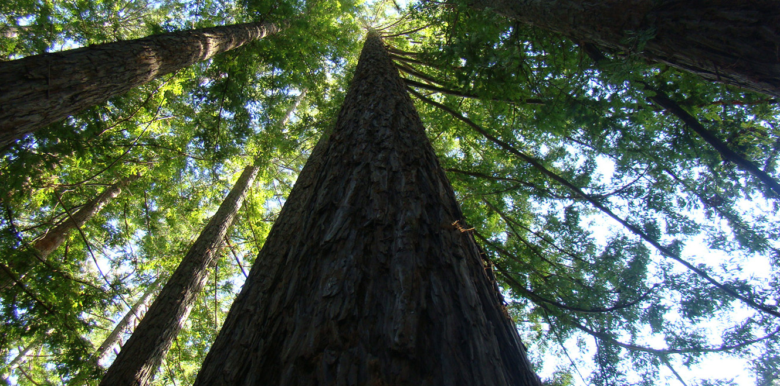
US Wildfire Patterns Detection and Prediction
Gregory Klevans
Liwei Liu

Slide 2
Problems and Data
Tasks*:
Exploratory analysis on fire distributions
Fire weather clustering
Predict wildfires using weather information
Predict fire size using merged data (239216 observations)
Data:
fire data: Kaggle 1.88 Million US Wildfires (Tatman 2020)
weather information: Wildland Fire Assessment System
land cover: Commission for Environmental Cooperation
population density by county: United States Census Bureau
* For all tasks, we focus on the following states: California, Washington, Oregon, Arizona, Nevada, Idaho, Utah, Wyoming, Montana, New Mexico, Colorado, Florida, Georgia, South Carolina, North Carolina

Slide 3
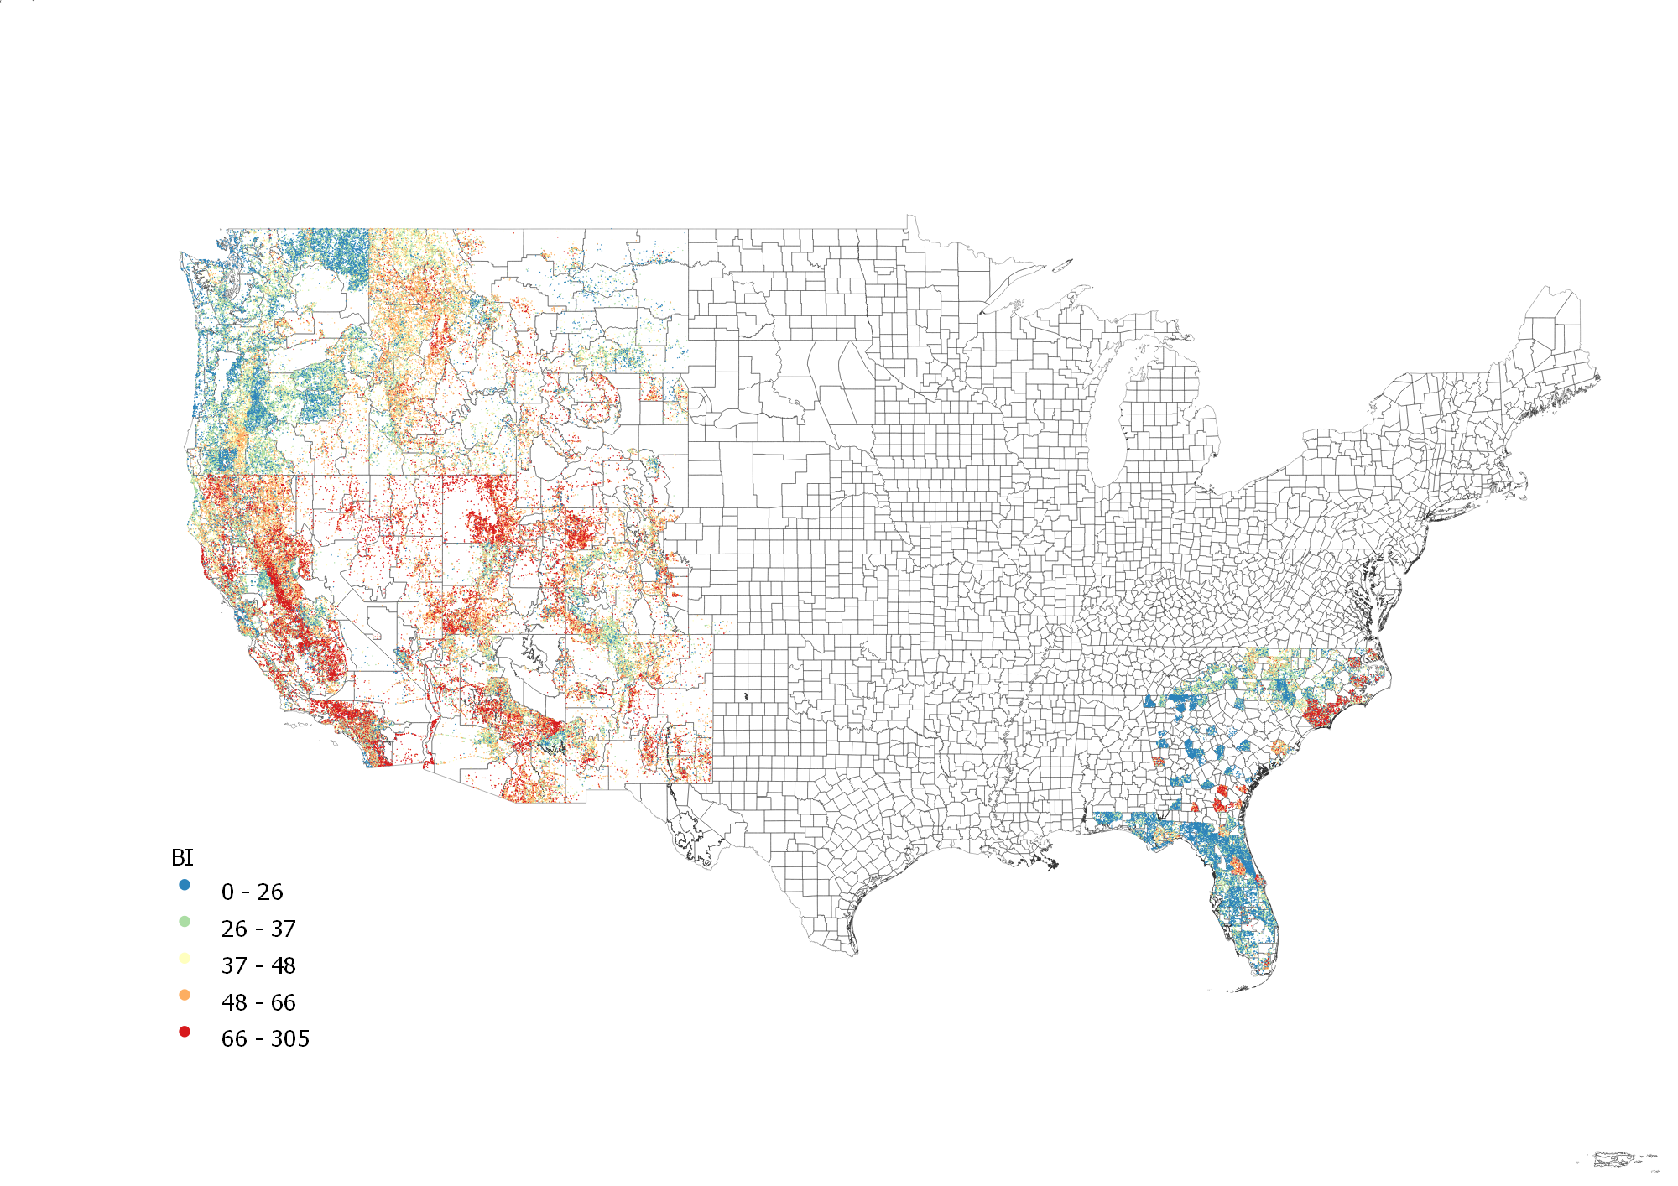
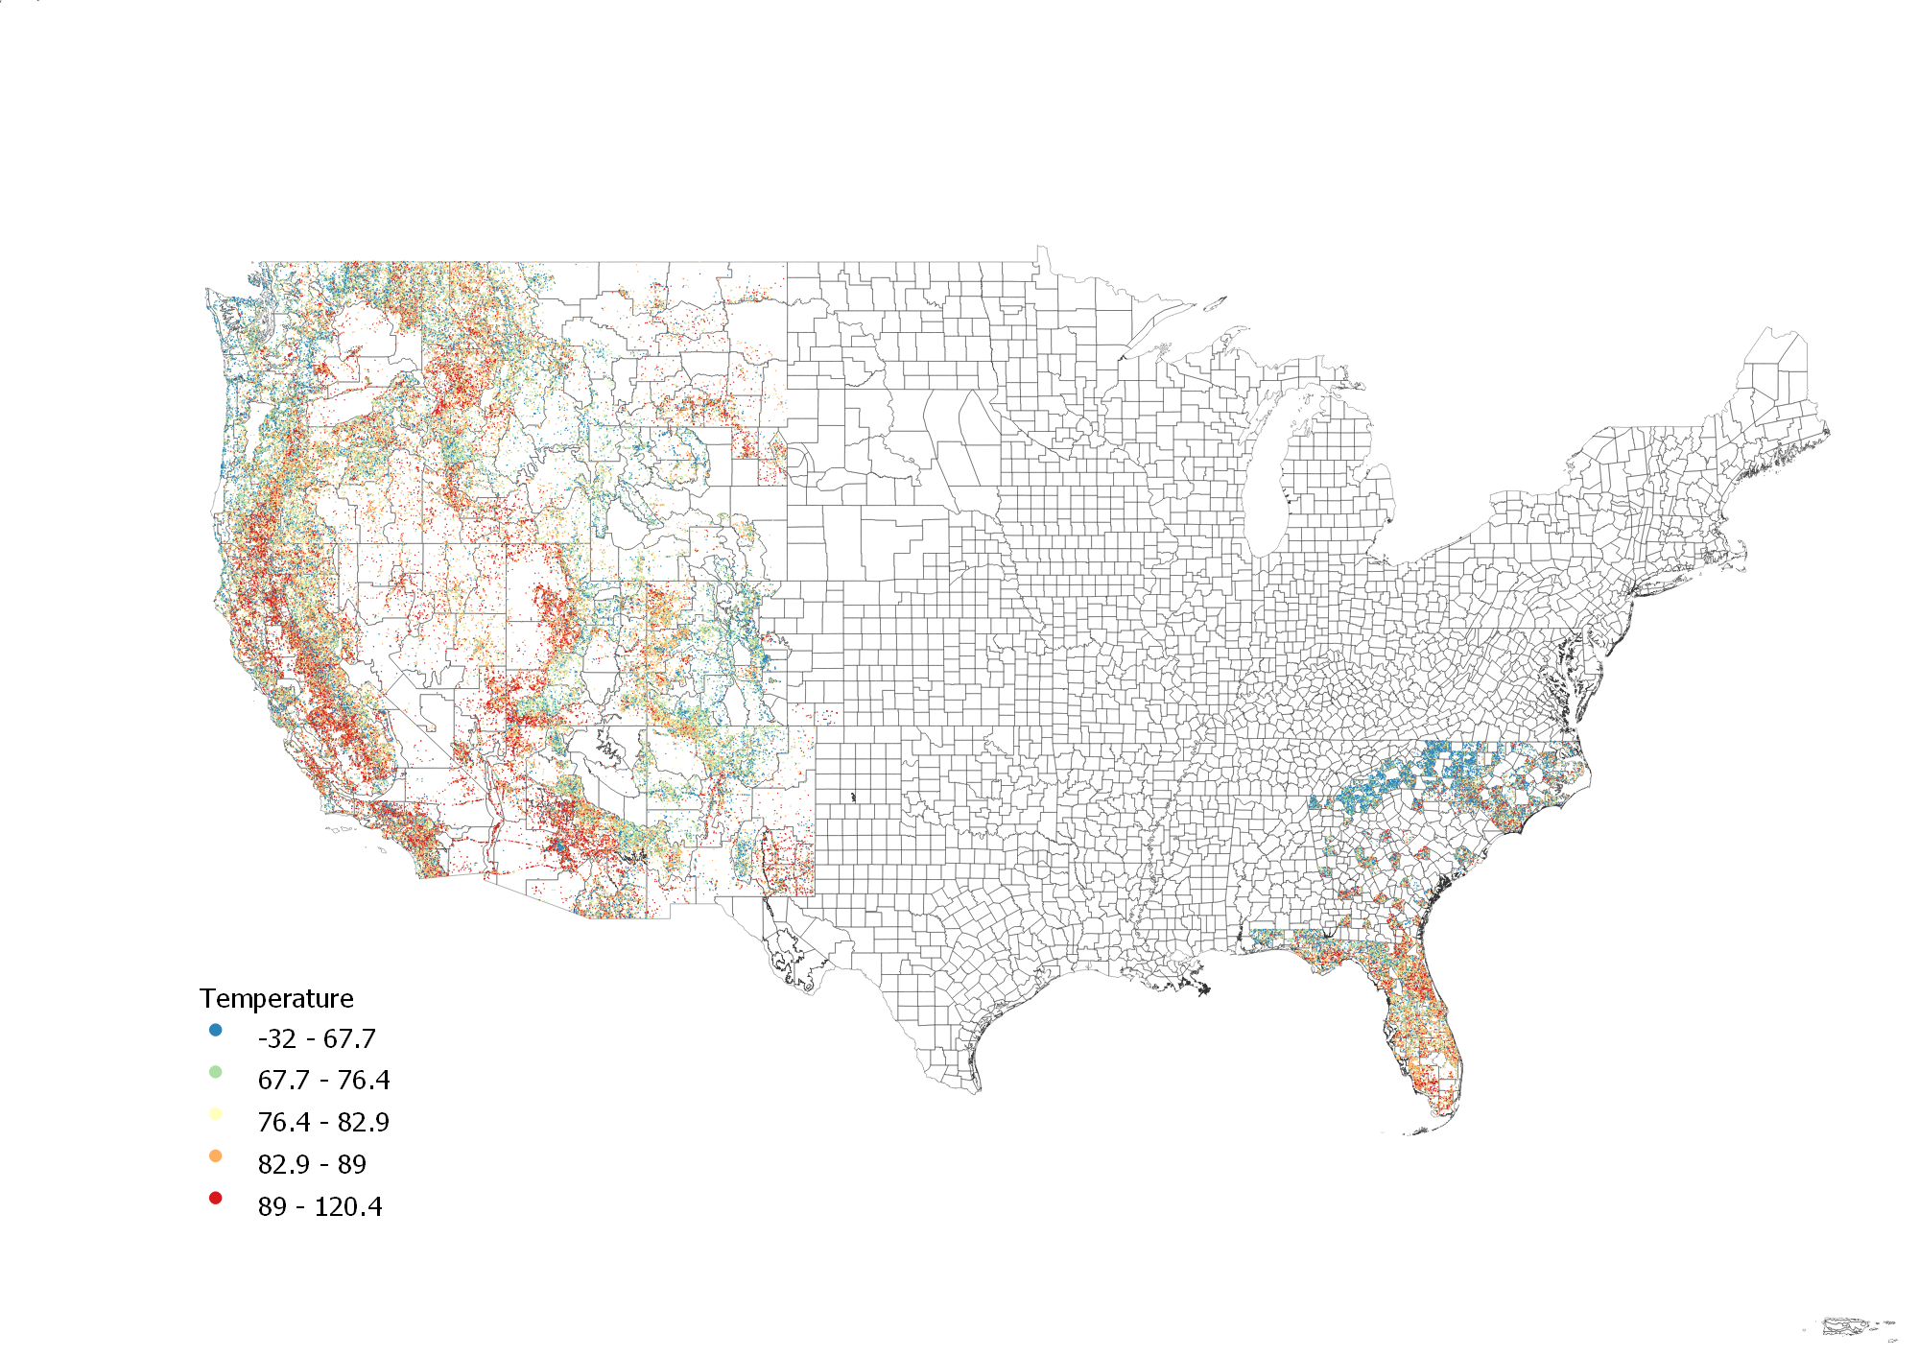
Exploratory Analysis on Wildfire Patterns
Fire distribution with weather information, 2005-2015
Notes:
BI: index related to the efforts to contain fire

Slide 4
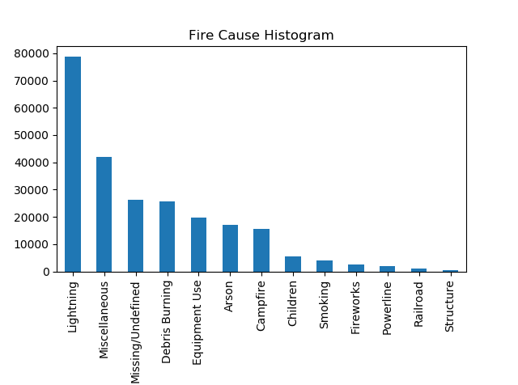
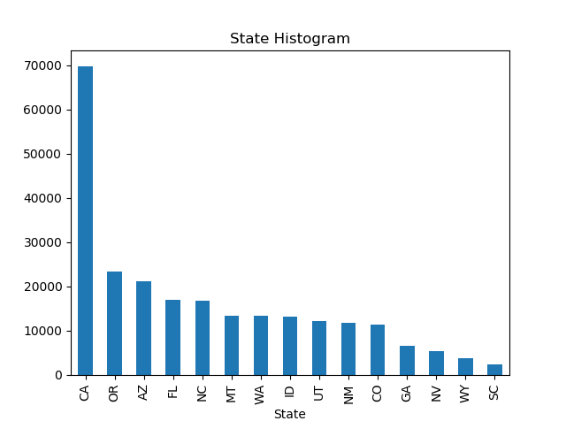
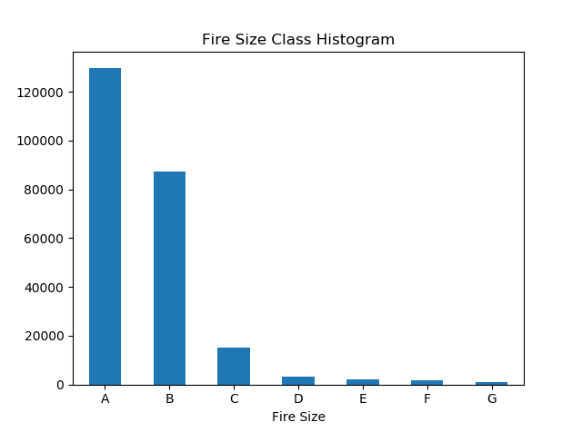
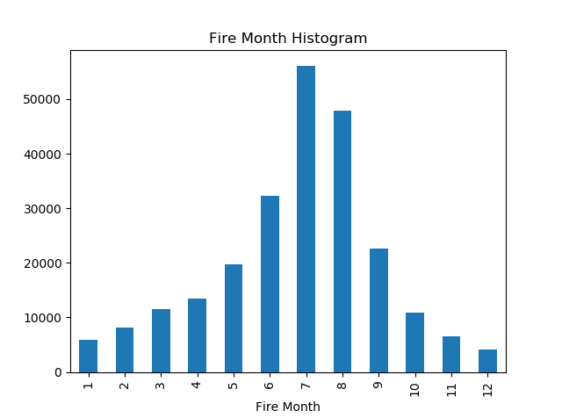
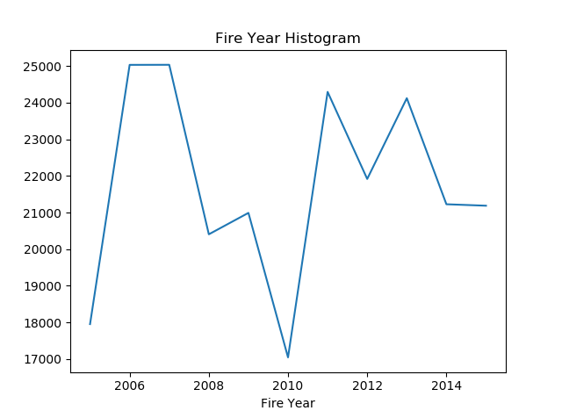
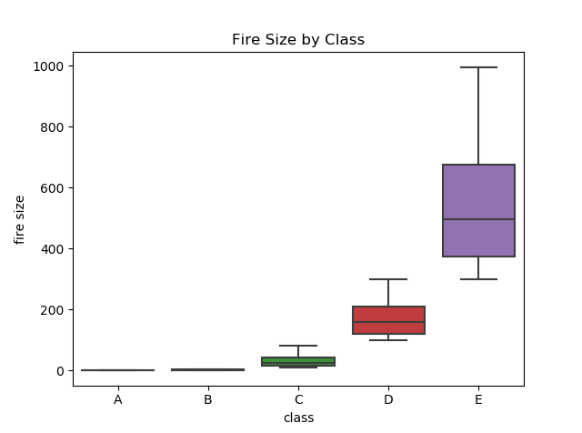
Fire Size Prediction
Data distribution

Slide 5
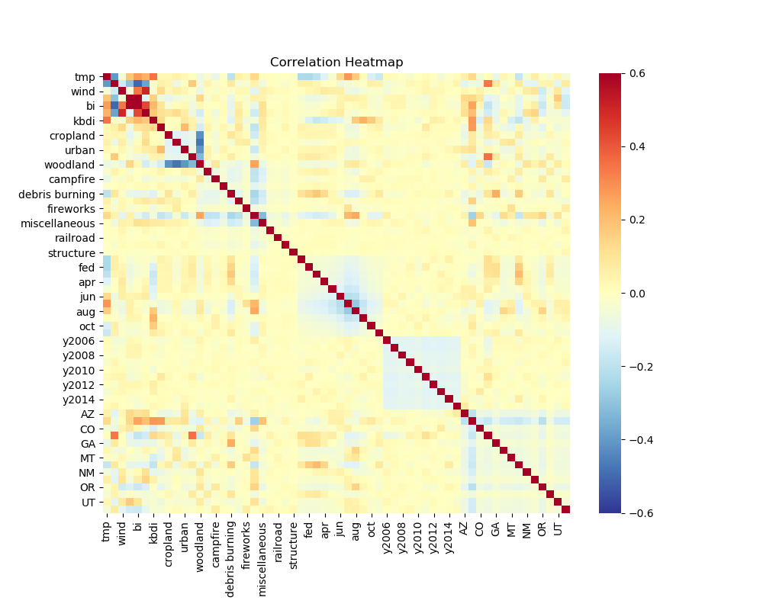
Fire Size Prediction
Feature correlation
Feature | Explanation
tmp | Temperature
wind | Wind speed
rh | Relative humidity
bi | burning index: a number related to the contribution of fire behavior to the effort of containing a fire
sc | spread component: a rating of the forward rate of spread of a headfire
kbdi | Keetch-Byram Drought Index: a stand-alone index that can be used to measure the effects of seasonal drought on fire potential.
Notes:
Check feature redundancy after merging data

Slide 6
Fire Size Prediction
Response variable: fire size class (A-G)
Training:
70% training and 30% test sets
stratified sampling
Experiment results
Model | Accuracy | Recall | F1 Score | ROC-AUC score
Baseline: predict class A | 0.539 | 0.539 | 0.377 | 0.500
Decision Tree | 0.595 | 0.595 | 0.560 | 0.536
Random Forest | 0.634 | 0.634 | 0.597 | 0.547
XGBoost | 0.636 | 0.636 | 0.601 | 0.550
Notes:
1. Use decision tree because it is easier to interpret the model, good at irrelevant feature and outliers; random forest and xgboost can help to increase classification accuracy;
2. random forest can handle high dimension data better than the other models, good at unbalanced data
3. xgboost can reach a higher accuracy.

Slide 7
Fire Size Prediction
Model improvements:
reduce number of classes
3 classes: Class A as small; Class B as medium; Class C-G as large
2 classes: Class A as small; Class B-G as large (large is positive label)
results:
# of classes | Accuracy | Recall | F1 Score | ROC-AUC score
3 | 0.639 | 0.639 | 0.616 | 0.536
2 | 0.699 | 0.649 | 0.601 | 0.665

Slide 8
Fire Size Prediction
Feature correlation with fire size and feature importance:
Top positive correlation | Value | Top negative correlation | Value | Top feature importance | Value | Top feature importance (CA) | Value
lightning | 0.034 | rh | -0.030 | FL | 0.254 | campfire | 0.208
ID | 0.030 | debris burning | -0.013 | campfire | 0.152 | y2008 | 0.088
sc | 0.026 | CA | -0.012 | SC | 0.052 | lightning | 0.081
tmp | 0.025 | NC | -0.010 | lightning | 0.035 | y2015 | 0.043
wind | 0.019 | urban | -0.010 | CO | 0.035 | woodland | 0.034
grassland | 0.018 | cropland | -0.009 | AZ | 0.032 | grassland | 0.027
bi | 0.018 | pop_dens | -0.008 | OR | 0.032 | smoking | 0.024

Slide 9
Conclusion and Recommendations
The most common reason for wildfires are lightnings. Wildfires turn to occur more frequently in western states and during summer (Jun-Sep).
Lightning-caused fires have larger sizes and impacts. Campfires is also a main predictor of large fire sizes. While fire size is positively correlated with temperature and wind speed, it is negatively correlated with relative humidity and is smaller in developed areas.
To avoid severe wildfires influences, we can have more restrictions on campfires, monitor weather more carefully, and have more precautious measures in undeveloped areas.

