Slide 1
Exploring
The Metrics
of Social Capital

Slide 2
WHAT IS SOCIAL CAPITAL?
Macro view — a society’s capacity to build cooperative institutions that promote stability and prosperity
Micro view — the ease with which a social network facilitates social transactions, like smiles and hugs between friends
Venture capitalist’s view — the enablement of deal flow and the secret to unicorn-hunting

Slide 3
lobste.rs — the hacker news for software engineers

Slide 4
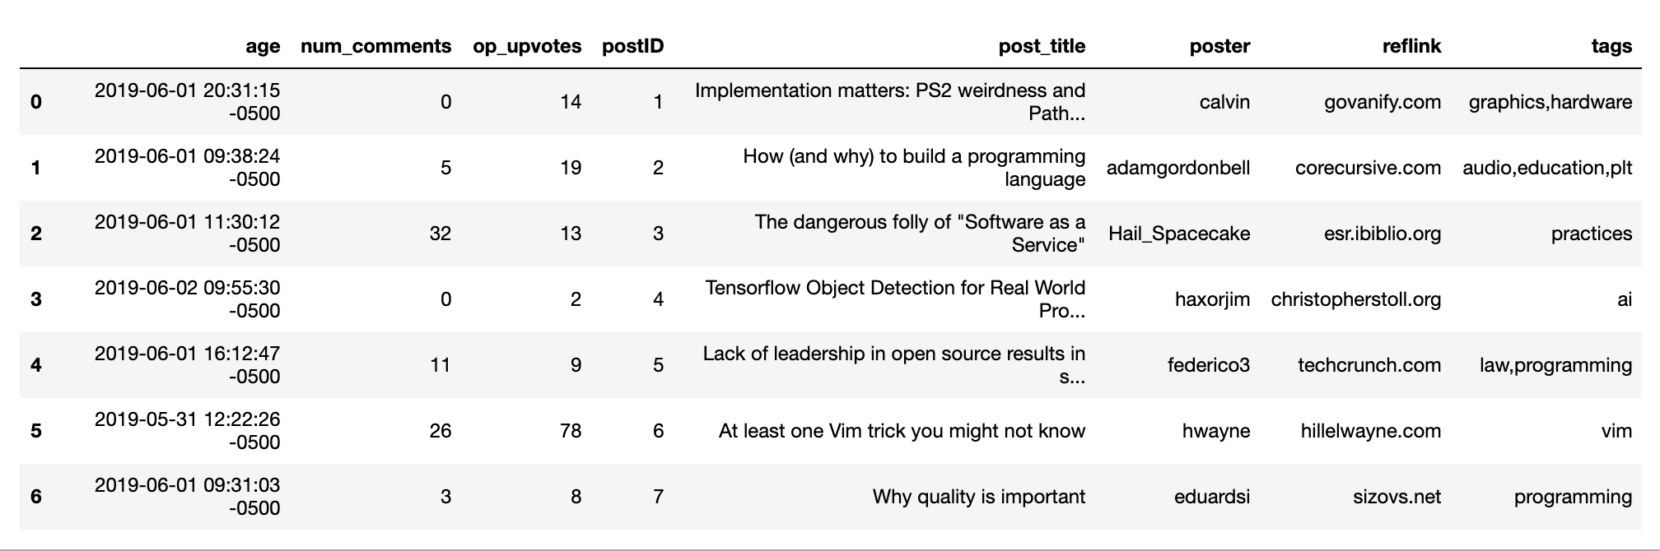
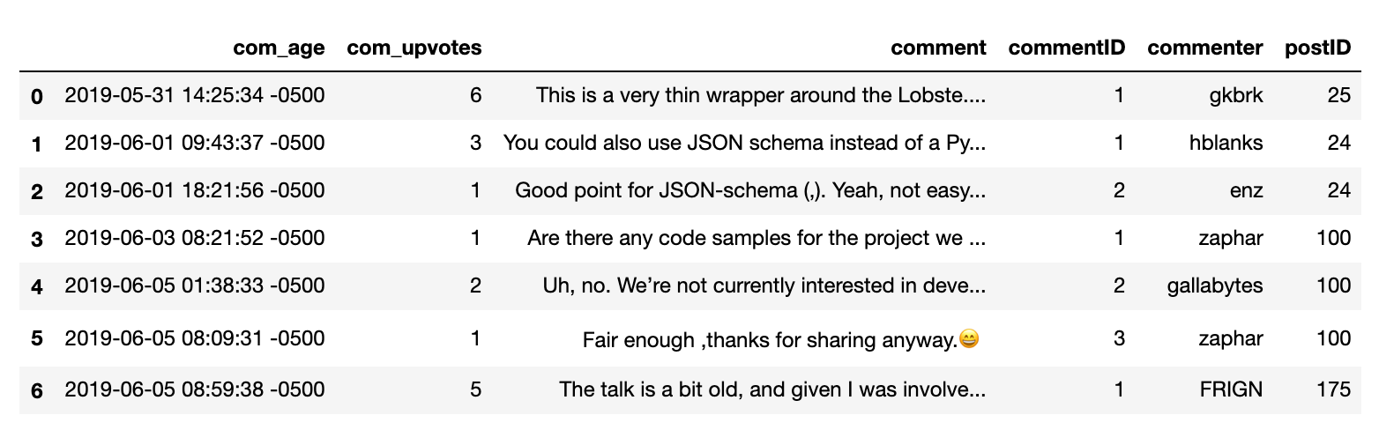
lobste.rs — scraped data

Slide 5
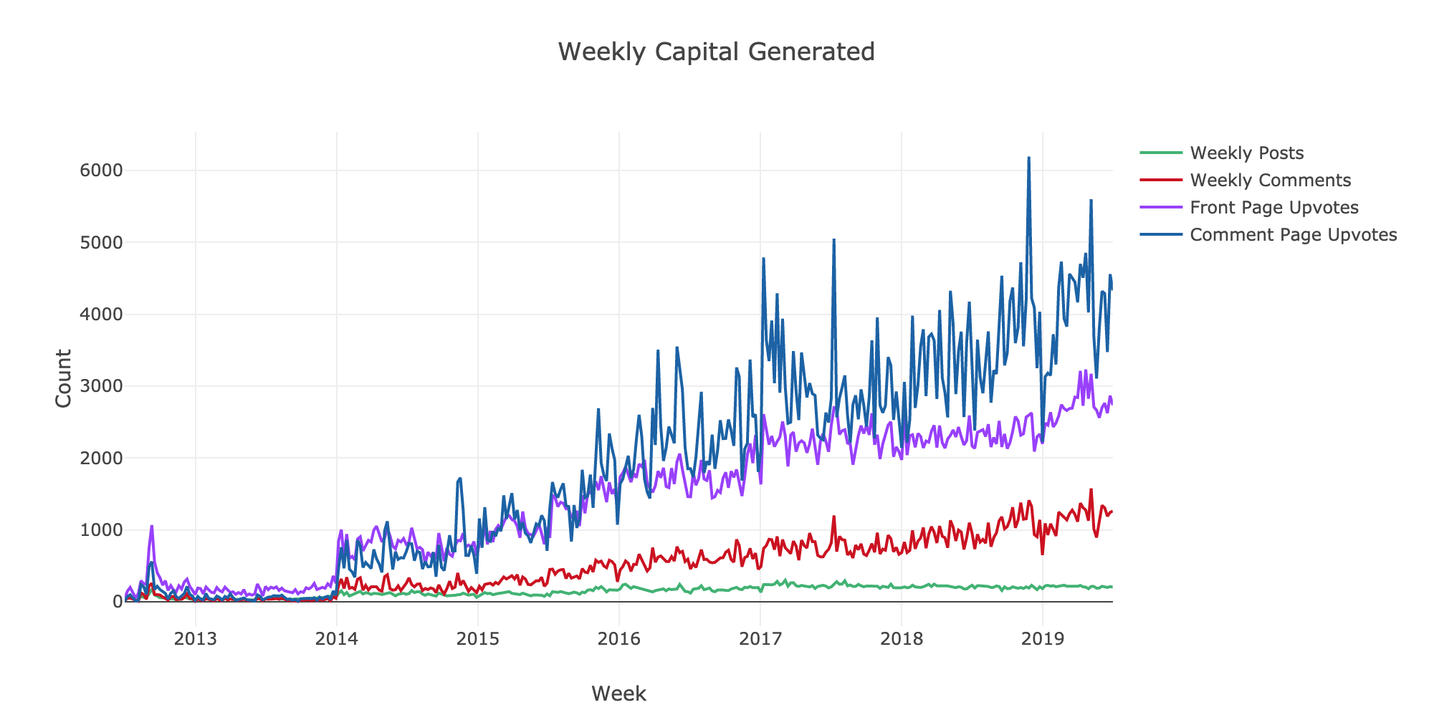

Slide 6
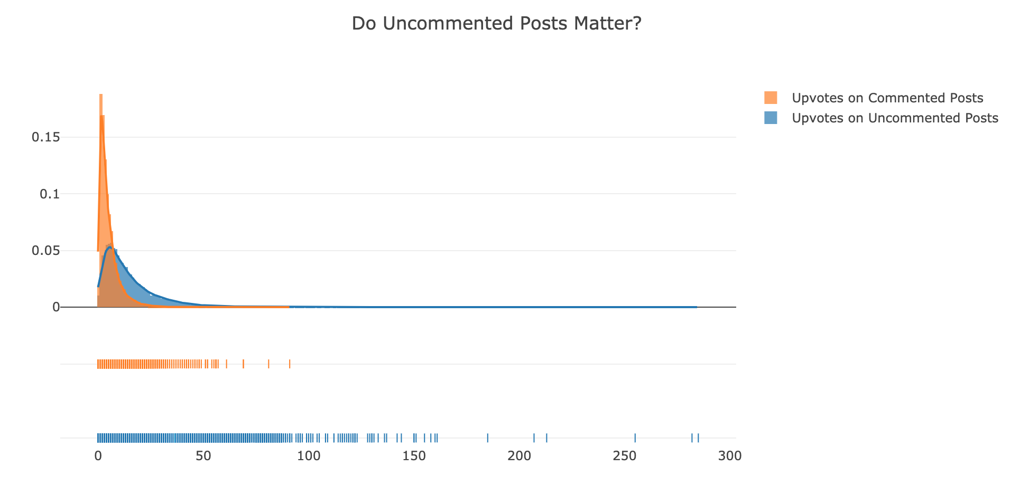

Slide 7
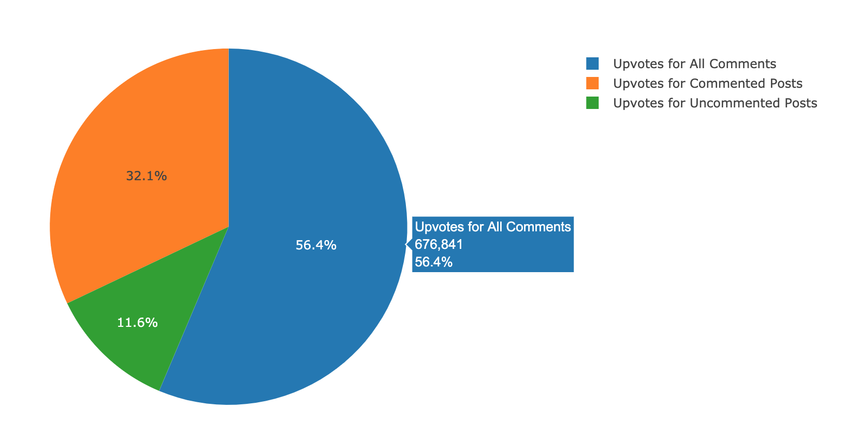

Slide 8
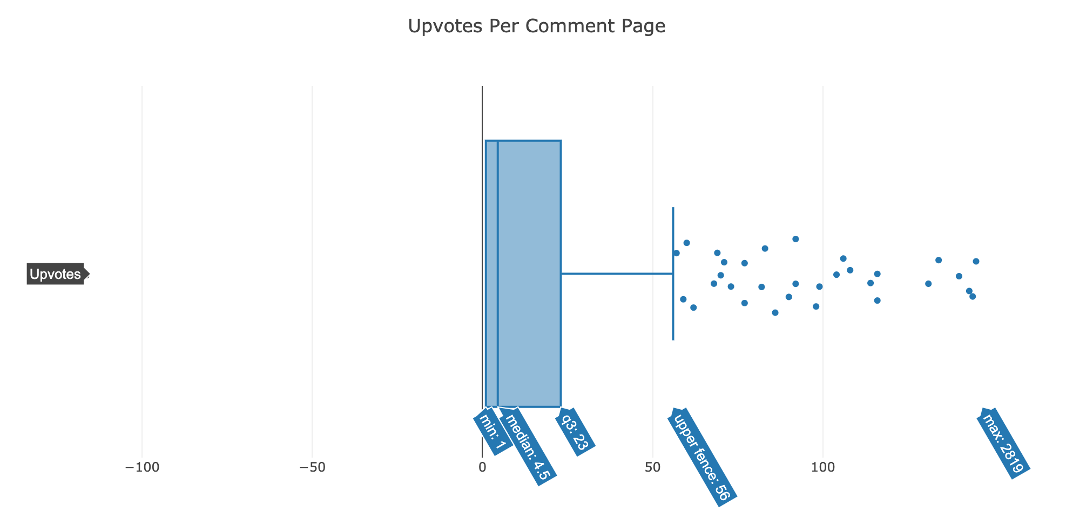

Slide 9
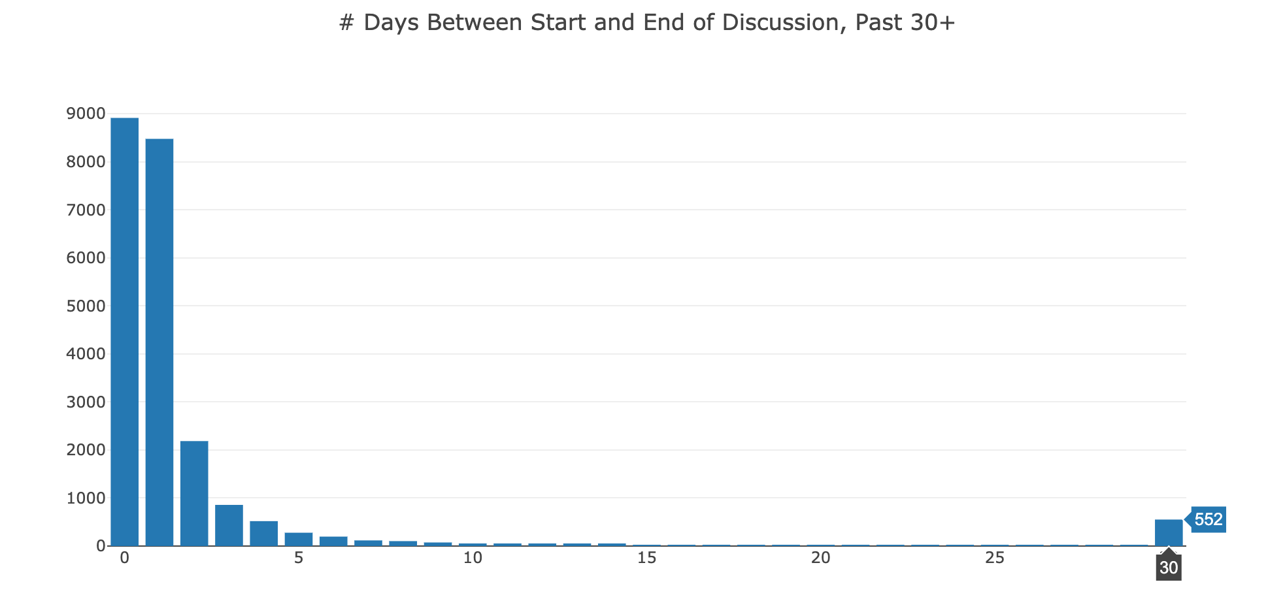

Slide 10
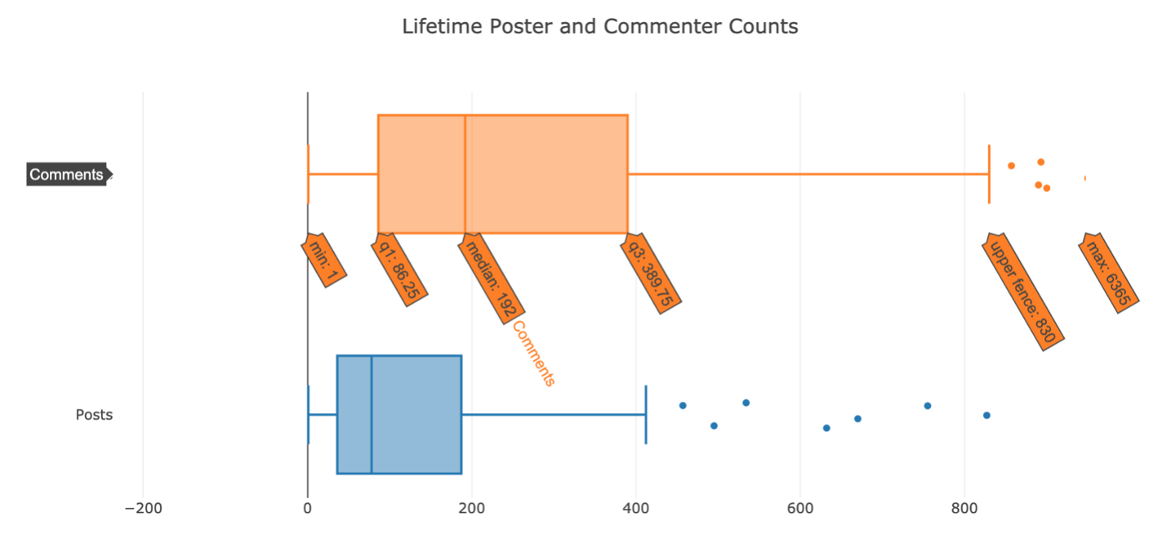

Slide 11
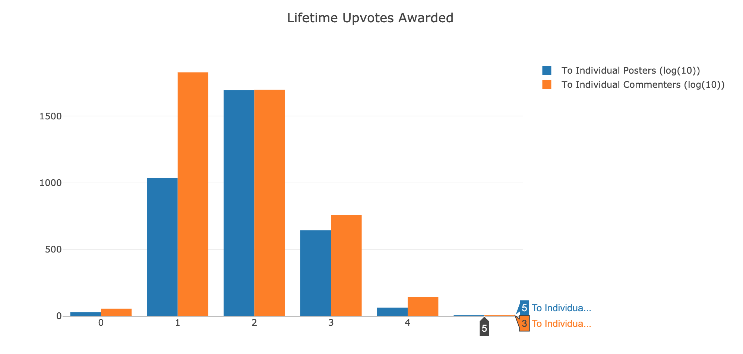

Slide 12
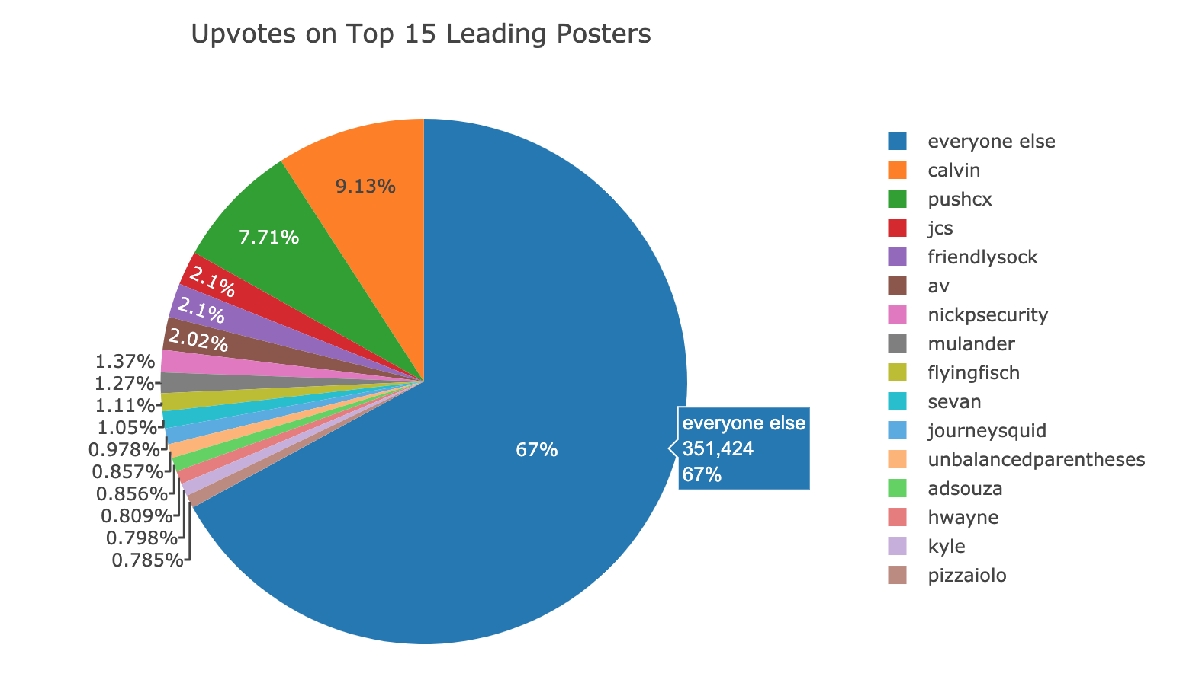
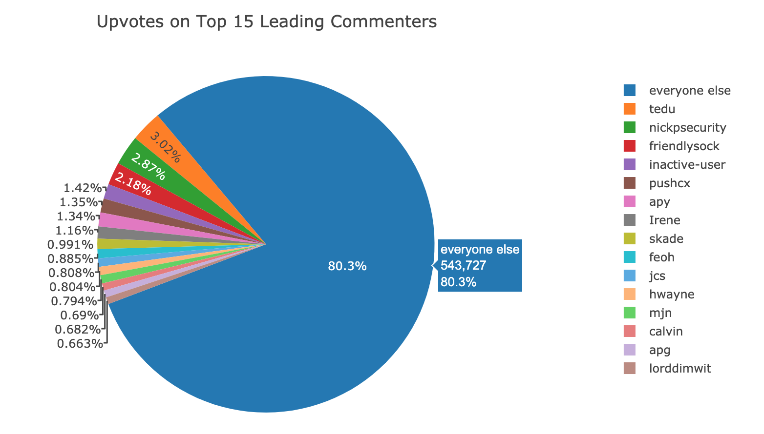

Slide 13
Development of more robust metrics
Information density
Liquidity
Staying power
Network analysis

Slide 14
ARIMA Forecasting

