Slide 1
Development and implementation of a Primary Cell Culture with Nanostring and alphaLISA readouts to support lead optimization for sickle cell disease
Christopher Olsen

Slide 2
Background

Slide 3
Outline
Background
  Sickle cell disease pathophysiology and unmet medical need.
  Development funnel and assay design considerations.
  Benefits and drawbacks of primary cell culture approach.
Assay Development
  Primary erythroid culture protocol optimization and automation
  Nanostring and alphaLISA endpoint Z’ achievement
  Assay validation and troubleshooting
Reflections and Learnings
  Technical and analytical challenges encountered.
  Key takeaways and broader applicability.

Slide 4
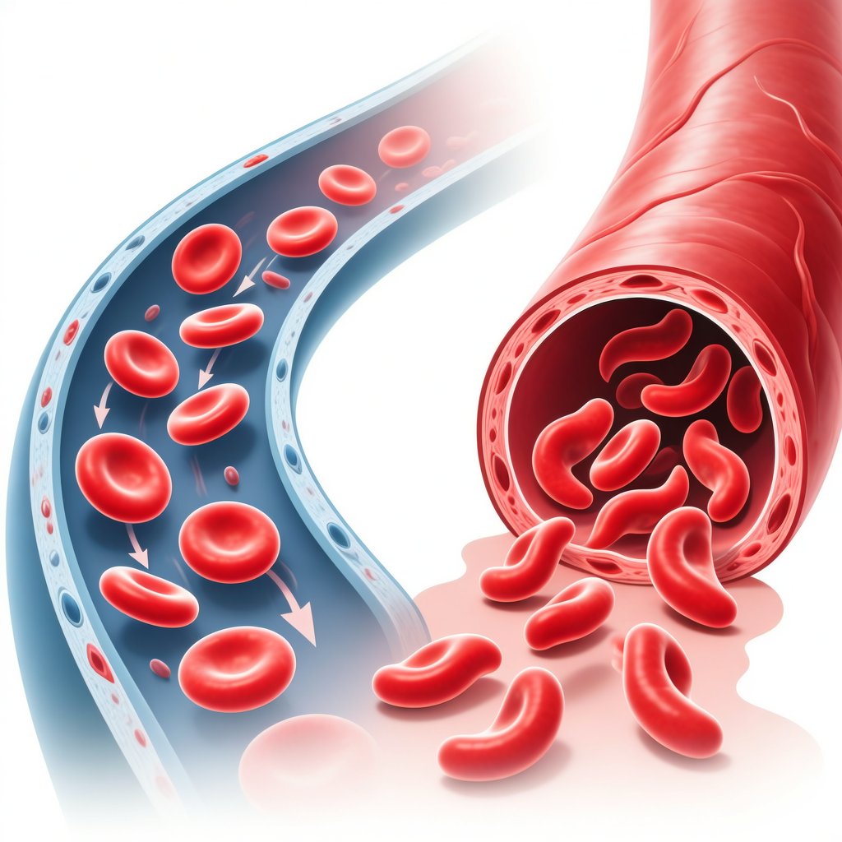
Sickle Cell Disease: Unmet Medical Need
Disease Background
Single nucleotide mutation in β-globin gene (HBB)
Polymerization of deoxygenated sickle hemoglobin (HbS)
Vaso-occlusive crises, chronic hemolysis, organ damage
~100,000 patients in US; millions worldwide
Sickle Cell Disease

Slide 5
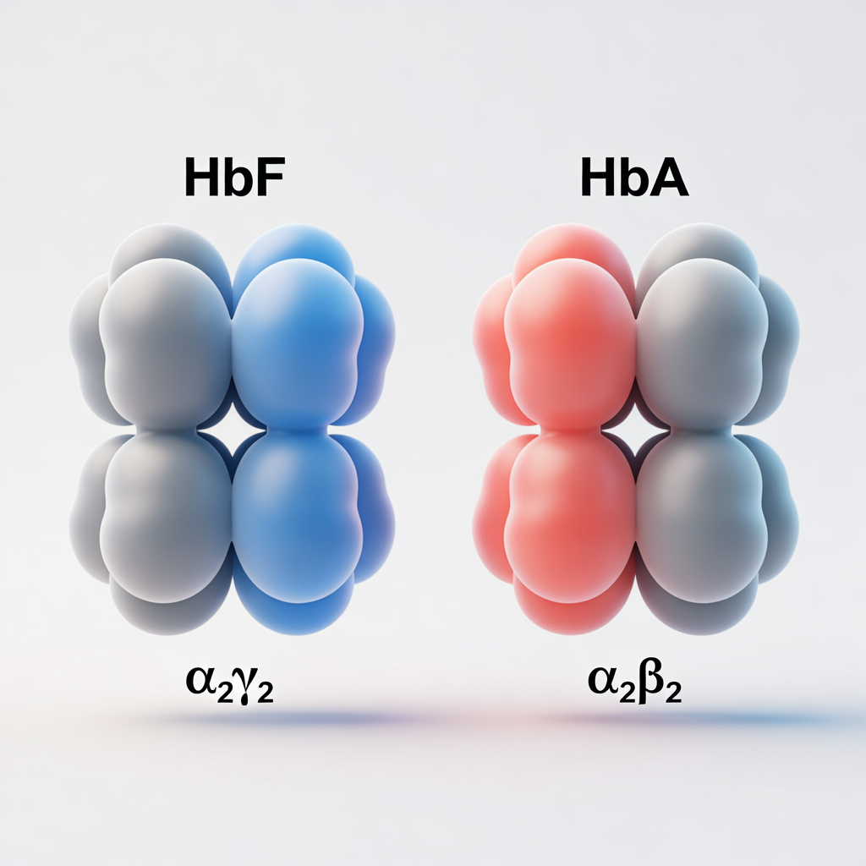
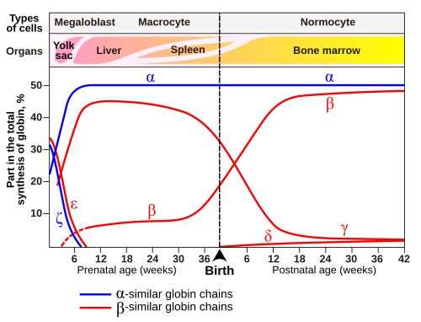
Molecular Biology of Hemoglobin Switching and Hemoglobin Types

Slide 6
Assay Strategy & Design Rationale
Tier 1: High-Throughput Biochemical Screening TR-FRET Assay, LC/MS ect.
Tier 2: Target Engagement in vitro alphaLISA in immortalized cell line, limited treatment time
⭐ Tier 3: Physiological Relevant Phenotypic Confirmation ⭐
  Primary cell culture model
  Nanostring gene expression
  alphaLISA protein quantification
  Built for screening ≈ 20 compounds weekly
Tier 4: Candidate Selection 3-5 candidates, in vivo testing

Slide 7
Assay Development

Slide 8
Assay Development Criteria: Production Readiness Checklist
NIH Assay Guidance Manual Standards
☒ Performance: Z’ ≥0.5 (0.82) | S/B ≥3 (12.5) | CV% <20% (8.2%)
☒ Reproducibility: Validated across operators & reagent lots
☒ Validation: Dose-response, EC₅₀/IC₅₀, dynamic range
☒ Interference: PAINS, autofluorescence, DMSO, matrix effects
☒ Operations: SOP, QC, data pipeline, throughput
Status: Qualified for Production Screening

Slide 9
Primary Erythroid Cell Culture Development
Phase 1: Expansion
Days -4 – 0 CD34+ cells Recovery / Maintenance Medium
→
Phase 2: Differentiation
Days 0 – 10 Compound addition Cytokine cocktail addition for differentiation 96-well plates Hemoglobin synthesis
FortessaCount
MantisNormalize
ViafloTransfer
→
NanostringnCounter
EnVisionalphaLISA
Phase 3: Readout
Day 10 Cell harvest Dual platform analysis

Slide 10
Assay Validation: Tool Compounds
Assay Robustness
Z’ Factor: 0.82 ✓
CV%: 8.2% ✓
Data Quality: 99.2%
Assay Performance
Signal-to-Background: 95%
S/B Ratio: 12.5
Throughput: 3,840/week
alt.LayerChart(...)

Slide 11
Assay Endpoints & Data Capture
Nanostring nCounter Gene Expression
Primary Endpoints: - HBG1/HBG2: Fetal γ-globin mRNA quantification - HBB: Adult β-globin expression - γ/(γ+β) Ratio: Hemoglobin switching metric
Mechanistic Insights: - BCL11A, KLF1, MYB: Transcriptional regulators - GATA1, TAL1: Erythroid differentiation markers - EPOR: EPO signaling pathway
Data Output: - Digital counts (no amplification bias) - Normalized to housekeeping genes - Fold-change vs vehicle control - Multi-donor comparison
EnVision alphaLISA Protein Quantification
Primary Endpoints: - HbF Protein: Direct fetal hemoglobin measurement - Total Hemoglobin: Cell health/differentiation marker - %HbF: Clinical translational endpoint
Advantages: - High sensitivity (pg/mL range) - No interference from test compounds - High-throughput compatible (384-well) - Orthogonal validation to mRNA data
Data Output: - Absolute protein concentration - EC₅₀ determination - mRNA-protein correlation analysis - Donor response profiles

Slide 12
Dual-platform approach enables comprehensive SAR development: mRNA mechanistic insights combined with clinically relevant protein endpoints

Slide 13
Reflections and Learnings

Slide 14
Challenges & Solutions
Technical Challenges
1. Donor Variability - Issue: 3-5 fold baseline HbF differences - Solution: Normalized fold-change metrics; qualified donor panel
2. Culture Reproducibility - Issue: Batch-to-batch media variation - Solution: Lot testing; controlled serum batches
3. Throughput Limitations - Issue: Manual culture steps - Solution: Semi-automation with Hamilton; batch processing
Analytical Challenges
4. Nanostring Sample Throughput - Issue: 12-24 samples/run limitation - Solution: Prioritized compounds; alphaLISA primary screen
5. Data Integration - Issue: Correlating mRNA and protein data - Solution: Custom analysis pipeline; unified database
6. Assay Interference - Issue: Autofluorescence from compounds - Solution: AlphaLISA format immune to interference

Slide 15
Key Takeaways & Impact
Primary Accomplishments

Slide 16
Assay Development
✓ Established robust primary cell culture system (Z’ >0.7)
✓ Implemented dual-readout platform (Nanostring + alphaLISA)
✓ Validated with clinical and tool compounds
✓ Achieved screening throughput capability
✓ Generated mechanistic insight framework
Drug Discovery Impact
✓ Supported 3 lead optimization campaigns
✓ Screened >2,500 compounds over 18 months
✓ Identified novel chemical series with <100 nM potency
✓ Enabled mechanism-based compound classification
✓ Informed candidate selection for in vivo studies

Slide 17
Scientific Contribution: Physiologically relevant, translational assay bridging medicinal chemistry and clinical development for sickle cell disease therapeutics

Slide 18
Acknowledgments
Collaborators & Contributors
Biology Team: - Primary cell culture development - Assay validation & execution - Data analysis & interpretation
Chemistry Team: - Compound synthesis & SAR - Lead optimization campaigns
Translational Sciences: - Clinical sample coordination - Biomarker strategy
Technical Support
Core Facilities: - Nanostring nCounter operations - Flow cytometry core - Automation support
External Partners: - SCD patient advocacy groups - Clinical material suppliers - Technology vendors

Slide 19
Questions?

Slide 20
Backup Slides
Supplementary Data & Technical Details

Slide 21
Nanostring nCounter Background
Technology Overview
Digital molecular barcoding for direct mRNA quantification without amplification
Custom CodeSet Design
Target Genes: HBG1, HBG2 (γ-globin), HBB, HBA1/2
Hemoglobin Switching: BCL11A, KLF1, MYB, SOX6
Erythroid Markers: GATA1, TAL1, EPOR
Housekeeping: GAPDH, ACTB, HPRT1
Total: 15-20 genes per panel
Workflow Implementation
Cell lysis & mRNA isolation
Hybridization with probe sets (16-18 hrs)
Nanostring nCounter detection
Digital counting & normalization
Data analysis pipeline
Throughput: 12-24 samples per run
Turnaround: 48 hours
Key Advantage: Minimal sample input (100 ng RNA)

