Slide 1
Graph Databases for Use with Timeseries IoT Datasets
By Colter Snyder

Slide 2
Introduction
IoT Devices have a lot of data
Many send thousands of flows per second
Need an efficient way to analyze
Relational Databases ok
Not great for connected data [2]
Solution: Graph Databases

Slide 3
Definitions
Graph Databases
Graph Theory
Nodes and Edges
Timeseries Data
Flow data over time
5-triple with timestamp

Slide 4
Motivation
IoT devices everywhere
Producing data all the time
Sometime transfers this data over the internet
Have a need to analyze timeseries data
Important to observe trends
Need an efficient method for small networks and homes
Not everyone has a powerful computer

Slide 5
Motivation
Enter Graph Databases
Great for connected data [2]
Very efficient for such data [2]
This timeseries data is connected data
An ideal choice to work with

Slide 6
Related Works
IoT Inspector [1]
Lot of Inspiration
Not focused on graph databases and their advantages
The Graph of Things [4]
Global IoT Experiment
Not focused on small networks and homes

Slide 7
Methodology
Decide on tech stack
Neo4J
Python
Decide on dataset
BoT IoT [3]
Real and Simulated IoT Data
Timeseries
Create Queries
Simple
Lots of info
Analyze Data

Slide 8
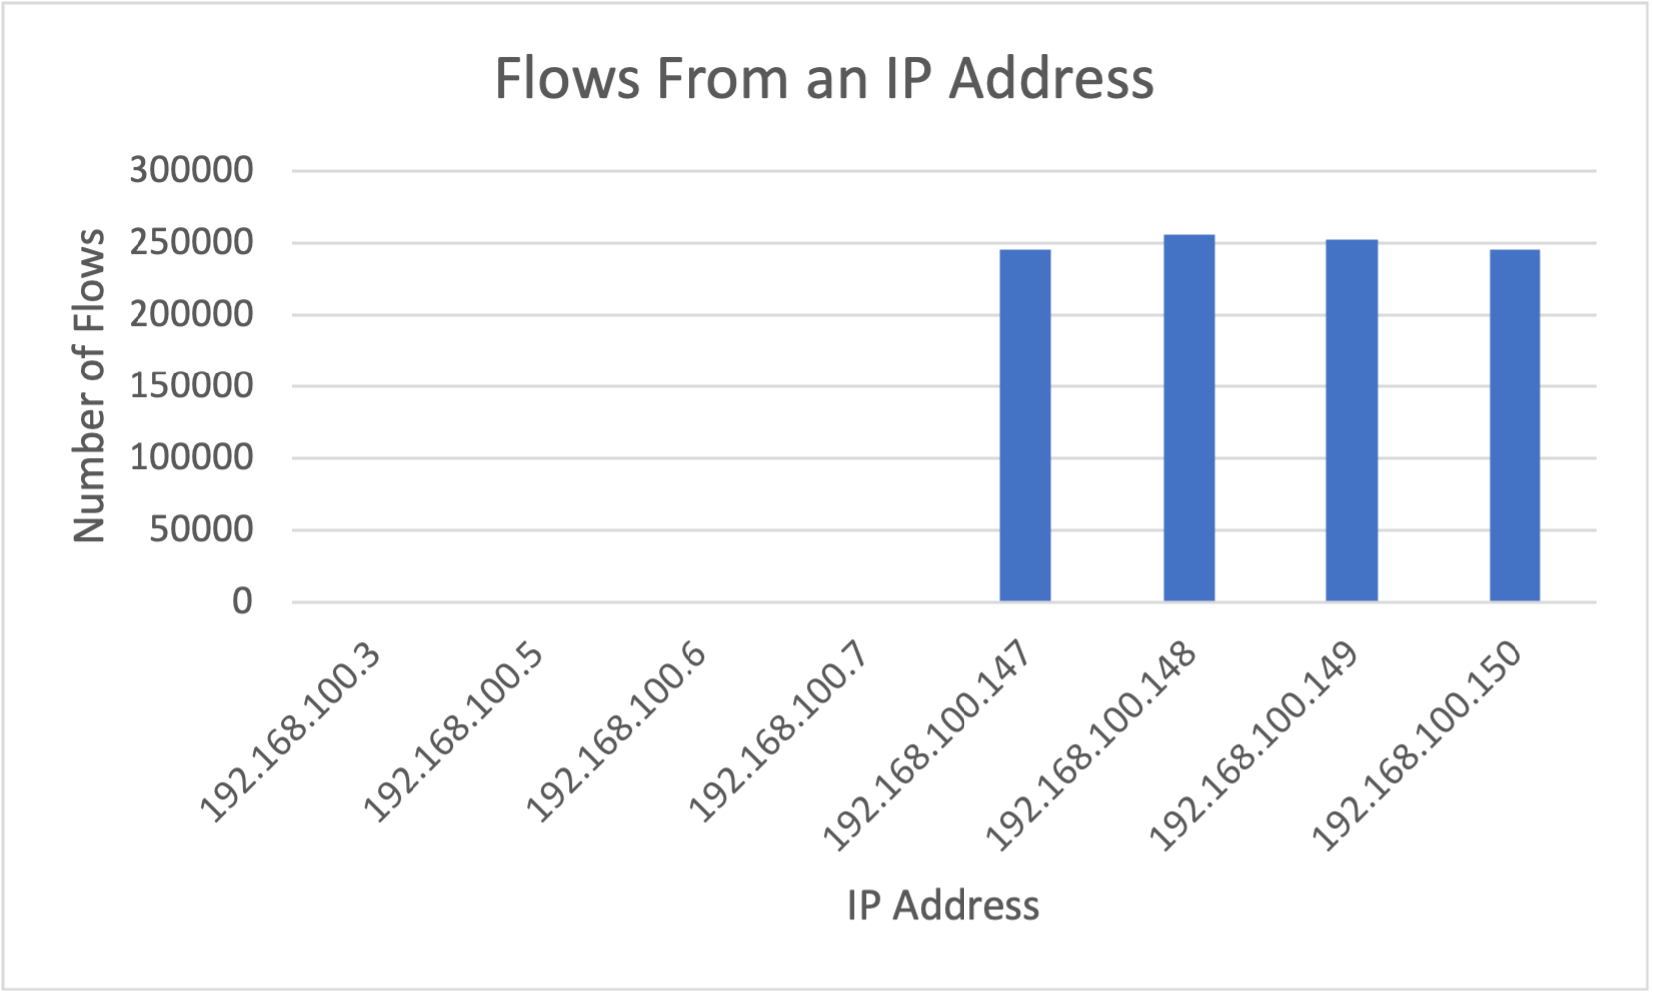
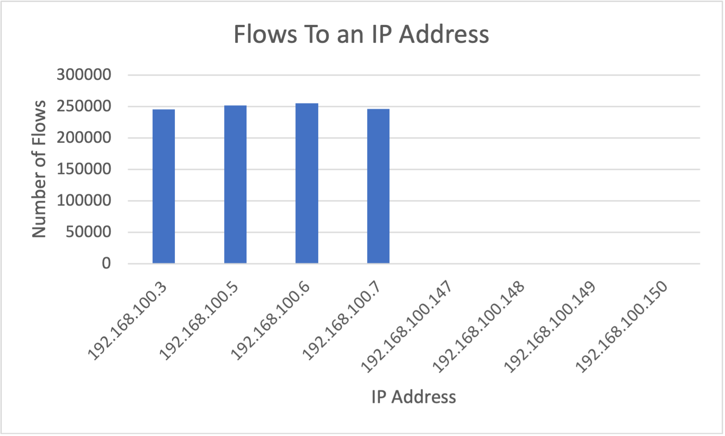
Results

Slide 9
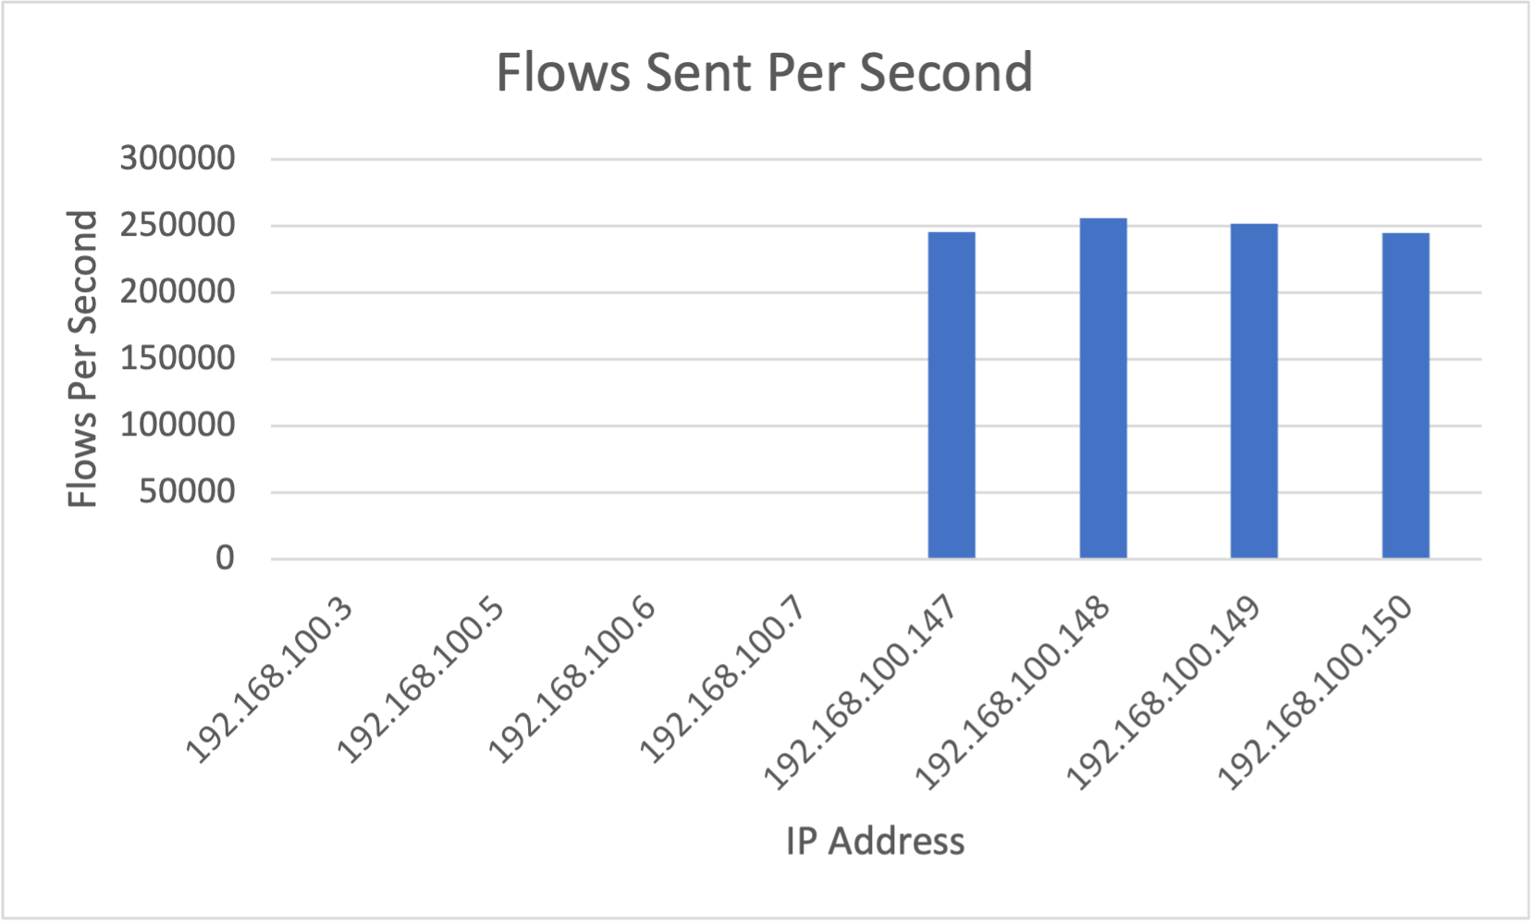
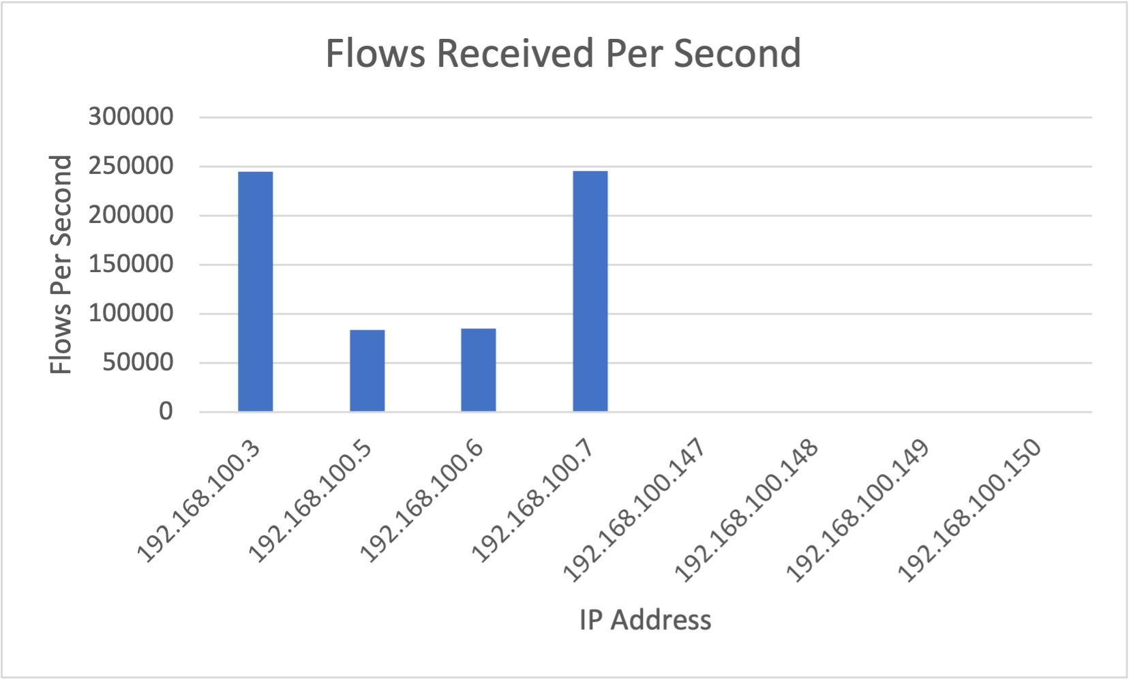
Results

Slide 10
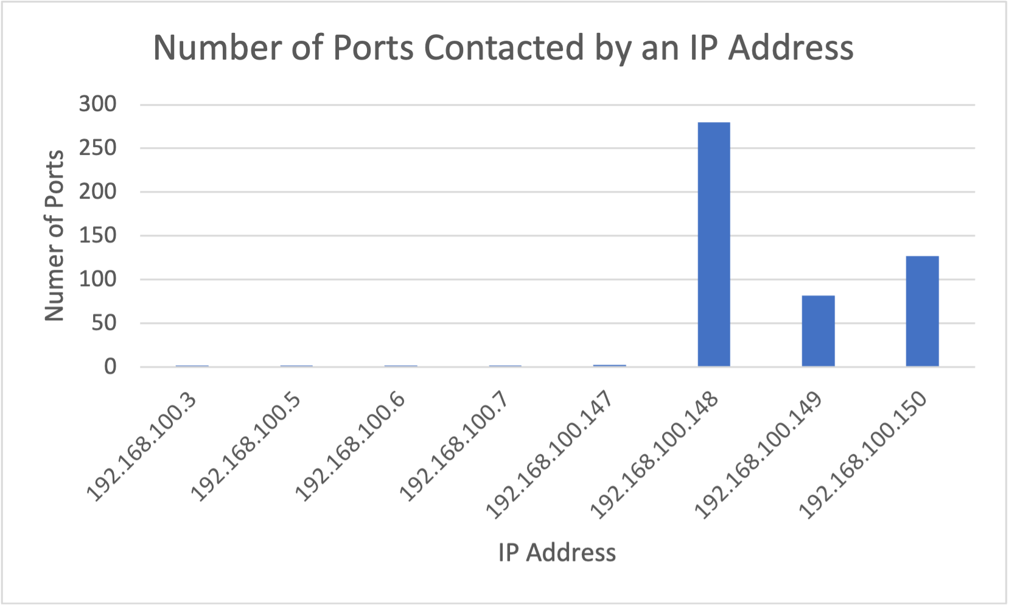
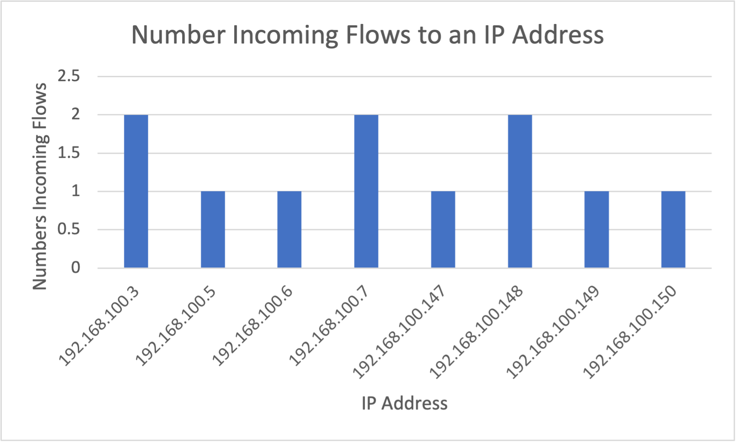
Results

Slide 11
Discussion
Graph Databases shown to be effective
Can answer questions that need to be answered
Do not take very long
A good solution
Only the beginning

Slide 12
Future Work
More advanced queries
Answer larger questions
Scale
Large amounts of timeseries data
Large amounts of nodes
Benchmarking
Comparing these results to other systems

Slide 13
Conclusion
Overall graphs are good
Answers what needs to be answered
Efficient
Much potential for the future!

Slide 14
Sources
[1] Danny Yuxing Huang et al. “IoT Inspector: Crowdsourcing Labeled Network Traffic from Smart Home Devices at Scale”. In: Proc. ACM Interact. Mob. Wearable Ubiquitous Technol. 4.2 (June 2020). DOI: 10.1145/3397333. URL: https://doi.org/10.1145/3397333.
[2] Rohit kumar Kaliyar. “Graph databases: A survey”. In: International Conference on Computing, Communication & Automation. 2015, pp. 785–790. DOI: 10.1109/CCAA. 2015.7148480.
[3] Nour Moustafa. The Bot-IoT dataset. 2019. DOI: 10 . 21227/r7v2- x988. URL: https://dx.doi.org/10.21227/ r7v2-x988.
[4] Danh Le-Phuoc et al. “The Graph of Things: A step towards the Live Knowledge Graph of connected things”. In: Journal of Web Semantics 37-38 (2016), pp. 25–35. ISSN: 1570-8268. DOI: https://doi.org/10.1016/j.websem. 2016 . 02 . 003. URL: https : / / www. sciencedirect . com / science/article/pii/S1570826816000196.

Slide 15
Questions?

