Slide 1
Graph Databases for Use with Timeseries IoT Datasets
By Colter Snyder

Slide 2
Introduction
IoT Devices have a lot of data
Many send thousands of flows per second
Need an efficient way to analyze
Relational Databases ok
Not great for connected data
Solution: Graph Databases

Slide 3
Definitions
Graph Databases
Graph Theory
Nodes and Edges
Timeseries Data
Flow data over time
5-triple with timestamp

Slide 4
Motivation
IoT devices everywhere
Producing data all the time
Sometime transfers this data over the internet
Have a need to analyze timeseries data
Important to observe trends
Need an efficient method for small networks and homes
Not everyone has a powerful computer

Slide 5
Related Works
IoT Inspector
Lot of Inspiration
Not focused on graph databases and their advantages
Global IoT Experiment
Not focused on small networks and homes

Slide 6
Methodology
Decide on tech stack
Neo4J
Python
Decide on dataset
BoT IoT
Create Queries
Simple
Lots of info
Analyze Data

Slide 7
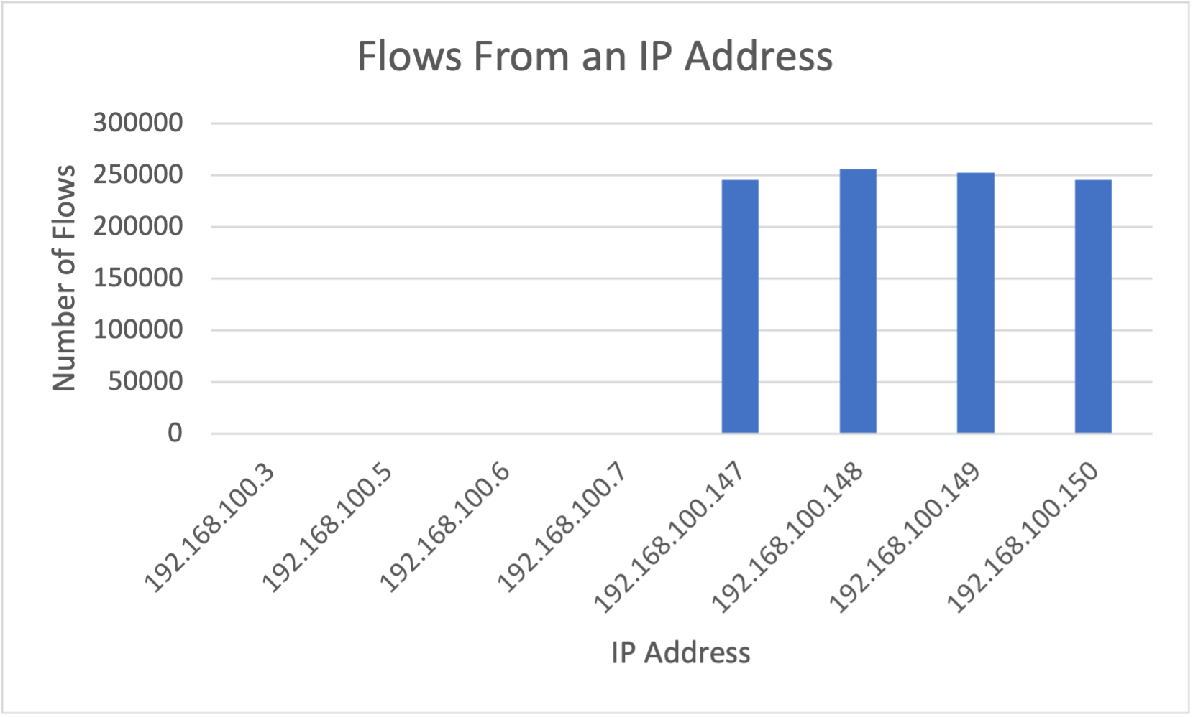
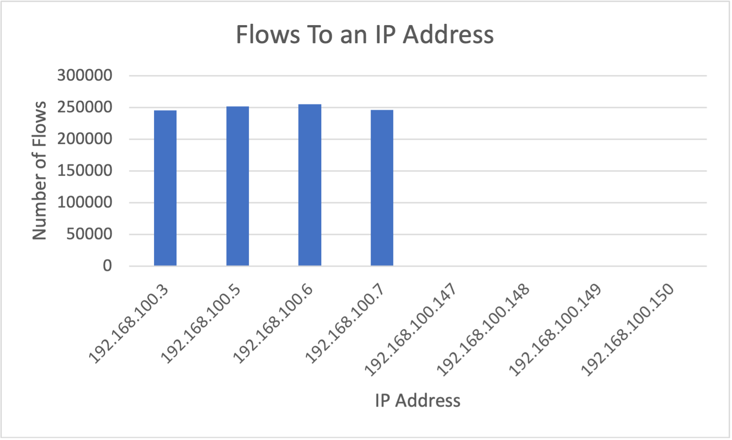
Results

Slide 8
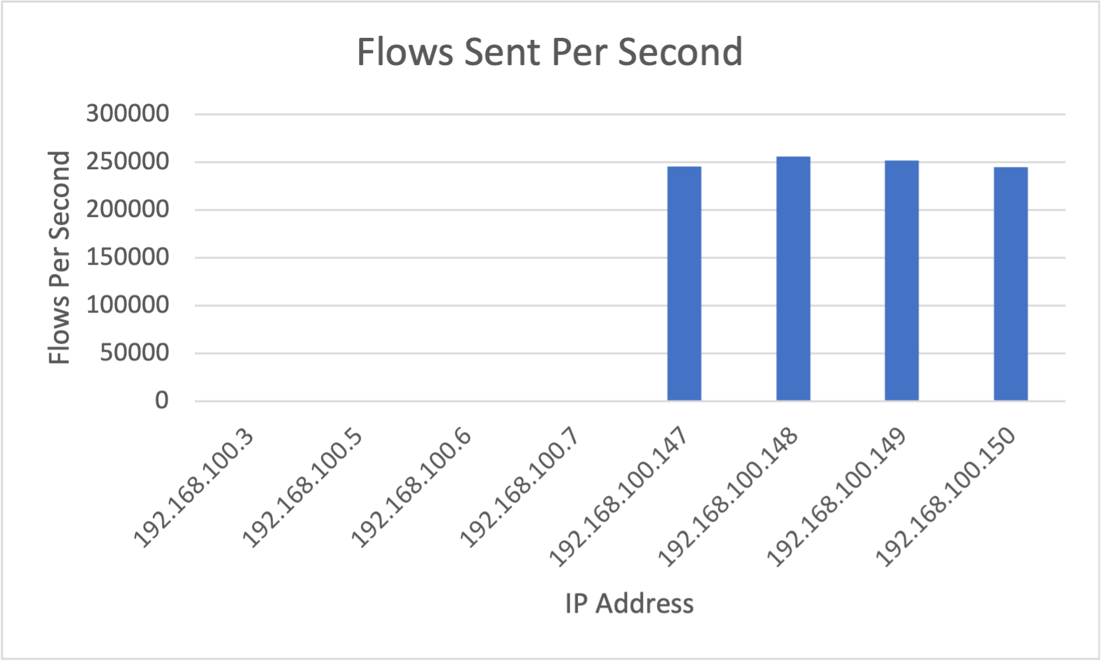
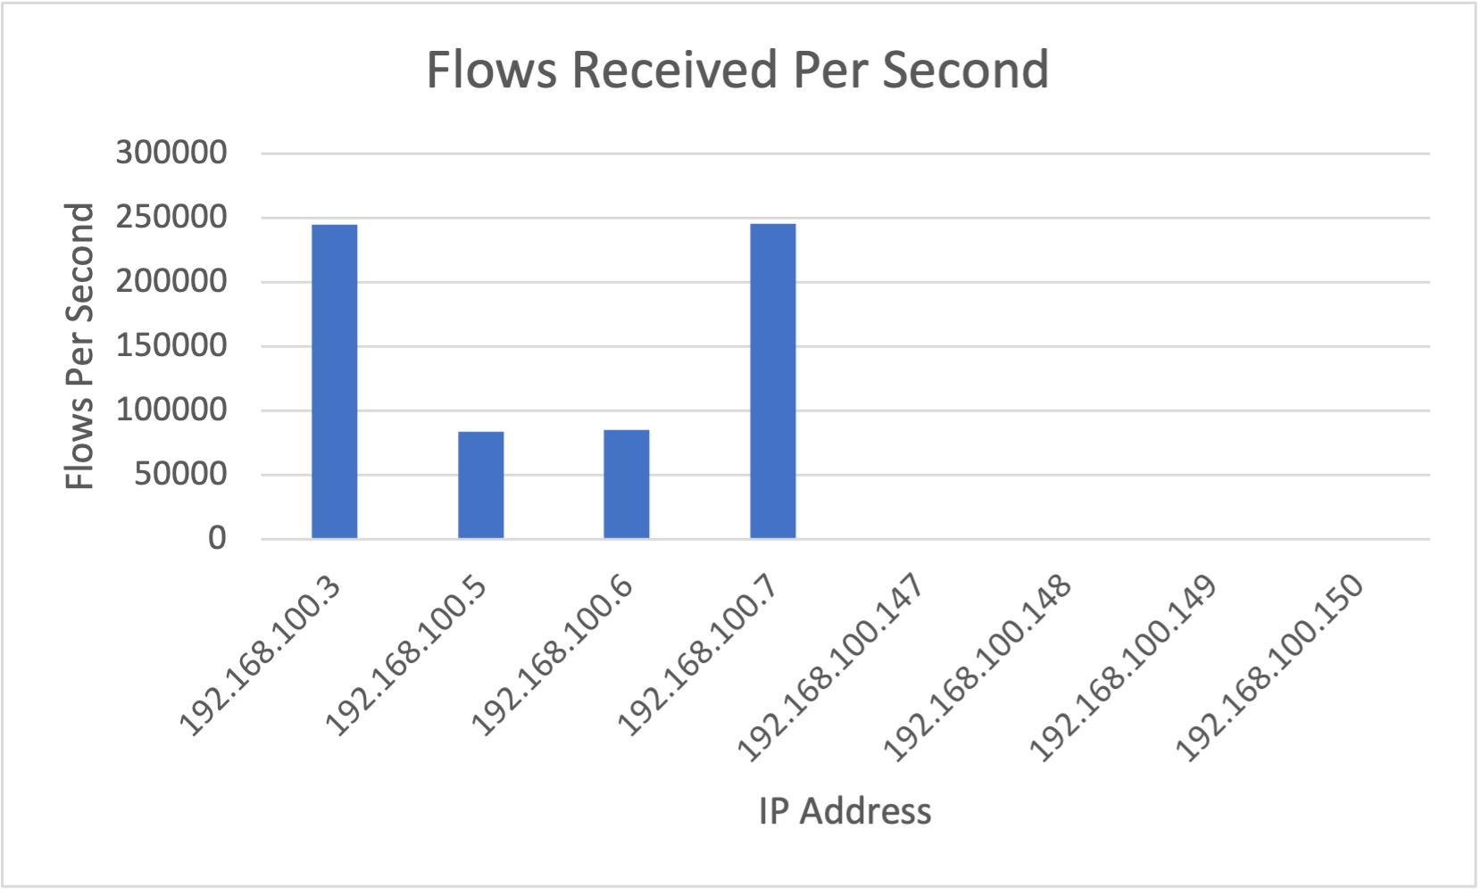
Results

Slide 9
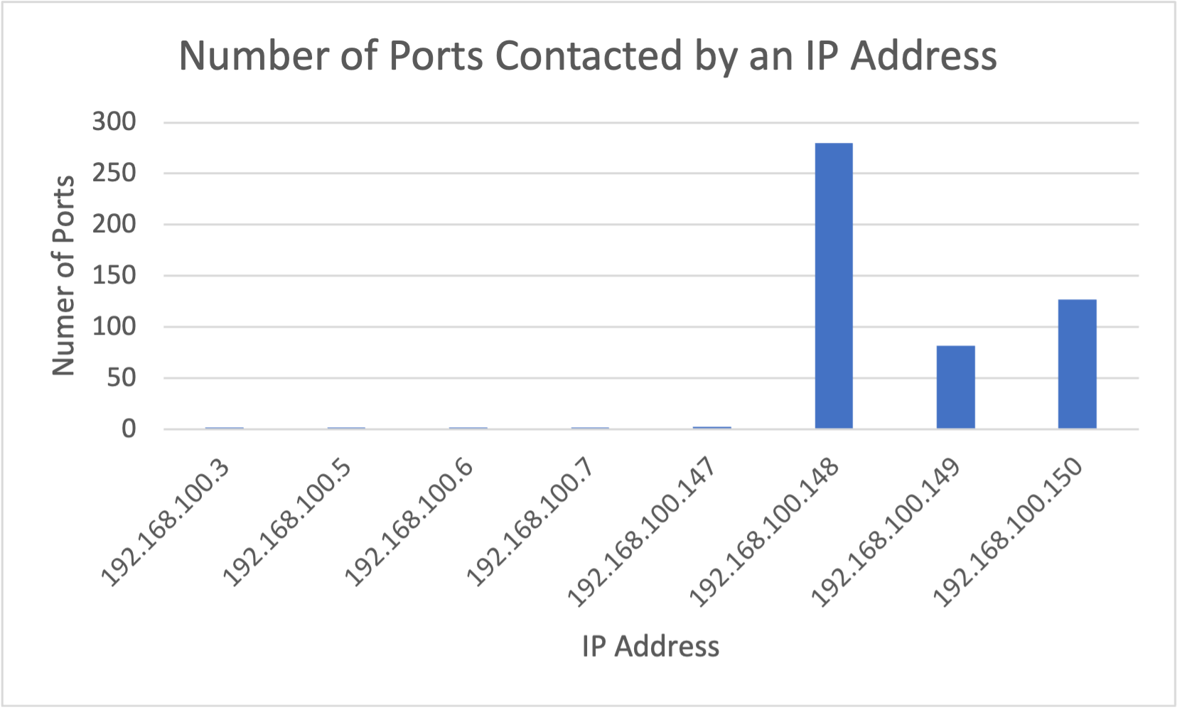
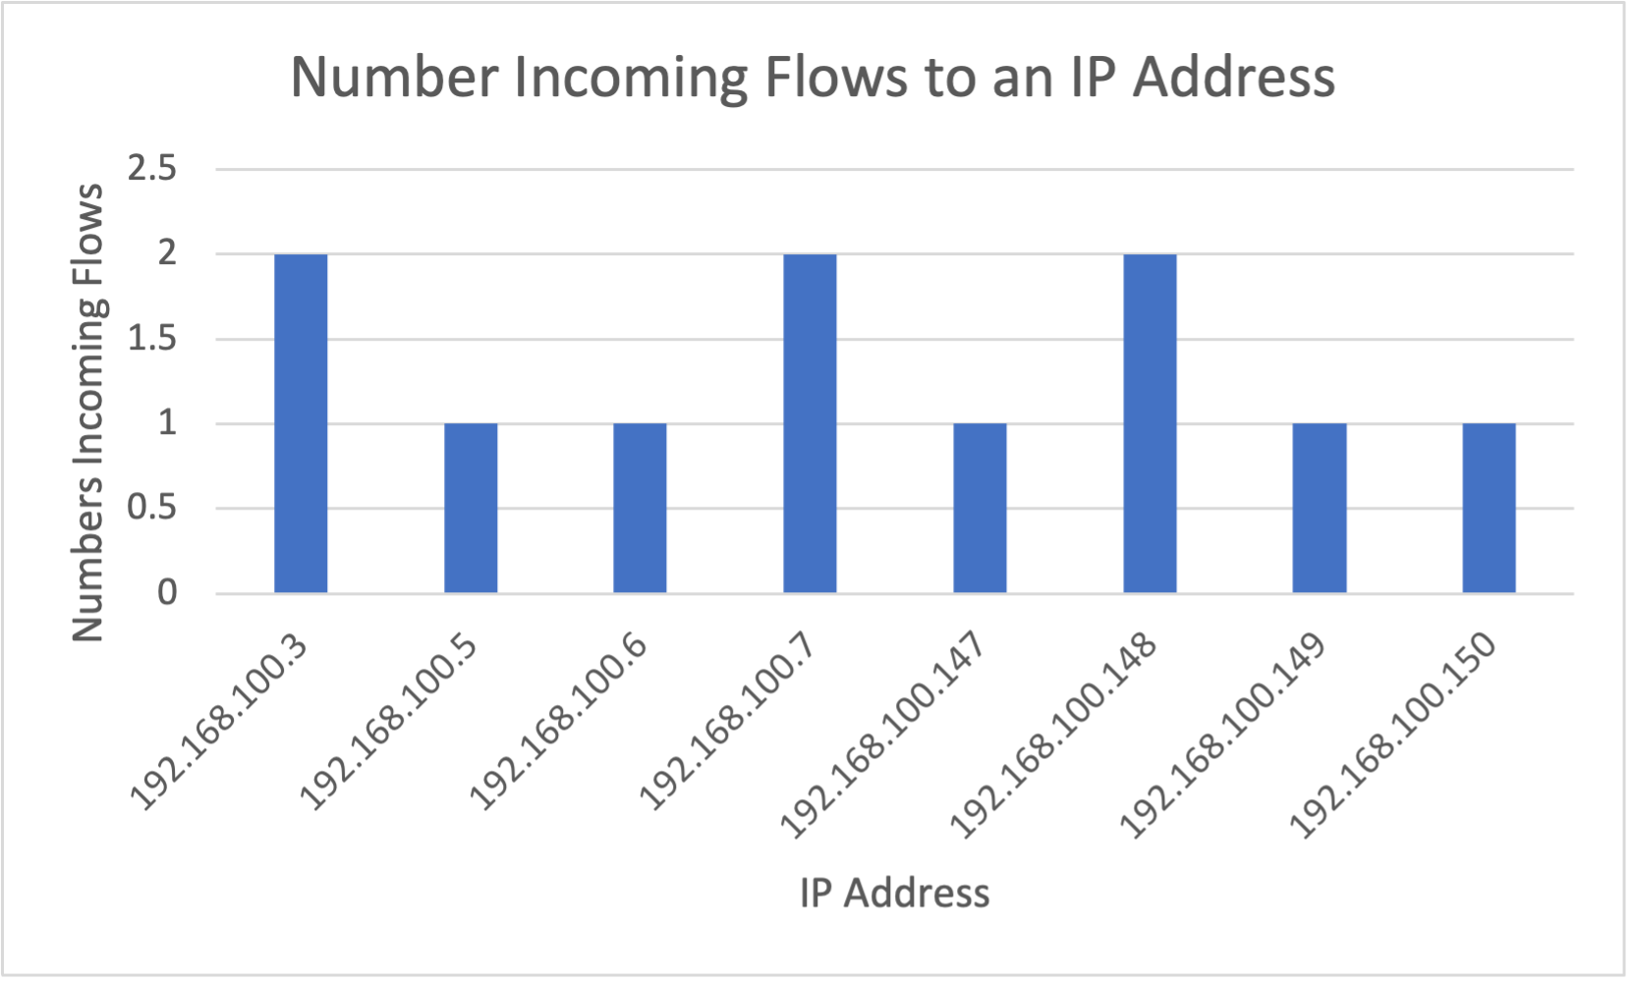
Results

Slide 10
Discussion
Graph Databases shown to be effective
Can answer questions that need to be answered
Do not take very long
A good solution
Only the beginning

Slide 11
Future Work
More advanced queries
Answer larger questions
Benchmarking
Comparing these results to other systems

Slide 12
Conclusion
Overall graphs are good
Answers what needs to be answered
Efficient

Slide 13
Sources

