Slide 1





What is The Best Brew?
Colton Flower
Notes:
Name
Prior to joining brainstation I work in public policy and investment banking
For my project I chose to look at craft beer to see what insights I could find

Slide 2

The question?
What characteristics are vital to brewing a good craft beer?
Notes:
In 2019 there was nearly 6000 breweries in the US so I wanted to see what type of beer a brewery could produce that drinkers would enjoy.

Slide 3

The Data
Beertadvocate.com
1.5 million individual reviews
66,055 beers
33,387 users
104 styles of beer
5,840 breweries
5 ratings
Overall
Taste
Aroma
Appearance
Palate

Slide 4
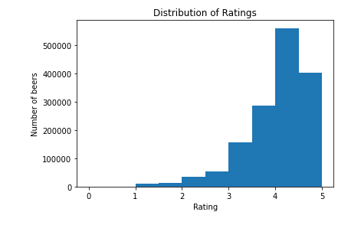
Exploratory Data Analysis
Drinking beer is a favorable thing
Over half of the ratings are a 4 or greater.
All rating distributions follow this pattern

Slide 5
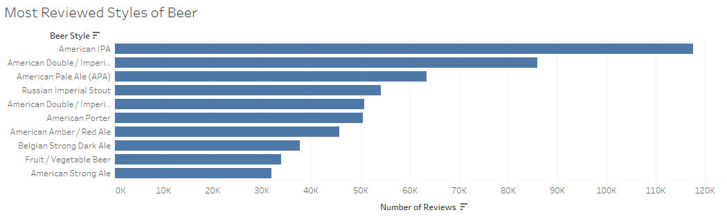
Exploratory Data Analysis

Slide 6
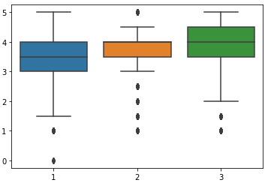
Exploratory Data Analysis
ABV broken down by level.
1 <5%
2 = 5%-6.8%
3 >6.9%
Beers with higher alcohol by volume receive more favorable ratings.
Rating
Level of Alcohol by Volume

Slide 7
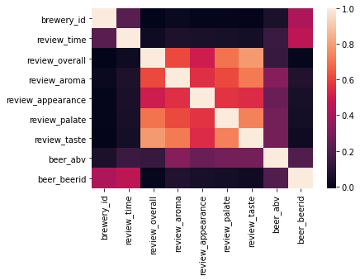
Exploratory Data Analysis
Palate and Taste strongly correlate with Overall Rating
Alcohol by volume weak correlation

Slide 8

Feature Engineering
Beer Style
Label & One Hot Encoding
Overall Rating-Catagorical
Good = 4 or higher
Bad = 3.5 or lower

Slide 9

Modeling
Regression Vs Classification
Random Forest Regression
Score
Avg tree: 43%
Random Forest: 63%
Random Forest Classification
Score
Avg Tree: 78%
Random Forest: 82%
CLASS | PERCISION | RECALL | F1
0 | .76 | .73 | .75
1 | .85 | .86 | .86

Slide 10
Feature Importance
Taste
ABV
Palate
Appearance/Aroma
Styles:
American Porter
American Pale Ale
American Strong Ale
American Pale Wheat Ale
Scotch Ale/Wee Heavy

Slide 11
Contact info
linkedin.com/in/coltonflower/
github.com/coltonflower/whatbeertobrew

