Slide 1
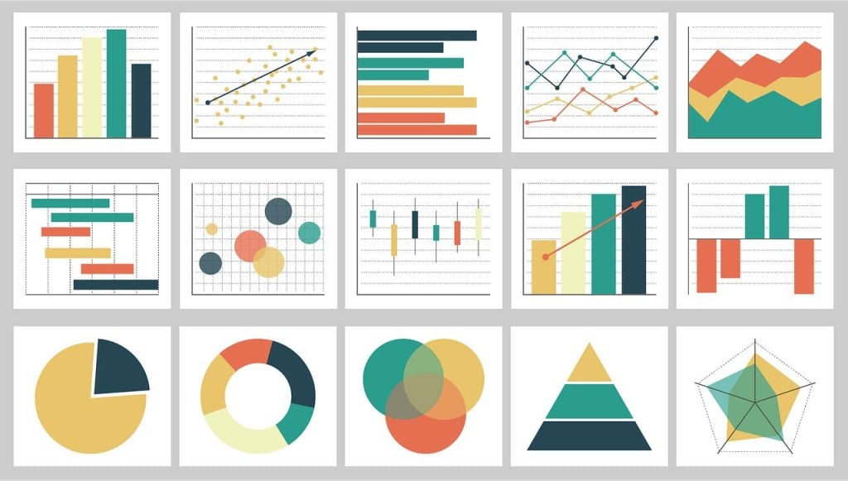
Intro to Data Viz

Slide 2
What, why and how Data Viz?
What is Data Viz?
Data visualization is the process of creating effective visuals to display complex trends in data
Why Data Viz?
Exploring to find trends or Explaining a research question
How Data Viz?
Software + Design + Narrative = Storytelling with Data

Slide 3
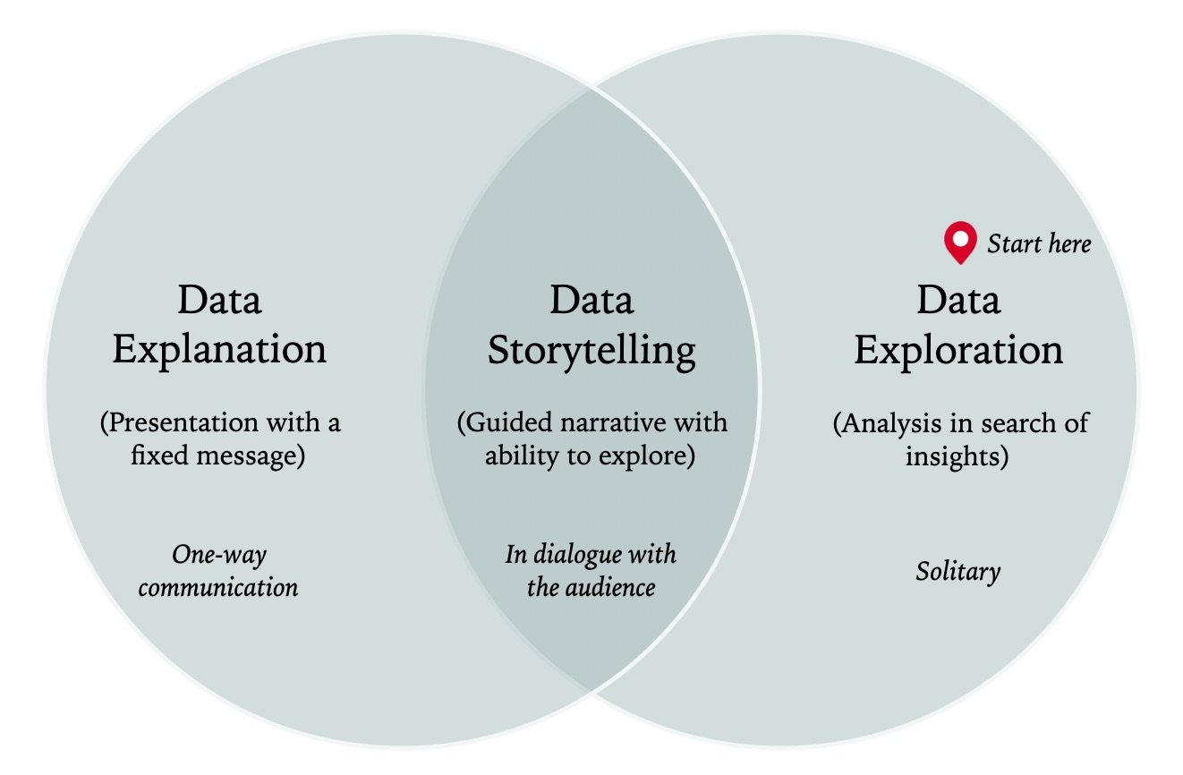

Slide 4
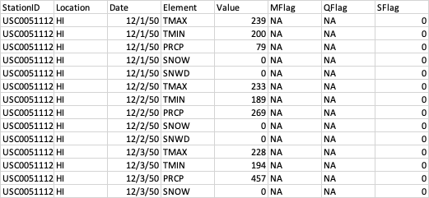
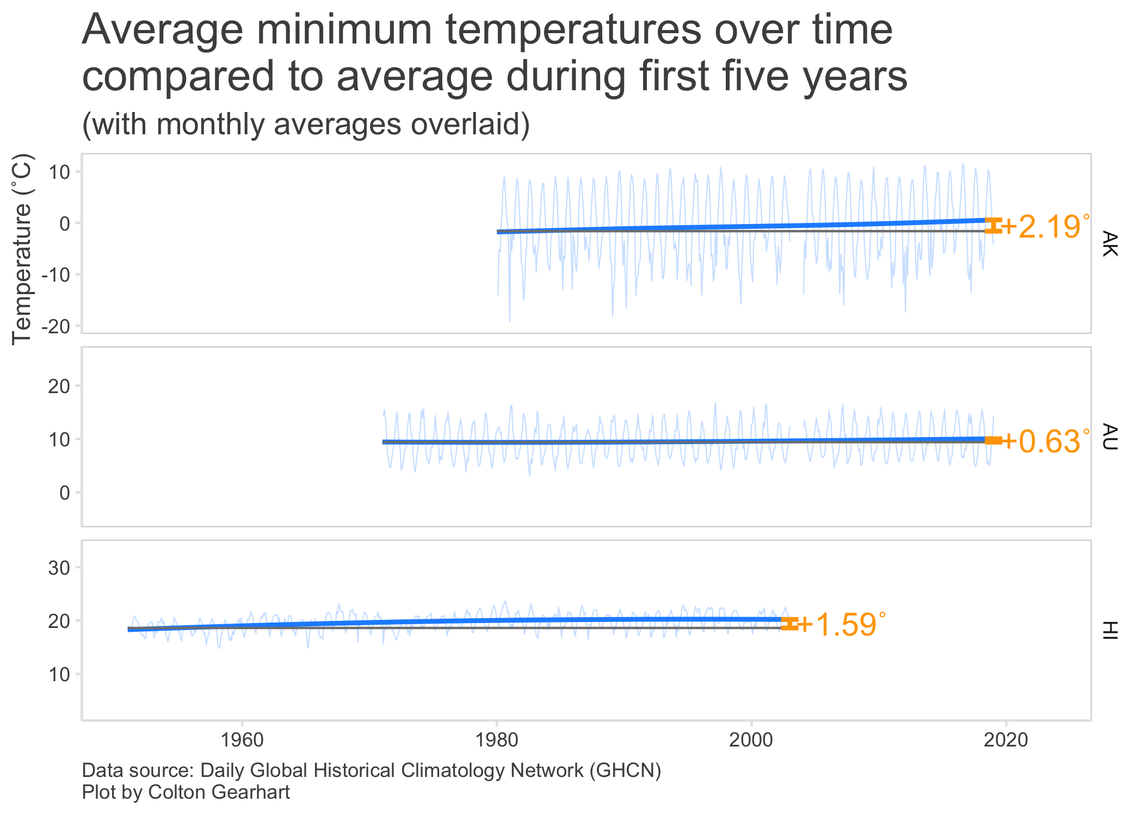
Data Viz Product Lifecycle

Slide 5

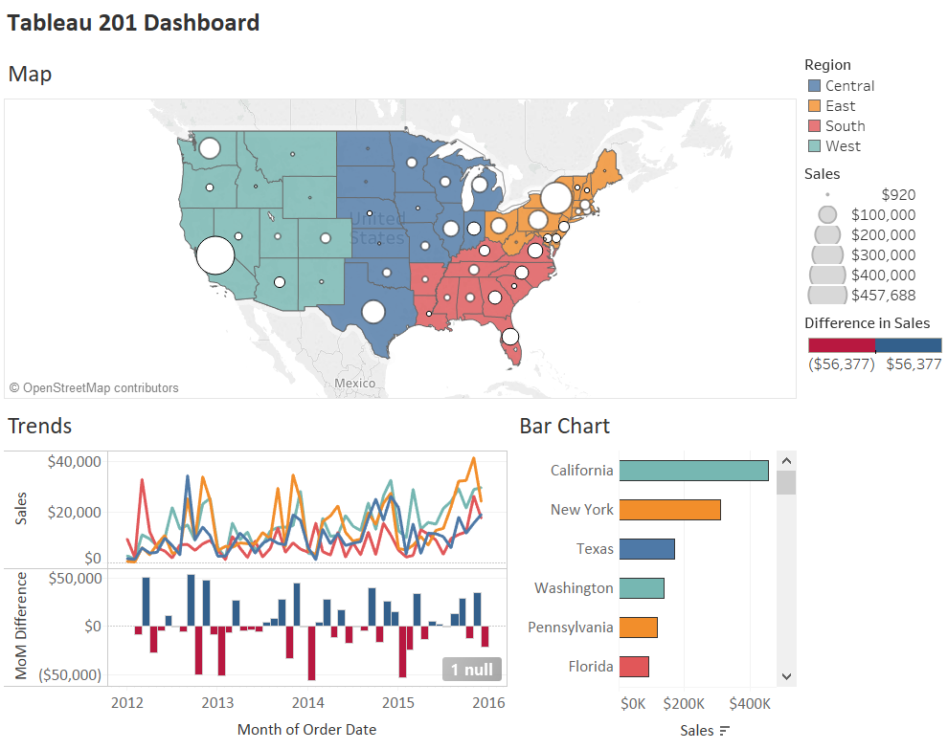
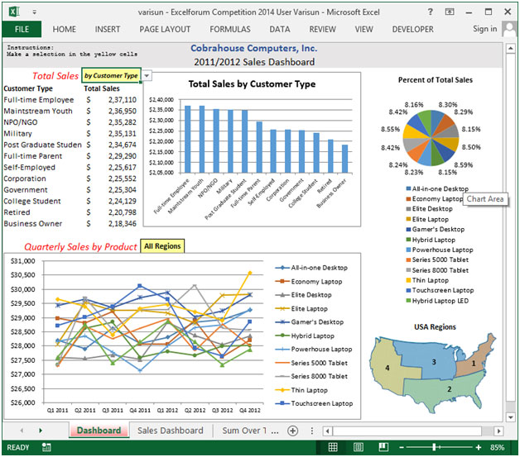
Data Viz for Us

Slide 6
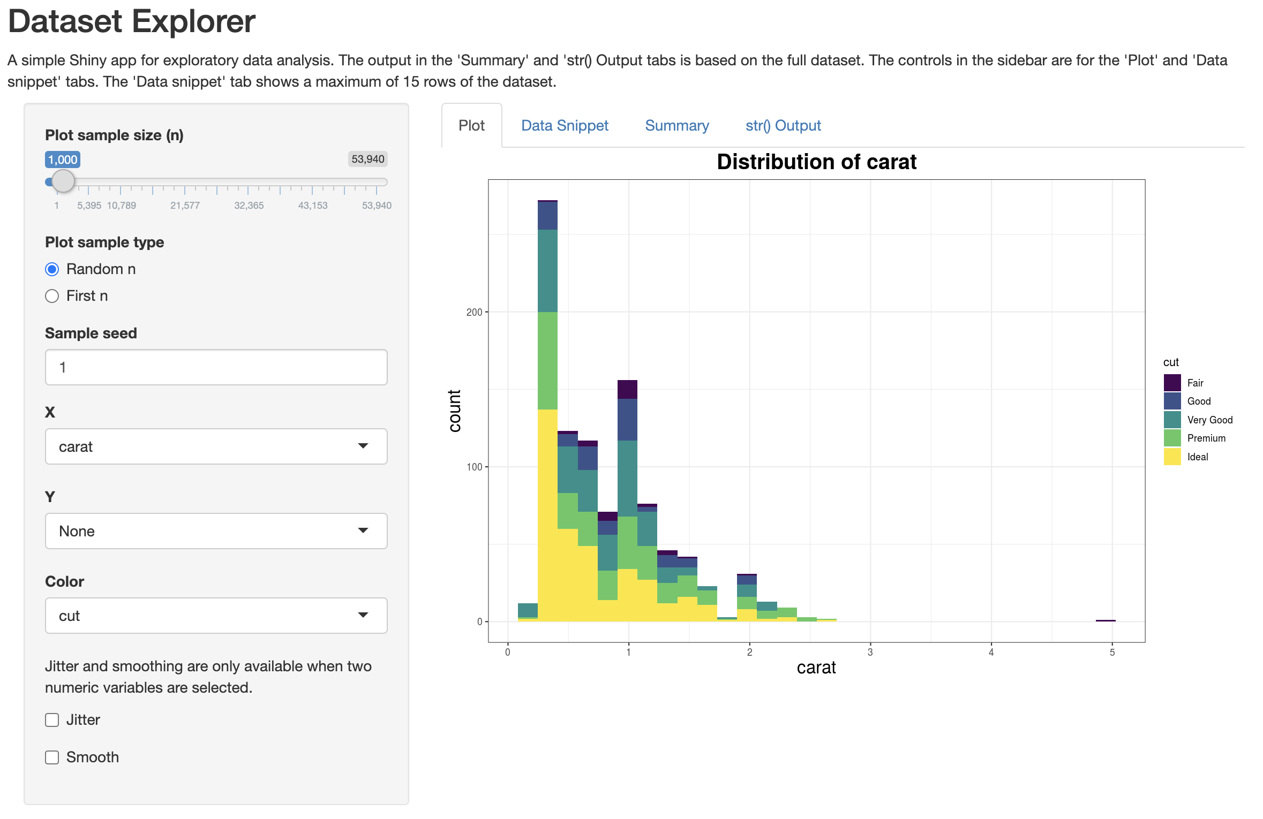
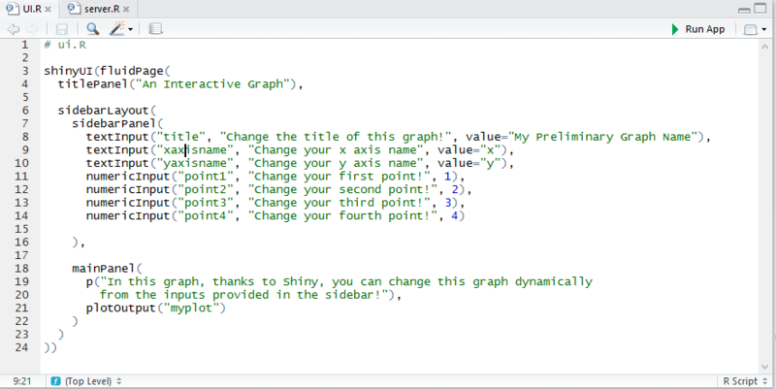

Slide 7
In Closing
Jobs
Data Visualization and the required skills are very relevant in the job market today
Opportunities
Lots of practice problems and additional resources
Challenge
Make the most of this class!

