Slide 1





Slide 2
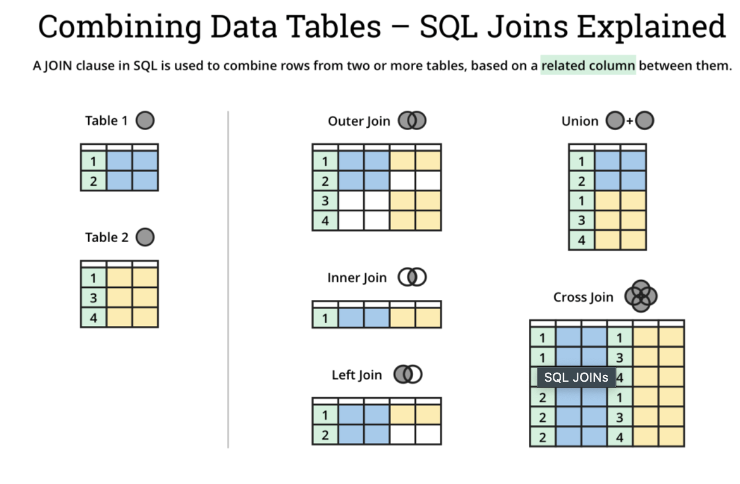

Slide 3
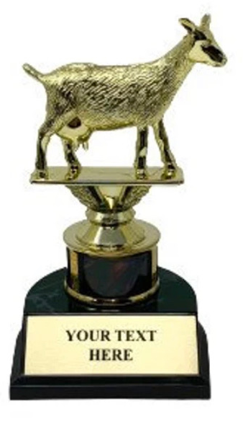
Greatest Feedback Collector

