Slide 1
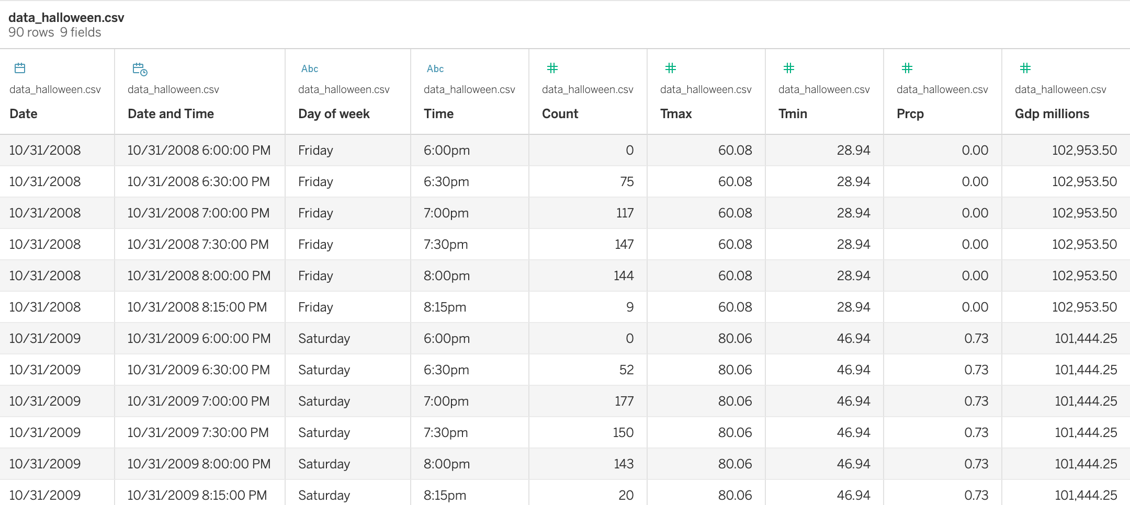
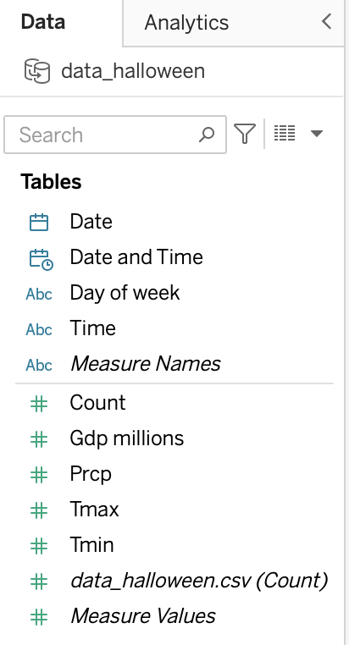
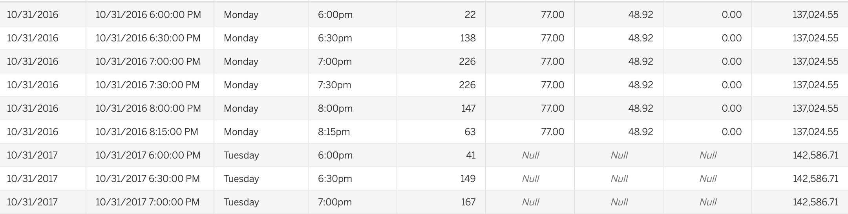
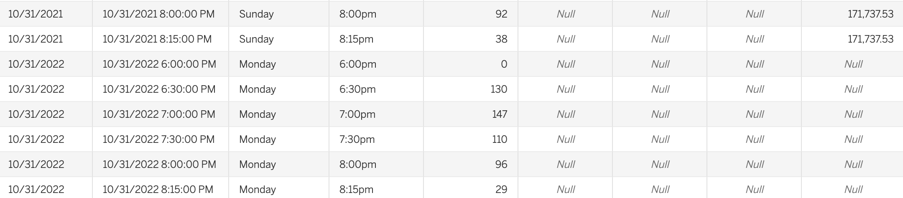

Slide 2
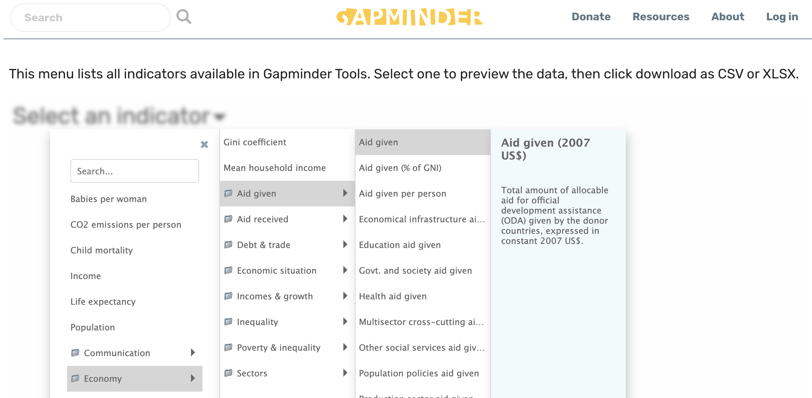
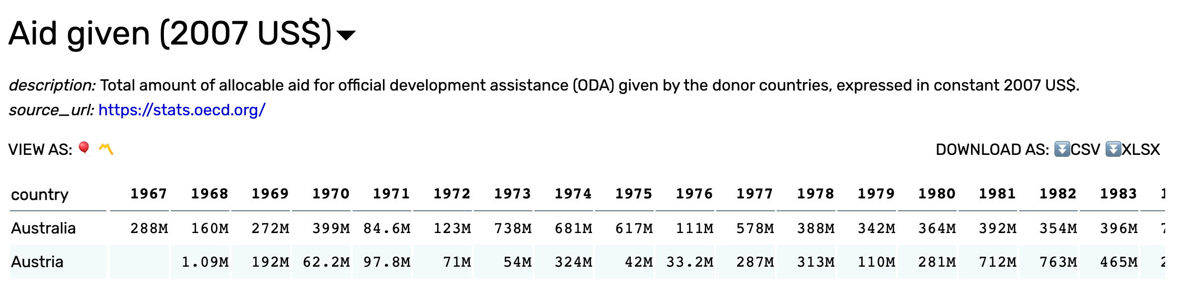

Slide 3
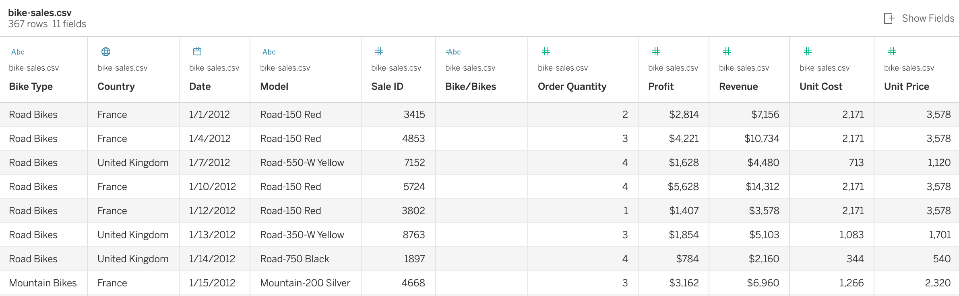

Slide 4
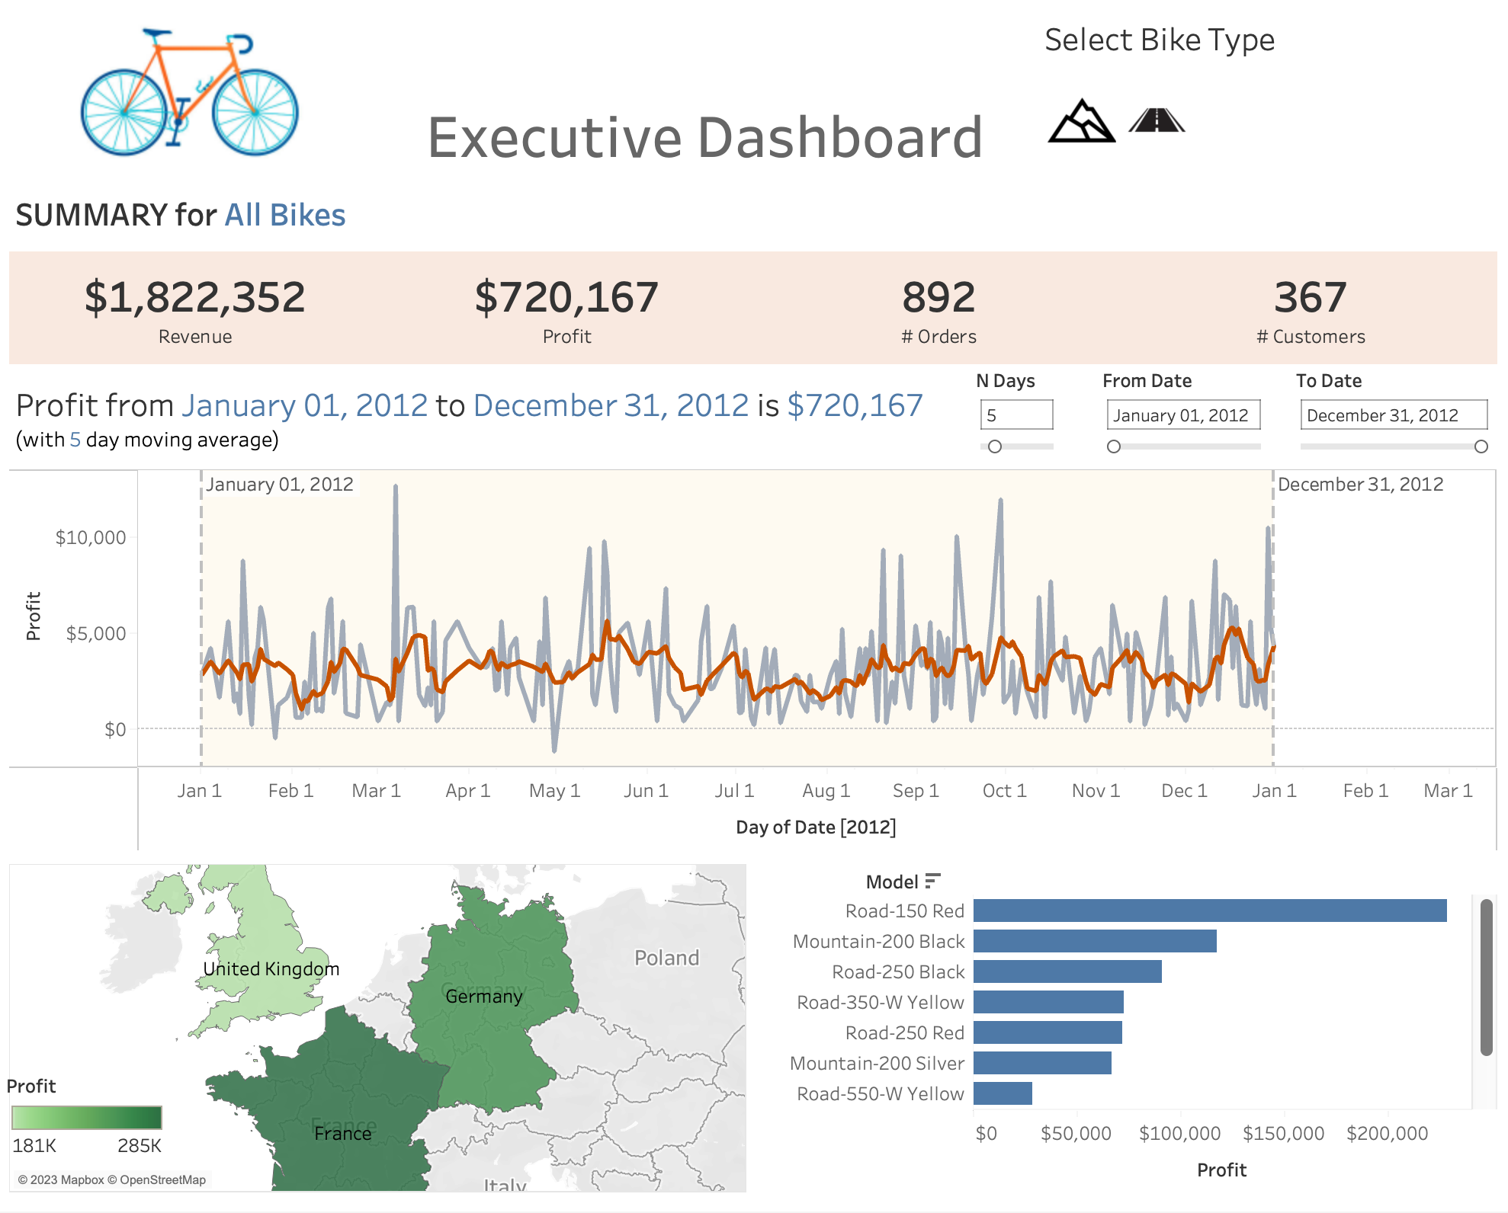
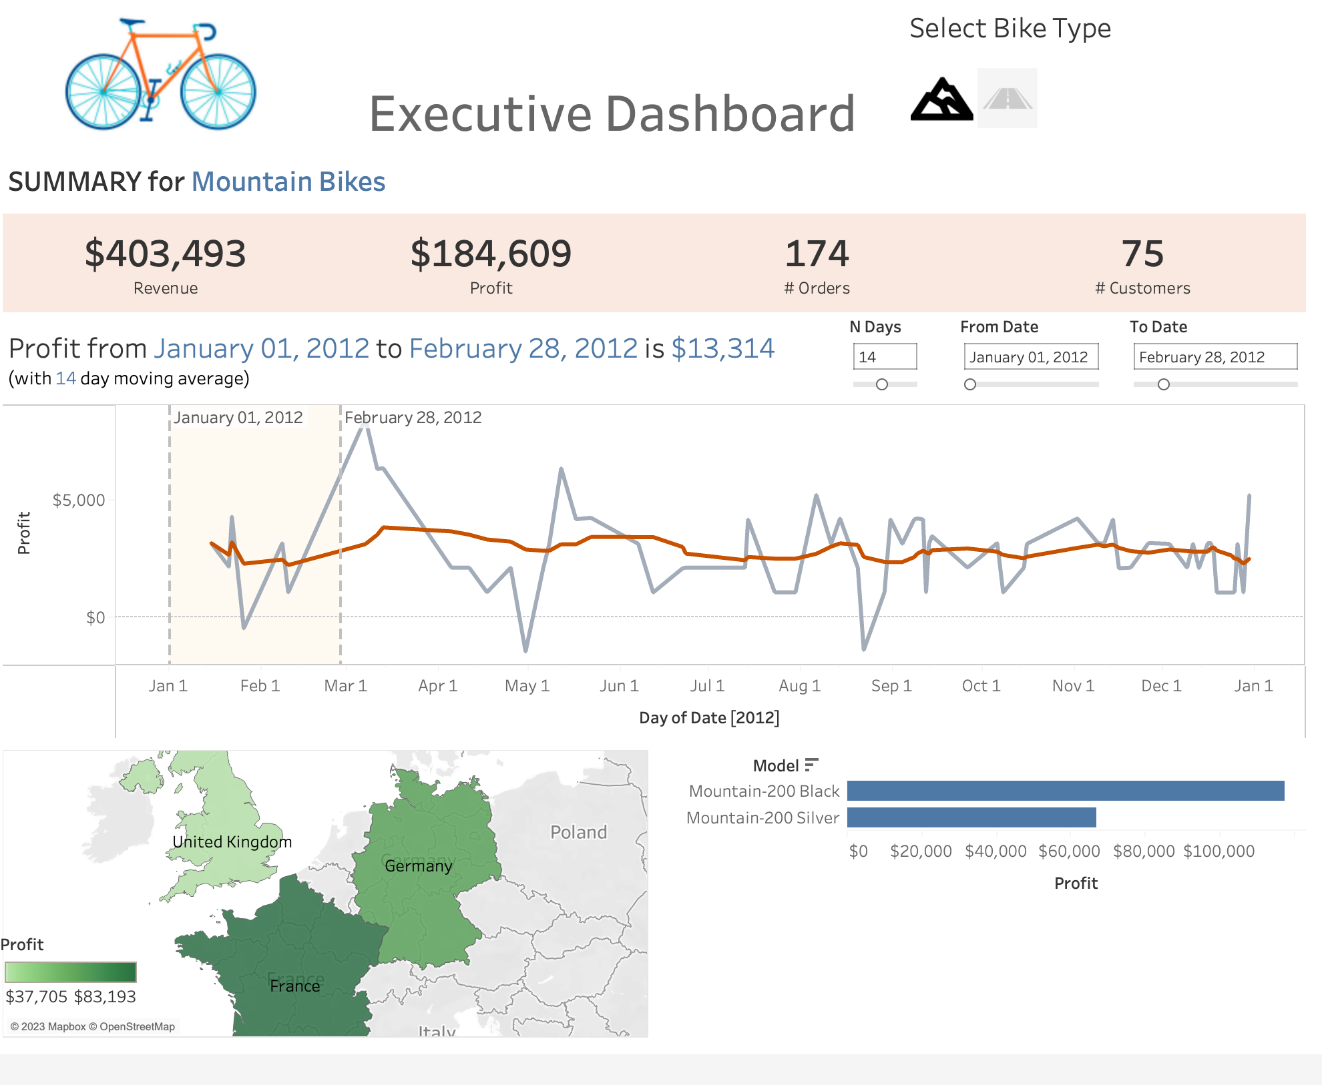
Action Filter (affects all dashboard items: # Summaries, line plot, map and bar chart)
Dynamic Titles showing Date Range (with sum) and N-day Moving Average
Dynamic Title for bike type (special formatting)
Parameter Controls for Date Range and
N-day Moving Average
Reference Band for Date Range

