Slide 1
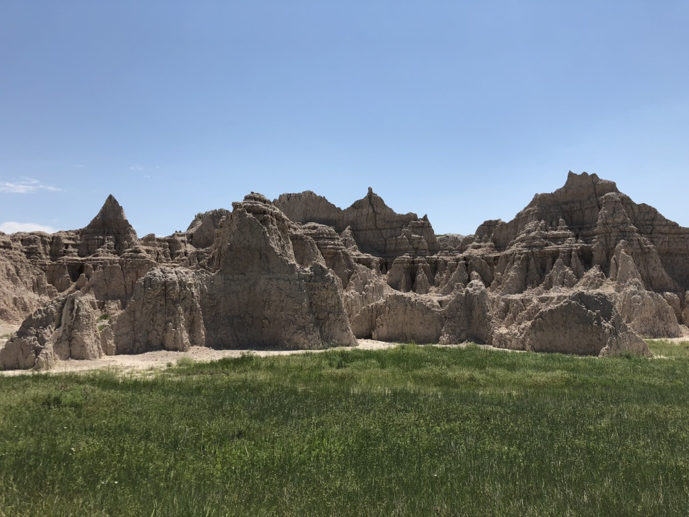
Can you guess what we are gonna study???
Unit 7 – Confidence Interval Estimates
Your Confident Professor Colton

Slide 2

Unit 7 - Outline
Unit 7 – Confidence Interval Estimates
Sampling Distribution and CLT of $\hat{p}$ Review
Intro
Populations and Samples
Proportions
Motivating Example
How to build a CI
Margin of Error
Formula
Interpreting CI
Practice

Slide 3
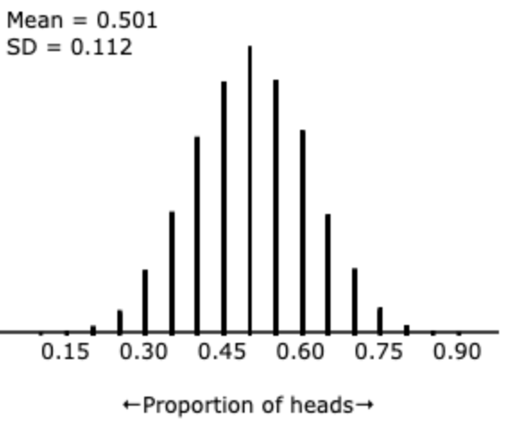
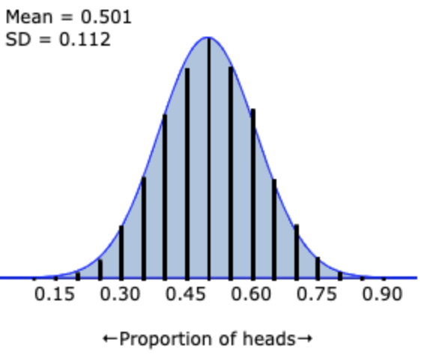
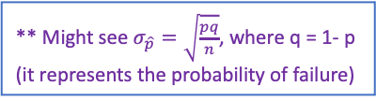
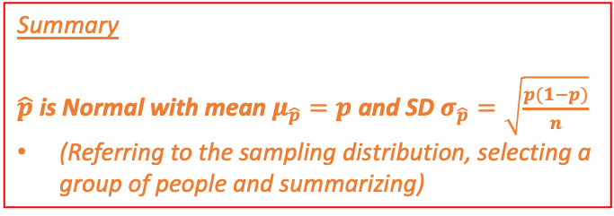
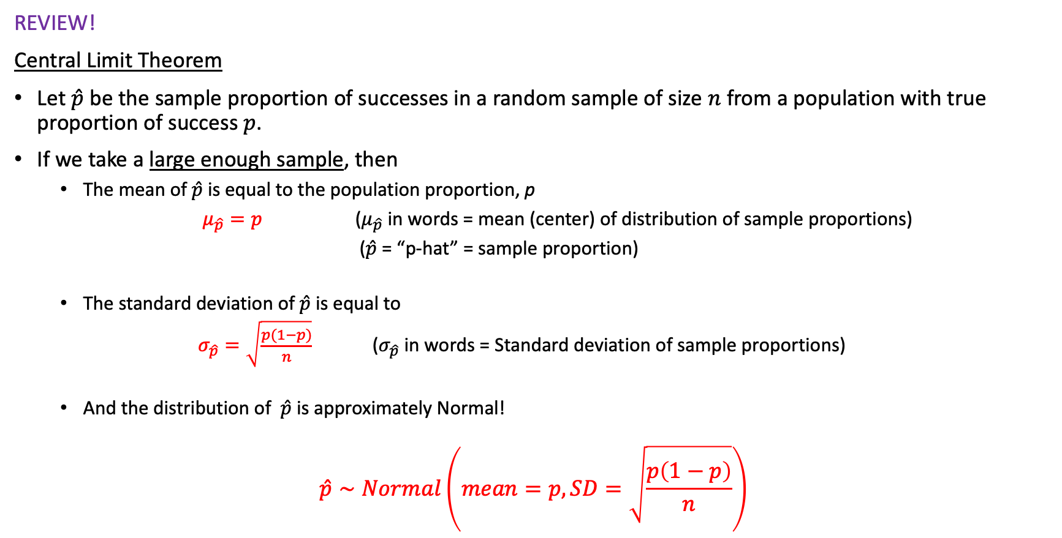
Central Limit Theorem for $\hat{p}$
Ex) Results from 10,000 samples of 20 coin tosses
→ p = 0.5
REVIEW!
Central Limit Theorem
Let $\hat{p}$ be the sample proportion of successes in a random sample of size $n$ from a population with true proportion of success $p$.
If we take a large enough sample, then
The mean of$\hat{p}$is equal to the population proportion, p
$μ_{\hat{p}}=p$ ($μ_{\hat{p}}$ in words = mean (center) of distribution of sample proportions)
($\hat{p}$ = “p-hat” = sample proportion)
The standard deviation of$\hat{p}$ is equal to
$σ_{\hat{p}}=\sqrt{\frac{p(1−p)}{n}}$ ($σ_{\hat{p}}$ in words = Standard deviation of sample proportions)
And the distribution of $\hat{p}$ is approximately Normal!
$$\hat{p}∼Normal\left(mean=p, SD=\sqrt{\frac{p\left(1−p\right)}{n}}\right)$$
** Might see $σ_{\hat{p}}=\sqrt{\frac{pq}{n}}$, where q = 1- p (it represents the probability of failure)
Summary
$\hat{p}$is Normal with mean $μ_{\hat{p}}=p$and SD $σ_{\hat{p}}=\sqrt{\frac{p(1−p)}{n}}$
(Referring to the sampling distribution, selecting a group of people and summarizing)
** Again, technically there are conditions for this (same idea, but different because proportions now). But we will ignore them ☺

Slide 4
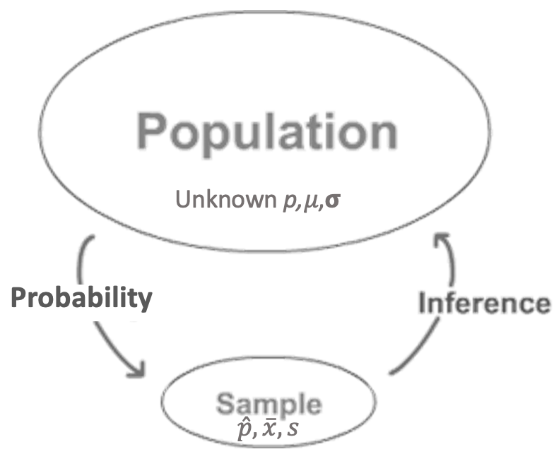
Motivation – Populations and Samples

Slide 5
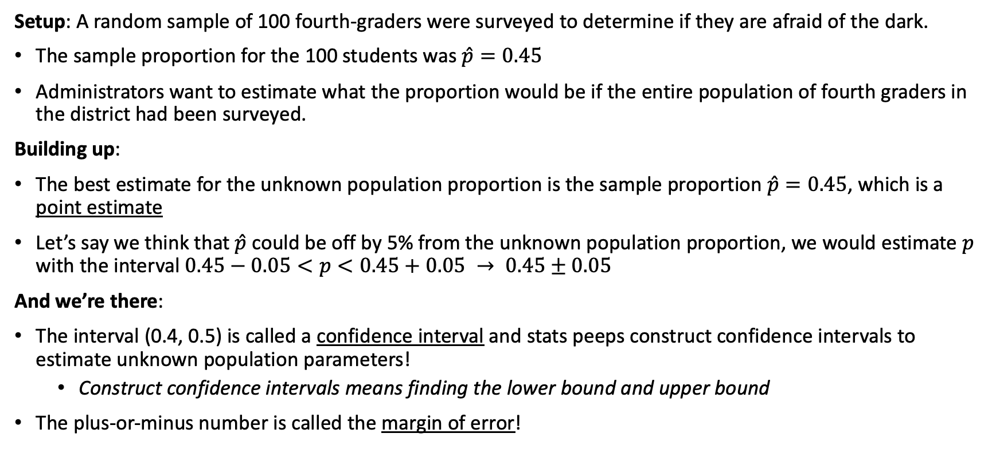
Motivating Example
Last time taught these slides, I lost myself and the students in all my explanations
Future teaching strategy:
I think slides are quality and there shouldn’t be a need to move calculations sooner
Just don’t over explain, they know what intervals are
The more I explain before they have done stuff the more confused. But on the surface this stuff isn’t hard to comprehend
Setup: A random sample of 100 fourth-graders were surveyed to determine if they are afraid of the dark.
The sample proportion for the 100 students was $\hat{p}=0.45$
Administrators want to estimate what the proportion would be if the entire population of fourth graders in the district had been surveyed.
Building up:
The best estimate for the unknown population proportion is the sample proportion $\hat{p}=0.45$, which is a point estimate
Let’s say we think that $\hat{p}$ could be off by 5% from the unknown population proportion, we would estimate $p$ with the interval $0.45−0.05<p<0.45+0.05 → 0.45±0.05$
And we’re there:
The interval (0.4, 0.5) is called a confidence interval and stats peeps construct confidence intervals to estimate unknown population parameters!
Construct confidence intervals means finding the lower bound and upper bound
The plus-or-minus number is called the margin of error!

Slide 6
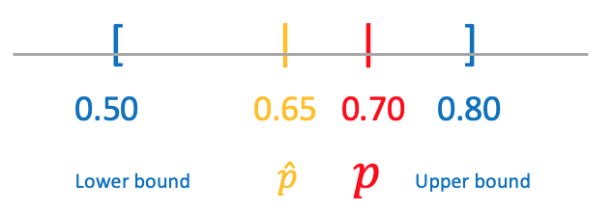
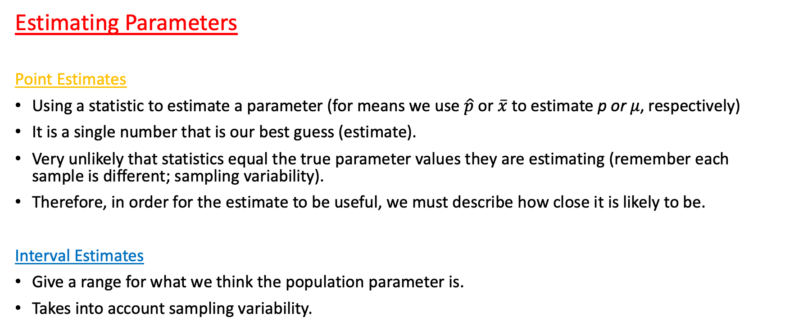
Motivation – Why Confidence Intervals
Estimating Parameters
Point Estimates
Using a statistic to estimate a parameter (for means we use $\hat{p}$ or $\overline{x}$ to estimate p or 𝜇, respectively)
It is a single number that is our best guess (estimate).
Very unlikely that statistics equal the true parameter values they are estimating (remember each sample is different; sampling variability).
Therefore, in order for the estimate to be useful, we must describe how close it is likely to be.
Interval Estimates
Give a range for what we think the population parameter is.
Takes into account sampling variability.

Slide 7
Now we are ready to dive deeper!
How do we formally build this interval?
What are the different pieces that make up a confidence interval?
How do we interpret the final interval? What does it mean?

Slide 8
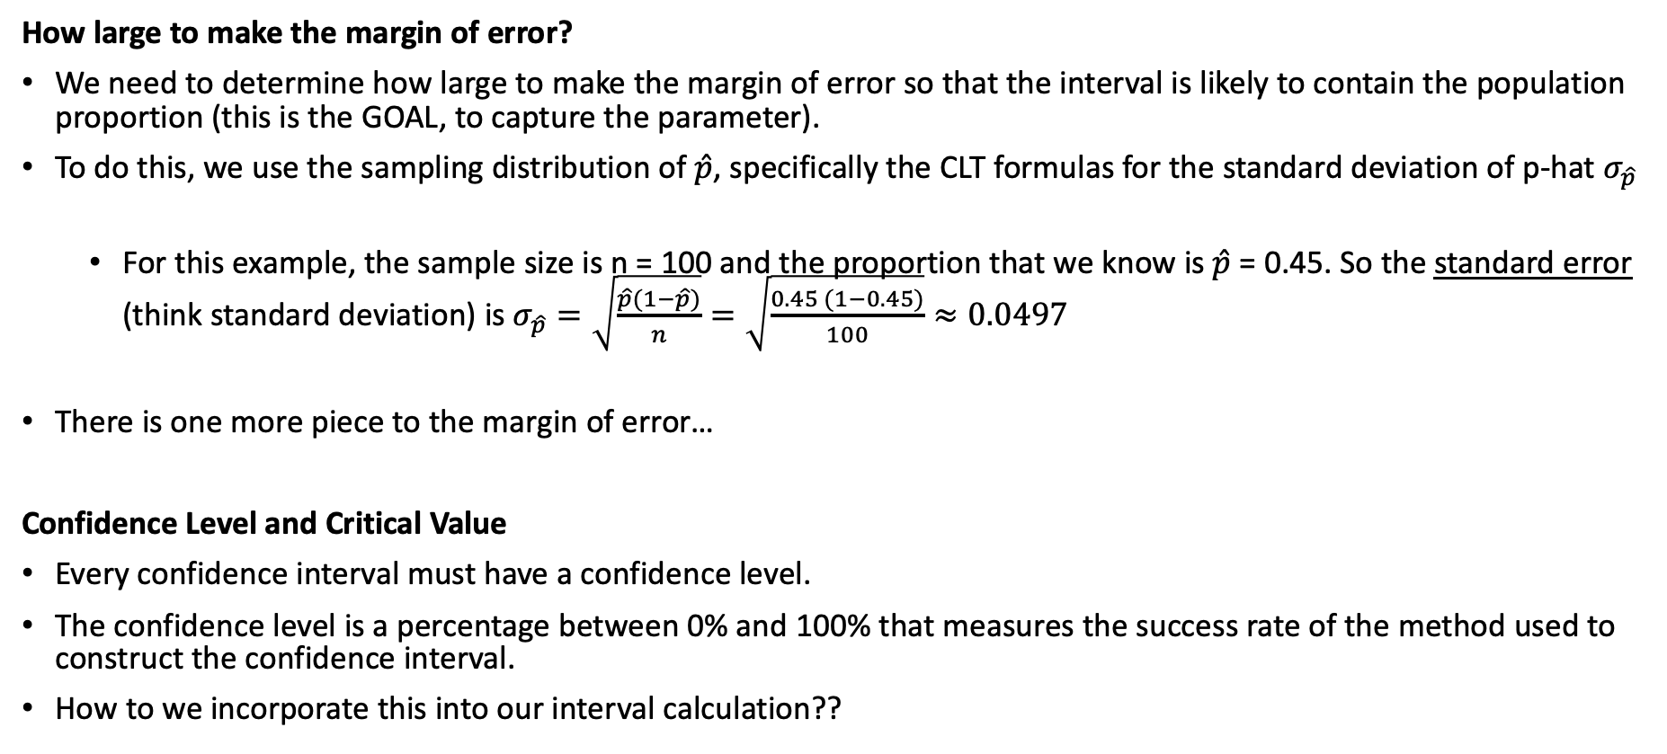
Return to Motivating Example
How large to make the margin of error?
We need to determine how large to make the margin of error so that the interval is likely to contain the population proportion (this is the GOAL, to capture the parameter).
To do this, we use the sampling distribution of $\hat{p}$, specifically the CLT formulas for the standard deviation of p-hat $σ_{\hat{p}}$
For this example, the sample size is n = 100 and the proportion that we know is $\hat{p}$ = 0.45. So the standard error (think standard deviation) is $σ_{\hat{p}}=\sqrt{\frac{\hat{p}(1−\hat{p})}{n}}=\sqrt{\frac{0.45 (1−0.45)}{100}}≈0.0497$
There is one more piece to the margin of error…
Confidence Level and Critical Value
Every confidence interval must have a confidence level.
The confidence level is a percentage between 0% and 100% that measures the success rate of the method used to construct the confidence interval.
How to we incorporate this into our interval calculation??

Slide 9
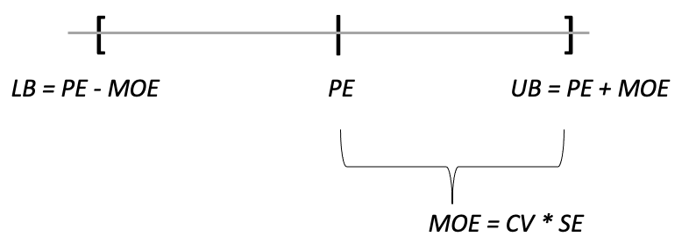
How to Build a Confidence Interval
C.I. = Point Estimate ± Margin of Error
Point Estimate
Point Estimate is your best guess; at the center of the interval.
Then we extend our guess in both directions in order to provide a wider range of plausible values.
This distance is called the Margin of Error.
Margin of Error
Margin of Error (MOE) is what makes our estimates intervals rather than just single points!
Made up of two components that will be discussed on the next slide!
MOE = Critical Value (CV) * Standard Error (SE).

Slide 10
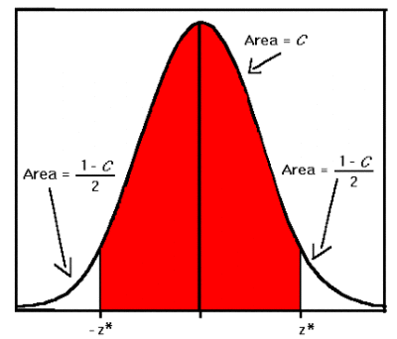
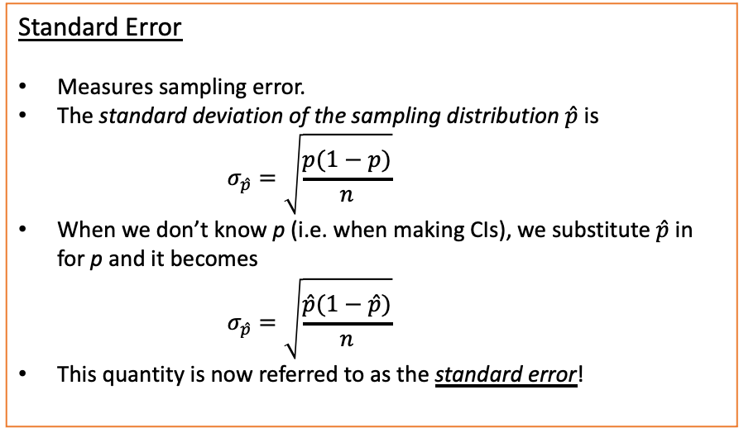
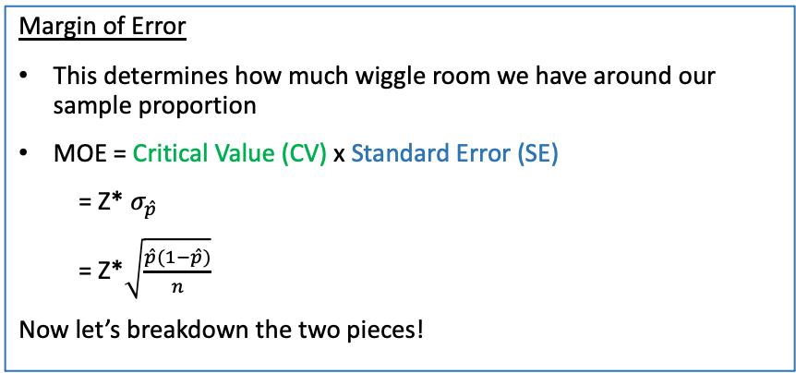
Margin of Error
Critical Value – Z Star
In a CI, the point estimate (center) and the SE (step size) are both based on the collected data.
There is nothing we can do as the researcher after the fact to change these…
But we CAN control the Confidence Level of our interval (‘We are 95% Confident’ or 90%, etc)!
We do this by changing the Critical Value (CV), Z*
Said another way, we decide how many steps to take in each direction from our sample proportion!
The specific values for Z* are just the Z-scores that mark the middle %C of the standard normal curve!
We are going to be given these values in a table!
Margin of Error
This determines how much wiggle room we have around our sample proportion
MOE = Critical Value (CV) x Standard Error (SE)
= Z* $σ_{\hat{p}}$
= Z*$\sqrt{\frac{\hat{p}(1−\hat{p})}{n}}$
Now let’s breakdown the two pieces!
MOE = (how many steps to take) x (how big is each step)
** this is another way to think about it
Standard Error
Measures sampling error.
The standard deviation of the sampling distribution $\hat{p}$ is
$$σ_{\hat{p}}=\sqrt{\frac{p(1−p)}{n}}$$
When we don’t know p (i.e. when making CIs), we substitute $\hat{p}$ in for p and it becomes
$$σ_{\hat{p}}=\sqrt{\frac{\hat{p}(1−\hat{p})}{n}}$$
This quantity is now referred to as the standard error!

Slide 11
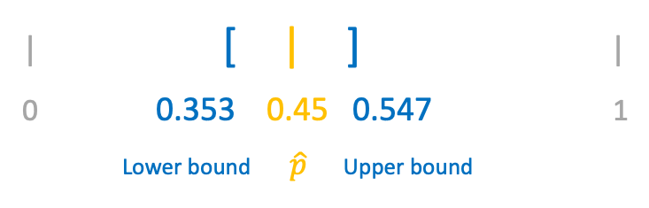
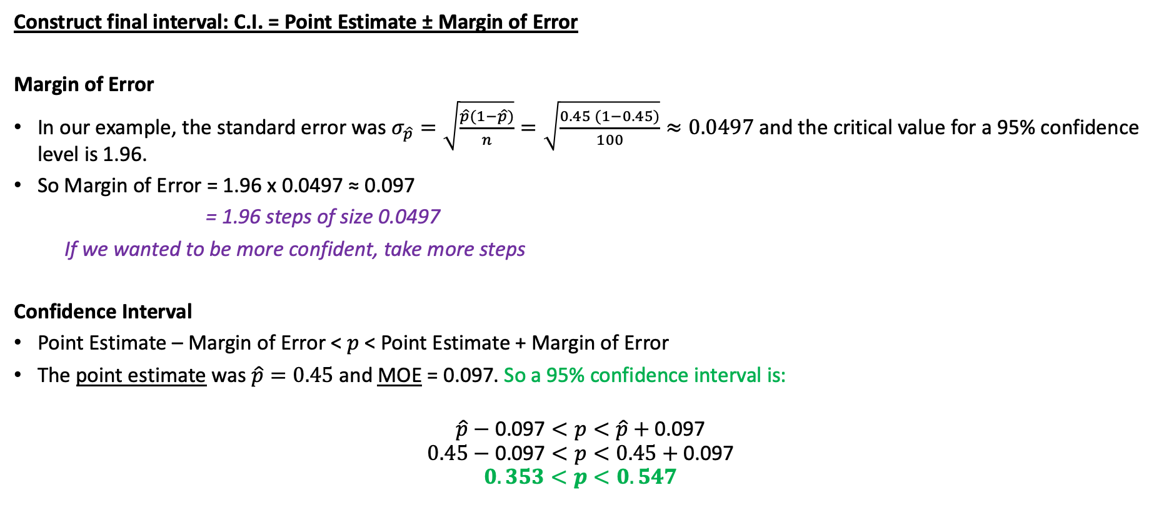
Return to Motivating Example
Construct final interval: C.I. = Point Estimate ± Margin of Error
Margin of Error
In our example, the standard error was $σ_{\hat{p}}=\sqrt{\frac{\hat{p}(1−\hat{p})}{n}}=\sqrt{\frac{0.45 (1−0.45)}{100}}≈0.0497$ and the critical value for a 95% confidence level is 1.96.
So Margin of Error = 1.96 x 0.0497 ≈ 0.097
= 1.96 steps of size 0.0497
If we wanted to be more confident, take more steps
Confidence Interval
Point Estimate – Margin of Error < $p$ < Point Estimate + Margin of Error
The point estimate was $\hat{p}=0.45$ and MOE = 0.097. So a 95% confidence interval is:
$$\hat{p}−\text{0.097}<p<\hat{p}\text{ + }\text{0.097}$$
$$0.45−\text{0.097}<p<0.45\text{ + }\text{0.097}$$
$$0.353<p<0.547$$
| [ | ] |
0 0.353 0.45 0.547 1
Lower bound $\hat{p}$ Upper bound

Slide 12
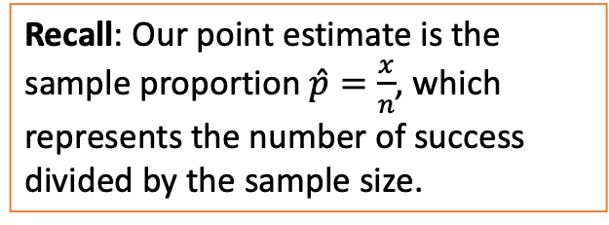

Final Confidence Interval for p
1 Proportion Z Interval
C.I. = Point Estimate ± Margin of Error
= $\hat{p}±Z^{∗}σ_{\hat{p}}$
= $\hat{p}±Z^{∗}\sqrt{\frac{\hat{p}\left(1−\hat{p}\right)}{n}}$ → $\left(\hat{p}−Z^{∗}\sqrt{\frac{\hat{p}\left(1−\hat{p}\right)}{n}},\hat{p}+Z^{∗}\sqrt{\frac{\hat{p}\left(1−\hat{p}\right)}{n}}\right)$
Recall: Our point estimate is the sample proportion $\hat{p}=\frac{x}{n}$, which represents the number of success divided by the sample size.

Slide 13

Summarizing LCQ!
Setup
A NatGeo Poll interviewed 1200 hiking enthusiasts and asked “Are you more afraid of spiders or snakes???” Out of the 1200 people, 768 responded “Ewww, snakes….”. Calculate the corresponding 95% confidence interval!
Solution
p = ??
$\hat{p}=$ ??
CV = ??
$SE=$ ??
$MOE=$ ??
$95\% CI=$ ??

Slide 14
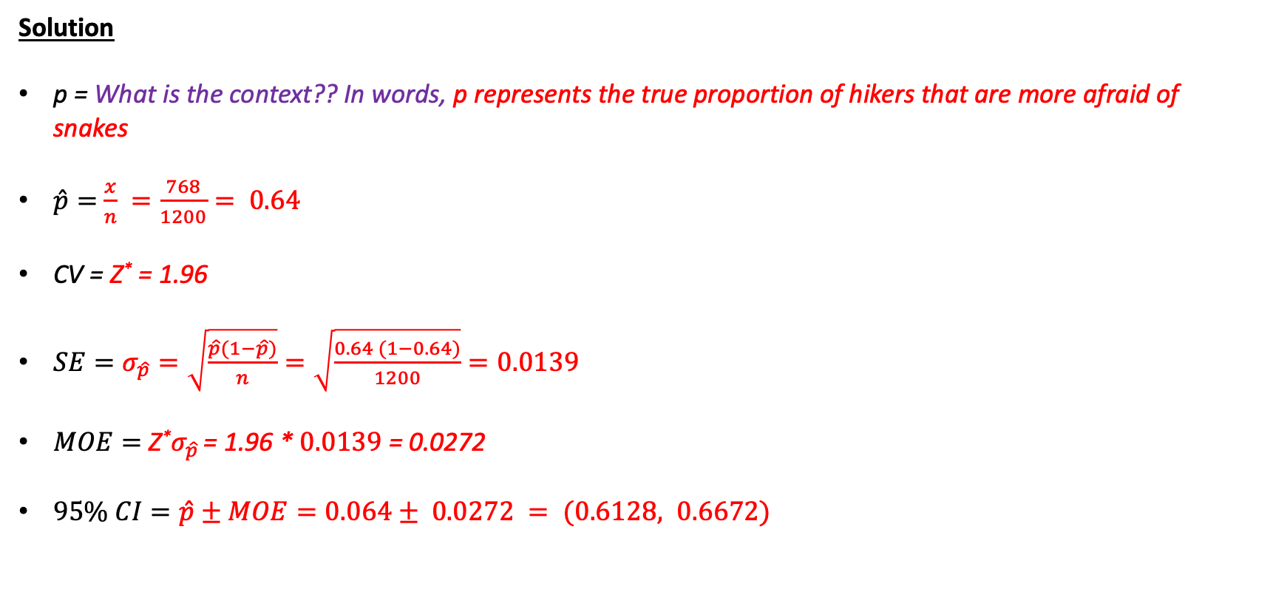
Summarizing LCQ!
Setup
A NatGeo Poll interviewed 1200 hiking enthusiasts and asked “Are you more afraid of spiders or snakes???” Out of the 1200 people, 768 responded “Ewww, snakes….”. Calculate the corresponding 95% confidence interval!
Solution
p = What is the context?? In words, p represents the true proportion of hikers that are more afraid of snakes
$\hat{p}=$ $\frac{x}{n} =\frac{768}{1200}= 0.64$
CV = Z* = 1.96
$SE=σ_{\hat{p}}=\sqrt{\frac{\hat{p}(1−\hat{p})}{n}}=\sqrt{\frac{0.64 (1−0.64)}{1200}}=0.0139$
$MOE=$ Z*$σ_{\hat{p} }$= 1.96 * $0.0139$ = 0.0272
$95\% CI=\hat{p}±MOE=0.064± 0.0272 = (0.6128, 0.6672)$
** This is how we would have to do it by hand!
But we are going to use the Calculator! Phew!

Slide 15
Using Calc!
Setup
A NatGeo Poll interviewed 1200 hiking enthusiasts and asked “Are you more afraid of spiders or snakes???” Out of the 1200 people, 768 responded “Ewww, snakes….”. Calculate and interpret the corresponding 95% confidence interval!
GOAL: Find the Confidence Interval!
1-PropZInt
x = # of successes (people that said yes)
n = sample size
C-Level = Confidence level (as a decimal or whole number, both work)
Interpret results:
??

Slide 16
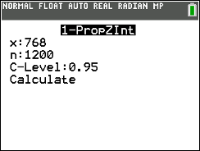
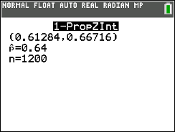
Using Calc!
Setup
A NatGeo Poll interviewed 1200 hiking enthusiasts and asked “Are you more afraid of spiders or snakes???” Out of the 1200 people, 768 responded “Ewww, snakes….”. Calculate and interpret the corresponding 95% confidence interval!
GOAL: Find the Confidence Interval!
1-PropZInt
x = # of successes (people that said yes)
n = sample size
C-Level = Confidence level (as a decimal or whole number, both work)
** Can just copy and paste the general structure and fill in the information and results for this specific problem!!
Show work: 95% CI = 1-PropZInt(x = 768, n = 1200, C-Level = 0.95) → (0.6128, 0.66716)
I am % confident that the true/population parameter + context is between (lower bound) and (upper bound).
Interpret results:
I am 95% confident that the true proportion of hikers who are more afraid of snakes than spiders is between 0.6128 and 0.6672.

Slide 17
Interpreting Confidence Intervals
General Structure
I am C% confident that the true/population parameter + context is between (lower bound) and (upper bound).
Example
Trying to estimate the proportion of all Columbus residents who enjoy running → 95% CI = (0.05, 0.25)
We are 95% confident that the true (population) proportion of all Columbus residents who enjoy running is between 0.05 and 0.25.
3 Pieces
95% Confident: This is a Confidence Statement
Tells us what percent off ALL possible samples result in a CI that captures the true proportion.
Parameter + Context: We are talking about population proportions.
But what population proportion??? We ALWAYS need context.
Interval: The range of plausible values!
Uses our sample statistic and MOE.
True = population (they mean the same thing) and
Parameter will either be MEAN or PPROPORTION

Slide 18
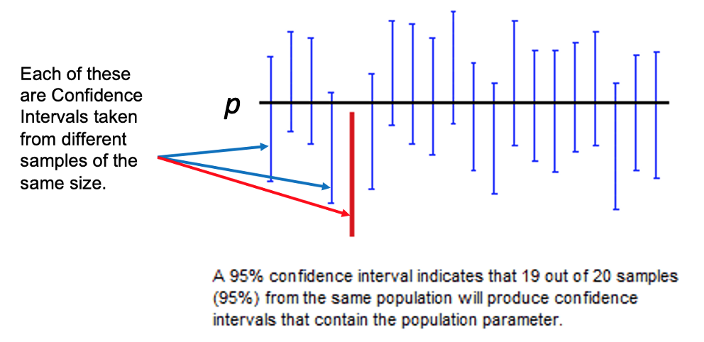
Interpreting Confidence Intervals
Confidence Interval Interpretation Visualized
Very Important!
The confidence level is NOT the probability the parameter is in the interval.
It refers to the long run capture rate (i.e. over many, many intervals constructed in the same way).
Either the interval contains the parameter or it does not.
Dope applet!

Slide 19
Another LCQ
Setup: 15 out of 23 people from a random sample said their National Championship team is still remaining in their NCAA March Madness Bracket.
1) Calculate the 90% Confidence Interval.
2) Interpret this interval.

Slide 20
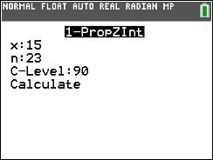
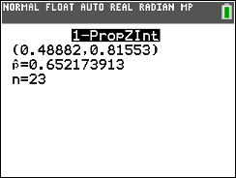
Another LCQ
Setup: 15 out of 23 people from a random sample said their National Championship team is still remaining in their NCAA March Madness Bracket.
1) Calculate the 90% Confidence Interval.
90% CI = 1-PropZInt(x = 15, n = 23, C-Level = 90) → (0.489, 0.816)
Writing out the calculator function and inputs like this is how we would show work for calculating our interval!
2) Interpret this interval.
We are 90% confident that the true proportion of people who’s national championship team is still remaining in their March Madness bracket is between 0.489 and 0.816. → This a PERFECT interpretation!
Examples of INCORRECT (and common) interpretations!
There’s a 90% chance that the sample proportion of people who’s national championship team is still remaining is between 0.489 and 0.816. → TWO things wrong
‘confident’ means something specific in Statistics, do NOT want to use the word ‘chance’ ‘probability’, etc.
We are trying to estimate the TRUE or the POPULATION proportion, that’s the goal. NOT the SAMPLE proportion, we already know what that is. So do NOT say ‘sample’
We are 90% Confident that the population proportion is between 0.489 and 0.816. → MISSING CONTEXT! Have to say what this proportion represents!

Slide 21
Another LCQ
Problem: From a random sample of 65 students, 40% said they prefer to wake up early to do their homework rather than stay up late.
Calculate and interpret the 98% confidence interval.
Solution

Slide 22
Another LCQ
Problem: From a random sample of 65 students, 40% said they prefer to wake up early to do their homework rather than stay up late.
Calculate and interpret the 98% confidence interval.
Solution
Calculate Interval:
1-PropZInt
x = 26 (=0.4(65))
n = 65
Confidence = 0.98
Result = (0.25864, 0.54136)
Interpret Interval:
We are 98% confident that the true proportion of students who prefer to wake up early to do their homework is between 0.259 and 0.541
MOE ≈ 0.14
LB = 0.259 $\hat{p}=\frac{26}{65}=0.4$ UB = 0.541

Slide 23
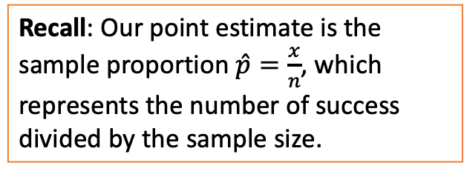
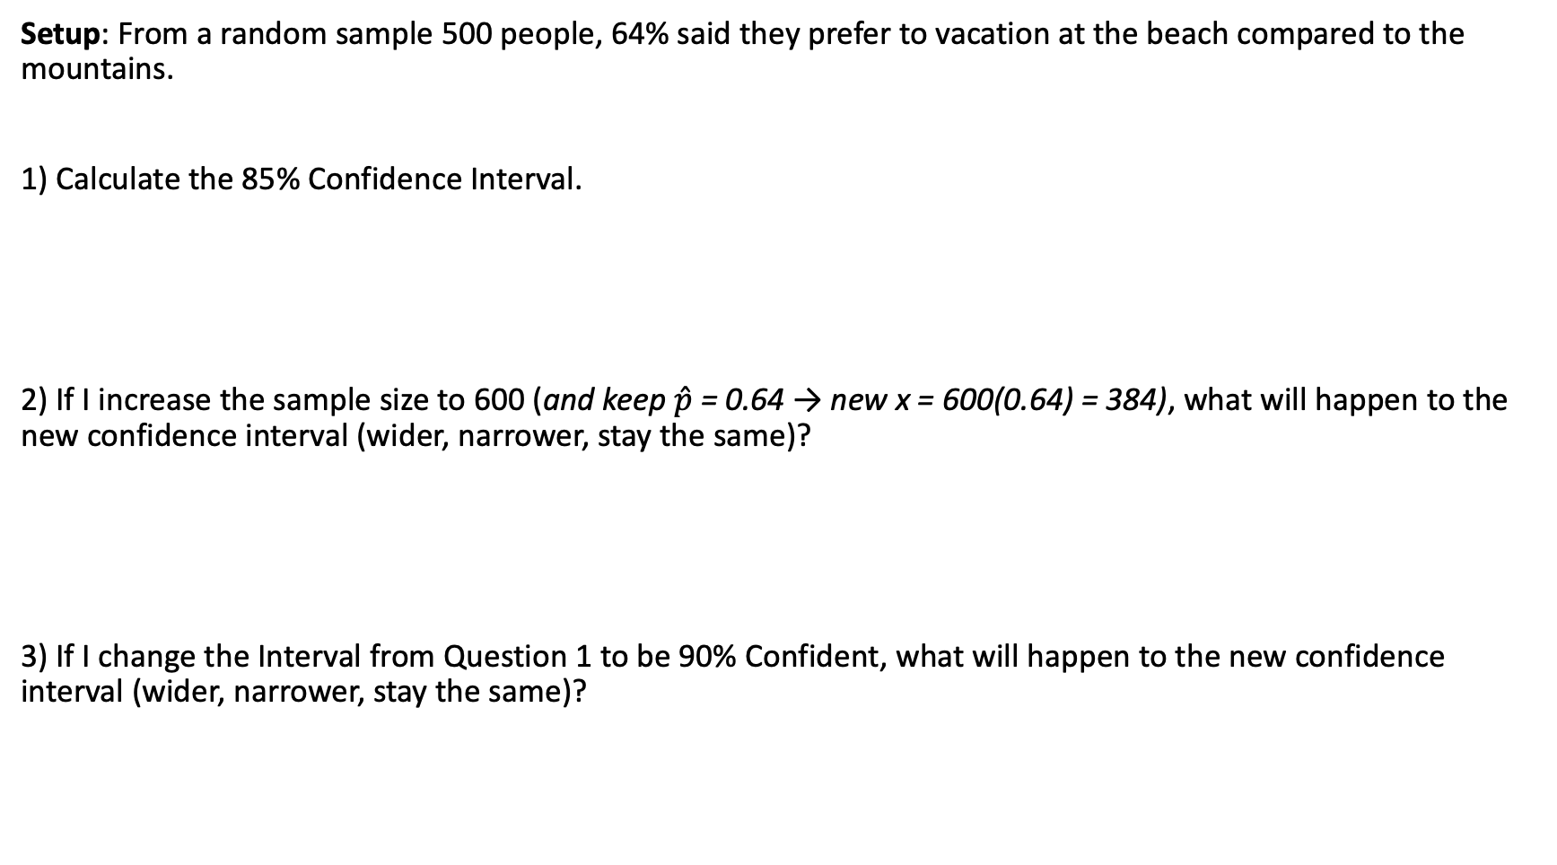
One more LCQ
Setup: From a random sample 500 people, 64% said they prefer to vacation at the beach compared to the mountains.
1) Calculate the 85% Confidence Interval.
2) If I increase the sample size to 600 (and keep $\hat{p}$ = 0.64 → new x = 600(0.64) = 384), what will happen to the new confidence interval (wider, narrower, stay the same)?
3) If I change the Interval from Question 1 to be 90% Confident, what will happen to the new confidence interval (wider, narrower, stay the same)?
Recall: Our point estimate is the sample proportion $\hat{p}=\frac{x}{n}$, which represents the number of success divided by the sample size.

Slide 24
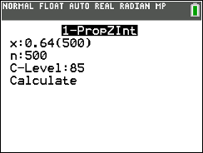
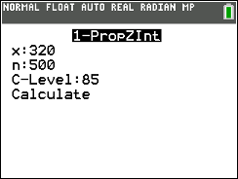
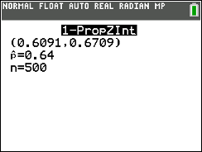


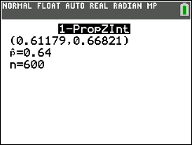

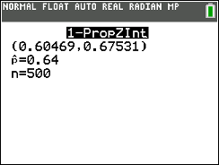
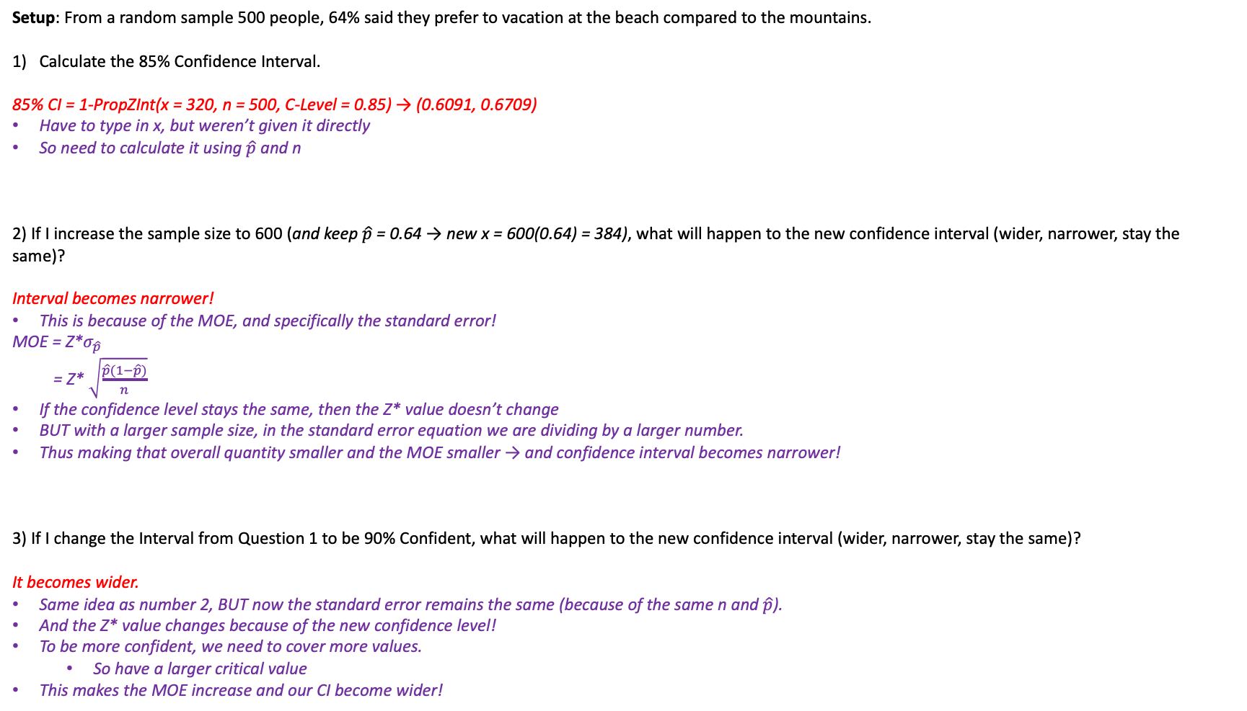
One more LCQ
Setup: From a random sample 500 people, 64% said they prefer to vacation at the beach compared to the mountains.
Calculate the 85% Confidence Interval.
85% CI = 1-PropZInt(x = 320, n = 500, C-Level = 0.85) → (0.6091, 0.6709)
Have to type in x, but weren’t given it directly
So need to calculate it using $\hat{p}$ and n
2) If I increase the sample size to 600 (and keep $\hat{p}$ = 0.64 → new x = 600(0.64) = 384), what will happen to the new confidence interval (wider, narrower, stay the same)?
Interval becomes narrower!
This is because of the MOE, and specifically the standard error!
MOE = Z*$σ_{\hat{p}}$
= Z* $\sqrt{\frac{\hat{p}(1−\hat{p})}{n}}$
If the confidence level stays the same, then the Z* value doesn’t change
BUT with a larger sample size, in the standard error equation we are dividing by a larger number.
Thus making that overall quantity smaller and the MOE smaller → and confidence interval becomes narrower!
3) If I change the Interval from Question 1 to be 90% Confident, what will happen to the new confidence interval (wider, narrower, stay the same)?
It becomes wider.
Same idea as number 2, BUT now the standard error remains the same (because of the same n and $\hat{p}$).
And the Z* value changes because of the new confidence level!
To be more confident, we need to cover more values.
So have a larger critical value
This makes the MOE increase and our CI become wider!
NOTE: I had to change x so that the $\hat{p}$ stayed the same

Slide 25
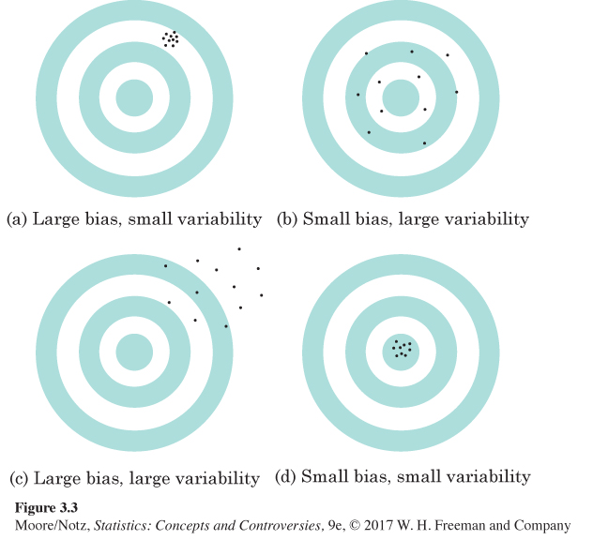
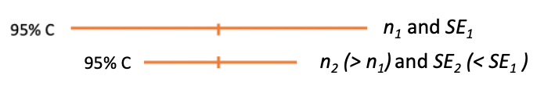
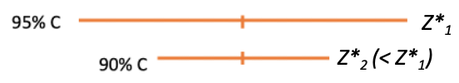
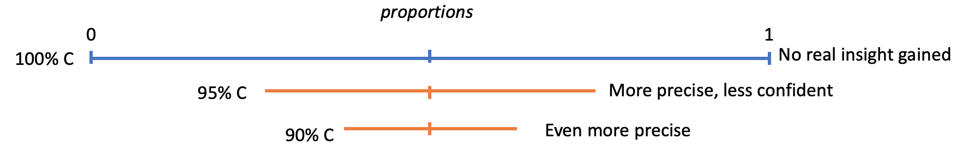
Summary of ideas from previous LCQ
Precision
Thinking back to sampling variability in surveys from Unit 1, we wanted to have good sampling methods so that our sample statistics could be precise (precision is GOOD)!
This same concept is present with Confidence Intervals!
Precision with Confidence Intervals
There are two ways to get a more precise (narrower) confidence interval!
Increase the sample size (before collecting data GOOD!)
This decreases the standard error and as a result the MOE.
Decrease the confidence level (after the fact, not so good)
This decreases the critical value and as a result the MOE.
(** Assuming everything else remains the same)
Tradeoff between Precision and Confidence
If we want to be more confident, we need to cover more values!
That of course decreases the precision…
So there a pro / con to being super confident

Slide 26
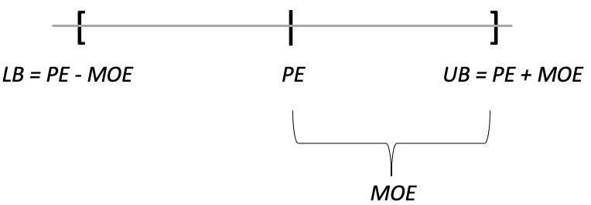
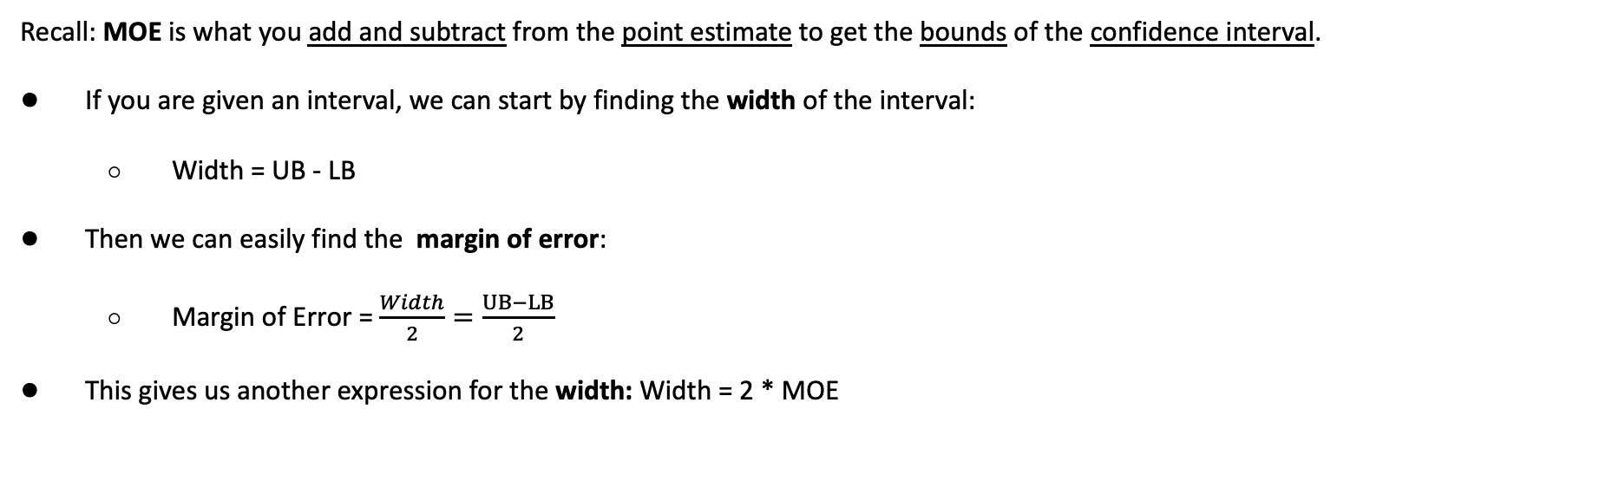
Margin of Error Revisited
Recall: MOE is what you add and subtract from the point estimate to get the bounds of the confidence interval.
If you are given an interval, we can start by finding the width of the interval:
Width = UB - LB
Then we can easily find the margin of error:
Margin of Error = $\frac{Width}{2}=\frac{UB−LB}{2}$
This gives us another expression for the width: Width = 2 * MOE
Example:
Find the Width and MOE based on the following output:

Slide 27
Margin of Error Revisited
Recall: MOE is what you add and subtract from the point estimate to get the bounds of the confidence interval.
If you are given an interval, we can start by finding the width of the interval:
Width = UB - LB
Then we can easily find the margin of error:
Margin of Error = $\frac{Width}{2}=\frac{UB−LB}{2}$
This gives us another expression for the width: Width = 2 * MOE
Example:
Find the Width and MOE based on the following output:
Width = UB – LB = 0.6709 – 0.6091 = 0.0618
MOE = width / 2 = 0.0618 /2 = 0.0309

