Slide 1
Only Two More Weeks!!
Unit 10 – Contingency Tables
Almost-Made-It-Through Professor Colton

Slide 2
Unit 10 - Outline
Unit 10 – Contingency Tables
Intro
Chi Square Test for Dependence
Observed and Expected Matrices
Hypotheses Statements
Test Statistic: Chi-Square Test and p-value
Examples

Slide 3
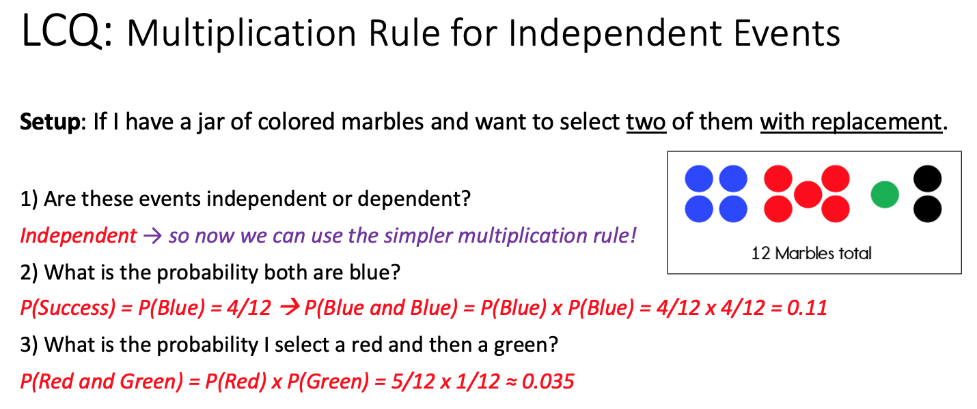
Review
Contingency Tables
Contingency Tables helped us organize data on two variables!
We used them to find probabilities such as: P(Statistics), P(Art and Poor Attendance), P(Good Attendance | Chemistry), etc.
We also learned about relationship between EVENTS, such as Perfect Attendance and Statistics.
Are these events mutually exclusive?? NO
How about independent??
Independence of EVENTS
Two EVENTS were independent if the prior EVENT had NO effect on the subsequent EVENT.
If this is true, the first EVENT does NOT change the probability of the second EVENT!
We could write this in terms of conditional probability:
P(B|A) = P(B) ==> P(A and B) = P(A) x P(B|A), simplify now!
= P(A) x P(B)
 | Statistics | Art | Chemistry | Total
Perfect | 100 | 40 | 80 | 220
Good | 20 | 50 | 70 | 140
Poor | 30 | 15 | 30 | 75
Total | 150 | 105 | 180 | 435

Slide 4
New
Independence of VARIABLES
Now we are going to study the independence of two entire VARIABLES, not just individual events
For this example, our variables are Attendance and Major.
Are Attendance and Major related / associated??? Is there a dependence relationship here?? Or are they independent??
To answer this, we need to actually look at the ALL of the relationships between events of each variable simultaneously (at the same time)!!
So that means analyzing: Perfect Attendance and Statistics, Perfect Attendance and Art,… Poor Attendance and Chemistry ALL AT THE SAME TIME!!
How to think about this → We are comparing the Global data (column / row totals) to the Local data (middle cells), are the patterns the same??
Sounds complex, but we actually have a nice Hypothesis Test that will do this!
Answering the questions above could be useful and is a very common interest in practice!
Let’s say the University was reviewing their attendance policy when all classes went virtual, should they have a department specific rule??
Or is a University-wide rule effective enough?
 | Statistics | Art | Chemistry | Total
Perfect | 100 | 4 | 80 | 220
Good | 20 | 50 | 70 | 140
Poor | 30 | 15 | 30 | 75
Total | 150 | 105 | 180 | 435
Comparison
Statistics OVERALL (globally) has P() = 150/435 ≈ 0.34
Is this probability similar to Statistics JUST WITHIN (locally) Perfect Attendance???
P(Statistics | Perfect) = 100/220 ≈ 0.45?? Is this close enough??

Slide 5
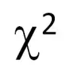
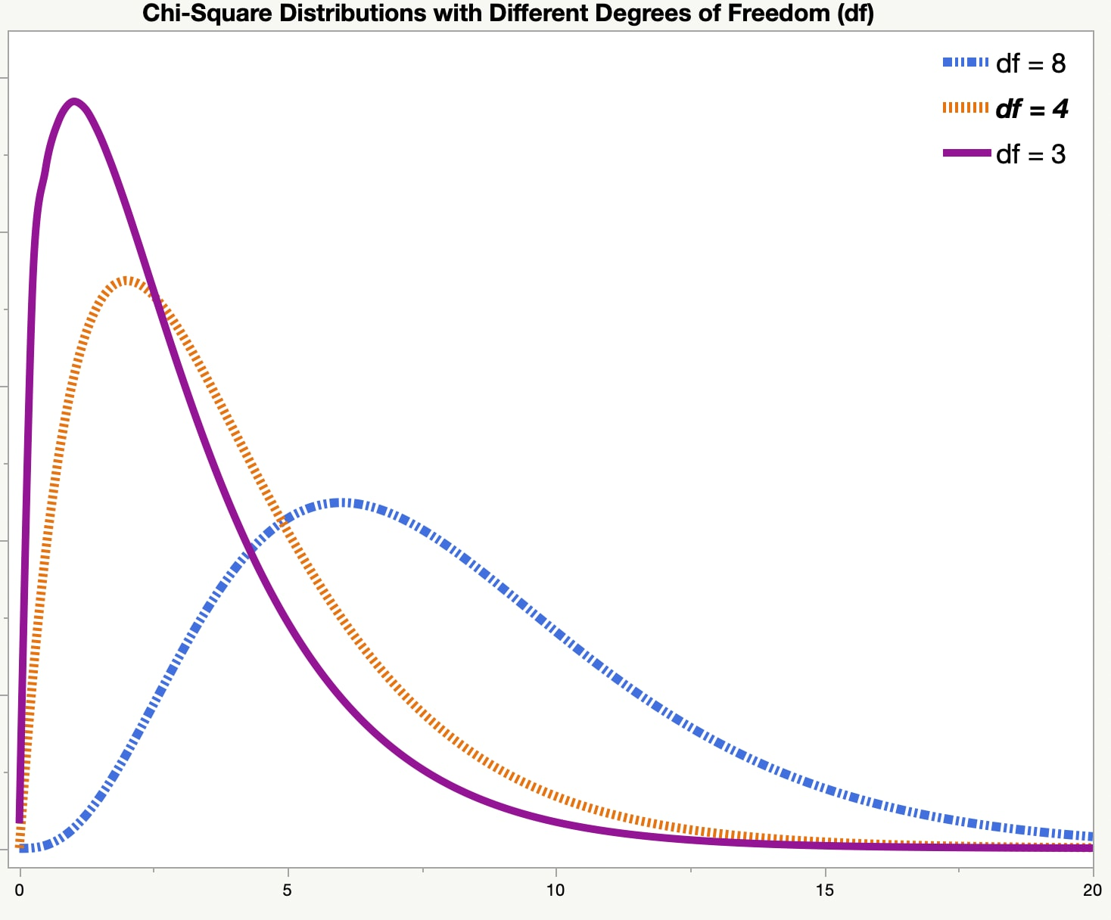
Chi-Square Test of Independence
Chi-Square Test of Independence
The formal name of the test we will be doing is a Chi-Square Test of Independence (X² Test of Independence)
This test is based on the Chi-Square (X²) distribution, hence the name
It is a right-skewed, continuous distribution that has a degrees of freedom parameter
This test determines if two categorical variables are associated or not
** We aren’t going to be checking any assumptions, we just need two categorical variables!
Process
We start by assuming two variables are unrelated. Here are some examples:
Movie genre (variable 1) and Snacks (variable 2)
Our idea is that the type of movie someone goes to see and whether or not they purchased snacks is unrelated
If true, easier to estimate how many snacks will be sold on any given night because what showings are available wouldn’t have an impact
Dog breed (variable 1) and Brand of food (variable 2)
We think the breed of dog a family has and the dog food brand they buy are unrelated.
If true, a store wouldn’t have to market small dog or big dog food
Then we look at the contingency table of the collected data and evaluate our assumption by comparing what actually happened to what should have happened if they were indeed unrelated!!
Said another way, the independence test checks to see if the actual data is “close enough” to the expected counts that would occur if the two variables are independent → Let’s demonstrate!
https://www.jmp.com/en_ca/statistics-knowledge-portal/chi-square-test/chi-square-distribution.html
https://www.jmp.com/en_au/statistics-knowledge-portal/chi-square-test/chi-square-test-of-independence.html

Slide 6
Hypotheses
Logic
This is pretty much the SAME thing that we have been doing with Hypothesis Tests for Proportions and Means
Except now we are studying the relationship between two variables (not parameters), specifically testing for independence between the row and column variables of a contingency table
Hypotheses
Null Hypothesis → We start by assuming the row and column variables are independent (i.e. NOT related)
Alternative Hypothesis → Then we are trying to show the opposite, that the row are column variables are NOT independent, or dependent (i.e. related)
So in general:
H₀: The row and column variables are independent
H_{A}: The row and column variables are dependent
But we NEED to add CONTEXT for our problem!
Examples:
1) H₀: Movie genre and Snacks are independent
H_{A}: Movie genre and Snacks or not are NOT independent (or dependent)
2) H₀: Dog breed and Type of food are NOT related
H_{A}: Dog breed and Type of food ARE related

Slide 7
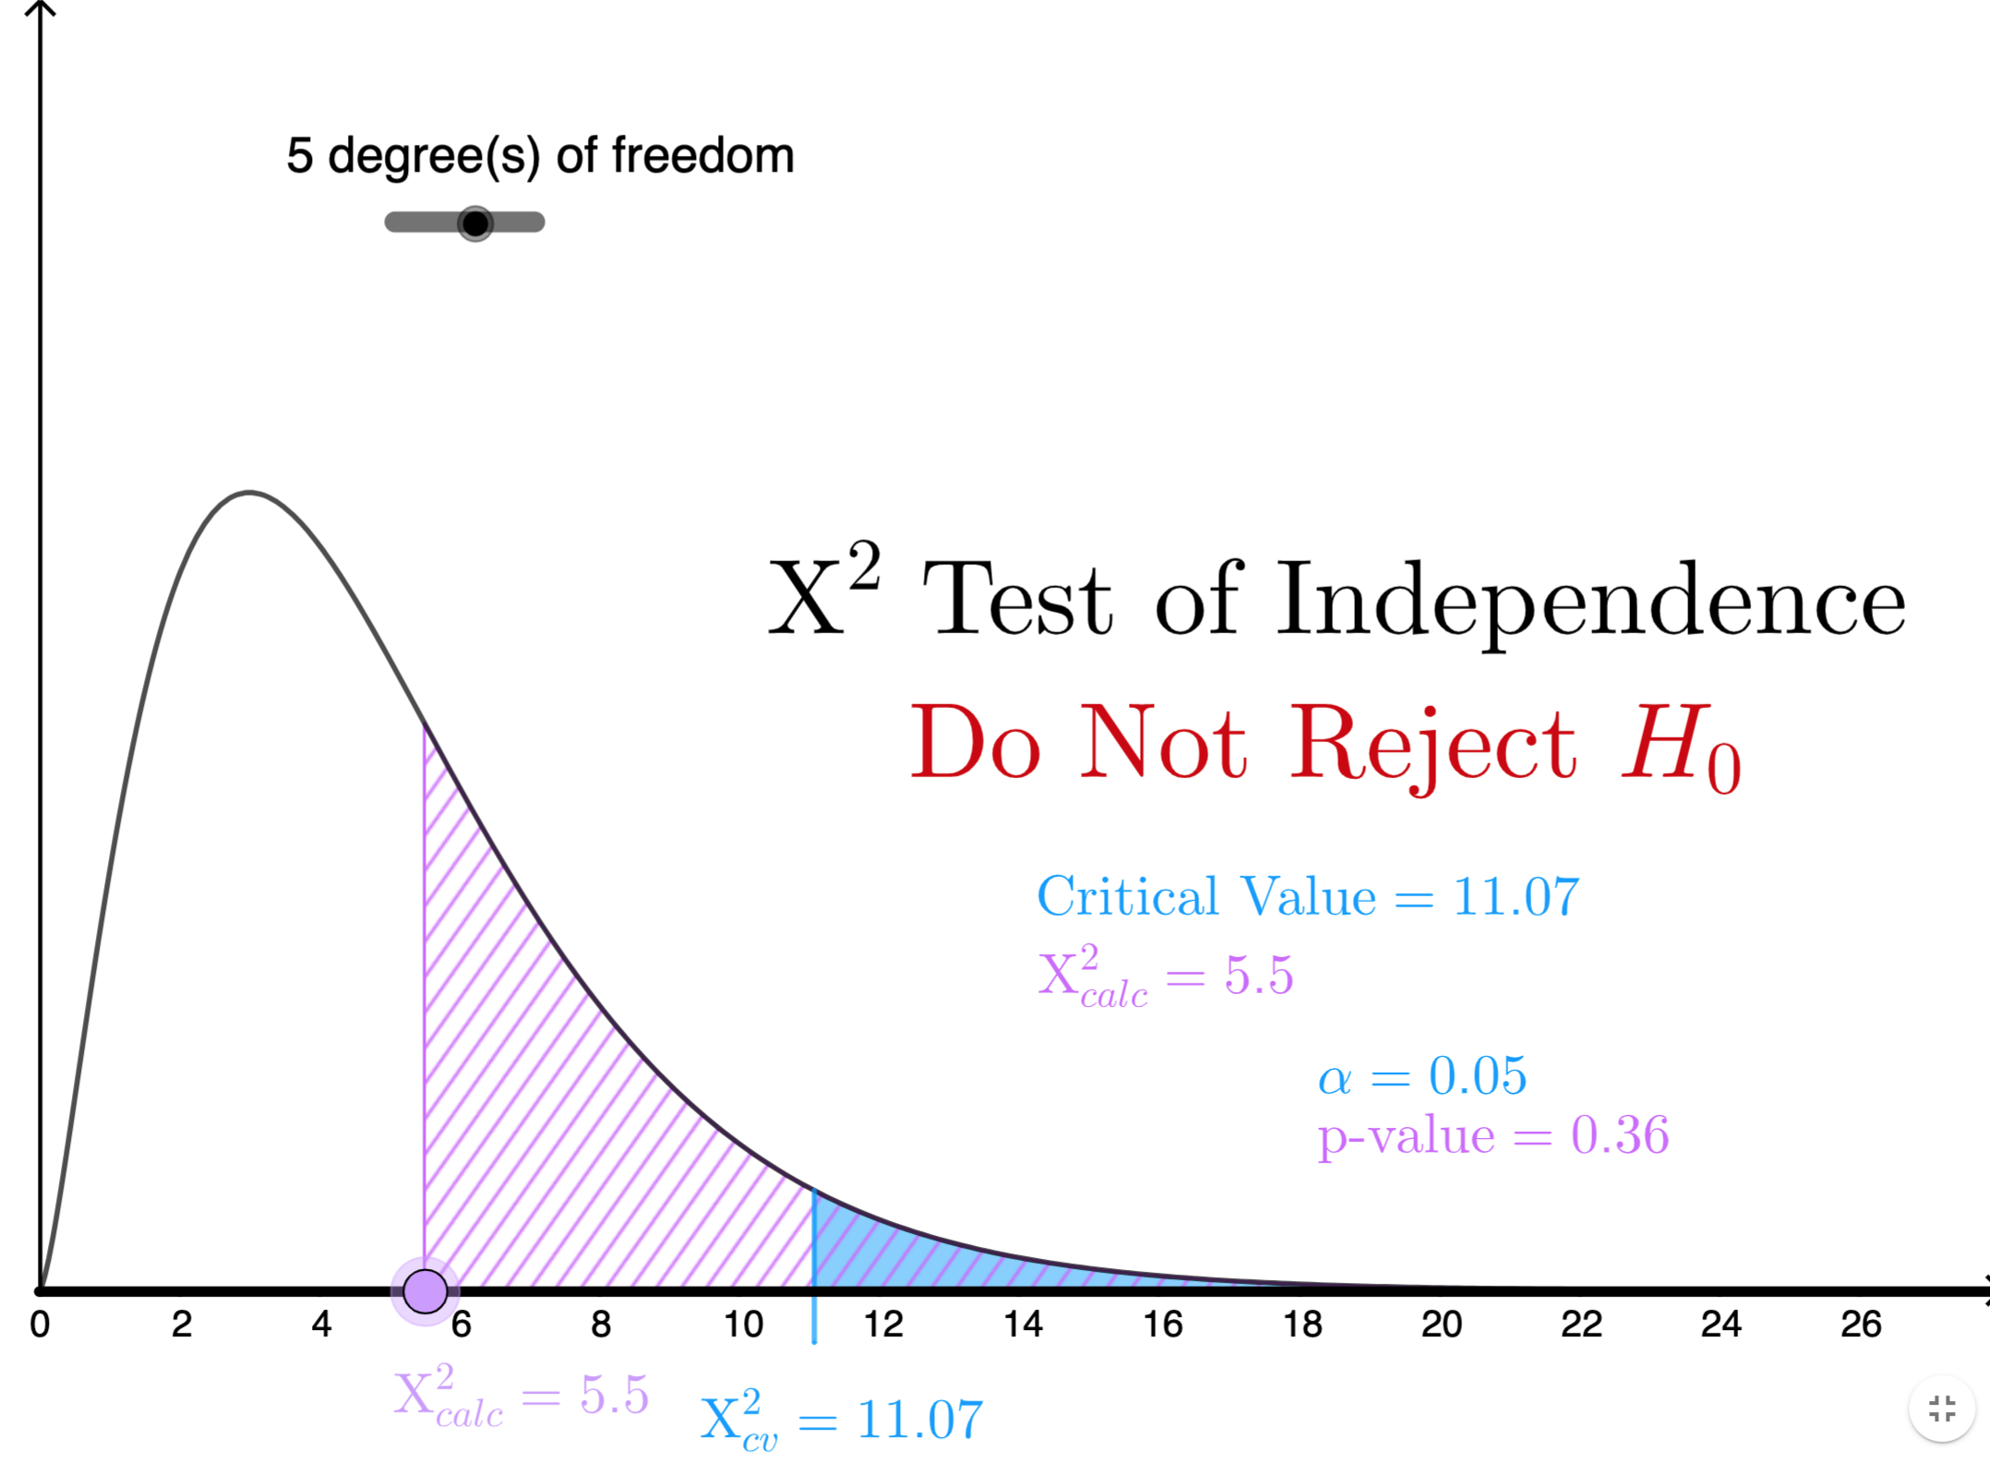
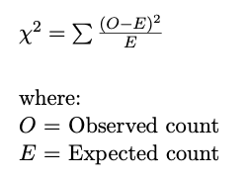
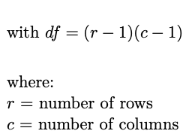
Test Statistic and P-value
https://www.geogebra.org/m/smhy8cxz
Test Statistic
The Test Statistic X²_{stat} has the following formula:
The Observed count is our sample data in the contingency table
The Expected count is what should have happened if our two variables were indeed unrelated!! In other words, the counts under the Null Hypothesis!
P-Value
Chi-Square Test for Independence is always RIGHT-tailed
So the p-value is the probability of getting our Test Statistic or greater
Decisions
We will make our decisions to Reject or Fail to Reject using the p-value method so that we don’t have to find the Critical Value for the X² distribution
Calculator
We are going to use the calculator to calculate everything! Phew!
But we need to understand what is happening behind the scenes first!

Slide 8
Expected Counts
Lets go through how expected counts are calculated very slowly with the following example
Here are our hypotheses:
H₀: Attendance and Major are unrelated
H_{A}: Attendance and Major are related
Process
We are going to use probabilities to calculate the expected counts, so lets first think about the marginal probabilities
Now we need to fill in the probabilities in the middle (joint probabilities, example: P(Perfect AND Statistics)). Well under the Null hypothesis, Attendance and Major are unrelated
In probability, that means they are independent!!
How can we calculate the probability of independent events???? Just multiply the marginal probabilities of each!
P(Perfect and Statistics) = P(Perfect) x P(Stats)

Slide 9
Expected Counts
So lets do that for each of the middle cells!
P(Perfect AND Statistics) = P(Perfect) x P(Statistics), … , P(Poor AND Chemistry) = P(Poor) x P(Chemistry)
Now to get the counts, what can we do???
We have the PERCENT of students with Perfect Attendance and Statistics Major
P(Perfect and Stats) = 0.17
Now I want the actual NUMBER of students in this group! Logically, it would make sense to just multiply this PROBABILITY by the TOTAL number of students in the sample. Correct!!
Expected Count of Perfect and Stats = 0.17 x 435 = 73.95

Slide 10
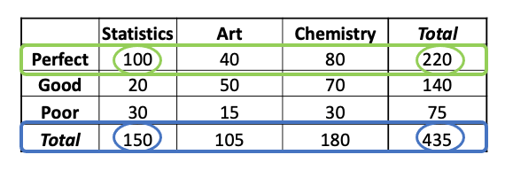



Expected Counts
So lets do that!!
We know have our table of Expected Counts
These counts represent what we would expect to see if there truly is no relationship between Attendance and Major.
Restated: If their probabilities were independent, then we should have observed these new counts based on the original row and column totals
Ex) If there is not a relationship between Attendance and Major, we would expect 73.95 students to have Perfect attendance and be Statistics majors!
Now, our Global data matches the Local data, same proportions! → Our marginal probabilities are the same as our conditional probabilities!
Ex) P(Statistics) = P(Statistics | Perfect) and P(Good) = P(Good | Chemistry)
Compared to originally (observed): P(Statistics | Perfect) $\frac{100}{220}=0.45$
$$\frac{150}{435}= 35\% ≈ 34\%=\frac{73.95}{220}$$
$$\frac{140}{435} =32\% ≈ 31\%=\frac{56.55}{180}$$
** Note that there is roundoff error in my numbers,
So these comparisons are just approximately equal ≈
But in theory (and our calc), they will be exactly equal =

Slide 11
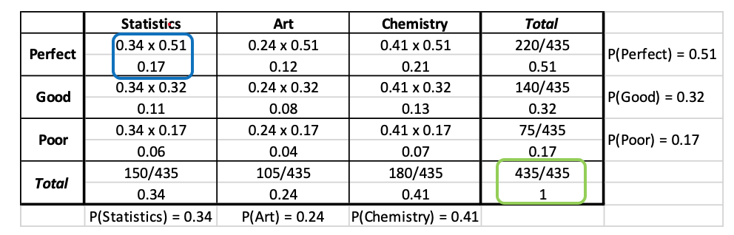

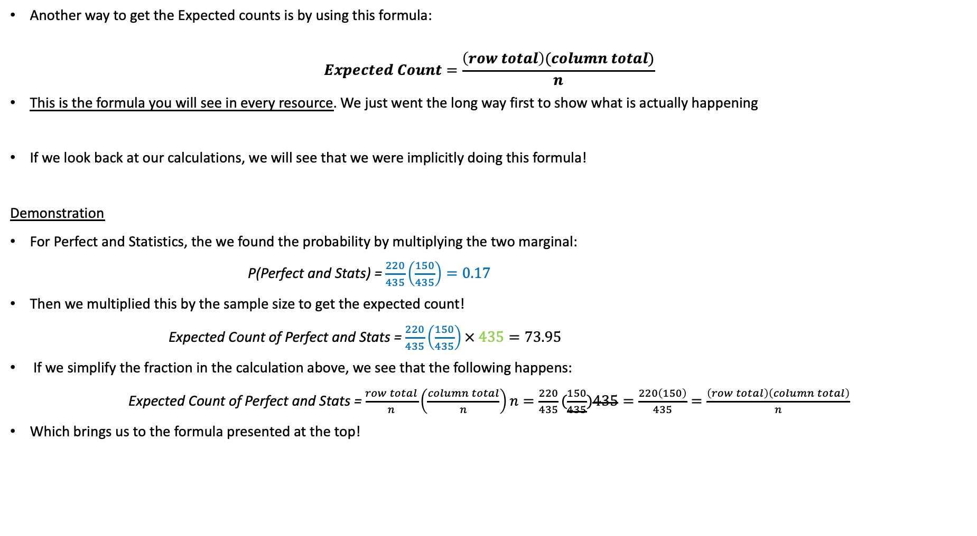
Expected Counts
Another way to get the Expected counts is by using this formula:
$$Expected Count=\frac{\left(row total\right)(column total)}{n}$$
This is the formula you will see in every resource. We just went the long way first to show what is actually happening
If we look back at our calculations, we will see that we were implicitly doing this formula!
Demonstration
For Perfect and Statistics, the we found the probability by multiplying the two marginal:
P(Perfect and Stats) = $\frac{220}{435}\left(\frac{150}{435}\right)=0.17$
Then we multiplied this by the sample size to get the expected count!
Expected Count of Perfect and Stats = $\frac{220}{435}\left(\frac{150}{435}\right)× 435=73.95$
If we simplify the fraction in the calculation above, we see that the following happens:
Expected Count of Perfect and Stats = $\frac{row total}{n}\left(\frac{column total}{n}\right)n=\frac{220}{435}(\frac{150}{435})435=\frac{220\left(150\right)}{435}=\frac{\left(row total\right)\left(column total\right)}{n}$
Which brings us to the formula presented at the top!

Slide 12
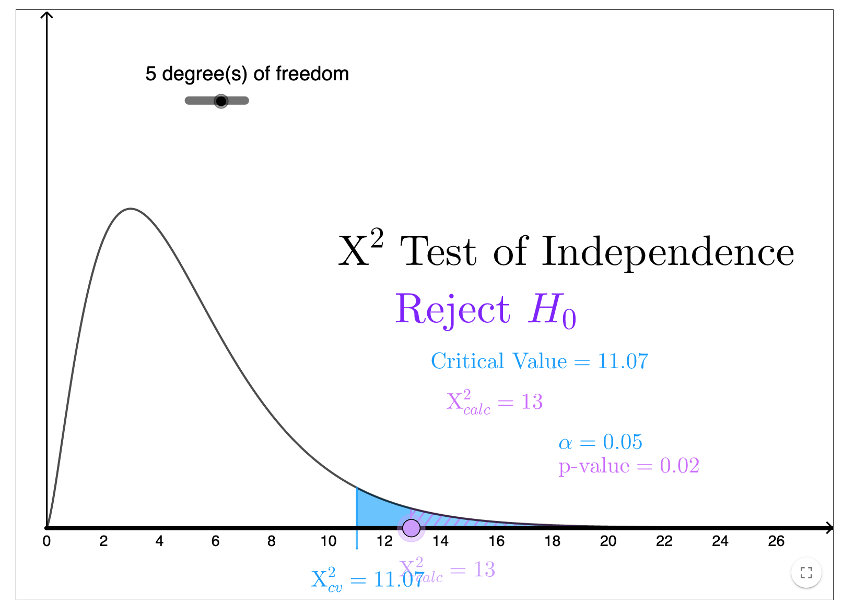
Comparison of Observed and Expected Counts
Now that we have calculated expected counts, we can compare them to the observed counts
If there is no relationship between Attendance and Major, the Observed (actual) counts and the Expected counts will be similar! If there is a relationship, the Observed and Expected will be different.
Finally, to calculate the Test Statistic X²_{stat} we would use this formula to the right:
And eventually p-value and decide to reject or fail to reject and interpret!
For this test, only reject for large values of the Test Statistic (which have small p-values)!
This is because of the right-skew of the distribution
Now let’s see how to do this in the calc
(after another example)!
Observed count
(Expected count)
https://www.geogebra.org/m/smhy8cxz

Slide 13
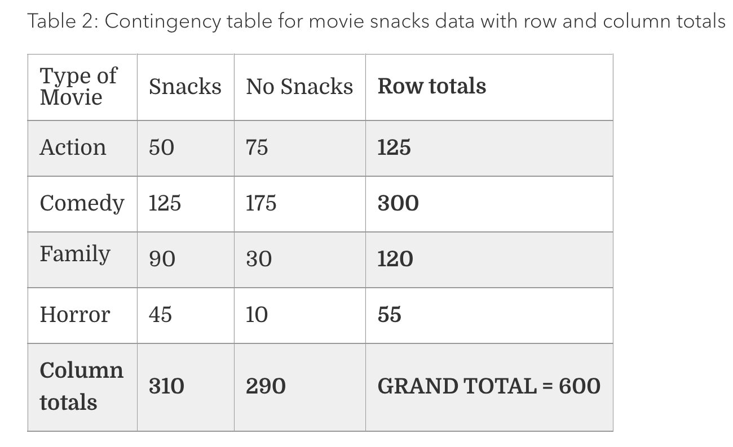
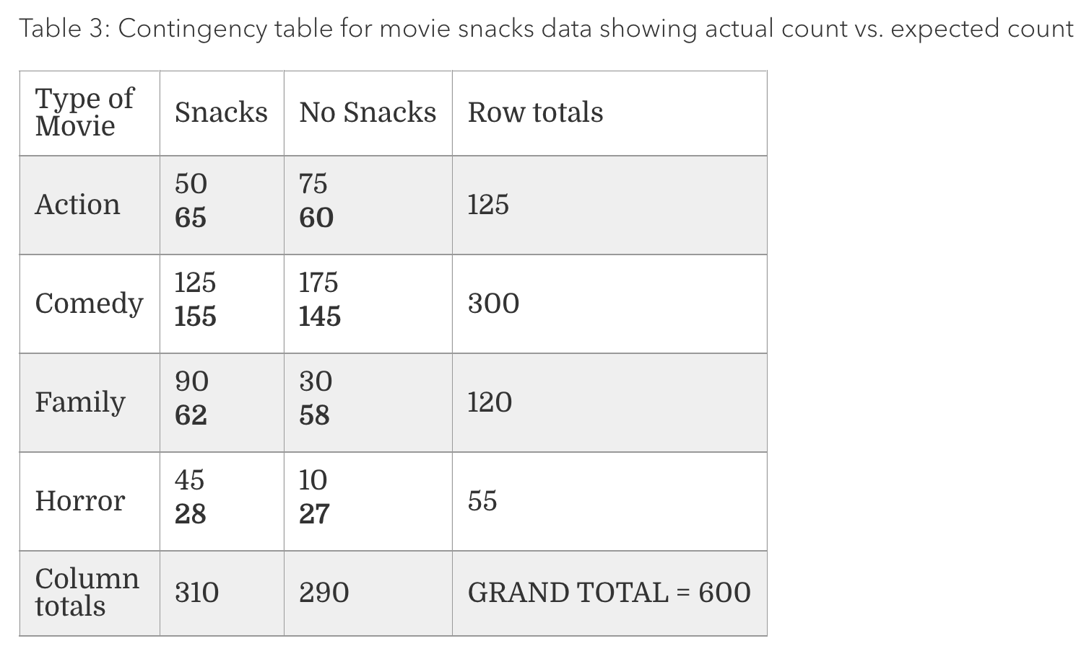
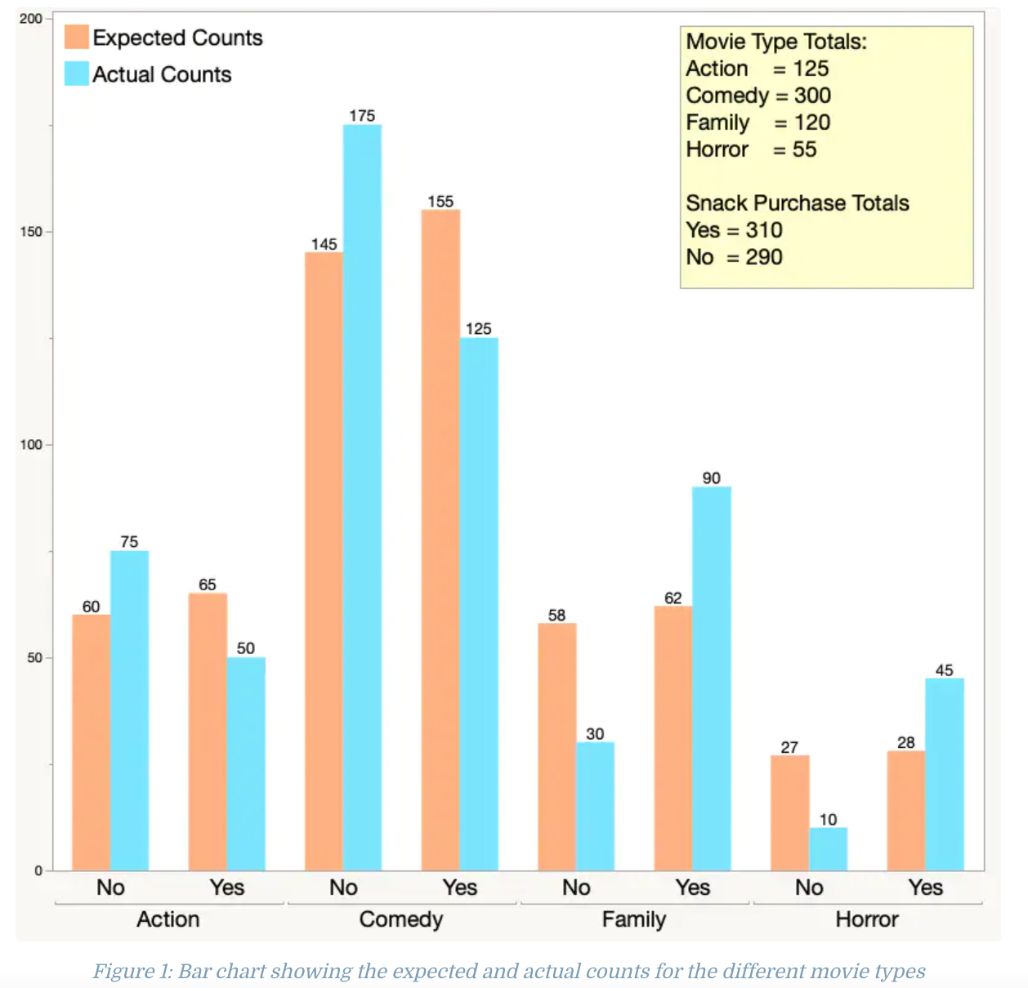
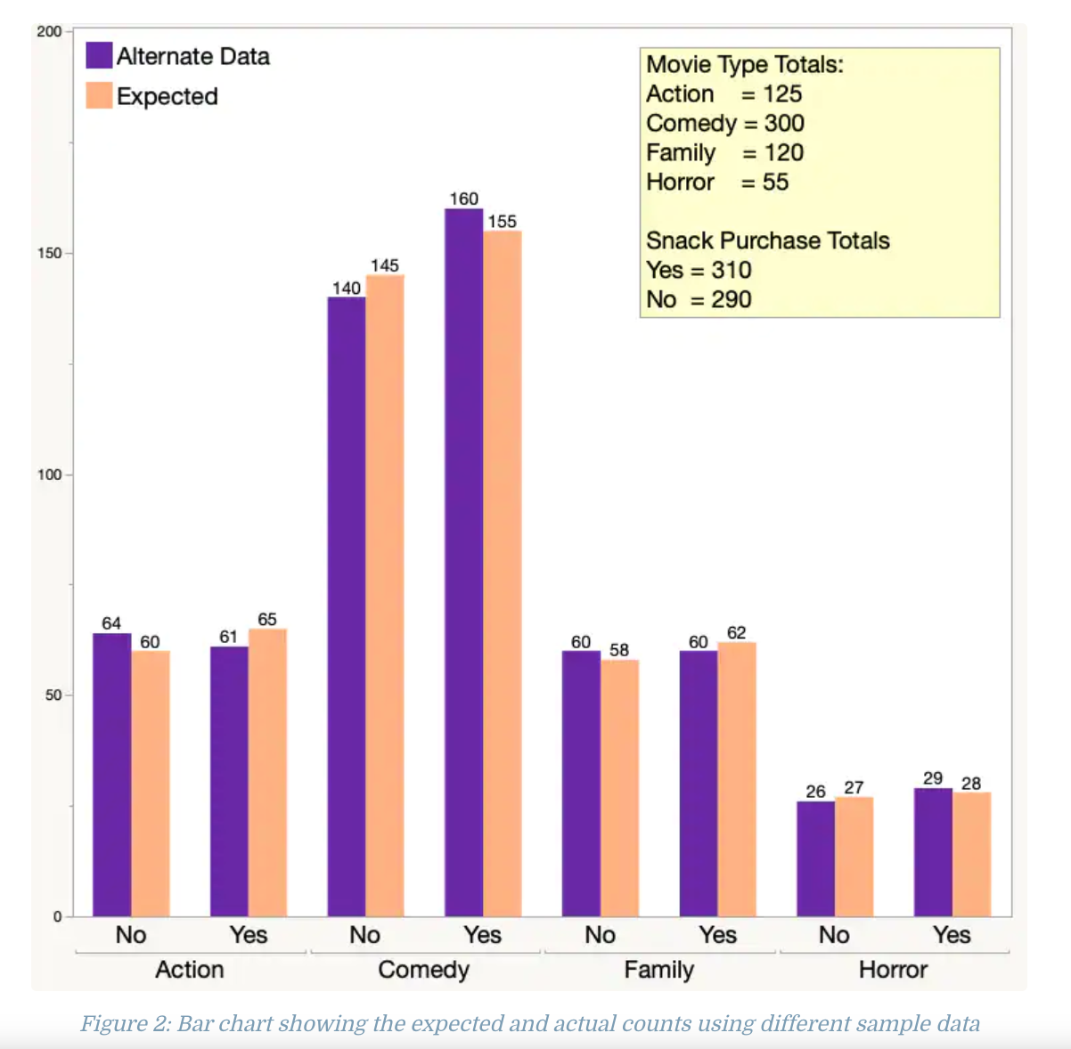
Comparison of Observed and Expected Counts
Here’s another example and visualization of this comparison of the Observed and Expected counts with the Movie and Snack context
Observed count
Expected count
Here is an alternate dataset
The row and column totals are the same
But the Yes/No splits for each movie genre are different (zoom in ☺):
61 64
160 140
The expected counts are the SAME because they are based on the row and column totals
But the observed have changed
source
Test Statistic X²_{stat} = 65.03 > 7.815 = Critical Value → Reject!
Test Statistic X²_{stat} = 0.903 < 7.815 = Critical Value → Fail to Reject
https://www.jmp.com/en_au/statistics-knowledge-portal/chi-square-test/chi-square-test-of-independence.html

Slide 14
Using Calc – X² Test of Independence
Setup
The University was reviewing their attendance policy when all classes went virtual. Is there enough evidence to conclude there is a significant relationship between Attendance and Major? Use 𝛼 = 0.1
GOAL: Conduct a Hypothesis Test!
Enter contingency table data
Edit Matrix
Enter correct dimensions (excluding row and column totals)
Enter data
X²–Test
Observed = matrix of contingency table data
Expected = Output of expected counts →
Calculate or Draw
Our calculator computes the Expected Counts for us!
So this is where is stores the calculated Expected Counts
Hypotheses
H₀: Attendance and Major are unrelated
H_{A}: Attendance and Major are related

Slide 15
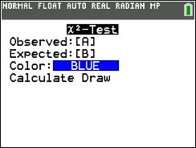
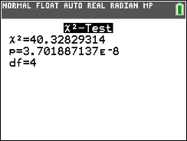
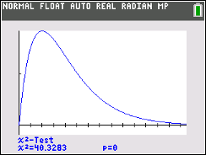
Using Calc – X² Test of Independence
Setup
The University was reviewing their attendance policy when all classes went virtual. Is there enough evidence to conclude there is a significant relationship between Attendance and Major? Use 𝛼 = 0.1
GOAL: Conduct a Hypothesis Test!
Enter contingency table data
Edit Matrix
Enter correct dimensions (excluding row and column totals)
Enter data
X²–Test
Observed = matrix of contingency table data
Expected = Output of expected counts →
Calculate or Draw
Our calculator computes the Expected Counts for us!
So this is where is stores the calculated Expected Counts
Hypotheses
H₀: Attendance and Major are unrelated
H_{A}: Attendance and Major are related
Calculate Output
X² = Test Statistic
p = p-value
df = Degrees of Freedom
Draw Output
Plot (and displays values) of p = p-value and X² = X²_{stat} on the standard X² curve with
df = (r – 1)(c – 1)
** Calculator notation for result here: 3.7 E-8 = 3.7 x 10⁻⁸ = 3.7/100,000,000 (super small!) → can just say it’s ≈ 0

Slide 16
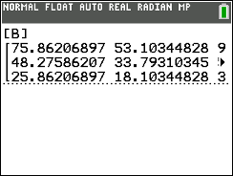
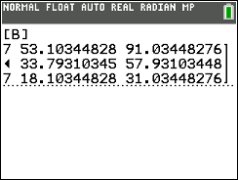
Comparing our Expected Counts to the Calculator’s
We did pretty good! Just roundoff error when we did it by hand (I rounded all the probabilities to 2 decimals)

Slide 17
LCQ - Interpretations
Problem: Write the conclusions and interpretations for our example.
Solution:
Setup
The University was reviewing their attendance policy when all classes went virtual. Is there enough evidence t conclude there is a significant relationship between Attendance and Major? Use 𝛼 = 0.1

Slide 18
LCQ - Interpretations
Problem: Write the conclusions and interpretations for our example.
Solution:
Need these:
Conclusion
Because the p-value ≈ zero is less than 𝛼 = 0.1, we reject the null hypothesis!
Interpretation
There IS enough evidence to conclude the alternative → NOT full credit, CONTEXT!!!
There IS enough evidence to conclude that Attendance and Major are related!
It's important to note that we CAN NOT conclude that the Attendance CAUSES a MAJOR (or vice versa).
The independence test tells us ONLY whether there is a relationship or not
Tt does NOT tell us that one variable causes the other
Setup
The University was reviewing their attendance policy when all classes went virtual. Is there enough evidence t conclude there is a significant relationship between Attendance and Major? Use 𝛼 = 0.1
Hypotheses
H₀: Attendance and Major are unrelated
H_{A}: Attendance and Major are related

Slide 19
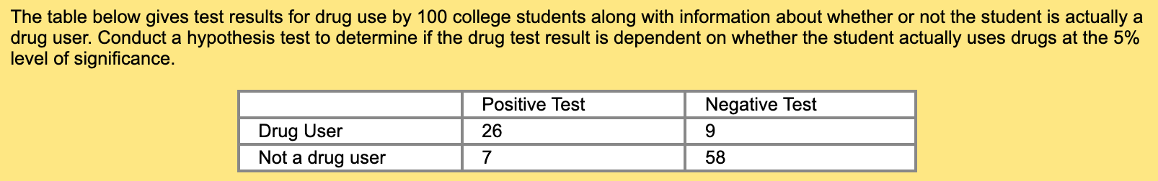
LCQ – Whole Test
Problem:
Solution:

Slide 20
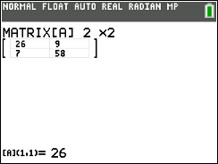
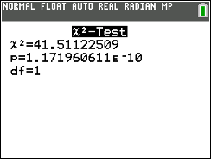
LCQ – Whole Test
Problem:
Solution: ** You should know all the steps required when conducting a full Hypothesis Test problem
Hypotheses
H₀: Positive test and drug use are unrelated → NOT CORRECT! Because positive test result is just a single EVENT, we are talking about the entire VARIABLES
H₀: Test result and drug use are unrelated
H_{A}: Test result and drug use are related
P-Value (and Test Statistic)
Entered contingency table into matrix [A]
P-value = X²-Test(Observed = [A], Expected = [B]) ≈ 0
Test Statistic X² = 41.511, df = 1
Conclusion and Interpretation
Since our p-value ≈ 0 is less than alpha = 0.05, we reject the null hypothesis!
We have sufficient evidence to conclude that drug use and test result are related
** Even though the menu options won’t ever change for this test, we still have to show our work by writing it out! This includes saying where we put the data
For demonstration purposes
Let’s say p-value = 0.10, what re the conclusion and interpretation now??
Since our p-value 0.1 is greater than significance level = 0.05, we fail to reject the null hypothesis! There is NOT enough evidence to that test result and drug use are related

