Slide 1
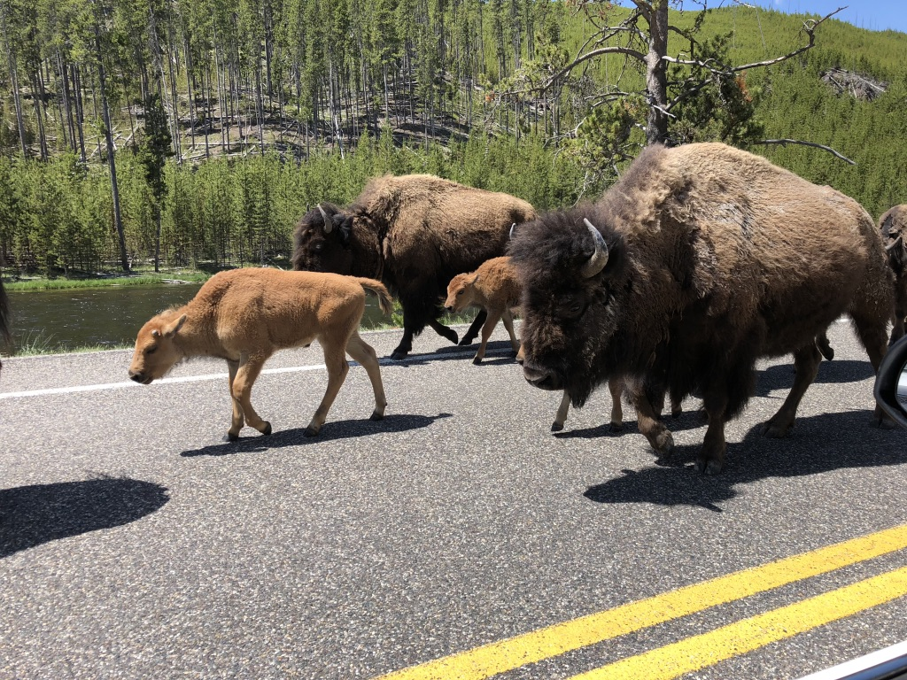
More Stats! (now our first Quiz is loooooming ☹)
Unit 1 – Basic Ideas
Your Seasoned Veteran Professor Colton

Slide 2
Unit 1 – Part 2
Data Classification
Individuals and Data
Types of Data

Slide 3
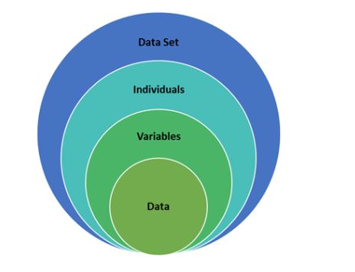
Where do Data come from?
Individuals
The objects described by a set of data.
Individuals may be people, but they may also be animals or things.
Variable
Any characteristic of an individual.
A variable can take different values for different individuals.
Data
The actual measurements recorded for individuals are called data.
Structure of a dataset

Slide 4
Where does Data Come from?
Name | Major | Points | Grade
Advani, Sura | Comm. | 397 | B
Barton, David | Hist. | 323 | C
Brown, Annette | Lit. | 446 | A
Chiu, Sun | Psyc. | 405 | B
Cortez, Maria | Psyc. | 461 | A
Who are the Individuals? The students
What are the Variables? Major, Points, Grade

Slide 5
Types of Data
Qualitative (Categorical) Data
Non-Numerical data with different categories.
Ex) States, letter grades, class standing, etc.
Quantitative Data
Numerical data, counts or measurements
Arithmetic operations such as adding and averaging make sense
Ex) Income, GPA, Height, Weight, etc.
Example
Researchers spent lots of time and money weighing the stuff put out for recycling in two neighborhoods.
Who are the Individuals?
Households (recycling pickup is done for residences, not for people, one at a time)
What is the Variable? What type of data is it?
Weight in pounds of recycling
Weight is a numerical (quantitative) variable.

Slide 6
LCQ: Data Types
On Tuesday, April 19, 2016, in the Boston Globe, a report on the 2016 Boston Marathon listed each runner’s gender, country, age, and time.
Who are the individuals for this study?
Identify the variables as categorical or quantitative, and include units (if applicable).

Slide 7
LCQ: Data Types
On Tuesday, April 19, 2016, in the Boston Globe, a report on the 2016 Boston Marathon listed each runner’s gender, country, age, and time.
Who are the individuals for this study? Boston Marathon runners
Identify the variables as categorical or quantitative, and include units (if applicable).
Gender: categorical
Country: categorical
Age: quantitative (years)
Time (hours, minutes, seconds): quantitative

Slide 8
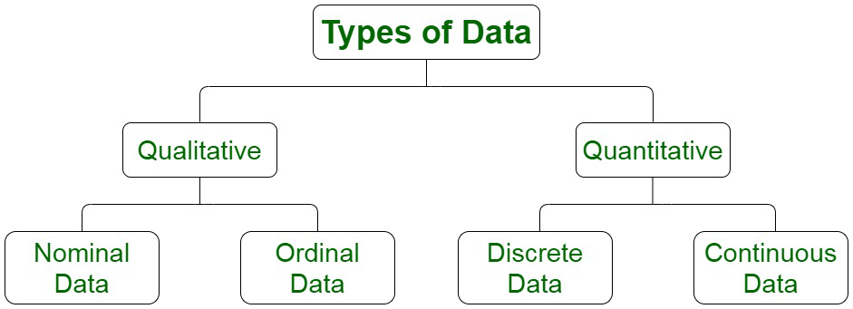
More Types of Data
Random Variable (RV)
Outcomes of random experiments
Interested in studying these, so we have to classify them as best as possible
Further Classification
Each data type (Qualitative and Quantitative) can further be divided into two distinct types
Important for determining what we can do with the data, how to describe, how to display
https://www.geeksforgeeks.org/explain-different-types-of-data-in-statistics/

Slide 9
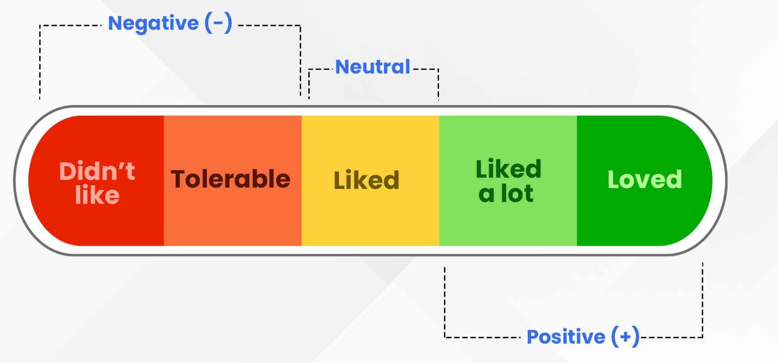
Qualitative Data Classification
The two below deal with Qualitative Random Variables.
Nominal Random Variable
Just categories, no order
Ex) Favorite color, yellow isn’t greater than blue
Lowest level of information
Ordinal Random Variable
Still categories, but there is an inherent (natural) order
Think rankings: 1st, 2nd, 3rd, …
Another example of an ordinal scale: Happiness - 1, 2, 3, 4, 5
https://www.voxco.com/blog/ordinal-data/

Slide 10
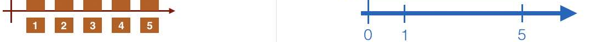
Quantitative Data Classification
These two deal with Quantitative Random Variables.
Discrete Random Variables
Have a finite number of possible values.
When thinking about Discrete RVs, think of numbers that are countable.
Examples - Number of doors on a car - Goals scored in a soccer season (24, 15, 3, etc)
Continuous Random Variables
Can take any number that is in a continuous interval.
When thinking about Continuous RVs, think of numbers that are measurable.
Examples - Time Spent on Quiz - Temperature Outside - Football Player Weight
https://prepnuggets.com/glossary/continuous-random-variable/

Slide 11
LCQ: Data Classification
Classify the following variables as either Qualitative or Quantitative.
If Quantitative, is it Discrete or Continuous?
If Qualitative, is it Nominal or Ordinal?
Time you woke up this morning:
Types of fruit:
Points scored in a single basketball game:
Age:
Class standing (freshman, sophomore, …):
Average points per game in basketball for a whole season:

Slide 12
LCQ: Data Classification
Classify the following variables as either Qualitative or Quantitative.
If Quantitative, is it Discrete or Continuous?
If Qualitative, is it Nominal or Ordinal?
Time you woke up this morning: Quantitative, continuous
Types of fruit: Qualitative, nominal
Points scored in a single basketball game: Quantitative, discrete
Age: Quantitative, continuous (but often reported as discrete)
Class standing (freshman, sophomore, …): Qualitative, ordinal
Average points per game in basketball for a whole season: Quantitative, continuous

Slide 13
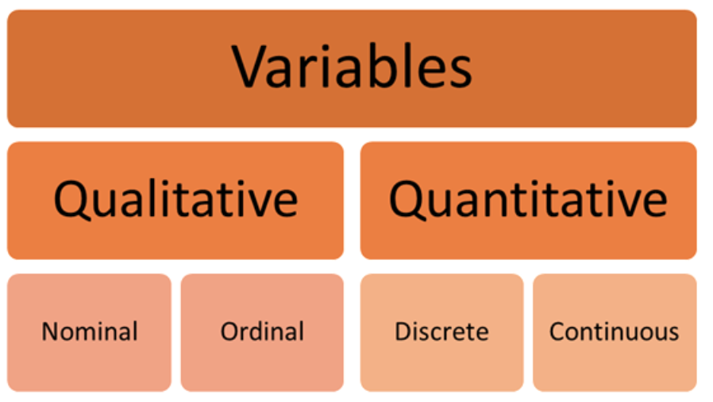
Summary of Data Types

Slide 14
Another LCQ: Data Classification
Classify the following variables as either Qualitative or Quantitative.
If Quantitative, is it Discrete or Continuous?
If Qualitative, is is Nominal or Ordinal?
Quality of a museum tour on scale 1 (poor) to 5 (great):
Population size of turtles in a country:
Temperature (Fahrenheit):
Car manufacturer (Toyato, Honda, etc.):
Starting time of class:
Cooking times of different meats:

Slide 15
Another LCQ: Data Classification
Classify the following variables as either Qualitative or Quantitative.
If Quantitative, is it Discrete or Continuous?
If Qualitative, is is Nominal or Ordinal?
Quality of a museum tour on scale 1 (poor) to 5 (great): Qualitative, ordinal
Population size of turtles in a country: Quantitative, discrete
Temperature (Fahrenheit): Quantitative, continuous
Car manufacturer (Toyato, Honda, etc.): Qualitative, nominal
Starting time of class: Quantitative, continuous
Cooking times of different meats: Quantitative, continuous

Slide 16
PROBLEM SESSION!!!!!!!!!!!

Slide 17
Problem #9
An automobile manufacturer wants to know what college students think about electric vehicles. They ask you to conduct a survey that asks students, “Do you think there will be more electric or gasoline powered vehicles on the road in 2025?” and “How likely are you to buy an electric vehicle in the next 10 years?” (scale of 1 = not at all likely to 5 = very likely).
Who are the individuals?
Name the variables & identify them as quantitative or categorical
Did the data come from a survey or experiment? And why?
Do you have any concerns about the data?

Slide 18
#9 Solution
Individuals - College students
There are 2 variables: Response to “Do you think….?” and Response to “Whether they’d purchase an electric vehicle”. Both are categorical.
Survey, just asking questions (observational) and NOT imposing a treatment
If the manufacture is trying to gauge market interest for electric vehicles, perhaps the audience of the survey isn’t the best. College students might not be able to afford electric vehicles soon. So maybe their responses aren’t the best indication for the manufacturer.

Slide 19
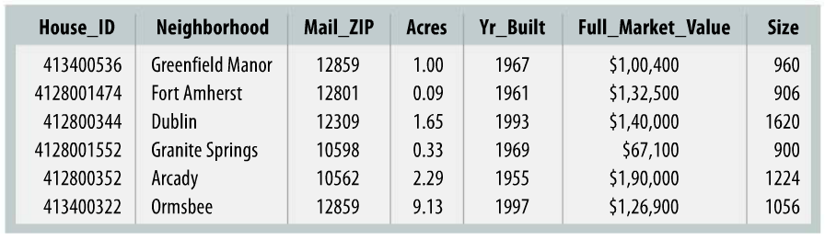
Problem #3
For each variable, would you describe it as primarily categorical, or quantitative? If quantitative, what are the units? If categorical, it is ordinal or simply nominal?

Slide 20
#3 solution
Describing variables
House_ID: categorical, nominal
Neighborhood: categorical, nominal
Mail_ZIP: categorical, nominal
Acres: quantitative, acres
Yr_Built: quantitative, years
Full_Market_Value: quantitative, dollars
Size: quantitative, square feet

Slide 21
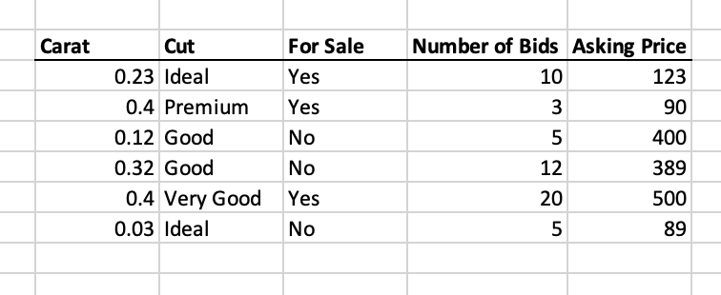
Problem #1
Here is a dataset about Diamonds. Classify each variable as Categorical or Quantitative
If Categorical, is it nominal or ordinal?
If Quantitative, discrete or continuous?

Slide 22
Problem #1 Solution
Here is a dataset about Diamonds. Classify each variable as Categorical or Quantitative
If Categorical, is it nominal or ordinal?
If Quantitative, discrete or continuous? Interval or ratio?
Carat: Quantitative, continuous
Cut: Categorical, ordinal
For Sale: Categorical, nominal
Number of bids: Quantitative, discrete
Asking Price: Quantitative, continuous

