Slide 1
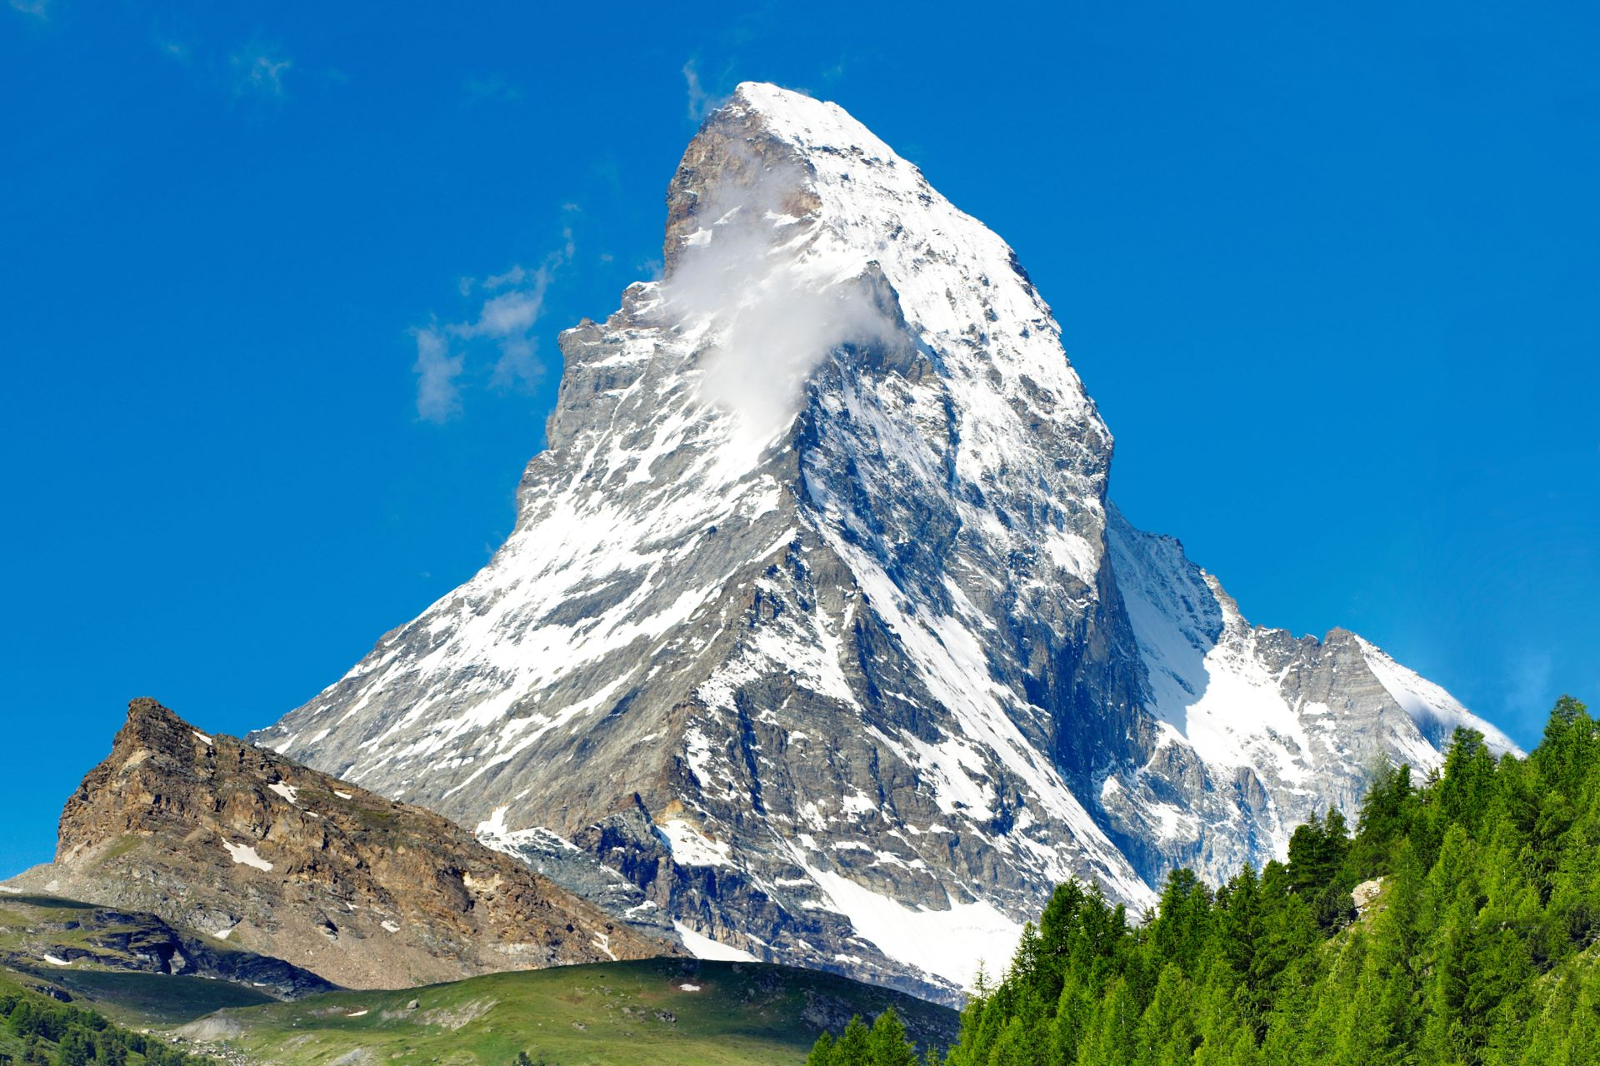
Sneak Peak!
Unit 2 and 3 Content

Slide 2
LCQ: Frequency Tables with Calc Help
GOAL: Enter and sort data!
Enter data in L₁: STAT → 1:Edit
12, 34, 50, 10, 11, 7, 8, 29, 30, 44, 21, 32, 30, 4, 28, 43, 12, 22, 38, 49
Sort data: STAT → 2:SortA(
Then find L₁ (2ND → 1). This sorts your list from smallest to largest
Then can go back into L₁ to view the sorted data set
Next Goal: Construct a Frequency Table!
Bin | Frequency | Relative Frequency
0-10
10-20
20-30
30-40
40-50
50-60
Total:

Slide 3
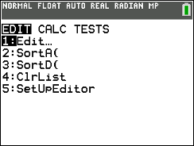
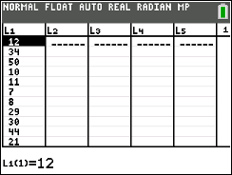
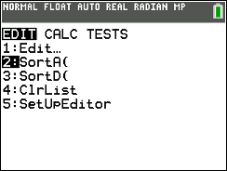
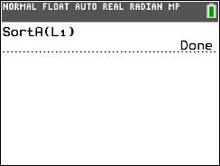
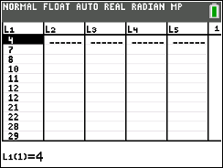
LCQ: Frequency Tables with Calc Help
Bin | Frequency | Relative Frequency
0-10 | 3 | 0.15
10-20 | 4 | 0.20
20-30 | 4 | 0.20
30-40 | 5 | 0.25
40-50 | 3 | 0.15
50-60 | 1 | 0.05
Total: | 20 | 1
GOAL: Enter and sort data!
Enter data in L₁: STAT → 1:Edit
12, 34, 50, 10, 11, 7, 8, 29, 30, 44, 21, 32, 30, 4, 28, 43, 12, 22, 38, 49
Sort data: STAT → 2:SortA(
Then find L₁ (2ND → 1). This sorts your list from smallest to largest
Then can go back into L₁ to view the sorted data set
Next Goal: Construct a Frequency Table!

Slide 4
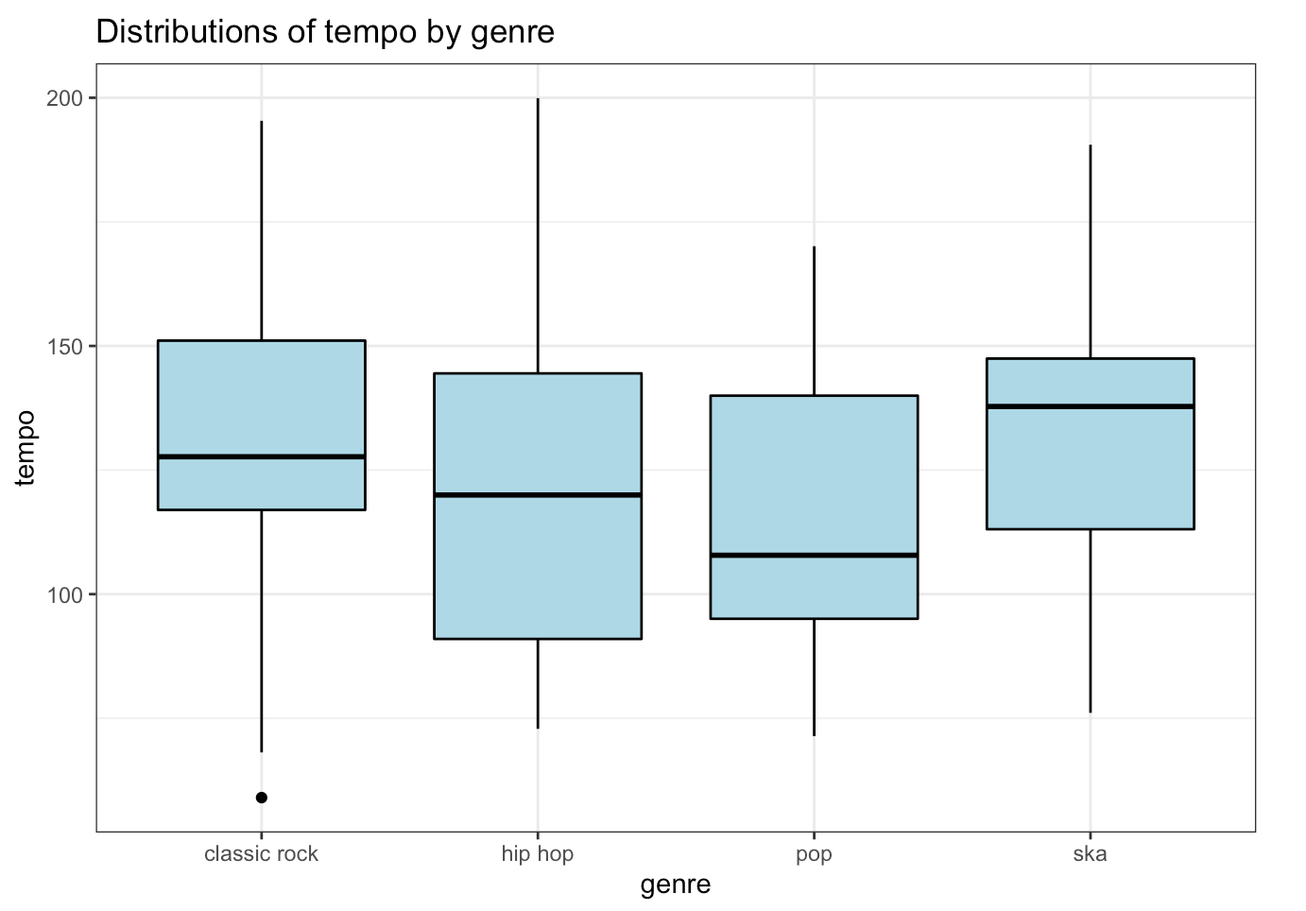
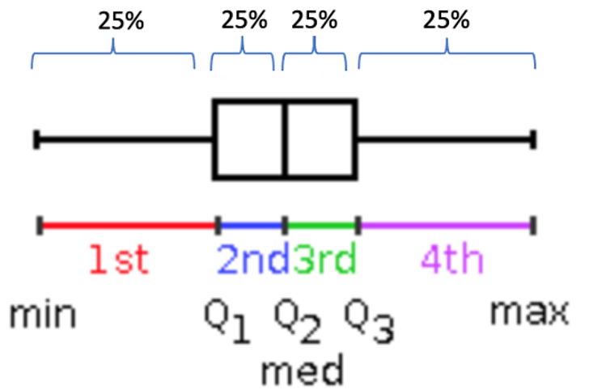
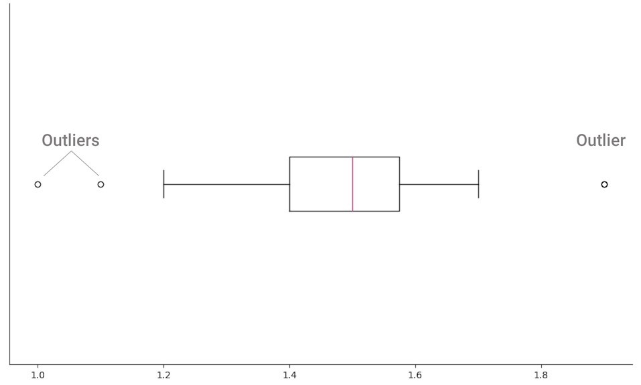
Boxplots
Boxplot (box and whisker)
Great display for quantitative data.
Shows summary information, not raw data.
Also shows outliers.
Splits data into quarters, called Quartiles.
Can see shape, but NOT modality!
How to Construct
Calculate the 5-number summary (min, Q1, median, Q3, max) and draw the shape.
Slight caveat when there is outliers…
Two Types of Boxplots
Both report 5-number summary information.
Only difference is if outliers are drawn separately.
Outliers are drawn with dots.
Fences are drawn at the next values that are NOT considered outliers!
We aren’t going to worry about how to we classify a point as an outlier, just eyeball from a histogram!
1,1,2,2,3,(Q1)3,4,4,5,5,(M=Q2)6,6,7,7,8,(Q3)8,9,9,10,10
https://towardsdatascience.com/create-and-customize-boxplots-with-pythons-matplotlib-to-get-lots-of-insights-from-your-data-d561c9883643

Slide 5



Two Types of Boxplots
“Advanced (modified) version” where outliers are separated
“Regular” version
How outliers look on histograms → few points separated from the majority of the data

Slide 6
Calculator Fun!!! Boxplot
GOAL: Make a Boxplot!
Enter raw data (20 observations):
38, 33, 5, 5, 47, 29, 24, 42, 3, 18, 30, 46, 25, 44, 40, 42, 39, 44, 29, 13
Set STAT PLOT: Boxplot.
Can do with outliers (the one with two dots) or without outliers.
ZOOM → 9:ZoomStat
This automatically zooms to whatever data range the stat plot requires
Graph and Trace!
This automatically computes the 5-number summary: Min, Q1, Med, Q3, Max in order to make the boxplot.
*** (Will learn what this is next week) Can confirm the results by doing STAT → (over one to CALC) → 1-Var Stats → Calculate → (scroll down)

Slide 7
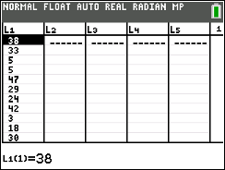
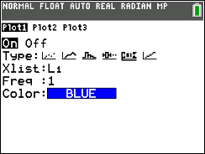
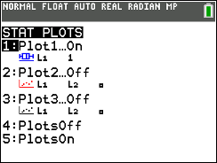
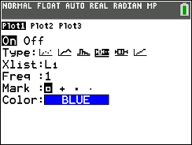

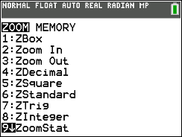
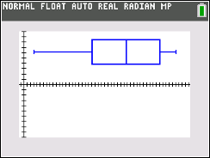
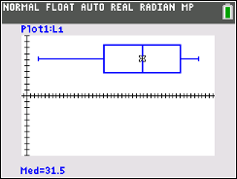
Calculator Fun!!! Boxplot
1)
GOAL: Make a Boxplot!
Enter raw data (20 observations):
38, 33, 5, 5, 47, 29, 24, 42, 3, 18, 30, 46, 25, 44, 40, 42, 39, 44, 29, 13
Set STAT PLOT: Boxplot.
Can do with outliers (the one with two dots) or without outliers.
** Can leave the option with outliers on and just use that from now on!
ZOOM → 9:ZoomStat
This automatically zooms to whatever data range the stat plot requires
Make sure to redo this step each time you enter new data and want to draw a new boxplot
Graph and Trace!
This automatically computes the 5-number summary: Min, Q1, Med, Q3, Max in order to make the boxplot.
*** (Will learn what this is next week) Can confirm the results by doing STAT → (over one to CALC) → 1-Var Stats → Calculate → (scroll down)
2)
Regular boxplot
Modified boxplot
3)
4)
There were no outliers in this dataset, so the regular and modified boxplots look the same
Trace lets you arrow over to each number in the boxplot and displays the value

Slide 8
Calculator Fun!!! Boxplot
Additional Demonstration
Lets add a new data point to see if it is classified as an outlier!
Add additional data point = 100 in L₁
Setting the STAT PLOT for the boxplot with outliers should already be done
We can leave this set so it is like our “default” option now
Now we will reset the Zoom
Remember we have to do this each time we make a new boxplot
Graph and Trace again!

Slide 9
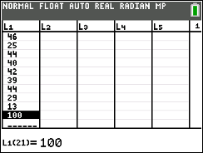
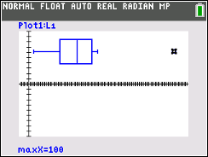
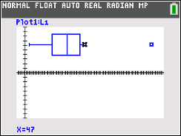
Calculator Fun!!! Boxplot
1)
Additional Demonstration
Lets add a new data point to see if it is classified as an outlier!
Add additional data point = 100 in L₁
Setting the STAT PLOT for the boxplot with outliers should already be done
We can leave this set so it is like our “default” option now
Now we will reset the Zoom
Remember we have to do this each time we make a new boxplot
Graph and Trace again!
2)
3)
4)
We see now that there is a point (100) that is drawn separately as an outlier!
And the previous maximum (47) is drawn as the right fence, indicating that it is the largest value NOT considered an outlier

Slide 10
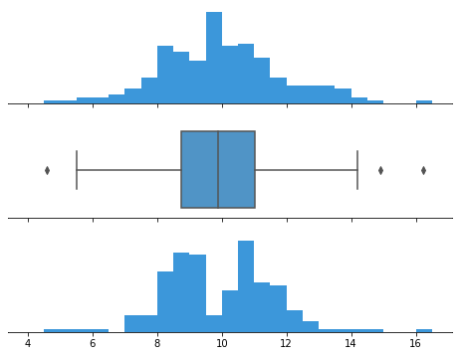
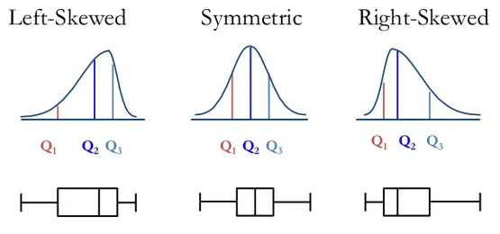
Other Visual Tools: Boxplots and Shape and Modality
CAN tell shape from a boxplot.
CANNOT tell modality from a boxplot.
https://www.simplypsychology.org/boxplots.html
https://chartio.com/learn/charts/box-plot-complete-guide/

Slide 11
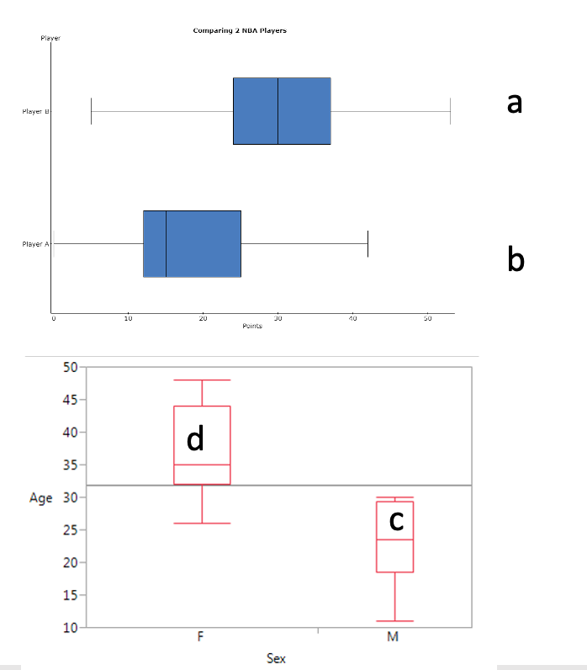
LCQ: Measures of Shape
Describe the SHAPE and MODALITY of each boxplot
a)
b)
c)
d)

Slide 12
LCQ: Measures of Shape
Describe the SHAPE and MODALITY of each boxplot
a) Roughly Symmetric
b) Right skewed
c) Left skewed → make sure to rotate the image correctly if that’s how you are going to look at it! Lower numbers need to be on the left and then increasing to the right. Then look at the shape
d) Skewed right

Slide 13
PROBLEM SESSION!!!!!!!!!!!

Slide 14
Problem #21
The five-number summary for the total revenue (in $M) of the top 100 movies of 2012 looks like this:
Sketch a boxplot and find the IQR and the Range
Min | Q1 | Med | Q3 | Max
28.8 | 44.9 | 64.1 | 123.0 | 623.4

Slide 15
Problem #21 Solution
Min | Q1 | Med | Q3 | Max
28.8 | 44.9 | 64.1 | 123.0 | 623.4
IQR = Q3 – Q1 = 123 – 44.9 = 78.1
Range = Max – Min = 623.4 – 28.8 = 594.6
(as much to scale as I could…)

Slide 16
Problem #13
As part of the marketing team at an Internet music site, you want to understand who your customers are. You send out a survey to 25 customers asking for demographic information. One of the variables is the customer’s age :
Construct a boxplot.
Does the boxplot nominate any outliers?
20 | 38 | 35 | 30 | 22 | 34 | 44 | 44 | 29 | 35 | 30 | 26 | 48
30 | 25 | 32 | 22 | 42 | 14 | 32 | 29 | 48 | 44 | 11 | 32

Slide 17

Problem #13 Solution
Boxplot
No outliers are present

Slide 18
Problem #17
The survey from Exercise 13 also asked the customers to say whether they were male or female.
Construct boxplots to compare the ages of men and women and write a sentence summarizing what you find.
Age | Sex | Age | Sex | Age | Sex | Age | Sex | Age | Sex | Age | Sex | Age | Sex
20 | M | 35 | F | 22 | M | 44 | F | 29 | M | 30 | M | 48 | F
30 | F | 32 | F | 42 | F | 32 | F | 48 | F | 11 | M | 44 | F
38 | F | 30 | M | 34 | F | 44 | F | 35 | F | 26 | F | 32 | F
25 | M | 22 | M | 14 | M | 29 | M

Slide 19
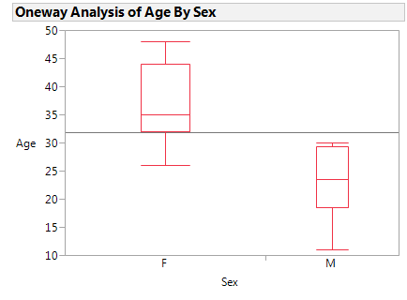
Problem #17 Solution
The females customers are much older than the male customers; more than 75% of the women are older than all of the all the men. Women have a median age of 35 compared to a median age of 23 for the men. No unusual values in either group. The range of ages for women is about 22 and the range for men is about 20.

Slide 20
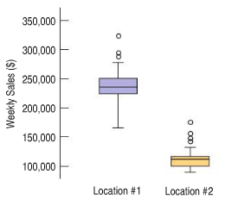
Problem #19
Here are boxplots of the weekly sales (in $US) over a two-year period for a regional food store for 2 locations. Location #1 is a metropolitan area that is known to be residential where shoppers walk to the store. Location #2 is a suburban area where shoppers drive to the store. Assume that the two towns have similar populations and that the two stores are similar in square footage. Write a brief report discussing what these data show.

Slide 21
Problem #19 Solution
Sales in Location #1 were higher than sales in Location #2 in nearly every week. However, there was much more variability in Location #1. Both distributions have outliers. The distribution for location #1 is roughly symmetric and for location #2 is right skewed. The company might want to compare other stores in locations like these to see if this phenomenon holds true for other locations.

Slide 22
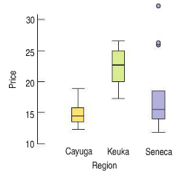
Problem #53
The boxplots display bottle prices (in dollars) of dry Riesling wines produced by vineyards along three of the Finger Lakes in upstate New York.
Which lake region produced the most expensive wine?
Which lake region produced the cheapest wine?
In which region were the wines generally more expensive?
Write a few sentences describing these prices.

Slide 23
Problem #53 Solution
The most expensive wine is produced in Seneca.
Cayuga and Seneca produce less expensive wines, with Cayuga producing the cheapest wines. Seneca has several high outliers.
The most expensive wines are typically produced in Keuka.
Cayuga Lake vineyards and Seneca Lake vineyards have approximately the same average price of about $15 per bottle, which a typical Keuka Lake vineyard has a price near $22. Keuka Lake vineyards have consistently high prices between about $18-$26 a bottle. Cayuga Lake vineyards have prices from $13-$19, and Seneca Lake vineyards have highly variable prices from $12 to over $30

