Slide 1

LAST CLASS!
Unit 10 – Forecasting
Your Final Professor Colton

Slide 2
Unit 10 - Outline
Forecasting
Time Series Review
Forecasting
Naïve Approach
Moving Averages
Exponential Smoothing

Slide 3
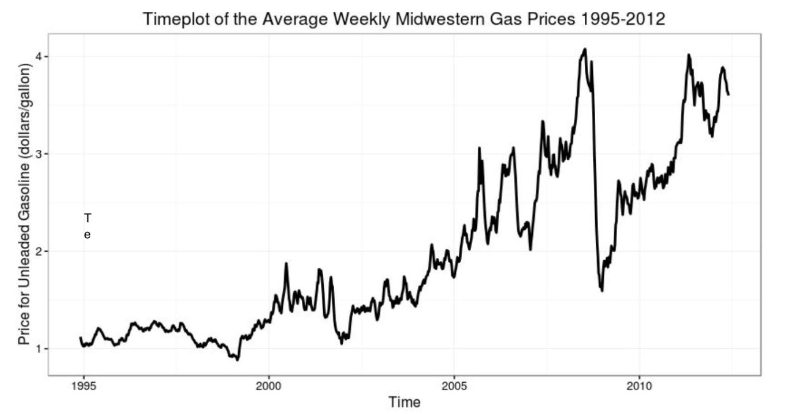
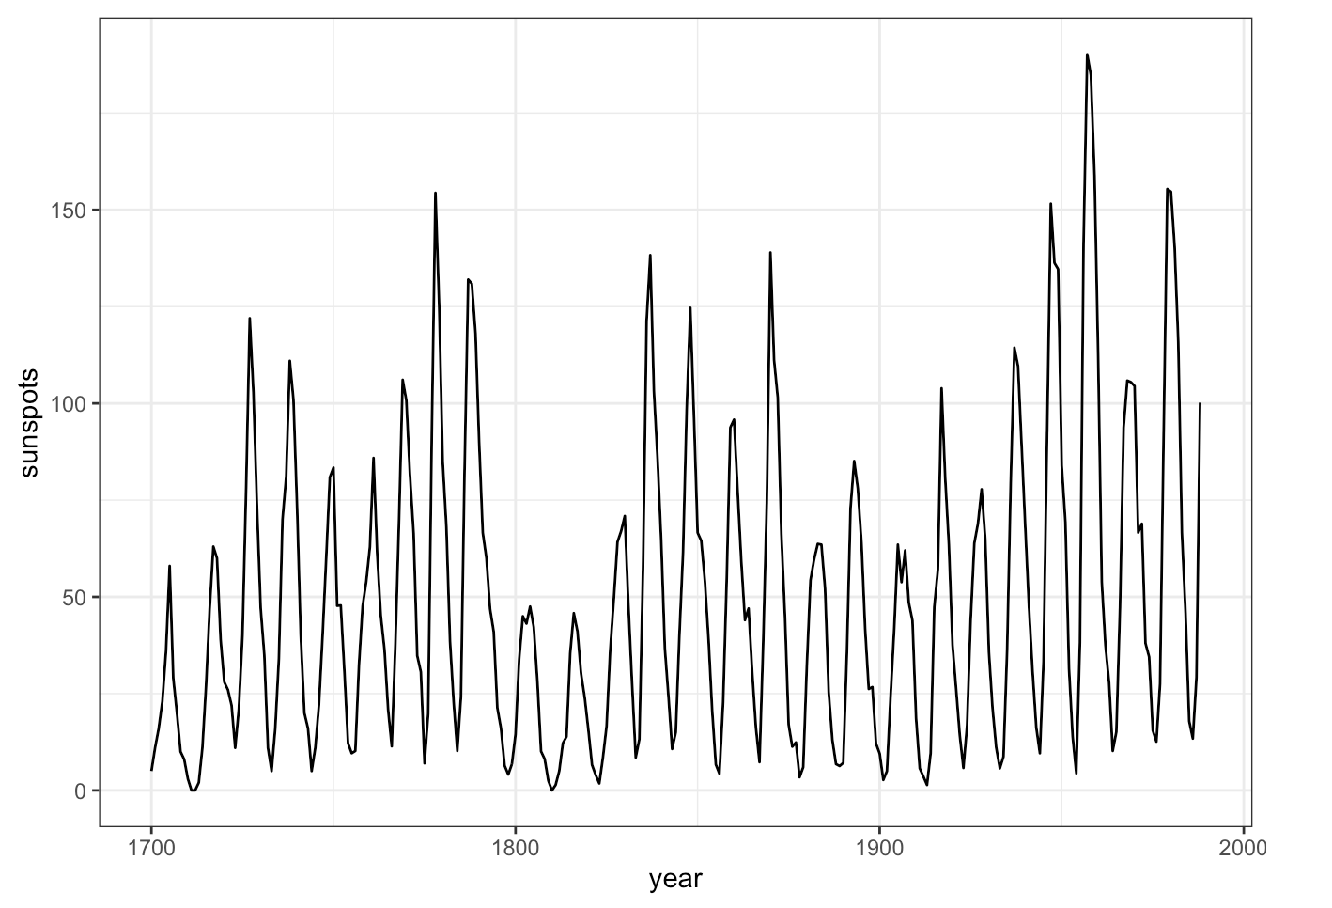
Review: Time Series Plots
Time Series Plot
Displays changes in a quantitative variable over time (aka time series data).
Time values on x-axis and values on y-axis.
Time is measured over equally spaced increments, e.g. days, months, years, etc.
Best way to see trends (long-term upwards or downwards) over time!
Also shows seasonal variation (cyclical pattern)!
This can be interpreted as change over time that has a regular pattern that repeats.
Examples: Hourly temperatures, monthly gym enrollment
How to Construct
Line graph (connect the dots) with time values on x-axis and values on y-axis.
https://wwwbis.sidc.be/silso/datafiles

Slide 4
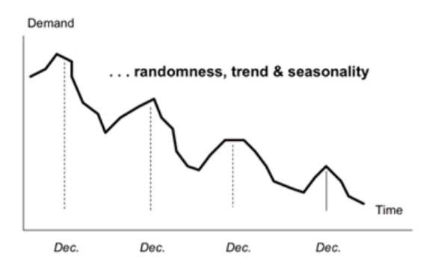
Components of Time Series
There are four components of time series we will consider:
Trend, is the gradual upward or downward movement of the data over time
Seasonality, a pattern that repeats itself after a period of days, weeks, months or quarters.
Cycles, patterns in the data that occur every several years
Random variation, are slight deviations in the data caused by chance and unusual situations. They do not follow an obvious pattern, so they cannot be predicted
Example
Setup:
The graph shows demand for some product or service (Y) measured monthly over four years (X = Time).
Observations:
There is a strong downward trend
A seasonal pattern that peaks around December and repeats itself every year
Small random up and downward that the than the trend and seasonality don’t account for
An example of a cycle would be if this pattern were to repeat every four years, perhaps coinciding with an election cycle or business cycle.

Slide 5
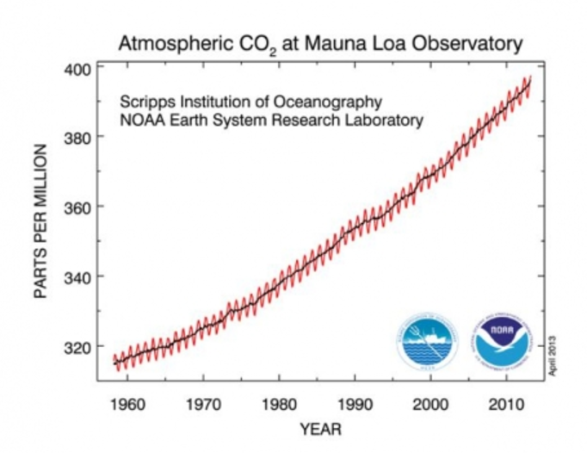

Forecasting
Example: If the time series is yearly and the current year is t = 2022, then t-1 = 2021 and t+1 = 2023
Overview
What we learned previously for predicting with Linear Regression won’t work on time series…
This is because the measurements are not independent
And we would be extrapolating (into the future), which was bad!
Therefore, we have techniques specifically used for time series, which we will only cover very briefly.
Although there are many ways we might analyze time series, we will be focusing on forecasting!
Predicting future values of a time series based on the values that have already occurred
Methods
There are three methods of forecasting we will use:
Naïve Approach
Moving Averages
Exponential Smoothing
 | Time | Demand
Past | t-3 | Y_{(t-3)}
 | t-2 | Y_{(t-2)}
 | t-1 | Y_{(t-1)}
Current | t | Y_{(t)}
Future | t+1 | Y_{(t+1)} = ??
 | t+2 | Y_{(t+2)} = ??
Lin Reg Method: $\hat{CO2}=a+b(1990)$

Slide 6
Naïve Approach
 | Time | Demand
Past | t-3 | Y_{(t-3)}
 | t-2 | Y_{(t-2)}
 | t-1 | Y_{(t-1)}
Current | t | Y_{(t)}
Future | t+1 | Y_{(t+1)} = Y_{(t)}
 | t+2 | Y_{(t+2)} = Y_{(t)}
Overview
The “Naïve approach” is by far the easiest way to forecast
If we want to estimate the next value of a time series, naturally we could use is the last value of the time series
If we want to forecast more values, we can also use the last recorded value
In a business context, all we do is simply assume that demand in the next period will be the SAME as the most recent period
Example
If a Chipotle location sells 60,000 burritos in a month, using the naive approach we forecast that 60,000 burritos will be sold in the next month.
And the following month we would predict 60,000 burritos again, and so on…
Interestingly, this method works for certain products, but one major problem with this approach is that it lacks sophistication needed for more complex situations because it does not take trend, seasonality or cycles into account
Month | Burritos
1 | 55000
2 | 62000
3 | 60000
4 | 60000
5 | 60000
All forecasts beyond 2012

Slide 7
Moving (rolling) Averages
 | Moving Average, MA(2)
 | Time | Demand
Past | t-3 | Y_{(t-3)}
 | t-2 | Y_{(t-2)}
 | t-1 | Y_{(t-1)}
Current | t | Y_{(t)}
Future | t+1 | Y_{(t+1)} = (Y_{(t-1)} + Y_{(t)}) / 2
 | t+2 | Y_{(t+2)} = (Y_{(t)} + Y_{(t+1)}) / 2
Overview
Moving average is a slightly more sophisticated approach to forecasting than using the naïve approach
The idea is to predict the next value by using the average of the last few observations.
So we are using recent past data (actual observed data) to generate the forecast for the next time period, t+1
Technique
We simply specify how many past observations to use each time and calculate the average
Lets say the number of past obs to use is n. Then the average is the sum of the n most recent values divided by n.
This description can be summarized with the notation MA(n)
This result is the new prediction!
We can continue to forecast as many future values as we want, each time using the new most recent n values (whether they be actual or predicted)
Or as time passes, we can continually make predictions for the next time period using the newest most recent n values
We can think of this as a rolling (moving) average!
NOTE: This is a general description of how calculate the forecast for a moving average, but it makes way more sense when actually looking at an example

Slide 8
LCQ: Moving Averages
Setup: The actual sales of a particular type of dishwasher in the United States are listed in the table below. Use a 3-month moving average to forecast sales in period 4 through 12.
Period | Sales (Actual) | Sales (Forecast - 3 month moving average)
1 | 1550
2 | 2000
3 | 3500
4 | 1000
5 | 2100
6 | 4000
7 | 2400
8 | 3200
9 | 1200
10 | 600
11 | 4200
12 | 2600

Slide 9
LCQ: Moving Averages
Setup: The actual sales of a particular type of dishwasher in the United States are listed in the table below. Use a 3-month moving average to forecast sales in period 4 through 12.
NOTES:
Notation: 3 month Moving Average = MA(3)
We need 3 months of data before we can make a prediction, so the first three forecast rows are blank
We always use the MOST RECENT n = 3 months if forecasting using MA(3)
Can think of this as a “sliding window” and we average only those past observations
BE CAREFUL not to use the current periods data in it’s own prediction
Ex) If we are predicting for time period 5, Sales for t = 5 is unknown
So we shouldn’t use 2100 in the average calculation, only data for t = 2, 3, 4
Period | Sales (Actual) | Sales (Forecast - 3 month moving average)
1 | 1550
2 | 2000
3 | 3500
4 | 1000 | (1550+2000+3500) / 3 = 2350
5 | 2100 | (2000+3500+1000) / 3 = 2166.67
6 | 4000 | (3500+1000+2100) / 3 = 2200
7 | 2400 | (1000+2100+4000) / 3 = 2366.67
8 | 3200 | (2100+4000+2400) / 3 = 2833.33
9 | 1200 | (4000+2400+3200) / 3 = 3200
10 | 600 | (2400+3200+1200) / 3 = 2266.67
11 | 4200 | (3200+1200+600) / 3 = 1666.67
12 | 2600 | (1200+600+4200) / 3 = 2000

Slide 10
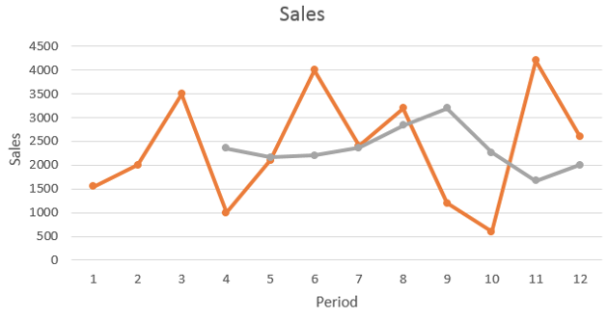
Moving Average – Final Points
Observations
Here is a plot of the actual sales and forecasts from the previous example:
Notice that there is less variation in the predicted values than the actual values, which is good for forecasting.
This is because three-month moving average smooths out the variability in the sales
Actual Sales
Moving Average Forecasts
Advantages of MA
Moving averages are effective in smoothing out sudden fluctuations in the demand to provide stable estimates
Disadvantages / Limitations of MA
As n, the number of periods used in the average increases, the moving average becomes less variable but also becomes less sensitive to changes in the data
Moving averages do not pick up trends very well
Since they are averages, the forecasts will stay within the minimum and maximum and not predict changes to either higher or lower levels.
They lag the actual values.
Moving averages require extensive records of past data, which may not always be available

Slide 11
Exponential Smoothing
Overview
Exponential smoothing is a method of weighted moving averages which does not require extensive data from the past.
It is only necessary to have the previous period’s forecast value (which can be a mere guess) and the previous period’s realized value.
A disadvantage is that we cannot forecast more than one period into the future as we need the realized value of the previous period.
Formula
The basic formula for exponential smoothing is:
Concept
The idea of exponential smoothing is that the next value will be previous forecast plus some fraction of the difference between the previous forecast and the realized value.
In other words, new forecast = previous forecast + the (adjusted) realized error in previous forecast
New forecast = Last period's forecast + α (Last period's actual demand – Last period's forecast),
where 0 ≤ α ≤ 1 → α is a weight, or smoothing constant, chosen by the forecaster

Slide 12
LCQ: Exponential Smoothing
Setup: Sales of a popular car have grown steadily at Buckeye Auto over the past 6 years. The sales manager predicted before the new model was introduced that first year sales would be 500. Use exponential smoothing with a weight of 𝛼 = 0.1 and 𝛼 = 0.5 to forecast sales for years 2 through 6.
New forecast = Last period's forecast + α (Last period's actual demand – Last period's forecast),
where 0 ≤ α ≤ 1 → α is a weight, or smoothing constant, chosen by the forecaster
Year | Sales (Actual) | Forecast (𝛼 = 0.1) | Forecast (𝛼 = 0.5)
1 | 460 | 500 (Initial Guess) | 500 (Initial Guess)
2 | 495
3 | 518
4 | 563
5 | 584
6 | 600

Slide 13
LCQ: Exponential Smoothing
Setup: Sales of a popular car have grown steadily at Buckeye Auto over the past 6 years. The sales manager predicted before the new model was introduced that first year sales would be 500. Use exponential smoothing with a weight of 𝛼 = 0.1 and 𝛼 = 0.5 to forecast sales for years 2 through 6.
New forecast = Last period's forecast + α (Last period's actual demand – Last period's forecast),
where 0 ≤ α ≤ 1 → α is a weight, or smoothing constant, chosen by the forecaster
NOTE: I rounded the Forecasts before doing the next calculations
Year | Sales (Actual) | Forecast (𝛼 = 0.1) | Forecast (𝛼 = 0.5)
1 | 460 | 500 (Initial Guess) | 500 (Initial Guess)
2 | 495 | 500 + 0.1(460-500) = 496 | 500 + 0.5(460-500) = 480
3 | 518 | 496 + 0.1(495-496) = 496 | 480 + 0.5(518 495-480) = 488
4 | 563 | 496 + 0.1(518-496) = 498 | 488 + 0.5(518-488) = 503
5 | 584 | 498 + 0.1(563-498) = 505 | 503 + 0.5(563-503) = 533
6 | 600 | 505 + 0.1(584-505) = 513 | 533 + 0.5(584-533) = 559
NOTES:
We are ALWAYS using ONLY the row directly above to make the forecasts!!
BE CAREFUL to not use the current year’s sales in its own prediction!! It is unknown when we are predicting it
Ex) When year 1 ends, we use that data to predict Year 2 sales. At this time, we don’t know what Year 2 sales will be
Another way to think of formula: New Forecast = Previous Forecast + 𝛼 (Previous Forecast – Previous Actual Sales)

Slide 14
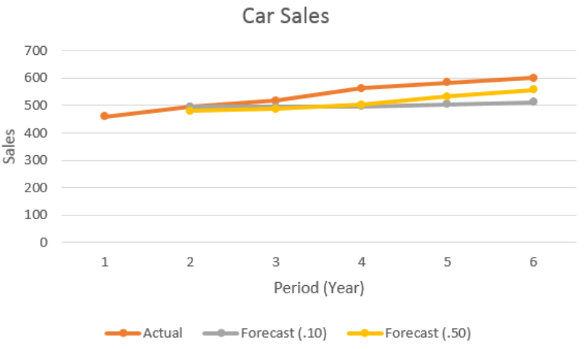
Exponential Smoothing – Final Points
Observations
Here is a plot of the actual sales and forecasts from the previous example:
Note that both exponential smoothing forecasts start close to the actual sales, then the one with a smoothing constant = 0.5 stays closer in later years
Although both underestimate the upward trend
Remarks about 𝛼
The smoothing constant α will typically be between .05 and .50 for business applications.
The researcher gets to choose this value
If we want to give more weight to recent data, we choose a higher value for α (this makes it easier to detect trends, as seen in the example).
However, if we want to give more weight to past data (and previous forecasts), we choose a lower value for α.
In the extreme, when α is 1, all of the weight is on the recent data and the forecast becomes identical to the naive model.
In other words, the forecast for the next period is just the same as this period's demand (we can see why this is the case if we look back at the formula!).
In general, high values of α are chosen when the underlying average is likely to change, and low values of α are chosen when the underlying average is pretty stable.

