Slide 1

Almost to the more fun parts!
Unit 2 – Graphical Summaries, Day 2
Your Ahead-of-the-game Professor Colton

Slide 2
LU 2, Day 2 - Outline
Graphs for Categorical Data
Frequency Tables for Categorical Variables
Pie Charts
Bar Graphs
Pareto Chars
Pictograms
Key Elements to a Good Graph

Slide 3
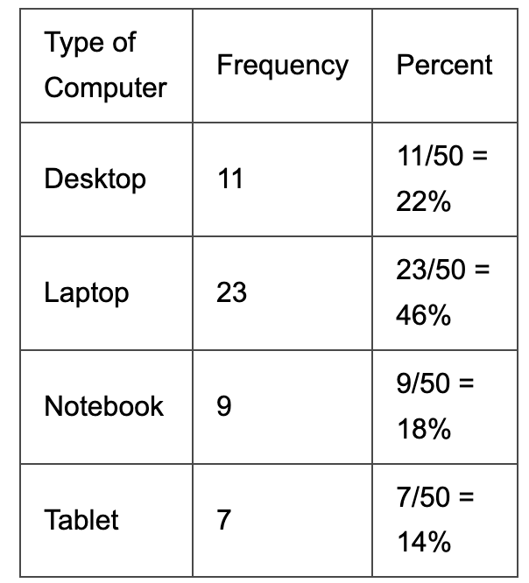
Frequency Tables for Categorical Variables
Example: Computer Sales
The following table summarizes the type of computer sold to the last 50 customers at a computer retailer.
The variable being studied, type of computer, is categorical because the values of the variable are categories (desktop, laptop, notebook, and tablet).
To visually summarize the distribution of a categorical variable, there are two main types of graphs that can be drawn.
Pie charts and Bar graphs.

Slide 4
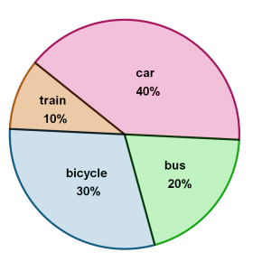
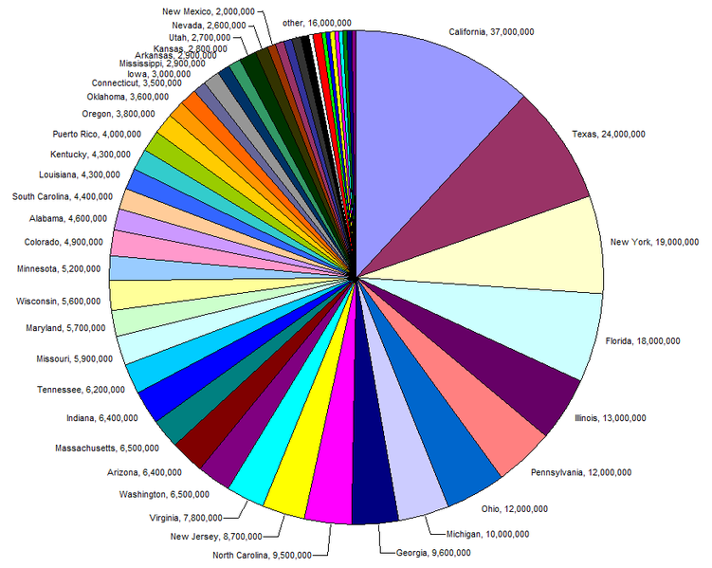
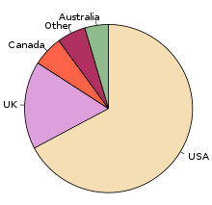
Pie Charts
https://www.mathemania.com/lesson/pie-chart/
Pie Chart
Shows one qualitative variable.
Separates parts of a whole into categories.
Each piece displays the category, the proportion, and usually the amount.
The parts should all add up to 100%.
Advantage
Simple and common.
Disadvantage
Harder to compare area than heights!
Not helpful when there are lots of categories!
Can make an ‘Other’ category and combine ones with smaller proportions, but be careful!
https://commons.wikimedia.org/wiki/File:Pie_chart_of_US_population_by_state.png
https://en.wikipedia.org/wiki/Pie_chart

Slide 5
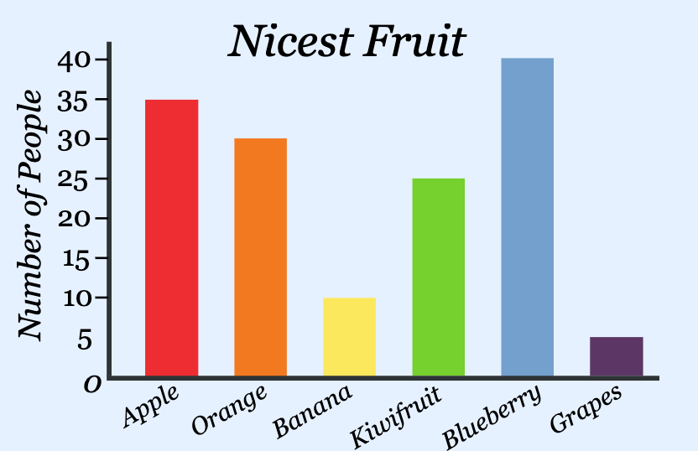
Bar Graphs
Bar Graph
Shows one qualitative variable.
Simple and common and easy to read!
Shows differences in frequencies well and the mode (most common group) well!
Features
Plots vertical bar for each category.
Height is the frequency or relative frequency.
Sum of the heights equals the sample size.
Differences from a Histogram
GAPS between bars.
X-axis is NOT a number scale, so this makes sense
SHAPE is NOT a thing with bar graphs.
Order of categories is MEANINGLESS.
Appearances obviously will change as reorder cats.
https://www.mathsisfun.com/data/bar-graphs.html

Slide 6
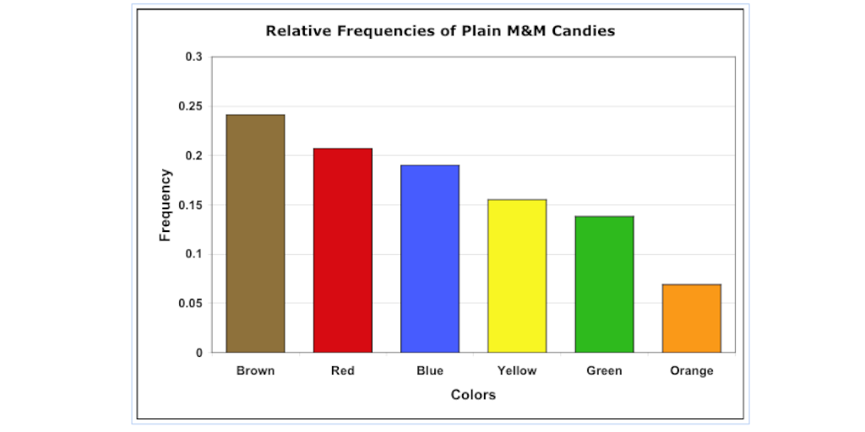
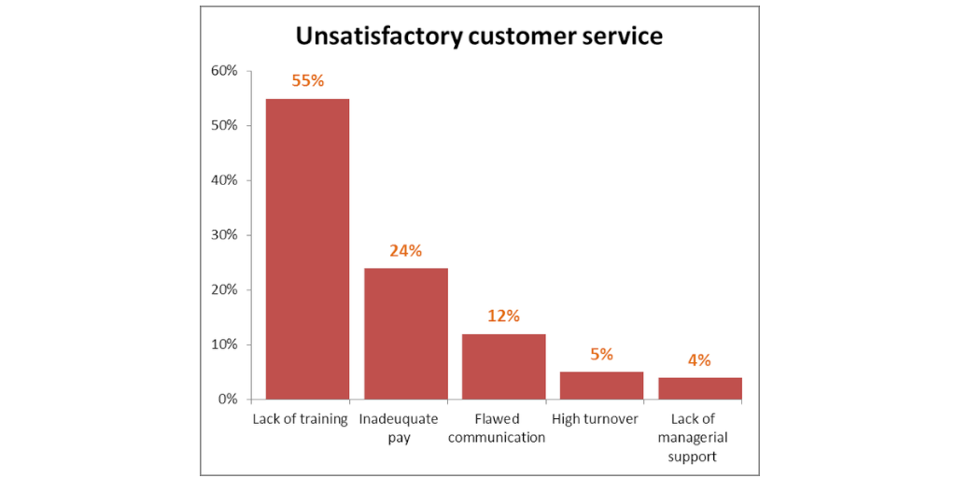
Pareto Charts
Pareto Chart
Just a bar graph with the categories arranged in decreasing order!
Tallest (largest frequency) on the left and then the next tallest to the right and so on…
Shows which categories / areas are more important.
https://www.process.st/pareto-chart/

Slide 7
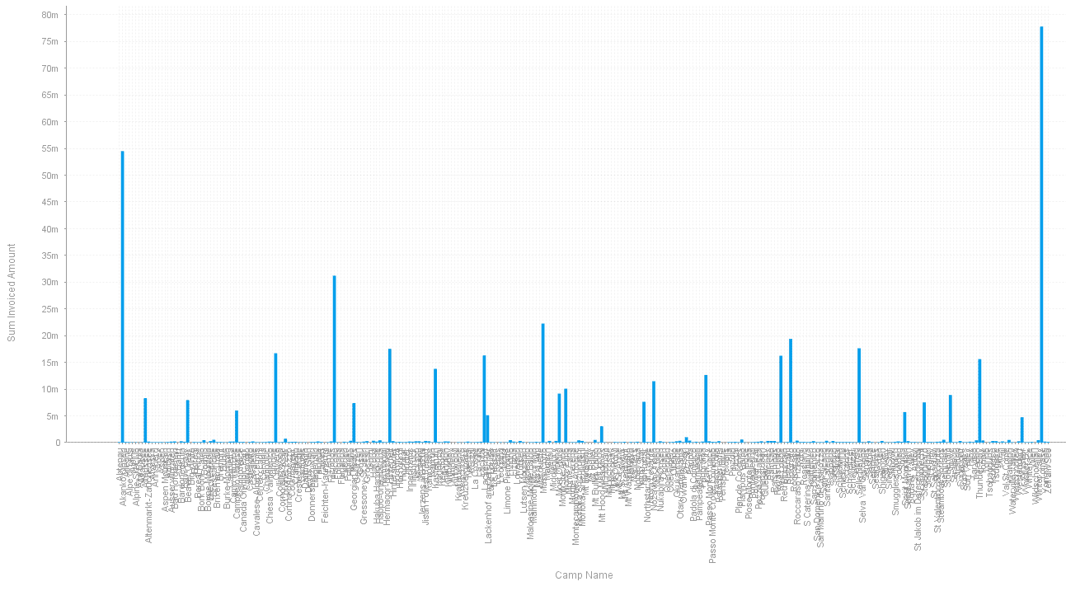
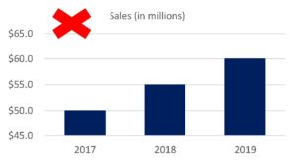
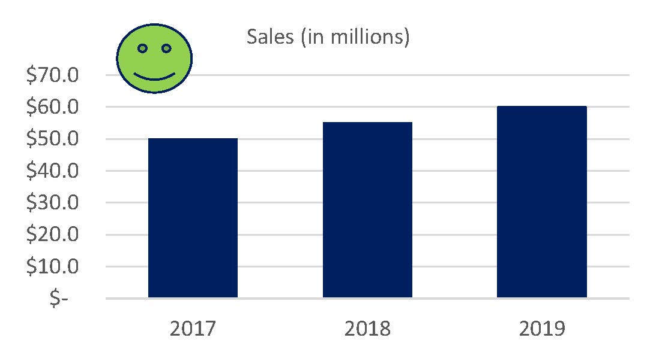
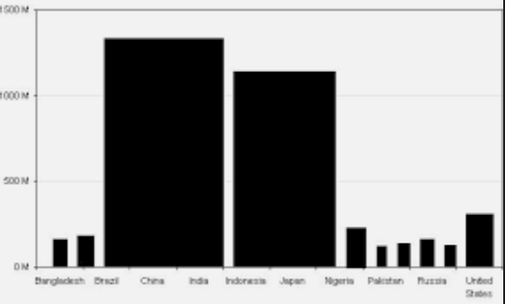
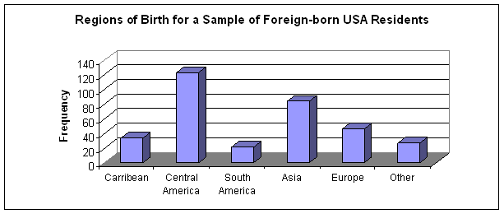
Bad Bar Graphs
Bad Bar Graphs
Too many cats
Misleading Bar Graphs
Very common….
Examples:
Truncating
Unnecessary modifications
http://www.deepdive.co.za/index.php/item/28-solved-charts-displaying-too-many-categories.html
https://www.redw.com/blog/2020/01/27/an-introduction-to-misleading-charts-when-good-data-is-plotted-badly/
https://www2.southeastern.edu/Academics/Faculty/dgurney/Math241/StatTopics/GraphGuide2.htm
https://www.pinterest.com/pin/766526799056875028/

Slide 8
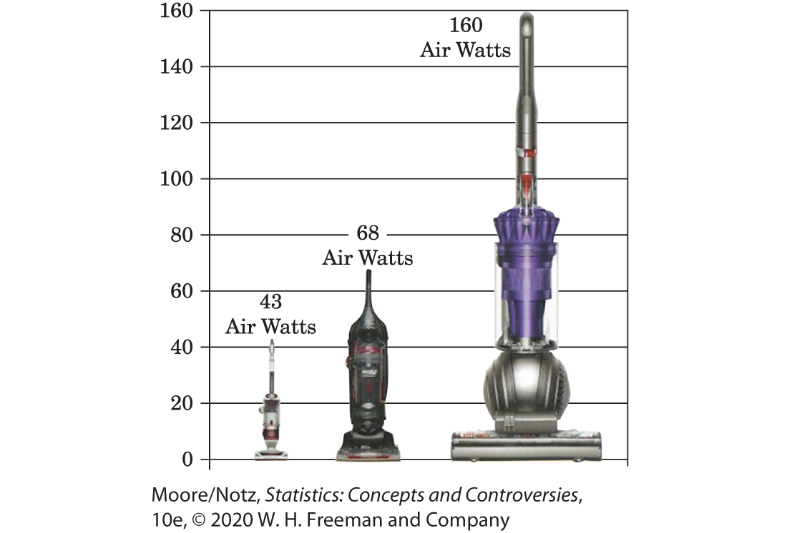
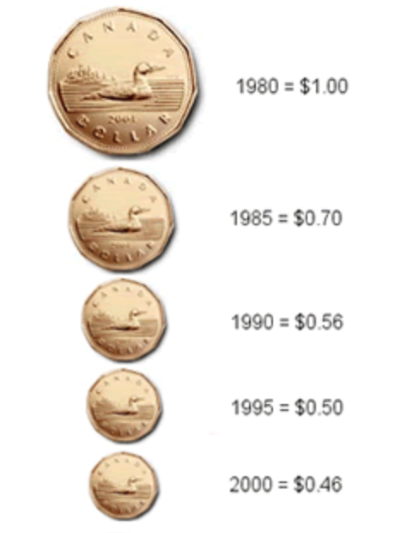
Pictograms
Pictograms
The pictogram replaces the bars of the bar graph with pictures to provide visual interest.
However, since both the height and width change, the viewer focuses on the area of the picture which can be misleading.
This violates the area principle
For this reason, we typically approach the pictogram with caution (i.e. don’t make them).
Canadian Coins
By the numbers, the value of the Canadian dollar is in 1980 ($1.00) is double of 1995 ($0.50).
By the looks, the 1980 coin is roughly 4 times larger than the 1995.
Very misleading.

Slide 9
Key Elements to a Good Graph
Use Labels and Legends
Label axes, give units, provide source of data.
Make Data Stand Out
Don’t add too much clutter.
Pay Attention to What the Eye Sees
Avoid pictograms, pay attention to scales.

Slide 10
PROBLEM SESSION!!!!!!!!!!!

Slide 11
Problem #1
As part of the human resource group of your company you are asked to summarize the educational levels of the 512 employees in your division. From company records you find that 164 have no college degree (None), 42 have an associate’s degree (AA), 225 have a bachelor’s degree (BA), 52 have a master’s degree (MA), and 29 have PhDs. For the educational level of your division:
Make a frequency table.
Make a relative frequency table.

Slide 12
Problem #3
As part of the human resource group of your company you are asked to summarize the educational levels of the 512 employees in your division. From company records you find that 164 have no college degree (None), 42 have an associate’s degree (AA), 225 have a bachelor’s degree (BA), 52 have a master’s degree (MA), and 29 have PhDs. For the educational level of your division:
Make a bar chart using counts on the y-axis.
Make a relative frequency bar chart using percentages on the y-axis.
Make a pie chart.

Slide 13
Problem #5
As part of the human resource group of your company you are asked to summarize the educational levels of the 512 employees in your division. From company records you find that 164 have no college degree (None), 42 have an associate’s degree (AA), 225 have a bachelor’s degree (BA), 52 have a master’s degree (MA), and 29 have PhDs. For the educational level of your division:
Write two to four sentences summarizing the distribution.
What conclusions, if any, could you make about the educational level at other companies?

Slide 14
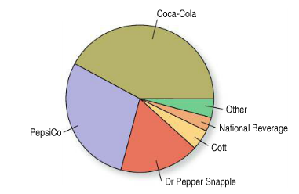
Problem #15
An article in The Wall Street Journal (March 18, 2011) reported the 2010 U.S. market share of leading sellers of carbonated soft drinks, summarized in the following pie chart:
Is this an appropriate display for these data?
Which company had the largest share of the market?

Slide 15
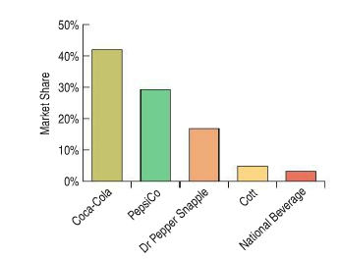
Problem #17
An article in The Wall Street Journal (March 18, 2011) reported the 2010 U.S. market share of leading sellers of carbonated soft drinks, summarized in the following bar chart:
Compared to the pie chart, which is better for displaying the relative portions of market share?
What is missing from this display that might make it somewhat misleading?

Slide 16
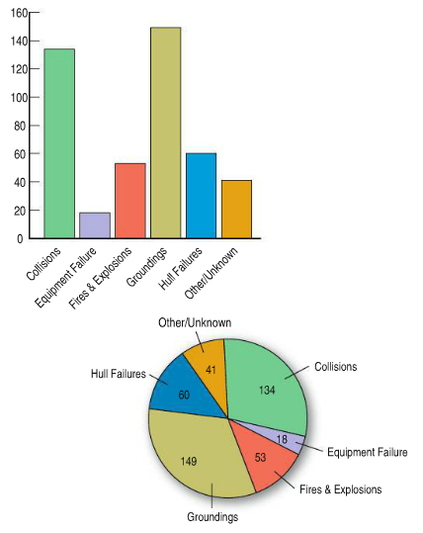
Problem #25
Data from the International Tanker Owners Pollution Federation Limited (www.itopf.com) gives the cause of spillage for 455 large oil tanker accidents from 1970 to 2012. Write a brief report interpreting what the displays show. Is a pie chart an appropriate display for these data? Why or why not?

