Slide 1

LETS GOOOOOOO DUKE!!!!!
Unit 8 – Hypothesis Testing
Your Corrected Professor Colton

Slide 2
Unit 8 - Outline
Unit 8 – Hypothesis Testing
Intro
8.2 Hypothesis Testing Overview
Determine Ho and Ha
Traditional Method: Critical Value, Test Statistic, Conclusion
P-value Method
8.3 Hypothesis Testing for Population Proportions
Determine Ho and Ha
Traditional Method: Critical Value Z, Test Statistic, Conclusion
Examples
P-value Method

Slide 3
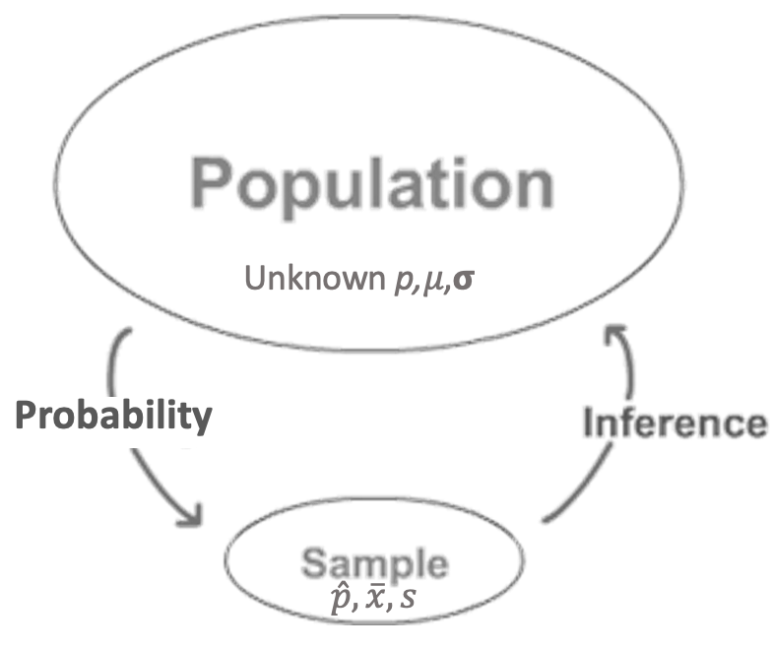
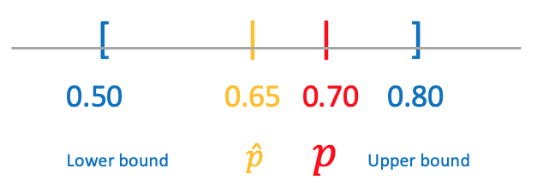
Inference! Our Second Look
Confidence Intervals
What’s next??

Slide 4
Intro to Hypothesis Tests
Testing a Claim
A company is criticized because only 13 of 43 people in executive-level positions are women. The company explains that although this proportion is lower than one might wish, it’s not surprising given that only 40% of their employees are women. What do you think?
This is a big claim!
Is there actually enough evidence to back this up?
Is the sample proportion 13/43 = 0.32 strange enough????
What if it was 30/43?? Or 3/43???
Compare this type of question to where we have been:
Estimating a Parameter
Estimate the proportion of female employees at this company with a confidence interval.

Slide 5
Logic Behind Hypothesis Testing
We believe something about a population
The Null Hypothesis (H₀)
Ex) 40% of the company employees are women, so 40% of the executives should also be women
We want to determine if something else is true
The Alternative Hypothesis (H_{A})
Ex) Less than 40% of the executives are women
We use sample data to make a decision / conclusion
Compute the Test Statistic (TS)
Ex) 13 out of the 43 executives are women, use this to find the TS
And then determine if we will continue to believe the null hypothesis or will reject it in favor of the alternative hypothesis.
Enough evidence?
How far must the sample statistic be from the hypothesized parameter?
This is set before running the test and depends on the the significance level α

Slide 6
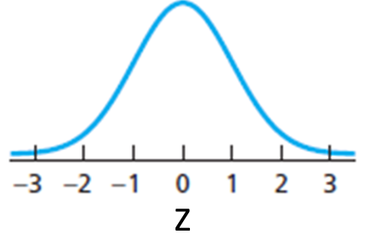
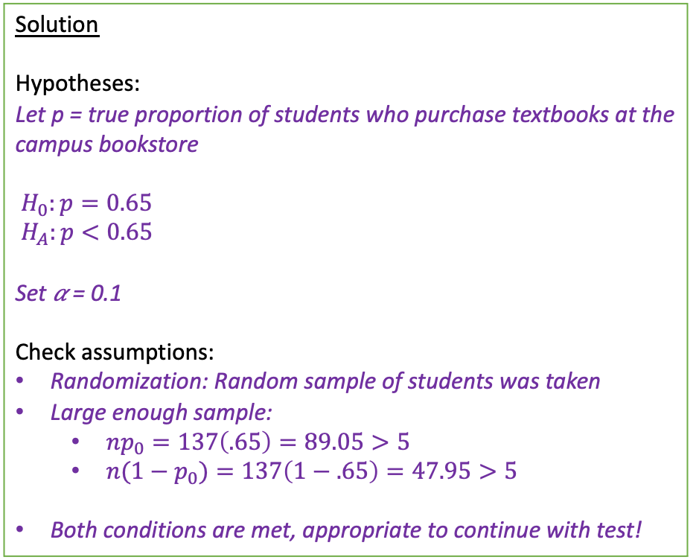
Full Problem
Here is an entire hypothesis problem worked out perfectly to show us where we are going!
Then we will break it down piece by piece!
Setup: The campus bookstore is determining if they need to increase their marketing budget. They would like at least 65% of students to buy their textbooks directly from them rather than off-campus stores. In order to check this, they took a random sample of 137 students in which 81 students said they buy their books at the campus bookstore.
Is there sufficient evidence to conclude that the proportion of students who purchase their books is less than 0.65? Test this at the 10% significance level.
Solution
Hypotheses:
Let p = true proportion of students who purchase textbooks at the campus bookstore
$H_{0}:p=0.65$
$H_{A}:p<0.65$
Set 𝛼 = 0.1
Check assumptions:
Randomization: Random sample of students was taken
Large enough sample:
$np_{0}=137\left(.65\right)=89.05>5$
$n(1−p_{0})=137\left(1−.65\right)=47.95>5$
Both conditions are met, appropriate to continue with test!
Rejection Region:
Z* = invNorm(area = 0.1, 𝜇 = 0, 𝞂 = 1) = -1.28
Test Statistic:
TS = Z_{stat} = 1-PropZTest(p₀ = 0.65, x = 81, n = 137, prop < p₀) = -1.44
Z_{stat} = -1.44 < -1.28 = Z* → Reject H₀!
Conclusion:
Because our Test Statistic Z_{stat} = -1.44 is less than the Critical Value Z*= -1.28 (10% significance level), we reject the Null hypothesis. We have sufficient evidence to conclude that the true proportion of students who buy their textbooks at the campus bookstore is less than 0.65.
The marketing team should increase their budget to reach their target percent of students.
𝛼 = 0.1
Z_{stat}
Z*

Slide 7
Hypothesis Test Steps – This is Your Life Now…
State the Hypotheses
Define parameter + context.
Check Assumptions.
Determine and Sketch Rejection Region based of Significance Level
Compute value of Test Statistic / P-value.
Conclude and Interpret
State whether you reject H₀ or fail to reject H₀ AND WHY!
Interpret your results in the context of the problem

Slide 8
The Hypothesis Statements
State the Hypotheses
Define parameter + context.
Full Example
Is there sufficient evidence to conclude that the proportion of students who purchase their books is less than 0.65?
(Parameter):
Let p = true proportion of students who purchase textbooks at the campus bookstore
Define Parameter
Always define your parameter at the start!
This helps orient us with the context of the problem and sets us up to correctly write our hypothesis statements
Think about the variable / quantity of interest!
Categorical (“success” and “failure”) → population proportion (p)
Quantitative (numeric) → population mean 𝜇
More Examples:
Let p = population proportion of students is statistics courses
Let 𝜇 = true height of oak trees in meters

Slide 9
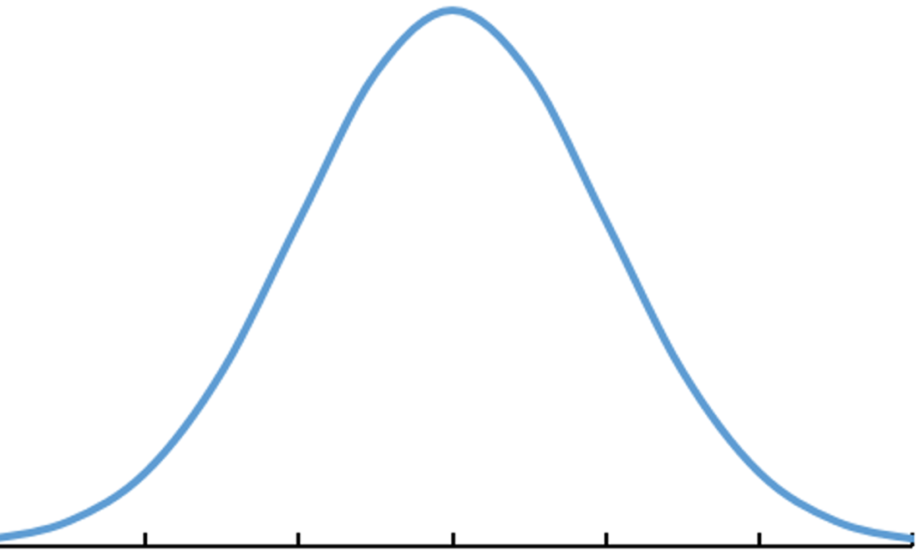
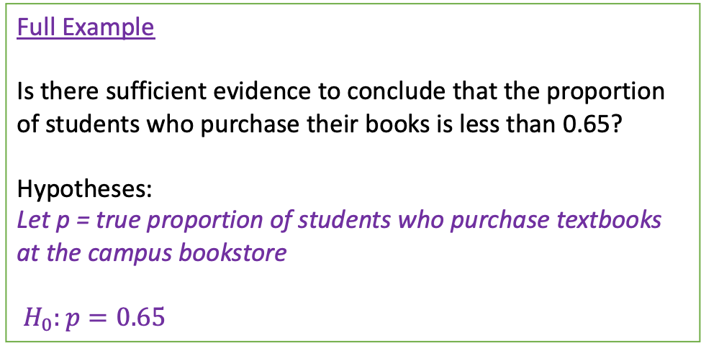
The Hypothesis Statements
Full Example
Is there sufficient evidence to conclude that the proportion of students who purchase their books is less than 0.65?
Hypotheses:
Let p = true proportion of students who purchase textbooks at the campus bookstore
$H_{0}:p=0.65$
State the Hypotheses
Define parameter + context.
Null Hypothesis H₀
The Null hypothesis is an equation that includes the population parameter
When written symbolically ALWAYS =
This is the status quo, typically a known value of the parameter (p₀ or 𝜇₀)
Said another way, it’s what we are starting with as TRUE
In doing so, we are placing the hypothesized value at the center of our distribution!
In general
H₀: p = p₀
H₀: μ = 𝜇₀
0.53 0.57 0.61 0.65 0.69 0.73 0.77
-3 -2 -1 0 1 2 3
p
Z
Standardize
More Examples:
H₀: p = 0.3, p = population proportion of students is statistics courses
H₀: μ = 70, 𝜇 = true height of oak trees in meters
‘Research from previous studies suggests the average number of people is 7’
Equal to → H₀: μ = 7

Slide 10
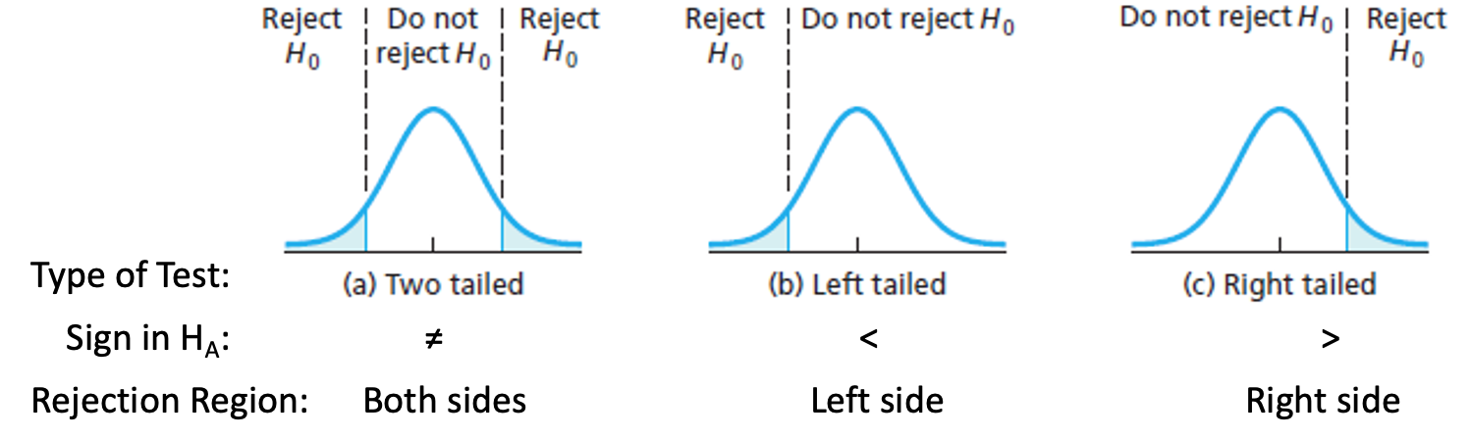
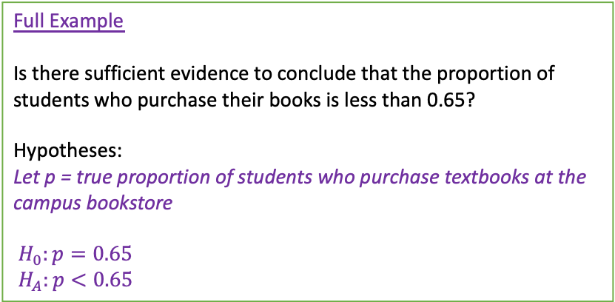
The Hypothesis Statements
Full Example
Is there sufficient evidence to conclude that the proportion of students who purchase their books is less than 0.65?
Hypotheses:
Let p = true proportion of students who purchase textbooks at the campus bookstore
$H_{0}:p=0.65$
$H_{A}:p<0.65$
State the Hypotheses
Define parameter + context.
Alternative Hypothesis H_{A}
The Alternative hypothesis is another equation that includes the population parameter
Uses the same value of the parameter as in the Null hypothesis H₀
May be left-tailed (<), right-tailed (>), or two-tailed (≠).
Depends on if we are interested in simply different than (≠), or a directional difference ( < or >)
This is the research interest, what we want to prove
In general
H₀: p = p₀ and H_{A}: p ≠, <, > p₀
H₀: μ = 𝜇₀ and H_{A}: μ ≠, <, > 𝜇₀
More Examples:
H₀: p = 0.3, p = population proportion of students is statistics courses
H_{A}: p > 0.3
H₀: μ = 70, 𝜇 = true height of oak trees in meters
H_{A}: μ ≠ 70
‘The owner believes his average monthly profit is more than $50,000’
In this case, greater than → H_{A}: μ > 50,000

Slide 11
LCQ – Hypotheses (again)
Problem: (1) Define the parameter of interest and (2) State the Null and Alternative Hypotheses and the directionality of the test (two-tailed, left-tailed or right-tailed) for the following scenarios:
a) A company reports that last year 40% of their reports in accounting were on time. From a random sample this year, they want to know if that proportion has changed.
b) Last year, 42% of the employees enrolled in at least one wellness class at the company’s site. Using a survey from randomly selected employees, they want to know if a greater percentage is planning to take a wellness class this year.
c) There are two political candidates, and one wants to know from the recent polls if she is going to win a majority of votes in next week’s election.

Slide 12
LCQ – Hypotheses (again)
Problem: (1) Define the parameter of interest and (2) State the Null and Alternative Hypotheses and the directionality of the test (two-tailed, left-tailed or right-tailed) for the following scenarios:
a) A company reports that last year 40% of their reports in accounting were on time. From a random sample this year, they want to know if that proportion has changed.
Let p = the true proportion of reports that were on time
H₀: p = 0.4 and H_{A}: p ≠ 0.4 → two tailed! PERFECTO!!
b) Last year, 42% of the employees enrolled in at least one wellness class at the company’s site. sing a survey from randomly selected employees, they want to know if a greater percentage is planning to take a wellness class this year.
Options
1) Let p = the true number PROPORTION of employees enrolled (+ more context) → Have to say PROPORTION (not ‘number’, ‘amount’, etc.)
2) P = TRUE proportion of employees enrolled in at least one wellness class → Need to make sure to say TRUE or POPULATION proportion
Options
1) H₀ > 0.42 and H_{A} < 0.42 → several things to correct: (1) ‘H₀’ is NOT our PARAMETER, p is (have to include p); (2) equals sign = always goes in the Null hypothesis; (3) from the wording of the problem (‘if a greater percentage is planning’) indicates greater than for the Alternative have to include our PARAMETER, less than 0.42, p
2) H₀: p = 0.42 and H_{A}: p > 0.42 → RIGHT (greater than) tailed! YES!!
c) There are two political candidates, and one wants to know from the recent polls if she is going to win a majority of votes in next week’s election.
Let p = the true proportion of votes she will receive
H₀: p = 0.5 → We use 0.5 because there was no prior information about how she had been polling, so we just start with assuming they are tied (evenly 50/50)
Options
H_{A} = wins election → INCORRECT! Yes this is the correct context, but what does this mean for the population proportion??? Have to have an INEQUALITY with our PARAMETER
H_{A}: p > 0.51 → Alternative hypothesis is INCORRECT! We have to have the SAME VALUE in the Null and Alternative; the strictly greater sign take care of getting ‘the majority’ because anything more than 0.5 is technically the majority (even 0.50001)
H_{A}: p > 0.5 RIGHT tailed → CORRECT!

Slide 13

Assumptions
Full Example
Is there sufficient evidence to conclude that the proportion of students who purchase their books is less than 0.65?
They took a random sample of 137 students
Check assumptions:
Randomization: Random sample of students was taken
Large enough sample:
$np_{0}=137\left(.65\right)=89.05>5$
$n(1−p_{0})=137\left(1−.65\right)=47.95>5$
Both conditions are met, appropriate to continue with test!
2. Check Assumptions.
Same Assumptions as for Confidence Intervals
Random Sample
Large enough sample
How we check the second assumption depends on the type of test (type of data)
Will go over these again when looking at Proportions Tests and Means Tests
* will go through these with the proportions slide

Slide 14
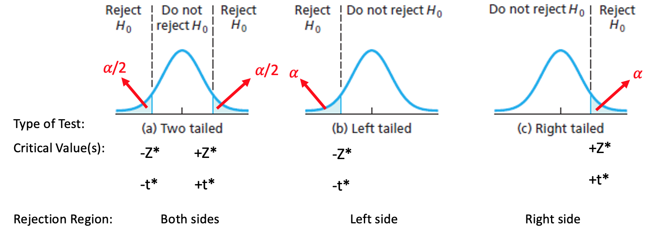
Rejection Region
Full Example
Is there sufficient evidence to conclude that the proportion of students who purchase their books is less than 0.65? Test this at the 10% significance level.
Rejection Region:
Set 𝛼 = 0.1 (which was set at beginning)
Z* = invNorm(area = 0.1, 𝜇 = 0, 𝞂 = 1) = -1.28
3. Determine and Sketch Rejection Region based of Significance Level
Rejection Region (RR)
We have to determine the the when there is or is not enough evidence against the Null.
In other words, what is the cutoff and in what direction do we make the conclusion of reject!
Our Rejection Region (RR) is based on whether we are doing a one or two tailed test (this is the direction from the H_{A})!
The specific value of the cutoff depends upon the significance level, α, of the test, which is chosen before running the test.
Setups will say something similar to: ”Determine if there is enough evidence at the 5% significance level.”
We use this alpha 𝛼 level to calculate the Critical Value!
𝛼 = 0.1
Z*

Slide 15
Rejection Region
Full Example
Is there sufficient evidence to conclude that the proportion of students who purchase their books is less than 0.65? Test this at the 10% significance level.
Rejection Region:
Set 𝛼 = 0.1 (which was set at beginning)
Z* = invNorm(lower = 0.1, 𝜇 = 0, 𝞂 = 1) = -1.28
3. Determine and Sketch Rejection Region based of Significance Level
Significance Level
The significance level represents the probability of rejecting the Null Hypothesis.
Visually, it is the area under the curve in the direction of the Alternative hypothesis
For a two-tailed test, area for 𝛼 is split equally between the upper and lower tails!
Recall from CI, Alpha level is just the complement probability of the % Confidence (so directly relates to a two-tailed test)!
Critical Values
The critical values for Hypothesis Tests are the the same critical value as when calculating Confidence Intervals!
We find these with invNorm() or invT() depending on what type of test we are doing
𝛼 = 0.1
Z*

Slide 16
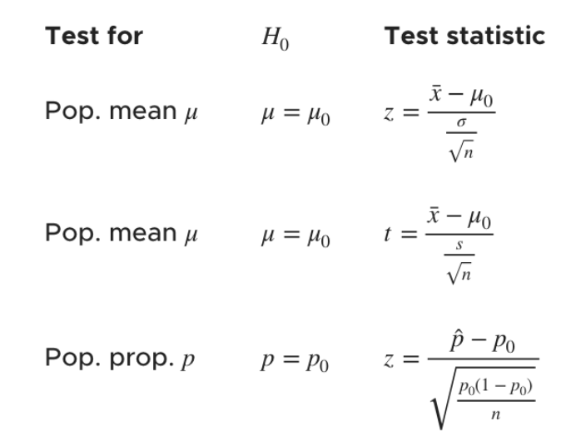

Test Statistic
Full Example
Is there sufficient evidence to conclude that the proportion of students who purchase their books is less than 0.65? Test this at the 10% significance level.
Test Statistic:
TS = Z_{stat} = 1-PropZTest(p₀ = 0.65, x = 81, n = 137, prop < p₀) = -1.44
Z_{stat} = -1.44 < -1.28 = Z* → Reject H₀!
4. Compute value of Test Statistic / P-value.
Test Statistic (TS)
This is the value we are comparing to the critical value from the set significance level!
Test Statistic (TS) is calculated using our sample statistics (or directly from the data)
Technically, the TS is just the standardized (Z or t) score of our sample statistic based on the corresponding sampling distribution of that statistic under the Null hypothesis
$$\hat{p}=\frac{81}{137}≈0.59→−1.44=Z_{stat}$$
𝛼 = 0.1
Two Methods
At this point in the Hypothesis Test procedure, we have two methods to make our conclusion:
Traditional method and P-Value method!
Both of which are correct! It will be your choice unless otherwise stated
Z_{stat}
Z*
We are not going to calculate these by hand because we’ve had lots of practice before
Instead, we will learn new calculator functions shortly!
1-PropZTest, Z-Test and T-Test
https://www.kristakingmath.com/blog/test-statistics-for-means-and-proportions

Slide 17
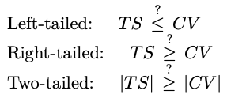
Test Statistic
Full Example
Is there sufficient evidence to conclude that the proportion of students who purchase their books is less than 0.65? Test this at the 10% significance level.
Test Statistic:
TS = Z_{stat} = 1-PropZTest(p₀ = 0.65, x = 81, n = 137, prop < p₀) = -1.44
Z_{stat} = -1.44 < -1.28 = Z* → Reject H₀!
4. Compute value of Test Statistic / P-value.
Traditional Method
This way just involves comparing our Test Statistic directly to the Critical Value
The specific comparison depends on the direction of the test
For the two-tailed test, can just look at the absolute value because we want it to be more extreme (i.e. more negative or more positive).
If the Test Statistic is in the Rejection Region, this is the implication:
Our statistic or anything more extreme (smaller or larger; depends on alternative) isn’t likely with the Null hypothesis being True!!
Thus we REJECT the Null hypothesis!
𝛼 = 0.1
If TRUE, Reject H₀!
If not true, Fail to Reject H₀!
Z_{stat}
Z*
Of the two methods, this one requires the one extra step of finding the CV. So maybe this one is slightly quicker

Slide 18
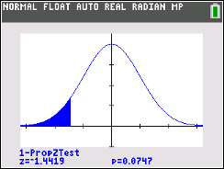
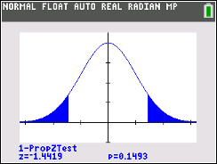
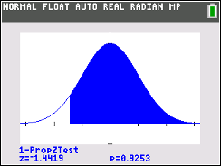
Test Statistic
Full Example
Is there sufficient evidence to conclude that the proportion of students who purchase their books is less than 0.65? Test this at the 10% significance level.
P-Value (not done originally, but showing here ☺):
p-value = 1-PropZTest(p₀ = 0.65, x = 81, n = 137, prop < p₀) = 0.075
p-value = 0.075 < 𝛼 = 0.1 → Reject H₀!
4. Compute value of Test Statistic / P-value.
P-Value
The p-value is the probability of getting a result as, or more extreme than, the result obtained from the sample given (assuming) the Null Hypothesis (H₀) is TRUE.
In other terms, “The P-Value is a measure of how plausible the data are, given our null hypothesis.”
P-Value Method
This way just involves comparing the p-value to the significance level.
If the p-value is less than the significance level, then we have the same implication as with the Traditional method:
Our statistic or anything more extreme (smaller or larger; depends on alternative) isn’t likely with the Null Hypothesis being True!! And thus we REJECT!
𝛼 = 0.1
p-value = 0.075
Z_{stat}
Z*
Our calculator draws the p-value.
P-Value depends on the alternative hypothesis!
* Same rules for all tests
If: p-value ≤ ⍺ Reject H₀!
If: p-value > ⍺ Fail to Reject H₀!
H_{A}: $p<0.65$ $p≠0.65$ $p>0.65$
* With two-tailed tests, the p-value is double that of the one-tailed

Slide 19
Conclude and Interpret
Full Example
Is there sufficient evidence to conclude that the proportion of students who purchase their books is less than 0.65? Test this at the 10% significance level.
Conclusion:
Because
our Test Statistic Z_{stat} = -1.44 is less than the Critical Value Z* = -1.28 (10% significance level)
OR
our p-value = 0.075 is less than the significance level 0.1
we reject the Null hypothesis. We have sufficient evidence to conclude that the true proportion of students who buy their textbooks at the campus bookstore is less than 0.65.
5. Conclude and Interpret
State whether you reject H₀ or fail to reject H₀ AND WHY!
Interpret your results in the context of the problem
This is where we formally (nicely) say the results of our hypothesis test!
How to Write Our Conclusion
(General structure)
P-Value Method
Because our P-Value (INSERT P-Value) is (LESS or GREATER) than our significance level (INSERT SIGNIFICANCE LEVEL), we (REJECT or FAIL TO REJECT) the Null Hypothesis. There (IS or IS NOT) sufficient evidence to conclude (THE ALTERNATIVE HYPOTHESIS).
Traditional Method (not as patterned, but same idea)
Because our Test Statistic (INSERT TS and Value) is (LESS or GREATER) than our Critical Value (INSERT CV and Value), we (REJECT or FAIL TO REJECT) the Null Hypothesis. There (IS or IS NOT) sufficient evidence to conclude (THE ALTERNATIVE HYPOTHESIS).
If P-value ≤ α, use the Red Text.
If P-value > α, use the Blue Text.
*** Always talk about the results in terms of the the problem!
Don’t just write ‘… conclude the alternative hypothesis’
* Depends on the direction of the test! Might be looking at absolute value if two-tailed
*** NEVER SAY WE ACCEPT THE NULL HYPOTHESIS!!!!!!
We aren’t saying that the Null is true, just that we can’t say it’s wrong! Think NOT GUILTY (not “Innocent”)

Slide 20
Hypothesis Tests for Proportions!
Everything above applies, now we are just going to apply it specifically to a Proportion Test!

Slide 21
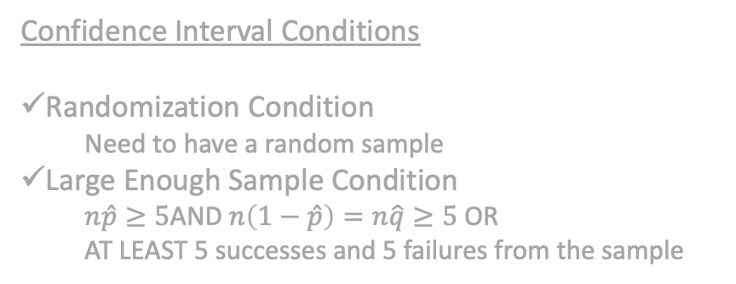

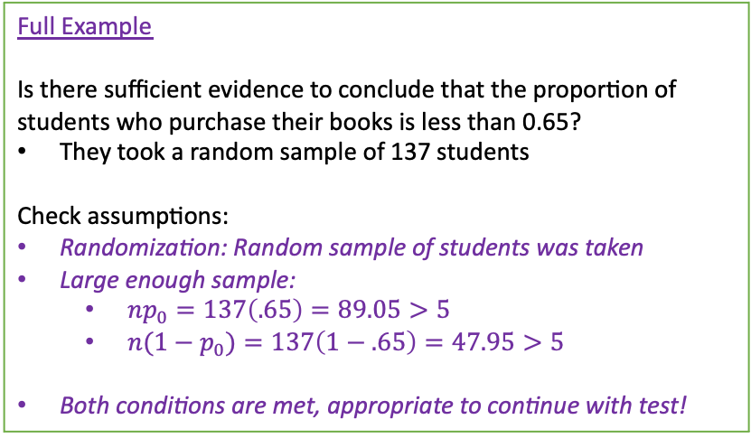
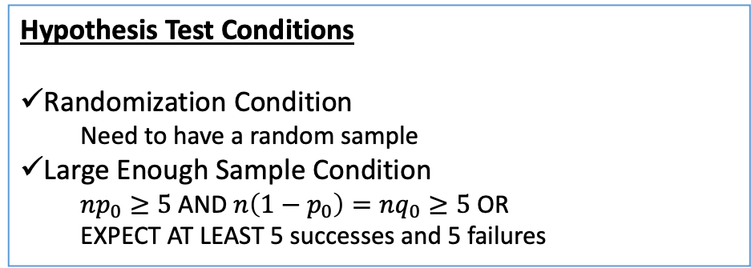
Proportions Assumptions
Full Example
Is there sufficient evidence to conclude that the proportion of students who purchase their books is less than 0.65?
They took a random sample of 137 students
Check assumptions:
Randomization: Random sample of students was taken
Large enough sample:
$np_{0}=137\left(.65\right)=89.05>5$
$n(1−p_{0})=137\left(1−.65\right)=47.95>5$
Both conditions are met, appropriate to continue with test!
2. Check Assumptions.
Same Assumptions as for Confidence Intervals that were based on the sampling distribution of $\hat{p}$ and the CLT!
The only thing that is different is what we use for the proportion when checking the Large Enough Sample Condition!
Because we are assuming the Null is TRUE, we want to use the null proportion p₀ NOT the sample proportion $\hat{p}$
Confidence Interval Conditions
Randomization Condition
Need to have a random sample
Large Enough Sample Condition
$n\hat{p}≥5$AND $n\left(1−\hat{p}\right)=n\hat{q}≥5$ OR
AT LEAST 5 successes and 5 failures from the sample
Hypothesis Test Conditions
Randomization Condition
Need to have a random sample
Large Enough Sample Condition
$np_{0}≥5$ AND $n\left(1−p_{0}\right)=nq_{0}≥5$ OR
EXPECT AT LEAST 5 successes and 5 failures
New conditions

Slide 22
LCQ – Assumptions
Problem: Check the conditions for a Hypothesis Test of the population proportion for the following scenarios:
a) A company reports that last year 40% of their reports in accounting were on time. From a random sample of 60 reports this year 35% of reports were on time, they want to know if that proportion has changed.
b) Last year, 42% of the employees enrolled in at least one wellness class at the company’s site. Using a survey from randomly selected employees, 56 out of 120 said they plan to take at least one wellness class this year. They want to know if a greater percentage is planning to take a wellness class this year.
c) A political candidate wants to know from the recent polls if she is going to win a majority of votes in next week’s election. She plans to survey her local coffee joint where there is typically 8 people there for breakfast.

Slide 23
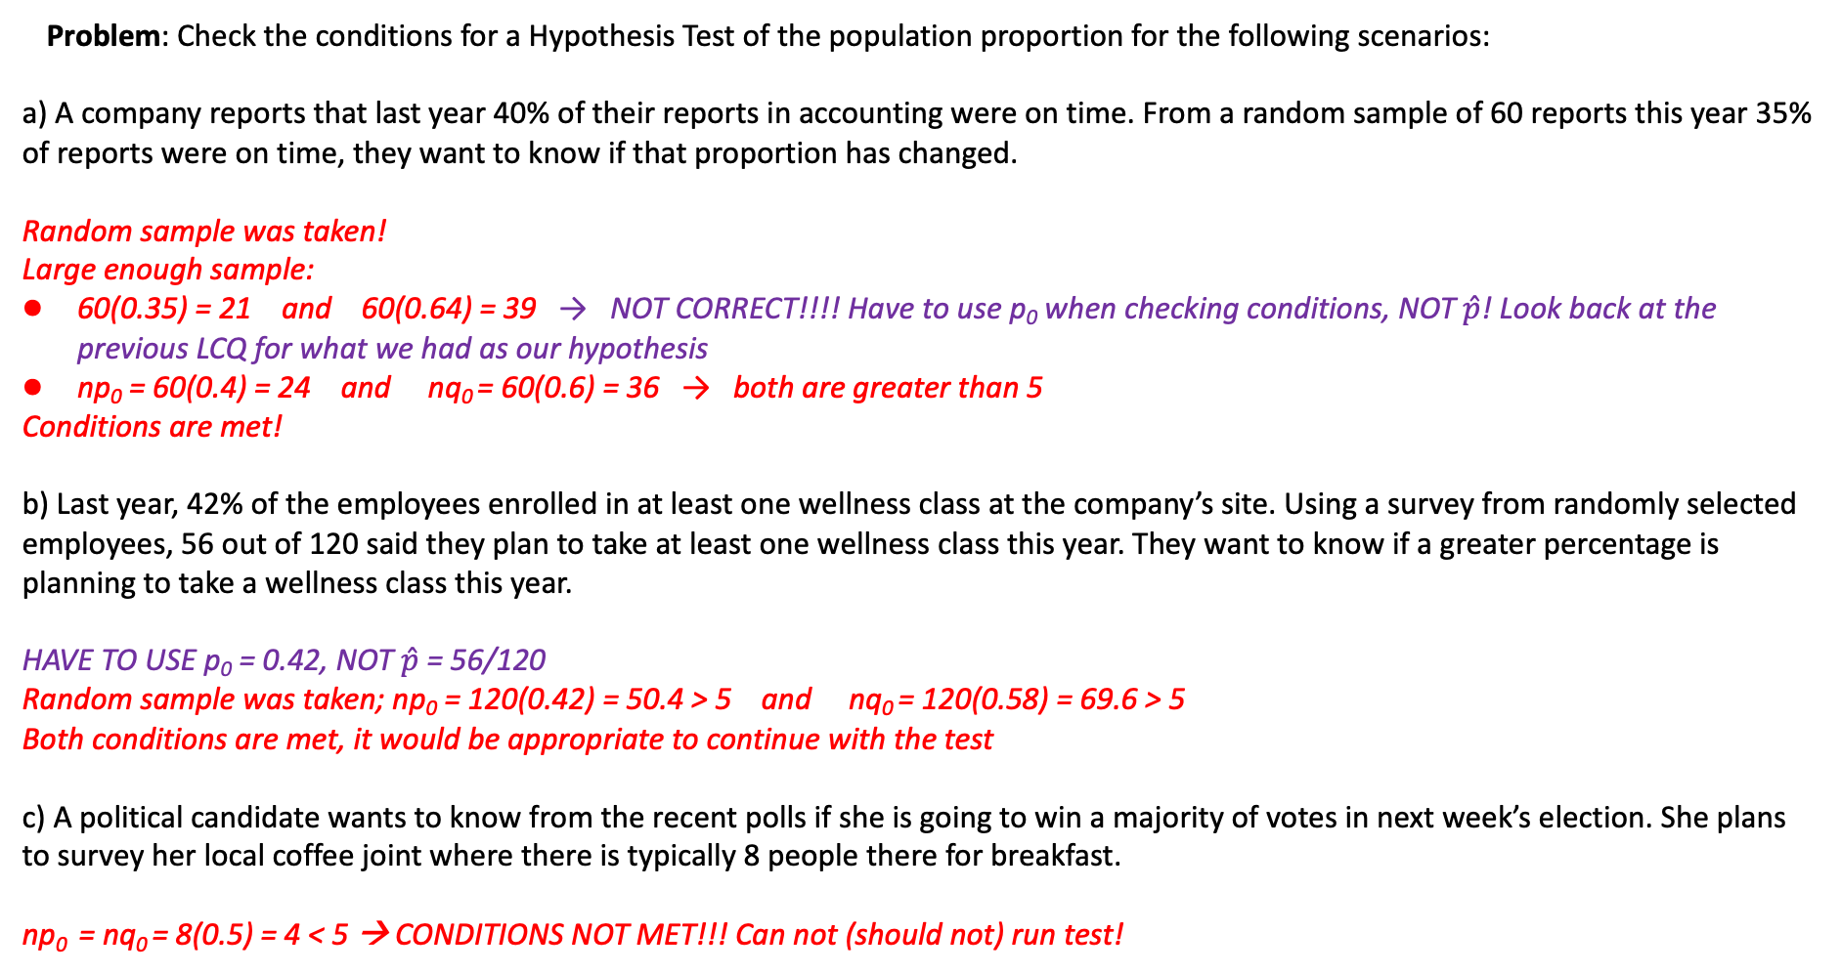
LCQ – Assumptions
Problem: Check the conditions for a Hypothesis Test of the population proportion for the following scenarios:
a) A company reports that last year 40% of their reports in accounting were on time. From a random sample of 60 reports this year 35% of reports were on time, they want to know if that proportion has changed.
Random sample was taken!
Large enough sample:
60(0.35) = 21 and 60(0.64) = 39 → NOT CORRECT!!!! Have to use p₀ when checking conditions, NOT $\hat{p}$! Look back at the previous LCQ for what we had as our hypothesis
np₀ = 60(0.4) = 24 and nq₀ = 60(0.6) = 36 → both are greater than 5
Conditions are met!
b) Last year, 42% of the employees enrolled in at least one wellness class at the company’s site. Using a survey from randomly selected employees, 56 out of 120 said they plan to take at least one wellness class this year. They want to know if a greater percentage is planning to take a wellness class this year.
HAVE TO USE p₀ = 0.42, NOT $\hat{p}$ = 56/120
Random sample was taken; np₀ = 120(0.42) = 50.4 > 5 and nq₀ = 120(0.58) = 69.6 > 5
Both conditions are met, it would be appropriate to continue with the test
c) A political candidate wants to know from the recent polls if she is going to win a majority of votes in next week’s election. She plans to survey her local coffee joint where there is typically 8 people there for breakfast.
np₀ = nq₀ = 8(0.5) = 4 < 5 → CONDITIONS NOT MET!!! Can not (should not) run test!

Slide 24
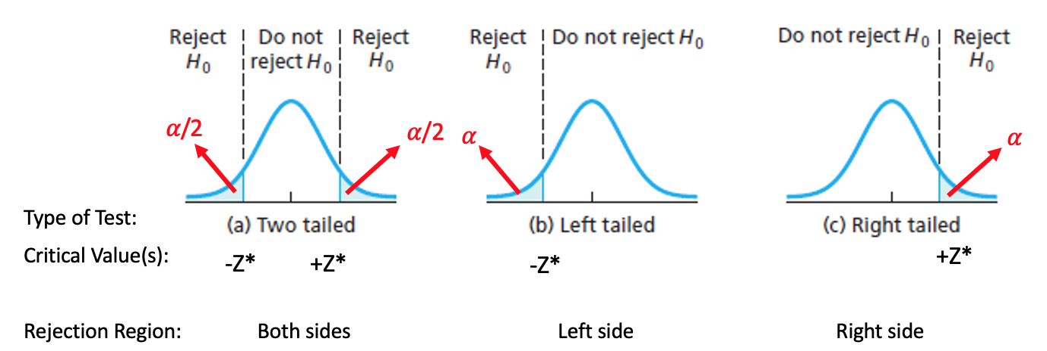
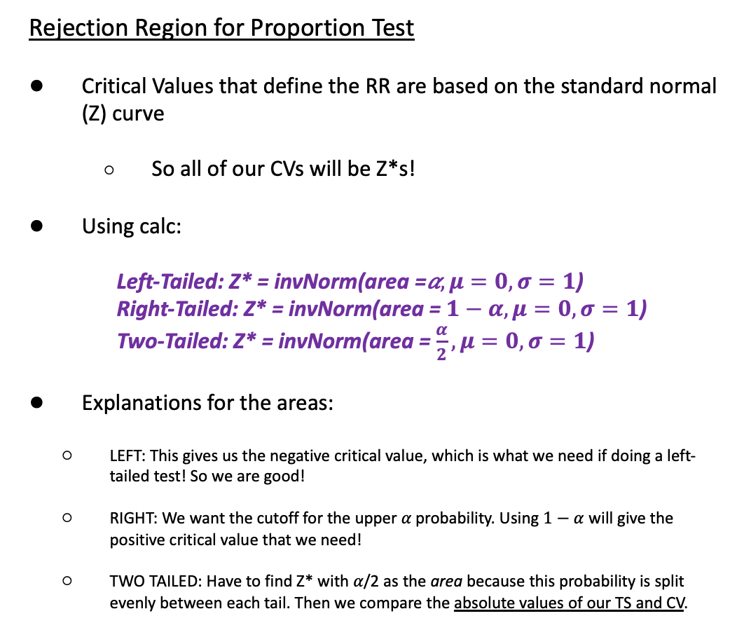
Rejection Region for Proportions
3. Determine and Sketch Rejection Region based of Significance Level
Rejection Region for Proportion Test
Critical Values that define the RR are based on the standard normal (Z) curve
So all of our CVs will be Z*s!
Using calc:
Left-Tailed: Z* = invNorm(area =𝛼$,μ=0, σ=1$)
Right-Tailed: Z* = invNorm(area =$1−α,μ=0, σ=1$)
Two-Tailed: Z* = invNorm(area =$\frac{α}{2},μ=0, σ=1$)
Explanations for the areas:
LEFT: This gives us the negative critical value, which is what we need if doing a left-tailed test! So we are good!
RIGHT: We want the cutoff for the upper 𝛼 probability. Using $1−α$ will give the positive critical value that we need!
TWO TAILED: Have to find Z* with 𝛼/2 as the area because this probability is split evenly between each tail. Then we compare the absolute values of our TS and CV.
Mini LCQ
Find the Critical Values for the following Alternative hypotheses and significance levels:
H_{A}: p > 0.7, 𝛼 = 0.08
H_{A}: p ≠ 0.7, 𝛼 = 0.15
H_{A}: p < 0.7, 𝛼 = 4%

Slide 25
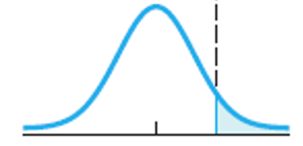
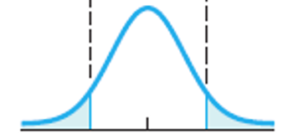
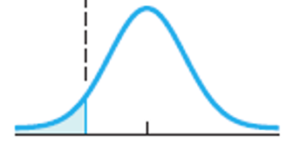
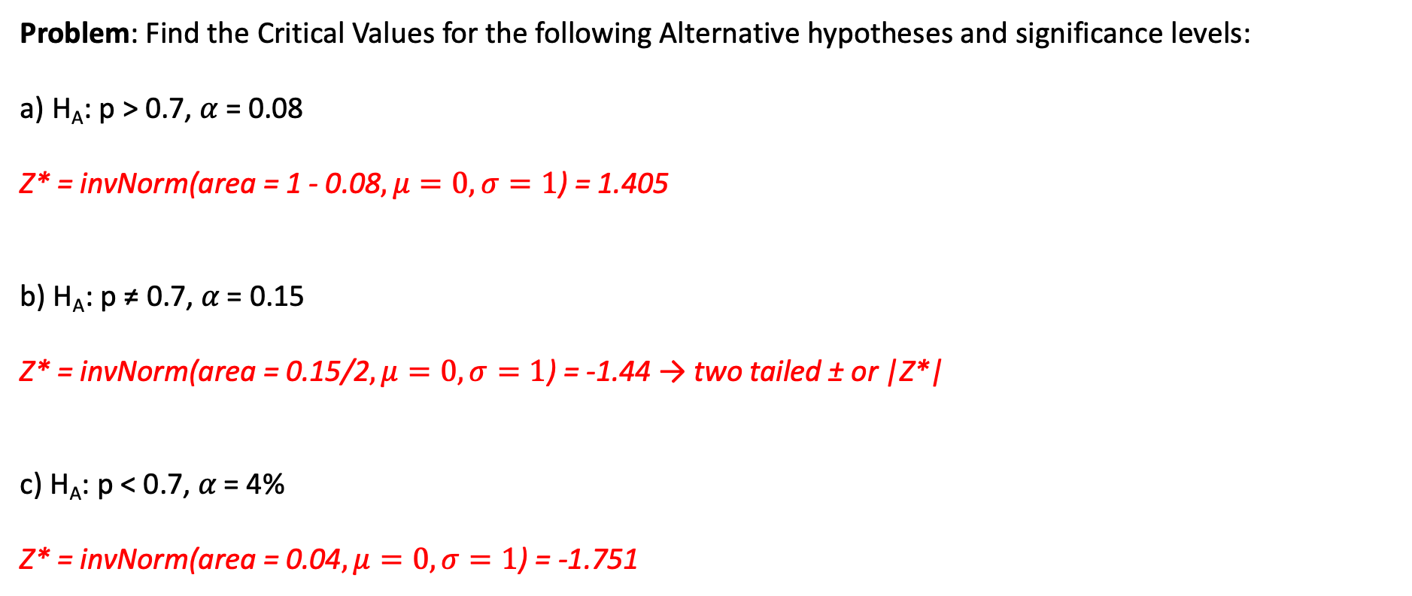
Mini LCQ Solution
Problem: Find the Critical Values for the following Alternative hypotheses and significance levels:
a) H_{A}: p > 0.7, 𝛼 = 0.08
Z* = invNorm(area = 1 - 0.08$,μ=0, σ=1$) = 1.405
b) H_{A}: p ≠ 0.7, 𝛼 = 0.15
Z* = invNorm(area = 0.15/2$,μ=0, σ=1$) = -1.44 → two tailed ± or |Z*|
c) H_{A}: p < 0.7, 𝛼 = 4%
Z* = invNorm(area = 0.04$,μ=0, σ=1$) = -1.751
𝛼 = 0.08
Z* = 1.405
0.075 = 𝛼/2
𝛼/2 = 0.15/2 = 0.075
Z* = -1.44
Z* = 1.44
0.04 = 𝛼
Z* = -1.751

Slide 26
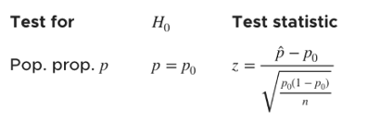
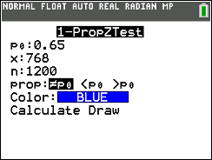
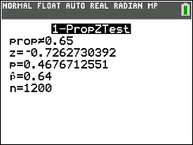
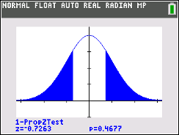
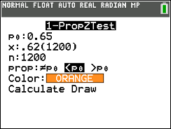
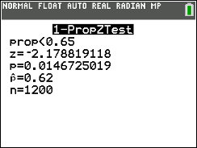
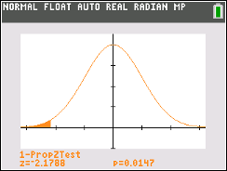
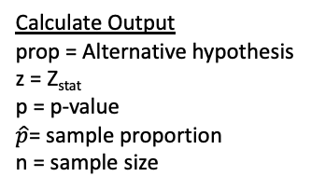
Using Calc - Test Statistic and P-Value for Proportions
4. Compute value of Test Statistic / P-value.
Formula for Z_{stat} by hand:
(Original) Setup
In 2020, A NatGeo Poll interviewed 1200 hiking enthusiasts and asked “Are you more afraid of spiders or snakes???” Out of the 1200 people, 768 responded “Ewww, snakes….”. Is there enough evidence to conclude the proportion of people who are more afraid of snakes is different than the 2010 proportion of 0.65. Use 𝛼 = 0.1
GOAL: Conduct a Hypothesis Test!
1-PropZTest
p₀ = the Null proportion
x = number of successes
n = sample size
prop: Alternative hypothesis
Calculate or Draw
Calculate Output
prop = Alternative hypothesis
z = Z_{stat}
p = p-value
$\hat{p}$= sample proportion
n = sample size
Draw Output
Plot (and displays values) of p = p-value and z = Z_{stat} on the standard normal curve
H₀: p = 0.65
H_{A}: p ≠ 0.65
*This does NOT give us the Critical Value Z*, we have to figure that out ourselves
New Scenario
Now lets say the 2020 sample proportion is equal to 0.62 (same sample size) AND we want to know if the proportion has decreased from 2010. Use 𝛼 = 0.05
Run another 1-PropZTest
H₀: p = 0.65
H_{A}: p < 0.65

Slide 27
LCQ – Conclusions and Interpretations
5. Conclude and Interpret
State whether you reject H₀ or fail to reject H₀ AND WHY!
Interpret your results in the context of the problem
Problem: Write the conclusions and interpretations for the previous scenarios using our results.
a) Use the Traditional Method
Original Setup: In 2020, A NatGeo Poll interviewed 1200 hiking enthusiasts and asked “Are you more afraid of spiders or snakes???” Out of the 1200 people, 768 responded “Ewww, snakes….”. Is there enough evidence to conclude the proportion of people who are more afraid of snakes is different than the 2010 proportion of 0.65. Use 𝛼 = 0.1
b) Use the P-Value Method
New Scenario: Now lets say the 2020 sample proportion is equal to 0.62 (same sample size) AND we want to know if the proportion has decreased from 2010. Use 𝛼 = 0.05

Slide 28
LCQ – Conclusions and Interpretations
5. Conclude and Interpret
State whether you reject H₀ or fail to reject H₀ AND WHY!
Interpret your results in the context of the problem
Problem: Use the specified method to write the conclusions and interpretations for the previous scenarios using our results.
a) Use the Traditional Method
Original Setup: In 2020, A NatGeo Poll interviewed 1200 hiking enthusiasts and asked “Are you more afraid of spiders or snakes???” Out of the 1200 people, 768 responded “Ewww, snakes….”. Is there enough evidence to conclude the proportion of people who are more afraid of snakes is different than the 2010 proportion of 0.65. Use 𝛼 = 0.1
Need these…
Test Statistic
Traditional method, so have to find the critical value first based on the significance level and alternative hypothesis
Z* = invNorm(area = 0.1/2, 𝜇 = 0, 𝞂 = 1) = -1.645 → two-tailed test, so will compare the absolute values of the TS and Z*
Z_{stat} = 1-PropZTest(p₀ = 0.65, x = 768, n = 1200, prop ≠ p₀) = -0.7263
|Z_{stat} |= |-0.7263| = 0.7263 < 1.645 = |-1.645| = |Z*| → Fail to Reject H₀
Conclusion and Interpretation
Because the absolute value of our Test Statistic Z_{stat} = 0.7263 is less than the absolute value of our Critical Value Z* = 1.645, we fail to reject the Null hypothesis. There is NOT sufficient evidence to conclude that the true proportion of hikers who are more afraid of snakes than spiders is different than the 2010 proportion of 0.65.
H₀: p = 0.65
H_{A}: p ≠ 0.65
𝛼 = 0.1

Slide 29
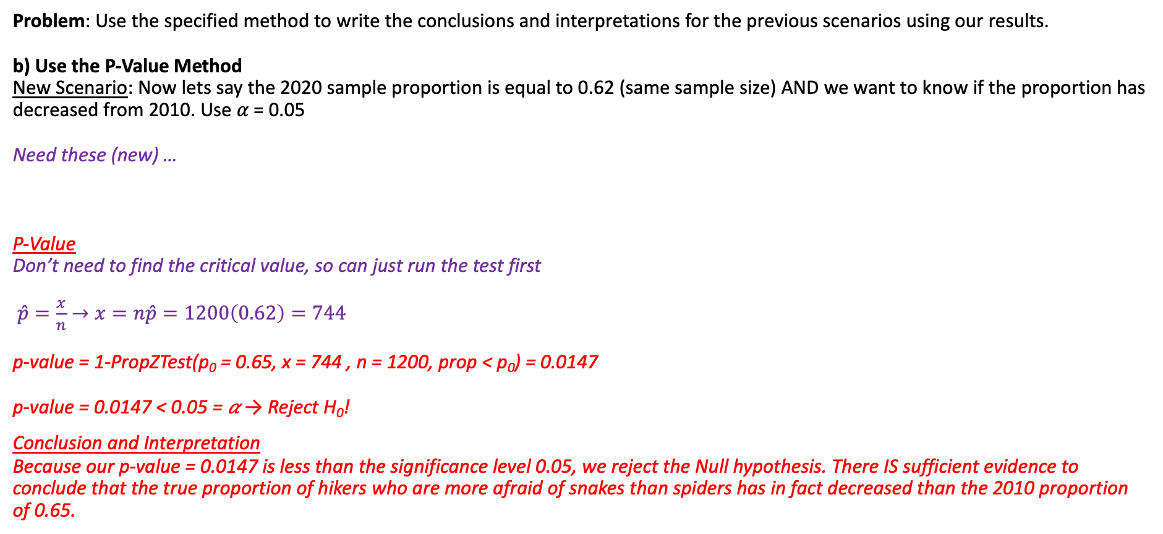
LCQ – Conclusions and Interpretations Cont…
5. Conclude and Interpret
State whether you reject H₀ or fail to reject H₀ AND WHY!
Interpret your results in the context of the problem
Problem: Use the specified method to write the conclusions and interpretations for the previous scenarios using our results.
b) Use the P-Value Method
New Scenario: Now lets say the 2020 sample proportion is equal to 0.62 (same sample size) AND we want to know if the proportion has decreased from 2010. Use 𝛼 = 0.05
Need these (new) …
P-Value
Don’t need to find the critical value, so can just run the test first
$\hat{p}=\frac{x}{n}→x=n\hat{p}=1200\left(0.62\right)=744$
p-value = 1-PropZTest(p₀ = 0.65, x = 744 , n = 1200, prop < p₀) = 0.0147
p-value = 0.0147 < 0.05 = 𝛼 → Reject H₀!
Conclusion and Interpretation
Because our p-value = 0.0147 is less than the significance level 0.05, we reject the Null hypothesis. There IS sufficient evidence to conclude that the true proportion of hikers who are more afraid of snakes than spiders has in fact decreased than the 2010 proportion of 0.65.
H₀: p = 0.65
H_{A}: p < 0.65
𝛼 = 0.05

Slide 30
Problem Session!!!

Slide 31
Example: Problem #23
Gallup reported in 2012 that 53% of American investors are likely to say the price of energy (including gas and oil) is hurting the US investment climate ‘a lot,’ according to a Wells Fargo/Gallup Investor and Retirement Optimism Index survey. The survey results are based on questions asked February 3-12, 2012, of a random sample of 1022 US adults having investable assets of $10,000 or more. The percentage reported to this same question in September 2011 was 62%.
Is the percentage in 2012 different from that in 2011? Test the appropriate hypothesis. Check conditions. Does the test provide evidence that the percentage has changed from 2011?
Find a 95% confidence interval for the true proportion of US adults who think the price of energy is hurting the US investment climate ‘a lot.’

Slide 32
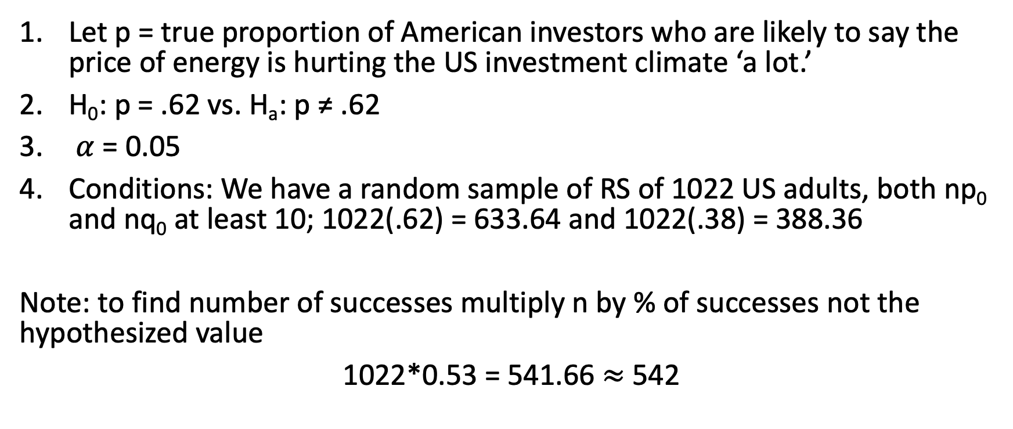
Problem #23(a) Solution
Let p = true proportion of American investors who are likely to say the price of energy is hurting the US investment climate ‘a lot.’
H₀: p = .62 vs. H_{a}: p ≠ .62
$α$ = 0.05
Conditions: We have a random sample of RS of 1022 US adults, both np₀ and nq₀ at least 10; 1022(.62) = 633.64 and 1022(.38) = 388.36
Note: to find number of successes multiply n by % of successes not the hypothesized value
1022*0.53 = 541.66 $≈$ 542

Slide 33
Problem #23(a) Solution
z = -5.9057
p-value < .0001
Reject H₀
Since the p-value is less than our 0.05 significance level there is sufficient evidence to reject H₀ and conclude that, in 2012, the true proportion of American investors who are likely to say the price of energy is hurting the US investment climate ‘a lot’ is not equal to 0.62; it has changed from 2011.

Slide 34
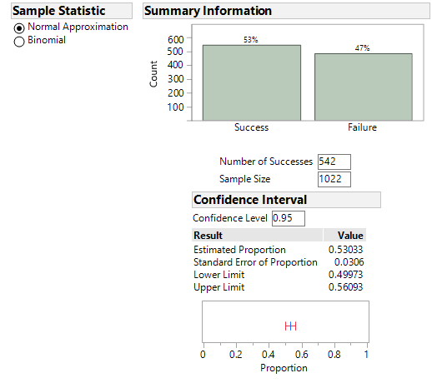
Problem #23(b) Solution
9. I am 95% confident that the true proportion of US adults who think the price of energy is hurting the US investment climate ‘a lot’ is between 0.500 and 0.561.

Slide 35
Template Problem 1
High blood pressure (hypertension) occurs when the force of blood against your artery walls is too strong. This added pressure can cause damage to your arteries, heart, and kidneys, and could lead to a stroke. 1100 adult Americans were randomly selected and examined for high blood pressure. The number of participants classified with hypertension was 319. The U.S. Department of Health and Human Services has a target of 16% for hypertension prevalence. Is there any evidence to suggest the prevalence of hypertension is differs from the target value? Use a significance level of 0.10.
Construct a 90% Confidence interval as well.

Slide 36
Template Problem 1 Solution
Let p = true proportion of American adults with hypertension
H₀: p = 0.16, H_{a}: p ≠ 0.16
α = 0.10
2. Check the assumptions:
We are told that the 1100 adults were randomly sampled.
One individual’s blood pressure does not affect the blood pressure of others
The sample size is large enough: np₀ = 1100(0.16) = 176 > 10 and n(q₀) = 1100(0.84) = 924 > 10
1100 adults is less than 10% of the population of US adults

Slide 37
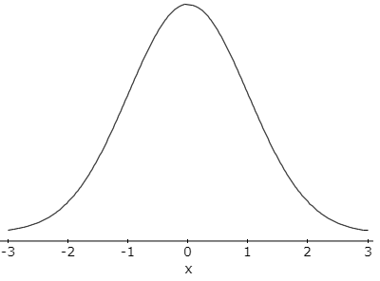
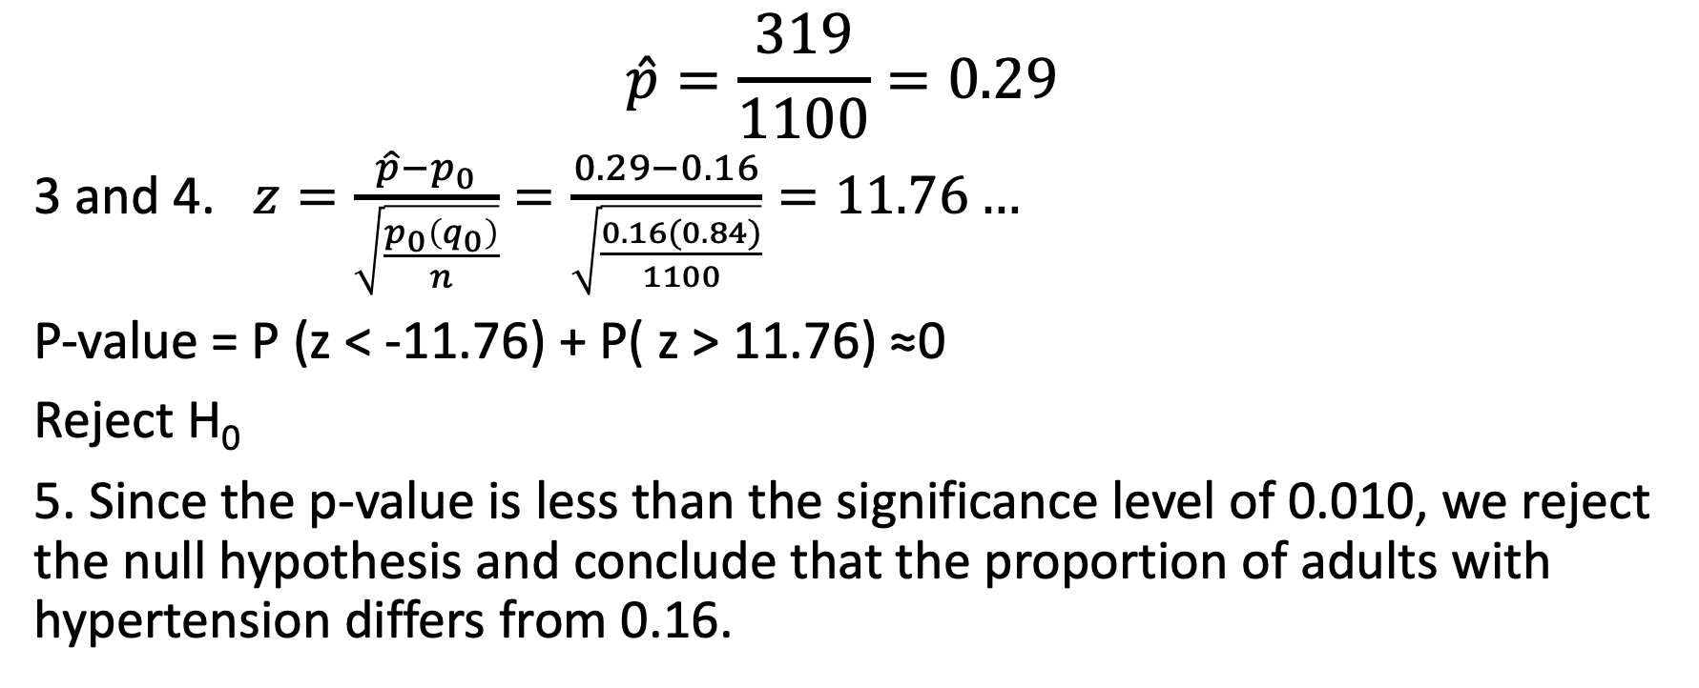
Template Problem 1 Solution, p. 2
$$\hat{p}=\frac{319}{1100}=0.29$$
3 and 4. $z=\frac{\hat{p}−p_{0}}{\sqrt{\frac{p_{0}\left(q_{0}\right)}{n}}}=\frac{0.29−0.16}{\sqrt{\frac{0.16(0.84)}{1100}}}=11.76…$
P-value = P (z < -11.76) + P( z > 11.76) ≈0
Reject H₀
5. Since the p-value is less than the significance level of 0.010, we reject the null hypothesis and conclude that the proportion of adults with hypertension differs from 0.16.

Slide 38
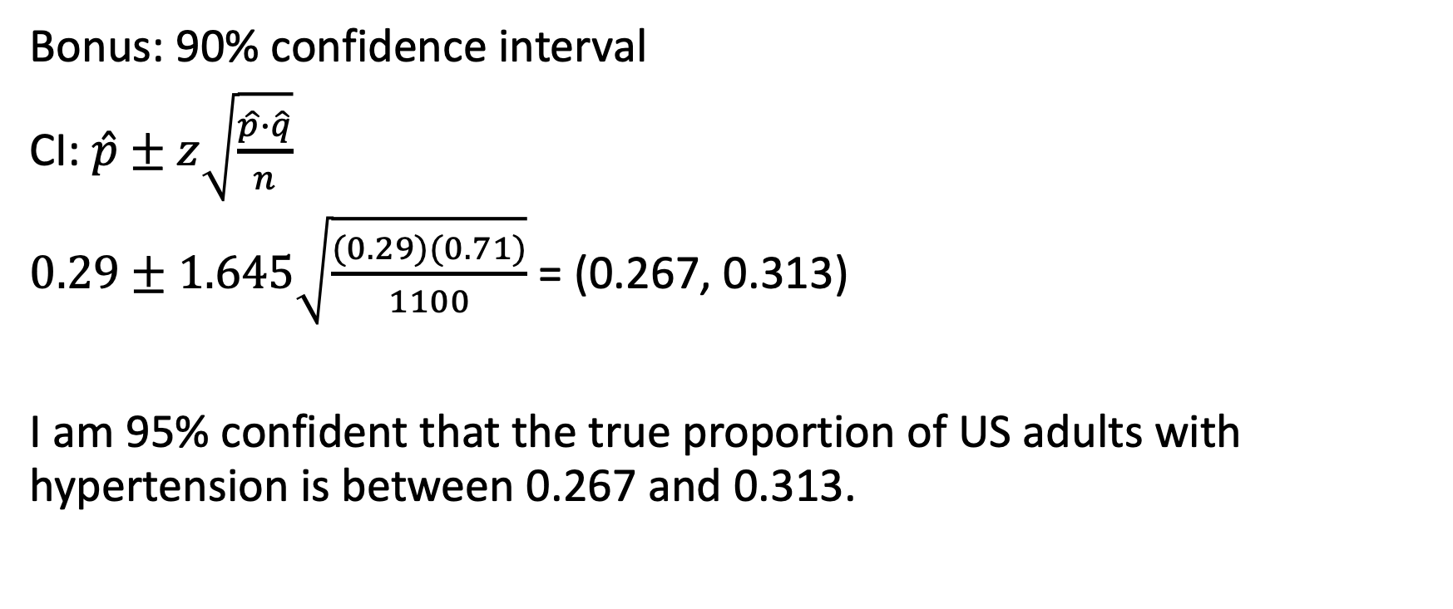
Template Problem 1 Solution, p. 3
Bonus: 90% confidence interval
CI: $\hat{p}±z\sqrt{\frac{\hat{p}∙\hat{q}}{n}}$
$0.29±1.645\sqrt{\frac{(0.29)(0.71)}{1100}}$ = (0.267, 0.313)
I am 95% confident that the true proportion of US adults with hypertension is between 0.267 and 0.313.

Slide 39
Template Problem 2
Many young adults live at home with their parents due to various reasons, such as lack of income, postponing marriage, and saving money for school. A recent survey reports that approximately 36% of all young adults (ages 18-31) live with their parents (Fry, 2013). In order to check this claim, a random sample of 440 young adults was obtained and 182 of them were found to live with their parents. Is there sufficient evidence to conclude that the proportion of young adults who live at home with their parents is different from 0.36? Test the appropriate hypotheses using a significance level of 0.01.

Slide 40
Template Problem 2 Solution
Let p = true proportion of young adults who live with their parents
H₀: p = 0.36, H_{a}: p ≠ 0.36
α = 0.01
2. Check the assumptions:
We are told that the 440 young adults were randomly sampled.
Whether or not one person lives with his/her parents does not affect where others live
The sample size is large enough: np₀ = 440(0.36) = 158.4 > 10 and n(q₀) = 440(0.64) = 281.6 > 10
440 young adults is less than 10% of the population of young adults

Slide 41
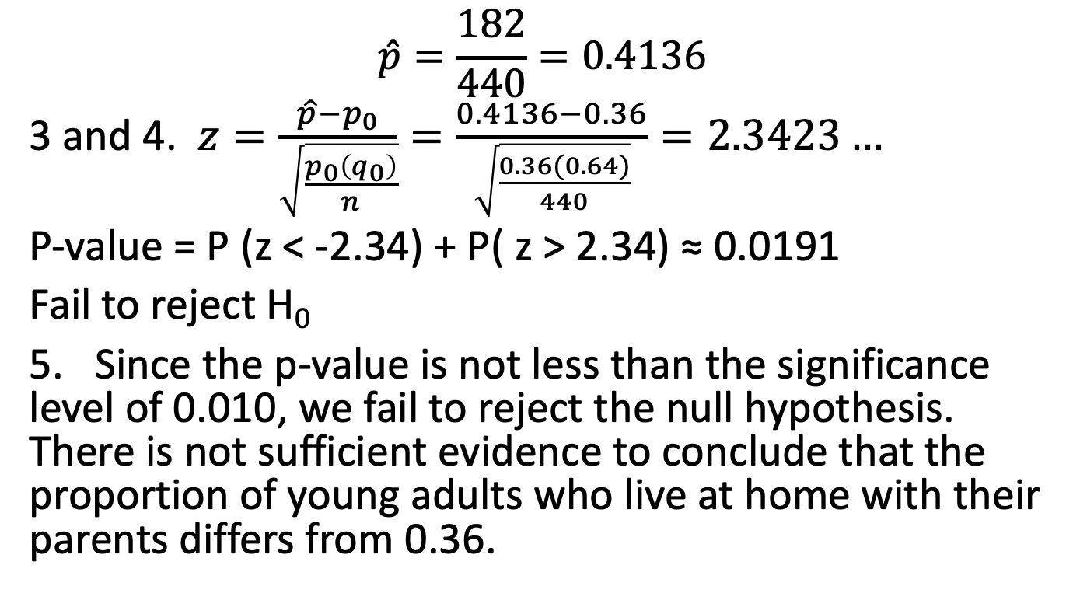
Template Solution, p. 2
$$\hat{p}=\frac{182}{440}=0.4136$$
3 and 4. $z=\frac{\hat{p}−p_{0}}{\sqrt{\frac{p_{0}\left(q_{0}\right)}{n}}}=\frac{0.4136−0.36}{\sqrt{\frac{0.36(0.64)}{440}}}=2.3423…$
P-value = P (z < -2.34) + P( z > 2.34) ≈ 0.0191
Fail to reject H₀
5. Since the p-value is not less than the significance level of 0.010, we fail to reject the null hypothesis. There is not sufficient evidence to conclude that the proportion of young adults who live at home with their parents differs from 0.36.

Slide 42
Problem #1
For each of the following situations, write the null and alternative hypotheses in terms of parameter values. Example: We want to know if the proportion of up days in the stock market is 50%. Answer: Let p = the proportion of up days. Ho: p = 0.5 vs. Ha: p ≠ 0.5.
A casino wants to know if their slot machine really delivers the 1 in 100 win rate that it claims.
A pharmaceutical company wonders if their new drug has a cure rate different from the 30% reported by the placebo.
A bank wants to know if the percentage of customers using their website has changed from the 40% that used it before their system crashed last week.

Slide 43
Problem #1 Solution
Let p = true proportion of wins of a slot machine
H₀: p = .01 vs. H_{a}: p ≠ .01
b) Let p = true proportion of cures by the drug
H₀: p = .30 vs. H_{a}: p ≠ .30
c) p = true proportion of customers using the bank website
H₀: p = .40 vs. H_{a}: p ≠ .40

Slide 44
Problem #3
Which of the following are true? If false, explain briefly.
A very high P-value is strong evidence that the null hypothesis is false.
A very low P-value proves that the null hypothesis is false.
A high P-value show that the null hypothesis is true.
A P-value below 0.05 is always considered sufficient evidence to reject a null hypothesis.

Slide 45
Problem #3 Solution
False, a very low p-value is strong evidence against the null hypothesis (H₀)
False, we never prove or disprove H₀
False, a high p-value does not provide strong evidence against H₀, it also does not provide strong evidence in favor of H₀.
False, the evidence required to reject H₀ depends upon the significance level of the test

Slide 46
Problem #5
A consulting firm had predicted that 35% of the employees at a large firm would take advantage of a new company Credit Union, but management is skeptical. They doubt the rate is that high. A survey of 300 employees shows that 138 of them are currently taking advantage of the Credit Union. From the sample proportion
Find the standard deviation of the sample proportion based on the null hypothesis.
Find the z-statistic.
Does the z-statistic seem like a particularly large or small value?

Slide 47
Problem #5 Solution
$σ_{\hat{p}}=\sqrt{\frac{p_{0}(1−p_{0})}{n}}=\sqrt{\frac{.35(1−.35)}{300}}≈.0275$
$z=\frac{\hat{p}−p_{0}}{\sqrt{\frac{p_{0}(1−p_{0})}{n}}}=\frac{\hat{p}−p_{0}}{σ_{\hat{p}}}=\frac{.46−.35}{.0275}=4$
Yes, that’s an unusually large z-value

Slide 48
Problem #7
For each of the following, write out the null and alternative hypotheses, being sure to state whether the alternative is one-sided or two-sided.
A company reports that last year 40% of their reports in accounting were on time. From a random sample this year, they want to know if that proportion has changed.
Last year, 42% of the employees enrolled in at least one wellness class at the company’s site. Using a survey, they want to know if a greater percentage is planning to take a wellness class this year.
A political candidate wants to know from the recent polls if she is going to garner a majority of votes in next week’s election.

Slide 49
Problem #7 Solution
Let p = true proportion of accounting reports that are on time
H₀: p = .4 vs. H_{a}: p ≠ .4; two-sided
b) Let p = true proportion of employees enrolled in at least one wellness class as the company’s site
H₀: p = .42 vs. H_{a}: p > .42; one-sided
c) Let p = true proportion of votes a political candidate will receive
H₀: p = .5 vs. H_{a}: p > .5; one-sided

Slide 50
Problem #11
Hypothesis. Write the null and alternative hypotheses to test each of the following situations.
An online clothing company is concerned about the timeliness of their deliveries. The VP of Operations and Marketing recently stated that she wanted the percentage of products delivered on time to be greater than 90%, and she wants to know if the company has succeeded.
A realty company recently announced that the proportion of houses tanking more than three months to sell is now greater than 50%.
A financial firm’s accounting department reports that after improvements in their system, they now have an error rate below 2%.

Slide 51
Problem #11 Solution
Let p = true proportion of on-time deliveries
H₀: p = .90 vs. H_{a}: p > .90
b) Let p = true proportion of houses taking more than 3 months to sell
H₀: p = .5 vs. H_{a}: p > .5
c) Let p = true proportion of errors in the accounting department
H₀: p = .02 vs. H_{a}: p < .02

Slide 52
Problem #13
The clothing company in Exercise 11a looks at a sample of delivery reports. They test the hypothesis that 90% of the deliveries are on time against the alternative that greater than 90% of the deliveries are on time and find a P-value of 0.22. Which of these conclusions is appropriate?
There’s a 22% chance that 90% of the deliveries are on time.
There’s a 78% chance that 90% of the deliveries are on time.
There’s a 22% chance that the sample they drew shows the correct percentage of on-time deliveries.
There’s a 22% chance that natural sampling variation could produce a sample with an observed proportion of on-time deliveries such as the one they obtained if, in fact, 90% of deliveries are on time.

Slide 53
Problem #13 Solution
The clothing company in Exercise 11a looks at a sample of delivery reports. They test the hypothesis that 90% of the deliveries are on time against the alternative that greater than 90% of the deliveries are on time and find a P-value of 0.22. Which of these conclusions is appropriate?
There’s a 22% chance that 90% of the deliveries are on time. NO
There’s a 78% chance that 90% of the deliveries are on time. NO
There’s a 22% chance that the sample they drew shows the correct percentage of on-time deliveries. NO
There’s a 22% chance that natural sampling variation could produce a sample with an observed proportion of on-time deliveries such as the one they obtained if, in fact, 90% of deliveries are on time. YES!

Slide 54
Problem #15
Have harsher penalties and ad campaigns increased seat-belt use among drivers and passengers? Observations of commuter traffic have failed to find evidence of a significant change compared with three years ago. Explain what the study’s P-value of 0.17 means in this context.

Slide 55
Problem #15 Solution
Have harsher penalties and ad campaigns increased seat-belt use among drivers and passengers? Observations of commuter traffic have failed to find evidence of a significant change compared with three years ago. Explain what the study’s P-value of 0.17 means in this context.
There is not sufficient evidence to reject the null hypothesis and therefore, we are unable to conclude that seatbelt use has increased.

Slide 56
Problem #17
An information technology analyst believes that they are losing customers on their website who find the checkout and purchase system too complicated. She adds a one-click feature to the website, to make it easier but finds that only about 10% of the customers are using it. She decides to launch an ad awareness campaign to tell customers about the new feature in hope of increasing the percentage. She doesn’t see much of difference, so she hires a consultant to help. The consultant selects a random sample of recent purchases, tests the hypothesis that the pads produced no change against the alternative that the percent who use the one click feature is now greater than 10% and finds a P-value of 0.22. Which conclusion is appropriate? Explain.
There’s a 22% chance the ads worked.
There’s a 78% chance the ads worked.
There’s a 22% chance that the null hypothesis is true.
There’s a 22% chance that natural sampling variation could produce poll results like these if the use of the one-click feature has increased.
There’s a 22% chance that natural sampling variation could produce poll results like these if there’s really no change in website use.

Slide 57
Problem #17 Solution
An information technology analyst believes that they are losing customers on their website who find the checkout and purchase system too complicated. She adds a one-click feature to the website, to make it easier but finds that only about 10% of the customers are using it. She decides to launch an ad awareness campaign to tell customers about the new feature in hope of increasing the percentage. She doesn’t see much of difference, so she hires a consultant to help. The consultant selects a random sample of recent purchases, tests the hypothesis that the pads produced no change against the alternative that the percent who use the one click feature is now greater than 10% and finds a P-value of 0.22. Which conclusion is appropriate? Explain.
There’s a 22% chance the ads worked. NO
There’s a 78% chance the ads worked. NO
There’s a 22% chance that the null hypothesis is true. NO
There’s a 22% chance that natural sampling variation could produce poll results like these if the use of the one-click feature has increased. NO
There’s a 22% chance that natural sampling variation could produce poll results like these if there’s really no change in website use. YES! The p-value is the probability of obtaining a result as or more extreme than the one obtained from the sample data if the null hypothesis is true.

Slide 58
Practice Problem #3
A company is criticized because only 13 of 43 people in executive-level positions are women. The company explains that although this proportion is lower than one might wish, it’s not surprising given that only 40% of their employees are women. What do you think?
Use a significance level of 0.10 to test an appropriate hypothesis and state your conclusion. Be sure the appropriate assumptions and conditions are satisfied before you proceed.
Explain what your P-value means in this context.
Construct and interpret a confidence interval if you have a statistically significant result.

Slide 59
Practice Problem #3 Solution
Let p = true proportion of women executives
H₀: p = 0.40, H_{a}: p < 0.40
α = 0.10
2. Check the assumptions:
The executives were not selected randomly, but it is reasonable to assume that they are representative of all potential executives over many years.
It is reasonable to assume that executives at this company were chosen independently.
The sample size is large enough: np₀ = 43(0.40) = 17.2 > 10 and n(q₀) = 43(0.60) = 25.8 > 10
The 43 executives represent all executives at the company, which may not be generalizable to other companies

Slide 60
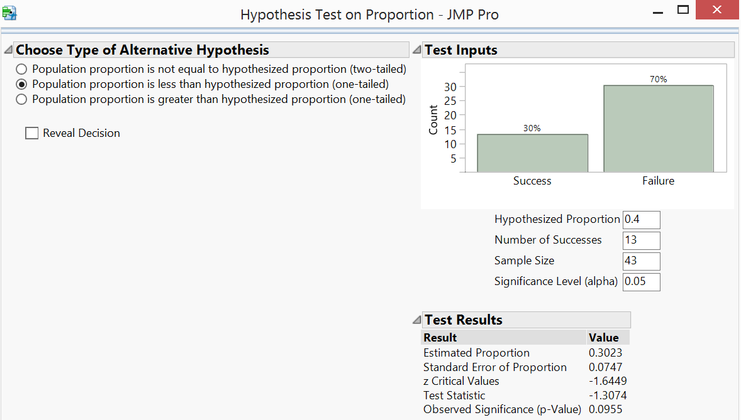
Practice Problem #3 Solution, p. 2
3 and 4. z-test statistic = -1.3074
P-value = 0.0955
Fail to reject H₀
5. Since the p-value of 0.0955 is less than the significance level of 0.10, we reject the null hypothesis. There is sufficient evidence to conclude that the true proportion of women executives is less than 40%, the proportion of women employees at the company.

Slide 61
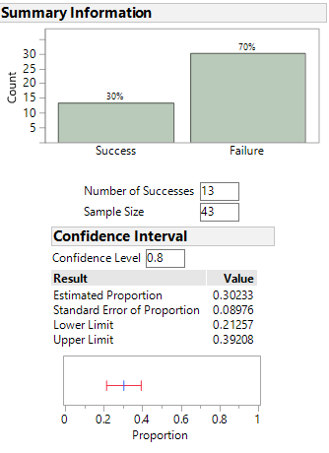
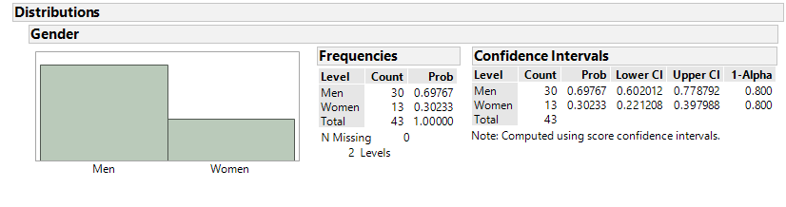
Practice Problem #3 Solution, p. 3
Part B: In this context, the p-value of 0.0955 indicates that the chance of observing 13 or fewer women executives at the company in a group of 43 executives is only 9.55% if the true proportion of women executives is actually 40%.
Part C: I am 80% confident that the true proportion of
women executives is between 0.213 (.221) and 0.392 (.398).

Slide 62
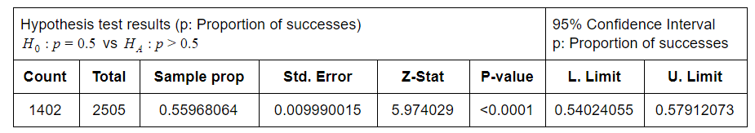
#4
A Pew Research Center poll in 2010 asked a random sample of 2505 adults about their attitudes and opinions concerning the U.S. government. When asked whether they felt content, frustrated, or angry, 1402 said that they were frustrated. Let p denote the population proportion who would say they are frustrated. The computer output shows the following results to analyze whether a majority or minority of Americans would say that they were frustrated.
What are the assumptions for the significance test? Do they seem to be satisfied for this application? Explain.
For this computer output, specify the null and alternative hypotheses that are tested (in context), and report the point estimate of p and the value of the test statistic.
Report and interpret the p-value in context.
Explain an advantage of the confidence interval shown over the significance test.
Interpret the confidence interval in context. Does the confidence interval confirm the results of the hypothesis test? Explain.

Slide 63
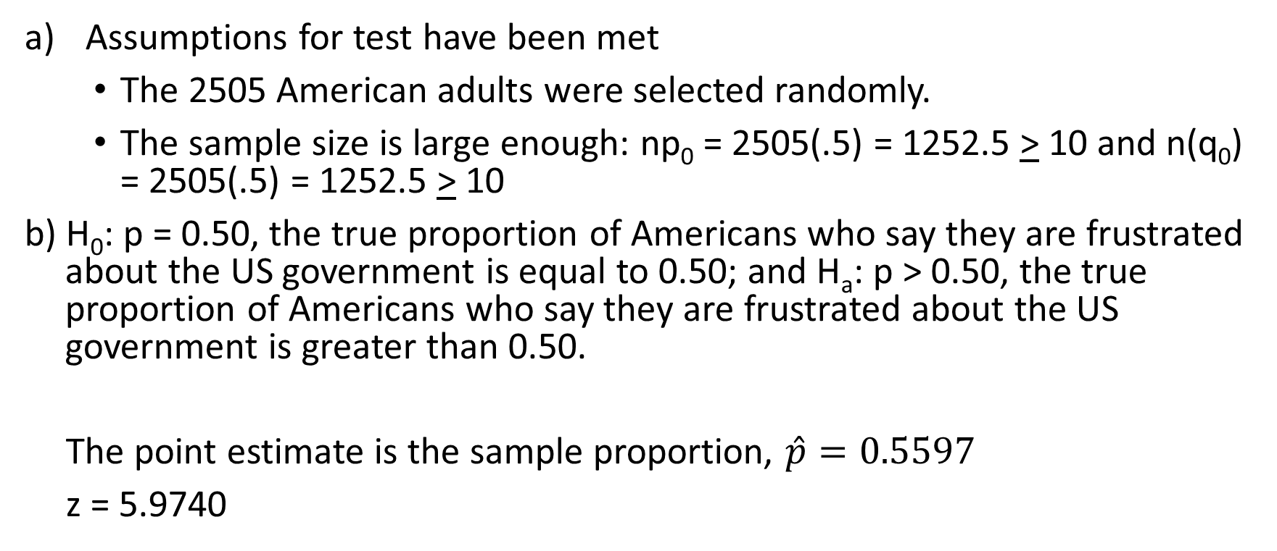
Practice Problem #4 Solution
Assumptions for test have been met
The 2505 American adults were selected randomly.
The sample size is large enough: np₀ = 2505(.5) = 1252.5 > 10 and n(q₀) = 2505(.5) = 1252.5 > 10
b) H₀: p = 0.50, the true proportion of Americans who say they are frustrated about the US government is equal to 0.50; and H_{a}: p > 0.50, the true proportion of Americans who say they are frustrated about the US government is greater than 0.50.
The point estimate is the sample proportion, $\hat{p}=0.5597$
z = 5.9740

Slide 64
Practice Problem #4 Solution, p. 2
c) The p-value is less than 0.0001. The p-value indicates that there is a less than 0.01% chance that natural sampling variability could produce poll results like these, in which 55.97%, or more, of American adults would say they are frustrated by the US government if actually the true proportion of American adults who are frustrated by the US government is less than or equal to 50%.
d) The advantage to using a confidence interval is it gives you a range of plausible values for the unknown population proportion of American adults who are frustrated by the US government. Whereas, the hypothesis test just indicates if you have enough evidence to reject the null hypothesis. In other words, if we have statistical significance, we don’t have a measure of our population parameter without constructing a confidence interval.

Slide 65
Practice Problem #4 Solution, p. 3
e) I am 95% confident that the true proportion of American adults who are frustrated by the US government is between 0.540 and 0.579. The confidence interval indicates that a majority of American adults are frustrated by the US government, which is the conclusion we draw when we run the hypothesis test.

Slide 66
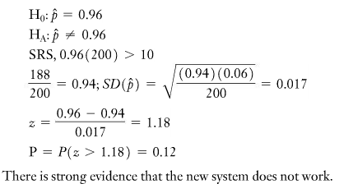
Practice Problem #5
Since many people have trouble using all of the features on their smart phones, an executive training company has developed what it hopes will be easier instructions. The goal is to have at least 96% of customers succeed at being able to use any feature they wish. The company tests the new system on 200 people, 188 of whom were successful. Is this strong evidence that the new system fails to meet the company’s goal? A student’s test of this hypothesis is shown here. How many mistakes can you find?

Slide 67
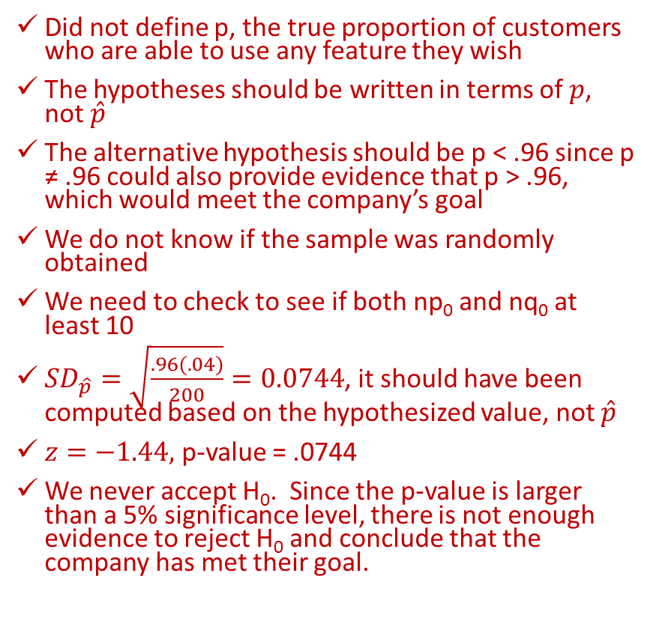
Practice Problem #5 Solution
Did not define p, the true proportion of customers who are able to use any feature they wish
The hypotheses should be written in terms of $p$, not $\hat{p}$
The alternative hypothesis should be p < .96 since p ≠ .96 could also provide evidence that p > .96, which would meet the company’s goal
We do not know if the sample was randomly obtained
We need to check to see if both np₀ and nq₀ at least 10
${SD}_{\hat{p}}=\sqrt{\frac{.96(.04)}{200}}=0.0744$, it should have been computed based on the hypothesized value, not $\hat{p}$
$z=−1.44,$ p-value = .0744
We never accept H₀. Since the p-value is larger than a 5% significance level, there is not enough evidence to reject H₀ and conclude that the company has met their goal.

Slide 68
Practice Problem #6
In the 1980s, it was generally believed that congenital abnormalities affected about 5% of the nation’s children. Some people believe that the increase in the number of chemicals in the environment has led to an increase in the incidence of abnormalities. A recent study examined 384 children and found that 46 of them showed signs of an abnormality. Is this strong evidence that the risk has increased? (We consider a P-value of around 5% to represent reasonable evidence.)
Perform a hypothesis test.
Explain carefully what the P-value means in this context.
What’s your conclusion? Do chemicals in the environment cause congenital abnormalities?

Slide 69
Practice Problem #6 Solution
Part A:
Let p = true proportion of children with congenital abnormalities.
H₀: p = .05 vs. H_{a}: p > .05
α = 0.05
2. Check the assumptions:
The children were selected randomly.
Whether or not one child has congenital abnormalities does not affect whether or not other children do.
The sample size is large enough: np₀ = 384(.05) = 19.2 > 10 and n(q₀) = 384(.95) = 364.8 > 10
384 is less than 10% of all children

Slide 70
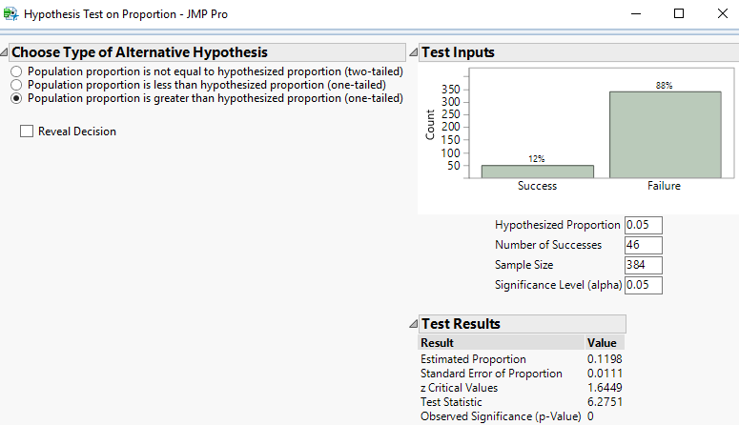
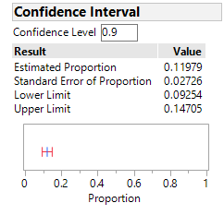
Problem #6 Solution, p. 3
3 and 4. z-test statistic = 6.2751
P-value < 0.0001
Reject H₀
5. Since the p-value is less than any reasonable significance level, we reject the null hypothesis. There is sufficient evidence to conclude that the true proportion of children with congenital abnormalities is greater than 0.05.
Bonus CI: We are 90% confident that the true proportion of children with congenital abnormalities is between 0.093 and 0.147.

Slide 71
Practice Problem #6 Solution, p. 4
Part B:
The p-value indicates that if the actual proportion of children with congenital abnormalities is 0.05, we would expect to get results like this less than .01% of the time.
Part C:
We cannot determine causation based on the results of a hypothesis test; we can only conclude that the proportion has increased.

