Slide 1

Almost there!!
Unit 8 – Hypothesis Testing
Your Scientist Professor Colton

Slide 2
Unit 8 - Outline
Unit 8 – Hypothesis Testing
Intro
Hypothesis Testing Overview
Define Parameter and State Hypotheses
Rejection Region
Test Statistic, P-value Method and Conclusion
Hypothesis Testing for Population Proportions
Calculator Work and Conclusions
Full Example

Slide 3
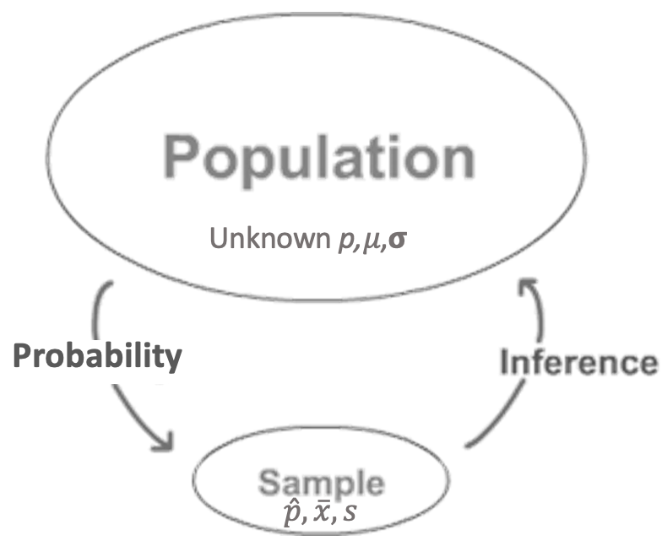
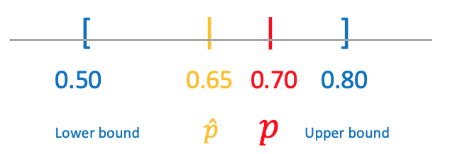
Inference! Our Second Look
Confidence Intervals
What’s next??

Slide 4
Intro to Hypothesis Tests
Testing a Claim
A company is criticized because only 13 of 43 people in executive-level positions are women. The company explains that this is not surprising given that only 40% of their employees are women. What do you think?
This is a big claim!
Is there actually enough evidence to back this up?
Is the sample proportion 13/43 = 0.32 strange enough????
What if it was 30/43?? Or 3/43???
Compare this type of question to where we have been:
Estimating a Parameter
Estimate the proportion of female employees at this company with a confidence interval.

Slide 5
Logic Behind Hypothesis Testing
We believe something about a population
The Null Hypothesis (H₀)
Ex) 40% of the company employees are women, so 40% of the executives should also be women
We want to determine if something else is true
The Alternative Hypothesis (H_{A})
Ex) Less than 40% of the executives are women
We use sample data to make a decision / conclusion
Compute the Test Statistic (TS)
Ex) 13 out of the 43 executives are women, use this to find the TS
And then determine if we will continue to believe the null hypothesis or will reject it in favor of the alternative hypothesis.
Enough evidence?
How far must the sample statistic be from the hypothesized parameter?
This is set before running the test and depends on the the significance level α

Slide 6
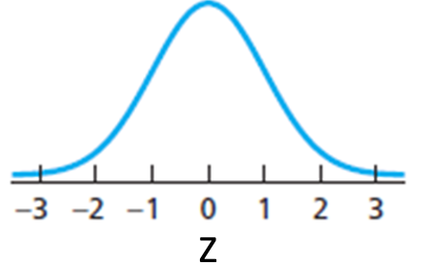
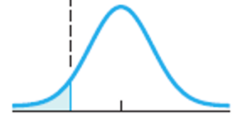
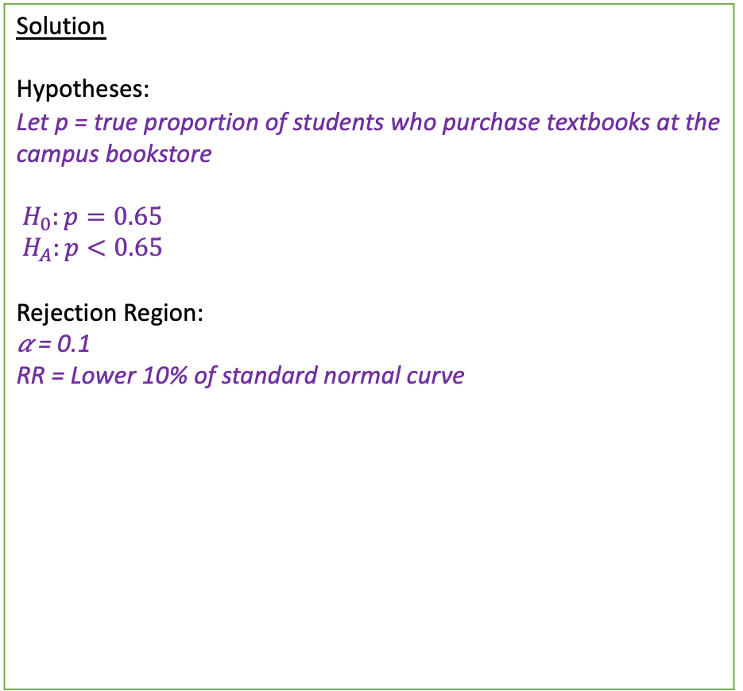
Full Problem
Here is an entire hypothesis problem worked out perfectly to show us where we are going!
Then we will break it down piece by piece!
Setup: The campus bookstore is determining if they need to increase their marketing budget. They would like at least 65% of students to buy their textbooks directly from them rather than off-campus stores. In order to check this, they took a random sample of 137 students in which 81 students said they buy their books at the campus bookstore.
Is there sufficient evidence to conclude that the proportion of students who purchase their books is less than 0.65? Test this at the 10% significance level.
Solution
Hypotheses:
Let p = true proportion of students who purchase textbooks at the campus bookstore
$H_{0}:p=0.65$
$H_{A}:p<0.65$
Rejection Region:
𝛼 = 0.1
RR = Lower 10% of standard normal curve
P-Value:
p-value = 1-PropZTest(p₀ = 0.65, x = 81, n = 137, prop < p₀) = 0.075
p-value = 0.075 < 𝛼 = 0.1 → Reject H₀!
Conclusion:
Because our p-value = 0.075 is less than the significance level 0.1,
we reject the Null hypothesis.
We have sufficient evidence to conclude that the true proportion of students who buy their textbooks at the campus bookstore is less than 0.65.
The marketing team should increase their budget to reach their target percent of students.
𝛼 = 0.1
p-value = 0.075
Z_{stat}
0.10 = 𝛼
0
Z

Slide 7
Hypothesis Test Steps – This is Your Life Now…
State the Hypotheses
Define parameter + context.
Sketch Rejection Region based of Significance Level
Compute P-value (and Test Statistic).
Conclude and Interpret
State whether you reject H₀ or fail to reject H₀ AND WHY!
Interpret your results in the context of the problem

Slide 8
The Hypothesis Statements
State the Hypotheses
Define parameter + context.
Full Example
Is there sufficient evidence to conclude that the proportion of students who purchase their books is less than 0.65?
(Parameter):
Let p = true proportion of students who purchase textbooks at the campus bookstore
Define Parameter
Always define your parameter at the start!
This helps orient us with the context of the problem and sets us up to correctly write our hypothesis statements
Think about the variable / quantity of interest!
Categorical (“success” and “failure”) → population proportion (p)
Quantitative (numeric) → population mean 𝜇
More Examples:
Let p = population proportion of students is statistics courses
Let 𝜇 = true mean height of oak trees in meters
This is similar to how we talked about the parameter + context in the confidence interval interpretation!

Slide 9
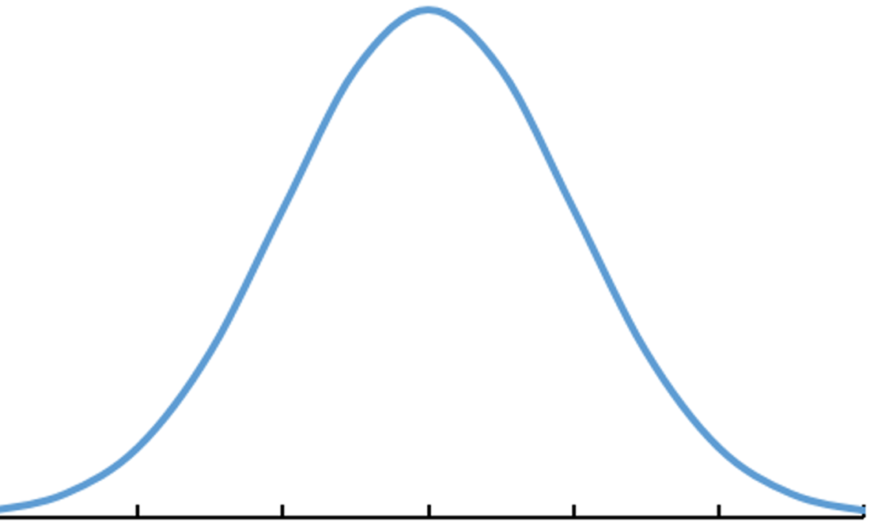
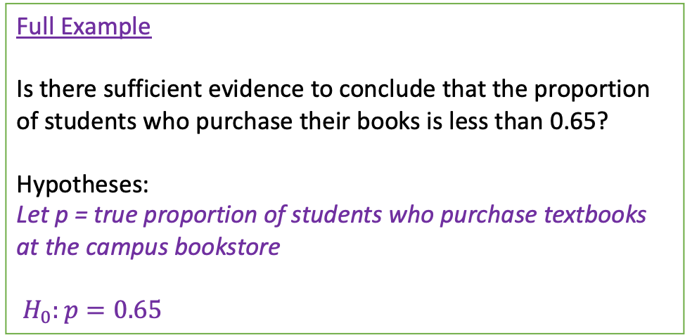
The Hypothesis Statements
Full Example
Is there sufficient evidence to conclude that the proportion of students who purchase their books is less than 0.65?
Hypotheses:
Let p = true proportion of students who purchase textbooks at the campus bookstore
$H_{0}:p=0.65$
State the Hypotheses
Define parameter + context.
Null Hypothesis H₀
The Null hypothesis is an equation that includes the population parameter
When written symbolically ALWAYS =
This is the status quo, typically a known value of the parameter (p₀ or 𝜇₀)
Said another way, it’s what we are starting with as TRUE
In doing so, we are placing the hypothesized value at the center of our distribution!
In general
H₀: p = p₀
H₀: μ = 𝜇₀
0.53 0.57 0.61 0.65 0.69 0.73 0.77
-3 -2 -1 0 1 2 3
p
Z
Standardize
More Examples:
H₀: p = 0.3, p = population proportion of students is statistics courses
H₀: μ = 70, 𝜇 = true mean height of oak trees in meters
‘Research from previous studies suggests the average number of people is 7’
Equal to → H₀: μ = 7

Slide 10
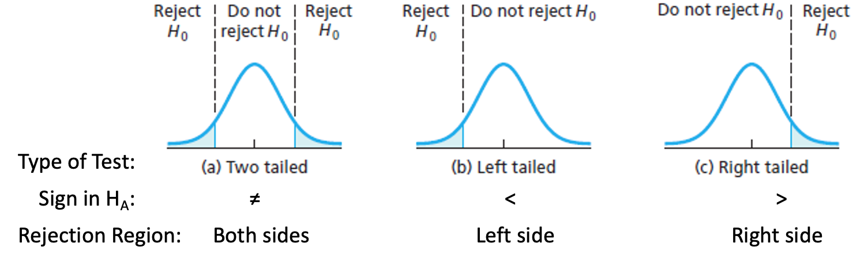
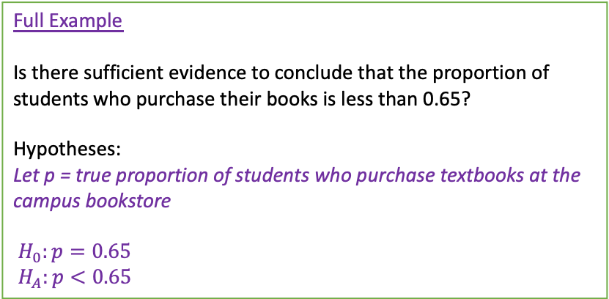
The Hypothesis Statements
Full Example
Is there sufficient evidence to conclude that the proportion of students who purchase their books is less than 0.65?
Hypotheses:
Let p = true proportion of students who purchase textbooks at the campus bookstore
$H_{0}:p=0.65$
$H_{A}:p<0.65$
State the Hypotheses
Define parameter + context.
Alternative Hypothesis H_{A}
The Alternative hypothesis is another equation that includes the population parameter
Uses the same value of the parameter as in the Null hypothesis H₀
May be left-tailed (<), right-tailed (>), or two-tailed (≠).
Depends on if we are interested in simply different than (≠), or a directional difference ( < or >)
This is the research interest, what we want to prove
In general
H₀: p = p₀ and H_{A}: p ≠, <, > p₀
H₀: μ = 𝜇₀ and H_{A}: μ ≠, <, > 𝜇₀
More Examples:
H₀: p = 0.3, p = population proportion of students is statistics courses
H_{A}: p > 0.3
H₀: μ = 70, 𝜇 = true mean height of oak trees in meters
H_{A}: μ ≠ 70
‘The owner believes his average monthly profit is more than $50,000’
In this case, greater than → H_{A}: μ > 50,000

Slide 11
LCQ – Hypotheses
Problem: (1) Define the parameter of interest and (2) State the Null and Alternative Hypotheses and the directionality of the test (two-tailed, left-tailed or right-tailed) for the following scenarios:
a) A company reports that last year 40% of their reports in accounting were on time. From a random sample this year, they want to know if that proportion has changed.
b) Last year, 42% of the employees enrolled in at least one wellness class at the company’s site. Using a survey from randomly selected employees, they want to know if a greater percentage is planning to take a wellness class this year.
c) There are two political candidates, and one wants to know from the recent polls if she is going to win a majority of votes in next week’s election.

Slide 12
LCQ – Hypotheses
Problem: (1) Define the parameter of interest and (2) State the Null and Alternative Hypotheses and the directionality of the test (two-tailed, left-tailed or right-tailed) for the following scenarios:
a) A company reports that last year 40% of their reports in accounting were on time. From a random sample this year, they want to know if that proportion has changed.
Let p = the true proportion of reports that were on time
H₀: p = 0.4 and H_{A}: p ≠ 0.4 → two tailed! PERFECTO!!
b) Last year, 42% of the employees enrolled in at least one wellness class at the company’s site. Using a survey from randomly selected employees, they want to know if a greater percentage is planning to take a wellness class this year.
Options
1) Let p = the true number PROPORTION of employees enrolled (+ more context) → Have to say PROPORTION (not ‘number’, ‘amount’, etc.)
2) P = TRUE proportion of employees enrolled in at least one wellness class → Need to make sure to say TRUE or POPULATION proportion
Options
1) H₀ > 0.42 and H_{A} < 0.42 → several things to correct: (1) ‘H₀’ is NOT our PARAMETER, p is (have to include p); (2) equals sign = always goes in the Null hypothesis; (3) from the wording of the problem (‘if a greater percentage is planning’) indicates greater than for the Alternative and have to include our PARAMETER, less than 0.42, p
2) H₀: p = 0.42 and H_{A}: p > 0.42 → RIGHT (greater than) tailed! YES!!
H_{A}: p ≥ 0.42 → INCORRECT, should never include any equality in the alternative hypothesis
c) There are two political candidates, and one wants to know from the recent polls if she is going to win a majority of votes in next week’s election.
Let p = the true proportion of votes she will receive
H₀: p = 0.5 → We use 0.5 because there was no prior information about how she had been polling, so we just start with assuming they are tied (evenly 50/50)
Options
H_{A} = wins election → INCORRECT! Yes this is the correct context, but what does this mean for the population proportion??? Have to have an INEQUALITY with our PARAMETER
H_{A}: p > 0.51 → Alternative hypothesis is INCORRECT! We have to have the SAME VALUE in the Null and Alternative; the strictly greater sign take care of getting ‘the majority’ because anything more than 0.5 is technically the majority (even 0.50001)
H_{A}: p > 0.5 RIGHT tailed → CORRECT!

Slide 13
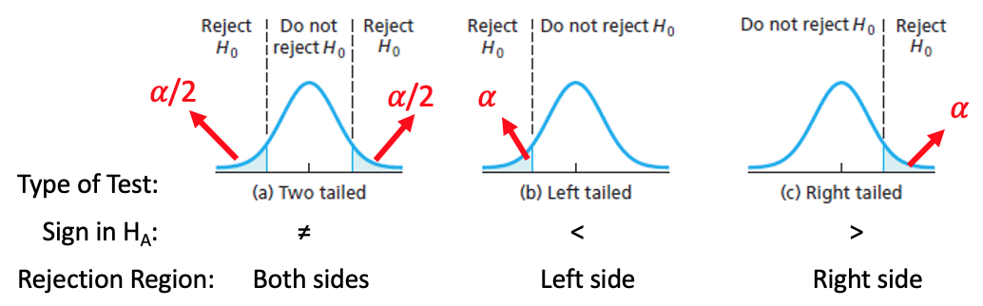
Rejection Region
Full Example
Is there sufficient evidence to conclude that the proportion of students who purchase their books is less than 0.65? Test this at the 10% significance level.
Rejection Region:
𝛼 = 0.1
RR = Lower 10% of standard normal curve
2. Sketch Rejection Region based of Significance Level
Rejection Region (RR)
We have to determine the the when there is or is not enough evidence against the Null.
In other words, which tail do we make the conclusion of reject and how large is the area!
Our Rejection Region (RR) is based on whether we are doing a one or two tailed test (this is the direction from the H_{A})!
Significance Level
The significance level (α) of the test is what determines how large the Rejection Region is!
It is chosen before running the test. Setups will say something similar to: ”Determine if there is enough evidence at the 5% significance level.”
It represents the probability of rejecting the Null Hypothesis.
Visually, it is the area under the curve in the direction of the Alternative hypothesis
For a two-tailed test, area for 𝛼 is split equally between the upper and lower tails!
𝛼 = 0.1
Z*

Slide 14
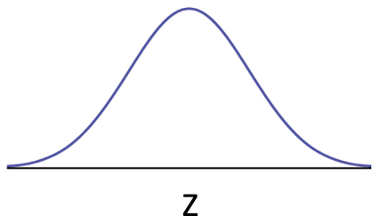
Mini LCQ
Problem: Sketch the Rejection Region for the following Alternative hypotheses and significance levels:
a) H_{A}: p > 0.7, 𝛼 = 0.08
b) H_{A}: p ≠ 0.7, 𝛼 = 0.15
c) H_{A}: p < 0.7, 𝛼 = 4%

Slide 15
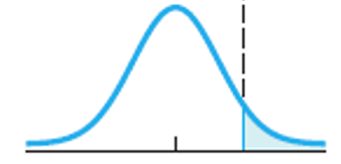
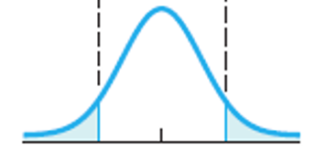
Mini LCQ Solution
Note: We can draw these RR on the original curve or the standardized. We will use the Z curve so that it is general and applies to all problems
0.7
-3 -2 -1 0 1 2 3
p
Z
Standardize
Problem: Sketch the Rejection Region for the following Alternative hypotheses and significance levels:
a) H_{A}: p > 0.7, 𝛼 = 0.08
Right tailed → RR = upper 0.08 probability on the standard normal curve
b) H_{A}: p ≠ 0.7, 𝛼 = 0.15
Two tailed → RR = lower and upper 0.075 probability on the standard normal curve
RR are always to the outside, so never the middle probability
c) H_{A}: p < 0.7, 𝛼 = 4%
Left tailed → RR = lower 0.04 probability on the standard normal curve
𝛼 = 0.08
Z
0.075 = 𝛼/2
𝛼/2 = 0.15/2 = 0.075
Z
0.04 = 𝛼
Z

Slide 16
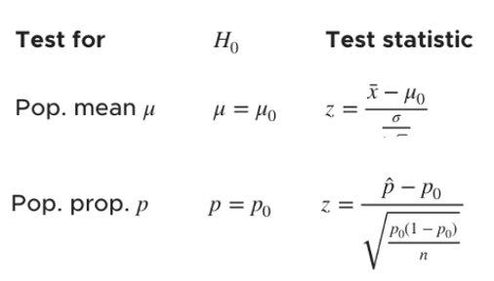

Test Statistic
Full Example
Is there sufficient evidence to conclude that the proportion of students who purchase their books is less than 0.65? Test this at the 10% significance level.
Test Statistic:
TS = Z_{stat} = 1-PropZTest(p₀ = 0.65, x = 81, n = 137, prop < p₀) = -1.44
Z_{stat} is in the Rejection Region → Reject H₀!
3. Compute P-value (and Test Statistic).
Test Statistic (TS)
Test Statistic (TS) is calculated using our sample statistics (or directly from the data)
Technically, the TS is just the standardized (Z) score of our sample statistic based on the corresponding sampling distribution of that statistic under the Null hypothesis
We could plot the TS to see if it is in the rejection region!
*** NOTE!! We are not going to use the Test Statistic to make conclusions, but it is helpful to know what it is!
$$\hat{p}=\frac{81}{137}≈0.59→−1.44=Z_{stat}$$
𝛼 = 0.1
Z_{stat}
Z*
We are not going to calculate these by hand because we’ve had lots of practice before
Instead, we will learn new calculator functions shortly!
1-PropZTest and Z-Test
** These are based on the CLT formulas proportions and means
https://www.kristakingmath.com/blog/test-statistics-for-means-and-proportions

Slide 17
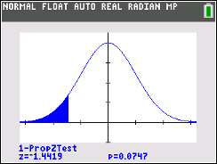
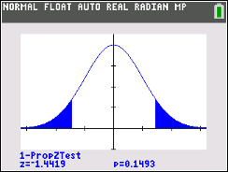
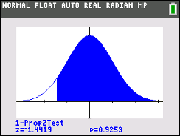

P-Value
Full Example
Is there sufficient evidence to conclude that the proportion of students who purchase their books is less than 0.65? Test this at the 10% significance level.
P-Value:
p-value = 1-PropZTest(p₀ = 0.65, x = 81, n = 137, prop < p₀) = 0.075
p-value = 0.075 < 𝛼 = 0.1 → Reject H₀!
3. Compute P-value (and Test Statistic).
P-Value
The p-value is the probability of getting a result as, or more extreme than, the result obtained from the sample given (assuming) the Null Hypothesis (H₀) is TRUE.
In other terms, “The P-Value is a measure of how plausible the data are, given our null hypothesis.”
P-Value Method
This way just involves comparing the p-value to the significance level.
If the p-value is less than the significance level, this is the implication:
Our statistic or anything more extreme (smaller or larger; depends on alternative) isn’t likely with the Null Hypothesis being True!! And thus we REJECT!
𝛼 = 0.1
p-value = 0.075
Z_{stat}
Our calculator draws the p-value.
P-Value depends on the alternative hypothesis!
Decision RULE:
If: p-value ≤ ⍺ Reject H₀! This means the TS in in the RR!
If: p-value > ⍺ Fail to Reject H₀!
H_{A}: $p<0.65$ $p≠0.65$ $p>0.65$
* With two-tailed tests, the p-value is double that of the one-tailed

Slide 18




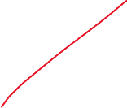





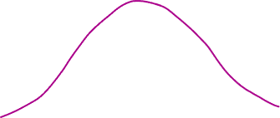

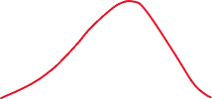







Slide 19
Conclude and Interpret
Full Example
Is there sufficient evidence to conclude that the proportion of students who purchase their books is less than 0.65? Test this at the 10% significance level.
Conclusion:
Because our p-value = 0.075 is less than the significance level 0.1, we reject the Null hypothesis.
We have sufficient evidence to conclude that the true proportion of students who buy their textbooks at the campus bookstore is less than 0.65.
4. Conclude and Interpret
State whether you reject H₀ or fail to reject H₀ AND WHY!
Interpret your results in the context of the problem
This is where we formally (nicely) say the results of our hypothesis test!
How to Write Our Conclusion
(General structure)
Reject or Rail to reject NULL
Because our P-Value (INSERT P-Value) is (LESS or GREATER) than our significance level (INSERT SIGNIFICANCE LEVEL), we (REJECT or FAIL TO REJECT) the Null Hypothesis.
There (IS or IS NOT) sufficient evidence to conclude (THE ALTERNATIVE HYPOTHESIS).
First part →
Second part →
DECISION RULE!!
If P-value ≤ α, REJECT (use the Red Text)
If P-value > α, FAIL TO REJECT (use the Blue Text)
*** Always talk about the results in terms of the the problem!
Don’t just write ‘… conclude the alternative hypothesis’
*** NEVER SAY WE ACCEPT THE NULL HYPOTHESIS!!!!!!
We aren’t saying that the Null is true, just that we can’t say it’s wrong! Think NOT GUILTY (not “Innocent”)

Slide 20
Hypothesis Tests for Proportions!
Everything above applies, now we are just going to apply it specifically to a Proportion Test!

Slide 21
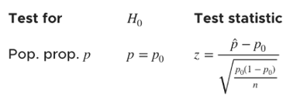
Using Calc - Test Statistic and P-Value for Proportions
3. Compute P-value (and Test Statistic).
Formula for Z_{stat} by hand:
(Original) Setup
In 2020, A NatGeo Poll interviewed 1200 hiking enthusiasts and asked “Are you more afraid of spiders or snakes???” Out of the 1200 people, 768 responded “Ewww, snakes….”. Is there enough evidence to conclude the proportion of people who are more afraid of snakes is different than the 2010 proportion of 0.65. Use 𝛼 = 0.1
GOAL: Conduct a Hypothesis Test!
1-PropZTest
p₀ = the Null proportion
x = number of successes
n = sample size
prop: Alternative hypothesis
Calculate or Draw
New Scenario
Now lets say the 2020 sample proportion is equal to 0.62 (same sample size) AND we want to know if the proportion has decreased from 2010. Use 𝛼 = 0.05
Run another 1-PropZTest

Slide 22
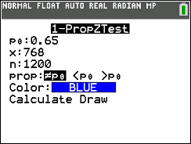
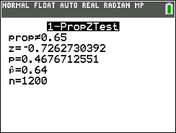
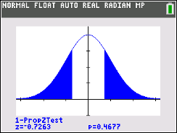
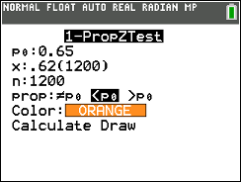
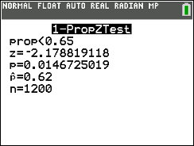
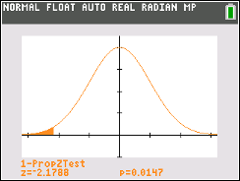
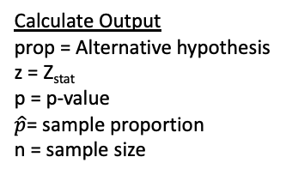
Using Calc - Test Statistic and P-Value for Proportions
3. Compute P-value (and Test Statistic).
Formula for Z_{stat} by hand:
(Original) Setup
In 2020, A NatGeo Poll interviewed 1200 hiking enthusiasts and asked “Are you more afraid of spiders or snakes???” Out of the 1200 people, 768 responded “Ewww, snakes….”. Is there enough evidence to conclude the proportion of people who are more afraid of snakes is different than the 2010 proportion of 0.65. Use 𝛼 = 0.1
GOAL: Conduct a Hypothesis Test!
1-PropZTest
p₀ = the Null proportion
x = number of successes
n = sample size
prop: Alternative hypothesis
Calculate or Draw
Calculate Output
prop = Alternative hypothesis
z = Z_{stat}
p = p-value
$\hat{p}$= sample proportion
n = sample size
Draw Output
Plot (and displays values) of p = p-value and z = Z_{stat} on the standard normal curve
H₀: p = 0.65
H_{A}: p ≠ 0.65
Show work: 1-PropZTest(p₀ = 0.65, x = 768, n = 1200, prop ≠ p)
Then we are looking for the p-value!
New Scenario
Now lets say the 2020 sample proportion is equal to 0.62 (same sample size) AND we want to know if the proportion has decreased from 2010. Use 𝛼 = 0.05
Run another 1-PropZTest
H₀: p = 0.65
H_{A}: p < 0.65

Slide 23
LCQ – Conclusions and Interpretations
4. Conclude and Interpret
State whether you reject H₀ or fail to reject H₀ AND WHY!
Interpret your results in the context of the problem
Problem: Write the conclusions and interpretations for the previous scenarios using our results.
a) Original Setup: In 2020, A NatGeo Poll interviewed 1200 hiking enthusiasts and asked “Are you more afraid of spiders or snakes???” Out of the 1200 people, 768 responded “Ewww, snakes….”. Is there enough evidence to conclude the proportion of people who are more afraid of snakes is different than the 2010 proportion of 0.65. Use 𝛼 = 0.1
b) New Scenario: Now lets say the 2020 sample proportion is equal to 0.62 (same sample size) AND we want to know if the proportion has decreased from 2010. Use 𝛼 = 0.05

Slide 24
LCQ – Conclusions and Interpretations
4. Conclude and Interpret
State whether you reject H₀ or fail to reject H₀ AND WHY!
Interpret your results in the context of the problem
Problem: Use the specified method to write the conclusions and interpretations for the previous scenarios using our results.
a) Original Setup: In 2020, A NatGeo Poll interviewed 1200 hiking enthusiasts and asked “Are you more afraid of spiders or snakes???” Out of the 1200 people, 768 responded “Ewww, snakes….”. Is there enough evidence to conclude the proportion of people who are more afraid of snakes is different than the 2010 proportion of 0.65. Use 𝛼 = 0.1
Need these…
P-Value
p-value = 1-PropZTest(p₀ = 0.65, x = 768, n = 1200, prop ≠ p₀) = 0.4667
p-value = 0.4667 < 0.10 = 𝛼 → Fail to Reject H₀! → The first part of the conclusion is really just writing this comparison in words
Conclusion and Interpretation
Decision (comparison of p-value and significance level):
Because our p-value = 0.4667 is greater than the significance level 0.10, we fail to reject the Null hypothesis → Perfect for the first part
Second part (then what does the decision mean):
First attempt at second part → There is not enough evidence to conclude the true proportion is different than the null hypothesis (0.65) → The ending part can be improved! Need context!!
Improvement
There is not enough evidence to conclude to that the true proportion of hikers who are more afraid of snakes is different than 0.65
** the underlined portion above is where we talk about the alternative hypothesis in CONTEXT! We can really just directly put into words what each part of the H_{A} represents!
Here’s what I mean: There is NOT enough evidence that p (the true proportion of hikers that are more afraid of snakes) is ≠ (different than) 0.65! So easy!
H₀: p = 0.65 Let p = true proportion of hikers who are more afraid of snakes
H_{A}: p ≠ 0.65
𝛼 = 0.1
First part →
Second part →

Slide 25
Entire Process LCQ
Problem: 24% of the state of Ohio speaks a second language. The local community center took a random of 96 community members in which 26 speak a second language.
Is there sufficient evidence that the proportion of local community members that speak a second language is higher than 0.24? Use $α$ = 0.15.
Solution:
Hypotheses and Parameter:
Rejection Region:
Test Statistic and P-value:
Conclusion and Interpretation:

Slide 26
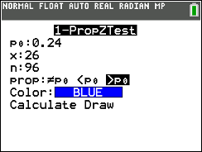
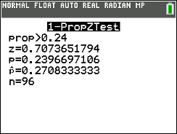
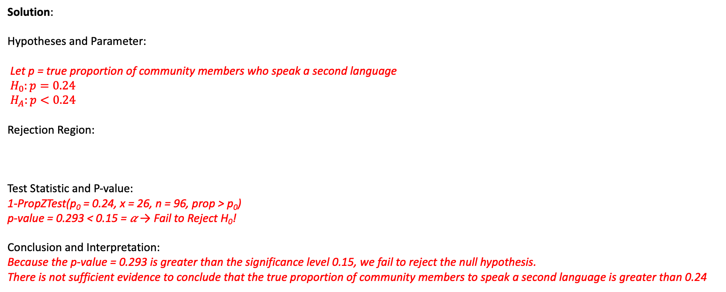
Entire Process LCQ
Problem: 24% of the state of Ohio speaks a second language. The local community center took a random of 96 community members in which 26 speak a second language.
Is there sufficient evidence that the proportion of local community members that speak a second language is higher than 0.24? Use $α$ = 0.15.
Solution:
Hypotheses and Parameter:
Let p = true proportion of community members who speak a second language
$H_{0}:p=0.24$
$H_{A}:p<0.24$
Rejection Region:
Test Statistic and P-value:
1-PropZTest(p₀ = 0.24, x = 26, n = 96, prop > p₀)
p-value = 0.293 < 0.15 = 𝛼 → Fail to Reject H₀!
Conclusion and Interpretation:
Because the p-value = 0.293 is greater than the significance level 0.15, we fail to reject the null hypothesis.
There is not sufficient evidence to conclude that the true proportion of community members to speak a second language is greater than 0.24
𝛼 = 0.15
Z

