Slide 1
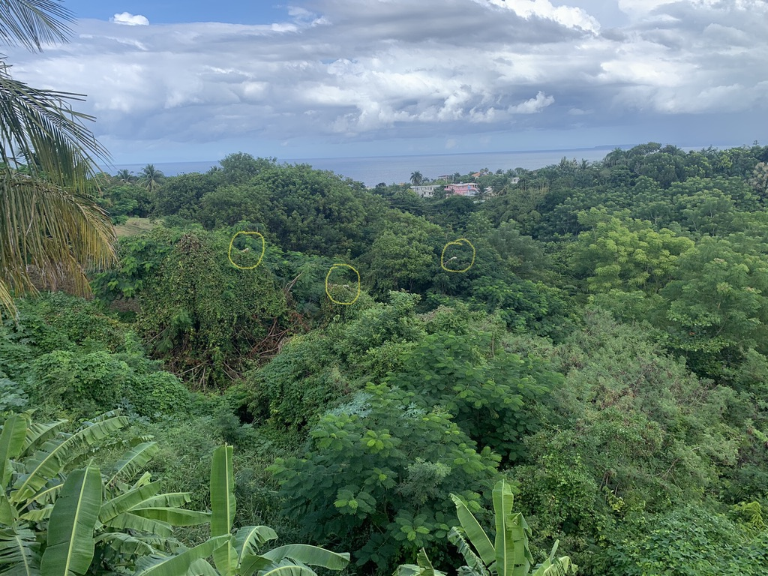
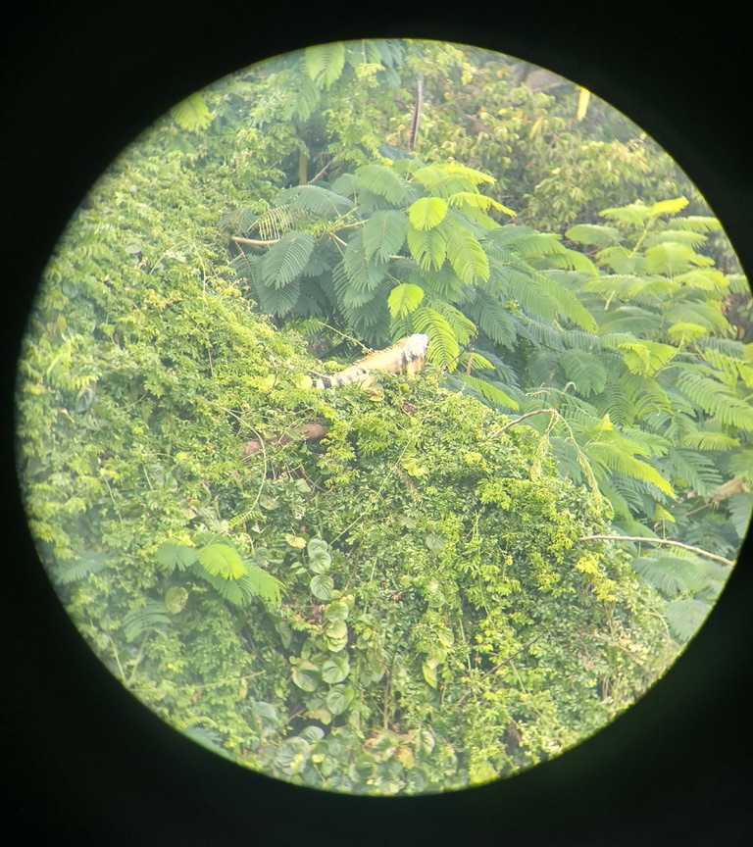
Not much left!
Unit 8 – Hypothesis Testing Day 2
Your Realizing-summer-is-almost-over Professor Colton

Slide 2
Unit 8 Day 2- Outline
Unit 8 – Hypothesis Testing
Hypothesis Testing for Population Means with KNOWN SD
Define Parameter and State Hypotheses
Rejection Region
Test Statistic, P-value Method and Conclusion
Hypothesis Testing for Population Means with UNKNOWN SD
Similarities and Differences
Calc work for Test Statistic and P-value Method
Decisions in Hypothesis Tests
Describing Type 1 and 2 Errors

Slide 3
Hypothesis Tests for Means with KNOWN 𝞂!
All of the previous Hypothesis tests overview applies, now we are just going to apply it specifically to a Means Test!
And going back to the Confidence Interval unit, we have a known population standard deviation! So the same logic and implications of that apply here as well!
We will be doing a Z-Test!

Slide 4
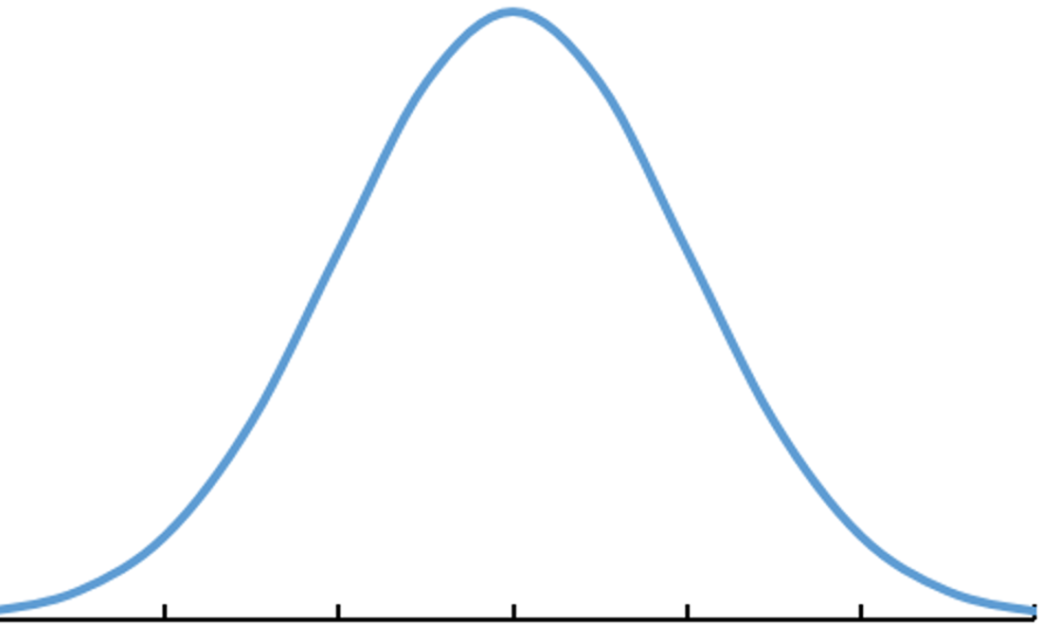
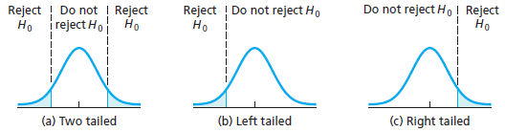
The Hypothesis Statements - Review
1. State the Hypotheses
Define parameter + context.
Define Parameter
Always define your parameter at the start!
Think about the variable / quantity of interest!
Quantitative (numeric) → population mean 𝜇
Null Hypothesis H₀
This is the status quo, typically a known value of the parameter (𝜇₀)
When written symbolically ALWAYS =
Alternative Hypothesis H_{A}
May be left-tailed (<), right-tailed (>), or two-tailed (≠).
Uses the same value of the parameter as in the Null hypothesis H₀
In general
H₀: μ = 𝜇₀ and H_{A}: μ ≠,<,> 𝜇₀
7 14 21 35 42 49 56
-3 -2 -1 0 1 2 3
𝜇
Z
Standardize
Type of Test:
Sign in H_{A}: ≠ < >
Critical Values: -Z* +Z* -Z* Z*
Examples:
‘Research from previous studies suggests the average number of people is 7’
Equal to → H₀: μ = 7
‘The owner believes his average monthly profit is more than $50,000’
In this case, greater than → H_{A}: μ > 50,000

Slide 5
LCQ – Hypotheses
Problem: (1) Define the parameter of interest and (2) State the Null and Alternative Hypotheses and the directionality of the test (two-tailed, left-tailed or right-tailed) for the following scenarios:
a) A random sample of 15 human body temperatures were obtained. Assume that human body temperatures are normally distributed. Is there sufficient evidence to conclude that the true mean human body temperature differs from 98.6ºF?
b) In 2012, a large number of foreclosed homes in Washington, D.C. were sold. Real estate experts say the standard deviation for sales the past 10 years was $190,000. In one community, a random sample of 30 foreclosed homes sold for an average of $443,705. A prospective home-buyer wants to know if prices have decreased from the 2002 average of $450,000.
c) Test 1 grades on the most fun class you’ve ever taken averaged 80.76 with standard deviation 13.34 points. From a random sample of 19 Test 2 grades, there was a mean of 83.39. Your super cool instructor wants to know if the Test 2 grades improved.

Slide 6
LCQ – Hypotheses
Problem: (1) Define the parameter of interest and (2) State the Null and Alternative Hypotheses and the directionality of the test (two-tailed, left-tailed or right-tailed) for the following scenarios:
a) A random sample of 15 human body temperatures were obtained. Assume that human body temperatures are normally distributed. Is there sufficient evidence to conclude that the true mean human body temperature differs from 98.6ºF?
Let µ = the true mean of human body temperature → VERY GOOD!
First try:
H₀ = 98.6 and H_{A} ≠ 98.6 → INCORRECT! MISSING µ!!!
H₀: µ = 98.6 and H_{A}: µ ≠ 98.6 → two-tailed → NOW IT’S PERFECT!
b) In 2012, a large number of foreclosed homes in Washington, D.C. were sold. Real estate experts say the standard deviation for sales the past 10 years was $190,000. In one community, a random sample of 30 foreclosed homes sold for an average of $443,705. A prospective home-buyer wants to know if prices have decreased from the 2002 average of $450,000.
First try:
H₀: p = 450,000 and H_{A}: p < 450,000 → INCORRECT!! NOT TALKING ABOUT PROPORTIONS!!! SHOULD BE NO Ps
Let µ = the true mean of the prices of foreclosed homes → PERFECT
H₀: µ = 443,705 and H_{A}: µ < 450,000 → INCORRECT! Remember both numbers in the H₀ and H_{A} need to be the same! So which one is correct?????
Hypotheses are NEVER based on SAMPLE information!!!! H₀: µ = 450,000 and H_{A}: µ < 450,000 left-tailed → NOW CORRECT!
c) Test 1 grades on the most fun class you’ve ever taken averaged 80.76 with standard deviation 13.34 points. From a random sample of 19 Test 2 grades, there was a mean of 83.39. Your super cool instructor wants to know if the Test 2 grades improved.
Both correct (I won’t be too picky with the context, technically we are looking at our Test 2 grade average and comparing that to a value from the Test 1 (the null):
Let µ be the true mean of the test 2 grades.
Let µ = represent the true mean of test scores
H₀: µ = 80.76 and H_{A}: µ > 8.076 right-tailed → CORRECT!

Slide 7
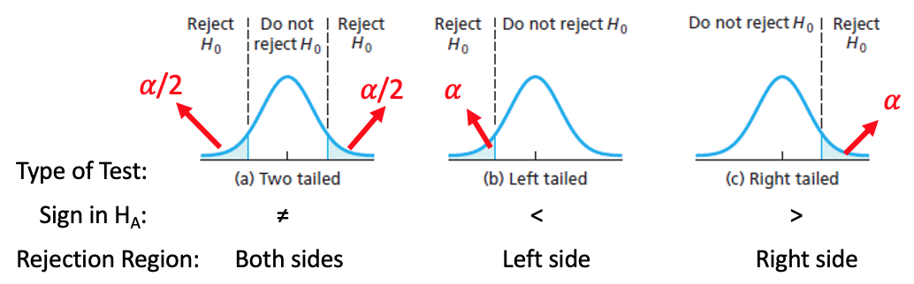
Rejection Region for Means with Known 𝞂
2. Sketch Rejection Region based of Significance Level
Rejection Region for Means Test with KNOWN 𝞂
This is the SAME as for a Proportions Test!
Review
We have to determine the the when there is or is not enough evidence against the Null.
Our Rejection Region (RR) is based on whether we are doing a one or two tailed test (this is the direction from the H_{A})!
Z Z Z

Slide 8
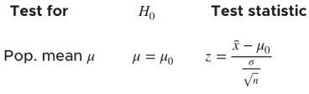

Using Calc - Test Statistic and P-Value for Means with Known 𝜎
3. Compute P-value (and Test Statistic).
Formula for Z_{stat} by hand:
(Original) Setup
Scientists discovered a new mountain range under the sea. Lets assume the sea mountain heights are normally distribution with known standard deviation of 5000 ft.
From a random sample of 13 peaks, there was an average height of 12,000 ft. Is there enough evidence to conclude the average heights of these new sea mountains is different than the Rocky Mountains, which average 14,400 ft? Use 𝛼 = 0.12
GOAL: Conduct a Hypothesis Test!
Z-Test
Input = Stats
μ₀ = the Null mean
𝜎 = population SD
$\overline{x}$ = sample mean
n = sample size
μ: Alternative hypothesis
Calculate or Draw
New Scenario
Three more sea mountains were discovered. The new sample mean is equal to 15,000 ft. Is there enough evidence to say the sea mountains are taller than the Rockies. Use 𝛼 = 0.10
Run another ZTest

Slide 9
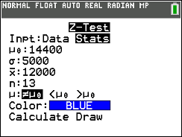
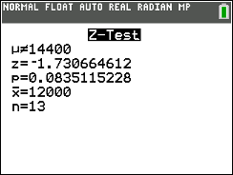
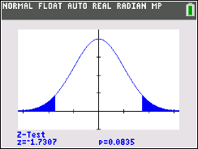
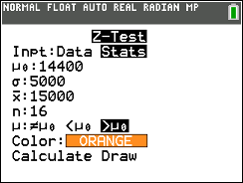
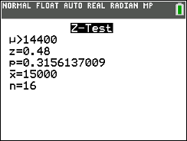
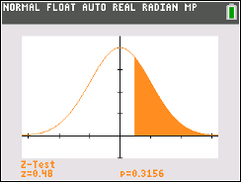
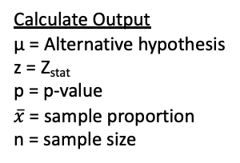
Using Calc - Test Statistic and P-Value for Means with Known 𝜎
3. Compute P-value (and Test Statistic).
Formula for Z_{stat} by hand:
(Original) Setup
Scientists discovered a new mountain range under the sea. Lets assume the sea mountain heights are normally distribution with known standard deviation of 5000 ft.
From a random sample of 13 peaks, there was an average height of 12,000 ft. Is there enough evidence to conclude the average heights of these new sea mountains is different than the Rocky Mountains, which average 14,400 ft? Use 𝛼 = 0.12
GOAL: Conduct a Hypothesis Test!
Z-Test
Input = Stats
μ₀ = the Null mean
𝜎 = population SD
$\overline{x}$ = sample mean
n = sample size
μ: Alternative hypothesis
Calculate or Draw
Calculate Output
μ = Alternative hypothesis
z = Z_{stat}
p = p-value
$\overline{x}$= sample proportion
n = sample size
Draw Output
Plot (and displays values) of p = p-value and z = Z_{stat} on the standard normal curve
H₀: μ = 14,400
H_{A}: μ ≠ 14,400
New Scenario
Three more sea mountains were discovered. The new sample mean is equal to 15,000 ft. Is there enough evidence to say the sea mountains are taller than the Rockies. Use 𝛼 = 0.10
Run another ZTest
H₀: μ = 14,400
H_{A}: μ > 14,400

Slide 10
LCQ – Conclusions and Interpretations
4. Conclude and Interpret
State whether you reject H₀ or fail to reject H₀ AND WHY!
Interpret your results in the context of the problem
Problem: Write the conclusions and interpretations for the previous scenarios using our results.
a) Original Setup: Scientists discovered a new mountain range under the sea. Lets assume the sea mountain heights are normally distribution with known standard deviation of 5000 ft. From a random sample of 13 peaks, there was an average height of 12000 ft. Is there enough evidence to conclude the average heights of these new sea mountains is different than the Rocky Mountains, which average 14,400 ft? Use 𝛼 = 0.12
b) New Scenario: Three more sea mountains were discovered. The new sample mean is equal to 15,000 ft. Is there enough evidence to say the sea mountains are taller than the Rockies. Use 𝛼 = 0.10

Slide 11
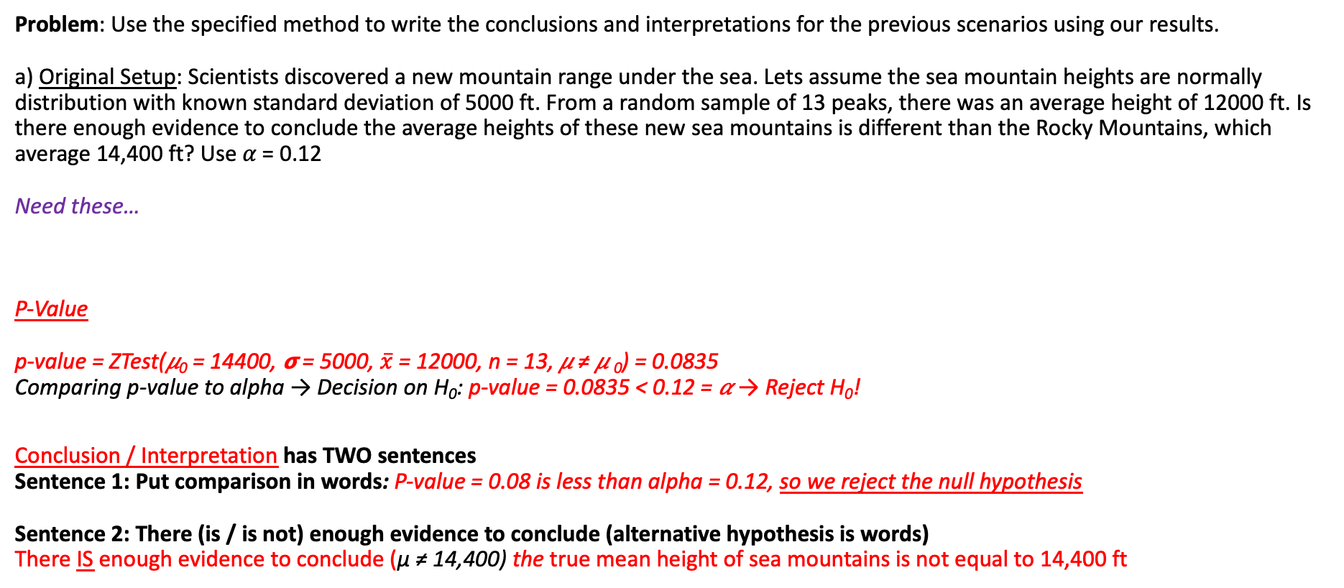
LCQ – Conclusions and Interpretations
4. Conclude and Interpret
State whether you reject H₀ or fail to reject H₀ AND WHY!
Interpret your results in the context of the problem
Problem: Use the specified method to write the conclusions and interpretations for the previous scenarios using our results.
a) Original Setup: Scientists discovered a new mountain range under the sea. Lets assume the sea mountain heights are normally distribution with known standard deviation of 5000 ft. From a random sample of 13 peaks, there was an average height of 12000 ft. Is there enough evidence to conclude the average heights of these new sea mountains is different than the Rocky Mountains, which average 14,400 ft? Use 𝛼 = 0.12
Need these…
P-Value
p-value = ZTest(𝜇₀ = 14400, 𝞂 = 5000, $\overline{x}$ = 12000, n = 13, 𝜇 ≠ 𝜇 ₀) = 0.0835
Comparing p-value to alpha → Decision on H₀: p-value = 0.0835 < 0.12 = 𝛼 → Reject H₀!
Conclusion / Interpretation has TWO sentences
Sentence 1: Put comparison in words: P-value = 0.08 is less than alpha = 0.12, so we reject the null hypothesis
Sentence 2: There (is / is not) enough evidence to conclude (alternative hypothesis is words)
There IS enough evidence to conclude (μ ≠ 14,400) the true mean height of sea mountains is not equal to 14,400 ft
H₀: μ = 14,400
H_{A}: μ ≠ 14,400
𝛼 = 0.12

Slide 12
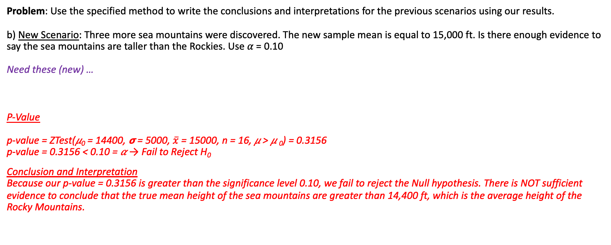
LCQ – Conclusions and Interpretations Cont…
4. Conclude and Interpret
State whether you reject H₀ or fail to reject H₀ AND WHY!
Interpret your results in the context of the problem
Problem: Use the specified method to write the conclusions and interpretations for the previous scenarios using our results.
b) New Scenario: Three more sea mountains were discovered. The new sample mean is equal to 15,000 ft. Is there enough evidence to say the sea mountains are taller than the Rockies. Use 𝛼 = 0.10
Need these (new) …
P-Value
p-value = ZTest(𝜇₀ = 14400, 𝞂 = 5000, $\overline{x}$ = 15000, n = 16, 𝜇 > 𝜇 ₀) = 0.3156
p-value = 0.3156 < 0.10 = 𝛼 → Fail to Reject H₀
Conclusion and Interpretation
Because our p-value = 0.3156 is greater than the significance level 0.10, we fail to reject the Null hypothesis. There is NOT sufficient evidence to conclude that the true mean height of the sea mountains are greater than 14,400 ft, which is the average height of the Rocky Mountains.
H₀: μ = 14,400
H_{A}: μ > 14,400
𝛼 = 0.10

Slide 13
Hypothesis Tests for Means with UNKNOWN 𝞂!
All of the previous Hypothesis tests overview and for Means applies, now we are just going to look at the situation when we have an unknown 𝞂 (unlike before)!
And going back to the Confidence Interval unit, we have now have an unknown population standard deviation! So the same logic and implications of that apply here as well!
We will be doing a T-Test!

Slide 14
T Test vs Z-Test - Step Similarities
1. State the Hypotheses
Define parameter + context.
Samesies
EXACT same overall process as for testing a Mean with known 𝞂!
BUT NOW, the population standard deviation 𝞂 is UNKNOWN and we only have the sample standard deviation s…
And the Conclusion / Interpretation is the same as well!
Different
The ONLY steps that involve something sightly different are the Rejection Region and the Test Statistic / P-Value
2. Sketch Rejection Region based of Significance Level
3. Compute P-value (and Test Statistic).
4. Conclude and Interpret
State whether you reject H₀ or fail to reject H₀ AND WHY!
Interpret your results in the context of the problem

Slide 15
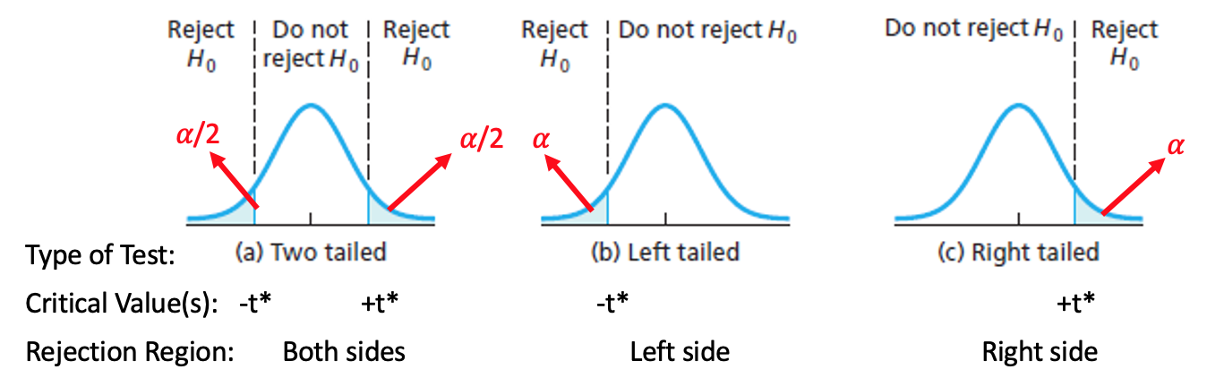
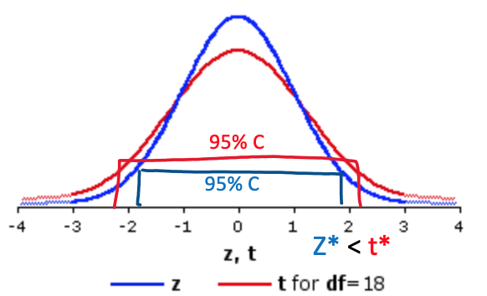
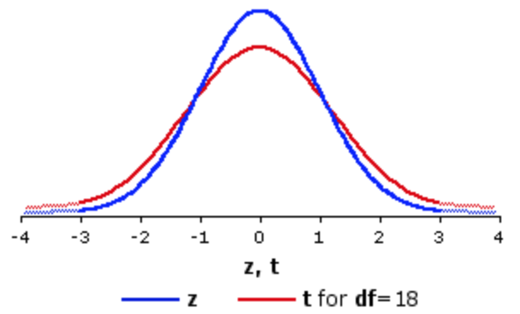

Rejection Region for Means with Unknown 𝞂
2. Sketch Rejection Region based of Significance Level
Rejection Region for Means Test with UNKNOWN 𝞂
It is now based on the t-distribution rather than the standard normal distribution Z (just like it was for the Confidence Intervals).
So the curve we draw is a T-curve!
(All of the CVs will be t*s with the correct degrees of freedom df)
Effect of Z vs T on Hypothesis Tests
Recall from CI that because we have to estimate 𝞂 with s, there is inherently more variability (uncertainty) which produces wider t-intervals compared to Z-intervals.
In Hypothesis Tests, this translates to Rejections Regions being further away from the center for the same 𝛼!
Which means we need to have more extreme results in order to reject when switching from Z to T Tests
𝛼 = 0.025
𝛼 = 0.025
𝛼 = 0.025
𝛼 = 0.025
Z* < t*

Slide 16
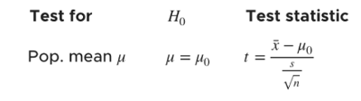

Using Calc - Test Statistic and P-Value for Means with Unknown 𝜎
3. Compute P-value (and Test Statistic).
Formula for t_{stat} by hand:
(ALMOST SAME Original) Setup
Scientists discovered a new mountain range under the sea. Lets assume the sea mountain heights are normally distribution.
From a random sample of 13 peaks, there was an average height of 11,308 ft and standard deviation of 5,287 ft. Is there enough evidence to conclude the average heights of these new sea mountains is different than the Rocky Mountains, which average 14,400 ft? Use 𝛼 = 0.12
** Only a sample standard deviation is provided, so σ is unknown → T-Test
GOAL: Conduct a Hypothesis Test!
T-Test
Option 1) Input = Stats
μ₀ = the Null mean
$\overline{x}$ = sample mean
Sx = sample SD
n = sample size
μ: Alternative hypothesis
Calculate or Draw
Option 2) Input = Data
Enter raw data in L₁
μ₀ = the Null mean
List = L1
Freq = 1
μ: Alternative hypothesis
Calculate or Draw

Slide 17
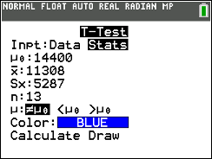
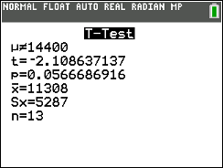
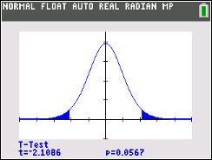
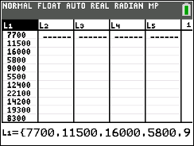
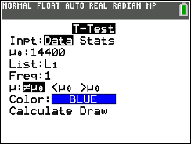
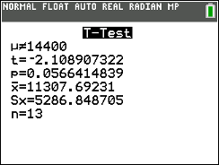


Using Calc - Test Statistic and P-Value for Means with Unknown 𝜎
3. Compute P-value (and Test Statistic).
Formula for t_{stat} by hand:
(ALMOST SAME Original) Setup
Scientists discovered a new mountain range under the sea. Lets assume the sea mountain heights are normally distribution.
From a random sample of 13 peaks, there was an average height of 11,308 ft and standard deviation of 5,287 ft. Is there enough evidence to conclude the average heights of these new sea mountains is different than the Rocky Mountains, which average 14,400 ft? Use 𝛼 = 0.12
** Only a sample standard deviation is provided, so σ is unknown → T-Test
GOAL: Conduct a Hypothesis Test!
T-Test
Option 1) Input = Stats
μ₀ = the Null mean
$\overline{x}$ = sample mean
Sx = sample SD
n = sample size
μ: Alternative hypothesis
Calculate or Draw
Option 2) Input = Data
Enter raw data in L₁
μ₀ = the Null mean
List = L1
Freq = 1
μ: Alternative hypothesis
Calculate or Draw
Calculate Output
μ = Alternative hypothesis
t = t_{stat}
p = p-value
$\overline{x}$= sample proportion
Sx = sample SD
n = sample size
Draw Output
Plot (and displays values) of p = p-value and t = t_{stat} on the t curve with df = n -1
H₀: μ = 14,400
H_{A}: μ ≠ 14,400
Same results! (maybe a little roundoff error from $\overline{x}$ or s)
T-Test(input = Stats, µ0 = 14,400, x-bar = 11308, Sx = 5287, n = 13, µ ≠ µ0)
T-Test(input = Data, µ0 = 14,400, List = L1, Freq = 1, µ ≠ µ0)

Slide 18
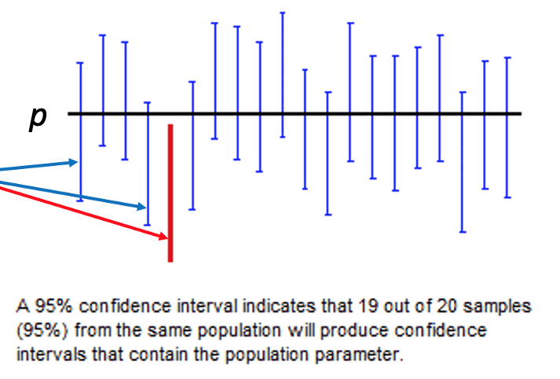
Decisions in Hypothesis Tests
Recall from Confidence Intervals that it’s not a guarantee that our interval captures the true population parameter!
As researchers we can do things to minimize the chances this happens such as having a high confidence level and a large sample size.
But we are working with real data when we take samples, and this is what your intervals are based on. There is always the possibility that our sample data leads us astray resulting in an interval that misses the population parameter ☹
Of course, we never actually know if we capture or don’t capture (because we don’t know the truth). But it’s something that we have to keep in mind when interpreting and making decisions based on our results.
This same dilemma is present in Hypothesis Tests as well!
There is the real possibility that we are making the WRONG conclusion to either Reject or Fail to Reject the Null hypothesis.
These are called Type 1 and Type 2 Errors!

Slide 19
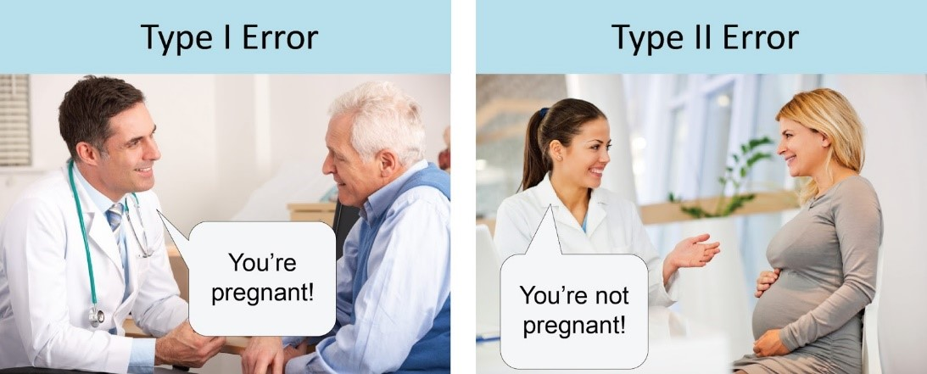
Incorrect Decisions Example
Null Hypothesis: Not pregnant
Alternative Hypothesis: Pregnant
WRONG CONCLUSION!
Telling someone they ARE pregnant when in reality they are NOT.
ANOTHER WRONG CONCLUSION!
Telling someone they are NOT pregnant when in reality they ARE.

Slide 20
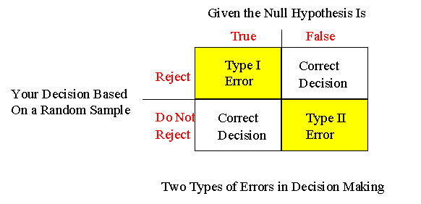
Type I and Type II Error
Type I Error
This occurs when we incorrectly reject a TRUE Null hypothesis
False Positive → The test says you have COVID, but you actually don’t
(Reject the Null Hypothesis and) Conclude the Alternative, when in reality the Null Hypothesis is actually correct.
Recall α is the probability of rejecting the Null hypothesis. This also means that …
Probability of committing Type I error = α
Type II error
This occurs when we fail to (2) reject a FALSE Null hypothesis
False Negative → The test says you don’t have COVID, but you actually do
(Fail to (2) Reject the Null Hypothesis and) Conclude the Null, when in reality the the alternative is actually correct.
** If I ask you to describe a Type 1 or Type 2 error, these are the structures you should use + CONTEXT!!
There’s two layers here:
The TRUTH (which we don’t actually know)
Our DECISION (which he hope is correct)
https://home.ubalt.edu/ntsbarsh/Business-stat/opre504.htm

Slide 21
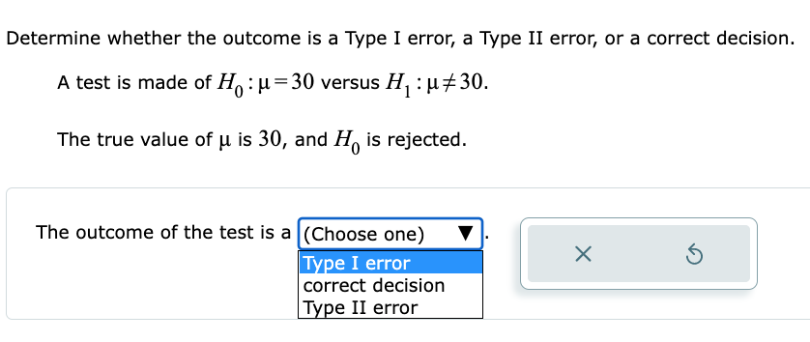
Errors Example
https://home.ubalt.edu/ntsbarsh/Business-stat/opre504.htm
Setup: All commercial elevators must pass yearly inspections. An inspector has to choose between certifying an elevator as safe (no repairs needed) or saying that the elevator is not safe (repairs are needed). There are two hypotheses:
H₀: The elevator is not safe (repairs are needed)
H_{A}: The elevator is safe (no repairs needed)
a) Describe Type I error.
b)Describe Type II error.
MAYBE ADD EXAMPLE WHERE WE ACTUALLY USE NUMBERS FROM A HYPOTHESIS TEST AND THEN DETERMINE WHICH TYPE OF ERROR WAS MADE BY (example from Connect HW below)

Slide 22
Errors Example - Solution
https://home.ubalt.edu/ntsbarsh/Business-stat/opre504.htm
H₀: The elevator is not safe (repairs are needed)
H_{A}: The elevator is safe (no repairs needed)
a) Describe Type I error → (Reject the Null Hypothesis and) Conclude the Alternative, when in reality the Null Hypothesis is actually correct
Description → A Type I error is wrongly concluding that the elevator is safe and no repairs are needed, when actually the elevator is not safe.
We add the phrase “wrongly concluding” because we are committing an error, so of course our conclusion is incorrect
b) Describe Type II error → (Fail to (2) Reject the Null Hypothesis and) Conclude the Null, when in reality the the alternative is actually correct
Description → A Type II error is wrongly concluding that the elevator is not safe and repairs are needed, when actually the elevator is safe.
TIP: When trying to decide which type of error has been committed in a problem, use these facts:
A Type 1 error can ONLY happen when we REJECT the null
A Type 2 error can ONLY happen when we FAIL TO REJECT the null

Slide 23
LCQ – Type 1 and Type 2 Errors
https://home.ubalt.edu/ntsbarsh/Business-stat/opre504.htm
Setup: A restaurant got their supply of food (meat, veggies, etc.) a few days late and are trying to decide if they are still able to serve it or not. There are two hypotheses:
H₀: The food is still fresh
H_{A}: The food has gone bad
a) Describe Type I error
b) Describe Type II error

Slide 24
LCQ – Type 1 and Type 2 Errors
https://home.ubalt.edu/ntsbarsh/Business-stat/opre504.htm
Setup: A restaurant got their supply of food (meat, veggies, etc.) a few days late and are trying to decide if they are still able to serve it or not. There are two hypotheses:
H₀: The food is still fresh
H_{A}: The food has gone bad
Describe Type I error→ (Reject the Null Hypothesis and) Conclude the Alternative, when in reality the Null Hypothesis is actually correct
Descriptions - Options
1) The food still would be thought as fresh, when the food is not fresh → INCORRECT! This would mean concluding the Null is TRUE but in reality the Alternative is correct (this is actually Type 2!)
2) Type I error is wrongly concluding that the food is not fresh → ALMOST, this has the first part perfect! But MISSING the ‘in reality the Null is TRUE’. So NEED to ADD ‘but in reality it’s good‘
3) We wrongly conclude that the food has gone bad, when it is still good → Very good! Stating we wrongly conclude alternative in context but the Null is actually true context!
b) Describe Type II error → (Fail to (2) Reject the Null Hypothesis and) Conclude the Null, when in reality the the alternative is actually correct
Descriptions - Options
1) We wrongly conclude that the food is fresh → ALMOST again! MISSING the second key part of committing an error, the truth being different than our conclusion! NEED to HAVE ’when it actually it has gone bad’
2) We wrongly conclude that the food is still good when it has actually gone bad → PERFECT! Conclude H_{A} in context but actually H₀ context is true!
To describe these errors, it is really as simple as plugging and chugging into the general description! Here’s what I mean:
Conclude the Null, when in reality the the alternative is actually correct
Wrongly Concluding the food is still fresh, when in reality the food has gone bad → Can add ‘wrongly’ at the start further indicating that we are making the incorrect decision!

