Slide 1
Bonus (but necessary) Content
Unit 9 – Inferences from DEPENDENT Samples
Your Extra Professor Colton

Slide 2
Unit 9 Extra - Outline
Unit 9 – Inferences from Two Samples
Hypothesis Testing of Two Population Means (Dependent Samples)
Means of Dependent Samples p-value method

Slide 3
Hypothesis Tests for Means – DEPENDENT Samples
Much of the logic from Two Sample Hypothesis Tests we have learned still applies!
Although there are some notable differences in how we conduct a test for dependent samples
First, let’s review what we have learned thus far!

Slide 4
Independent vs Dependent Samples
Recall that for Two Sample Hypothesis Tests, we have to know the relationship between our two samples
For two sample proportions and the two sample means, both known and unknown population standard deviations, we needed to have INDEPENDENT samples!
This was one of the necessary assumptions!
We had ways to think about our two samples in order to determine if indeed they were independent:
Let’s review the LCQ we had to practice this!
How to think about samples
Independent samples → Groups are unrelated, no connection, no relationship
Dependent samples → Groups have some relationship between one another, can link the two; PAIRS

Slide 5
LCQ: Independent vs Dependent Samples
How to think about samples
Independent samples → Groups are unrelated, no connection, no relationship
Dependent samples → Groups have some relationship between one another, can link the two; PAIRS
Problem: Determine if the following scenarios are independent or dependent samples.
1) Comparing the blood pressure of STAT 1450 students before the final exam and after completing the final exam.
Dependent! → There is a relationship between the blood pressure before the final and after the completion of the final. Connection is measuring the SAME student twice
2) Seeing if the height of Faculty is shorter than the undergraduate population.
Independent → There is no direct connection (or inherent relationship) between faculty and undergrads
3) Looking to see if there is a difference in the price of the same Video Game Consoles at Target or Walmart.
Independent??? Two different stores
Dependent! → No relationship between Target and Walmart, BUT we are looking at the SAME console at the two different stores (groups). So there is a relationship with the consoles (think pairs of X-boxes, one at Walmart and one at Target; same for a PS4)
4) A study is conducted to see what effect a new drug has on dexterity. A random sample of 30 students is chosen. They are given a series of tasks to perform and a score reflecting their performance. A dose of the drug is given to the 30 students and they again perform similar tasks and are scored again.
Dependent → SAME students before and after drug. So there is a relationship between the two groups

Slide 6
Dependent Samples
Two Types of Dependent Samples
If samples are dependent, they can be dependent in one of two ways!
The test that we run is that same for both, but nonetheless it is important to know the structure of our data and how it was obtained!
Paired
Two values from the SAME subject
Examples) Before and After experiments, coordination test for left vs right hand
Matched
Two values from DIFFERENT subjects connected in some way
Examples) Husband and Wife heights, comparing rental car prices from two companies for the same 10 cities

Slide 7
LCQ: Paired or Matched Samples
Problem: Determine if the following scenarios have Paired or Matched samples.
1) Comparing the blood pressure of STAT 1450 students before the final exam and after completing the final exam.
2) Are brothers or sisters smarter? A researcher studied ACT scores of 8 brother and sister pairs.
3) A study is conducted to see what effect a new drug has on dexterity. A random sample of 30 students is chosen. They are given a series of tasks to perform and a score reflecting their performance. A dose of the drug is given to the 30 students and they again perform similar tasks and are scored again.
4) Looking to see if there is a difference in the price of the same Video Game Consoles at Target or Walmart.
5) Seeing if the height of Faculty is shorter than the undergraduate population.

Slide 8
LCQ: Paired or Matched Samples
Problem: Determine if the following scenarios have Paired or Matched samples.
1) Comparing the blood pressure of STAT 1450 students before the final exam and after completing the final exam.
PAIRED → We are measuring the same student twice; repeat measurements from the same person
2) Are brothers or sisters smarter? A researcher studied ACT scores of 8 brother and sister pairs.
MATCHED → Dependent sample, connection is from the same family; but not paired because different test-takers
3) A study is conducted to see what effect a new drug has on dexterity. A random sample of 30 students is chosen. They are given a series of tasks to perform and a score reflecting their performance. A dose of the drug is given to the 30 students and they again perform similar tasks and are scored again.
PAIRED → Before and after measurements on the SAME student (repeated measures)
4) Looking to see if there is a difference in the price of the same Video Game Consoles at Target or Walmart.
Matched / Paired? Tough to tell based on context → It will be more obvious when paired
5) Seeing if the height of Faculty is shorter than the undergraduate population.
NEITHER → These are INDEPENDENT samples, matched and paired are only for dependent samples

Slide 9
Dependent Samples Test (aka Paired T-Test)
If we had INDEPENDENT samples, we would either run a 2-SampZTest or a 2-SampTTest based on whether or not we knew 𝞂₁ and 𝞂₂
But what do we do if we don’t have INDEPENDENT samples and therefore that assumption is NOT MET?? That’s what we are going to learn here.
We will see that we actually end up running a One Sample T Test on the DIFFERENCES between the dependent samples!
This might sound similar to how we thought about Two Samples earlier, but the difference is that we are really treating this as ONE sample! We are only going to have ONE sample size, ONE sample mean and ONE sample standard deviation!
This is because we are actually NOT studying the overall differences between the two population like before (i.e. a separate µ₁ and a separate µ₂). We are studying the differences between EACH PAIR in the POPULATION!!!
Sample 2 – Sample 1
After – Before
Sample 2
Sample 1
Run T Test ONLY on the Differences
-
-
-

Slide 10
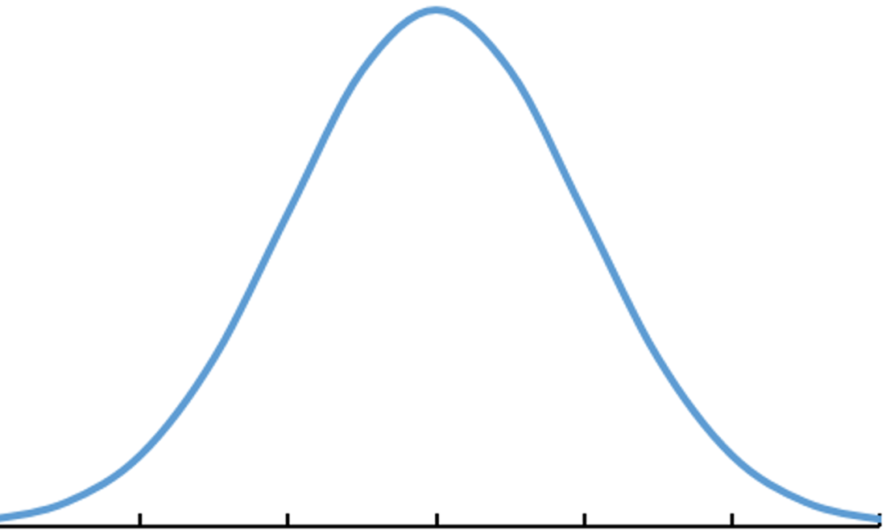
The Hypothesis Statements for Dependent Samples
State the Hypotheses
Define parameter + context.
** We are directly studying the DIFFERENCES of EACH PAIR!
Define Parameters
We still have our two parameters like before! Population means 𝜇₁ and 𝜇₂
But now we define a NEW parameter that is the DIFFERENCE between our original two parameters:
𝜇_{d} = 𝜇₁ – 𝜇₂
𝜇_{d} represents is the mean of the differences in each pair of data for the entire population that the sample is drawn from
Null Hypothesis H₀ and Alternative Hypothesis H_{A}
These are now written using our population mean of the differences, 𝜇_{d}
We start by assuming the differences are equal to ZERO! Which of course implies the two original parameters are equivalent!
Then we try to show otherwise, the same way we have done!
-30 -20 -10 0 10 20 30
-3 -2 -1 0 1 2 3
𝜇_{d}
t
Standardize
** We still have to define our two parameters in context like before
How to define Parameters and write Hypotheses
Let 𝜇₁ = true mean + context
Let 𝜇₂ = true mean + context
𝜇_{d} = 𝜇₁ – 𝜇₂
H₀: µ_{d} = 0
H_{A}: µ_{d} ≠ 0
H_{A}: µ_{d} < 0
H_{A}: µ_{d} > 0
** The order of subtraction is IMPORTANT, so we have to be clear when we define 𝜇_{d}
** The direction here implies which population mean of the pair we believe to be larger

Slide 11
LCQ – Dependent Samples Hypotheses
Problem: (1) Define the parameters of interest and (2) State the Null and Alternative for the following scenarios:
a) The University is investigating the safety of statistics courses for their students. To do this, they plan a study to compare the blood pressure of STAT 1450 students before the final exam and after completing the final exam. Is there sufficient evidence that the blood pressure has increased from before to after the final?
b) Are brothers or sisters smarter? A researcher studied ACT scores of 8 brother and sister pairs. Is there enough evidence to conclude there is a significant difference in performance on the ACT among brother and sister pairs?

Slide 12
LCQ – Dependent Samples Hypotheses
Problem: (1) Define the parameters of interest and (2) State the Null and Alternative for the following scenarios:
a) The University is investigating the safety of statistics courses for their students. To do this, they plan a study to compare the blood pressure of STAT 1450 students before the final exam and after completing the final exam. Is there sufficient evidence that the blood pressure has increased from before to after the final?
Define parameters
µ₁ = true mean blood pressure BEFORE the final exam → We start by defining our two parameters like usual
µ₂ = true mean blood pressure AFTER the final exam
µ_{d} = µ₁ - µ₂ = BEFORE – AFTER → Then we define our new parameter that represents the difference between each pair! We can choose the order of subtraction, but keep in mind that this may affect the direction of the correct Alternative hypothesis
Write Hypothesis
H₀: µ_{d} = 0 → Our hypotheses are written in terms of our new parameter; difference equals zero of course implies that there is NO difference between the pairs
H_{A}: µ_{d} < 0 → Based on the context, we want to know if blood pressure has increased! So that means we want to show that the AFTER is larger. Based on our definition of µ_{d} we need to have a less than sign indicating we want a negative difference
b) Are brothers or sisters smarter? A researcher studied ACT scores of 8 brother and sister pairs. Is there enough evidence to conclude there is a significant difference in performance on the ACT among brother and sister pairs?
Define parameters
µ₁ = true mean ACT score of BROTHERS
µ₂ = true mean ACT score of SISTERS
µ_{d} = µ₁ - µ₂ = BROTHERS – SISTERS → New parameter special for dependent samples. Again the order is up to us, we could have done SISTER - BROTHER
Write Hypothesis
H₀: µ_{d} = 0
H_{A}: µ_{d} ≠ 0 → Based on the context, we just want to show a significant difference (no indication of Brothers or Sisters being better). So just need a difference not equal to zero in the Alternative!

Slide 13
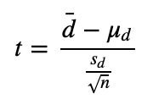
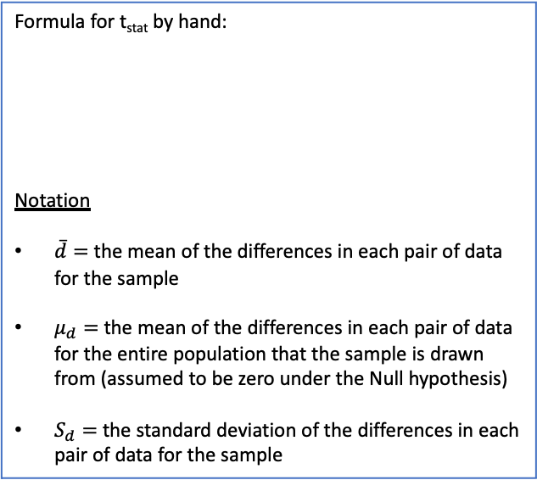
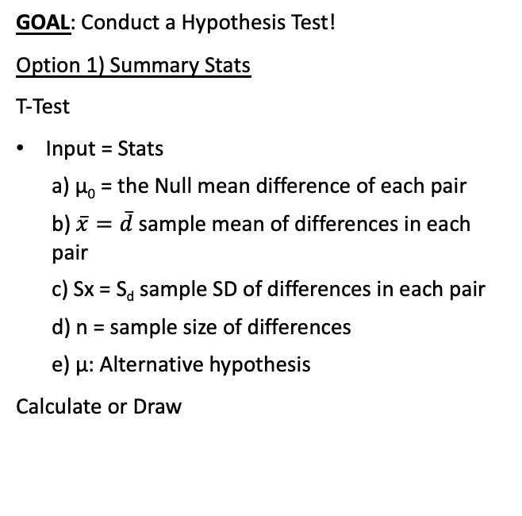
Using Calc - Test Statistic and P-Value for Paired T-Test
Minor Note → Standard Deviations
We will be doing a T-Test and using the sample standard deviation of the differences
So we do NOT need to know the original population standard deviations
Compute value of Test Statistic / P-value.
Setup: The University is investigating the safety of statistics courses for their students. To do this, they plan a study to compare the blood pressure of STAT 1450 students before the final exam and after completing the final exam. 40 randomly selected students are participating in this study.
After the study is completed, they found a mean difference Before – After = -10 mm Hg with standard deviation 30 mm Hg. Is there sufficient evidence that the blood pressure has increased from before to after the final? Use 𝛼 = 0.05
Formula for t_{stat} by hand:
Notation
$\overline{d}=$ the mean of the differences in each pair of data for the sample
$μ_{d}=$ the mean of the differences in each pair of data for the entire population that the sample is drawn from (assumed to be zero under the Null hypothesis)
$S_{d}=$ the standard deviation of the differences in each pair of data for the sample
GOAL: Conduct a Hypothesis Test!
Option 1) Summary Stats
T-Test
Input = Stats
μ₀ = the Null mean difference of each pair
$\overline{x}=\overline{d}$ sample mean of differences in each pair
Sx = S_{d} sample SD of differences in each pair
n = sample size of differences
μ: Alternative hypothesis
Calculate or Draw
df = n - 1
NOTE!! These are the same inputs that we used originally for the One Sample T-Test, just now each quantity has a slightly different meaning

Slide 14
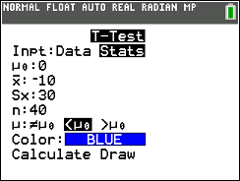
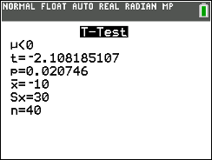
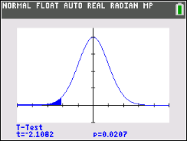
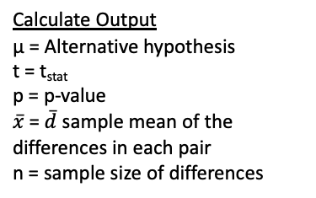
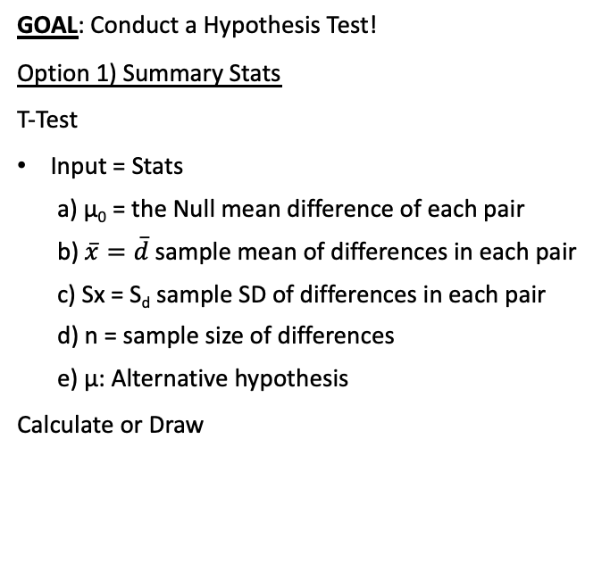
Using Calc - Test Statistic and P-Value for Paired T-Test
Minor Note → Standard Deviations
We will be doing a T-Test and using the sample standard deviation of the differences
So we do NOT need to know the original population standard deviations
Compute value of Test Statistic / P-value.
Setup: The University is investigating the safety of statistics courses for their students. To do this, they plan a study to compare the blood pressure of STAT 1450 students before the final exam and after completing the final exam. 40 randomly selected students are participating in this study.
After the study is completed, they found a mean difference Before – After = -10 mm Hg with standard deviation 30 mm Hg. Is there sufficient evidence that the blood pressure has increased from before to after the final? Use 𝛼 = 0.05
Formula for t_{stat} by hand:
Notation
$\overline{d}=$ the mean of the differences in each pair of data for the sample
$μ_{d}=$ the mean of the differences in each pair of data for the entire population that the sample is drawn from (assumed to be zero under the Null hypothesis)
$S_{d}=$ the standard deviation of the differences in each pair of data for the sample
GOAL: Conduct a Hypothesis Test!
Option 1) Summary Stats
T-Test
Input = Stats
μ₀ = the Null mean difference of each pair
$\overline{x}=\overline{d}$ sample mean of differences in each pair
Sx = S_{d} sample SD of differences in each pair
n = sample size of differences
μ: Alternative hypothesis
Calculate or Draw
H₀: μ_{d} = 0 Before - After
H_{A}: μ_{d} < 0
df = n - 1
Calculate Output
μ = Alternative hypothesis
t = t_{stat}
p = p-value
$\overline{x}$= $\overline{d}$ sample mean of the differences in each pair
n = sample size of differences
Draw Output
Plot (and displays values) of p = p-value and t = t_{stat} on the t curve with df = n - 1
NOTE!! These are the same inputs that we used originally for the One Sample T-Test, just now each quantity has a slightly different meaning

Slide 15
Using Calc - Test Statistic and P-Value for Paired T-Test
Minor Note → Standard Deviations
We will be doing a T-Test and using the sample standard deviation of the differences
So we do NOT need to know the original population standard deviations
Compute value of Test Statistic / P-value.
Setup: Are brothers or sisters smarter? A researcher studied ACT scores of 8 randomly selected brother and sister pairs.
Is there enough evidence to conclude there is a significant difference in performance on the ACT among brother and sister pairs? Use 𝛼 = 0.1
GOAL: Conduct a Hypothesis Test!
Option 2) Raw Data
Enter data
Sample 1 in L₁
Sample 2 in L₂
Calculate the differences in L₃ = L₁ – L₂
MATCH the order of subtraction in μ_{d}
T-Test
Input = Data
μ₀ = the Null mean difference of each pair
List = List with differences (L₃)
Freq = 1
μ: Alternative hypothesis
Calculate or Draw
Formula for t_{stat} by hand:
Notation
$\overline{d}=$ the mean of the differences in each pair of data for the sample
$μ_{d}=$ the mean of the differences in each pair of data for the entire population that the sample is drawn from (assumed to be zero under the Null hypothesis)
$S_{d}=$ the standard deviation of the differences in each pair of data for the sample
df = n - 1
NOTE!! These are the same inputs that we used originally for the One Sample T-Test, just now each quantity has a slightly different meaning

Slide 16
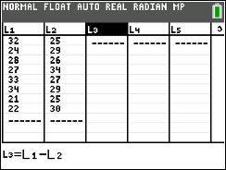
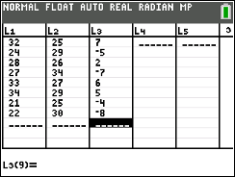
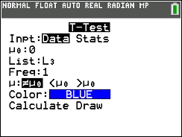
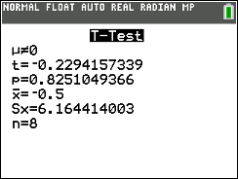
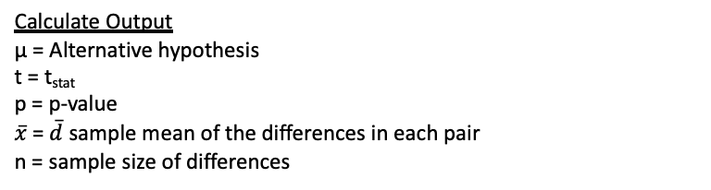
Using Calc - Test Statistic and P-Value for Paired T-Test
Process Note
We could have calculated the differences ourselves and just put them in L₁
But might as well eliminate the chance for a simple algebra mistake and let the calculator do it for us!
Calculate Differences
Once Samples 1 and 2 are entered, scroll over and up to L₃ (click enter)
Type in the subtraction involving the Lists into the formula bar and click enter
Now run test on list of differences
H₀: μ_{d} = 0 Brother - Sister
H_{A}: μ_{d} ≠ 0
Calculate Output
μ = Alternative hypothesis
t = t_{stat}
p = p-value
$\overline{x}$= $\overline{d}$ sample mean of the differences in each pair
n = sample size of differences

Slide 17
LCQ – Conclusions and Interpretations
Conclude and Interpret
State whether you reject H₀ or fail to reject H₀ AND WHY!
Interpret your results in the context of the problem
Problem: Write the conclusions and interpretations for the previous scenarios using our results.
A) Setup: The University is investigating the safety of statistics courses for their students. To do this, they plan a study to compare the blood pressure of STAT 1450 students before the final exam and after completing the final exam. 40 randomly selected students are participating in this study.
After the study is completed, they found a mean difference Before – After = -10 mm Hg with standard deviation 30 mm Hg. Is there sufficient evidence that the blood pressure has increased from before to after the final? Use 𝛼 = 0.05
Solution:
B) Setup: Are brothers or sisters smarter? A researcher studied ACT scores of 8 randomly selected brother and sister pairs. Assume ACT scores for all students are normally distributed blood pressures are always normally distributed.
Is there enough evidence to conclude there is a significant difference in performance on the ACT among brother and sister pairs? Use 𝛼 = 0.1
Solution:
H₀: μ_{d} = 0 Before - After
H_{A}: μ_{d} < 0
H₀: μ_{d} = 0 Brother - Sister
H_{A}: μ_{d} < 0

Slide 18
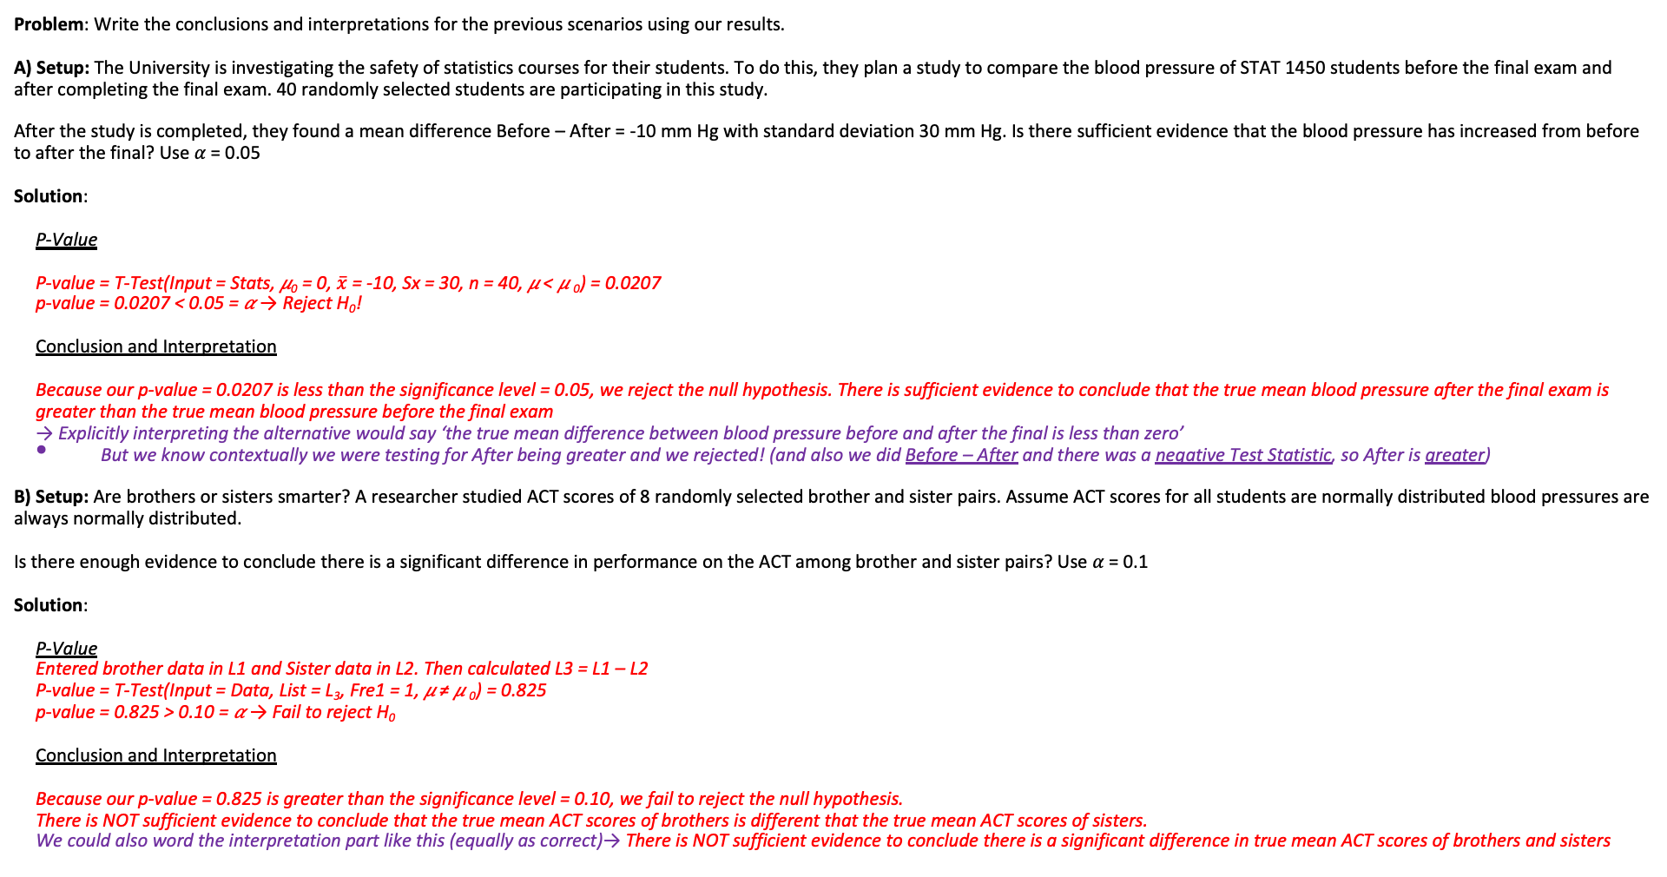
LCQ – Conclusions and Interpretations
Conclude and Interpret
State whether you reject H₀ or fail to reject H₀ AND WHY!
Interpret your results in the context of the problem
Problem: Write the conclusions and interpretations for the previous scenarios using our results.
A) Setup: The University is investigating the safety of statistics courses for their students. To do this, they plan a study to compare the blood pressure of STAT 1450 students before the final exam and after completing the final exam. 40 randomly selected students are participating in this study.
After the study is completed, they found a mean difference Before – After = -10 mm Hg with standard deviation 30 mm Hg. Is there sufficient evidence that the blood pressure has increased from before to after the final? Use 𝛼 = 0.05
Solution:
P-Value
P-value = T-Test(Input = Stats, 𝜇₀ = 0, $\overline{x}$ = -10, Sx = 30, n = 40, 𝜇 < 𝜇 ₀) = 0.0207
p-value = 0.0207 < 0.05 = 𝛼 → Reject H₀!
Conclusion and Interpretation
Because our p-value = 0.0207 is less than the significance level = 0.05, we reject the null hypothesis. There is sufficient evidence to conclude that the true mean blood pressure after the final exam is greater than the true mean blood pressure before the final exam
→ Explicitly interpreting the alternative would say ‘the true mean difference between blood pressure before and after the final is less than zero’
But we know contextually we were testing for After being greater and we rejected! (and also we did Before – After and there was a negative Test Statistic, so After is greater)
B) Setup: Are brothers or sisters smarter? A researcher studied ACT scores of 8 randomly selected brother and sister pairs. Assume ACT scores for all students are normally distributed blood pressures are always normally distributed.
Is there enough evidence to conclude there is a significant difference in performance on the ACT among brother and sister pairs? Use 𝛼 = 0.1
Solution:
P-Value
Entered brother data in L1 and Sister data in L2. Then calculated L3 = L1 – L2
P-value = T-Test(Input = Data, List = L₃, Fre1 = 1, 𝜇 ≠ 𝜇 ₀) = 0.825
p-value = 0.825 > 0.10 = 𝛼 → Fail to reject H₀
Conclusion and Interpretation
Because our p-value = 0.825 is greater than the significance level = 0.10, we fail to reject the null hypothesis.
There is NOT sufficient evidence to conclude that the true mean ACT scores of brothers is different that the true mean ACT scores of sisters.
We could also word the interpretation part like this (equally as correct)→ There is NOT sufficient evidence to conclude there is a significant difference in true mean ACT scores of brothers and sisters
H₀: μ_{d} = 0 Before - After
H_{A}: μ_{d} < 0
H₀: μ_{d} = 0 Brother - Sister
H_{A}: μ_{d} ≠ 0

