Slide 1

Yay!!! First Day of Stats Content!
Unit 1 – Basic Ideas
Your Excitedly Optimistic Professor Colton

Slide 2
Unit 1
Introduction
Why Stats?
Introduction to Statistics
Population vs. Sample
Parameter vs. Statistic
Descriptive vs Inferential
Methods of Data Collection
Experimental vs Observational
Data Collection Methods: Experiment, Simulation, Census, Sampling
Sampling Methods: Simple Random, Cluster, Stratified, Systematic, Convenience, Volunteer Response
Errors in Sampling (Sources of Bias)

Slide 3
Introduction – Why Statistics?
Lets say we want to know if Ohio is a cat or dog state…
How can we figure this out?
Is that practical?
What do we do with all that info?
How can we make sense of it?
Data! There’s too much of it!
How do we learn from it?
Statistics!

Slide 4
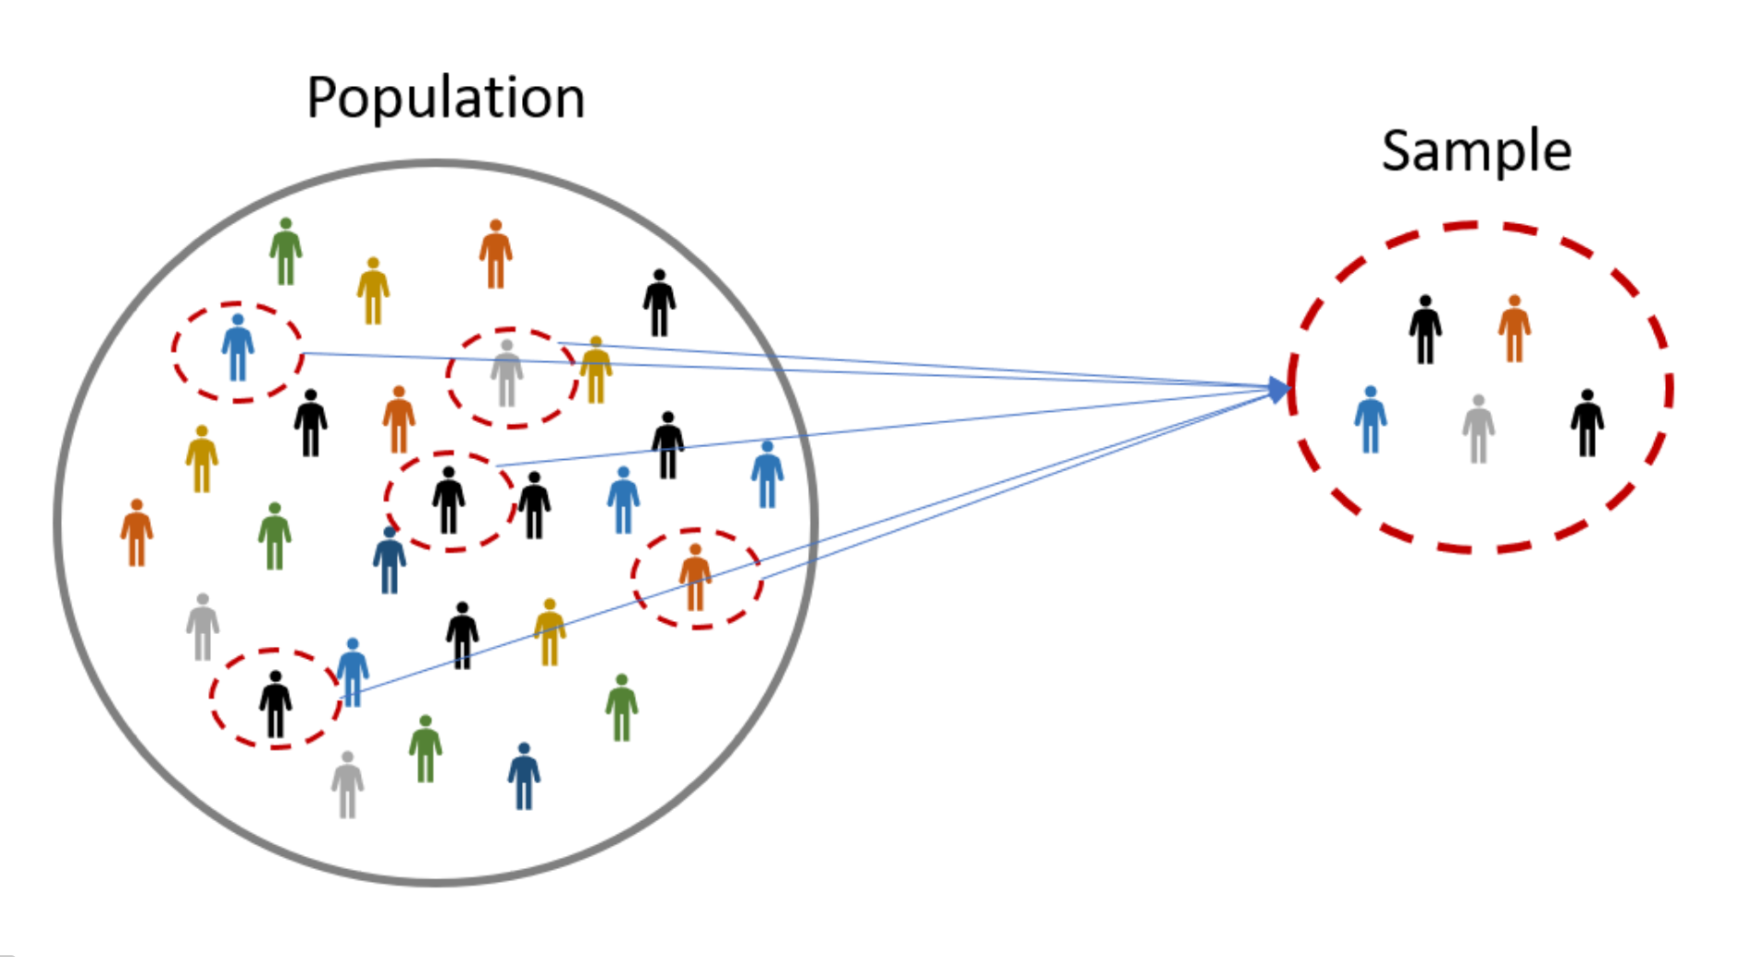
Population vs Sample
What is the difference between a Population and a Sample?
Population is the set of all individuals/objects of interest
Ex) Back to Ohio cats vs dogs – Population is EVERY person in ALL of Ohio
A Sample is a subset of individuals/objects from the population of interest
Ex) Everybody in ONLY Columbus
https://www.omniconvert.com/what-is/sample-size/

Slide 5
Parameter vs Statistic
What is the difference between a Parameter and a Statistic?
Parameter is a fixed numerical value that describes the Population
The OVERALL percentage of ALL people in Ohio that prefer cats (probably >> dogs ☺)
Why?? It describes the proportion for the ENTIRE population
A Statistic is a numerical value that describes the sample that can vary
The percentage for people in Columbus or the percentage for Cincinnati
Would the percentages for these two cities be different?

Slide 6
Statistic
Parameter
https://www.omniconvert.com/what-is/sample-size/

Slide 7
Types of Studies by Goals
Descriptive studies involve summarizing/describing the data
Mean, median, standard deviation, etc…
Graphical displays
Can be done on BOTH Sample and Population data
Ex: Drawing a bar graph of College Majors in STAT 1450
Inferential studies involve drawing conclusions about a population based on a sample (infer something)
Confidence intervals
Hypothesis tests
Can ONLY be done with sample data
Ex: Is the true mean GPA of STAT 1450 students above 3.0?

Slide 8
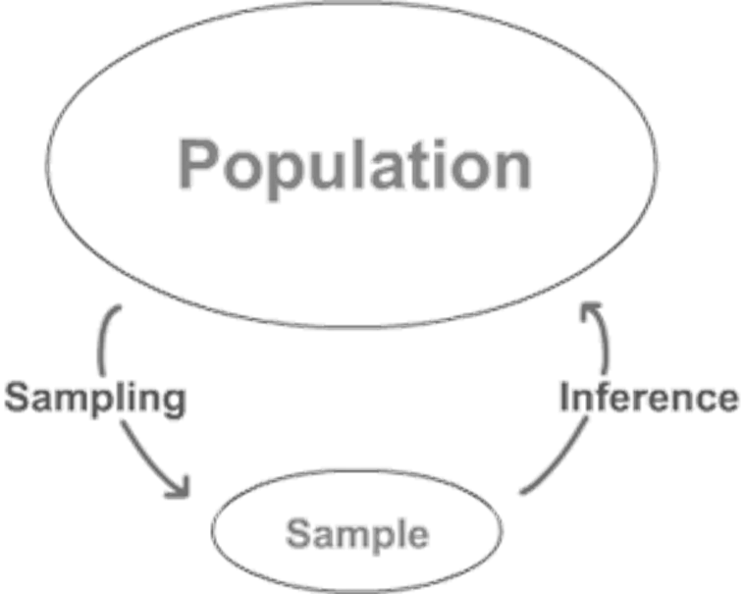

Slide 9
Learning Check Quiz (LCQ): Descriptive vs Inferential
Descriptive or Inferential?
A researcher runs a controlled experiment of participants in a driving simulator. Half the participants are instructed to talk on their cell phone and the other half to talk to their passenger. The researcher records driving performance and wants to generalize the results to draw conclusions about distracted driving.
The Statistics department maintains records concerning all student evaluations of their instructors. A semester report includes graphical displays and summary statistics for the scores of the faculty members.
The Academic Integrity office keeps records on the occurrences of academic misconduct. Using past records, the office estimates how many incidents will occur during the upcoming school year.

Slide 10
Learning Check Quiz (LCQ): Descriptive vs Inferential
Descriptive or Inferential?
A researcher runs a controlled experiment of participants in a driving simulator. Half the participants are instructed to talk on their cell phone and the other half to talk to their passenger. The researcher records driving performance and wants to generalize the results to draw conclusions about distracted driving. Inferential, trying to draw a conclusion about driving performance.
The Statistics department maintains records concerning all student evaluations of their instructors. A semester report includes graphical displays and summary statistics for the scores of the faculty members. Descriptive, showing graphs to describe student evals.
The Academic Integrity office keeps records on the occurrences of academic misconduct. Using past records, the office estimates how many incidents will occur during the upcoming school year. Inferential, using old results to predict next year (make a conclusion about next year’s number of incidents)

Slide 11
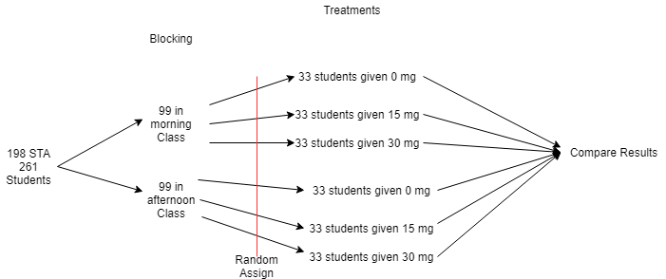
Types of Studies – By Data Collection Methods
Experimental Studies
Imposes treatments and then observes results.
Can help determine a causation
Reduces the potential a lurking variable can affect the results (controls for them)
More accurate to determine a relationship between the explanatory variable and response.
Ex) Clinical trials
Observational Studies
Observe what happens without imposing restraints.
No random assignment
Can reveal an association or correlation between variables but not causation.
Causation requires a lot of extra work and research
Ex) Car accidents at an intersection

Slide 12
Types of Studies – By Data Collection Methods
Experiments
Imposes treatments and records response
Census
Collect data from EVERY member of the population
Observational study on the ENTIRE population
Ex) US Census
Simulation
Not always practical to do an experiment (cost, time, etc.)
Simulations allows us to use computers to mimic what would happen in real life, or what we believe happens in real life.
The Matrix
Can use computers to simulate or use “devices” that are random
Dice
Coin
Deck of Cards
Sampling
Collect data from a SUBSET of the population of interest
Observational study on a SAMPLE (a PORTION of the population
Lots of different ways to do this!
Ex) Randomly selecting 30 CSCC students

Slide 13
Sampling Methods
Sample Surveys
Sample surveys are an important kind of observational study.
They survey some group of individuals by studying only some of its members.
Individuals are selected not because they are of special interest, but because they represent the larger group (the population).
Good ones!
All statistical sampling designs use chance, rather than human choice, to select the sample
Simple Random Samples (SRS)
Stratified Sampling
Cluster Sampling
Systematic Sampling
Bad ones ☹
Convenience Sampling
Volunteer Response Sampling

Slide 14
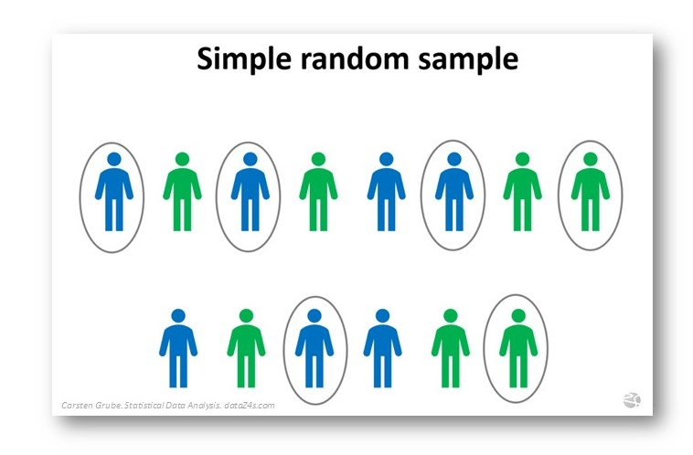
Sampling Methods
Simple random samples (SRS)
Two key parts to taking an SRS:
Every individual in the population has an equal chance of being selected
Every possible sample of the size we plan to draw has an equal chance to be selected
In other words, each combination of people has an equal chance of being selected
Sampling frame – a list of individuals from which the sample is drawn
Assign a random number to each individual in the sampling frame
Ex) Use a random number generator to select names from a list

Slide 15
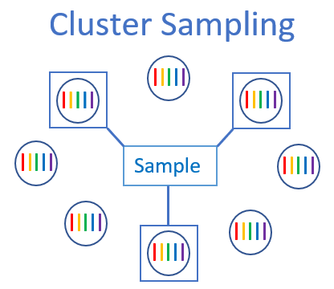
More Sampling Methods
Cluster Sampling
Split the population into representative groups called clusters
Use random sampling to select several clusters
Perform a census of each selected cluster
If each cluster represents the full population fairly, cluster sampling will give an unbiased sample
Clusters are heterogeneous and resemble the overall population
Cluster sampling is usually more practical and affordable
https://statisticsbyjim.com/basics/cluster-sampling/

Slide 16
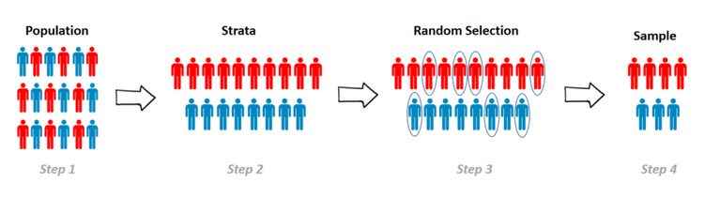
More Sampling Methods
Stratified Random Sampling
Strata – homogeneous groups
Used to reduce sampling variability
Ensures that the proportions of characteristic(s) in our sample match the proportions of the characteristic(s) in the population
Helps us to see differences among groups
Sampling procedure may be more difficult
Stratify the population – Divide the population into homogeneous groups
Use SRS to choose members from each strata
Combine the groups from each strata to form your sample
Each stratum is different from the others
https://uedufy.com/what-is-stratified-sampling/

Slide 17
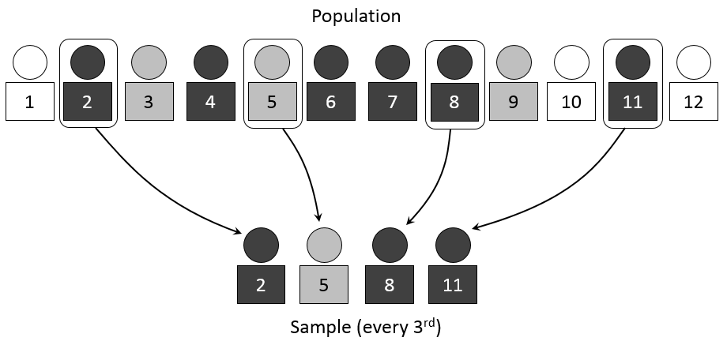
More Sampling Methods
Systematic Sampling
Much less expensive than SRS
Must justify the assumption that the systematic method is NOT associated with any of the measured variables
Randomly select a starting place
Employ a systematic method to continue choosing your sample
For example, take every 20th name on a list of names
The order of the list cannot be associated in any way with the responses sought
Beware of confounding variables
https://www.netquest.com/blog/en/systematic-sampling

Slide 18
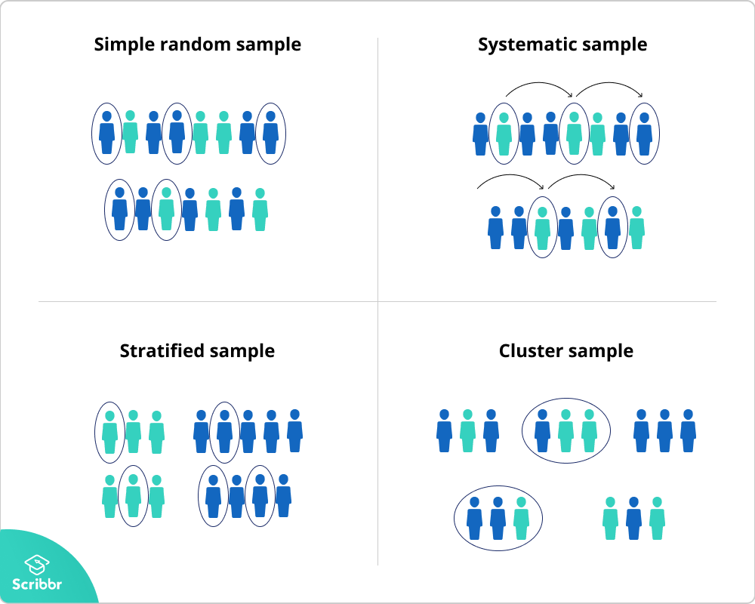
Summary of Sampling Methods
https://anthonybmasters.medium.com/systematic-sampling-c65bb51e29dd

Slide 19
Sampling Methods Example
Example
I wish to determine the proportion of the STAT 1450 class that has a Mac laptop. How can I go about getting data to answer this question from our class?
Simple Random Sample
Randomly ask 10 students from class what laptop they use.
Systematic Sampling
Ask every 4th person to that walks into class what type of laptop they use.
Cluster Random Sampling
Randomly sample 3 breakout groups; ask everyone in that (take a census of the) group about what type of laptop they use.
Stratified Random Sampling
Randomly sample 5 students from the list of Freshman and Sophomores respectively and ask them what type of laptop they use.

Slide 20
LCQ: Sampling Methods
You are tasked with conducting a survey to answer the question, “What is the favorite subject of students who attend East High School?” Describe how you could obtain a sample to answer this question using each of the following types of sampling methods listed below.
Simple Random Sample:
Systematic Sample:
Cluster Sample:
Stratified Random Sample:

Slide 21
LCQ: Sampling Methods
You are tasked with conducting a survey to answer the question, “What is the favorite subject of students who attend East High School?” Describe how you could obtain a sample to answer this question using each of the following types of sampling methods listed below.
Possible answers:
Simple Random Sample:
Randomly select 30 students from the entire student body.
Assign random numbers to all students, use random number generator and 20 pick numbers
Systematic Sample:
Ask every 10th student that arrives that morning
Assign numbers to all students, ask every fifth student
Cluster Sample:
Randomly select 5 classrooms and ask every student in each of those classrooms
Randomly select a few lunch periods to and ask all students there → this works because we can assume that there is a mix of students from all grades in each lunch period)
Randomly select 5 buses and survey all students on the bus → again it is reasonable to believe that there are lots of students of different types on each bus, so each bus is like a mini population that is ~ representative of the entire school
Stratified Random Sample:
Divide the students based on class (Freshman, Sophomore, …), then randomly sample 10 students from each class
Divide students based on Male / Female, then randomly sample within each group → this is good because students within each group are similar (homogeneous), and we then random sample

Slide 22
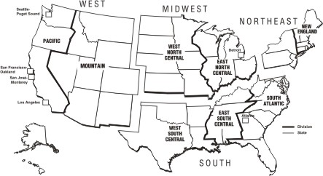
Harder LCQ: Sampling Methods
A researcher wants to study regional differences in dental care. He takes a multistage sample by dividing the United States into four regions, taking a simple random sample of ten schools in each region, randomly sampling three classrooms in each school, and interviewing all students in those classrooms. Identify the type of sampling employed in each stage of this sampling design. (Agresti & Franklin, 2013, p. 192)
Stage(s)???:
1)
2)
3)
4)
5)

Slide 23
Harder LCQ: Sampling Methods
A researcher wants to study regional differences in dental care. He takes a multistage sample by dividing the United States into four regions, taking a simple random sample of ten schools in each region, randomly sampling three classrooms in each school, and interviewing all students in those classrooms. Identify the type of sampling employed in each stage of this sampling design. (Agresti & Franklin, 2013, p. 192)
Stage(s):
1) Stratified → this is stratified (not cluster) because we think there are regional differences, so states within each region are similar in terms of dental care. And the regions are our different strata
2) SRS
3) Cluster → classrooms within schools are the clusters and we census in each room

Slide 24
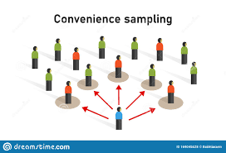
Bad Sampling Method
Convenience Sample
Include individuals who are convenient to sample
The group may not be representative of the population
Examples: pollsters in shopping malls, internet polls
Beware of confounding variables
This is a sampling technique to AVOID! Bad Sampling that tends to Bias results
http://researcharticles.com/index.php/convenience-sampling-in-qualitative-research/

Slide 25
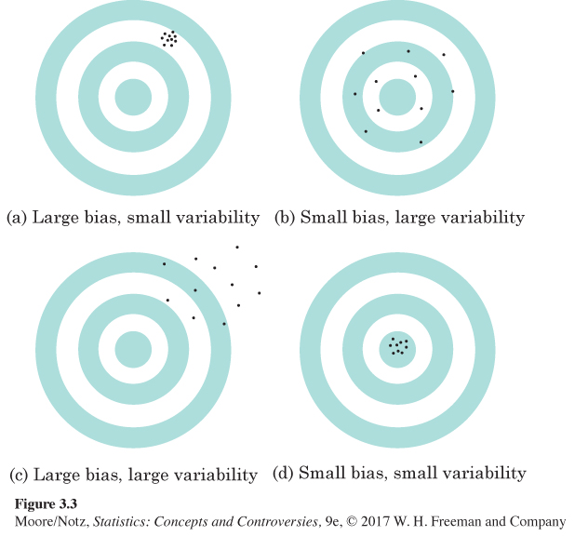
Bias and Variability
UNBIASED
Bias
Studies are biased if they consistently underestimates or consistently overestimates the true value of the characteristic it measures.
Variability
Refers to how consistent results are.

Slide 26
Another Bad Sampling Method
Voluntary Response Sample
A large group of individuals are invited to respond and all who do respond are counted
Those who volunteer generally feel more strongly than those in general population
Opinions of a volunteer response sample may be very different from the population as a whole
Usually only get either STRONG positive or STRONG negative opinions
Examples: Call-in shows, text-in polls, internet polls, etc…
This is another sampling technique to AVOID! Bad Sampling that tends to Bias results

Slide 27
Errors in Sampling (Sources of Bias)
Random Sampling Error
The different results from sample to sample.
Caused by chance in selecting a random sample.
This is natural and always present!
Sampling Errors
Errors caused by the act of taking a sample.
They cause sample results to be different from the results of a census.
Nonsampling Errors
Errors not related to the act of selecting a sample from the population. They can be present even in a census.
Misuse of Survey Results

Slide 28
Errors in Sampling (Sources of Bias)
Sampling Errors
Convenience Sampling
Under or over represents certain groups of a population.
Volunteer Response Sampling
Only receive opinions that are usually stronger (either negatively or positively) that don’t reflect opinions of the population as a whole.
Undercoverage
Occurs when certain groups of the population are left out.
An incomplete sampling frame can cause undercoverage.
Example:
Only households are contacted, so students in dormitories, prison inmates, most members of the armed forces, the homeless, and people staying in shelters are left out.
Many polls interview only in English, which leaves some immigrant households out of their samples.
Overcoverage
Including people outside of our population of interest in the sampling frame.
Simple example: Only interested in Freshman and Sophomores, but some Seniors sneak into our list of students to ask.

Slide 29
Errors in Sampling (Sources of Bias)
Non Sampling Errors
Poorly Worded Questions
Can be based on how a question is worded (guiding people to answer a particular way)
Response Errors
Incorrect or untrue responses (for whatever reason: lying, bad memory, etc.).
Ex. Asking someone face to face their GPA in proximity of others.
Social Acceptability Bias
People are reluctant to admit to behavior that may reflect negatively on them.
Nonresponse Error
Lack of participation, i.e. failure to obtain data from individuals that are selected for the sample
Missing data
Processing Errors
Mistakes in mechanical tasks such as arithmetic or data entry.
Misuses of Survey Results
Generalizing Results - generalizing survey results beyond the scope of the actual data setting (lab rats do not respond the same as people)
Self Interest Bias - People who have an interest in the outcome of an experiment have an incentive to use biased methods
Researchers may dismiss rare negative findings if the company that is paying for the study would be adversely affected

Slide 30
Summary of Sampling Methods
Why we use other sampling methods
SRS is the simplest method, but…
Because each sample of size n has the same chance of being selected, we cannot obtain information for separate groups of individuals
(e.g., individuals of different gender, race, income class, or religion).
Our selected sample might miss them….
So to ensure we get data from each group of interest in our sample…
We use methods like Stratified Random Samples and Cluster Samples
GOAL
Goal of these good methods and good survey techniques (like well worded questions) is to reduce bias.
Ideally, we want the ONLY ERROR to come from Random Sampling Error.
Of course this is not possible in most cases, so we try to minimize other sources of errors in our samples.

Slide 31
PROBLEM SESSION!!!!!!!!!!!

Slide 32
Problem #5
As discussed in the chapter, GfK Roper Consulting conducts a global consumer survey to help multinational companies understand different consumer attitudes throughout the world. In India, the researchers interviewed 1000 people ages 13-65. There samples is designed so that they get 500 males and 500 females.
Are they using a simple random sample? How do you know?
What kind of design do you think they are using?

Slide 33
Problem #5 Solution
No, because they have an equal number of males and females.
Stratified random sampling, stratified by gender

Slide 34
Problem #9
A business magazine mailed a questionnaire to the human resource directors of all Fortune 500 companies, and received response from 23% of them. Those responding reported that they did not find that such surveys intruded significantly on their workday. Identify the following, if possible. (If not, say why.)
The population
The population parameter of interest
The sampling frame
The sample
The sampling method, including whether or not randomization was employed.

Slide 35
Problem #9 Solution
Human resource directors of Fortune 500 companies
The proportion of those who don’t feel surveys intrude significantly on their workday.
Human resource directors at Fortune 500 companies
The 23% who responded
Attempted census – nonrandom
Bias – hard to generalize because who responded is related to the question itself (nonresponse bias)

Slide 36
Problem #13
An intern is working for Pacific TV (PTV), a small cable and internet provider, and has proposed some questions that might be used in the survey to assess whether customers are willing to pay $50 for a new service.
Question 1: If PTV offered state-of-the-art high-speed Internet service for $50 per month, would you subscribe to the service?
Question 2: Would you find $50 per month –less than the cost of a daily cappuccino– an appropriate price for high-speed Internet service?
Do you think these are appropriately worded questions? Why or why not?
Which one has a more neutral wording? Explain.

Slide 37
Problem #13 Solution
Question 1 seems appropriate. However, Question 2 predisposes the respondent to answer the question in the affirmative.
Question 1 is more neutral in wording. Question 2 is biased; a leading question in which respondents are encouraged or led to answer, “yes.”

Slide 38
Problem #17
For your marketing class, you’d like to take a survey from a sample of all the Catholic Church members in you city to assess the market for a DVD about Pope Francis’s first year as pope. A list of churches shows 17 Catholic churches within the city limits. Rather than try to obtain a list of all members of these churches, you decide to pick 3 churches at random. For those churches, you’ll ask to get a list of all current members and contact 100 members at random.
What kind of design have you used?
What could go wrong with the design you have proposed?

Slide 39
Problem #17 Solution
Multistage design; first you select clusters (the churches) and then you employ simple random sampling to contact 100 members.
If any of the 3 selected churches is not representative of the population then you will introduce bias into your sample by including that church in your sample.

Slide 40
Problem #33
A local cable TV company, Pacific TV (PTV), with customers in 15 towns is considering offering high-speed Internet service on its cable lines. Before launching the new service they want to find out whether customers would pay the $75 per month that they plan to charge. An intern has prepared several alternative plans for assessing customer demand. For each, indicate what kind of sampling strategy is involved and what (if any) biases might result.
Put a big ad in the newspaper asking people to log their opinions on the PTV website.
Randomly select one of the towns and contact every cable subscriber by phone.
Send a survey to each customer and ask them to fill it out and return it.
Randomly select 20 customers from each town. Send them a survey, and follow up with a phone call if they do not return the survey within a week.

Slide 41
Problem #33 Solution
Volunteer sample – only those with strong opinions will respond
Cluster sample – if the town is not representative of the population, then the sample will be biased
Census – plagued by nonresponse bias – those who respond will differ from those who don’t
Stratified random sample – stratified by town, with follow-up. Should be unbiased.

