Slide 1

…..
Unit 3 – Data Ethics and Measurement
Your Gametime Professor Colton

Slide 2
Unit 3 - Outline
Measuring
Motivating Example
Basic Principles
Validity
Bias
Reliability
Do the Numbers Make Sense?
Check Measurements for Sensibility
Examples

Slide 3
Motivating Example
Setup: How big a brain you got? Do people with larger brains have more intelligence?
GOAL:
To answer this question, we have to measure intelligence.
This requires us to reduce the vague idea to a number that can go up or down.
Considerations
What do we mean by intelligence?
  Does knowledge about lots of subjects make you smart? Or is it lots of knowledge about one subject?
  Problem solving abilities via puzzles? Complicated Math calculations?
Okay, once we decide that. Then how do we get a number??
  Do we just give people a test?
  Look at their grades in school?
Can we trust this number?
  Does it actually measure what we want it to?
This is NOT a straightforward task….

Slide 4
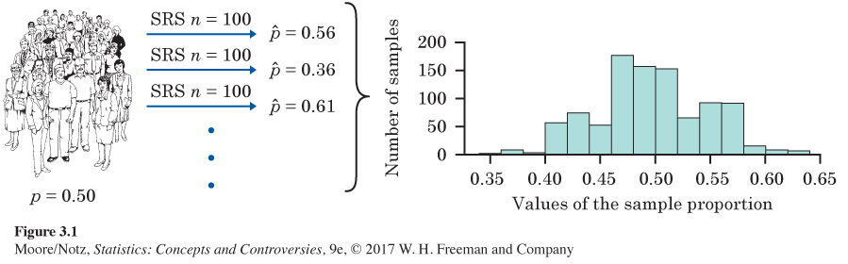
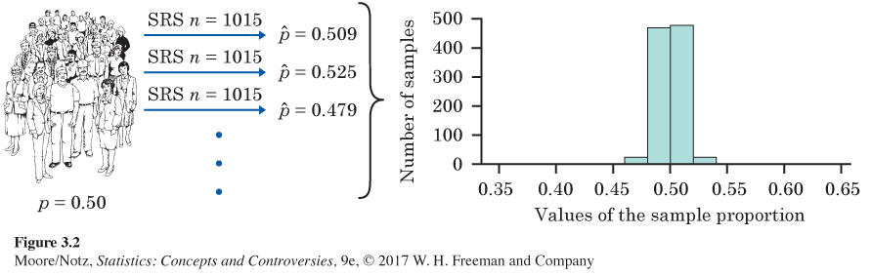
Review + New
Statistics and Data
Statistics is the science of getting information from data.
  The information we get is only as good as the data we collect.
Good Sampling Methods
Techniques to use to reduce bias when selecting our sample (random chance).
Larger Samples
Decrease variability of our estimates by selecting larger samples.
NOW
Once I select my sample, I now have to measure the characteristic of interest.

Slide 5
Measurement: The Basics
Measure
To measure is the process of assigning a numerical value to the characteristic of interest.
Variable
The result of a measurement is a numerical variable since the values of the measurement vary for each individual in the sample.
Good Measurements
To take a good measurement, I must know…
  What characteristic I want to measure.
  Decide the best way to assign a numerical value to that characteristic.
For example, if I am trying to measure my weight:
  I need an instrument, logically a scale. What type of scale?
  How to measure weight consistently for everyone? Shoes or no shoes? Adjust for clothing?
  Units? Lbs or Kg?
Final Result
If I measure the weight of all the individuals in my sample, then I have the values of a numerical variable called weight.

Slide 6
Measurement: Properties
Properties of Measurements
Any measurement I take must also possess the following properties:
  The measurement must be valid.
  The measurement cannot be biased.
  The measurement must be reliable.

Slide 7
Measurement: Validity
Validity
A measurement is valid if that measurement represents an appropriate way to assign a numerical value to the characteristic I am measuring.
  It is valid to measure length with a tape measure.
  It is not valid to measure a student’s readiness for college by recording her height.
Improving Validity
Use the rate at which something occurs rather than the count of occurrences!
For example: If I am totaling my correct points on a test…
  If I score a 40 on Stats and a 215 on Biology? Which did I do better on???
  Now if we know Stats was 40 out of 50 (90%) and Biology was 215 out of 300 (72%)….
So a rate is a more valid (appropriate) measure that a simple count.
Considerations
Often hard to find a valid measure for some abstract ideas, such as psychological states or other characteristics that are not physical.
For example, what is a valid way to measure depression?

Slide 8
Measurement: Validity
Setup: Is the SAT a valid measure of readiness for college?
“Readiness for college academic work” is a vague concept that probably combines many factors.
Opinions will always differ about whether SAT scores (or any other measure) accurately reflect this vague concept.
Instead, we ask a simpler and more easily answered question: Do SAT scores help predict students’ success in college?
More Promising Solution: Success in college is a clear concept, measured by whether students graduate and by their college grades.
Students with high SAT scores are more likely to graduate and earn (on the average) higher grades than students with low SAT scores.
We say that SAT scores have predictive validity as measures of readiness for college.
Predictive Validity
A measurement of a property has predictive validity if it can be used to predict success on tasks that are related to the property measured.
But… We must ask how accurately SAT scores predict college grades.

Slide 9
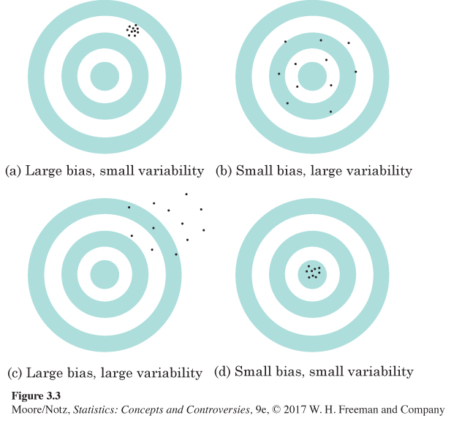
Measurement: Bias and Reliability
Bias
A measurement is biased if it consistently underestimates or consistently overestimates the true value of the characteristic it measures.
Reliability
A measurement is reliable if the results are repeatable.

Slide 10
Measurement: Bias and Reliability
Illustration
Using a bathroom scale to measure your weight is valid, but the measurement may not be very accurate.
  It measures weight, but it may not give the true weight.
Let’s say that, originally, your scale always read three pounds too high.
  Measured weight = 138 Lbs (True Weight) + three pounds
But scales often vary a bit…
  They don’t always give the same reading when you step off and step right back on.
  Measured weight = 138 Lbs (True Weight) + three pounds – one pound
  Try again: Measured weight = 138 Lbs (True Weight) + three pounds + 1.5 pounds
Two Kinds of Error
Always three pounds too much.
  This systematic error that occurs every time we make a measurement is called bias.
It changes the reading differs every time someone steps on the scale repeatedly.
  We can’t predict the error, so we call it random error.
SO we can think about our measured weight like this:
  Measured weight = 138 Lbs (True Weight) + three pounds (Bias) + 1.5 pounds (Random Error)
Measurement = True + Bias + Random Error

Slide 11
Number Sense: Check Measurements for Sensibility
Statistics and Numbers
Making sense of numbers and measurements is essential in the study of statistics.
How do we understand data? By examining numbers!
How to Evaluate Claims
As you encounter numbers, remember to ask the following questions as appropriate:
1. Is the measurement valid?
2. Is there missing information?
3. Are the units of measure appropriate?
4. Is the magnitude of the numbers appropriate?
5. Is the arithmetic correct?
6. Are there inconsistencies?
7. Are the numbers too regular or do they agree to well with what the author would like to see? If so, is there a hidden agenda?

Slide 12
Number Sense: Check Measurements for Sensibility
'What didn't they tell us?’
This is the most valuable question to ask when reading conclusions about data.
The most common way to mislead with data is to cite correct numbers that don't quite mean what they appear to say because the full story has not been disclosed.

Slide 13
Example 1
Setup: In 1994, according to the Department of Labor, the median salary for government workers was $29,528, while the median salary for private workers was $26,494. Conservative groups have claimed that this shows that government workers are an overpaid “privileged class.”
Considerations
Does this make sense?
What didn’t they tell us???
  Nature of jobs are so different that comparisons can be misleading
  Lots of missing information!

Slide 14
Example 2
Setup: A.R.M., Allergy Relief Medicine switched to “new formula maximum strength.” But the old formula had 37.5 mg of active ingredient while the new formula had only 25 mg. So Consumer Reports (April 1985) queried the manufacturer.
Considerations
What didn’t they tell us?
FDA changed regulations to only allow max of 25 mg.
  Very creative advertising but still misleading.
Relative change = (New value – Old value) / Old value = (25 – 37.5) / 37.5 = -0.33 -> -33%

Slide 15
Example 3
Setup: Two papers were written on similar topics and it turned out that identical data points appeared in each paper, but the actual number of subjects cited was different for each paper.
Considerations
Do you have any questions as to whether or not these are legitimate results?
Regularity of data but inconsistent in number of subjects
Falsified data or reported inaccurately

Slide 16
Example 4
Setup: In a student project (June 1999) the following statistics were given: A sample of 1000 M&M Peanut candies was investigated to determine the proportion of each color produced.
Results: 20% Brown 20% Yellow 20% Red 20% Blue 10% Orange 10% Green
Considerations
Numbers are too good to be true, too regular, too even
  These are the EXACT population proportions.
Fake data

Slide 17
Example 5
Setup: An article in the Durham Morning Herald, February 23, 1982 entitled “Most people surveyed like Chapel Hill parks” reports that “Three fourths of Chapel Hill residents are satisfied with the town’s parks and recreation programs, according to a survey conducted by the Chapel Hill Parks and Recreation Commission.
Of 258 persons who answered the survey [on Chapel Hill parks], 96 percent were white.
Thirty-eight percent of the 10 non-whites surveyed said they were satisfied with recreation services.
73 percent indicated they used the parks.”
Considerations
Look at percentages: 10 x 0.38 = 3.8 people?????? Cause for concern, percentages maka no sense

Slide 18
Example 6
Setup: An Associated Press article in the Lafayette Journal and Courier June 12, 2000 entitled “TWA thinks positively as industry consolidates without it” states that “Southwest does, however, carry a far greater number of passengers, 65,288 in 1999 to TWA’s 25,790.”
Considerations
Do these values seem believable?
600 million people flew in the US alone in 1997
Only 65000 passengers for Southwest???? No, author meant 65 million……
Inconsistent!

Slide 19
Example 7
Setup: An article in Forbes magazine (April 8, 1996) said that the computer maker “Packard Bell had sales of $20 billion over ten years and $45 million in profits, a profit margin of 2% of sales.”
Considerations
Does this seem right to you?
Check arithmetic: % = Part / Whole = Profit / Sales = 45 million / 20 billion = 0.00225 = 0.225% (10 times smaller than what was reported)

Slide 20
Example 8
Setup: Feminist guru Gloria Steinem claimed in Revolution from Within that in the United States “150,000 females die of anorexia each year.” The truth from the National Center for Health Statistics says about 50 die per year.
Considerations
150,000 to 200,000 women suffer from anorexia… Hidden agenda!
Be wary of numbers reported from groups with a cause.

Slide 21
Example 9
Setup: An Affirmative Action poll appeared in The Press of Atlantic City on March 25, 1995, p. A6. Litton industries claimed: “76% of independent microwave oven technicians surveyed recommended Litton.”
Considerations
PROBLEM: survey included only technicians who serviced Litton ovens and at least one other brand, some of whom were actually Litton dealers.
What are some questions you could ask about these numbers?
Hidden agenda? – Increased sales
Biased sample

Slide 22
Example 10
Setup: A health club reports that of its members over 50 years of age, 45% are men and 25% are women.
Considerations
Does this seem fishy to you?
45% + 25% = 70%! What about the other 30%?????
Check the arithmetic!

Slide 23
Example 11
Setup: Samples of 20 individuals were taken from five different age groups at the health club.
For each sample of 20 individuals, the percentage that used the swimming pool for exercise was reported as follows: 8% 14% 16% 21% 37%
Considerations
What should you check about these numbers?
Precents for 20 individuals are multiples of 5: 20/100 = 0.05 = 5%
14% of 20 is 2.8????
Inconsistent data!

Slide 24
Number Sense: Questions
Questions to ask of numbers:
What didn’t they tell us??
  Missing data or information
Are the numbers consistent / plausible / too good to be true?
  Distorted data
  Fake or falsified data
  Too much precision or regularity
  Data could be from a biased sample
Is the arithmetic correct?
  Check percentages!
Is there a hidden agenda?
  Often need to do some research

