Slide 1
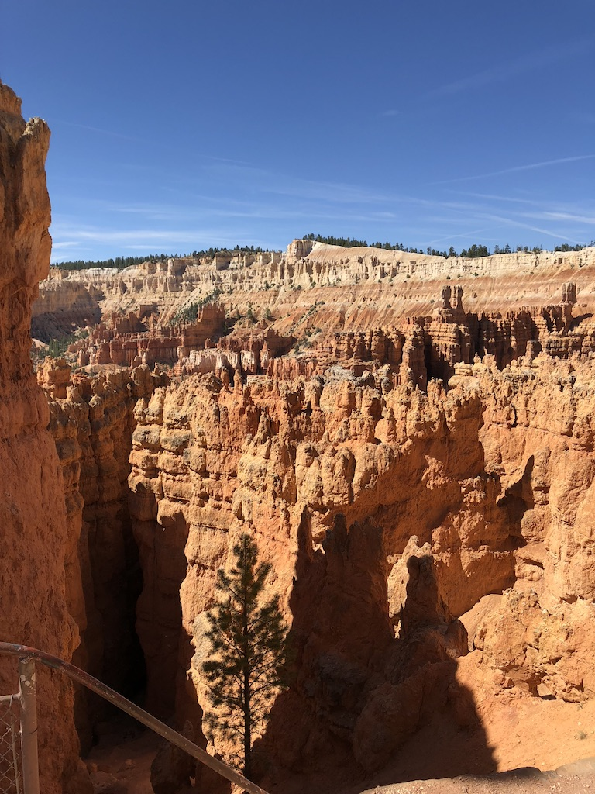
Second Half!
Unit 6 – Normal Distribution, Sampling Dists and CLT
Your Backpacking Professor Colton

Slide 2
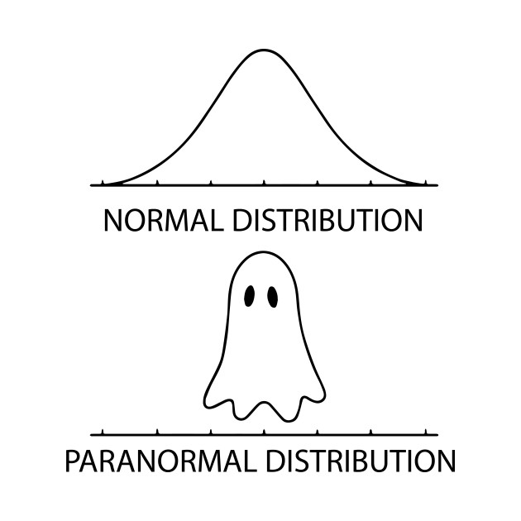
Unit 6 - Outline
Unit 6 – Normal Distribution, Sampling Dists and CLT
Intro
Density Curves
Density curve properties
Normal Distribution
Standard Normal Distributions
Find z, given area
Normal Distributions
Find x, given area

Slide 3
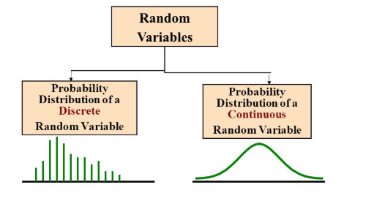
Discrete vs Continuous RVs
X | P(X)
Win = 3 | 0.3
Tie = 1 | 0.5
Loss = 0 | 0.2
Can find probabilities for specific points, e.g. P(5) = 0.3, P(10) = 0.6
Can find probabilities of multiple events, such as:
P(5 < X < 10) = P(6) + P(7) + P(8) + P(9)
Just adding up individual probabilities from the
probability distribution table.
Can NOT find probabilities for specific points, e.g. P(5) = 0, P(10) = 0
Have to find probabilities for intervals:
P(5 ≤ X ≤ 10) or like in the Empirical Rule
This is finding the area under the curve between the end points.
https://medium.com/@seema.singh/probability-distributions-discrete-and-continuous-7a94ede66dc0

Slide 4
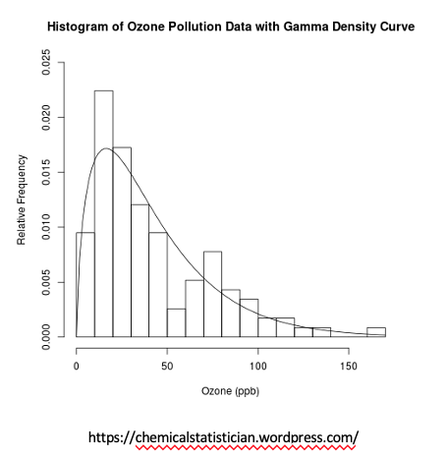
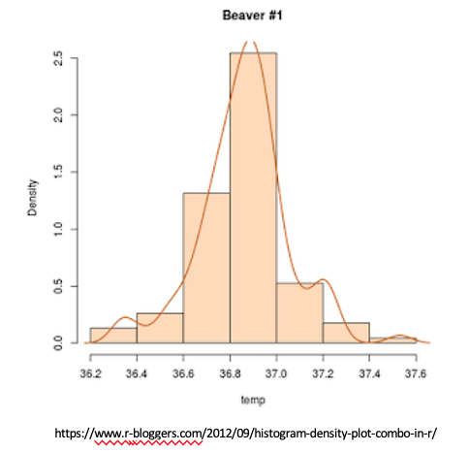
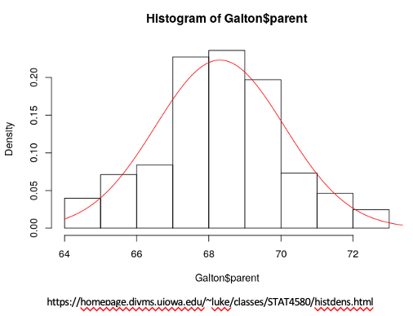
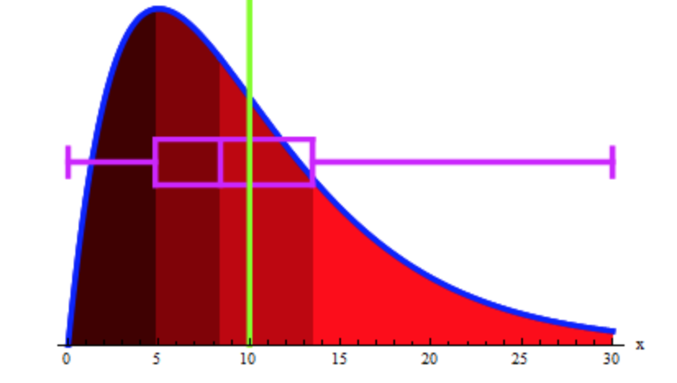
Density Curves
Density Curves
Describe the overall pattern of the distribution. It’s like a “smoothed-out histogram”.
The density curves are an “idealized” picture of the distribution. The proportions obtained from the density curve will not exactly equal the observed proportions.
Typically, density curves are used to describe populations for continuous random variables

Slide 5
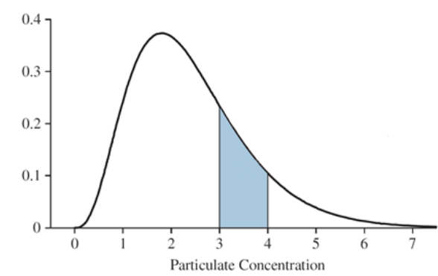
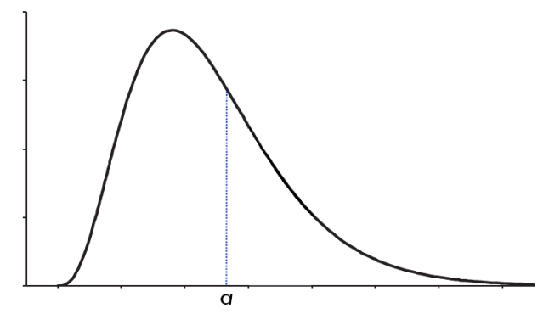
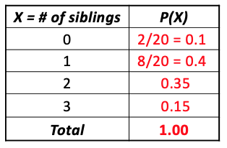
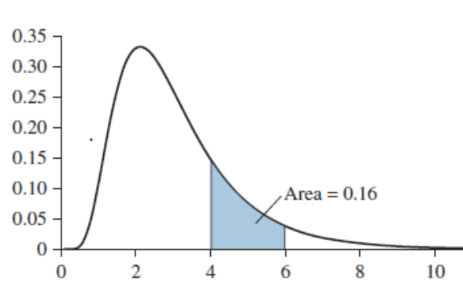
Density Curves Properties
Density Curves Properties
Remember these are all for continuous distributions (populations):
The probability of a particular value is 0 → P(X = a) = 0, for any number a
This is why we have to find probabilities for intervals!
The probability between two endpoints is found by calculating the area under the density curve
P(a < X < b) = P(a ≤ X ≤ b), for any number a and b
For any density curve, the total area under the entire curve equals 1
Analogous to discrete probability distributions and how the sum P(X) = 1, there is a total probability of 100%
Probability Interpretations
The area under a density curve between any two values a and b has two interpretations:
It is the percent of the population whose values are between a and b
It is the probability that a randomly selected individual will have a value between a and b
Examples:
What proportion of the population is between 4 and 6? P(4 < X < 6) = 0.16
If a value is chosen at random from this population, what is the probability that it is NOT between 4 and 6?
Complement!! 1 – 0.16 = 0.84

Slide 6
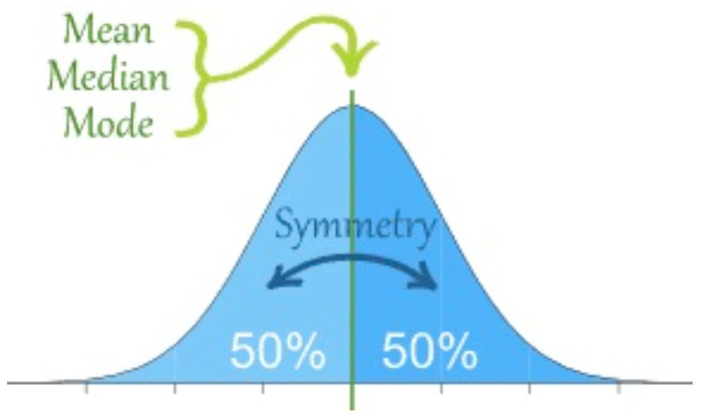
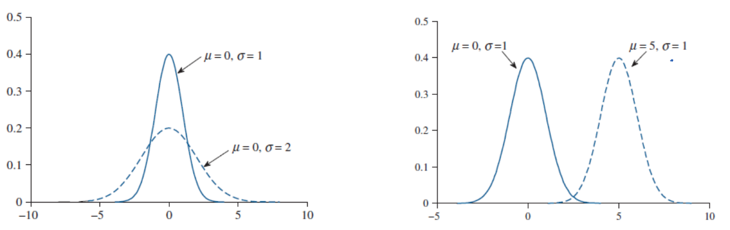
Normal Distributions
Probability density curves come in many varieties, depending on the characteristics of the populations they represent.
Many important statistical procedures can be carried out using only one type of density curve, called a Normal Curve
A population that is represented by a normal curve is said to Normally Distributed, or to have (follow ~) a Normal Distribution
Normal Distribution
The most special case of a Continuous Probability Distribution, with the following properties:
Describes a continuous random variable.
It’s a symmetric, unimodal, bell-shaped distribution → which implies mean = median = mode
Completely described by its mean 𝜇 (which determines the location of the peak) and standard deviation 𝞂 (which measures the spread of the population)
The notation we will see often is:
X ~ Normal(𝜇 , 𝞂)
Example) X ~ Normal(𝜇 = 5 , 𝞂 = 1)

Slide 7
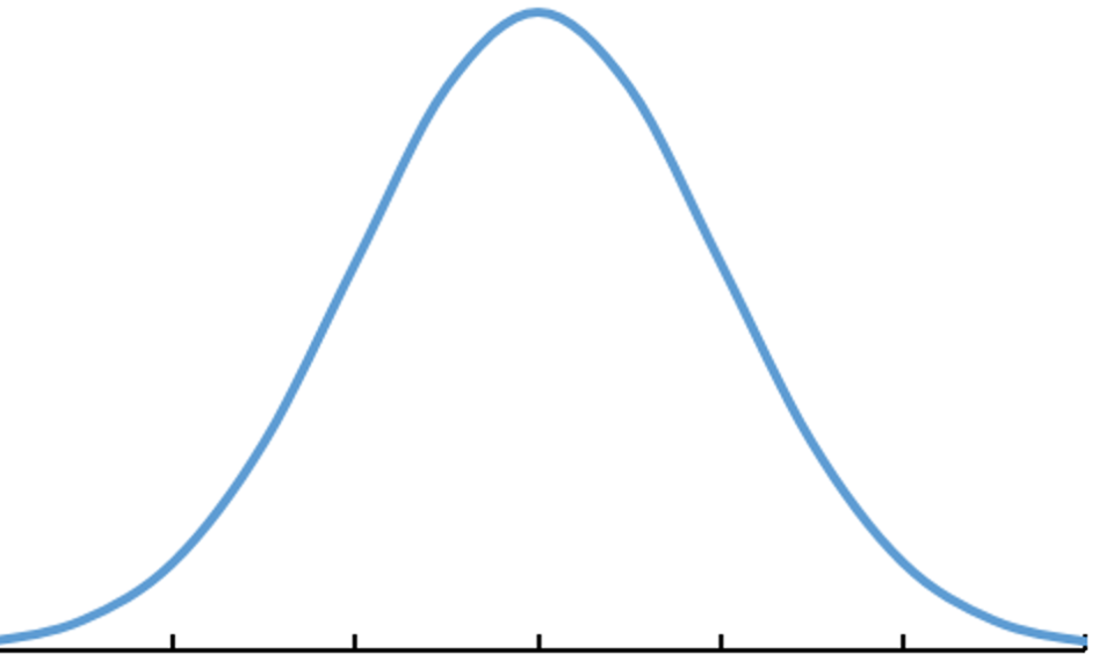
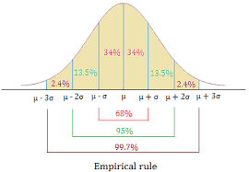
Finding Probabilities with the Normal Curve
Empirical Rule
We know probabilities associated with intervals that are 1, 2, or 3 standard deviations away from the mean!
Could also find probabilities to the left or right of these endpoints.
But what do we do if we want probabilities for points that don’t lie exactly ± 1,2,3 𝞂 from μ???

Slide 8
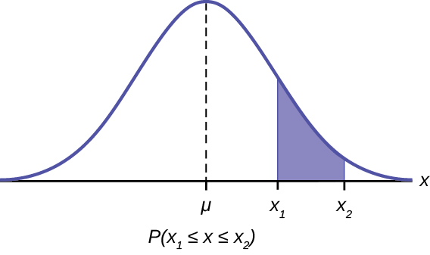
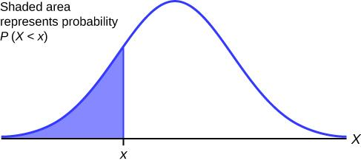
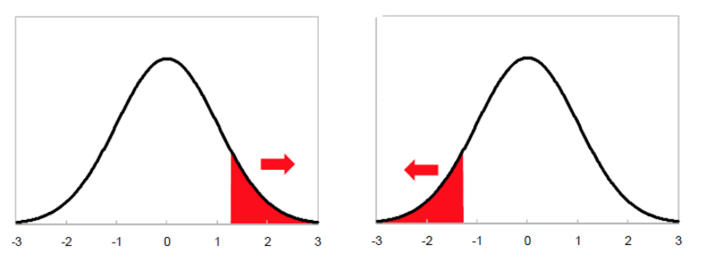
Normal Calc Fun Sess!: Finding Probabilities
Finding Probabilities
We are given a value for X (our R.V.), want a percent/probability
Think about this as being going forward, X → P
GOAL: Use the Normal distribution to calculate probabilities!
Choose correct Dist: 2ND → VARS
ALWAYS want normalcdf()
Enter in information (endpoints and parameters)
lower = lower boundary
upper = upper boundary
μ = Mean
𝞂 = SD
If you have TI-83, you would type normalcdf(lower, upper, mean, sd)
*** Special Cases
If finding a left tailed probability, enter lower = -10000 (some really big negative number)
If finding a right tailed probability, enter upper = 10000 or 10^6 (really big positive number)
https://opentextbc.ca/introbusinessstatopenstax/chapter/using-the-normal-distribution/
https://www.teksguide.org/resource/62-using-normal-distribution
https://www.researchgate.net/

Slide 9
Normal Calc Fun Sess!: Finding Probabilities
Setup: Lets say X ~ Normal(μ = 40, 𝞂 = 5), find the following probabilities.
a) What is the probability X is less than 43?
b) What is the probability X is in between 26 and 39?
c) Find the area to the right of 43?
d) What is the probability X greater than or equal to 27?
e) What is the probability X greater than 31 but less than 52? What is the probability X is outside of this interval?
STEP 1: Draw Normal Curve and Label!!!
STEP 2: Write in terms of a probability statement!!!
STEP 3: Shade the curve
STEP 4: Show work and write answer!

Slide 10
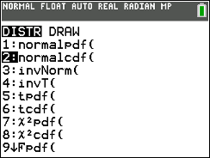
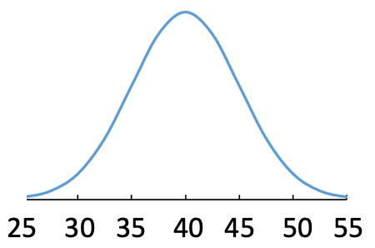
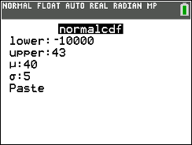
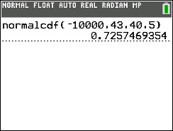
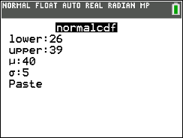
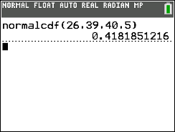
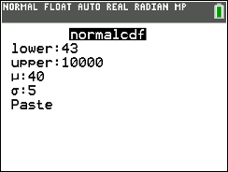
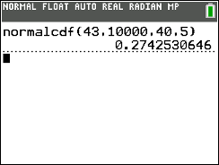



Normal Calc Fun Sess!: Finding Probabilities
Setup: Lets say X ~ Normal(μ = 40, 𝞂 = 5), find the following probabilities
a) What is the probability X is less than 43?
Step 1: Draw and label the curve just like we did with empirical rule problems
Step 2: Writing as a probability statement means translating the words to notation
(This helps with drawing the picture and showing work for partial credit)
Step 3: Make sure this matches our probability statement (one way to self check your work)
Step 4: Show the calc function and the inputs (REQUIRED WORK)
P(X < 43) = normalcdf(lower = -10000, upper = 43, mean = 40, sd = 5) = 0.7257
b) What is the probability X is in between 26 and 39?
Unlike in the discrete case, < > vs ≤ ≥ doesn’t matter because of the density curve properties (so use whatever makes more sense to you)
P(26 < X < 39) = normalcdf(26,39,40,5) = 0.4181
c) Find the area to the right of 43?
This is an upper tail probability, so there is no upper boundary; just need to put in a large positive number
P(X ≥ 43) = normalcdf(lower = 43, upper = 100000, mean = 40, sd = 5) = 0.2743
Notice this area represents the complement of part (a) → So could have answered this without another normalcdf()
P(X ≥ 43) = 1 - P(X ≤ 43) = 1 - 0.7257 = 0.2743
STEP 1: Draw Normal Curve and Label!!!
STEP 2: Write in terms of a probability statement!!!
STEP 3: Shade the curve
STEP 4: Show work and write answer!

Slide 11

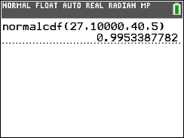
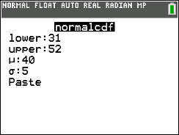
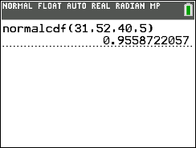
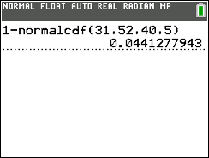


Normal Calc Fun Sess!: Finding Probabilities
STEP 1: Draw Normal Curve and Label!!!
STEP 2: Write in terms of a probability statement!!!
STEP 3: Shade the curve
STEP 4: Show work and write answer!
Setup: Lets say X ~ Normal(μ = 40, 𝞂 = 5), find the following probabilities.
d) What is the probability X greater than or equal to 27?
P(X ≥ 27) = normalcdf(lower = 27, upper = 100000, mean = 40, sd = 5) = 0.9953
It would NOT be correct to use upper = 55
This technically cuts our region off at 55, but there should be no upper bound
It won’t change the answer probably, but want to be correct
e) What is the probability X greater than 31 but less than 52?
Translating the words directly may lead to P(X > 31 < 52)
The idea is correct, but we want to rearrange so that X is in the middle
P(31 ≤ X ≤ 52) = normalcdf(lower = 31 upper = 52, mean = 40, sd = 5) = 0.9558
This will always be the format of P( ) when there is both a lower and upper bound
What is the probability X is outside of this interval?
Just use the complement rule whenever finding probabilities OUTSIDE a certain interval!
First find the probability for in between the interval (because this is what our calculator can do
Then do the subtraction from 1 to get the outside region
If you don’t do it this way, you would need to do two separate normalcdf() calculations and add the results
P(X ≤ 31 OR X ≥ 52) = 1 - normalcdf(lower = 31 upper = 52, mean = 40, sd = 5) = 0.0441
Is this event unusual?
Yes because the probability is less than 0.05

Slide 12
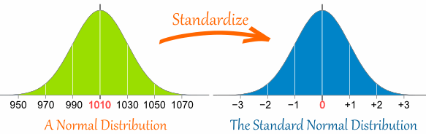
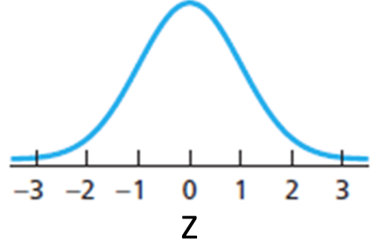
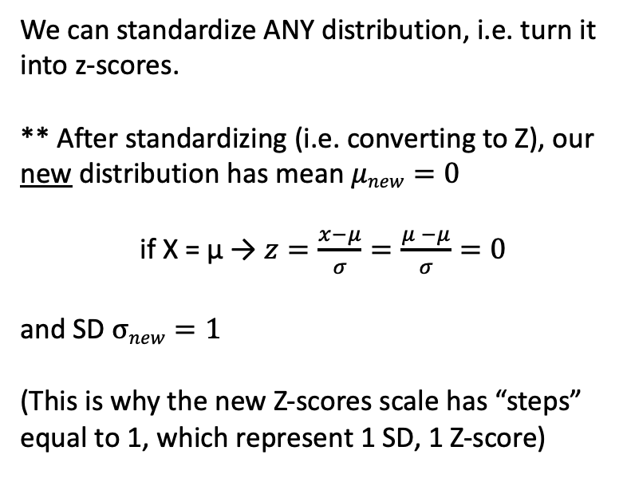
Z-Scores and Standard Normal Curve - Review
But when starting with a Normal distribution, we get a result that is very common!
Standard Normal Curve
Just a specific Normal distribution that has mean mean 𝜇 = 0 and standard deviation 𝞂 = 1
If a random variable follows a Standard Normal distribution then,
Z ~ Normal(𝜇 = 0, 𝞂 = 1)
We can find probabilities for this too!!
Z-Score - Conceptual
We can standardize ANY distribution, i.e. turn it into z-scores.
** After standardizing (i.e. converting to Z), our new distribution has mean $μnew=0$
if X = µ → $z=\frac{x−μ}{σ}=\frac{μ −μ}{σ}=0$
and SD $σnew=1$
(This is why the new Z-scores scale has “steps” equal to 1, which represent 1 SD, 1 Z-score)
https://www.mathsisfun.com/data/standard-normal-distribution.html

Slide 13
Normal Calc Fun Sess!: Finding Probabilities
Same setup: Lets say X ~ Normal(μ = 40, 𝞂 = 5), find the following probabilities.
a) What is the probability a standardized score is less than 0.6?
b) What is the probability Z is in between -2.3 and 1.5?
c) What is the probability Z less than zero?
STEP 1: Draw Normal Curve and Label!!!
STEP 2: Write in terms of a probability statement!!!
STEP 3: Shade the curve
STEP 4: Show work and write answer!

Slide 14
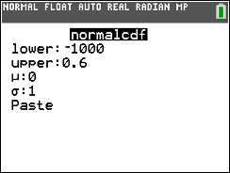
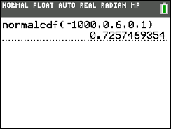
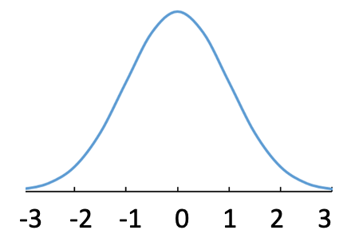
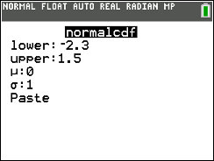
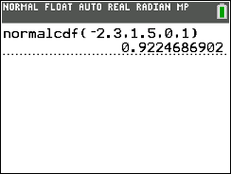



Normal Calc Fun Sess!: Finding Probabilities
Setup: Lets say X ~ Normal(μ = 40, 𝞂 = 5), find the following probabilities
a) What is the probability a standardized score is less than 0.6?
P(X Z < 0.6) → Using the standard normal curve!!!!! NEW 𝜇 = 0 and 𝜎 = 1
Really easy to switch to our new distribution, just need to use the new mean and sd
P(Z < 0.6) = normalcdf(lower = -1000, upper = 0.6, mean = 0, sd = 1) = 0.7257
b) What is the probability Z is in between -2.3 and 1.5?
P(-2.3 ≤ Z ≤ 1.5) = normalcdf(lower = -2.3, upper = 1.5, mean = 0, sd = 1) = 0.9224
c) What is the probability Z less than zero?
The mean of the Z curve is zero! Half the data is less than the mean
P(Z ≤ 0) = 0.5 → no normalcdf() needed
STEP 1: Draw Normal Curve and Label!!!
STEP 2: Write in terms of a probability statement!!!
STEP 3: Shade the curve
STEP 4: Show work and write answer!
X: 25 30 35 40 45 50 55
Z: -3 -2 -1 0 1 2 3

Slide 15
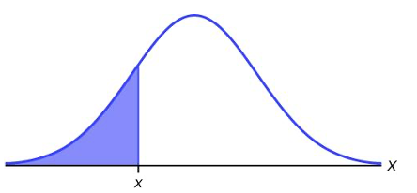
Finding Percentiles with Normal Distribution
Finding Percentiles
We are given a probability or percent (0.95 or 95%), want a value for X or a range of X’s
Think of this as working backwards X ← P
Probabilities vs Percentiles
Calculating a Percentile when…
We ask for the value of the Random Variable that tells us that a certain percentage lies above or below.
Sometimes can ask for the values of the R.V. that gives us a symmetric interval around the mean that gives us a certain percentage.
Ex. At what GPA is the 90th percentile?
Ex. What exam score is needed to be in the top 10%?
Think about this as being going backwards, P → X
Calculating a Probability when…
We ask for the probability our random variable is below, above, between a value or values.
Ex. What is the probability of weighing between 10 lbs and 14 lbs?
P(10 ≤ X ≤ 14) = ??
Think about this as being going forward, X → P
Probability = ??
Probability = 0.3
X = 2, P(X ≤ 2) = ??
P(X ≤ ??) = 0.3, x = ??

Slide 16


Normal Calc Fun Sess!: Finding Percentiles
GOAL: Use the Normal distribution to calculate percentiles!
Choose invNorm(): 2ND → VARS
Enter in information (area and parameters)
area = Probability (LEFT, percentile!)
μ = Mean
𝞂 = SD
We are entering the probability that corresponds to the left of X (like a Percentile)!
If you have TI-83, you would type invNorm(area,mean,sd)
*** If you get a right tail (upper probability), you need to rewrite as probability to the left!
https://www.teksguide.org/resource/62-using-normal-distribution
In calc:
If given:
P = 0.15
P = 1-0.15= 0.85
x =??

Slide 17
Normal Calc Fun Sess!: Finding Percentiles
Setup: Lets say X ~ Normal(μ = 10, 𝞂 = 1.5), find the following values:
a) Find the X value that has an area of 0.3 to the left
b) Find the X value that has an area of 0.15 to the right
c) Find the X value with 0.65 probability above
STEP 1: Draw Normal Curve and Label!!!
STEP 2: Write in terms of a probability statement!!!
STEP 3: Shade the curve
STEP 4: Show work and write answer!

Slide 18
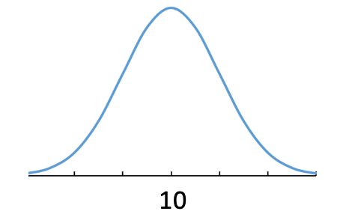
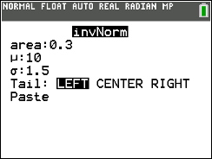
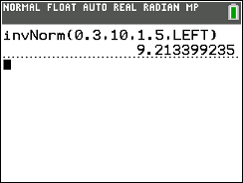
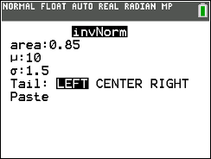
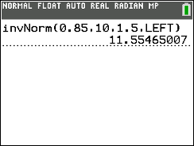
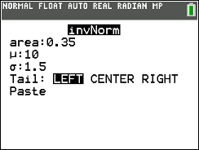



Normal Calc Fun Sess!: Finding Percentiles
Thought Process Tips
Step 2 is a little more difficult (below is my notation to help think about it)
P(X ) need to figure out what else goes in here
Looking for area to left, this means <
But less than what #?? That’s what we are trying to figure out, so I put ‘??’ there
We know that probability statement must equal 0.3, so = 0.3
Then use invNorm() to figure out the ??, which is an x value
Setup: Lets say X ~ Normal(μ = 10, 𝞂 = 1.5), find the following values:
a) Find the X value that has an area of 0.3 to the left
Same steps as before when finding probabilities
P(X ≤ ??) = 0.3 → x = invNorm(area = 0.3, mean = 10, sd = 1.5) = 9.21
→ Can check this by plugging our answer the normalcdf to see if get close to the given probability (some roundoff error)!
b) Find the X value that has an area of 0.15 to the right
Now we want to the right, which means > in our P( )
P(X > ??) = 0.15 → need to rewrite as a left-tail probability to enter in our calc!
P(X >??) = 0.15 ⬅➔ P(X < ??) = 0.85 → so switch direction of inequality and use the left side probability
Now solve for the X value → x = invNorm(area = 0.85, mean = 10, sd = 1.5) = 11.55
c) Find the X value with 0.65 probability above
P(X ≥ ??) = 0.65 → need to rewrite as a left-tail probability!
P(X ≥ ??) = 0.65 ⬅➔ P(X ≤ ??) = 0.35
x = invNorm(area = 0.35, mean = 10, sd = 1.5) = 9.42
STEP 1: Draw Normal Curve and Label!!!
STEP 2: Write in terms of a probability statement!!!
STEP 3: Shade the curve
STEP 4: Show work and write answer!
** Remember your calculator might not have that last argument (so just ignore it in these pictures)!
1 – 0.15 = 0.85
1 – 0.65 = 0.35

Slide 19
Normal Calc Fun Sess!: Finding Percentiles
STEP 1: Draw Normal Curve and Label!!!
STEP 2: Write in terms of a probability statement!!!
STEP 3: Shade the curve
STEP 4: Show work and write answer!
Setup: Lets say X ~ Normal(μ = 10, 𝞂 = 1.5), find the following values:
d) Find the X values for the middle 70% of data
e) Find the Z score that represents the 30th percentile
f) Find the Z values that bound the middle 15% of the area under the standard normal curve

Slide 20
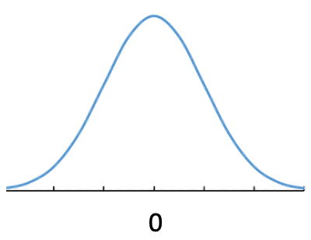
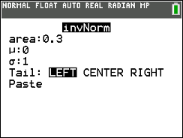
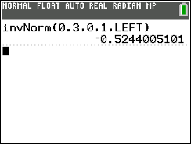



Normal Calc Fun Sess!: Finding Percentiles
STEP 1: Draw Normal Curve and Label!!!
STEP 2: Write in terms of a probability statement!!!
STEP 3: Shade the curve
STEP 4: Show work and write answer!
Setup: Lets say X ~ Normal(μ = 10, 𝞂 = 1.5), find the following values:
d) Find the X values for the middle 70% of data
Need to setup a symmetric interval and find both endpoints!
→ So solve for two X values by writing both as a left-tail probabilities!
X1: P(X < ??) = 0.15
x1 = invNorm(area = 0.15, mean = 10, sd = 1.5) = 8.45
X2: P(X < ??) = 0.85
x2 = invNorm(area = 0.85, mean = 10, sd = 1.5) = 11.55
e) Find the Z score that represents the 30th percentile
Using the standard normal curve!!!!! NEW 𝜇 = 0 and 𝜎 = 1
P(Z ≤ ??) = 0.3) → invNorm(area = 0.3, mean = 0, sd = 1) = -0.52
f) Find the Z values that bound the middle 15% of the area under the standard normal curve
→ Again need to setup a symmetric interval and find both endpoints! (i.e. write both as a left-tail probabilities!)
X1: P(X < ??) = 0.425
x1 = invNorm(area = 0.425, mean = 10, sd = 1.5) = -0.189
X2: P(X < ??) = 0.575
x2 = nvNorm(area = 0.85, mean = 10, sd = 1.5) = 0.189
→ Because the standard normal curve is centered at zero, symmetric interval endpoints will be the same just the positive and negative version!
Prob outside: 1 – 0.7 = 0.3
Prob on left (for X1): 0.3 / 2 = 0.15
X2: 0.15 + 0.7 = 1 – 0.15 = 0.85
Prob outside: 1 – 0.15 = 0.85
Prob on left (for X1): 0.85 / 2 = 0.425
X2: 0.425 + 0.15 = 1 – 0.425 = 0.575

Slide 21
PROBLEM SESSION!!!!!!!!!!!

Slide 22
Finding Probabilities and Percentiles Example
The 3 point shooting percentage (number made/number attempted) for NBA players are Normally Distributed with a mean of 0.33 and standard deviation of 0.05.
What is the probability a randomly selected player makes more than 25% of their 3 point shots?

Slide 23
Finding Probabilities and Percentiles Example
The 3 point shooting percentage (number made/number attempted) for NBA players are Normally Distributed with a mean of 0.33 and standard deviation of 0.05.
What is the probability a randomly selected player makes more than 25% of their 3 point shots?
P(X>=0.25) = ??

Slide 24
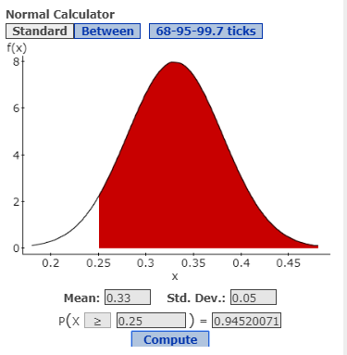
Finding Probabilities and Percentiles Example
The 3 point shooting percentage (number made/number attempted) for NBA players are Normally Distributed with a mean of 0.33 and standard deviation of 0.05.
What is the probability a randomly selected player makes more than 25% of their 3 point shots?
P(X>=0.25) = 0.9452

Slide 25
Finding Probabilities and Percentiles Example
The 3 point shooting percentage (number made/number attempted) for NBA players are Normally Distributed with a mean of 0.33 and standard deviation of 0.05.
What 3 point percentage do the top 1% have?

Slide 26
Finding Probabilities and Percentiles Example
The 3 point shooting percentage (number made/number attempted) for NBA players are Normally Distributed with a mean of 0.33 and standard deviation of 0.05.
What 3 point percentage do the top 1% have?
P(X=>??) = 0.01

Slide 27
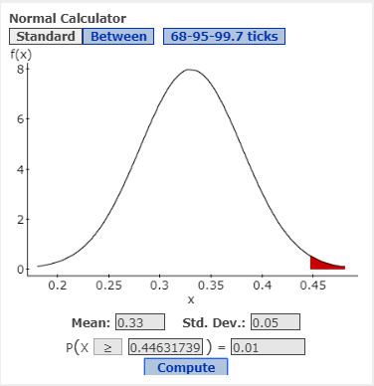
Finding Probabilities and Percentiles Example
The 3 point shooting percentage (number made/number attempted) for NBA players are Normally Distributed with a mean of 0.33 and standard deviation of 0.05.
What 3 point percentage do the top 1% have?
P(X=>0.446) = 0.01
The top 1% make 44.6% of their 3 point shots.

Slide 28

Problem 7
The intelligence quotient (IQ) is a measure of mental ability. IQs are normally distributed with a mean of 100 and a standard deviation of 15.

Slide 29
Problem 7a
What is the probability of randomly selecting an individual with an IQ greater than 120?

Slide 30

Problem 7a
What is the probability of randomly selecting an individual with an IQ greater than 120?
P(X>=120) = 0.0912

Slide 31
Problem 7b
What is the probability of randomly selecting an individual with an IQ less than 90?

Slide 32

Problem 7b
What is the probability of randomly selecting an individual with an IQ less than 90?
P(X<=90) = 0.2525

Slide 33
Problem 7c
Individuals with mild to moderate intellectual disability have IQs between 40 and 69. What is the probability of randomly selecting an individual with mild to moderate intellectual disability?

Slide 34
Problem 7c
Individuals with mild to moderate intellectual disability have IQs between 40 and 69. What is the probability of randomly selecting an individual with mild to moderate intellectual disability?
P(40<=X<=69) = 0.0194

Slide 35
Problem 7d
Find a symmetric interval about the mean IQ such that 50% of all IQs lie in this interval. What are the endpoints of this interval called?

Slide 36
Problem 7d
Find a symmetric interval about the mean IQ such that 50% of all IQs lie in this interval. What are the endpoints of this interval called?
The amount data between Q1 and Q3 is 50%.
P(?<X<?) = 0.5

Slide 37

Problem 7d
Find a symmetric interval about the mean IQ such that 50% of all IQs lie in this interval. What are the endpoints of this interval called?
The amount data between Q1 and Q3 is 50%.
P(89.88<=X<=110.12) = 0.5
Q1 = 89.88 Q3 = 110.12

Slide 38
Problem 7e
In order to qualify for membership in Mensa (a high IQ society) your IQ must be at (or above) the 98th percentile. What must your IQ be in order to qualify for membership in Mensa? Explain.

Slide 39

Problem 7e
In order to qualify for membership in Mensa (a high IQ society) your IQ must be at (or above) the 98th percentile. What must your IQ be in order to qualify for membership in Mensa? Explain.
To be in the 98th percentile, you need to have an IQ higher than 98% of everyone else. What does that look like?
P(X<=???) = 0.98

Slide 40

Problem 7e
In order to qualify for membership in Mensa (a high IQ society) your IQ must be at (or above) the 98th percentile. What must your IQ be in order to qualify for membership in Mensa? Explain.
P(X<=130.81) = 0.98
You would need an IQ score of higher than 130.81.

Slide 41
Problem 8
A common complaint of students is back pain due to lugging around laptops and all of the accessories. The weights of laptops are normally distributed with mean 7.4 pounds and standard deviation 2.2 pounds. Find a symmetric interval about the mean weight such that 90% of all laptop weights lie in this interval.

Slide 42

Problem 8
A common complaint of students is back pain due to lugging around laptops and all of the accessories. The weights of laptops are normally distributed with mean 7.4 pounds and standard deviation 2.2 pounds. Find a symmetric interval about the mean weight such that 90% of all laptop weights lie in this interval.
We will start with a picture.
P(??<=X<=??) = 0.9

Slide 43

Problem 8
A common complaint of students is back pain due to lugging around laptops and all of the accessories. The weights of laptops are normally distributed with mean 7.4 pounds and standard deviation 2.2 pounds. Find a symmetric interval about the mean weight such that 90% of all laptop weights lie in this interval.
P(3.78<=X<=11.02) = 0.9

Slide 44

Standard Normal Curve Solution (a)
P(z < 1.45) = 0.9265

Slide 45

Standard Normal Curve Solution (b)
P(z > -0.6) = 0.7257

Slide 46

Standard Normal Curve Solution (c)
P(-1.25 < z < 2.13) = 0.8778

Slide 47

Standard Normal Curve Solution (d)
Find the value of the 90th percentile
The 90th percentile means find b such that
P(z < b) = 0.90
The value of the 90th percentile is 1.2816

Slide 48
Problem #9
What percent of a standard Normal model is found in each region? Be sure to draw a picture first.
z => 1.5
z <= 2.25
-1 <= z <= 1.15
|z| => 0.5

Slide 49





Problem #9 Solution
Remember the standard normal curve has a mean = 0 and a SD = 1
P(z >= 1.5) = 0.0668 b) P(z <= 2.25) = 0.9878
c) P(-1 <= z <= 1.15) = 0.7163 d) P(|z| => 0.5) = 0.6171

Slide 50
Problem #11
In a standard Normal model, what value(s) of a z cut(s) off the region described? Don’t forget to draw a picture.
the highest 20%
the highest 75%
the lowest 3%
the middle 90%

Slide 51




Problem #11 Solution
z = 0.8416 b) z = -0.6745
c) z = -1.8808 d) P(-1.645 <= z <= 1.645) = 0.90

Slide 52
Problem #5
Your company’s Human Resources department administers a test of “Executive Aptitude.” Your company will admit to the executive training program only people who score in the top 3% on the executive aptitude test. They report test grades as z-scores, and you got a score of 2.20.
With your score of 2.20, did you make the cut?
What do you need to assume about test scores to find your answer in part (a)?

Slide 53
Problem #5 Solution
P(z >= 2.20) = 0.0139 which means you scored in the top 1.39%. So, yes, you made the cut.
You have to assume that the test scores are normally distributed.

Slide 54

Normal Variables
Find the following probabilities (and percentiles) by using the Normal calculator on JMP. Sketch and label a picture for each problem.
$μ=8, σ=3, x=17, P\left(x≥17\right)$
$μ=100, σ=16, x=80, P(x≤80)$
$μ=100, σ=16, x=80, P\left(80≤x≤105\right)$
$μ=100, σ=16,$find the value of the 99th percentile

Slide 55


Normal Variables (a) Solution
$μ=8, σ=3, x=17, P\left(x≥17\right)$
$P\left(x≥17\right)=0.0013$

Slide 56


Normal Variables (b) Solution
$μ=100, σ=16, x=80, P\left(x≤80\right)$
$P(x≤80)$ = 0.1056

Slide 57


Normal Variables (c) Solution
$μ=100, σ=16, x=80, P\left(80≤x≤105\right)$
$P\left(80≤x≤105\right)$ = 0.5170

Slide 58


Normal Variables (d) Solution
$μ=100, σ=16,$find the value of the 99th percentile
The 99th percentile means find b such that
$$P\left(x≤b\right)=0.99$$
The value of the 99th percentile is $x=137.22$

Slide 59
Problem #7
The Environmental Protection Agency (EPA) fuel economy estimates for automobiles suggest a mean of 24.8 mpg and a standard deviation of 6.2 mpg for highway driving. Assume that a Normal model can be applied.
Draw the model for auto fuel economy. Clearly label it, showing what the 68-95-99.7 Rule predicts about miles per gallon.
In what interval would you expect the central 68% of autos to be found.
About what percent of autos should get more than 31 mpg?
About what percent of cars should get between 31 and 37.2 mpg?
Describe the gas mileage of the worst 2.5% of all cars.

Slide 60





Problem #7 Solution
$μ=24.8, σ=6.2$
24.8 ± 6.2 = 18.6 mpg to 31 mpg
= 0.1567 ≈ 16%
= 0.1359 ≈ 13.6%
= 12.64, cars that get 12.6 mpg or less are the worst 2.5% of all cars

Slide 61
Problem #31
According to the Normal model N(0.062, 0.018) describing mutual fund returns in the 1st quarter of 2013 in Exercise 23, what percent of this group of funds would you expect to have return
over 6.8%
between 0% and 7.6%
more than 1%
less than 0%

Slide 62




Problem #31 Solution
N(0.062, 0.018)
P(x => 6.8%) = 0.3694 b) P(0% <= x <= 7.6%) = 0.7814
c) P(x => 1%) = 0.9981 d) P(x <= 0%) = 0.0003

Slide 63
Problem #33
Based on the model N(0.062, 0.018) for quarterly returns from Exercise 23, what are the cutoff values for the
highest 10% of these funds?
lowest 20%?
middle 40%?
highest 80%?

Slide 64




Problem #33 Solution
N(0.062, 0.018)
Highest 10%, x = 8.51% b) Lowest 20%, x = 4.69%
c) Middle 40%, (5.26%, 7.14%) d) Highest 80%, x = 4.69%

