Slide 1
Last Slides!!!
Unit 11 – Regression
Your Final Professor Colton

Slide 2
Unit 11 - Outline
Unit 11 – Correlation and Regression
Regression Equation
Predictions
Coefficient of Determination

Slide 3
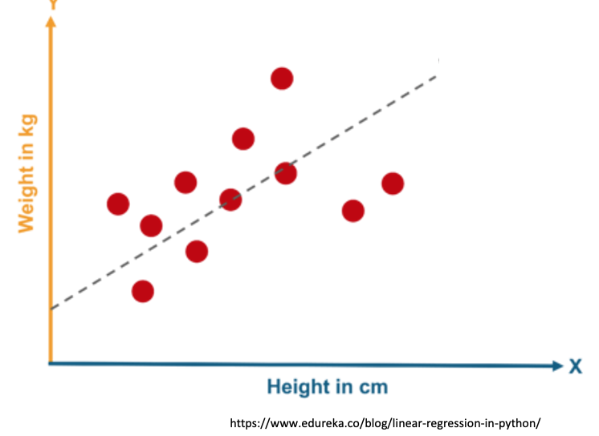
Motivation
In the case where our data does show evidence of a significant linear correlation, we would like to model that relationship!
Modeling the relationship will allow us to predict Y values for new X values.
The process is called linear regression.

Slide 4
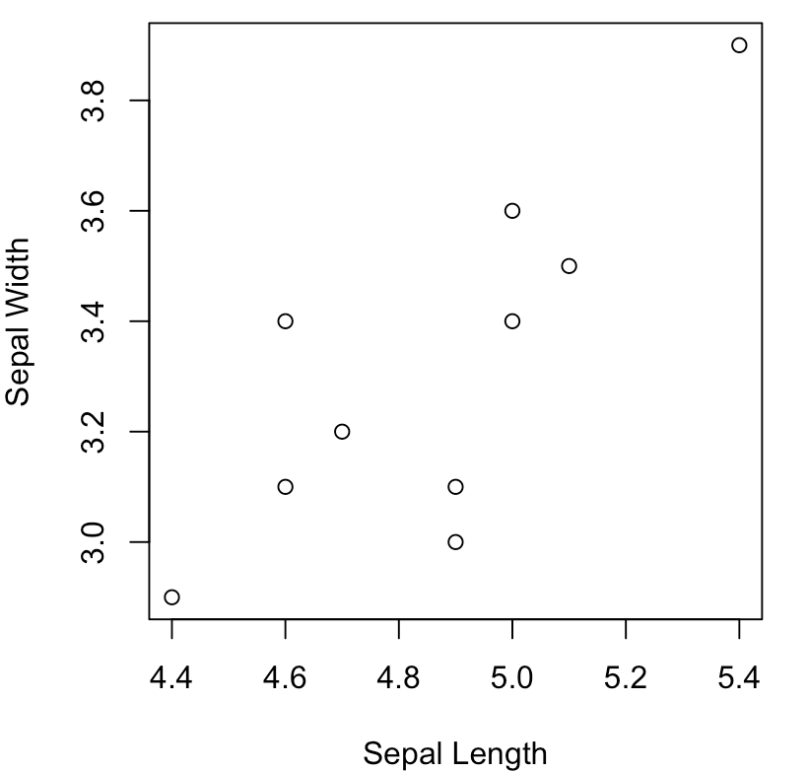
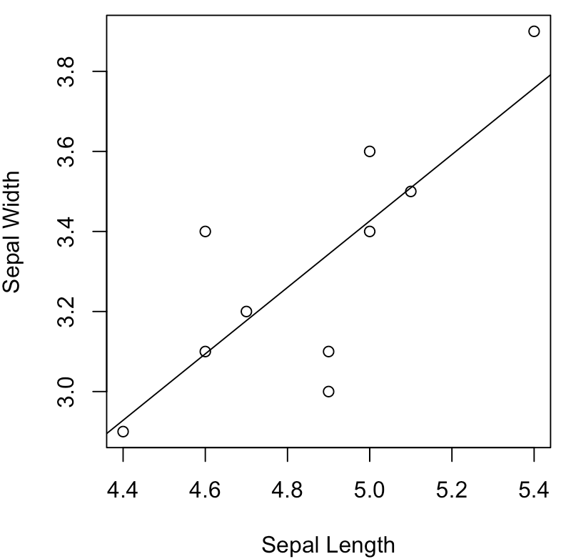
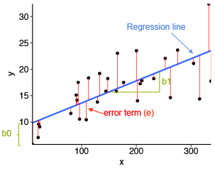
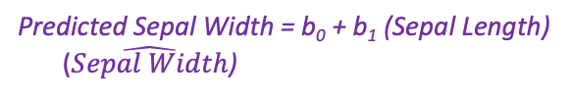
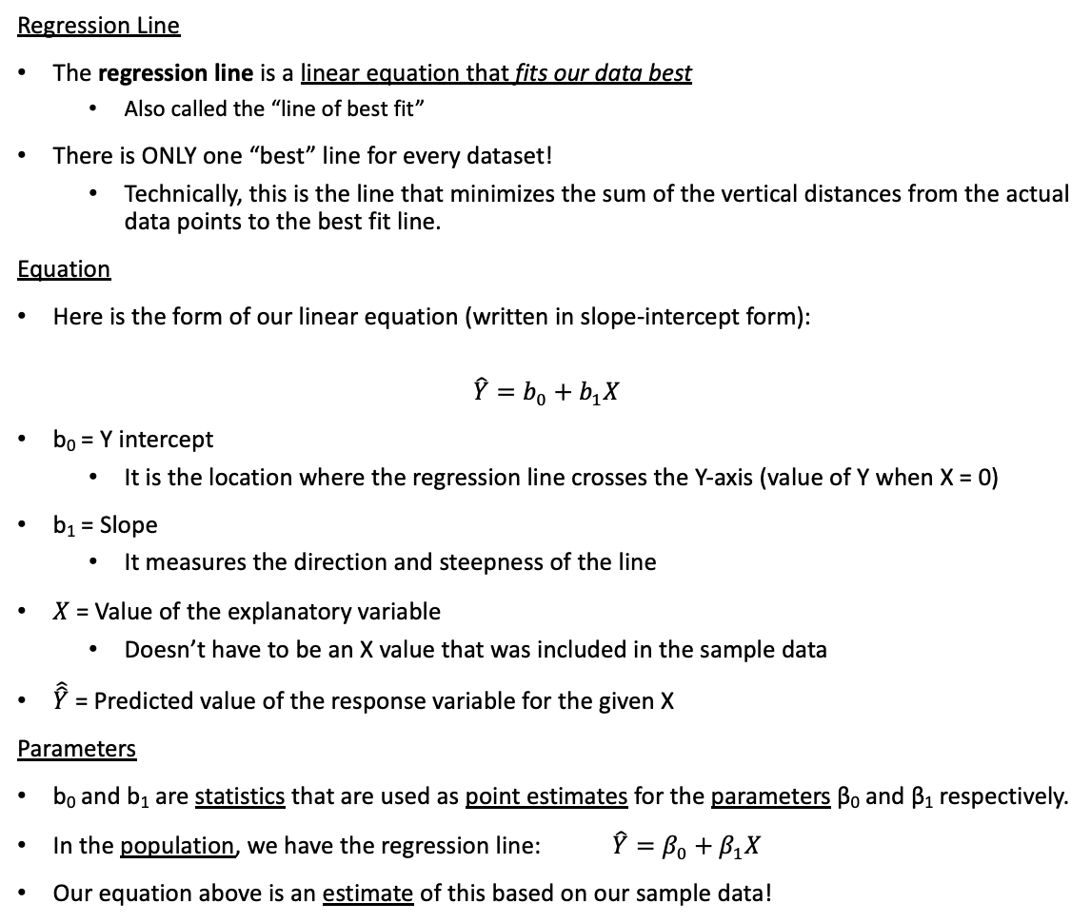
Regression Line
Regression Line
The regression line is a linear equation that fits our data best
Also called the “line of best fit”
There is ONLY one “best” line for every dataset!
Technically, this is the line that minimizes the sum of the vertical distances from the actual data points to the best fit line.
Equation
Here is the form of our linear equation (written in slope-intercept form):
$$\hat{Y}=b_{0}+b_{1}X$$
b₀ = Y intercept
It is the location where the regression line crosses the Y-axis (value of Y when X = 0)
b₁ = Slope
It measures the direction and steepness of the line
$X$ = Value of the explanatory variable
Doesn’t have to be an X value that was included in the sample data
$\hat{\hat{Y}}$ = Predicted value of the response variable for the given X
Parameters
b₀ and b₁ are statistics that are used as point estimates for the parameters β₀ and β₁ respectively.
In the population, we have the regression line: $\hat{Y}=β_{0}+β_{1}X$
Our equation above is an estimate of this based on our sample data!
Predicted Sepal Width = b₀ + b₁ (Sepal Length)
($\hat{Sepal Width}$)
It’s important to get the X and Y variables correct or else our equation’s variables will be backwards!
https://www.analyticsvidhya.com/blog/2021/06/25-questions-to-test-your-skills-on-linear-regression-algorithm/

Slide 5
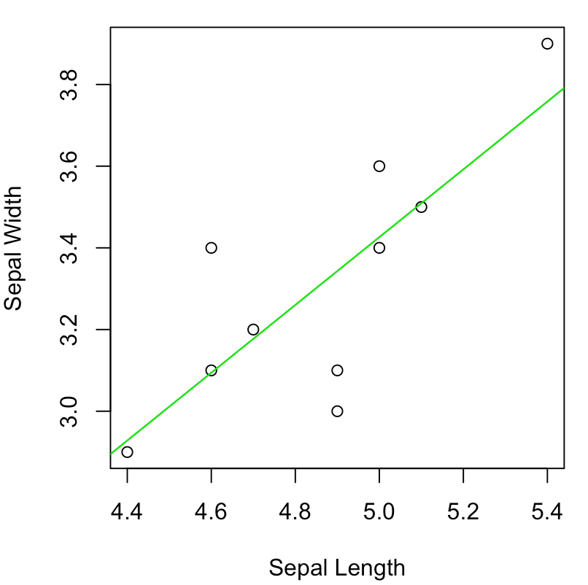
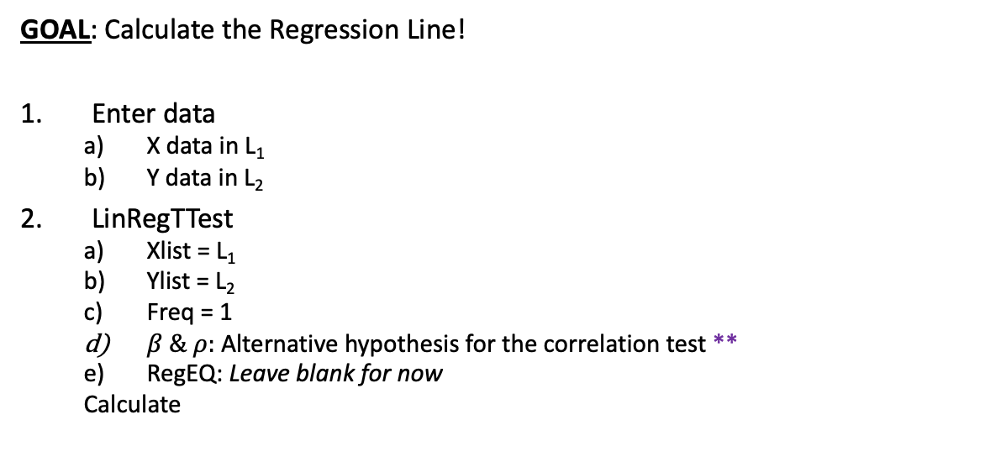

Using Calc – Calculating Regression Line
X Y
GOAL: Calculate the Regression Line!
Enter data
X data in L₁
Y data in L₂
LinRegTTest
Xlist = L₁
Ylist = L₂
Freq = 1
$β \& ρ:$Alternative hypothesis for the correlation test **
RegEQ: Leave blank for now
Calculate
$\hat{Y}=b_{0}+b_{1}X$
b₀ = ?? and b₁ = ??
** The Alternative Hypothesis will NOT change the equation of the regression line, only the p-value of the correlation test
New point
Outliers Demonstration
Let’s change one data point to see the effects on the regression line:
9th observation: (4.4, 2.9) → (4.4, 3.8)
Now recalculate the equation!

Slide 6
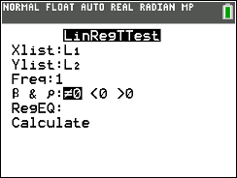
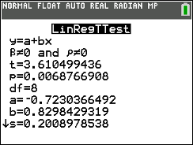
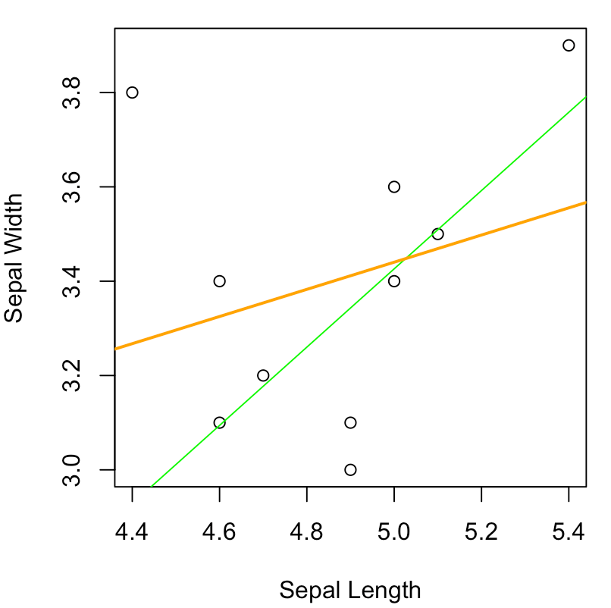
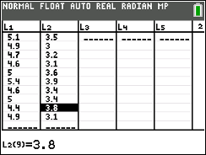
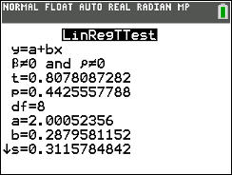

Using Calc – Calculating Regression Line
X Y
GOAL: Calculate the Regression Line!
Enter data
X data in L₁
Y data in L₂
LinRegTTest
Xlist = L₁
Ylist = L₂
Freq = 1
$β \& ρ:$Alternative hypothesis for the correlation test **
RegEQ: Leave blank for now
Calculate
$\hat{Y}=b_{0}+b_{1}X$
b₀ = ?? and b₁ = ??
Calculator Output
y = a + bx → calculator’s notation for the regression equation
a = intercept b₀
b = slope b₁
BIG difference between the two regression equations just from changing the one point
NOTE that this change is kinda amplified because of the small sample size
But nonetheless illustrates the effects of outliers on regression as well as correlation
** The Alternative Hypothesis will NOT change the equation of the regression line, only the p-value of the correlation test
Regression Equation: $\hat{Y}=−0.723+0.83X$
New point
Outliers Demonstration
Let’s change one data point to see the effects on the regression line:
9th observation: (4.4, 2.9) → (4.4, 3.8)
Now recalculate the equation!
New Regression Equation: $\hat{Y}=2.001+0.288X$

Slide 7
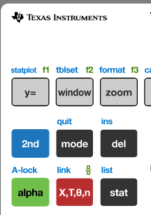
Using Calc – Plotting Regression Line
GOAL: Plotting the Regression Line!
1) Make Scatterplot
Enter data: X (L₁) and Y (L₂)
STAT PLOT
ON, Type = Scatter plot image, Xlist = L₁, Ylist = L₂
ZOOM → 9:ZoomStat
This automatically zooms to whatever data range the stat plot requires
Two Options to Add Regression Line
Option 1) Manually add regression line
Get regression equation from LinRegTTest output
Type equation in Y= → Y₁
Use Red button to type in the Variable X
Graph

Slide 8
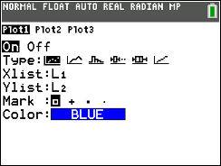
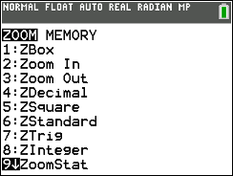
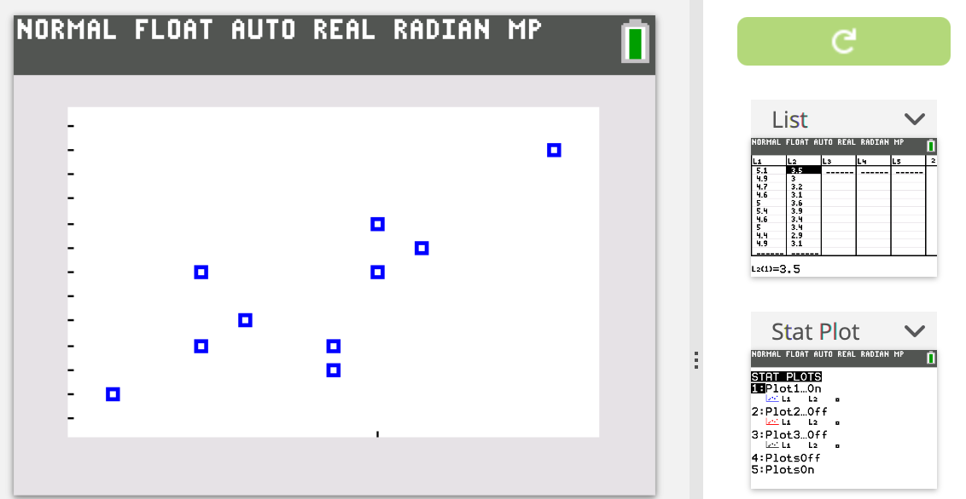
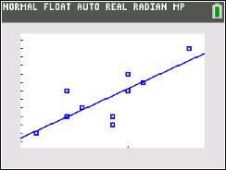
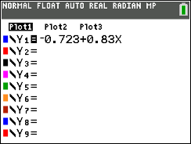
Using Calc – Plotting Regression Line
GOAL: Plotting the Regression Line!
1) Make Scatterplot
Enter data: X (L₁) and Y (L₂)
STAT PLOT
ON, Type = Scatter plot image, Xlist = L₁, Ylist = L₂
ZOOM → 9:ZoomStat
This automatically zooms to whatever data range the stat plot requires
Two Options to Add Regression Line
Option 1) Manually add regression line
Get regression equation from LinRegTTest output
Type equation in Y= → Y₁
Use Red button to type in the Variable X
Graph
Regression Equation: $\hat{Y}=−0.723+0.83X$

Slide 9
Using Calc – Plotting Regression Line
GOAL: Plotting the Regression Line!
Option 2) Let calc add regression line
LinRegTTest
RegEQ: Y₁
All other options are the same, we just need to tell our calculator to put the resulting regression equation in Y₁ for us!
To do this: Vars → Y-Vars → Function → Y₁
This should be a ONE TIME SETUP
Calculate
If you look in Y= now, should see the exact regression equation from the output!
Graph

Slide 10
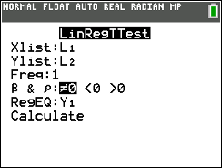
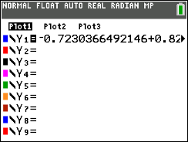

Using Calc – Plotting Regression Line
GOAL: Plotting the Regression Line!
Option 2) Leta Calc add regression line
LinRegTTest
RegEQ: Y₁
All other options are the same, we just need to tell our calculator to put the resulting regression equation in Y₁ for us!
To do this: Vars → Y-Vars → Function → Y₁
This should be a ONE TIME SETUP
Calculate
If you look in Y= now, should see the exact regression equation from the output!
Graph

Slide 11
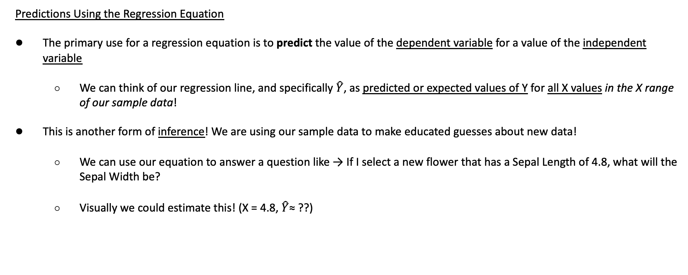
Predicting
Predictions Using the Regression Equation
The primary use for a regression equation is to predict the value of the dependent variable for a value of the independent variable
We can think of our regression line, and specifically $\hat{Y}$, as predicted or expected values of Y for all X values in the X range of our sample data!
This is another form of inference! We are using our sample data to make educated guesses about new data!
We can use our equation to answer a question like → If I select a new flower that has a Sepal Length of 4.8, what will the Sepal Width be?
Visually we could estimate this! (X = 4.8, $\hat{Y}$≈ ??)
3.26 ≈

Slide 12
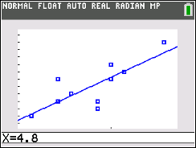
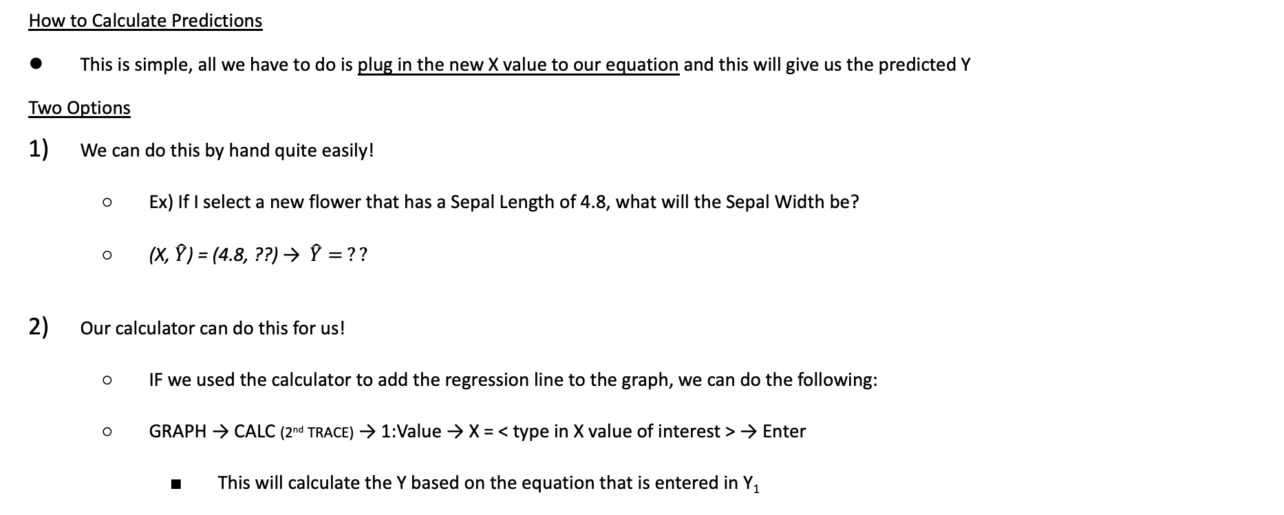
Calculating Predictions
How to Calculate Predictions
This is simple, all we have to do is plug in the new X value to our equation and this will give us the predicted Y
Two Options
We can do this by hand quite easily!
Ex) If I select a new flower that has a Sepal Length of 4.8, what will the Sepal Width be?
(X, $\hat{Y}$) = (4.8, ??) → $\hat{Y}= ??$
Our calculator can do this for us!
IF we used the calculator to add the regression line to the graph, we can do the following:
GRAPH → CALC (2nd TRACE) → 1:Value → X = < type in X value of interest > → Enter
This will calculate the Y based on the equation that is entered in Y₁
* Note this will work even if we manually typed in the rounded regression equation to Y₁, but we might as well be more precise!
LCQ: Try for a new length: X = 5.3
Manual way:
???
Calc way:
???
X = 4.8 → $Predicted Y= ??$

Slide 13
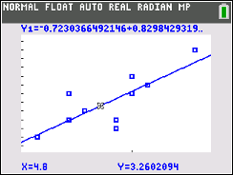

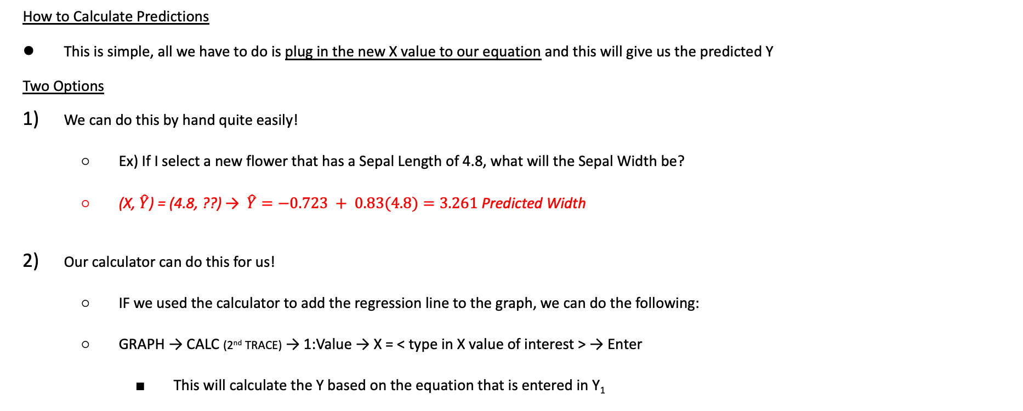
Calculating Predictions
How to Calculate Predictions
This is simple, all we have to do is plug in the new X value to our equation and this will give us the predicted Y
Two Options
We can do this by hand quite easily!
Ex) If I select a new flower that has a Sepal Length of 4.8, what will the Sepal Width be?
(X, $\hat{Y}$) = (4.8, ??) → $\hat{Y}=−0.723 + 0.83(4.8)=3.261$ Predicted Width
Our calculator can do this for us!
IF we used the calculator to add the regression line to the graph, we can do the following:
GRAPH → CALC (2nd TRACE) → 1:Value → X = < type in X value of interest > → Enter
This will calculate the Y based on the equation that is entered in Y₁
* Note this will work even if we manually typed in the rounded regression equation to Y₁, but we might as well be more precise!
LCQ: Try for a new length: X = 5.3
Manual way:
$\hat{Y}=−0.723 + 0.83(5.3)=3.676$
Calc way:
X (Length) = 5.3 → Predicted Y (Width) = 3.6707
X = 4.8 → $Predicted Y=3.2602$
* Difference between this answer and the previous is because of roundoff error

Slide 14
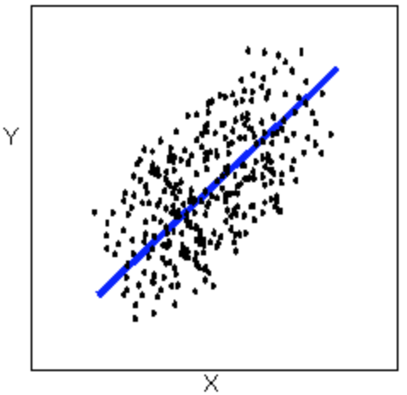

Interpolating vs Extrapolating
When we predict, we are actually doing one of two things (one is good, one is bad):
Interpolation
Interpolation results when the X value of interest falls between given values of X in our original data set
Generally interpolation is considered a safe prediction method because we have already shown that our data behaves in a linear way within the range that we used to come up with the regression equation
Extrapolation
Extrapolation results when the X value of interest falls outside the range of values for X in our original data set
Extrapolation is considered riskier than interpolation because we have no way of knowing what the behavior of the data will be outside of the range we studied.
It is a BIG assumption to think the regression line will continue in the EXACT same pattern (It could level off, or curve, or anything)
https://bolt.mph.ufl.edu/6050-6052/unit-1/case-q-q/scatterplots/

Slide 15
LCQ: Interpolating vs Extrapolating
Problem: Determine if the following predictions are interpolating or extrapolating. Then calculate the prediction.
Predict the Sepal Width for a Sepal Length = 4.0
Predict the Sepal Width for a Sepal Length = 5.1
Predict the Sepal Width for a Sepal Length = 5.5

Slide 16
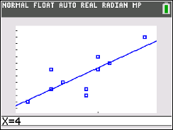
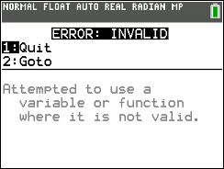

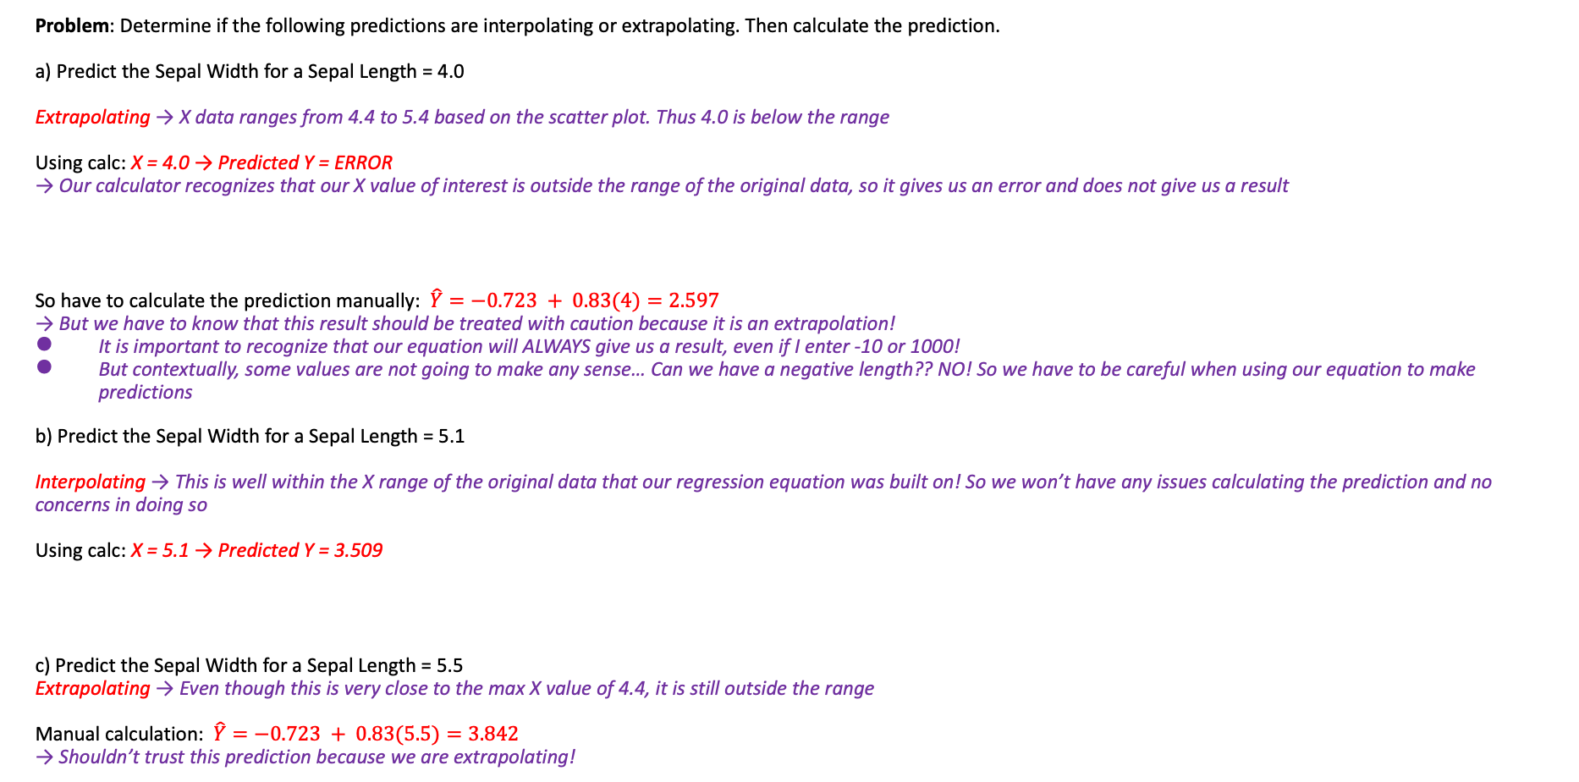
LCQ: Interpolating vs Extrapolating
Problem: Determine if the following predictions are interpolating or extrapolating. Then calculate the prediction.
a) Predict the Sepal Width for a Sepal Length = 4.0
Extrapolating → X data ranges from 4.4 to 5.4 based on the scatter plot. Thus 4.0 is below the range
Using calc: X = 4.0 → Predicted Y = ERROR
→ Our calculator recognizes that our X value of interest is outside the range of the original data, so it gives us an error and does not give us a result
So have to calculate the prediction manually: $\hat{Y}=−0.723 + 0.83(4)=2.597$
→ But we have to know that this result should be treated with caution because it is an extrapolation!
It is important to recognize that our equation will ALWAYS give us a result, even if I enter -10 or 1000!
But contextually, some values are not going to make any sense… Can we have a negative length?? NO! So we have to be careful when using our equation to make predictions
b) Predict the Sepal Width for a Sepal Length = 5.1
Interpolating → This is well within the X range of the original data that our regression equation was built on! So we won’t have any issues calculating the prediction and no concerns in doing so
Using calc: X = 5.1 → Predicted Y = 3.509
c) Predict the Sepal Width for a Sepal Length = 5.5
Extrapolating → Even though this is very close to the max X value of 4.4, it is still outside the range
Manual calculation: $\hat{Y}=−0.723 + 0.83(5.5)=3.842$
→ Shouldn’t trust this prediction because we are extrapolating!

Slide 17
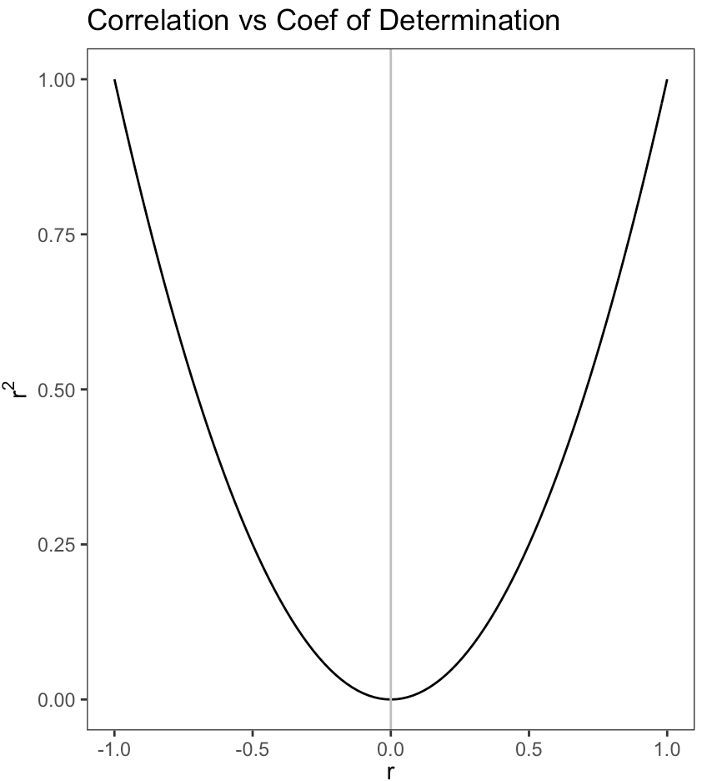
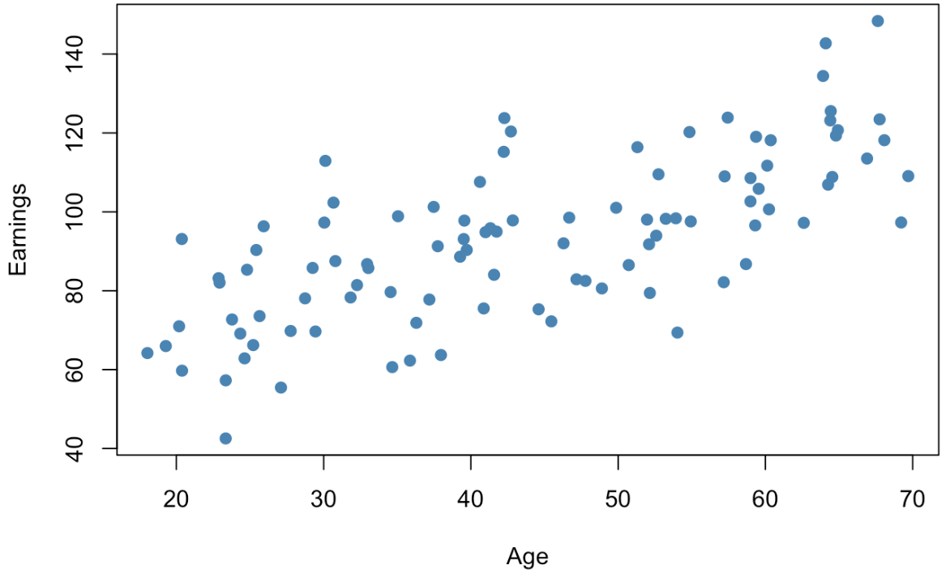
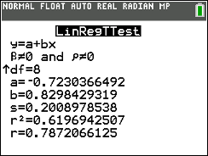
Coefficient of Determination
In addition to correlation, we can also assess the strength of the relationship using another measure called the Coefficient of Determination
Coefficient of Determination
The Coefficient of Determination (r²) is the square of the correlation
It measures the usefulness of the regression line in making predictions
Specifically, it determines the percent of the variation in the Y variable that can be explained by the linear relationship with the X variable
Interpreting r²
We have a general structure for how to interpret this measure:
USING CONTEXT!
r² % of the variation Y can be explained by the linear relationship with X
Example
62% of the variation in Sepal Width can be explained by the linear relationship with Sepal Length
Properties of r²
Range from 0% to 100%
The closer r² is to 100%, the stronger the relationship between X and Y
As r gets closer to -1 or 1, r² increases
Calculating r²
Our calculator gives us this when we find the regression line!
r = 0.706
LCQ: Interpret r²
First calculate r² = (0.706)² = 0.498
49.8% of the variation in Earnings can be explained by the linear relationship to Age →
This is just using the general structure and filling in the value and context for this scenario!

Slide 18

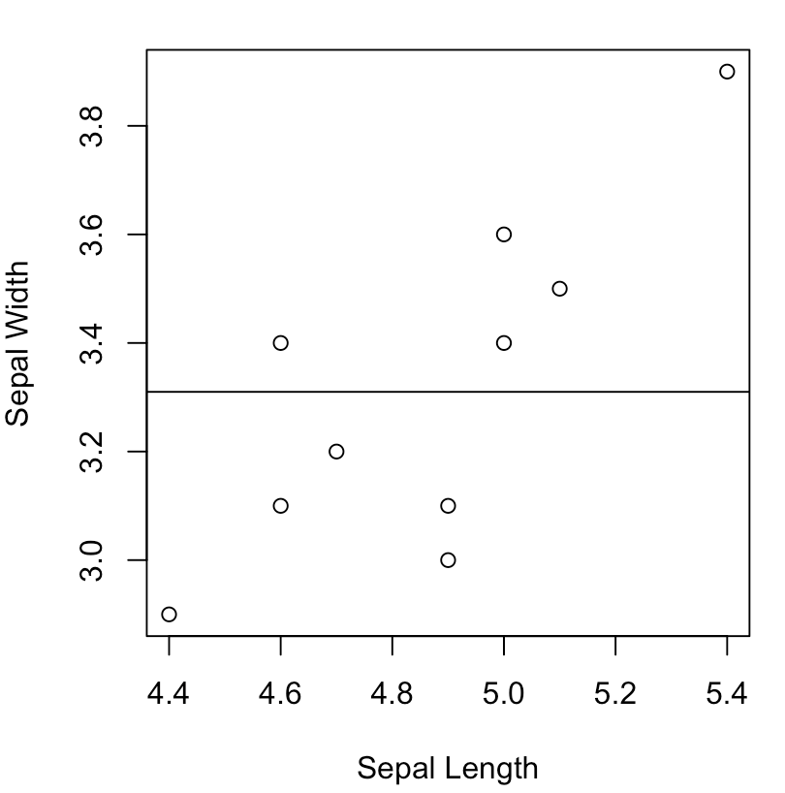
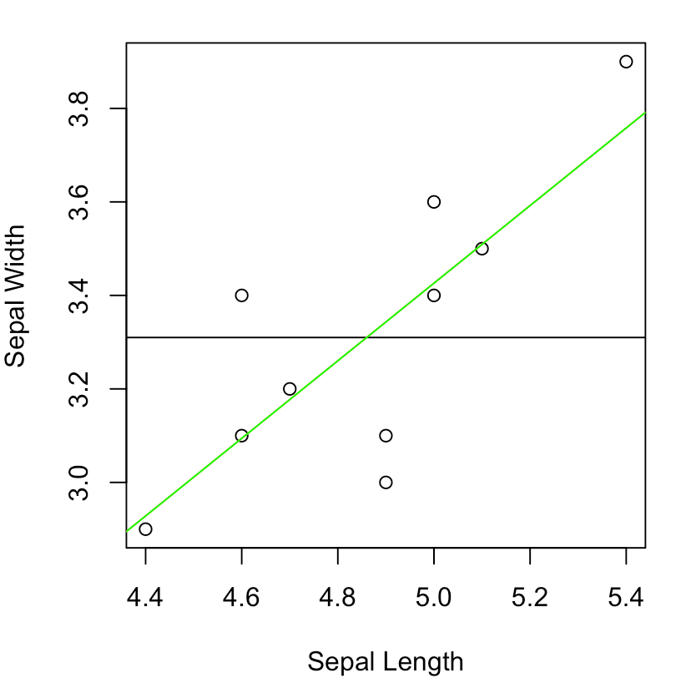
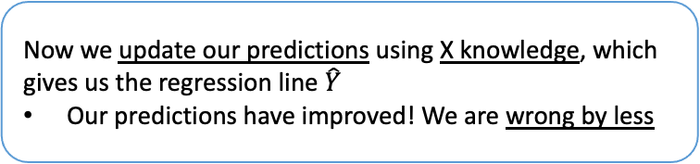



Idea Behind Coefficient of Determination:
Explained and Unexplained Variation
$$Predictions=\overline{Y}$$
$$Predictions=\hat{Y}$$
Remaining error
Error = Actual value – Predicted value
= By how much our prediction is wrong
Explained error (variation)
Not all predictions improve
But overall, they are better!
We start by ONLY looking at the Y variable
Our best prediction would the mean $\overline{Y}$!
We see our predictions aren’t very good…
Now we update our predictions using X knowledge, which gives us the regression line $\hat{Y}$
Our predictions have improved! We are wrong by less

Slide 19
Problem Session!!!

Slide 20
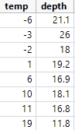
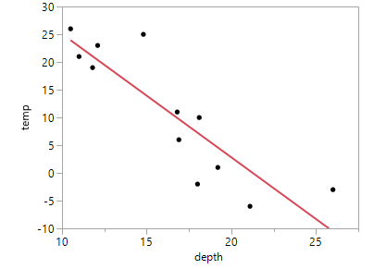
Example 2
The article “Snow Cover and Temperature Relationships in North America and Eurasia” (Journal of Climate and Applied Meteorology [1983]: 460-469) explored the relationship between October-November continental snow cover and December-February temperature.
Does there seem to be a positive association, a negative association, or no association from the scatter plot?
Can the trend in the data points be approximated reasonably well by a straight line?
Find and interpret the correlation coefficient, r, and r².
Find and interpret the equation for the line of best fit.
What temperature will the model predict if we have 12 inches of snow? If we have 36 inches of snow?

Slide 21
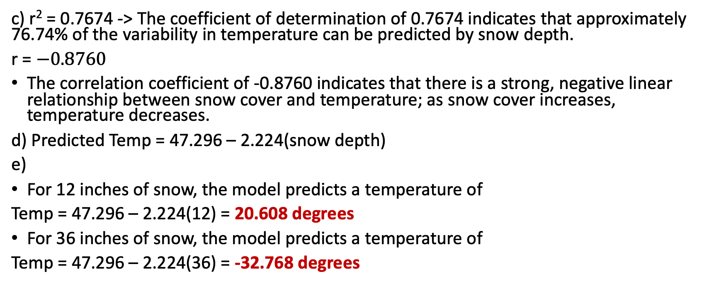
Some Solutions
c) r² = 0.7674 -> The coefficient of determination of 0.7674 indicates that approximately 76.74% of the variability in temperature can be predicted by snow depth.
r = $−0.8760$
The correlation coefficient of -0.8760 indicates that there is a strong, negative linear relationship between snow cover and temperature; as snow cover increases, temperature decreases.
d) Predicted Temp = 47.296 – 2.224(snow depth)
e)
For 12 inches of snow, the model predicts a temperature of
Temp = 47.296 – 2.224(12) = 20.608 degrees
For 36 inches of snow, the model predicts a temperature of
Temp = 47.296 – 2.224(36) = -32.768 degrees

Slide 22
Problem #13
For the bookstore sales data in Exercise 1, the manager wants to predict Sales from Number of Sales People Working.
Find the slope estimate, b₁.
Find the intercept, b₀.
Write down the equation that predicts Sales from Number of Sales People Working.
If 18 people are working, what Sales do you predict?

Slide 23
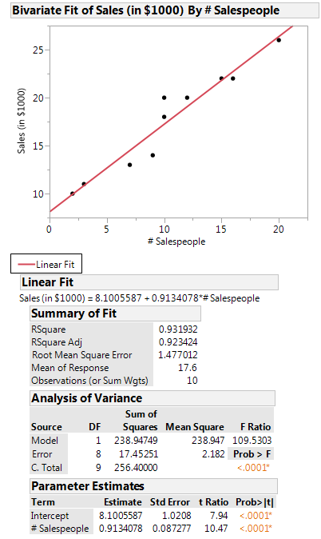
Problem #13 Output
Find the slope estimate.
Find the intercept.

Slide 24
Problem #13 Solution
Find the slope estimate, b₁ = 0.913
Find the intercept, b₀= 8.101

Slide 25
Problem #13, cont.
c) Write down the equation that predicts Sales from Number of Sales People Working.
d) If 18 people are working, what Sales do you predict?

Slide 26
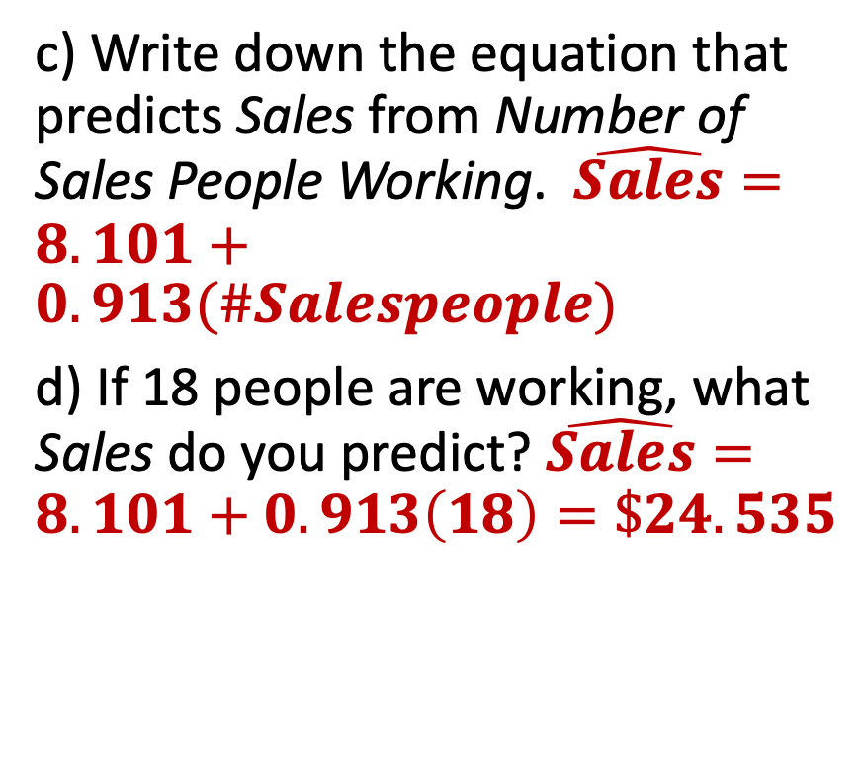
Problem #13 Solution
c) Write down the equation that predicts Sales from Number of Sales People Working. $\hat{Sales}=8.101+0.913(\#Salespeople)$
d) If 18 people are working, what Sales do you predict? $\hat{Sales}=8.101+0.913\left(18\right)=\$24.535$

Slide 27
Problem #19
For the regression model for the bookstore of Exercise 1, what is the value of R² and what does it mean?

Slide 28
Problem #19 Solution
For the regression model for the bookstore of Exercise 1, what is the value of R² and what does it mean?
R² = 0.9319, which indicates that approximately 93.19% of the variability in Sales can be predicted by the linear relationship between the number of salespeople and sales.

Slide 29
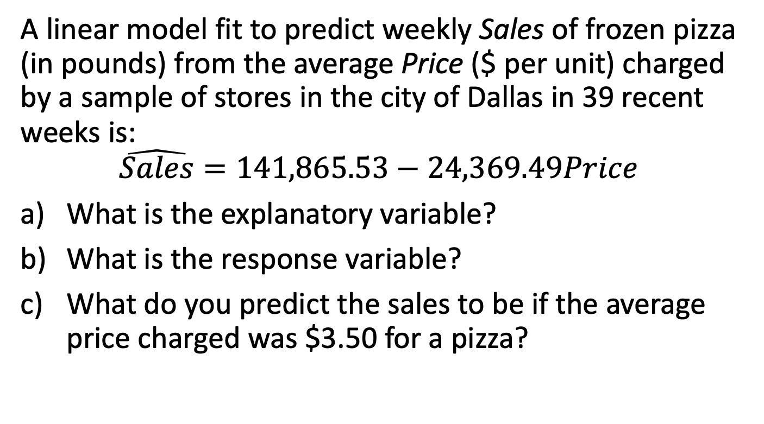
Problem #31
A linear model fit to predict weekly Sales of frozen pizza (in pounds) from the average Price ($ per unit) charged by a sample of stores in the city of Dallas in 39 recent weeks is:
$$\hat{Sales}=141,865.53−24,369.49Price$$
What is the explanatory variable?
What is the response variable?
What do you predict the sales to be if the average price charged was $3.50 for a pizza?

Slide 30
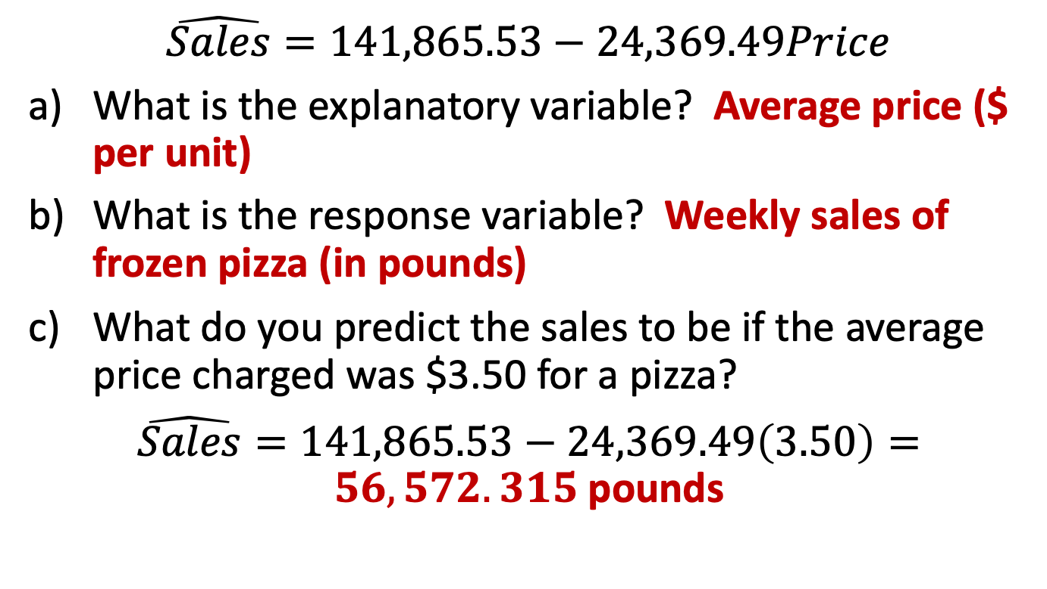
Problem #31 Solution
$$\hat{Sales}=141,865.53−24,369.49Price$$
What is the explanatory variable? Average price ($ per unit)
What is the response variable? Weekly sales of frozen pizza (in pounds)
What do you predict the sales to be if the average price charged was $3.50 for a pizza?
$\hat{Sales}=141,865.53−24,369.49\left(3.50\right)=56,572.315$pounds

