Slide 1
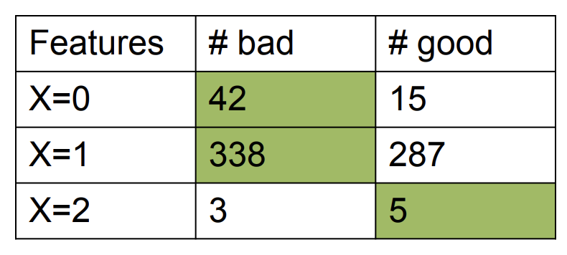
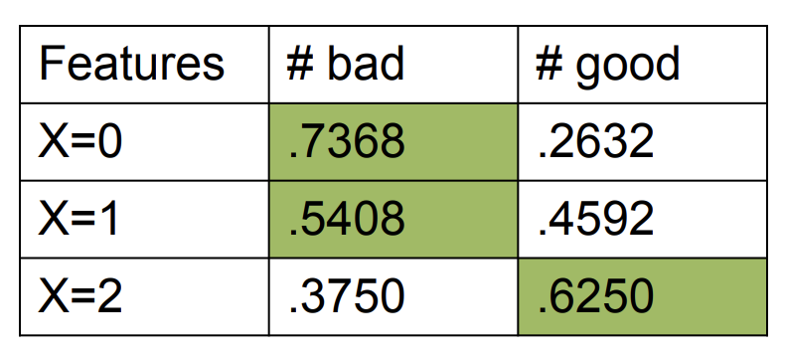
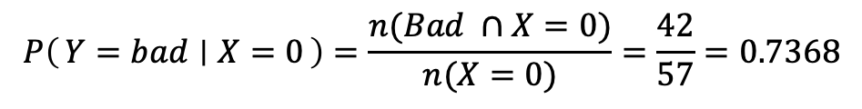
Summarized raw data
Conditional probabilities used for Bayes classifier
$$P\left(Y=bad ∣ X=0\right)=\frac{n(Bad ∩X=0)}{n(X=0)}=\frac{42}{57}=0.7368$$

