Slide 1
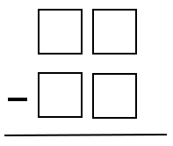
Fun math thinking task!
Level 1: Using each of the digits 2, 4, 6, and 8 exactly once, find the two 2-digit numbers that produce the the smallest possible positive sum when added.

Slide 2
Additional tasks:
Level 2: Still using 2, 4, 6, 8, find the largest possible positive difference when subtracted.
Level 3: Still using 2, 4, 6, 8, find the smallest possible positive difference when subtracted.
Level 4: Now using the digits 1-9, find the two 2-digit numbers that produce the smallest possible positive difference (without repeating any of the digits).
Level 5: Again using digits 1-9, find the two 3-digit numbers that produce the smallest possible positive difference (without repeating any of the digits).

Slide 3
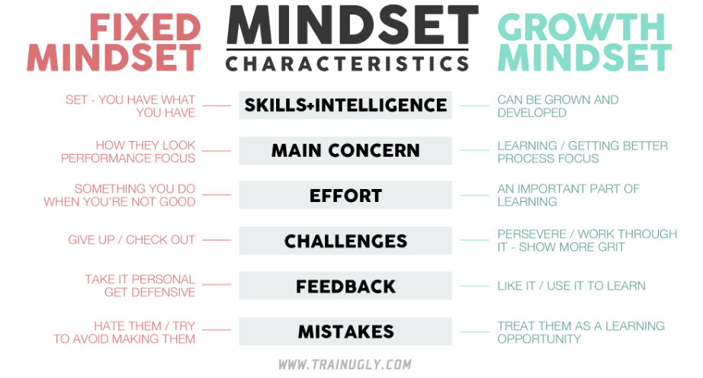
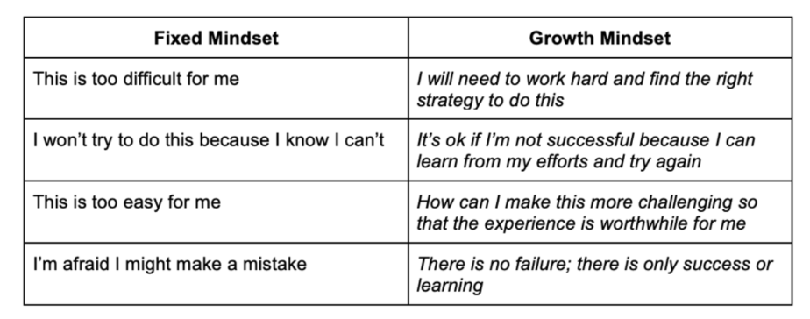
Growth mindset

Slide 4
Growth Mindset videos
Video 1: https://www.youtube.com/watch?v=75GFzikmRY0 (8 min)
Video 2: https://www.youtube.com/watch?v=V7XjFTrPl6o (18 min)

Slide 5
