Slide 1
Hawkes Information

Slide 2
Getting Started
Hawkes is the platform where the eBook and HW system are
DO NOT BUY A PHYSICAL TEXTBOOK!!
Logon
ALWAYS sign on through Canvas, the ‘Hawkes Single Sign On’ link
This automatically links you to our course, no course code or anything needed
Register
You have 21-days free trial access from your first logon
After that, it will cost $?? dollars to register → LESS EXPENSIVE through Hawkes than the bookstore
You can purchase this through Hawkes (this is the recommended way) or the bookstore

Slide 3
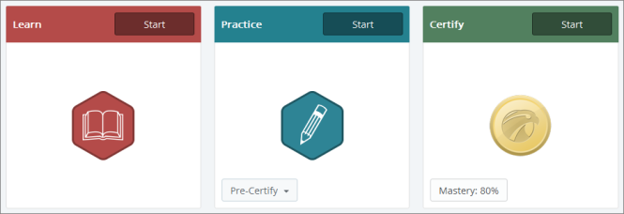
3 Parts of Hawkes
Canvas Quizzes: Graded
Practice for HW: NOT Graded
Homework: Graded

Slide 4
Learn
Learn is the online textbook
Learn screens are the eBook, just embedded into the specific lesson
Probably will take like 30ish minutes to read through (maybe like 10 or 15 pages)
There are videos going through examples and skill checks (quick questions)
Canvas Quizzes
These are directly from Learn, it’s like a note quiz
These are the prep before class
Grading
Get two attempts
Have to be done before the start of class on the respective due date
These can’t be done late, two lowest grades are dropped

Slide 5
Practice
Practice is a bunch of practice problems based on the lesson
Should spend most of the time on practice
NOT GRADED
Questions
Can skip or try similar (new numbers)
Answers are checked automatically
Question help → If not sure how to do a question, you can click the ‘Tutor’ button
Gives you step-by-step guide or the solution
If you get a question wrong (which is okay!) → Can choose to have the error

Slide 6
Certify
Certify is the HW piece
It is the GRADED portion for HW
It is the same as Practice, but there is no learning aids (the tutor button and step-by-step guides)
This is why you should spend a lot of time of Practice!!
Grade
Have to be done before the start of class on the respective due date
NO GRADES are dropped.

Slide 7
Certify – Grading
Grading
You either get a 0% or a 100% (if late, the 100% is subject to the 25% reduction per 24 hours after the deadline → start of class on the due date)
The goal is to reach “Mastery” level, which is approximately 80% correct on the entire assignment
If achieved, you get a 100% on the assignment
Once you get to the 80% mastery level, you can continue to answer questions and you won’t be penalized
If NOT achieved, you can redo the certify as many times as desired in order to get mastery level
You have to restart the whole assignment
Lets say you skip the Practice and go straight to the Certify
If you do not achieve Mastery, you are forced to go back and do practice before you can attempt Certify again
So don’t skip the Practice!

Slide 8
Certify – Last Items
Asking me questions
I will be less helpful on Certify
(If you have questions on this, then you need to practice more)
Flex Strike
If you get a question wrong, you get one more attempt for the same type of question with different values
If wrong the second time, it stays incorrect
Save and Exit
Can save and exit as many times as needed
When you come back, the question you were on will have new values
Do the Learn and Practice so you are ready for Certify!!!

