Slide 1
Steps for the TI-83/84
1. Enter data: STAT → Edit →Enter X values in
L₁ and probabilities in L₂
2. Calculate: STAT → CALC → 1-Var Stats
List: L₁.
FreqList: L₂.
Calculate!
Steps for the TI-30XS MultiView
1. Data → Enter X values in L₁
and probabilities in L₂
2. 2nd → stat → 1-Var Stats
a) DATA: L1
b) FRQ: L2
c) CALC

Slide 2
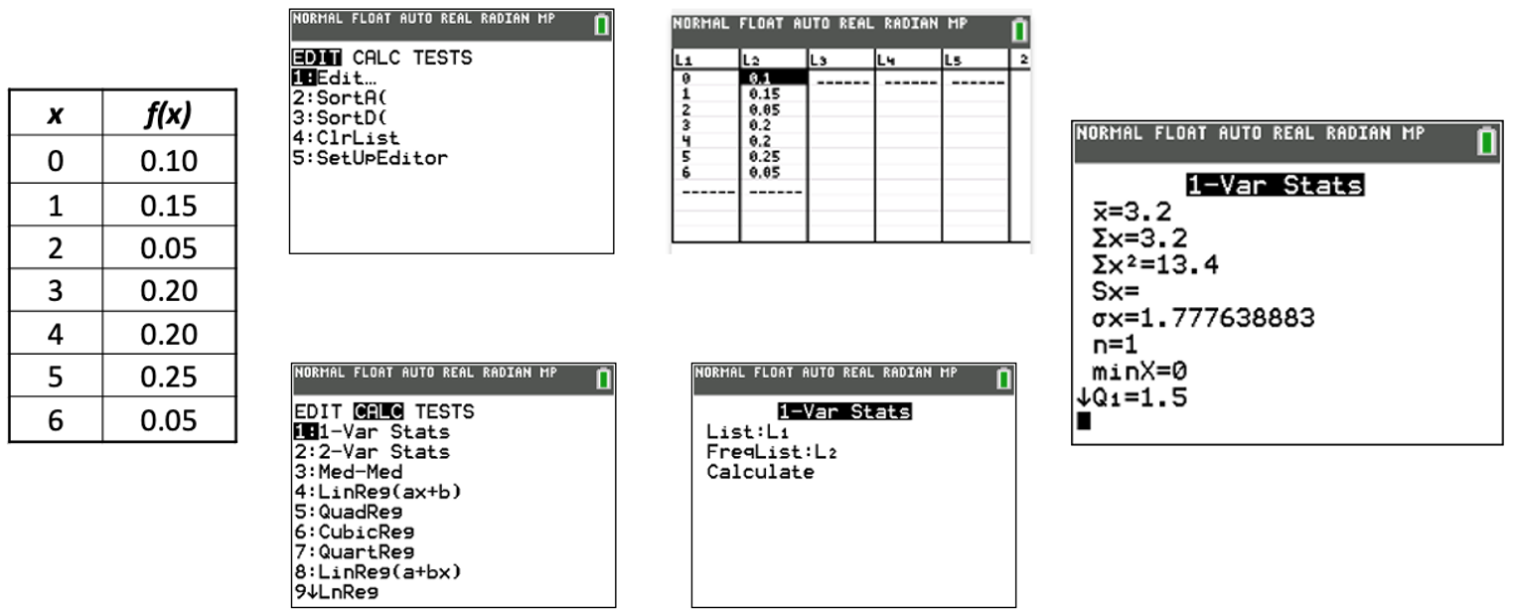

Inputs
Results
$P\left(X_{i}\right)$
Expected
Value
If typed in probabilities
correctly → Sum(Probs) = 1

