Slide 1

6.3 Borrowing Money

Slide 2
Goals for the Day
Credit Cards
Loans
Amortization
Schedules
Examples
1
2
3
4

Slide 3
Credit Cards
1

Slide 4
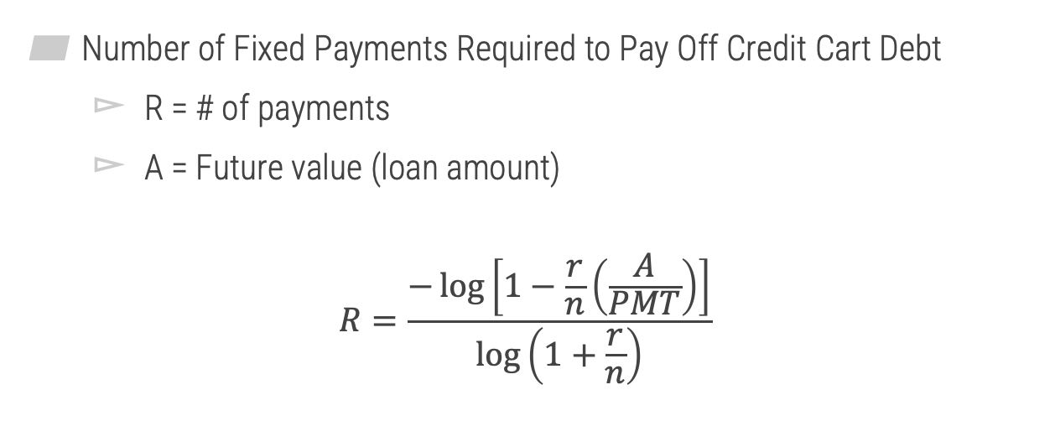
Paying off credit cards
2
Number of Fixed Payments Required to Pay Off Credit Cart Debt
R = # of payments
A = Future value (loan amount)
$$R=\frac{−\log\left[1−\frac{r}{n}\left(\frac{A}{PMT}\right)\right]}{\log\left(1+\frac{r}{n}\right)}$$

Slide 5


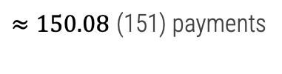
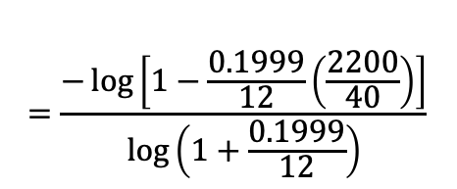

Credit Card Payments
2
Example
Franz wants to buy a new computer that costs $2200 using a credit card that has an APR of 19.99%. How long will it take him to pay off the computer if he makes regular monthly payments of $40? How much will he pay overall for the computer?
$$=\frac{−\log\left[1−\frac{0.1999}{12}\left(\frac{2200}{40}\right)\right]}{\log\left(1+\frac{0.1999}{12}\right)}$$
$$R=\frac{−\log\left[1−\frac{r}{n}\left(\frac{A}{PMT}\right)\right]}{\log\left(1+\frac{r}{n}\right)}$$
$≈150.08$ (151) payments
$$Total paid=PMT∗\# payments$$
$$=40∗151=\$6,040$$

Slide 6
Loans
2

Slide 7
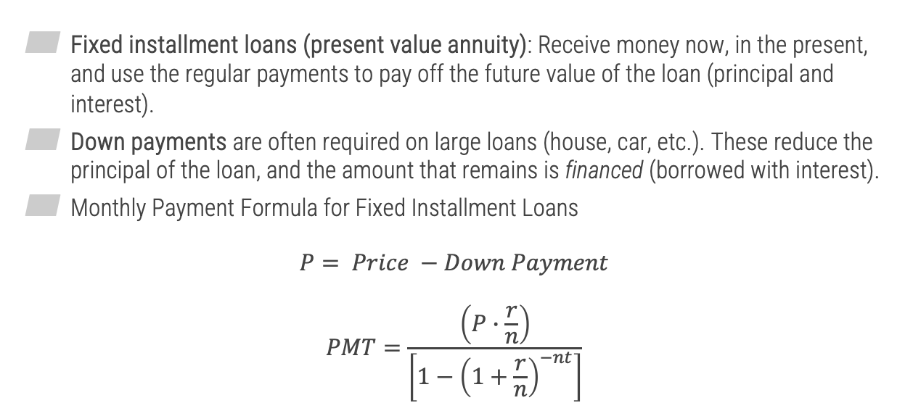
Fixed Installment Loans
2
Fixed installment loans (present value annuity): Receive money now, in the present, and use the regular payments to pay off the future value of the loan (principal and interest).
Down payments are often required on large loans (house, car, etc.). These reduce the principal of the loan, and the amount that remains is financed (borrowed with interest).
Monthly Payment Formula for Fixed Installment Loans
$$P= Price −Down Payment$$
$$PMT=\frac{\left(P∙\frac{r}{n}\right)}{\left[1−{\left(1+\frac{r}{n}\right)}^{−nt}\right]}$$
Principal that is financed

Slide 8



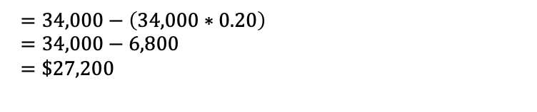
Monthly Payments
2
Example
Owen wants to buy a new car for $34,000 (including taxes and fees). He chooses to make a down payment of 20% and wants to finance the remainder. If Owen can get an APR of 3.99% for a 72-month loan, what is the amount of his monthly payment?
$$=\frac{\left(27,200∙\frac{0.0399}{12}\right)}{\left[1−{\left(1+\frac{0.0399}{12}\right)}^{−12∙6}\right]}$$
$$PMT=\frac{\left(P∙\frac{r}{n}\right)}{\left[1−{\left(1+\frac{r}{n}\right)}^{−nt}\right]}$$
$$P=Price −Down payment$$
$=34,000−\left(34,000∗0.20\right)$
$=34,000−6,800$
$=\$27,200$
$$≈\$425.43$$

Slide 9
Amortization Schedules
3

Slide 10
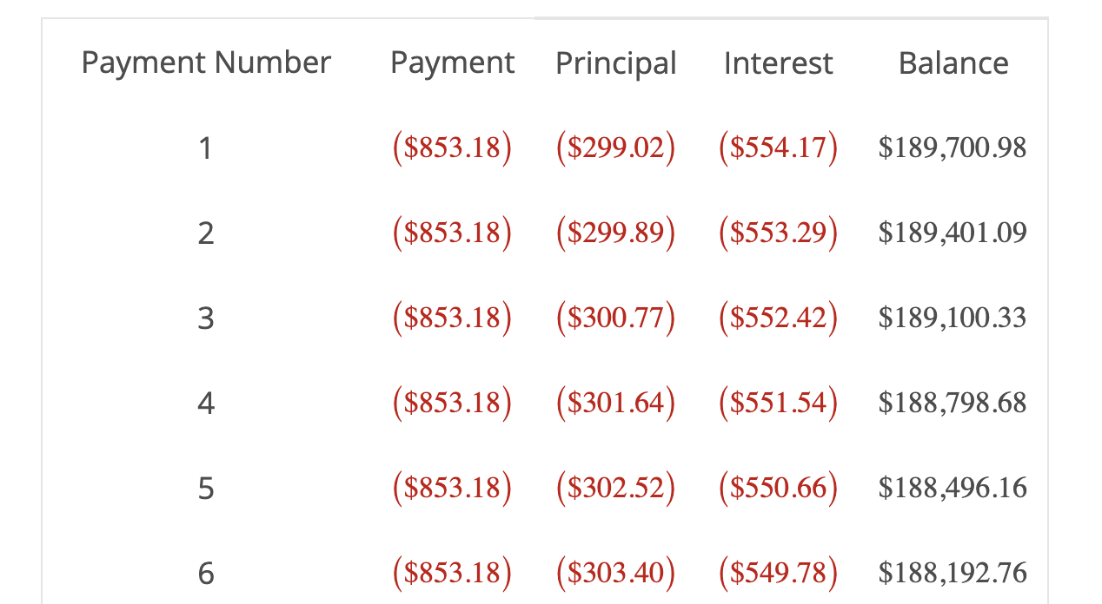

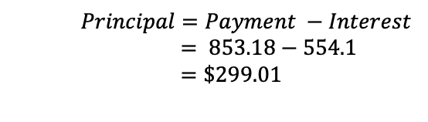
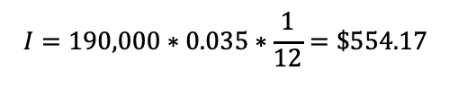
Home Mortgages – Maximum Purchase Price
3
Amortization schedule: Payments on loans such as mortgages are portioned out between interest and principal. To show you this breakdown over time, lenders provide loan amortization schedules.
When the monthly schedule is made, the interest is computed using the simple interest formula $I=Prt$.
Loan amount: $190,000 @ 3.5% APR
$$I=190,000∗0.035∗\frac{1}{12}=\$554.17$$
$Principal=Payment −Interest$
$= 853.18−554.1$
$=\$299.01$

Slide 11










Home Mortgage
3
Example
Find the mortgage balance after the first three payments on a 30-year $180,000 mortgage that was financed at an APR of 5.25% and has a monthly payment of $993.97.
Payment Number | Interest Payment | Principal Payment | Mortgage Balance
1 | $787.50 | $206.47
2 | $786.60 | $207.37
3 | $785.69 | $208.28
$$New Balance=Old Balance −Principal Payment$$
$$\$179,793.53$$
$$Balance 1=$$
$$Balance 2=$$
$$Balance 3=$$
$$180,000.00−206.47$$
$$=\$179,793.53$$
$$\$179,586.16$$
$$179,793.53−207.37$$
$$=\$179,586.16$$
$$\$179,377.88$$
$$179,586.16−208.28$$
$$=\$179,377.88$$

Slide 12
Examples
4

Slide 13
Example #1
4
Natalie bought a new car for $26,000. She paid a 10% down payment and financed the remaining balance for 36 months with an APR of 4.8%. Assuming she made monthly payments, determine the total cost of Natalie’s car. Round your answer to the nearest cent. Then, determine how much interest she paid.
Total cost = $27,771.92
Interest = $1,771.92

Slide 14
Example #2
4
Jake bought several concert tickets for a total of $900. He used a credit card that has an APR of 17.77%. How much will he pay in total to pay off the purchases if he makes monthly payments of $30? Round the number of monthly payments up to the nearest whole number. Round your final answer to the nearest whole number, if necessary.
40 payments $1200

