Slide 1
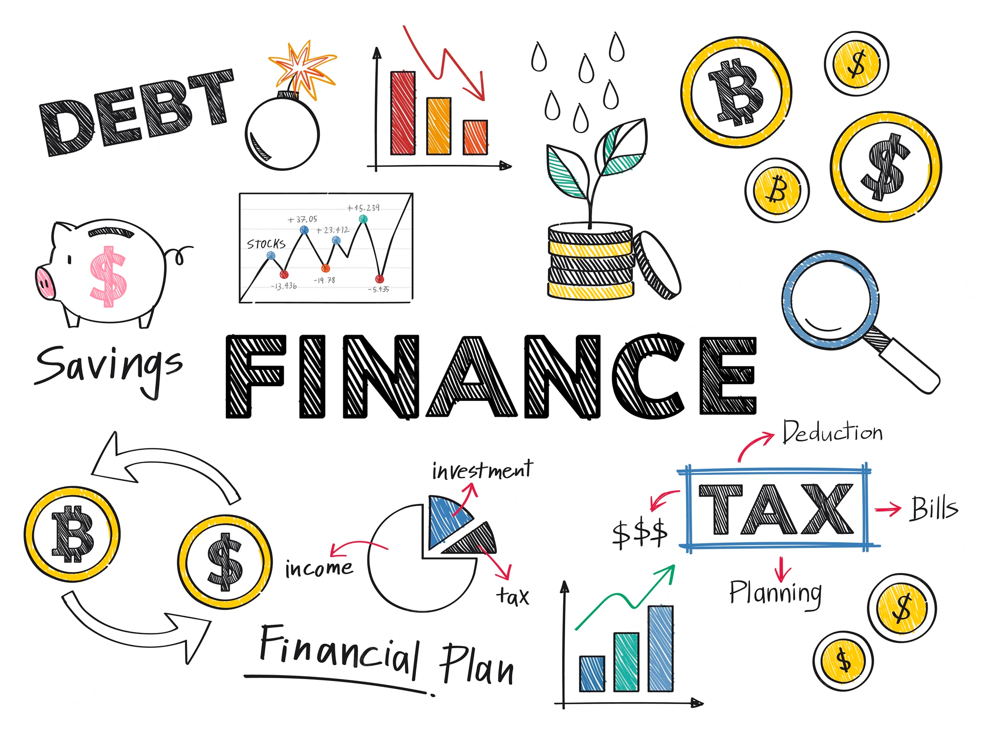
6.2 Saving and Investing

Slide 2
Goals for the Day
Saving Money and Annuities
Examples
1
2

Slide 3
Saving Money and Annuities
1

Slide 4



What is future value (FV or A)?
1
Amount of money at some future time
$A=P{\left(1+\frac{r}{n}\right)}^{nt}$
Know: Initial investment (P)
Want to know: How much will I have later (FV, A)
$$FV$$
Think: Principal = Present Value PV

Slide 5
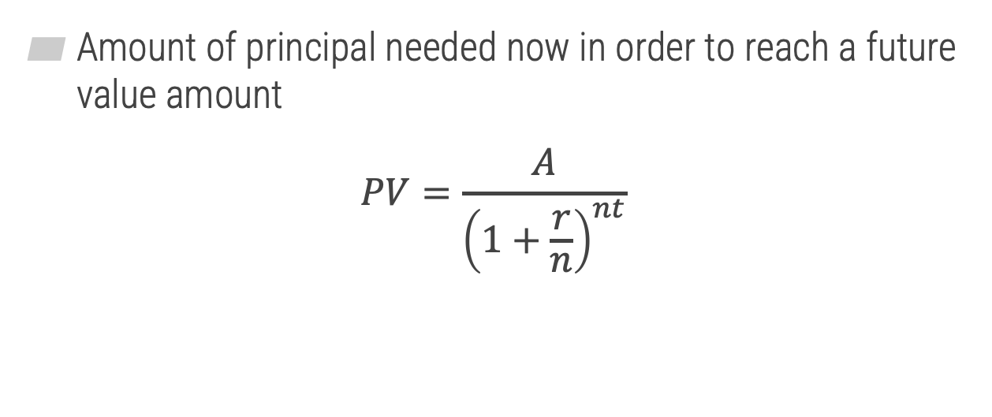
What is present value?
1
Amount of principal needed now in order to reach a future value amount
$$PV=\frac{A}{{\left(1+\frac{r}{n}\right)}^{nt}}$$
Know: How much will I have later (A)
Want to know: Initial investment (PV)

Slide 6



Present Value
1
Example
Lyric wants to have $20,000 in 10 years. If she can get an 8% APR compounded semiannually, how much money does she need to invest right now to reach her goal?
$$PV=\frac{A}{{\left(1+\frac{r}{n}\right)}^{nt}}$$
$$=\frac{20,000}{{\left(1+\frac{0.08}{2}\right)}^{2∗10}}$$
$$≈\$9,127.74$$

Slide 7
What is an annuity?
1
Making regular, repeated payments into an account (or taken out of an account) over time
Annuities earn compound interest

Slide 8

Finding Future Value of an Annuity
1
$$FV=PMT\frac{\left[{\left(1+\frac{r}{n}\right)}^{nt}−1\right]}{\left(\frac{r}{n}\right)}$$
Know: Regular payment amount (PMT)
Want to know: How much will I have later (FV)

Slide 9


Annuities – Finding Future Value
1
Example
Regina deposits $200 every month into a savings account earning 5% APR.
How much money will be in her account after 15 years?
$$FV=PMT\frac{\left[{\left(1+\frac{r}{n}\right)}^{nt}−1\right]}{\left(\frac{r}{n}\right)}=$$
$$200∗\frac{\left[{\left(1+\frac{0.05}{12}\right)}^{12∗15}−1\right]}{\left(\frac{0.05}{12}\right)}$$
$$≈\$53,457.79$$

Slide 10

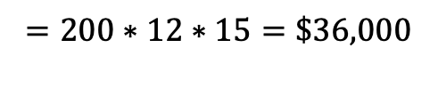
Annuities – Finding Future Value
1
Example
Continuing the previous example.
How much money will Regina contribute to her account over 15 years?
$$Total Deposited=PMT∗＃ of payments$$
$$n ∗t$$
$$=200∗12∗15=\$36,000$$

Slide 11

Finding Payments from an Annuity
1
$$PMT=FV\frac{\left(\frac{r}{n}\right)}{\left[{\left(1+\frac{r}{n}\right)}^{nt}−1\right]}$$
Know: How much I will have later (FV)
Want to know: Regular payment amount (PMT)

Slide 12

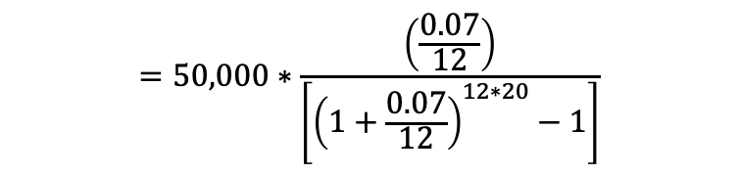
Annuities – Finding Payments
1
Example
Anna wants to have $50,000 in 20 years. How much does she need to deposit each month into a savings account earning 7% APR?
$$PMT=FV\frac{\left(\frac{r}{n}\right)}{\left[{\left(1+\frac{r}{n}\right)}^{nt}−1\right]}$$
$$=50,000∗\frac{\left(\frac{0.07}{12}\right)}{\left[{\left(1+\frac{0.07}{12}\right)}^{12∗20}−1\right]}$$
$$≈\$95.98$$

Slide 13
Examples
2

Slide 14
Example #1
2
Calculate the amount of money Audrey needs to invest right now (in one lump sum) in order to have $100,000 after 18 years with an APR of 7% compounded monthly. Round your answer to the nearest cent, if necessary.
$28,469.43

Slide 15
Example #2
2
Drake starts an IRA (Individual Retirement Account) at the age of 22 to save for retirement. He deposits $400 each month. The IRA has an average annual interest rate of 7% compounded monthly. How much money will he have saved when he retires at the age of 65? Round your answer to the nearest cent, if necessary.
$1,310,451.88

Slide 16
Example #3
2
Jacob deposits $203.77 each month into an annuity account for his child’s college fund in order to accumulate a future value of $60,000 in 18 years. How much of the $60,000 will Jacob deposit into the account in total, and how much will be interest he has earned? Round your answers to the nearest cent, if necessary.
Total invested = $44,014.32
Interest earned = $15,985.68

Slide 17
Example #4
2
Devon deposits a fixed amount monthly into an annuity account for his child’s college fund. He wishes to accumulate $65,000 in 17 years. Assuming an APR of 3.6% compounded monthly, how much of the $65,000 will Devon deposit into the account in total, and how much will be interest he has earned? Round your answers to the nearest cent, if necessary.
PMT = $231.47 (rounded to nearest cent)
Total invested = $47,219.88
Interest earned = $17,780.12

