Slide 1
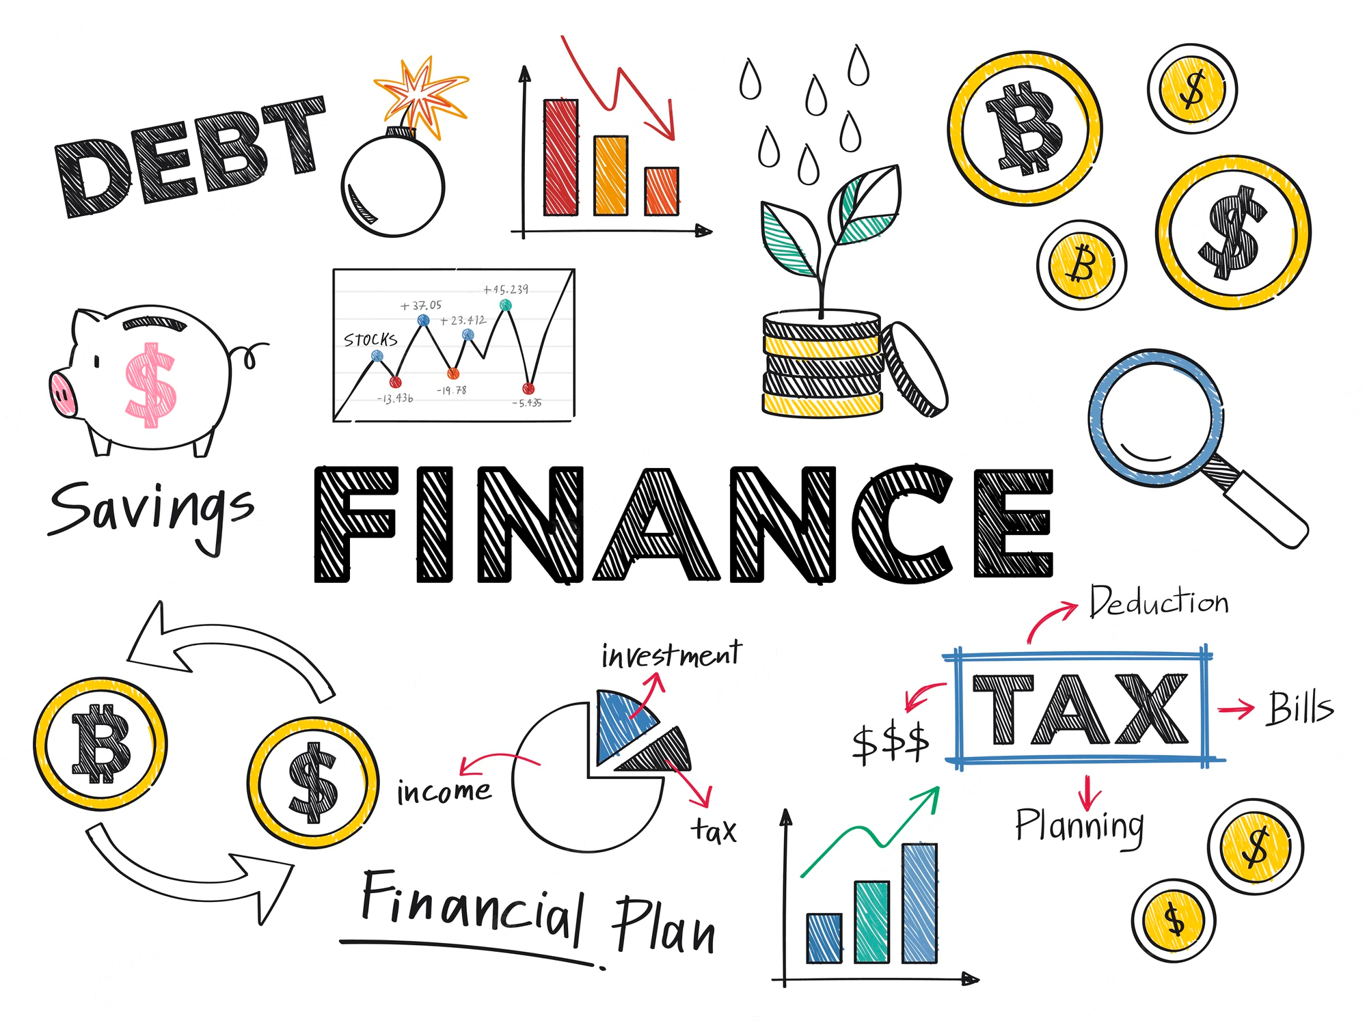
6.1 Understanding Interest

Slide 2
Goals for the Day
Interest
Annual Percentage Yield
Examples
1
2
3

Slide 3
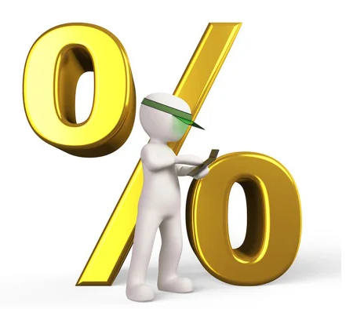
Some Terms We Need
1
Principal – the sum of money on which interest is charged (the initial investment)
Interest rate – the amount charged to the borrower expressed as a percentage of the principal OR the amount you earn on an investment (still as a percentage)
Annual Percentage Rate (APR) – the yearly interest rate that is charged for borrowing

Slide 4
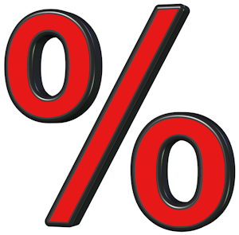
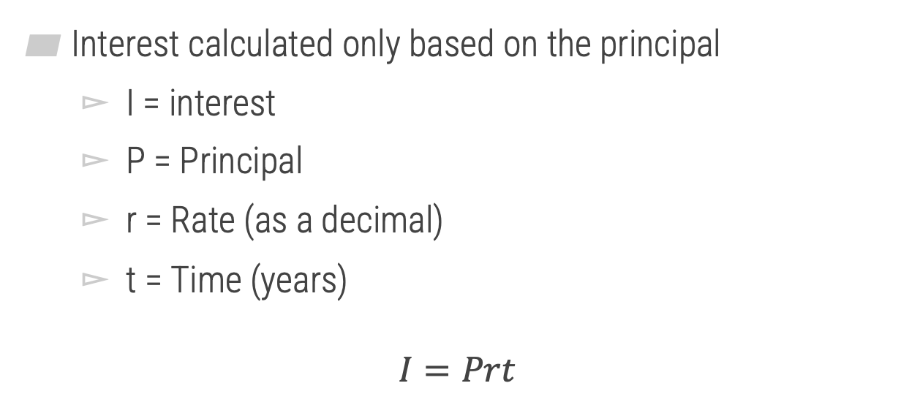
Simple Interest
1
Interest calculated only based on the principal
I = interest
P = Principal
r = Rate (as a decimal)
t = Time (years)
$$I=Prt$$

Slide 5

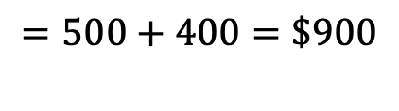

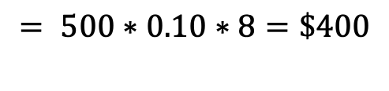
Simple Interest
1
Example
How much money will I have if... And how much interest will I earn if...
I invest $500 at 10% APR for 8 years (with simple interest).
$$I =Prt$$
$$Total: A=P+I$$
$$= 500∗0.10∗8=\$400$$
$$=500+400=\$900$$

Slide 6
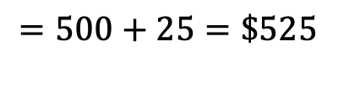
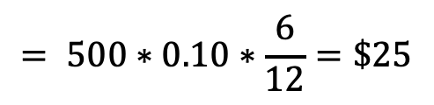
Simple Interest
1
Example
How much money will I have if... And how much interest will I earn if...
I invest $500 at 10% APR for 6 months (with simple interest).
$$I =Prt$$
$$Total: A=P+I$$
$$= 500∗0.10∗\frac{6}{12}=\$25$$
$$=500+25=\$525$$

Slide 7
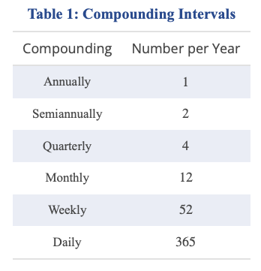
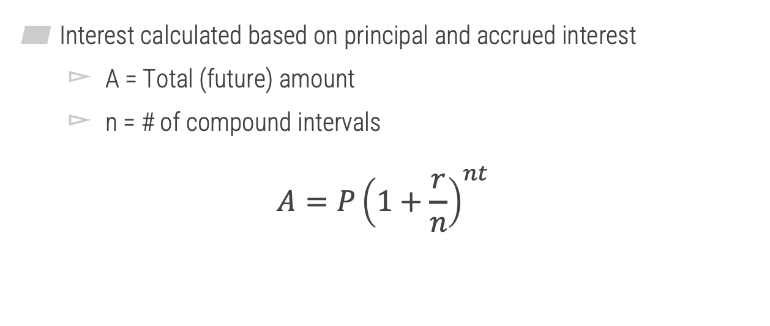
Compound Interest
1
Interest calculated based on principal and accrued interest
A = Total (future) amount
n = # of compound intervals
$$A=P{\left(1+\frac{r}{n}\right)}^{nt}$$
(n values)

Slide 8





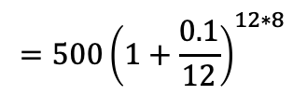



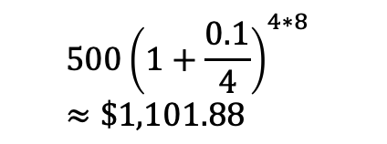

Compound Interest
1
Example
How much money will I have if... And how much interest will I earn if...
I invests $500 at 10% APR for 8 years compounded monthly? Quarterly?
$$A_{monthly}=P{\left(1+\frac{r}{n}\right)}^{nt}$$
$$500{\left(1+\frac{0.1}{4}\right)}^{4∗8}≈\$1,101.88$$
$$A_{quarterly}=$$
What do you notice about the relationship between n and A?
$$=500{\left(1+\frac{0.1}{12}\right)}^{12∗8}$$
$$≈\$1,109.09$$
$$I_{monthly}=$$
$$A −P$$
$$I_{quarterly}=$$
$$A −P$$
$$=1,109.09−500=609.09$$
$$=1,101.88−500=601.88$$

Slide 9
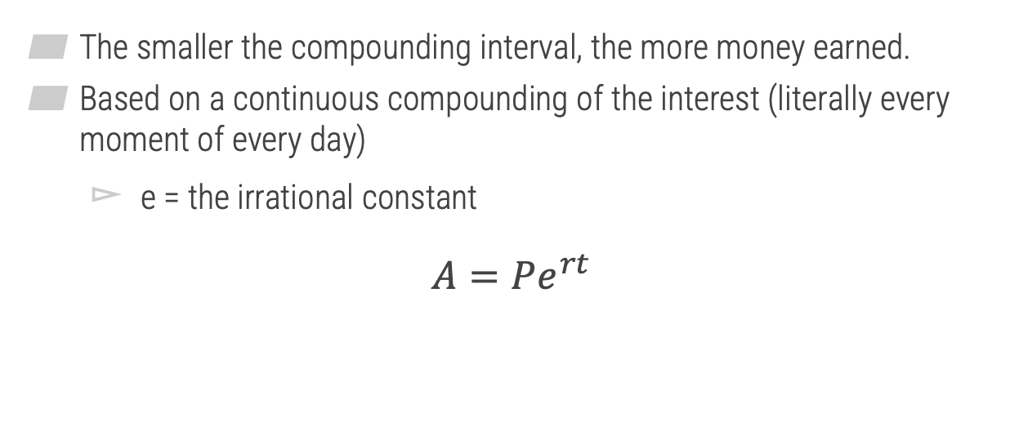
Continuously Compounded Interest
1
The smaller the compounding interval, the more money earned.
Based on a continuous compounding of the interest (literally every moment of every day)
e = the irrational constant
$$A=Pe^{rt}$$

Slide 10

Compound Interest
1
Example
How much money will I have if... And how much interest will I earn if...
I invests $500 at 10% APR for 8 years, compounded continuously?
$$A=Pe^{rt}$$
$$=500e^{0.1∗8}$$
$$≈\$1,112.77$$

Slide 11
Annual Percentage Yield
2

Slide 12
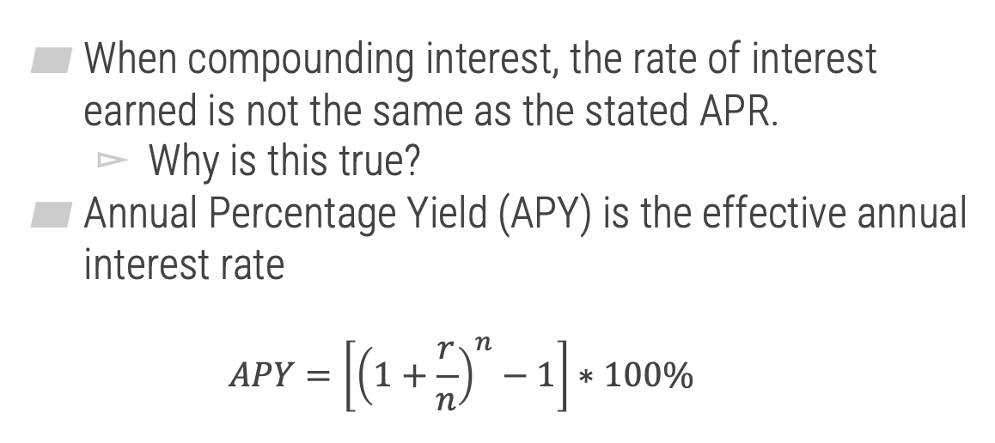
Annual Percentage Yield (APY)
2
When compounding interest, the rate of interest earned is not the same as the stated APR.
Why is this true?
Annual Percentage Yield (APY) is the effective annual interest rate
$$APY=\left[{\left(1+\frac{r}{n}\right)}^{n}−1\right]∗100\%$$

Slide 13


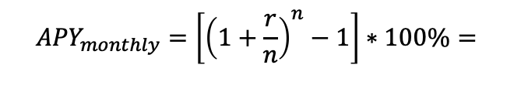
Annual Percentage Yield (APY)
2
Example
Revisit my investment of $500 at 10% APR for 8 years. What is his APY if this investment is compounded monthly?
$${APY}_{monthly}=\left[{\left(1+\frac{r}{n}\right)}^{n}−1\right]∗100\%=$$
$$\left[{\left(1+\frac{0.1}{12}\right)}^{12}−1\right]∗100\%$$
$$=10.47\%$$

Slide 14
Examples
3

Slide 15
Example #1
4
Suppose Gavin wants to borrow $200 for five weeks. The amount of interest he ends up paying is $20 per $100 borrowed. What is the APR at which Gavin is borrowing money?
208%

Slide 16
Example #2
4
Suppose that Casey deposited $13,000 for eight years at 4% APR. How much interest did Casey earn if the interest is compounded weekly? Round your answer to the nearest cent.
$4,900.46

