Slide 1

4.2 Using Percentages

Slide 2
Goals for the Day
Definitions and Formulas
Examples
1
2

Slide 3
Definitions and Formulas
1

Slide 4






List Price
1
List price is the price of an item as it is listed for public sale.
Total price = List price + Taxes
(New price = Original + Increase)
Example:
At a restaurant, your total bill was $70. If you tip 15%, how much is the tip?
What is the total bill including tip?
$Tip=Original ∗Tip \%$
→ $Tip=70∗\frac{15}{100}$
$=\$10.50$
$$Total =Original+Tip$$
→ $Total=70+10.50$
$=\$80.50$

Slide 5
Discount and Sale Price
1
Discount is the reduction from the list price. This is usually given as a percentage of the list price.
Discount $ = List price x (Discount % / 100)
Sale Price is the actual cost of an item after a discount
Sale price = List price – Discount
(New price = Original – Decrease)

Slide 6




Discount Example
1
Example
a) A new computer is listed at $899 but is on sale for 20% off. What is the sale price (before taxes)?
$$Sale Price =List Price−Discount$$
$$=899 − 0.20(899)$$
$$=899 −179.80$$
$$=\$719.20$$
20% of 899

Slide 7


Discount Example
1
Example
b) Evan bought a gaming system on sale for $198.45. The list price of the system was $330.75. What was the (approximate) percentage discount?
Discount $ Discount %
$$Sale Price=List Price−Discount$$
$$Discount=132.30$$
$$198.45=330.75−Discount$$
$$x\% of 330.75=132.30$$
$$−132.30=−Discount$$
$$330.75x=132.30$$
$$Discount=132.30$$
$$x=0.4$$
$$Discount=40\%$$

Slide 8
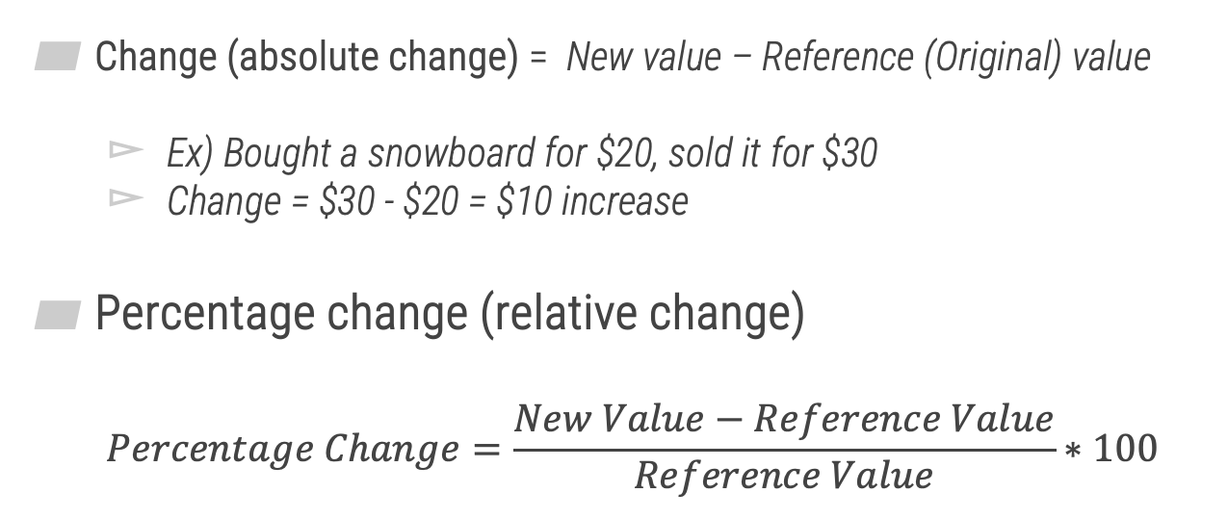

Percentage Change
1
Change (absolute change) = New value – Reference (Original) value
Ex) Bought a snowboard for $20, sold it for $30
Change = $30 - $20 = $10 increase
Percentage change (relative change)
$$Percentage Change=\frac{New Value−Reference Value}{Reference Value}∗100$$
Ex) $\frac{\$30−\$20}{\$20}×100=50\%$ increase

Slide 9
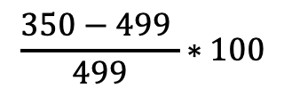

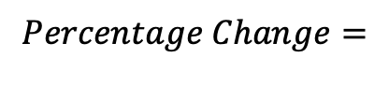
Percentage Change
1
Example
Two years ago, Maci bought an iPad for $499. After the release of the newer iPad, the iPad that Maci bought could be purchased for $350. What is the approximate percent change in the cost of the iPad?
Original (old value)
New value
$$Percentage Change=$$
$$\frac{350−499 }{499}∗100$$
$≈−29.86$%
decrease

Slide 10
Examples
2

Slide 11
Example #1
2
Luis found a receipt for a pair of sunglasses for $127.18, tax included. If the sales tax rate was 6%, what was the list price of the sunglasses? Round your answer to the nearest cent.
$119.98

Slide 12
Example #2
2
A store is having a 70% off sale. The sale price of an item is $175. What is the list price?
$583.33

Slide 13
Example #3
2
During the last year, the value of your house decreased by 30%. If the value of your house is $194,000 today, what was the value of your house last year? Round your answer to the nearest cent, if necessary.
$277,142.86

Slide 14
Example #4
2
The value of your stock investment decreased by 28% after a stock market crash. What percentage increase in value would the stocks have to rise in order to return to the value they were before the stock market crash? Round your answer to the nearest tenth of a percent.
38.9%

