Slide 1

10.1 Intro to Probability

Slide 2
Goals for the Day
Definitions
Calculate Probabilities
Examples
1
2
3

Slide 3
Definitions
1

Slide 4
Definitions
1
An experiment or trial is the process by which a random observation or outcome is generated.
Ex: Flipping a coin, rolling a die, determining the sex of a baby
An outcome is any possible individual observation of that experiment
Ex: If you flip a coin, you have two possible outcomes: heads, or tails. Heads is an outcome, and tails is another outcome.

Slide 5

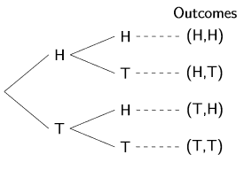
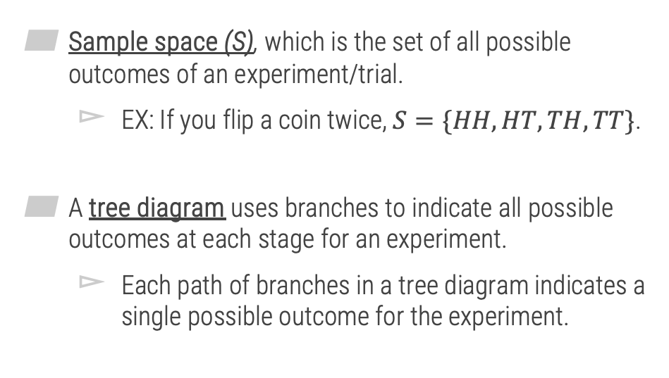
Definitions
1
Sample space (S), which is the set of all possible outcomes of an experiment/trial.
EX: If you flip a coin twice, $S=\{HH, HT, TH, TT\}$.
A tree diagram uses branches to indicate all possible outcomes at each stage for an experiment.
Each path of branches in a tree diagram indicates a single possible outcome for the experiment.

Slide 6
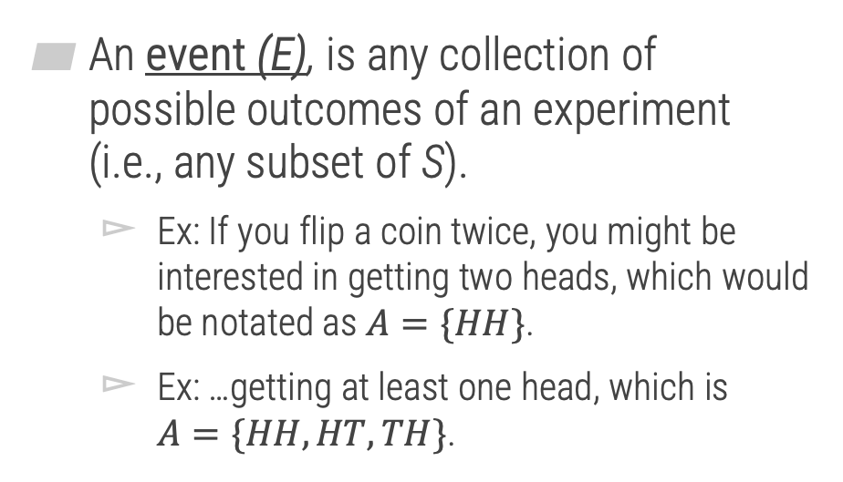
Definitions
1
An event (E), is any collection of possible outcomes of an experiment (i.e., any subset of S).
Ex: If you flip a coin twice, you might be interested in getting two heads, which would be notated as $A=\{HH\}$.
Ex: …getting at least one head, which is $A=\{HH,HT,TH\}$.

Slide 7



Example
1
You are playing a game in which you roll a pair of 4-sided die. To determine your next move, you need to know the sum of the two die.
Using proper notation:
Write the sample space:
Write the event of rolling a sum that is even:
Write the event of rolling a sum that less than 6:
$$S=\{2,3,4,5,6,7,8\}$$
$$E=\{2,4,6,8\}$$
$$E=\{2,3,4,5\}$$

Slide 8
Calculating Probabilities
2

Slide 9
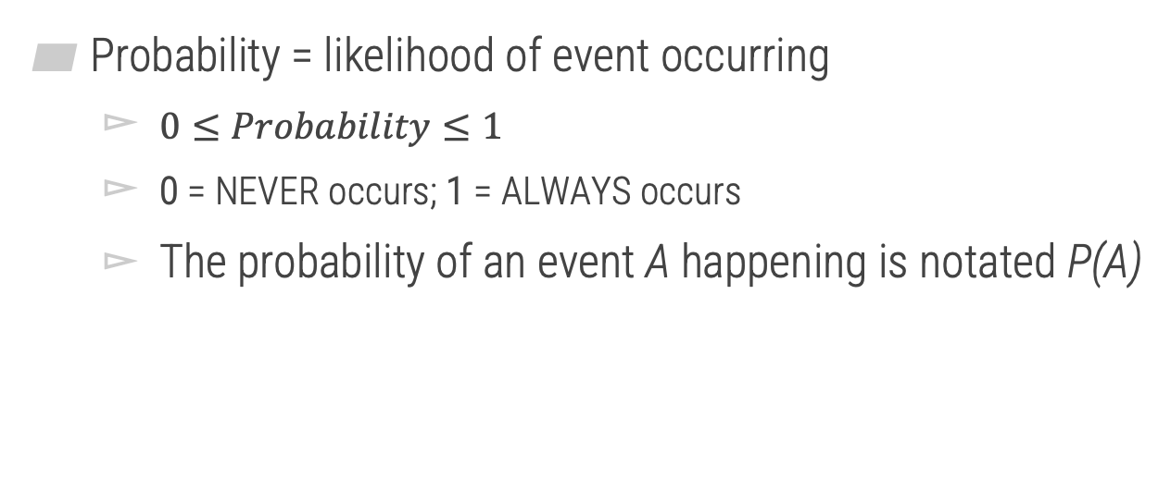
Probability
2
Probability = likelihood of event occurring
$0≤Probability≤1$
0 = NEVER occurs; 1 = ALWAYS occurs
The probability of an event A happening is notated P(A)

Slide 10
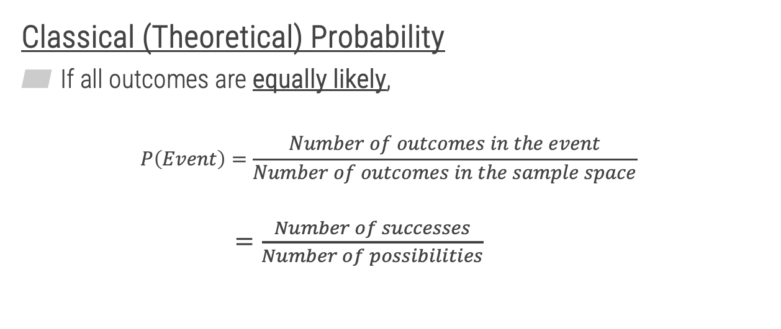
Classical (Theoretical) Probability
2
Classical (Theoretical) Probability
If all outcomes are equally likely,
$$P\left(Event\right)=\frac{Number of outcomes in the event}{Number of outcomes in the sample space}$$
$=\frac{Number of successes}{Number of possibilities}$

Slide 11
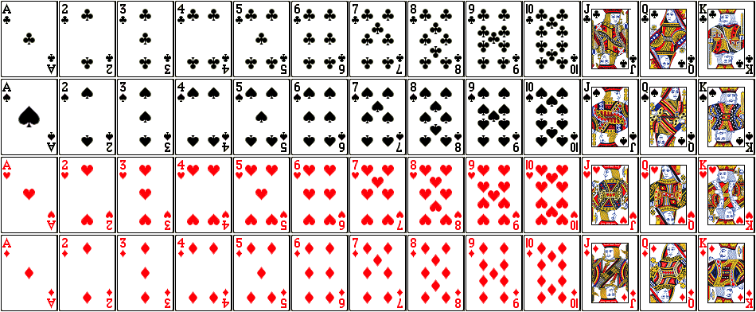
Classical (Theoretical) Probability
2
Example
Suppose you are randomly selecting cards from a standard 52-card deck of playing cards.

Slide 12






Classical (Theoretical) Probability
2
Examples
Find the probability of drawing a red card.
Find the probability of a King.
$$P\left(Red\right)=$$
$$\frac{\# Successes}{\# Possible}=$$
$$\frac{26}{52}=\frac{1}{2}=0.5$$
$$P\left(King\right)=$$
$$\frac{\# Kings}{Total \# of cards}=$$
$$\frac{4}{52}=\frac{1}{13}≈0.077$$

Slide 13







Classical (Theoretical) Probability
2
Examples
Find the probability of drawing a Heart or a 10.
Find the probability of drawing a card that is not a Club.
$$\frac{13+3}{52}=\frac{16}{52}=\frac{4}{13}$$
$$\frac{\# Hearts or 10s}{Total \# of cards}=$$
$$P\left(Heart or 10\right)=$$
$$\frac{\# Not Club}{Total}=$$
$$\frac{39}{52}=$$
$$P\left(NOT a club\right)=$$
$$\frac{52−13}{52}=\frac{3}{4}$$

Slide 14
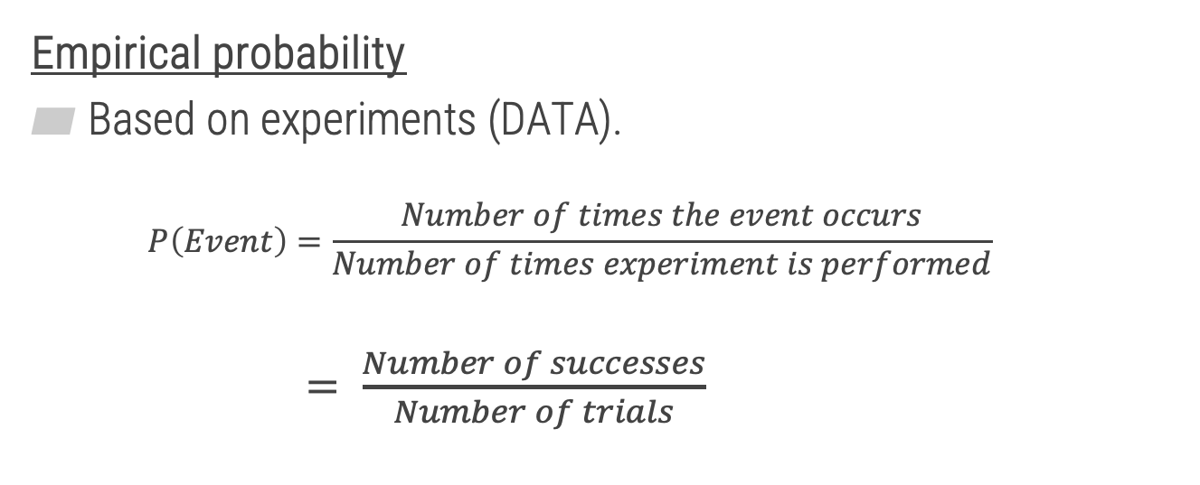
Empirical Probability
3
Empirical probability
Based on experiments (DATA).
$$P\left(Event\right)=\frac{Number of times the event occurs}{Number of times experiment is performed}$$
$= \frac{Number of successes}{Number of trials}$

Slide 15
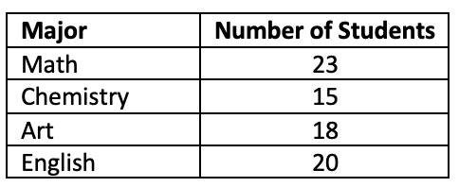



Empirical Probability
2
Examples
Suppose we collected data on MATH 125 students and are selecting a single student randomly.
Find the probability the student is a Math major.
$$\frac{\# Math}{\# Students}$$
$$=\frac{23}{76}$$
$$P\left(Math\right)=$$

Slide 16



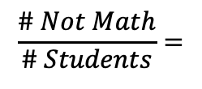
Empirical Probability
2
Examples
Find the probability the student is not a Math major.
$$P\left(Not Math\right)=$$
$$\frac{\# Not Math}{\# Students}=$$
$$\frac{15+18+20}{76}=$$
$$\frac{76−23}{76}=\frac{53}{76}$$

Slide 17



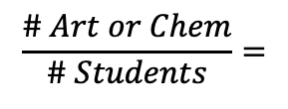
Empirical Probability
2
Examples
Find the probability the student is an Art or Chemistry major.
$$\frac{\# Art or Chem}{\# Students}=$$
$$\frac{18+15}{76}=$$
$$P(Art or Chem)=$$
$$\frac{33}{76}$$

Slide 18




Empirical Probability
2
Examples
Find the probability the student is a Math, Chemistry, or English major.
$$P(Math, Chem, or English)=$$
$$\frac{\# Successes}{\# Possibilities}=$$
$$\frac{23+15+20}{76}=$$
$$\frac{58}{76}$$

Slide 19
Examples
3

Slide 20
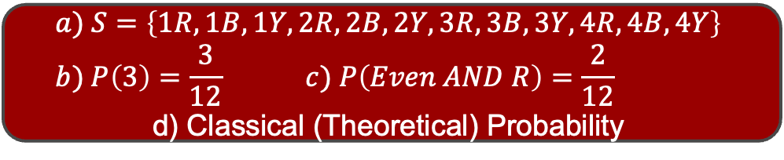
Example
3
An experiment is performed where a fair 4-sided die is rolled, then a fair 3-color spinner is spun. The possible outcomes for each event are 1, 2, 3, and 4 for the 4-sided die and red (R), blue (B), and yellow (Y) for the 3-color spinner.
Identify the sample space for this experiment.
Find the probability of rolling a 3
Find the probability of rolling an even number AND spinning red.
Determine if this is classical or empirical probability.
$$a) S=\left\{1R,1B,1Y,2R,2B,2Y,3R,3B,3Y,4R,4B,4Y\right\} \\ b) P\left(3\right)=\frac{3}{12} c) P\left(Even AND R\right)=\frac{2}{12}$$
d) Classical (Theoretical) Probability

