Slide 1

10.3 Probability of Single Events

Slide 2
Goals for the Day
Odds
Complements
Calculating More Probabilities
Examples
1
2
3
4

Slide 3
Odds
1

Slide 4
What are odds?
1
Odds: Another way to express probability
But not interchangeable with probability
Usually expressed as a ratio
“a:b for” or “a:b against”
Can be expressed as a fraction of probabilities

Slide 5
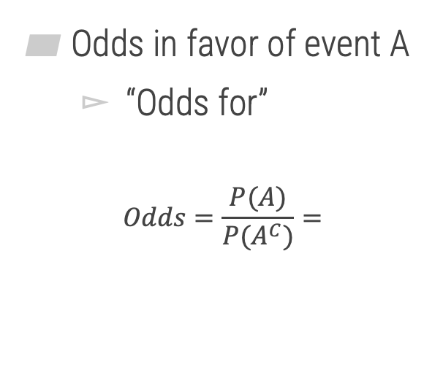
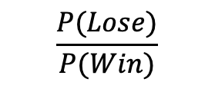
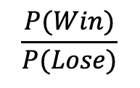
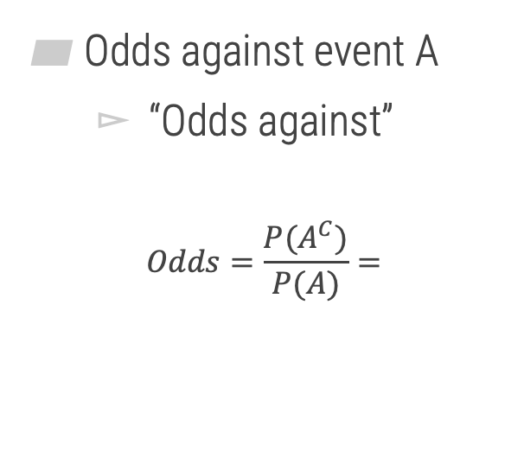
How can we calculate odds?
1
Odds in favor of event A
“Odds for”
$$Odds=\frac{P(A)}{P(A^{C})}=$$
Odds against event A
“Odds against”
$$Odds=\frac{P(A^{C})}{P(A)}=$$
$$\frac{P(Win)}{P(Lose)}$$
$$\frac{P(Lose)}{P(Win)}$$

Slide 6




Odds
1
Example
Suppose the probability of a soccer team winning a playoff game is 0.20. What are the odds of winning? Express your answer in the form a:b.
1 “part” winning
$$P\left(W\right)=0.20=$$
$$\frac{1}{5}$$
4 “parts” losing
$$Odds Winning=$$
$$1:4$$

Slide 7
Complements
2

Slide 8
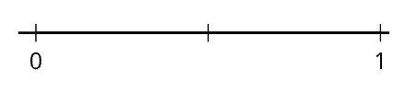
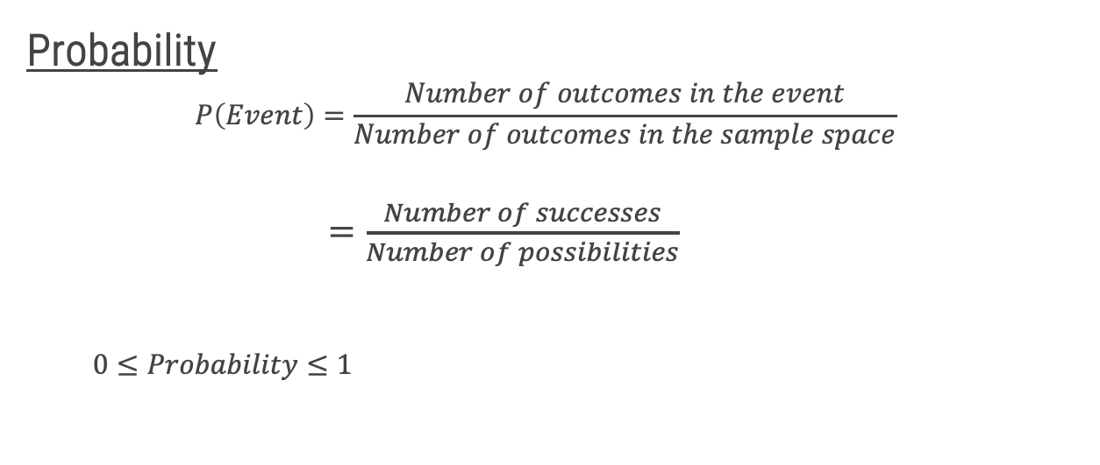

Probability Review
2
Probability
$$P\left(Event\right)=\frac{Number of outcomes in the event}{Number of outcomes in the sample space}$$
$=\frac{Number of successes}{Number of possibilities}$
$0≤Probability≤1$
$$P(E)$$

Slide 9
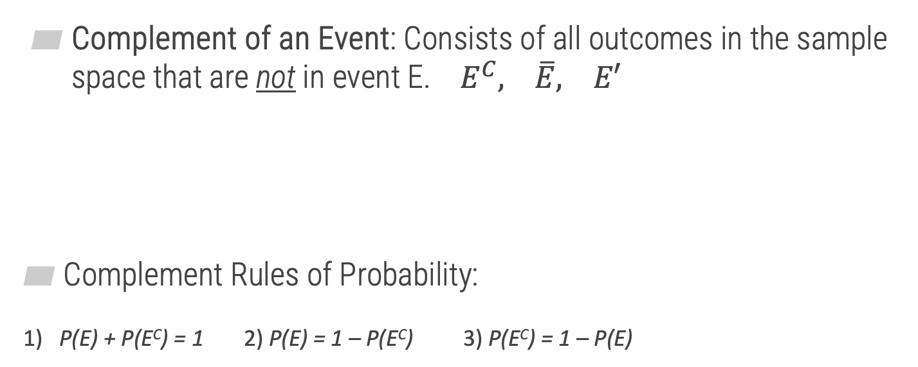



Complements
2
Opposite
Complement of an Event: Consists of all outcomes in the sample space that are not in event E. $E^{C}, \overline{E}, E′$
Complement Rules of Probability:
1) P(E) + P(E^{C}) = 1 2) P(E) = 1 – P(E^{C}) 3) P(E^{C}) = 1 – P(E)
$$S$$
$$E$$
$$E^{C}$$

Slide 10






Complement Examples
2
Example: Suppose we are randomly selecting a single card from a standard 52-card deck.
Find the probability of a diamond.
Find the probability of not a diamond.
$$P\left(Diamond\right)=$$
$$\frac{13}{52}=\frac{1}{4}$$
$$P\left(Not Diamond\right)=$$
$$\frac{39}{52}=$$
$$1 −\frac{1}{4}=$$
$$\frac{3}{4}$$
Directly
Using complements

Slide 11
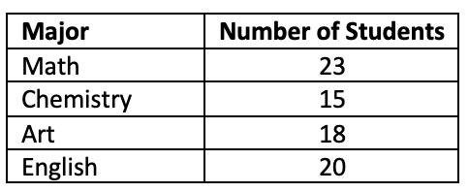








Complement Examples
2
Example: Suppose we collected data on majors of MATH 125 students and are randomly selecting a single student.
Find the probability that the student is NOT an Art major.
Find the probability that the student is NOT an English nor Chemistry major.
$$1 − \frac{18}{76}=$$
$$P\left(Not Art\right)=$$
$Art^{C}$
$$1 −P(Art)=$$
$$\frac{58}{76}$$
$$1 −\frac{20+15}{76}=$$
$$\frac{23+18}{76} =$$
$$\frac{41}{76}$$
$$P\left(Not English nor Chem\right)=$$

Slide 12
Calculating More Probabilities
3

Slide 13
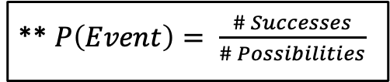
Calculating (Harder) Probabilities
3
Example 1: Liam and Michael are going to play video games this afternoon. Together, they have 41 video games. If they decide to randomly choose two video games, what is the probability that the two they choose will consist of each of their favorite video games? Assume they have different favorites.
Two Approaches: 1) Direct way 2) Counting methods
** $P\left(Event\right)= \frac{\# Successes}{\# Possibilities}$

Slide 14
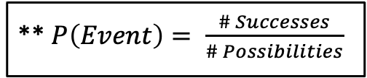
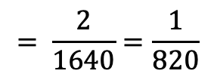


Direct Way
3
Example 1: Liam and Michael are going to play video games this afternoon. Together, they have 41 video games. If they decide to randomly choose two video games, what is the probability that the two they choose will consist of each of their favorite video games? Assume they have different favorites.
$$\frac{2}{41}$$
$$\frac{1}{40}$$
$$= \frac{2}{1640}=\frac{1}{820}$$
** $P\left(Event\right)= \frac{\# Successes}{\# Possibilities}$
x
_____ _____
1st Choice
2nd Choice
Without replacement

Slide 15
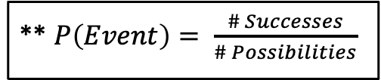



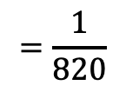
Counting Methods Way
3
** $P\left(Event\right)= \frac{\# Successes}{\# Possibilities}$
1
$$=\frac{1}{820}$$
$$Prob=$$
2
** Solve numerator and denominator separately
2
Denominator → “No Condition”
1
Numerator → “Is a Condition”
_{n} C _{r} → Combinations
(Order doesn’t matter)
Only selecting from favorites
Total ways to select
2 from 41
_{n} C _{r} →
₂ C ₂
$$=1$$
₄₁ C ₂
$$=820$$

Slide 16

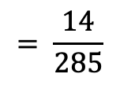


Direct Way
3
Example 2: A box of jerseys for a pick-up game of basketball contains 8 extra-large jerseys, 7 large jerseys, and 5 medium jerseys. If you are first to the box and grab 3 jerseys, what is the probability that you randomly grab 3 extra-large jerseys.
20 Total
8 XL
$$\frac{8}{20}$$
$$\frac{7}{19}$$
$$\frac{6}{18}$$
** $P\left(Event\right)= \frac{\# Successes}{\# Possibilities}$
$$= \frac{14}{285}$$
x x
_____ _____ _____
1st Selection 2nd 3rd

Slide 17


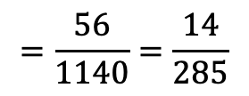
Counting Methods Way
3
** $P\left(Event\right)= \frac{\# Successes}{\# Possibilities}$
1
$$=\frac{56}{1140}=\frac{14}{285}$$
$$Prob=$$
2
** Solve numerator and denominator separately
1
Selecting 3 XL jerseys
₈ C ₃
$$=56$$
2
Selecting 3 jerseys from all jerseys
₂₀ C ₃
$$=1140$$

Slide 18
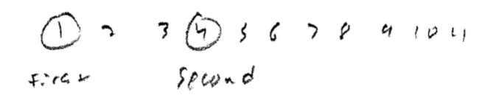

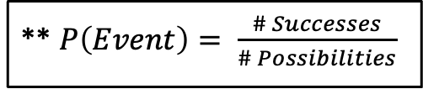

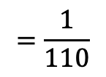


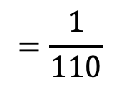
Another Example
3
Example 3: There are 11 balls numbered 1 through 11 placed in a bucket. What is the probability of reaching into the bucket and randomly drawing two balls numbered 1 and 4 without replacement, in that order?
** $P\left(Event\right)= \frac{\# Successes}{\# Possibilities}$
Direct Way
$$\frac{1}{11}$$
$$\frac{1}{10}$$
$$=\frac{1}{110}$$
x
_____ _____
#1 #4
$$\frac{1}{11P_{2}}$$
$$=\frac{1}{110}$$
Numerator → Only 1 way to get
a 1, then a 4
Counting Way
$$P(1,4)=$$
Order matters! →
_{n} P _{r}

Slide 19
Examples
4

Slide 20
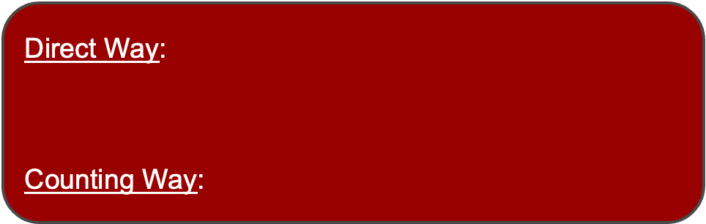


Example
3
Example 4: Julia sets up a passcode on her smart phone, which allows only six-digit codes. A spy sneaks a look at Julia's smart phone and sees her fingerprints on the screen over six numbers. What is the probability the spy is able to unlock the smart phone on his first try?
Direct Way:
$\text{Counting} \text{Way}$:
$$\frac{1}{6} × \frac{1}{5} × \frac{1}{4} × \frac{1}{3} × \frac{1}{2} × \frac{1}{1}=\frac{1}{720}$$
Numerator: Only 1 correct
password
Denominator: 6 #s to choose from
(6 fingerprints)
and Ordering all 6
→ r = 6
___ ___ ___ ___ ___ ___
$$P\left(Correct Password\right)=\frac{1}{6P_{6}}=\frac{1}{6!}=\frac{1}{720}$$

Slide 21

Odds
3
Example 5
If the odds on a bet are 18:1 against, what is the probability of winning?
Strategy: To convert from odds to a probability $a:b→P\left(A\right)=\frac{a}{a+b}$
$$Odds against=18:1→ P\left(Loss\right)=\frac{18}{18+1}=\frac{18}{19}$$
$$P\left(Win\right)=1−P\left(Win^{C}\right)=1−\frac{18}{19}=\frac{1}{19}$$
= Loss

