Slide 1
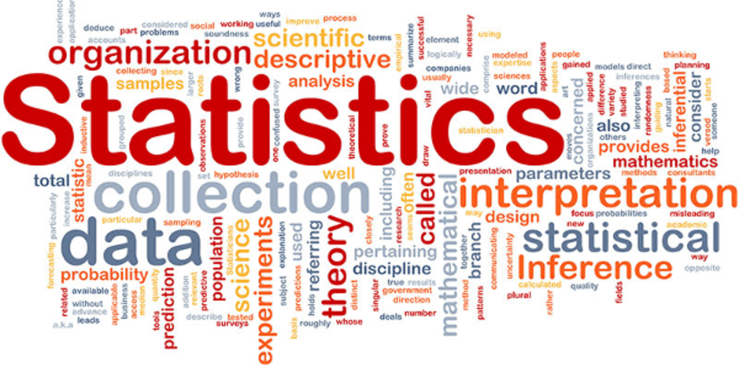
11.5 Confidence Intervals

Slide 2
Goals for the Day
Inference
How to Build a Confidence Interval
Interpreting a Confidence Interval
1
2
3

Slide 3
Inference
1

Slide 4
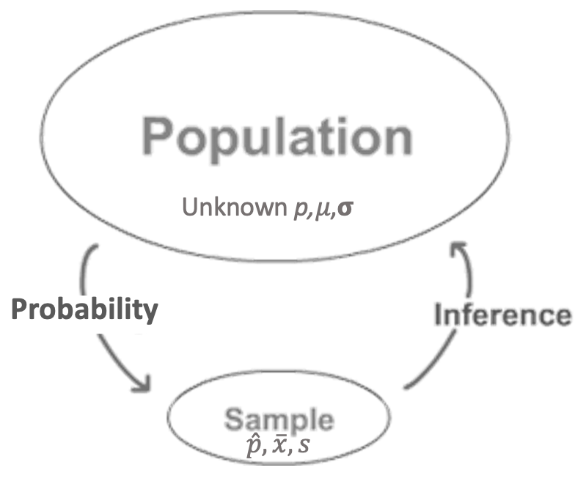
Inference
1
Inferential statistics involves using descriptive statistics to estimate population parameters.
The GOAL is to learn about a POPULATION.

Slide 5
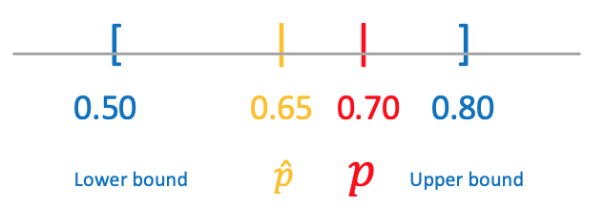
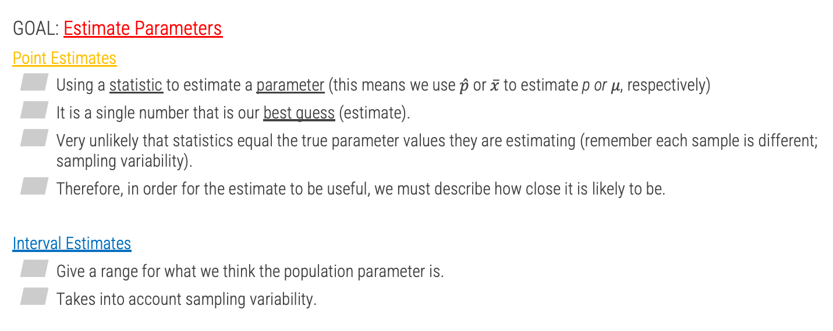
Why Confidence Intervals?
1
GOAL: Estimate Parameters
Point Estimates
Using a statistic to estimate a parameter (this means we use $\hat{p}$ or $\overline{x}$ to estimate p or 𝜇, respectively)
It is a single number that is our best guess (estimate).
Very unlikely that statistics equal the true parameter values they are estimating (remember each sample is different; sampling variability).
Therefore, in order for the estimate to be useful, we must describe how close it is likely to be.
Interval Estimates
Give a range for what we think the population parameter is.
Takes into account sampling variability.

Slide 6
How to Build a Confidence Interval
2

Slide 7


Point Estimates
2
Example 1: Calculate the point estimates for the following scenarios.
The campus bookstore is determining if they need to increase their marketing budget. In order to check this, they took a random sample of 137 students in which 81 students said they buy their books at the campus bookstore.
Scientists discovered a new mountain range under the sea. From a random sample of 13 peaks, there they recorded the following heights.
$$\hat{p}=\frac{x}{n}=\frac{81}{137}≈0.591$$
$$\overline{x}=\frac{∑x}{n}=\frac{7,700+11,500+⋯+6,100}{13}=11,308$$

Slide 8
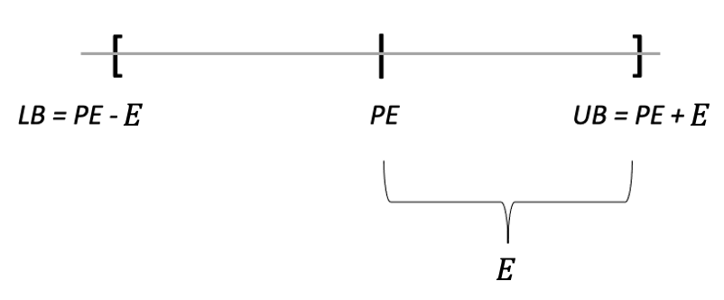
Margin of Error
2
C.I. = Point Estimate ± Margin of Error
Point Estimate is your best guess; at the center of the interval.
Then we extend our guess in both directions in order to provide a wider range of plausible values.
This distance is called the Margin of Error.
Margin of Error (E) is what makes our estimates intervals rather than just single points!

Slide 9

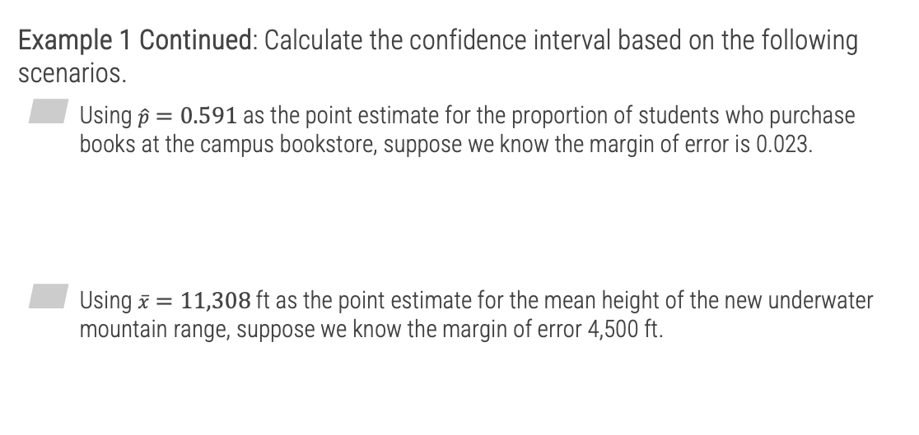





Margin of Error
2
Example 1 Continued: Calculate the confidence interval based on the following scenarios.
Using $\hat{p}=0.591$ as the point estimate for the proportion of students who purchase books at the campus bookstore, suppose we know the margin of error is 0.023.
Using $\overline{x}=11,308$ ft as the point estimate for the mean height of the new underwater mountain range, suppose we know the margin of error 4,500 ft.
$$CI=\left[LB, UB\right]$$
$$PE±E=$$
$$0.591±0.023$$
$$=[0.568, 0.614]$$
$$CI=\left[LB, UB\right]=PE±E$$
$$11,308±4,500=[6808, 15808]$$

Slide 10
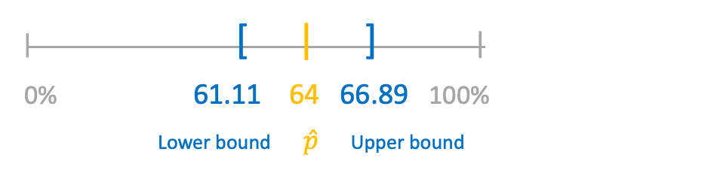
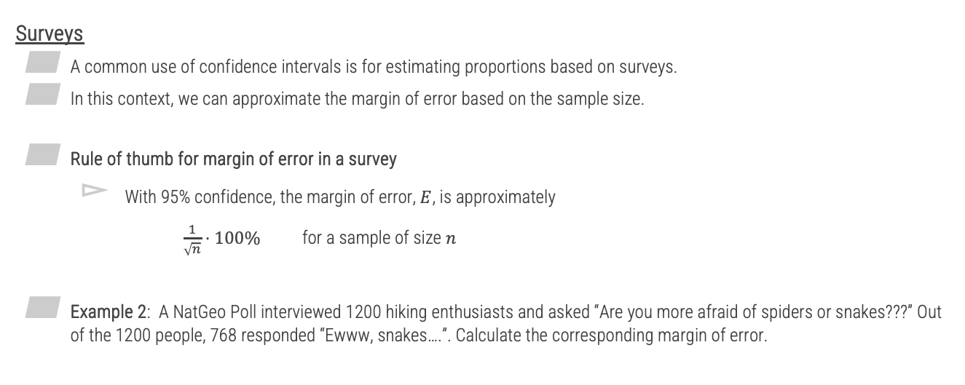


Margin of Error
2
Surveys
A common use of confidence intervals is for estimating proportions based on surveys.
In this context, we can approximate the margin of error based on the sample size.
Rule of thumb for margin of error in a survey
With 95% confidence, the margin of error, $E$, is approximately
$\frac{1}{\sqrt{n}}⋅100\%$ for a sample of size $n$
Example 2: A NatGeo Poll interviewed 1200 hiking enthusiasts and asked “Are you more afraid of spiders or snakes???” Out of the 1200 people, 768 responded “Ewww, snakes….”. Calculate the corresponding margin of error.
$$\frac{1}{\sqrt{1200}}⋅100\%$$
$$≈2.89\%$$

Slide 11
How to Interpret a Confidence Interval
3

Slide 12
Interpretation
3
A General Structure
I am C% confident that the true/population parameter + context is between (lower bound) and (upper bound).
Example
Trying to estimate the proportion of all Muncie residents who enjoy running → 95% CI = (0.05, 0.25)
We are 95% confident that the true (population) proportion of all Muncie residents who enjoy running is between 0.05 and 0.25.

Slide 13
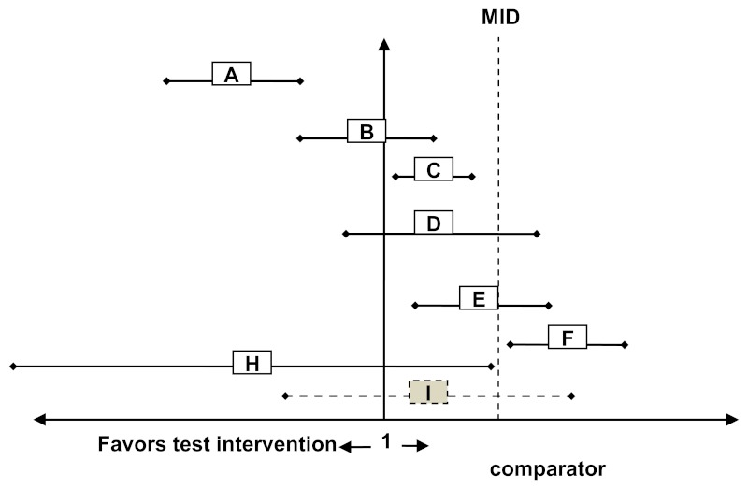
Comparing Confidence Intervals
3
When comparing confidence intervals to a particular value, or other intervals, we need to look at the ENTIRE interval to see if it is COMPLETELY below or above our comparison.
Comparisons
A 60
B 60
C 60
A B
A C
B C
<<
??
>>
??
60
<<
??

Slide 14
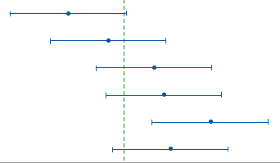
Example
3
Determine the total number of significant comparisons that we can conclude from the given confidence intervals.
In other words, how many confidence intervals are below / above 15 and/or below / above each other?
Fruity Pebbles
Comparisons
Raison Bran >> 15
Raison Bran >> Fruity Pebbles
Fruit Loops
Apple Jacks
Cheerios
Raison Bran
Cap’n Crunch
15
Healthy rating

Slide 15
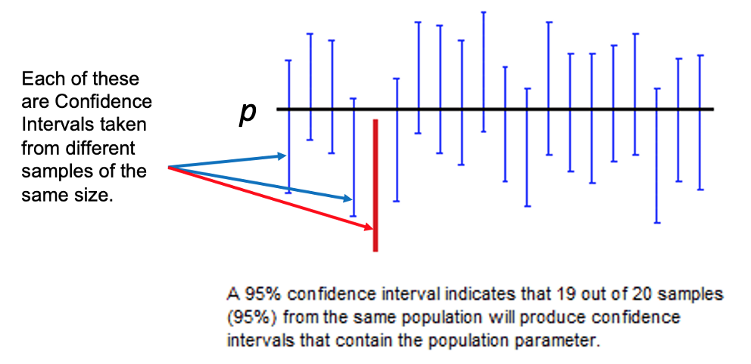
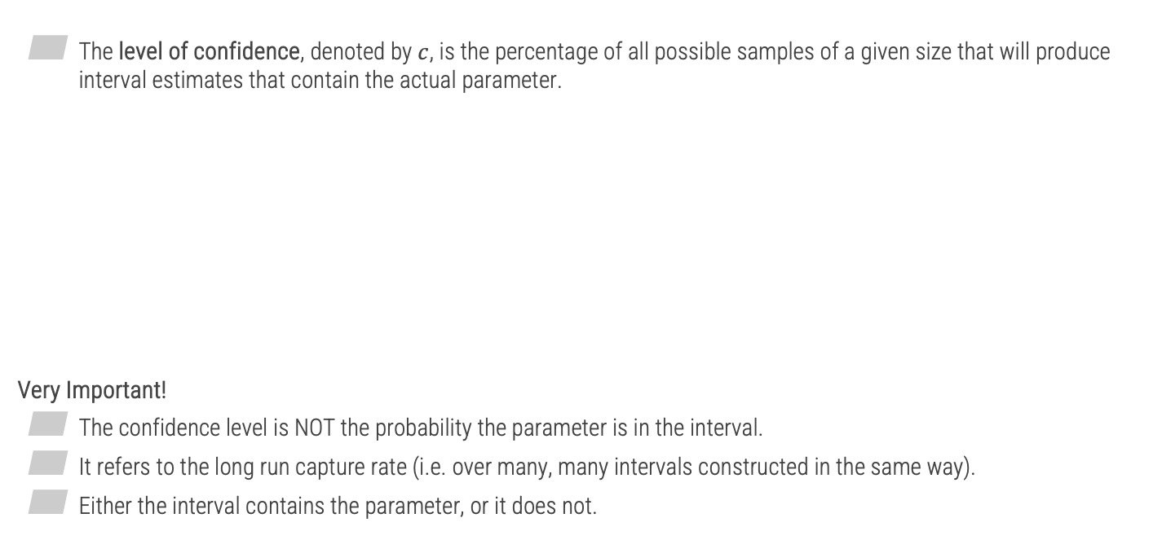
Level of Confidence
3
The level of confidence, denoted by $c$, is the percentage of all possible samples of a given size that will produce interval estimates that contain the actual parameter.
Very Important!
The confidence level is NOT the probability the parameter is in the interval.
It refers to the long run capture rate (i.e. over many, many intervals constructed in the same way).
Either the interval contains the parameter, or it does not.

Slide 16
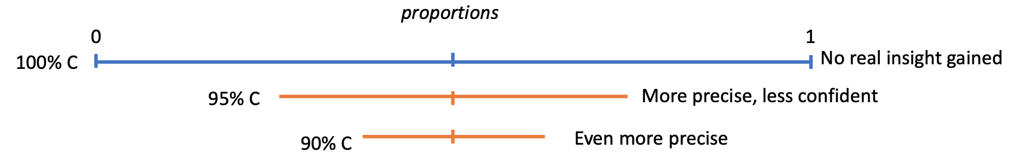
Level of Confidence
3
How to choose the level of confidence?
Tradeoff between Precision and Confidence
If we want to be more confident, we need to cover more values!
That of course decreases the precision…
So there is a pro / con to being super confident.

