Slide 1
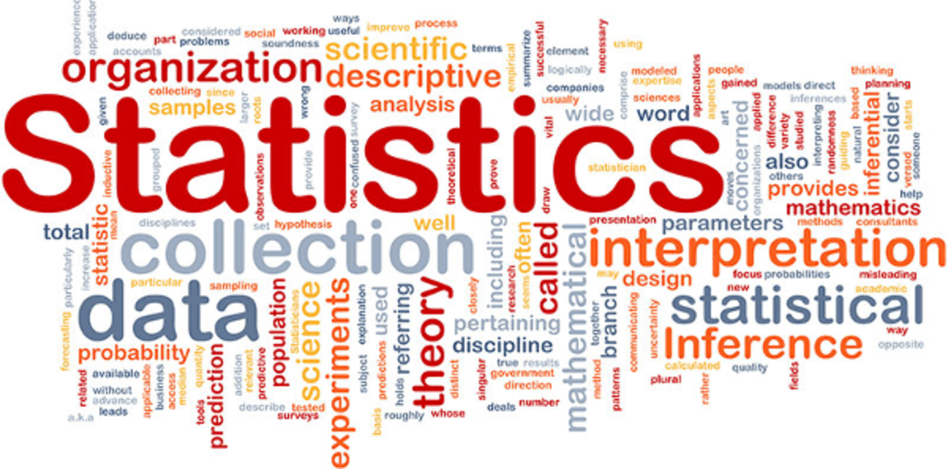
12.3 Data Exploration

Slide 2
Goals for the Day
Scatterplots
Correlation
Using Your Calculator
Regression
1
2
3
4

Slide 3
Scatterplots
1

Slide 4
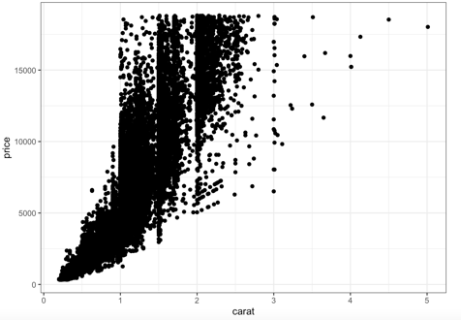
Scatterplots
1
Displays the relationship between two quantitative variables measured on the same individuals.
Useful to determine if an association exists!
So is there a pattern where some values of one variable tend to occur with some values of the other variable.
Ex) Smaller carat diamonds tend to have lower prices, and as the carat increases prices tend to increase as well.

Slide 5
Scatterplots
1
Setup of axes
The explanatory (independent) variable goes on the X (horizontal) axis.
The response (dependent) variable goes on the Y (vertical) axis.
Ex) How large a diamond is impacts how much it costs → Carat = X; Price = Y.

Slide 6


Interpreting Scatterplots
1
Interpreting a scatterplot (what we are looking for in a scatterplot)
Form (pattern of the dots)
Linear → Points follow a general linear trend; Straight line.
Curved → Points show some evidence of curvature; NOT a straight line.
Random scatter → No pattern, points are just scattered about randomly kinda like a cloud of points.

Slide 7
Interpreting Scatterplots
1
Interpreting a scatterplot (what we are looking for in a scatterplot)
Direction (of the association; only applies to linear relationships)
Positive → Upward trend.
Negative → Downward trend.
No Association → There is no pattern or general trend (corresponds to random scatter).

Slide 8
Interpreting Scatterplots
1
Interpreting a scatterplot (what we are looking for in a scatterplot)
Strength (how strong the association is; how well the data fits the pattern; only applying this to linear relationships)

Slide 9
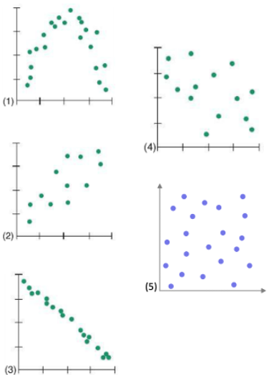
Interpreting Scatterplots Example
1
Example
Curved
N/A (+/-)
N/A (strong)
Linear
Positive
Moderate
Linear
Negative
Strong
Roughly linear
Negative
Weak
Random scatter
No association
Very weak

Slide 10
Correlation
2

Slide 11
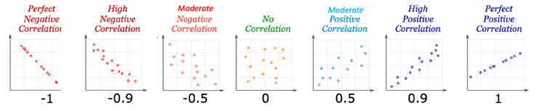
Correlation
2
The correlation (r) is an index that expresses the direction and strength of the relationship.
It combines both of these aspects into a single number measure.
Often referred to as the correlation coefficient (or Pearson’s correlation).
Interpreting correlation
Sign = Direction
Absolute value |r| = Strength

Slide 12
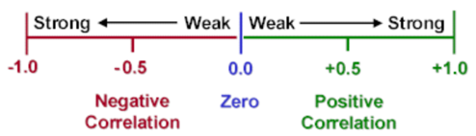
Correlation
2
Properties of Correlation
Scale goes from -1 to 1 → −1 ≤𝑟 ≤1
Only applies to LINEAR relationships.
r has no units and is the same regardless of which variable is X or Y.
Does NOT imply a cause-and-effect relationship.
Ex) Ice cream sales and shark attacks have a strong positive correlation.

Slide 13
Using Your Calculator
3

Slide 14
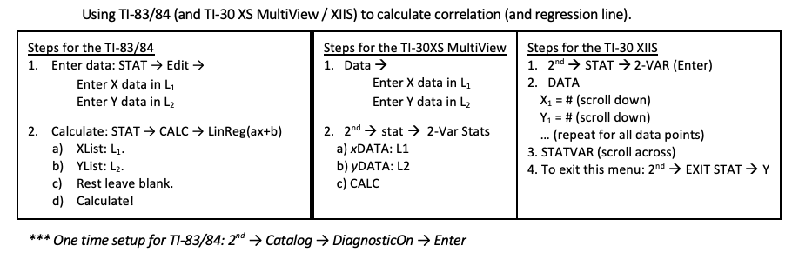
Using Your Calculator
3
“LEFT”

Slide 15
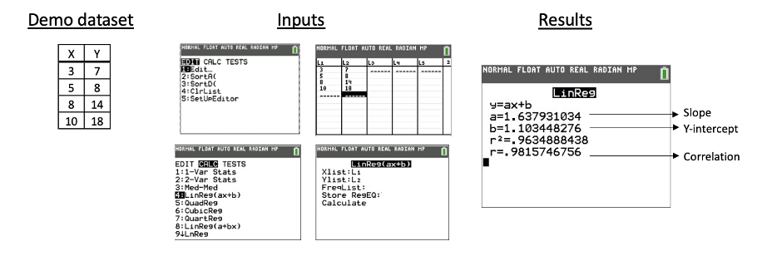
Using Your Calculator
3
n = 4
“LEFT”
L₁ L₂

Slide 16
Regression
4

Slide 17
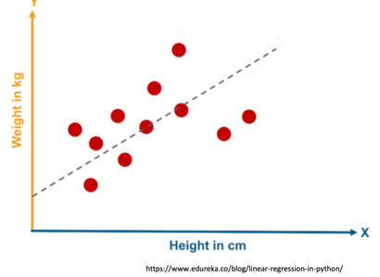
Regression
4
Ultimately, we want to determine if we can use a straight line to model the relationship between two variables → If so, we can use that model to make predictions!
This process is called Linear Regression.

Slide 18
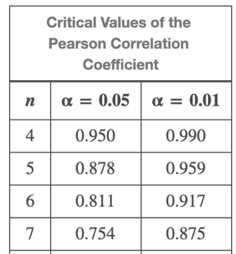
Regression
4
Step 1 → Determine if there is a significant correlation (linear relationship).
Calculate correlation.
Compare it to the Table of Critical Values or the Pearson Correlation Coefficient to see if it is statistically significant.
Match the sample size n and the Level of significance → (Probability our claims about the data are wrong) to the specific problem.
If |r| > Critical Value (CV) → r is statistically significant (unlikely to have occurred by chance).
Demo ex) n = 4, ⍺ = 0.05
→ r = 0.982 >
0.950 = CV
→ Significant ✅
→ Can make predictions ✅

Slide 19
Regression
4
Step 2 → Once we have a significant correlation, we can find the regression line.
Linear equation that fits our data best (aka ‘line of best fit’).
It is IMPORTANT to get the X and Y variables correct!
Our calculator gives us our equation!

Slide 20
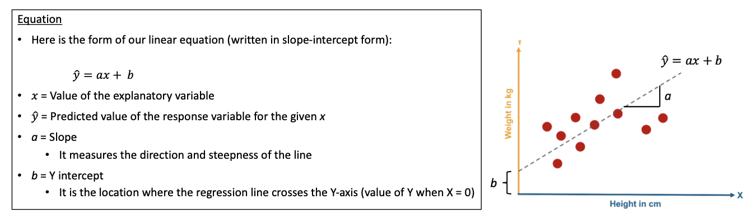
Regression
4

Slide 21
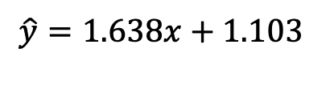
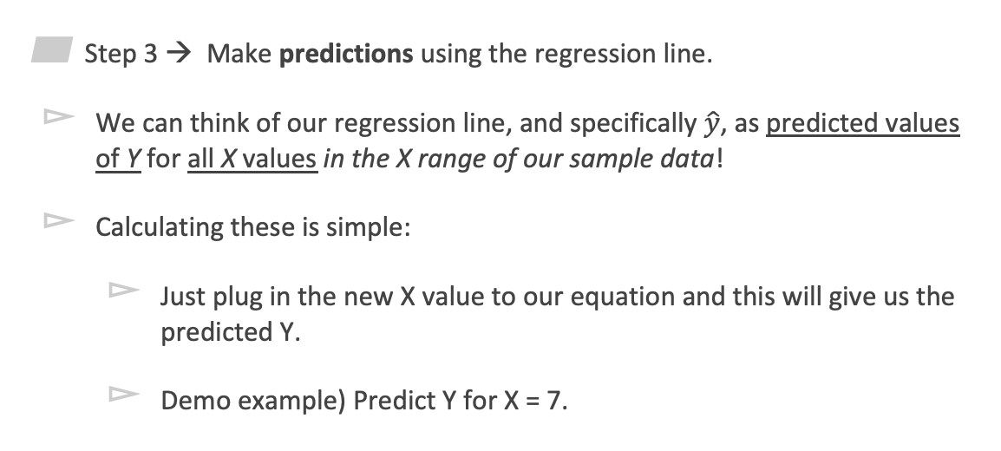


Regression
4
Step 3 → Make predictions using the regression line.
We can think of our regression line, and specifically $\hat{y}$, as predicted values of Y for all X values in the X range of our sample data!
Calculating these is simple:
Just plug in the new X value to our equation and this will give us the predicted Y.
Demo example) Predict Y for X = 7.
$$\hat{y}=1.638x+1.103$$
→ $\hat{y}=1.638\left(7\right)+1.103$
$$=12.569$$
ax + b

Slide 22
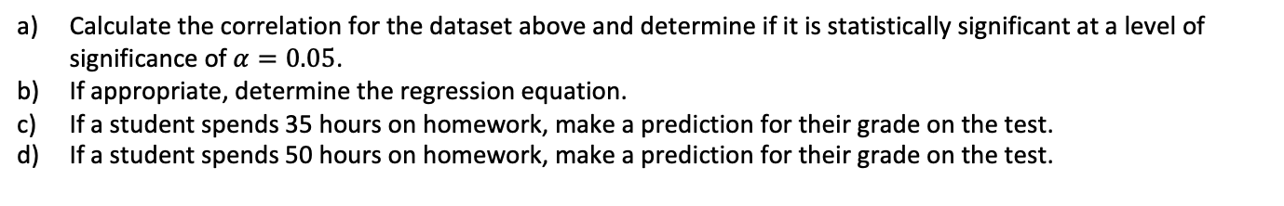

Full Example
4
Calculate the correlation for the dataset above and determine if it is statistically significant at a level of significance of $α=0.05$.
If appropriate, determine the regression equation.
If a student spends 35 hours on homework, make a prediction for their grade on the test.
If a student spends 50 hours on homework, make a prediction for their grade on the test.
a) r = 0.779 > 0.632 → Significant
b) Appropriate → $\hat{y}=0.676x+56.459$
c) $\hat{y}=80.119$
d) $\hat{y}=90.259$

