Slide 1
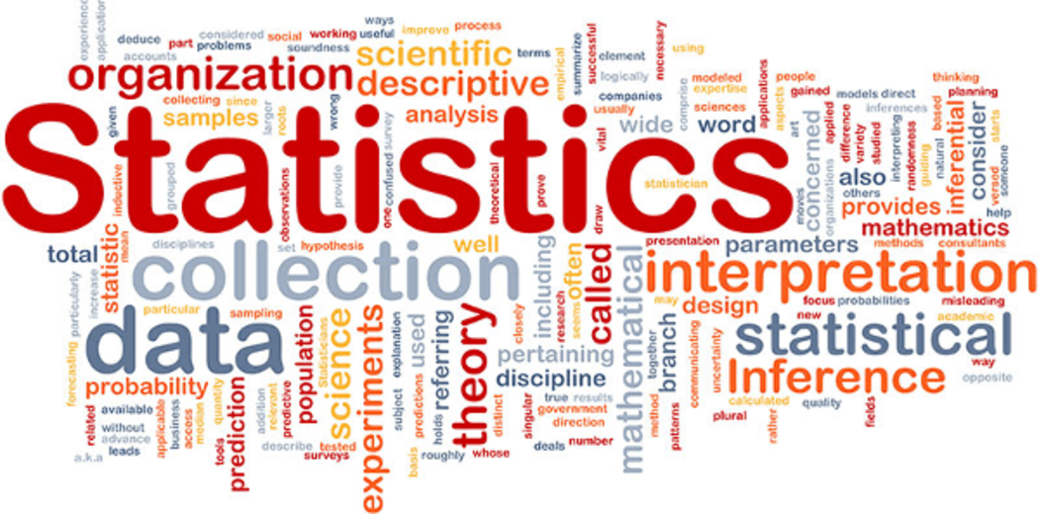
11.3 Describing and Analyzing Data

Slide 2
Goals for the Day
Measures of Center
Measures of Spread
Using your Calculator
Measures of Relative Position
1
2
3
4

Slide 3
Measures of Center
1

Slide 4
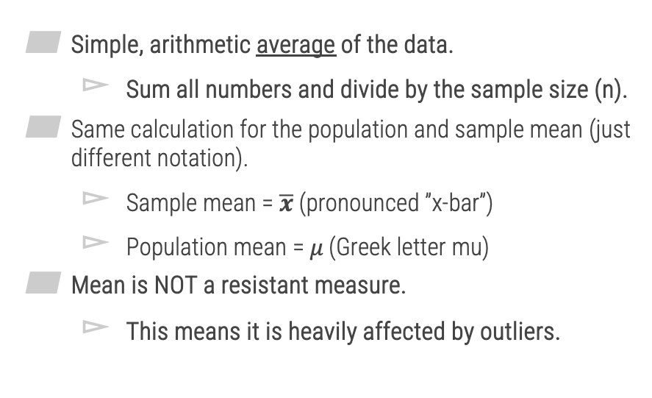

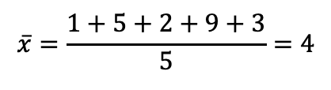
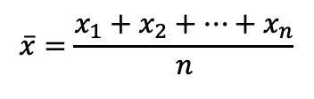
Mean (Average Value)
1
Simple, arithmetic average of the data.
Sum all numbers and divide by the sample size (n).
Same calculation for the population and sample mean (just different notation).
Sample mean = $\overline{x}$ (pronounced ”x-bar”)
Population mean = 𝜇 (Greek letter mu)
Mean is NOT a resistant measure.
This means it is heavily affected by outliers.
$$\overline{x}=\frac{x_{1}+x_{2}+…+x_{n}}{n}$$
Example 1 – Mean
Data: 1, 5, 2, 9, 3
$$\overline{x}=\frac{1+5+2+9+3}{5}=4$$
Now change 3 to 30
New $\overline{x}=9.4$

Slide 5


Median (Middle Value)
1
The middle value in an ordered list.
Median IS a resistant measure.
NOT affected by outliers.
Example 2 – Median
Case 1 – Odd n
7 Obs: 10, 5, 6, 1, 3, 9, 8
Sorted:
1, 3, 5, 6, 8, 9, 10
$$Med=6$$
Case 2 – Even n
8 Obs: 10, 5, 6, 1, 3, 9, 8, 3
Sorted:
1, 3, 3, 5, 6, 8, 9, 10
$$Med=\frac{5+6}{2}=5.5$$

Slide 6
Mode (Most Common Value)
1
The most frequently occurring value(s).
Unimodal data has one mode.
Bimodal data has 2 modes.
Multimodal data has more than 2 modes.
Can be no modes (every value is distinct).
This is the only measure of center that can be used with categorical data.
Ex) Most common favorite color (can’t average this)
Example 2 – Median
Case 2
8 Obs: 10, 5, 6, 1, 3, 9, 8, 3
Mode =
3 (twice)

Slide 7
Measures of Spread
2

Slide 8
Range
2
Range = Max - Min
Gives idea of the entire ”range” of values, how much distance do they span in total.
Ex) Case 2: Range =
10 – 1 = 9
Example 2 – Median
Case 2
8 Obs: 10, 5, 6, 1, 3, 9, 8, 3
1
10

Slide 9
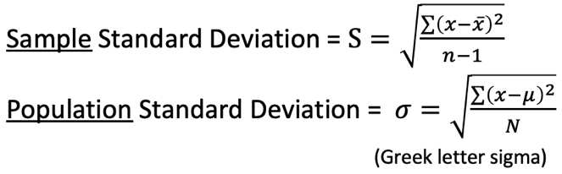
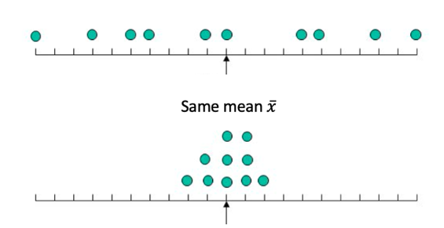

Standard Deviation
2
Complex formula that measures the average distance that each data point is from the mean.
Larger st dev
Smaller st dev

Slide 10
Using your Calculator
3

Slide 11
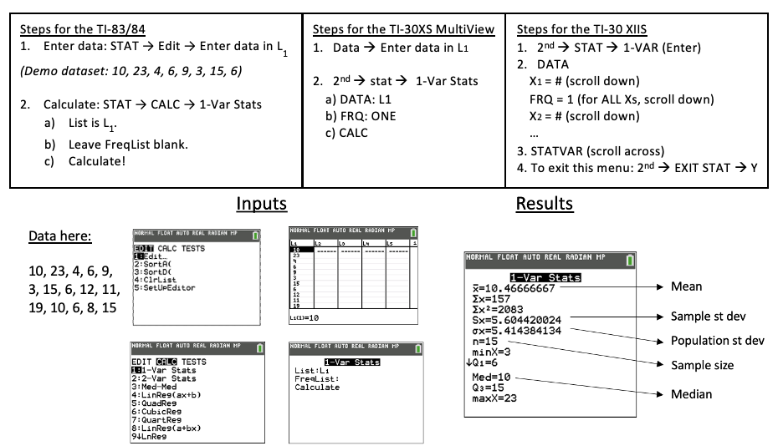
Using Your Calculator
3
Does not give median

Slide 12

Using Your Calculator Example
3
Example 3: Find the mean, median, mode and sample standard deviation of the following dataset.
Data (7 obs): 35, 70, 31, 37, 65, 38, 38
Results
Mean $\overline{x}=44.86$
Sample st dev: $Sx=15.72$
Pop st dev $σ_{x}=14.55$
Med = 38

Slide 13
Other Considerations
3
Outliers
Data values that are extreme when compared to the rest of the data.
Can significantly impact measures of center and spread.
Example 3:
- Data (7 obs): 31, 35, 37, 38, 38, 65, 70
Outliers

Slide 14
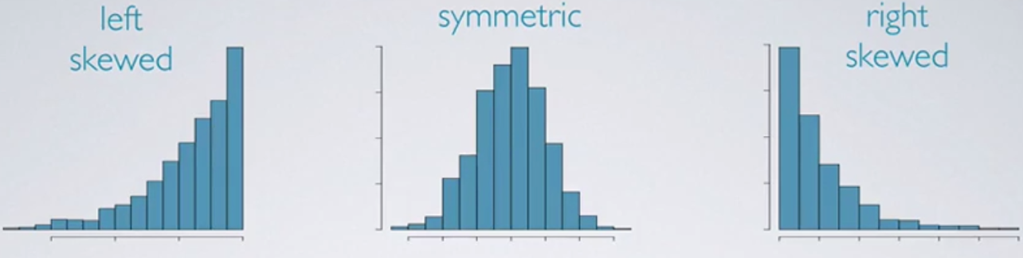
Other Considerations
3
Types of Distributions
Outliers
Outliers
Best measure of center:
Median
Mean
Median

Slide 15
Measures of Relative Position
4

Slide 16
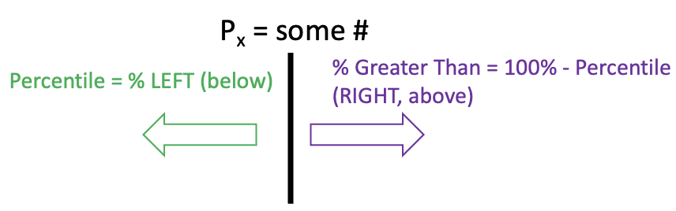
Percentiles
4
A percentile tells you the percent of observations/individuals you are higher than.
Interpreting example: You are told you scored in the 90th percentile on GRE. This means you have a score that is higher than 90% of all others that took the test.
Range from 0th to 100th percentile!
There is complement aspect to percentiles as well; for example, if you are the 80th percentile, there is ______ greater than you!
Best way to remember!
Notation: Xth Percentile = P_{x}
20%
80%
P₈₀
0
100
20%

Slide 17
5-Number Summary and Boxplots
4
Quartiles are specific percentiles.
Q₁ is the 25th Percentile.
Q₃ is the 75th Percentile.
Q₂ is the 50th Percentile = Median.
Inner Quartile Range (IQR)
Another measure of variation, less informative than the standard deviation.
Uses quartiles to measure how far data is spread out around the median. Specifically, it measures the range of the middle 50% of the data
IQR = Q₃ – Q₁
Visualized very well in boxplots! It is the length of the box!
5-number summary
Min, Q₁, Med, Q₃, Max → Points of a boxplot

Slide 18
5-Number Summary and Boxplots
4

Slide 19
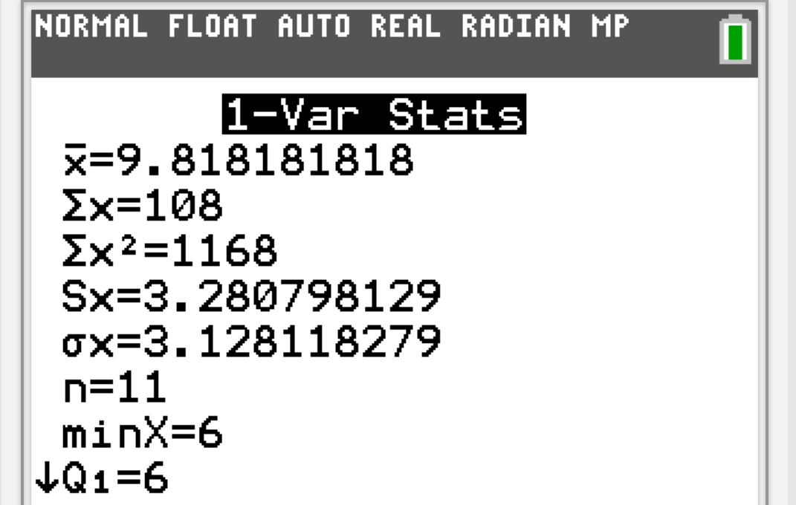
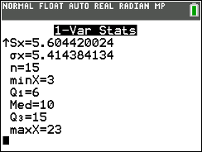



Examples
4
Example 4:
Using this output from a 1-Var Stat, what is the IQR?
Find the IQR from this boxplot.
$$IQR =9$$
$$IQR =15$$

Slide 20
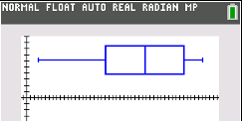

Examples
4
5-number summary
$Min = 3$
$Q1 = 15.5$
$Med = 29.5$
$Q3 = 41$
$Max = 47$
Example 5:
Calculate the 5-number summary of the following dataset (20 numbers):
Draw a boxplot based on the 5-number summary from (a).
38, 33, 5, 5, 47, 29, 24, 42, 3, 18, 30, 46, 25, 44, 40, 42, 39, 44, 29, 13
3 15.5 29.5 41 47

