Slide 1
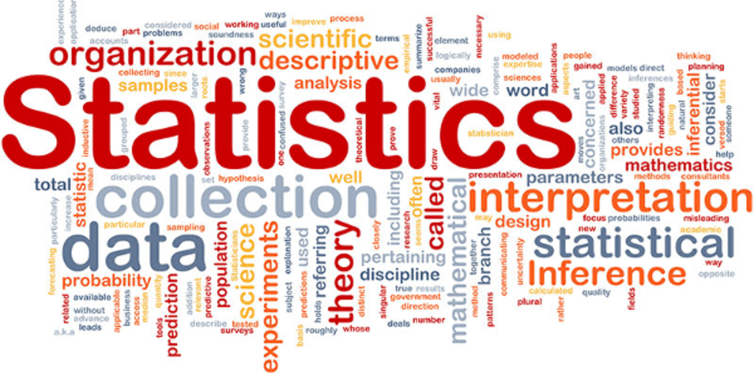
11.1 Statistical Studies

Slide 2
Goals for the Day
Definitions / Key Ideas
Observational Studies
Experiments
Examples
1
2
3
4

Slide 3
Definitions / Key Ideas
1

Slide 4

What is Statistics?
1
Statistics is the science of gathering, describing, and analyzing data.

Slide 5
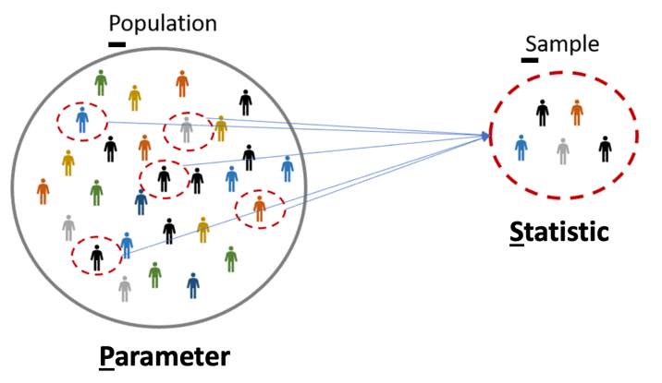
Population vs Sample
1
Population – the particular group of interest in a study
The set of all individuals/objects of interest
Sample – a subset of the individuals/objects from the population of interest

Slide 6
Population vs Sample
1
Example
Let’s say we want to know if Indiana is a cat or dog state.
What is the population?
What is the sample?
Every person in ALL of Indiana
Everybody in Muncie ONLY

Slide 7
Parameter vs Statistic
2
(Population) Parameter – a fixed numerical value that describes the population
EX: Percentage of people in all of Indiana who prefer cats
Would need to take a census (ask everyone in the population) to know this value (or estimate it)
(Sample) Statistic – a numerical value that describes the sample that can vary from sample to sample
EX: Percentage of people in Muncie who prefer cats (will be different than for Indy)

Slide 8
Observational Study vs Experiment
2
An observational study observes existing data.
Does not impose any restraints (no random assignment).
Can reveal association or correlation between variables, but not causation.
An experiment generates data to help identify cause-and-effect relationships.
Imposes treatments and controls randomly to groups.
More accurate to determine a relationship between the explanatory variable and response.

Slide 9
Observational Studies
2

Slide 10
Sampling
3
In the context of observational studies, we need to find a way to pick who/what is going to be included in the sample.
Goal: A representative sample – a sample that has the same relevant characteristics as the population AND does not favor one group of the population over another.
Many different methods for sampling.

Slide 11
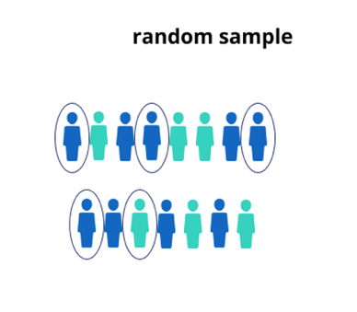
Sampling Techniques
3
Random Sample – every member of the population has an equal chance of being selected
This is generally desirable but can be difficult to achieve.

Slide 12
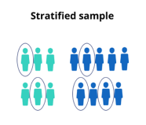
Sampling Techniques
3
Stratified Random Sample – dividing the population into homogeneous (similar characteristics) groups
Stratify the population - divide the population into similar groups (e.g., based on age or gender)
Take random sample from each group (strata)
Combine the groups from each strata to form your sample

Slide 13
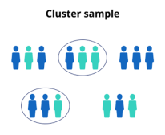
Sampling Techniques
3
Cluster Sample – dividing the population into mini-populations. This gives us an unbiased sample and is often a more practical / affordable method.
Split the population into representative groups called clusters (should resemble overall population)
Use random sampling to select several whole clusters
Perform a census of each selected (collect data from every member).

Slide 14
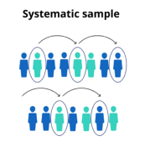

Sampling Techniques
3
Systematic Sample – selecting every $n^{th}$ member of the population

Slide 15
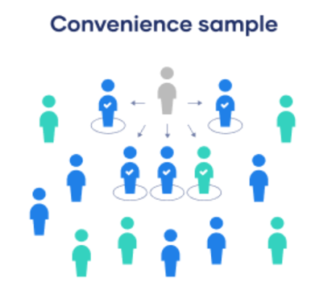
Sampling Techniques
3
Convenience Sample – include individuals who are convenient to sample (for the researcher); AVOID!
This group may not be representative of population
Frequently leads to biased results

Slide 16
Example #1
4
Describe how you could obtain a sample to answer the question below using each of the following types of sampling methods.
I want to determine the proportion of MATH 125 students that has a Mac laptop.
Random – Randomly ask 10 students from class
Stratified – Randomly sample 5 students from the list of Freshman and Sophomores respectively
Cluster – Randomly sample 3 tables; ask everyone in that (take a census of the) table
Systematic – choose every 4th student off the roster
Convenience – Ask the 5 students closest to me

Slide 17
Experiments
3

Slide 18
Definitions
3
Explanatory Variable
The variable(s) being used to explain a response (the variable doing the explaining).
Response Variable
The variable we are ultimately interested in (the one trying to be explained).
Our GOAL is to see if we can describe our response with an explanatory variable(s).

Slide 19
More Definitions
3
Subjects (also called Experimental Units) are what the treatment is being applied to.
Treatment is the experimental condition.
Different Groups in an Experiment
Treatment Groups – The group the receives the treatment.
Control Group
The group that does not receive the treatment.
We have a control group to compare our treatment groups to.
We have to know what the “base” level of our response is.

Slide 20
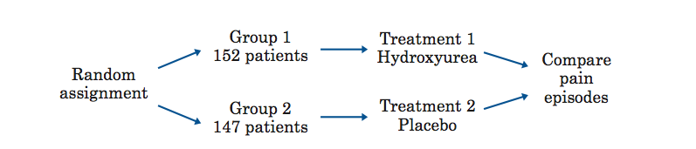
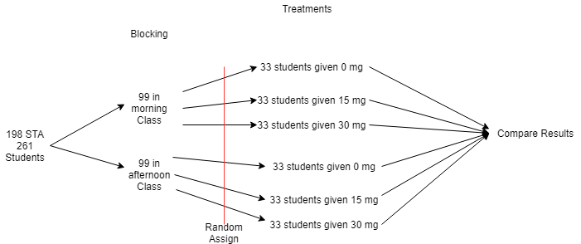
Principles of Experimental Design
3
Randomize the control and treatment groups.
Equalize effects of known and unknown variation.
Control for outside effects on the variable.
Make conditions as similar as possible for all groups so that the only difference is the imposed treatment
Replicate the experiment a significant number of times to see meaningful patterns.
Apply each treatment to a number of subjects.

Slide 21
More Terms
3
Experiments can get complicated, lots of things to consider. These include but are not limited to:
Placebo and its effects
Single- or double-blind studies
Confounding variables
Blocking

Slide 22
Example #2
4
Describe how you could obtain a sample to answer the question below using each of the following types of sampling methods.
You are tasked with conducting a survey to answer the question, “What is the favorite subjects of students who attend East High School?”
Random – Get a list of all student names and randomly select 10 names
(could number each name and randomly generate 10 numbers)
Stratified –Divide students by grade level OR by social group band, football, etc.) and then randomly sample within each group
(Students are the same WITHIN each group, but different ACROSS groups)
Cluster – Randomly sample 5 classrooms OR buses, and then ask every student in each.
(Should be a mix of students in each cluster, all clusters  same)
Systematic – Ask every 5th student that arrives in the morning.
Get a list of all students names and select every 10th name.
Convenience – Walk through hallway and ask first 20 students you pass.
(Bad because maybe I am by the chem lab and only ask chem students; their opinions might not match the overall student body’s opinion

Slide 23
Example #3
4
Identify the response variable, subjects, and treatment for the following experiment:
The MATH 125 team is interested if the amount of sleep affects students’ memory of a 5-minute video shown in class. 25 students were randomly chosen to sleep for 6 hours, another 30 were randomly chosen to sleep for 8 hours; the rest of the class (28 students) were assigned to sleep for 10 hours. Students were then scored on the amount they were able to remember on the video.
Response variable – Score on video
Subjects – Students
Treatment – Amount of sleep

