Slide 1

8.1 Collecting Data

Slide 2
Goals for the Day
Population vs Sample
Parameter vs Statistic
Sampling Techniques
Examples
1
2
3
4

Slide 3
Population vs Sample
1

Slide 4
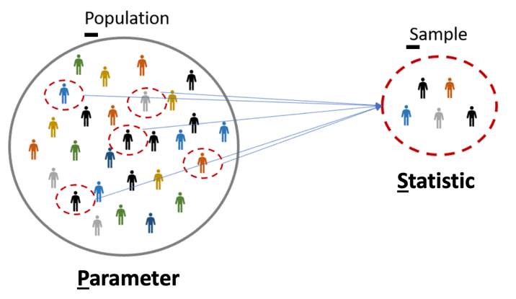
What’s the difference?
1
Population – the particular group of interest in a study
The set of all individuals/objects of interest
Sample – a subset of the individuals/objects from the population of interest

Slide 5
What’s the difference?
1
Example
Let’s say we want to know if Indiana is a cat or dog state.
What is the population?
What is the sample?
Every person in ALL of Indiana
Everybody in Muncie ONLY

Slide 6
Parameter vs Statistic
2

Slide 7
What’s the difference?
2
(Population) Parameter – a fixed numerical value that describes the population
EX: Percentage of people in all of Indiana who prefer cats
Would need to take a census (ask everyone in the population) to know this value (or estimate it)
(Sample) Statistic – a numerical value that describes the sample that can vary from sample to sample
EX: Percentage of people in Muncie who prefer cats (will be different than for Indy)

Slide 8
Sampling Techniques
3

Slide 9
Sampling
3
Need to find a way to pick who/what is going to be included in the sample
Goal: A representative sample – a sample that has the same relevant characteristics as the population AND does not favor one group of the population over another.
Many different methods for sampling

Slide 10
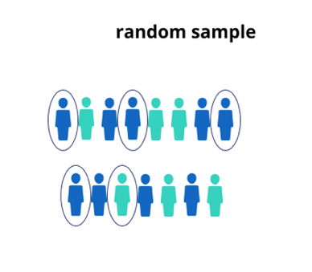
Sampling Strategies
3
Random Sample – every member of the population has an equal chance of being selected
This is generally desirable but can be difficult to achieve.

Slide 11
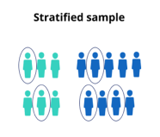
Sampling Strategies
3
Stratified Random Sample – dividing the population into homogeneous (similar characteristics) groups
Stratify the population - divide the population into similar groups (e.g., based on age or gender)
Take random sample from each group (strata)
Combine the groups from each strata to form your sample

Slide 12
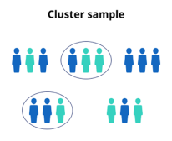
Sampling Strategies
3
Cluster Sample – dividing the population into mini-populations. This gives us an unbiased sample and is often a more practical / affordable method.
Split the population into representative groups called clusters (should resemble overall population)
Use random sampling to select several whole clusters
Perform a census of each selected (collect data from every member).

Slide 13
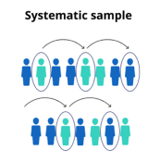

Sampling Strategies
3
Systematic Sample – selecting every $n^{th}$ member of the population

Slide 14
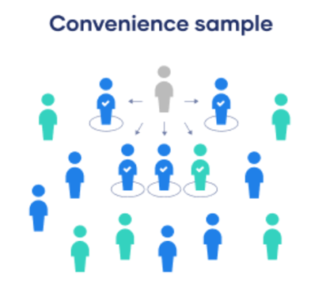
Sampling Strategies
3
Convenience Sample – include individuals who are convenient to sample (for the researcher); AVOID!
This group may not be representative of population
Frequently leads to biased results

Slide 15
Examples
4

Slide 16
Example #1
4
Describe how you could obtain a sample to answer the question below using each of the following types of sampling methods.
I want to determine the proportion of MATH 125 students that has a Mac laptop.
Random – Randomly ask 10 students from class
Stratified – Randomly sample 5 students from the list of Freshman and Sophomores respectively
Cluster – Randomly sample 3 tables; ask everyone in that (take a census of the) table
Systematic – choose every 4th student off the roster
Convenience – Ask the 5 students closest to me

Slide 17
Example #2
4
Describe how you could obtain a sample to answer the question below using each of the following types of sampling methods.
You are tasked with conducting a survey to answer the question, “What is the favorite subjects of students who attend East High School?”
Random – Get a list of all student names and randomly select 10 names
(could number each name and randomly generate 10 numbers)
Stratified –Divide students by grade level OR by social group band, football, etc.) and then randomly sample within each group
(Students are the same WITHIN each group, but different ACROSS groups)
Cluster – Randomly sample 5 classrooms OR buses, and then ask every student in each.
(Should be a mix of students in each cluster, all clusters → same)
Systematic – Ask every 5th student that arrives in the morning.
Get a list of all students names and select every 10th name.
Convenience – Walk through hallway and ask first 20 students you pass.
(Bad because maybe I am by the chem lab and only ask chem students; their opinions might not match the overall student body’s opinion

