Slide 1

10.6 Expected Value

Slide 2
Goals for the Day
Expected Value
Examples + Calculator Fun Sess
1
2

Slide 3
Expected Value
1

Slide 4
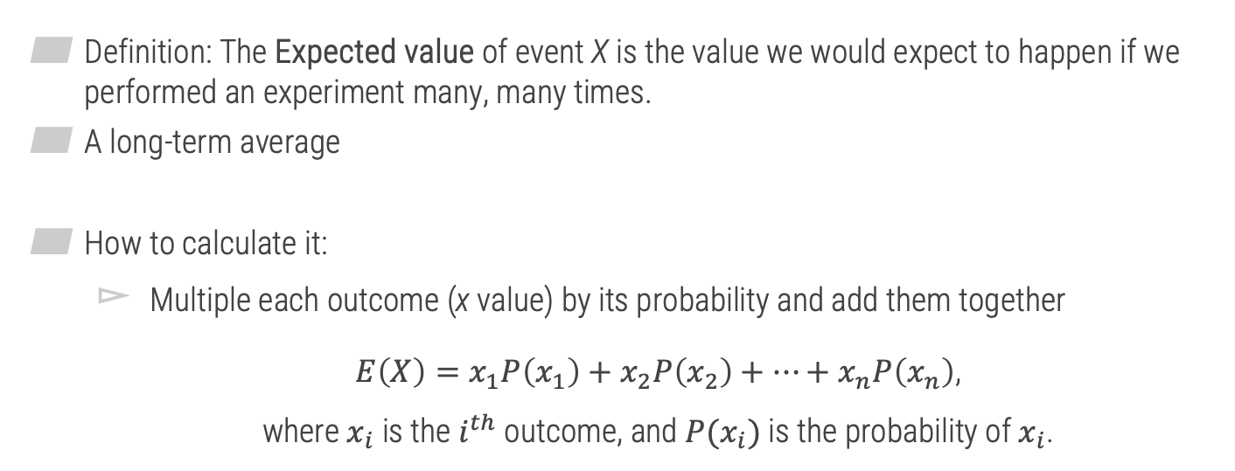
Expected Value
1
Definition: The Expected value of event X is the value we would expect to happen if we performed an experiment many, many times.
A long-term average
How to calculate it:
Multiple each outcome (x value) by its probability and add them together
$E\left(X\right)=x_{1}P\left(x_{1}\right)+x_{2}P\left(x_{2}\right)+…+x_{n}P\left(x_{n}\right)$, where $x_{i}$ is the $i^{th}$ outcome, and ${P(x}_{i})$ is the probability of $x_{i}$.
“Weighted average”

Slide 5



Expected Value
1
Example 1
In soccer, you earn a certain number of points based on the result of a game, as shown in the table below. Calculate the expected value of the number of points earned for a single game.
$E\left(X\right)$ =
$$=1.4 points$$
$$3\left(0.3\right)+1\left(0.5\right)+0\left(0.2\right)$$
X | P(X)
Win (3 points) | 0.3
Tie (1 point) | 0.5
Loss (No points) | 0.2
(Long term average)

Slide 6

Sum of Expected Values
1
Sum of Expected Values: To find the combined expected value of multiple events, add the individual expected values of each event.
$$E\left(X or Y\right)=E\left(X\right)+E(Y)$$

Slide 7





Sum of Expected Values
1
Example 1 (Continued)
Find the expected value for the total number of points earned in a season if the season has 12 games.
$$X_{1}=Game 1, …, X_{12}=Game 12$$
$$E\left(Total Points\right)=$$
$E\left(X_{1}\right)+E\left(X_{2}\right)+ …+E\left(X_{12}\right)$
$$= 1.4 + 1.4 + … +1.4$$
Same E(X) for each
$$= 12\left(1.4\right)=16.8 Points$$

Slide 8
Expected Value
1
Strategy
Think about the possible X values
THEN the probabilities
Example 2
Jim likes to day trade on the Internet. On a good day, he averages a $1400 gain. On a bad day, he averages a $900 loss. Suppose that he has good days 30% of the time, bad days 50% of the time, and the rest of the time, he breaks even ($0 gain). What is the expected value for one day of Jim’s day-trading hobby? (Hint: Fill in the table to help solve the problem.)
X | P(X) | E(X) | Overall E(X) 420+0+(-450) = -30
+$1400 | 0.3 | 1400(0.3)=420
+$0 | 0.2 | 0(0.2)=0
-$900 | 0.5 | -900(0.5)=-450

Slide 9
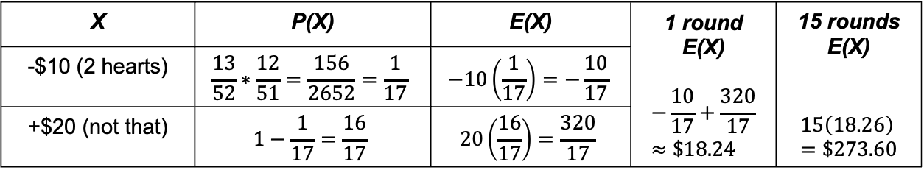
Expected Value
1
Example 3
Suppose that you and a friend are playing cards and decide to make a bet. If your friend draws two hearts in a row from a standard deck of 52 cards without replacing the first card, you give him $10. Otherwise, he pays you $20. If the same bet was made 15 times, how much would you expect to win or lose? Round your answer to the nearest cent, if necessary.
X | P(X) | E(X) | 1 round E(X) $$−\frac{10}{17}+\frac{320}{17}≈\$18.24$$ | 15 rounds E(X) $$15\left(18.26\right)=\$273.60$$
-$10 (2 hearts) | $$\frac{13}{52}∗\frac{12}{51}=\frac{156}{2652}=\frac{1}{17}$$ | $$−10\left(\frac{1}{17}\right)=−\frac{10}{17}$$
+$20 (not that) | $$1−\frac{1}{17}=\frac{16}{17}$$ | $$20\left(\frac{16}{17}\right)=\frac{320}{17}$$

Slide 10
Examples
2

Slide 11
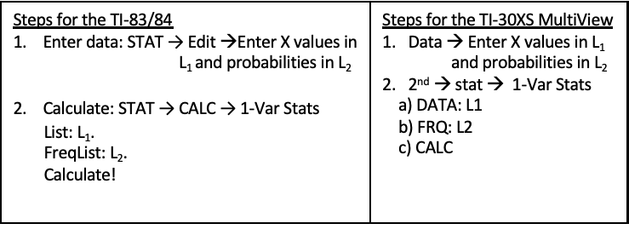
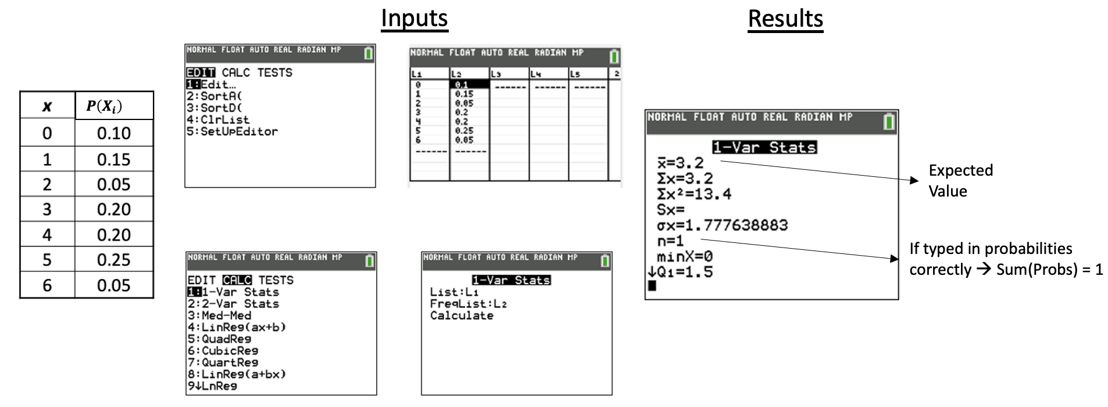
Examples - Calculator Fun Sess
2
** Note: Unable to do this on the TI-30 XIIS
Example 4
Calculate the expected
value of the scenario:

Slide 12
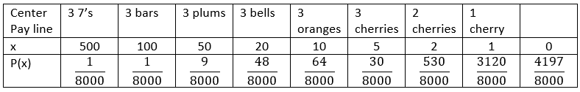
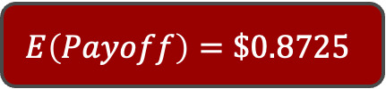
Examples - Calculator Fun Sess
2
Example 5
A typical three-reel mechanical slot machine has different payoffs determined by the number and position of various pictures. Suppose the payoff (in dollars) has the probability distribution given in the table below.
Find the expected payoff.
$$E\left(Payoff\right)=\$0.8725$$

