Slide 1
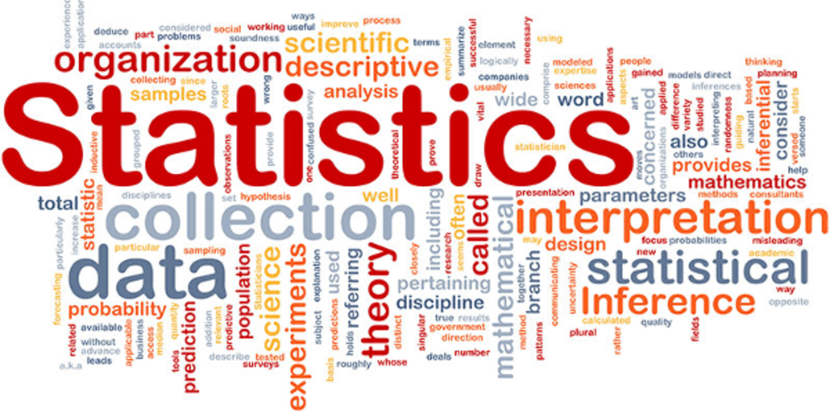
11.4 The Normal Distribution

Slide 2
Goals for the Day
Normal Distribution Properties
Empirical Rule
Z-scores and Finding Probabilities
Examples
1
2
3
4

Slide 3
Normal Distribution Properties
1

Slide 4
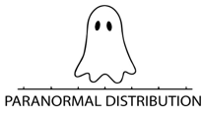
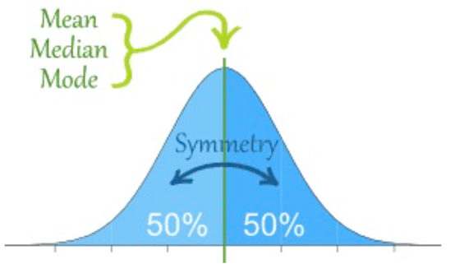
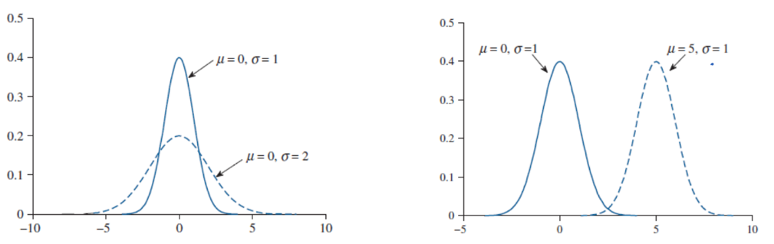
Normal Distribution Properties
1
It’s a symmetric, unimodal and bell-shaped distribution
→ which implies mean = median = mode.
Total area under curve (probability) is equal to 1 = 100%.
Completely described by its mean 𝜇 (location) and standard deviation 𝞂 (spread).

Slide 5
Empirical Rule
2

Slide 6
Empirical Rule (68 – 95 – 99.7 Rule)
2
When data is approximately bell shaped, the standard deviation allows us to make fairly accurate approximations about the locations of our data values.
_____ of the data lies within 1 standard deviation of the mean.
_____ of the data lies within 2 standard deviations of the mean.
_____ of the data lies within 3 standard deviations of the mean.
68%
95%
99.7%

Slide 7
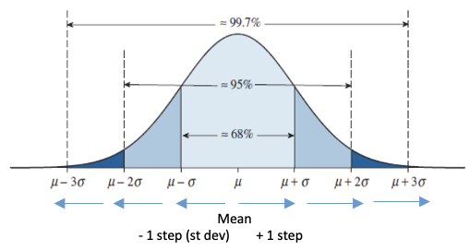
Empirical Rule (68 – 95 – 99.7 Rule)
2
We can use these breakdowns to find probabilities within certain intervals.

Slide 8
Empirical Rule Examples
2
Example 1: Suppose that diameters of a new species of apple have a bell-shaped distribution with a mean of 7 cm and a standard deviation of 0.5 cm. Using the empirical rule, find the following percentages of apples with diameters that are:
Between 5.5 cm and 8.5 cm
More than 7.5 cm
No more than 5.5 cm
99.7%
Step 1
Draw and label curve
Step 2
Shade area of interest
16%
0.15%

Slide 9
Z-scores and Finding Probabilities
3

Slide 10
How We Use the Normal Curve
3
The normal distribution allows us to find any probability, not just for points that lie exactly 1, 2, or 3 standard deviations (“steps”) away from the mean like with the empirical rule!

Slide 11

Z-scores
3
Z-scores (“Standard” scores in Hawkes Certify)
Definition: A z-score standardizes observations based on the mean (center) and standard deviation (spread) of the distribution
Allows for comparisons on different scales.
Ex) ACT vs SAT
Formula: $z=\frac{x−μ}{σ}=\frac{x −\overline{x}}{s}=\frac{obs −mean}{st dev}$

Slide 12
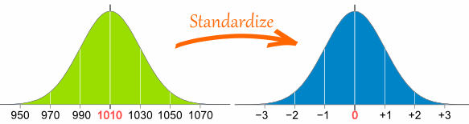
Z-scores
3
Interpretation: A z-score tells us how many standard deviations an observation is away from the mean.
STEPS
– below
Mean
+ above

Slide 13
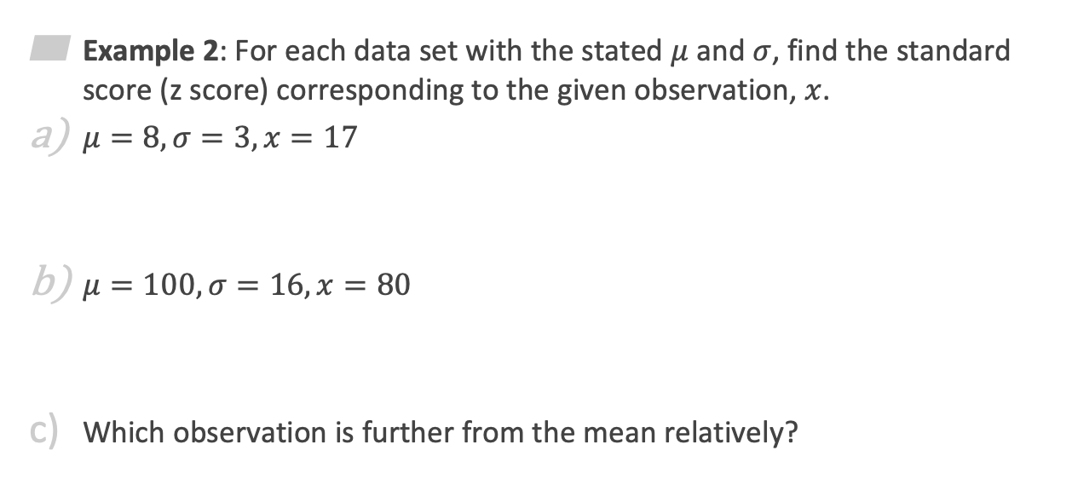


Z-scores Examples
3
Example 2: For each data set with the stated $μ$ and $σ$, find the standard score (z score) corresponding to the given observation, $x$.
$μ=8, σ=3, x=17$
$μ=100, σ=16, x=80$
Which observation is further from the mean relatively?
$$z=\frac{17 −8}{3}=3$$
Above mean
$$z=\frac{80 −100}{16}=−1.25$$
Below mean
(a) because z = 3 is a “larger” value

Slide 14
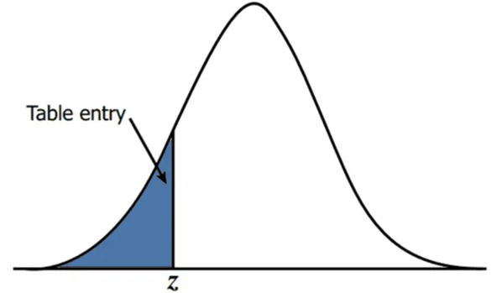
Finding probabilities based on the Normal Distribution
3
Handout: Normal Distribution Table
Use the handout to convert z-scores to percentiles (“left probabilities”).
ALWAYS gives probability LESS THAN Z: P(Z < z).
“LEFT”

Slide 15
Different Types of Probabilities
3
Draw, Label and Shade curve
Left Probability = Table (directly)
Right Probability = 1 – Left (table)
Between Probability = Left Z₂ – Left Z₁
Outside Probability = Left Z₁ + Right Z₂

Slide 16
Examples
4

Slide 17
Empirical Rule Examples
4
Example 3: Suppose that IQ scores have a bell-shaped distribution with a mean of 105 and a standard deviation of 15. Using the empirical rule answer the following questions:
What percentage of IQ scores are greater than 75?
Between which two values do the middle 68% of IQ scores fall between?
Step 1
Draw and label curve
Step 2
Shade area of interest
97.5%
(90, 120)

Slide 18

Empirical Rule Examples
4
Example 4: Suppose there is a new breed of giant cats, whose weights are normally distributed with an average of 100 pounds and a standard deviation of 15 lbs. You would like to own a smaller version of this type of cat, specifically between 59 lbs and 69 lbs.
What is the probability you can find a cat between these two weights.
$$P\left(59≤X≤69\right)=$$
$$P\left(−2.73≤Z≤−2.07\right)=$$
$$0.016$$

