Slide 1

9.1 Understanding
Personal Finance

Slide 2
Goals for the Day
Definitions and Formulas
Examples
1
2

Slide 3
Definitions and Formulas
1

Slide 4









Net Income
1
Net Income (take home pay) is equal to total, or gross, income minus taxes.
  Net Income = Gross Income – Taxes
Example: Hannah makes $45,000 per year and expects to pay approximately 20% for all taxes.
  How much of her income can Hannah expect to pay in taxes?
  What is Hannah’s net income?
  What is Hannah’s monthly take-home pay?
$$=45,000 ×\frac{20}{100}$$
$$Taxes = Salary × Tax rate$$
$$=\$9000$$
$$Net Income = Salary − Taxes$$
$$=45,000−9,000$$
$$=\$36,000$$
$$Monthly Take Home Pay=\frac{Net income}{12}$$
$$=\frac{36000}{12}$$
$$=\$3,000$$

Slide 5
Disposable Income
1
Disposable income is the money left over after taxes and expenses.
  Disposable income = Net income – Expenses

Slide 6




List Price
1
List price is the price of an item as it is listed for public sale.
    Total price = List price + Taxes
    (New price = Original + Increase)
Example: At a restaurant, your total bill was $70. If you tip 15%, what is the total bill including tip?
$$Taxes =Original+Tip$$
$$=70+\frac{15}{100}(70)$$
$$=70+10.50$$
$$=\$80.50$$
0.15

Slide 7
Discount and Sale Price
1
Discount is the reduction from the list price. This is usually given as a percentage of the list price.
  Discount $ = List price x (Discount % / 100)
Sale Price is the actual cost of an item after a discount
  Sale price = List price – Discount
    (New price = Original – Decrease)

Slide 8




Discount Example
1
Example
a) A new computer is listed at $899 but is on sale for 20% off. What is the sale price (before taxes)?
$$Sale Price =List Price−Discount$$
$$=899 − 0.20(899)$$
$$=899 −179.80$$
$$=\$719.20$$
20% of 899

Slide 9


Discount Example
1
Example
b) Evan bought a gaming system on sale for $198.45. The list price of the system was $330.75. What was the (approximate) percentage discount?
Discount $ Discount %
$$Sale Price=List Price−Discount$$
$$Discount=132.30$$
$$198.45=330.75−Discount$$
$$x\% of 330.75=132.30$$
$$−132.30=−Discount$$
$$330.75x=132.30$$
$$Discount=132.30$$
$$x=0.4$$
$$Discount=40\%$$

Slide 10
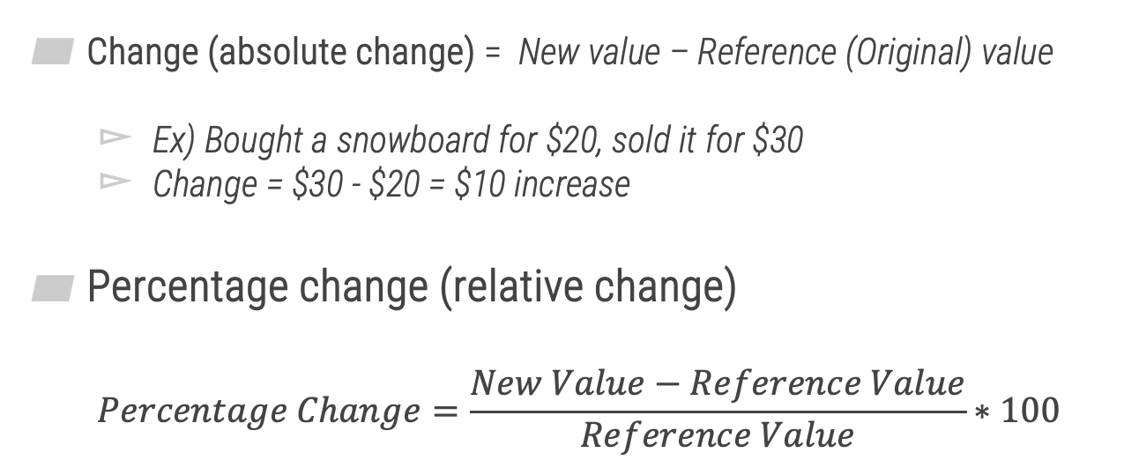

Percentage Change
1
Change (absolute change) = New value – Reference (Original) value
  Ex) Bought a snowboard for $20, sold it for $30
  Change = $30 - $20 = $10 increase
Percentage change (relative change)
  $$Percentage Change=\frac{New Value−Reference Value}{Reference Value}∗100$$
Ex) $\frac{\$30−\$20}{\$20}×100=50\%$ increase

Slide 11
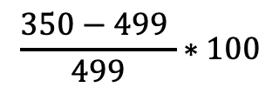

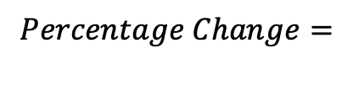
Percentage Change
1
Example
Two years ago, Maci bought an iPad for $499. After the release of the newer iPad, the iPad that Maci bought could be purchased for $350. What is the approximate percent change in the cost of the iPad?
Original (old value)
New value
$$Percentage Change=$$
$$\frac{350−499 }{499}∗100$$
$≈−29.86$%
decrease

Slide 12
Examples
2

Slide 13
Example #1
2
Luis found a receipt for a pair of sunglasses for $127.18, tax included. If the sales tax rate was 6%, what was the list price of the sunglasses? Round your answer to the nearest cent.
$119.98

Slide 14
Example #2
2
During the last year, the value of your house decreased by 30%. If the value of your house is $194,000 today, what was the value of your house last year? Round your answer to the nearest cent, if necessary.
$277,142.86

Slide 15
Example #3
2
The value of your stock investment decreased by 28% after a stock market crash. What percentage increase in value would the stocks have to rise in order to return to the value they were before the stock market crash? Round your answer to the nearest tenth of a percent.
38.9%

