Slide 1

7.4 Addition and Multiplication Rules of Probability

Slide 2
Goals for the Day
Addition Rules
Conditional Probability
Multiplication Rules
1
2
3
Bad news: No formula sheet on Exam ☹ → Focus on the PROCESS!!!

Slide 3
Addition Rules
1

Slide 4
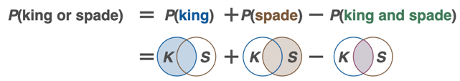

Addition Rules
1
Addition Rule for Probability: Consider two events A and B.
The probability of A or B occurring is:
$$P\left(A or B\right)=P\left(A\right)+P\left(B\right)−P(A and B)$$
K
S
=
Double counted intersection

Slide 5
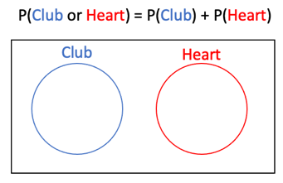

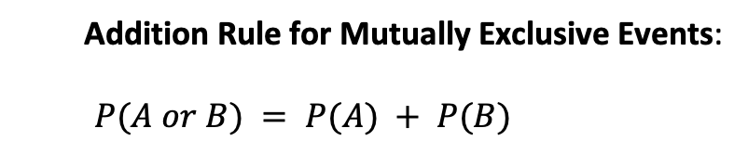
Mutually Exclusive Events
1
Mutually Exclusive Events: Two events are considered to be mutually exclusive if they have no outcomes in common.
Addition Rule for Mutually Exclusive Events:
$$P(A or B) = P(A) + P(B)$$
No Overlap → $P\left(A and B\right)=0$

Slide 6
Addition Rule
1
Example
Suppose we collected data from MATH 125 students about their majors and attendance records and recorded the data in the table below. Then we randomly selected a single student. For this example, assume that no students are double majors.
 | Statistics | Art | Chemistry | Total
Perfect | 100 | 40 | 80 | 220
Good | 20 | 50 | 70 | 140
Poor | 30 | 15 | 30 | 75
Total | 150 | 105 | 180 | 435

Slide 7



Addition Rule
1
Example
a) What is the probability that the student is a Statistics major?
 | Statistics | Art | Chemistry | Total
Perfect | 100 | 40 | 80 | 220
Good | 20 | 50 | 70 | 140
Poor | 30 | 15 | 30 | 75
Total | 150 | 105 | 180 | 435
$$\frac{\# of statistics}{\# of students}$$
$$=\frac{150}{435}$$
$$P\left(Statistics\right)=$$

Slide 8

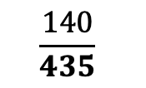
Addition Rule
1
Example
b) What is the probability that the student has Good attendance?
 | Statistics | Art | Chemistry | Total
Perfect | 100 | 40 | 80 | 220
Good | 20 | 50 | 70 | 140
Poor | 30 | 15 | 30 | 75
Total | 150 | 105 | 180 | 435
$$P\left(Good\right)=$$
$$\frac{140}{435}$$

Slide 9



Addition Rule
1
Example
c) What is the probability that the student is a Statistics major AND has Good attendance?
 | Statistics | Art | Chemistry | Total
Perfect | 100 | 40 | 80 | 220
Good | 20 | 50 | 70 | 140
Poor | 30 | 15 | 30 | 75
Total | 150 | 105 | 180 | 435
$$\frac{\# of stats and good}{\# of students}$$
$$=\frac{20}{435}$$
$$P\left(Stats AND Good\right)=$$

Slide 10

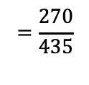



Addition Rule
1
Example
d) What is the probability that the student is a Statistics major OR has Good attendance?
 | Statistics | Art | Chemistry | Total
Perfect | 100 | 40 | 80 | 220
Good | 20 | 50 | 70 | 140
Poor | 30 | 15 | 30 | 75
Total | 150 | 105 | 180 | 435
$$P\left(Stats OR Good\right)=$$
$$\frac{150}{435}$$
$$+\frac{140}{435}$$
$$−\frac{20}{435}$$
$$=\frac{270}{435}$$

Slide 11



Addition Rule
1
Example
e) What is the probability that the student is a Chemistry major OR has Poor attendance?
 | Statistics | Art | Chemistry | Total
Perfect | 100 | 40 | 80 | 220
Good | 20 | 50 | 70 | 140
Poor | 30 | 15 | 30 | 75
Total | 150 | 105 | 180 | 435
$$P\left(Chem OR Poor\right)=$$
$$\frac{180 +75 −30}{435}$$
$$=\frac{225}{435}$$

Slide 12



Addition Rule
1
Example
f) What is the probability that the student is a Art major OR has Chemistry?
 | Statistics | Art | Chemistry | Total
Perfect | 100 | 40 | 80 | 220
Good | 20 | 50 | 70 | 140
Poor | 30 | 15 | 30 | 75
Total | 150 | 105 | 180 | 435
$$P\left(Art OR Chem\right)=$$
$$\frac{105 +180 −0}{435}$$
$$=\frac{285}{435}$$
No overlap → Mutually exclusive!

Slide 13
Conditional Probability
2

Slide 14
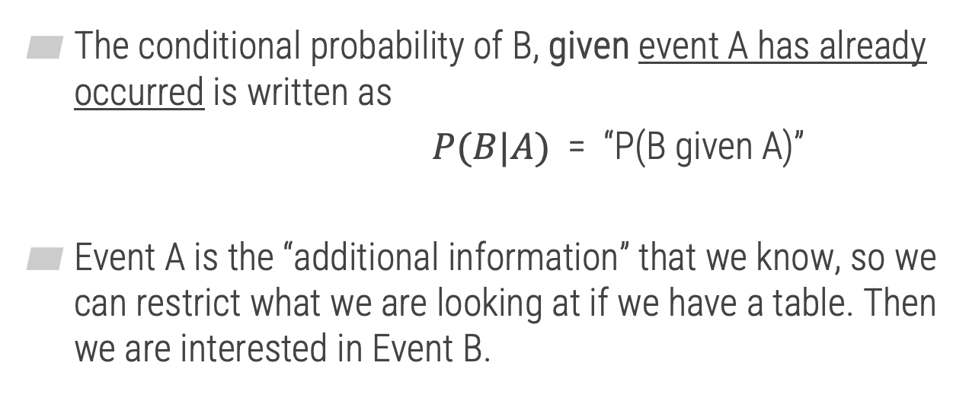
Conditional Probability
2
The conditional probability of B, given event A has already occurred is written as
$P(B|A)$ = “P(B given A)”
Event A is the “additional information” that we know, so we can restrict what we are looking at if we have a table. Then we are interested in Event B.

Slide 15


Conditional Probability
2
Goes first
Example 2
a) Given the student has Perfect attendance, find the probability they are a Chemistry major.
Goes second
 | Statistics | Art | Chemistry | Total
Perfect | 100 | 40 | 80 | 220
Good | 20 | 50 | 70 | 140
Poor | 30 | 15 | 30 | 75
Total | 150 | 105 | 180 | 435
$$P\left(Chemistry | Perfect\right)=$$
$$\frac{80}{220}$$

Slide 16


Conditional Probability
2
Example 2
b) Find the probability the student has Perfect attendance, given they are a Chemistry major.
 | Statistics | Art | Chemistry | Total
Perfect | 100 | 40 | 80 | 220
Good | 20 | 50 | 70 | 140
Poor | 30 | 15 | 30 | 75
Total | 150 | 105 | 180 | 435
$$P\left(Perfect | Chem\right)=$$
$$\frac{80}{180}$$

Slide 17


Conditional Probability
2
Example 2
c) Given the student is an Art major, find the probability they have Poor attendance.
 | Statistics | Art | Chemistry | Total
Perfect | 100 | 40 | 80 | 220
Good | 20 | 50 | 70 | 140
Poor | 30 | 15 | 30 | 75
Total | 150 | 105 | 180 | 435
$$P\left(Poor | Art\right)=$$
$$\frac{15}{105}$$

Slide 18
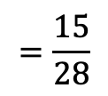

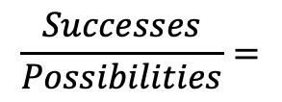

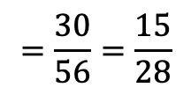


Another Example
2
Example 3: A swim team consists of 6 boys and 4 girls. A relay team of 4 swimmers is chosen at random from the team members. What is the probability that 2 boys are selected for the relay team given that the first two selections were girls?
Conditional probability
Additional info
G G
___ ___ ___ ___
8 Total
6 Boys
2 Girls
Direct Way
$$\frac{6}{8}$$
$$\frac{5}{7}$$
$$=\frac{30}{56}=\frac{15}{28}$$
$$P\left(Next 2 Boys\right)= ??$$
x
_____ _____
Boy 1 Boy 2
Counting Way
$$\frac{Successes}{Possibilities}=$$
$$\frac{6C2}{8C_{2}}$$
$$=\frac{15}{28}$$
Order doesn’t matter →
_{n} C _{r}

Slide 19
Multiplication Rules
3

Slide 20
Different Types of Events
3
No impact
Independent events – The result of one does not influence the probability of the other.
Dependent events – The result of one does influence the probability of the other.
Independent IF
- With replacement
- Unrelated experiments

Slide 21
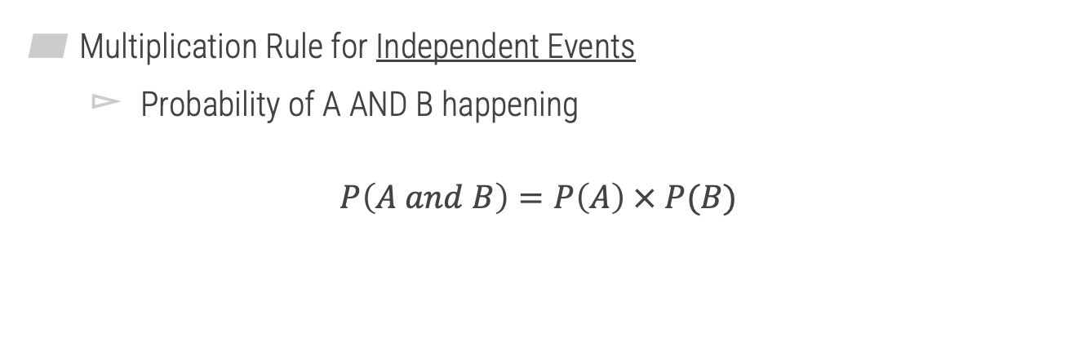
Independent Events
3
Multiplication Rule for Independent Events
Probability of A AND B happening
$$P\left(A and B\right)=P\left(A\right) × P(B)$$

Slide 22




Independent Events
3
Independent
Example 2
Three cards are drawn with replacement from a standard deck of 52 cards. Find the probability that the first card will be a diamond, the second card will be a red card, and the third card will be a queen.
$$\frac{13}{52}×\frac{26}{52}×\frac{4}{52}$$
$$=\frac{4}{416}=\frac{1}{104}$$
$$P\left(D and R and Q\right)=$$
$$P\left(D\right) × P\left(R\right)×P\left(Q\right)$$

Slide 23
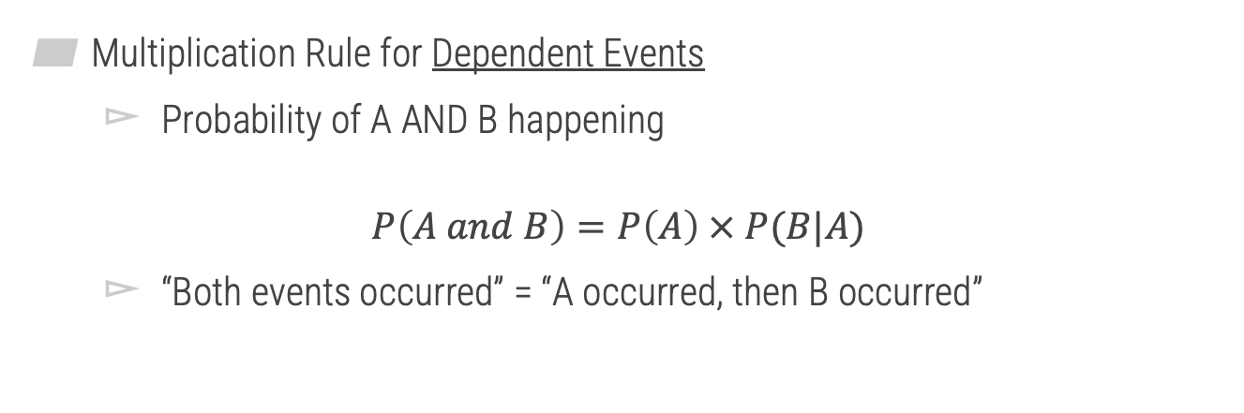
Dependent Events
3
Multiplication Rule for Dependent Events
Probability of A AND B happening
$$P\left(A and B\right)=P\left(A\right) × P(B|A)$$
“Both events occurred” = “A occurred, then B occurred”

Slide 24




Independent Events
3
Dependent
Example 3
If you are dealt two cards from a standard 52-card deck without replacement, find the probability of getting a 10 of hearts and then a red card.
$$\frac{1}{52} × \frac{25}{51}$$
$$=\frac{25}{2652}$$
$$P\left(10H and Red\right)=$$
$$P\left(10H\right) × P\left(Red \right|10H)$$

Slide 25
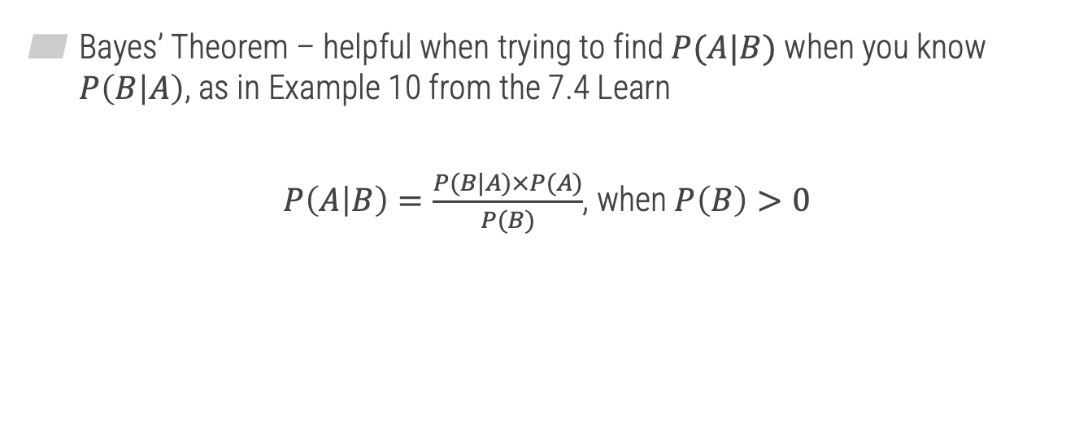
One More Thing
3
Bayes’ Theorem – helpful when trying to find $P(A|B)$ when you know $P\left(B | A\right)$, as in Example 10 from the 7.4 Learn
$P\left(A | B\right)=\frac{P(B|A)×P(A)}{P(B)}$, when $P\left(B\right)>0$

Slide 26
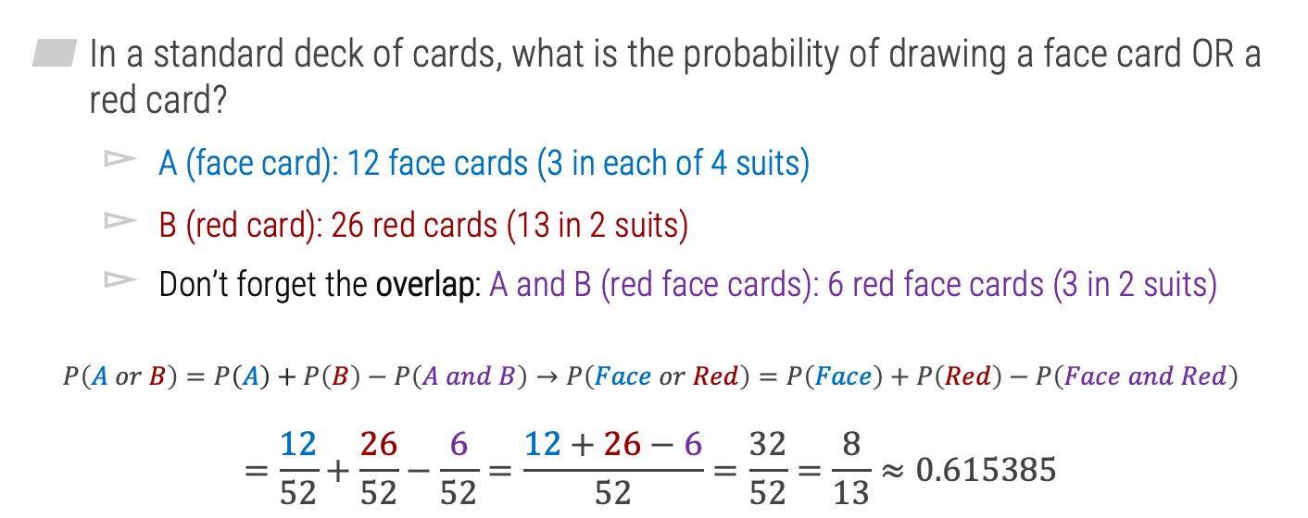
Additional Example: The Probability of A OR B
1
In a standard deck of cards, what is the probability of drawing a face card OR a red card?
A (face card): 12 face cards (3 in each of 4 suits)
B (red card): 26 red cards (13 in 2 suits)
Don’t forget the overlap: A and B (red face cards): 6 red face cards (3 in 2 suits)
$$P\left(A or B\right)=P\left(A\right)+P\left(B\right)−P\left(A and B\right)→P\left(Face or Red\right)=P\left(Face\right)+P\left(Red\right)−P\left(Face and Red\right)$$
$$=\frac{12}{52}+\frac{26}{52}−\frac{6}{52}=\frac{12+26−6}{52}=\frac{32}{52}=\frac{8}{13}≈0.615385$$

