Slide 1

7.2 Counting Our Way to Probabilities

Slide 2
Goals for the Day
Fundamental Counting Principle
Factorials
Permutations and Combinations
1
2
3

Slide 3
Fundamental Counting Principle
1

Slide 4
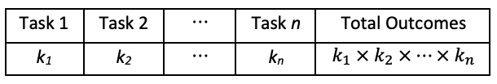
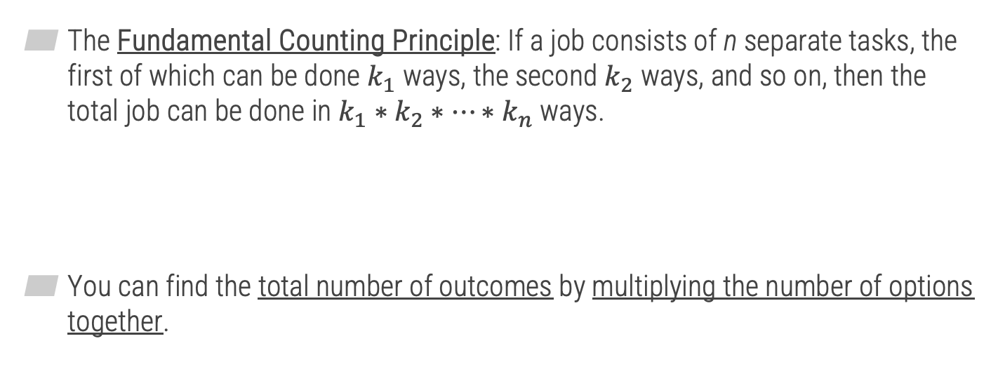
The Fundamental Counting Principle
1
The Fundamental Counting Principle: If a job consists of n separate tasks, the first of which can be done $k_{1}$ ways, the second $k_{2}$ ways, and so on, then the total job can be done in $k_{1}∗k_{2}∗…∗k_{n}$ ways.
You can find the total number of outcomes by multiplying the number of options together.

Slide 5
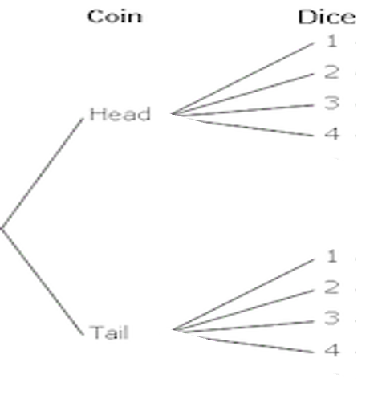

Determining Number of Outcomes
1
Example: Flip a coin and roll a 4-sided die.
How many total outcomes are there?
Example: Sally has 6 pairs of socks, 4 shorts, 5 shirts and 3 sunglasses. How many ways can she get dressed?
Task 1 Task 2
$2 ×4=8 outcomes$
6 4 5 3
x x x
= 360 total outcomes
_____ _____ _____ _____
Socks Shorts Shirts Sunglasses

Slide 6


Replacement
1
With or without replacement: We need to take into account whether or not objects can be repeated in our calculations.
Examples:
How many passwords can you make if it requires 4 digits?
How many passwords can you make if it requires 4 digits, but you cannot repeat digits?
With replacement
10 x 10 x 10 x 10
$={10}^{4}=10,000$ passwords
_____ _____ _____ _____
Without replacement
10 x 9 x 8 x 7
$$=5,040$$
_____ _____ _____ _____

Slide 7
Factorials
2

Slide 8
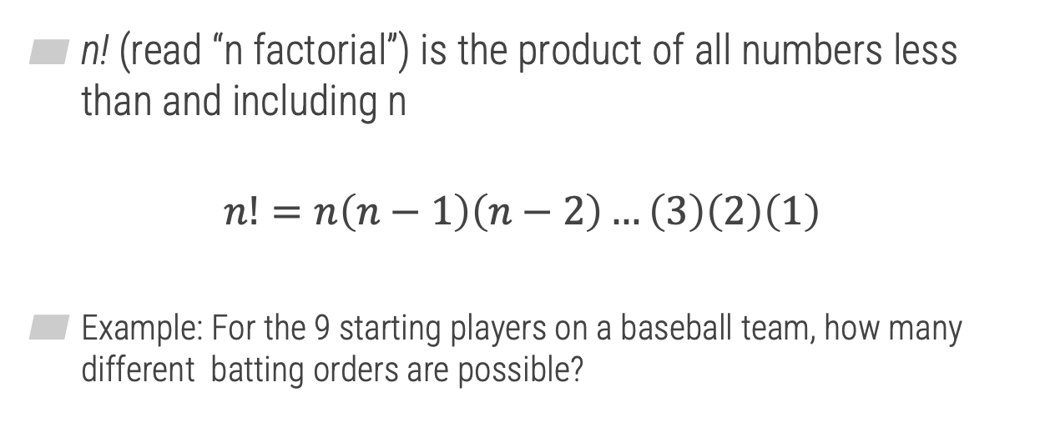

Factorials
2
n! (read “n factorial”) is the product of all numbers less than and including n
$$n!=n\left(n−1\right)\left(n−2\right)…\left(3\right)\left(2\right)\left(1\right)$$
Example: For the 9 starting players on a baseball team, how many different batting orders are possible?
Without replacement
9 x 8 x 7 x … x 1
$$= 9!$$
_____ _____ _____ _____

Slide 9
Permutations and Combinations
3

Slide 10

Selecting From a Group
3
Often useful to count the number of ways to choose objects from a group (without replacement)
“Selecting r objects from a total of n objects”
Two methods
Permutation – order matters (e.g., first place, second place, …)
Combinations – order doesn’t matter (e.g., being picked for a team)
$$r≤n$$

Slide 11

Permutations
3
Order matters
When you are selected is important; position has meaning
Example
Ranking favorite movies
Total #
How many selecting

Slide 12

Combinations
3
Order does not matter
When you are selected is unimportant; only matters that you were selected
Example
Picking pizza toppings

Slide 13
Permutations and Combinations
3
Examples
There are 8 runners in a race. How many ways can they place 1st, 2nd, and 3rd?
Out of 12 students, how many ways can we select a committee of 4 students?
We are forming a committee, and we need to select a president, vice president, and secretary. If there are 10 members, how many ways can this be done?
_____ _____ _____
Order matters → Permutation
₈ P₃ =
336
1st 2nd 3rd
Order doesn’t matter → Combination
₁₂ C ₄ =
495
Order matters → Permutation
₁₀ P₃ =
720
_____ _____ _____
Pres VP Sec

Slide 14
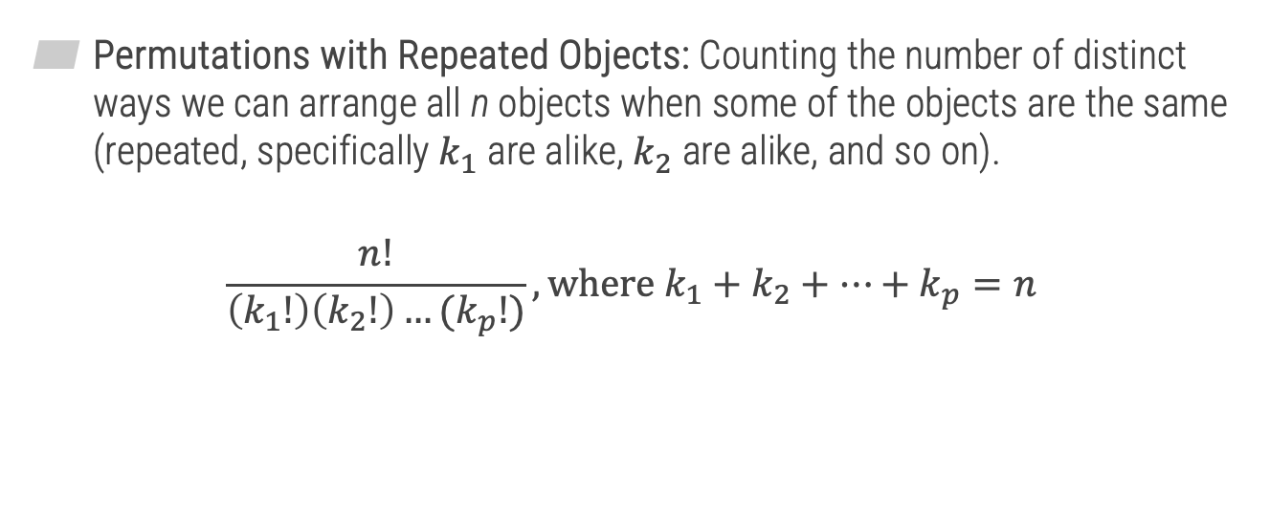
Permutations with Repeated Objects
3
Permutations with Repeated Objects: Counting the number of distinct ways we can arrange all n objects when some of the objects are the same (repeated, specifically $k_{1}$ are alike, $k_{2}$ are alike, and so on).
$$\frac{n!}{\left(k_{1}!\right)\left(k_{2}!\right)…(k_{p}!)}, where k_{1}+k_{2}+…+k_{p}=n$$

Slide 15


Permutations and Combinations
3
Example
Harmony was born on 05/19/1991. How many eight-digit codes could she make using the digits in her birthday?
8 total digits
$$\frac{8!}{3! 3! 1! 1!}$$
9
1
5
0
----> 3 times
----> 3 times
----> 1
----> 1
$$=1,120$$

