Slide 1

7.5 Expected Value

Slide 2
Goals for the Day
Expected Value
Odds
1
2

Slide 3
Expected Value
1

Slide 4
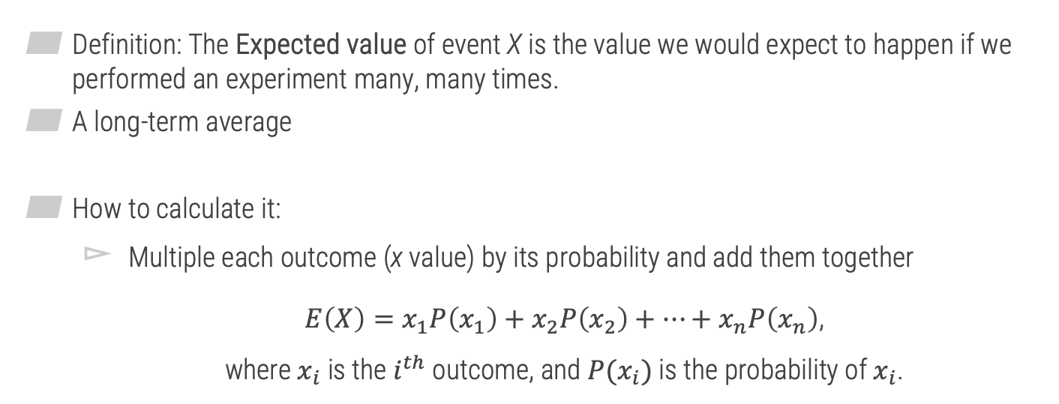
Expected Value
1
Definition: The Expected value of event X is the value we would expect to happen if we performed an experiment many, many times.
A long-term average
How to calculate it:
Multiple each outcome (x value) by its probability and add them together
$E\left(X\right)=x_{1}P\left(x_{1}\right)+x_{2}P\left(x_{2}\right)+…+x_{n}P\left(x_{n}\right)$, where $x_{i}$ is the $i^{th}$ outcome, and ${P(x}_{i})$ is the probability of $x_{i}$.

Slide 5



Expected Value
1
Example
In soccer, you earn a certain number of points based on the result of a game, as shown in the table below. Calculate the expected value of the number of points earned for a single game.
$E\left(X\right)$ =
$$=1.4 points$$
$$3\left(0.3\right)+1\left(0.5\right)+0\left(0.2\right)$$
X | P(X)
Win (3 points) | 0.3
Tie (1 point) | 0.5
Loss (No points) | 0.2
(Long term average)

Slide 6

Sum of Expected Values
1
Sum of Expected Values: To find the combined expected value of multiple events, add the individual expected values of each event.
$$E\left(X or Y\right)=E\left(X\right)+E(Y)$$

Slide 7





Sum of Expected Values
1
Example (Revisited)
Find the expected value for the total number of points earned in a season if the season has 12 games.
$$X_{1}=Game 1, …., X_{12}=Game 12$$
$$E\left(Total Points\right)=$$
$E\left(X_{1}\right)+E\left(X_{2}\right)+ …+E\left(X_{12}\right)$
$$= 1.4 + 1.4 + … +1.4$$
Same E(X) for each
$$= 12\left(1.4\right)=16.8 Points$$

Slide 8
Expected Value
1
Strategy
Think about the possible X values
THEN the probabilities
Example
Jim likes to day trade on the Internet. On a good day, he averages a $1400 gain. On a bad day, he averages a $900 loss. Suppose that he has good days 30% of the time, bad days 50% of the time, and the rest of the time, he breaks even ($0 gain). What is the expected value for one day of Jim’s day-trading hobby? (Hint: Fill in the table to help solve the problem.)
X | P(X) | E(X) | Overall E(X) 420+0+(-450) = -30
+$1400 | 0.3 | 1400(0.3)=420
+$0 | 0.2 | 0(0.2)=0
-$900 | 0.5 | -900(0.5)=-450

Slide 9
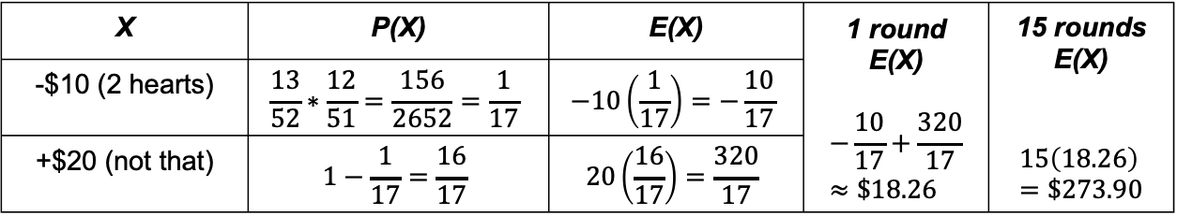
Expected Value
1
Example
Suppose that you and a friend are playing cards and decide to make a bet. If your friend draws two hearts in a row from a standard deck of 52 cards without replacing the first card, you give him $10. Otherwise, he pays you $20. If the same bet was made 15 times, how much would you expect to win or lose? Round your answer to the nearest cent, if necessary.
X | P(X) | E(X) | 1 round E(X) $$−\frac{10}{17}+\frac{320}{17}≈\$18.26$$ | 15 rounds E(X) $$15\left(18.26\right)=\$273.90$$
-$10 (2 hearts) | $$\frac{13}{52}∗\frac{12}{51}=\frac{156}{2652}=\frac{1}{17}$$ | $$−10\left(\frac{1}{17}\right)=−\frac{10}{17}$$
+$20 (not that) | $$1−\frac{1}{17}=\frac{16}{17}$$ | $$20\left(\frac{16}{17}\right)=\frac{320}{17}$$

Slide 10
Odds
2

Slide 11
What are odds?
2
Odds: Another way to express probability
But not interchangeable with probability
Usually expressed as a ratio
“a:b for” or “a:b against”
Can be expressed as a fraction of probabilities

Slide 12
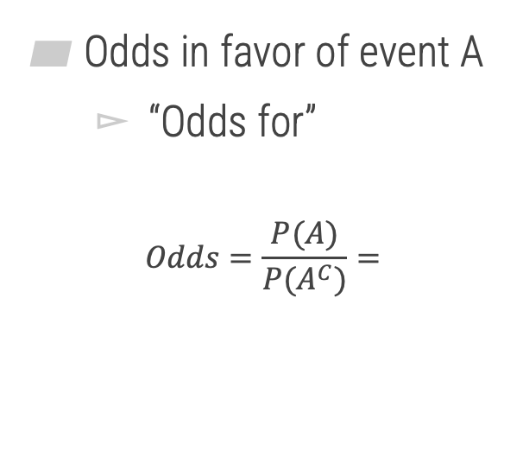
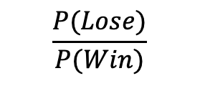
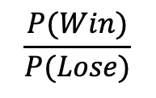
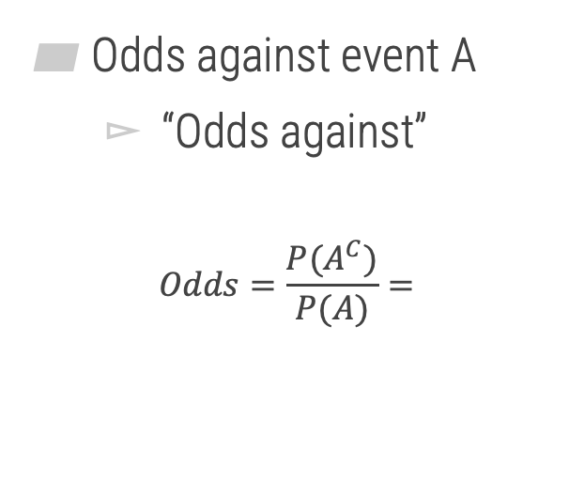
How can we calculate odds?
2
Odds in favor of event A
“Odds for”
$$Odds=\frac{P(A)}{P(A^{C})}=$$
Odds against event A
“Odds against”
$$Odds=\frac{P(A^{C})}{P(A)}=$$
$$\frac{P(Win)}{P(Lose)}$$
$$\frac{P(Lose)}{P(Win)}$$

Slide 13




Odds
2
Example
Suppose the probability of a soccer team winning a playoff game is 0.20. What are the odds of winning? Express your answer in the form a:b.
1 “part” winning
$$P\left(W\right)=0.20=$$
$$\frac{1}{5}$$
4 “parts” losing
$$Odds Winning=$$
$$1:4$$

Slide 14

Odds
2
Example
If the odds on a bet are 18:1 against, what is the probability of winning?
Strategy: To convert from odds to a probability $a:b→P\left(A\right)=\frac{a}{a+b}$
$$Odds against=18:1→ P\left(Loss\right)=\frac{18}{18+1}=\frac{18}{19}$$
$$P\left(Win\right)=1−P\left(Win^{C}\right)=1−\frac{18}{19}=\frac{1}{19}$$
= Loss

