Slide 1

7.3 Using Counting Methods to find Probabilities

Slide 2
Goals for the Day
Complements
Calculating More Probabilities
Examples
1
2
3

Slide 3
Complements
1

Slide 4
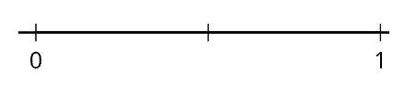
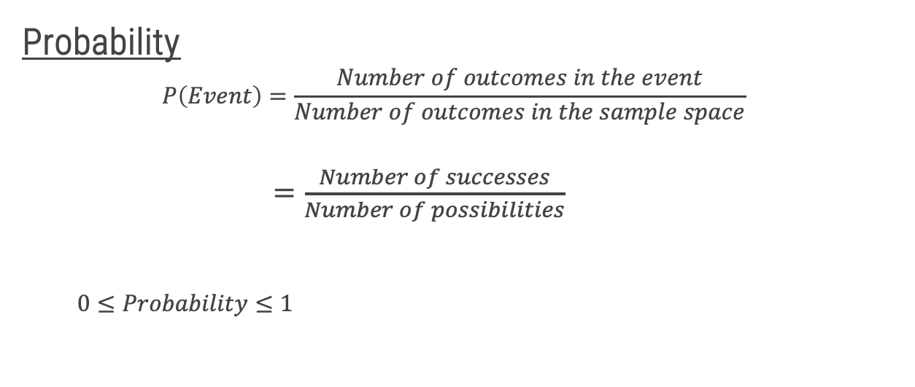

Probability Review
2
Probability
$$P\left(Event\right)=\frac{Number of outcomes in the event}{Number of outcomes in the sample space}$$
$=\frac{Number of successes}{Number of possibilities}$
$0≤Probability≤1$
$$P(E)$$

Slide 5
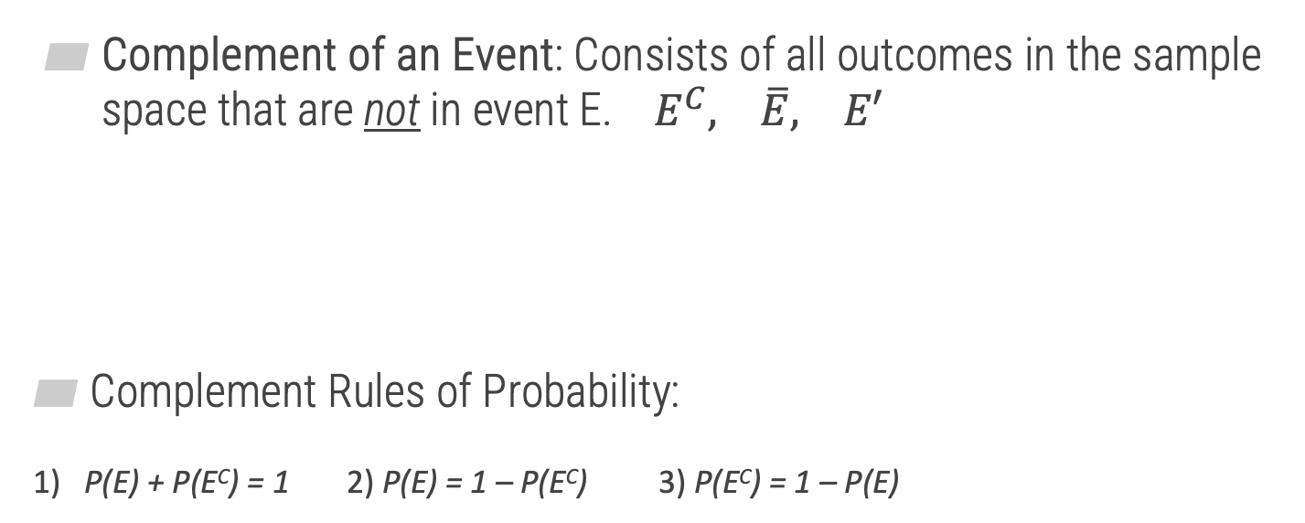



Complements
1
Opposite
Complement of an Event: Consists of all outcomes in the sample space that are not in event E. $E^{C}, \overline{E}, E′$
Complement Rules of Probability:
1) P(E) + P(E^{C}) = 1 2) P(E) = 1 – P(E^{C}) 3) P(E^{C}) = 1 – P(E)
$$S$$
$$E$$
$$E^{C}$$

Slide 6






Complement Examples
1
Example: Suppose we are randomly selecting a single card from a standard 52-card deck.
Find the probability of a diamond.
Find the probability of not a diamond.
$$P\left(Diamond\right)=$$
$$\frac{13}{52}=\frac{1}{4}$$
$$P\left(Not Diamond\right)=$$
$$\frac{39}{52}=$$
$$1 −\frac{1}{4}=$$
$$\frac{3}{4}$$
Directly
Using complements

Slide 7
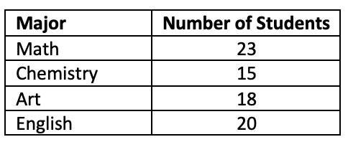








Complement Examples
1
Example: Suppose we collected data on majors of MATH 125 students and are randomly selecting a single student.
Find the probability that the student is NOT an Art major.
Find the probability that the student is NOT an English nor Chemistry major.
$$1 − \frac{18}{76}=$$
$$P\left(Not Art\right)=$$
$Art^{C}$
$$1 −P(Art)=$$
$$\frac{58}{76}$$
$$1 −\frac{20+15}{76}=$$
$$\frac{23+18}{76} =$$
$$\frac{41}{76}$$
$$P\left(Not English nor Chem\right)=$$

Slide 8
Calculating More Probabilities
2

Slide 9
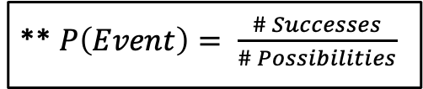
Calculating (Harder) Probabilities
2
Example 1: Liam and Michael are going to play video games this afternoon. Together, they have 41 video games. If they decide to randomly choose two video games, what is the probability that the two they choose will consist of each of their favorite video games? Assume they have different favorites.
Two Approaches: 1) Direct way 2) Counting methods
** $P\left(Event\right)= \frac{\# Successes}{\# Possibilities}$

Slide 10
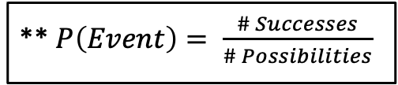
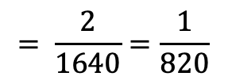


Direct Way
2
Example 1: Liam and Michael are going to play video games this afternoon. Together, they have 41 video games. If they decide to randomly choose two video games, what is the probability that the two they choose will consist of each of their favorite video games? Assume they have different favorites.
$$\frac{2}{41}$$
$$\frac{1}{40}$$
$$= \frac{2}{1640}=\frac{1}{820}$$
** $P\left(Event\right)= \frac{\# Successes}{\# Possibilities}$
x
_____ _____
1st Choice
2nd Choice
Without replacement

Slide 11
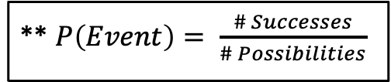



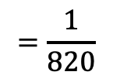
Counting Methods Way
2
** $P\left(Event\right)= \frac{\# Successes}{\# Possibilities}$
1
$$=\frac{1}{820}$$
$$Prob=$$
2
** Solve numerator and denominator separately
2
Denominator → “No Condition”
1
Numerator → “Is a Condition”
_{n} C _{r} → Combinations
(Order doesn’t matter)
Only selecting from favorites
Total ways to select
2 from 41
_{n} C _{r} →
₂ C ₂
$$=1$$
₄₁ C ₂
$$=820$$

Slide 12

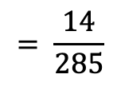


Direct Way
2
Example 2: A box of jerseys for a pick-up game of basketball contains 8 extra-large jerseys, 7 large jerseys, and 5 medium jerseys. If you are first to the box and grab 3 jerseys, what is the probability that you randomly grab 3 extra-large jerseys.
20 Total
8 XL
$$\frac{8}{20}$$
$$\frac{7}{19}$$
$$\frac{6}{18}$$
** $P\left(Event\right)= \frac{\# Successes}{\# Possibilities}$
$$= \frac{14}{285}$$
x x
_____ _____ _____
1st Selection 2nd 3rd

Slide 13


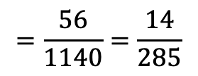
Counting Methods Way
2
** $P\left(Event\right)= \frac{\# Successes}{\# Possibilities}$
1
$$=\frac{56}{1140}=\frac{14}{285}$$
$$Prob=$$
2
** Solve numerator and denominator separately
1
Selecting 3 XL jerseys
₈ C ₃
$$=56$$
2
Selecting 3 jerseys from all jerseys
₂₀ C ₃
$$=1140$$

Slide 14
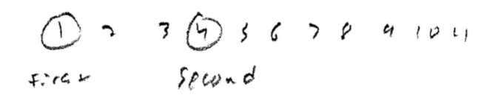



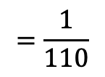


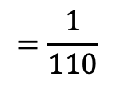
Another Example
2
Example 3: There are 11 balls numbered 1 through 11 placed in a bucket. What is the probability of reaching into the bucket and randomly drawing two balls numbered 1 and 4 without replacement, in that order?
** $P\left(Event\right)= \frac{\# Successes}{\# Possibilities}$
Direct Way
$$\frac{1}{11}$$
$$\frac{1}{10}$$
$$=\frac{1}{110}$$
x
_____ _____
#1 #4
$$\frac{1}{11P_{2}}$$
$$=\frac{1}{110}$$
Numerator → Only 1 way to get
a 1, then a 4
Counting Way
$$P(1,4)=$$
Order matters! →
_{n} P _{r}

Slide 15
Examples
3

Slide 16
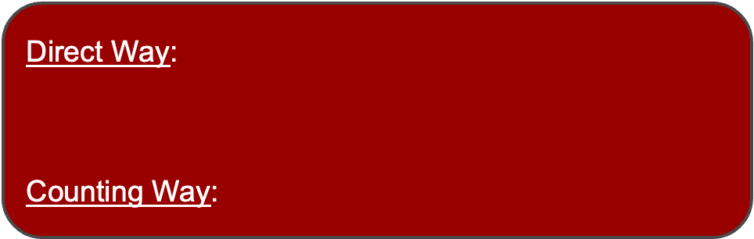


Example
3
Example 4: Julia sets up a passcode on her smart phone, which allows only six-digit codes. A spy sneaks a look at Julia's smart phone and sees her fingerprints on the screen over six numbers. What is the probability the spy is able to unlock the smart phone on his first try?
Direct Way:
$\text{Counting} \text{Way}$:
$$\frac{1}{6} × \frac{1}{5} × \frac{1}{4} × \frac{1}{3} × \frac{1}{2} × \frac{1}{1}=\frac{1}{720}$$
Numerator: Only 1 correct
password
Denominator: 6 #s to choose from
(6 fingerprints)
and Ordering all 6
→ r = 6
___ ___ ___ ___ ___ ___
$$P\left(Correct Password\right)=\frac{1}{6P_{6}}=\frac{1}{6!}=\frac{1}{720}$$

