Slide 1
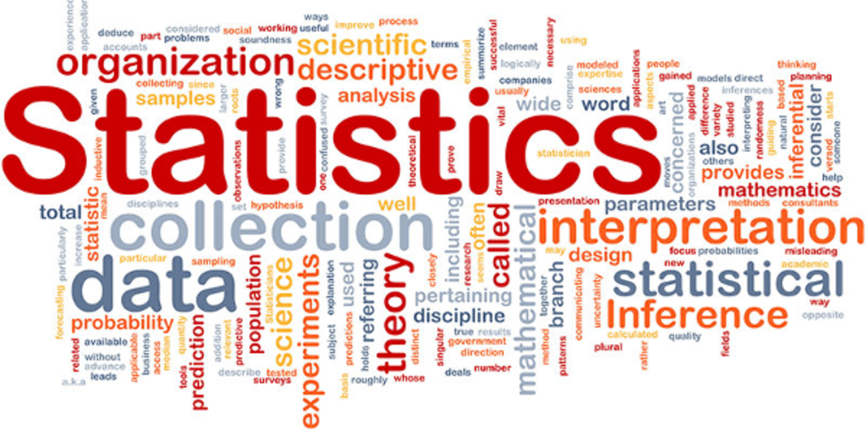
8.3 Describing and Analyzing Data

Slide 2
Goals for the Day
Measures of Center
Measures of Spread
Using your Calculator
Empirical Rule
1
2
3
4

Slide 3
Measures of Center
1

Slide 4
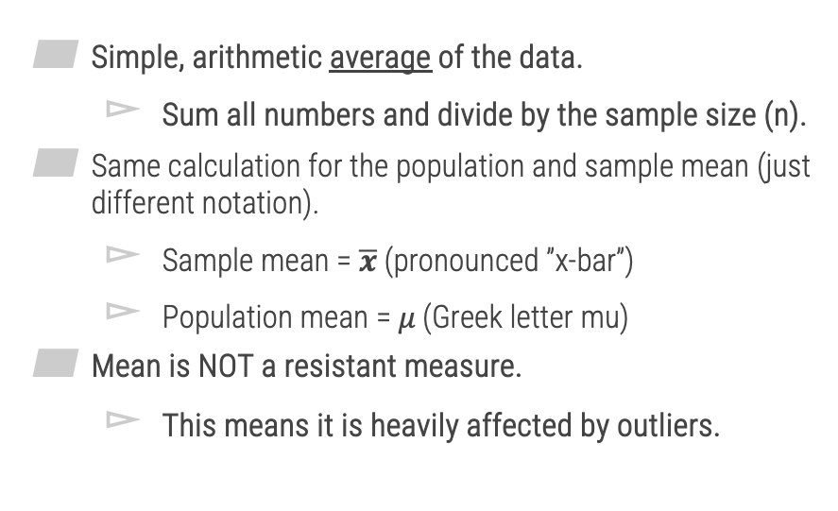

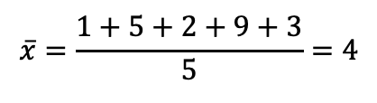
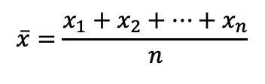
Mean (Average Value)
1
Simple, arithmetic average of the data.
Sum all numbers and divide by the sample size (n).
Same calculation for the population and sample mean (just different notation).
Sample mean = $\overline{x}$ (pronounced ”x-bar”)
Population mean = 𝜇 (Greek letter mu)
Mean is NOT a resistant measure.
This means it is heavily affected by outliers.
$$\overline{x}=\frac{x_{1}+x_{2}+…+x_{n}}{n}$$
Example 1 – Mean
Data: 1, 5, 2, 9, 3
$$\overline{x}=\frac{1+5+2+9+3}{5}=4$$
Now change 3 to 30
New $\overline{x}=9.4$

Slide 5


Median (Middle Value)
1
The middle value in an ordered list.
Median IS a resistant measure.
NOT affected by outliers.
Example 2 – Median
Case 1 – Odd n
7 Obs: 10, 5, 6, 1, 3, 9, 8
Sorted:
1, 3, 5, 6, 8, 9, 10
$$Med=6$$
Case 2 – Even n
8 Obs: 10, 5, 6, 1, 3, 9, 8, 3
Sorted:
1, 3, 3, 5, 6, 8, 9, 10
$$Med=\frac{5+6}{2}=5.5$$

Slide 6
Mode (Most Common Value)
1
The most frequently occurring value(s).
Unimodal data has one mode.
Bimodal data has 2 modes.
Multimodal data has more than 2 modes.
Can be no modes (every value is distinct).
This is the only measure of center that can be used with categorical data.
Ex) Most common favorite color (can’t average this)
Example 2 – Median
Case 2
8 Obs: 10, 5, 6, 1, 3, 9, 8, 3
Mode =
3 (twice)

Slide 7
Measures of Spread
2

Slide 8
Range
2
Range = Max - Min
Gives idea of the entire ”range” of values, how much distance do they span in total.
Ex) Case 2: Range =
10 – 1 = 9
Example 2 – Median
Case 2
8 Obs: 10, 5, 6, 1, 3, 9, 8, 3
1
10

Slide 9
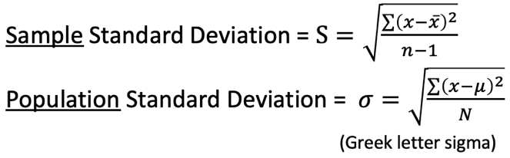
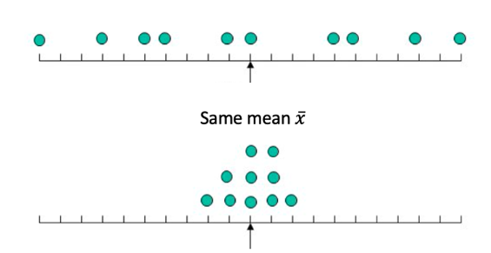

Standard Deviation
2
Complex formula that measures the average distance that each data point is from the mean.
Larger st dev
Smaller st dev

Slide 10
Using your Calculator
3

Slide 11
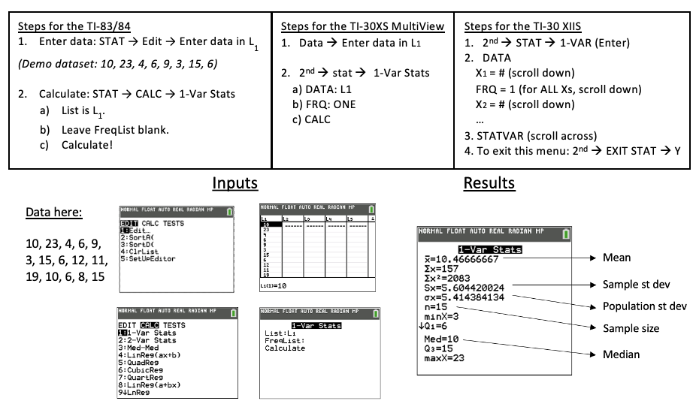
Using Your Calculator
3
Does not give median

Slide 12

Using Your Calculator Example
3
Example 3: Find the mean, median, mode and sample standard deviation of the following dataset.
Data (7 obs): 35, 70, 31, 37, 65, 38, 38
Results
Mean $\overline{x}=44.86$
Sample st dev: $Sx=15.72$
Pop st dev $σ_{x}=14.55$
Med = 38

Slide 13
Other Considerations
3
Outliers
Data values that are extreme when compared to the rest of the data.
Can significantly impact measures of center and spread.
Example:
- Data (7 obs): 31, 35, 37, 38, 38, 65, 70
Outliers

Slide 14
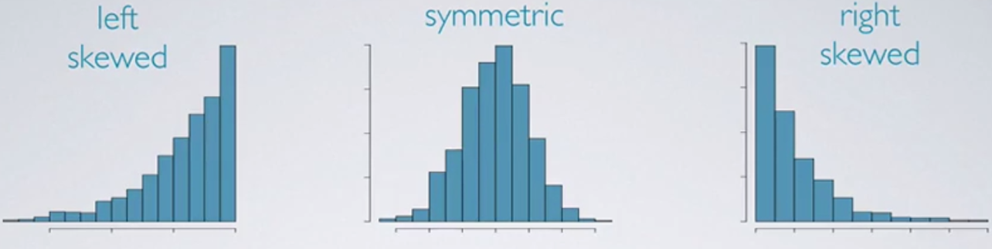
Other Considerations
3
Types of Distributions
Outliers
Outliers
Best measure of center:
Median
Mean
Median

Slide 15
Empirical Rule
4

Slide 16
Empirical Rule (68 – 95 – 99.7 Rule)
4
When data is approximately bell shaped, the standard deviation allows us to make fairly accurate approximations about the locations of our data values.
_____ of the data lies within 1 standard deviation of the mean.
_____ of the data lies within 2 standard deviations of the mean.
_____ of the data lies within 3 standard deviations of the mean.
68%
95%
99.7%

Slide 17
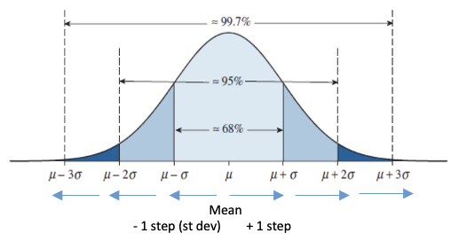
Empirical Rule (68 – 95 – 99.7 Rule)
4
We can use these breakdowns to find probabilities within certain intervals.

Slide 18
Empirical Rule Examples
4
Example 5: Suppose that IQ scores have a bell-shaped distribution with a mean of 105 and a standard deviation of 15. Using the empirical rule answer the following questions:
What percentage of IQ scores are greater than 75?
b) Between which two values do the middle 68% of IQ scores fall between?
Step 1
Draw and label curve
Step 2
Shade area of interest
97.5%
(90, 120)

